Slide 1
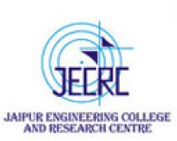
JAIPUR ENGINEERING COLLEGE AND RESEARCH CENTRE
Year & Sem – II Year & 3 Sem
Subject – Advanced Engineering Mathematics-I
Unit – IV
Presented by – (Dr.Shivshankar Sharma, Associate Professor)
1

Slide 2
VISION AND MISSION OF INSTITUTE
VISION OF INSTITUTE
To became a renowned centre of outcome based learning and work towards academic professional, cultural and social enrichment of the lives of individuals and communities .
MISSION OF INSTITUTE
Focus on evaluation of learning, outcomes and motivate students to research aptitude
by project based learning.
Identify based on informed perception of Indian, regional and global needs, the area of focus and provide platform to gain knowledge and solutions.
Offer opportunities for interaction between academic and industry .
Develop human potential to its fullest extent so that intellectually capable and imaginatively gifted leaders may emerge.
1

Slide 3
VISION AND MISSION OF DEPARTMENT
The Mechanical Engineering Department strives to be recognized globally for outcome based technical knowledge and to produce quality human resource, who can manage the advance technologies and contribute to society.
M1. To impart quality technical knowledge to the learners to make them globally competitive mechanical engineers.
M2. To provide the learners ethical guidelines along with excellent academic environment for a long productive career.
M3. To promote industry-institute relationship
1

Slide 4
CONTENTS (TO BE COVERED)
Examples of Fourier-Transform
1

Slide 5
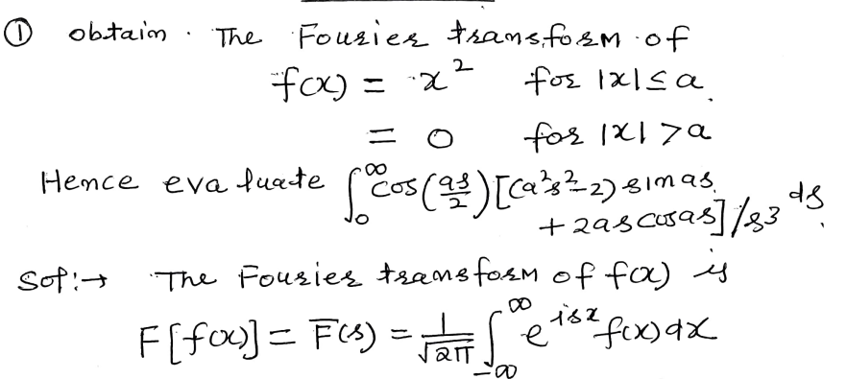
1

Slide 6
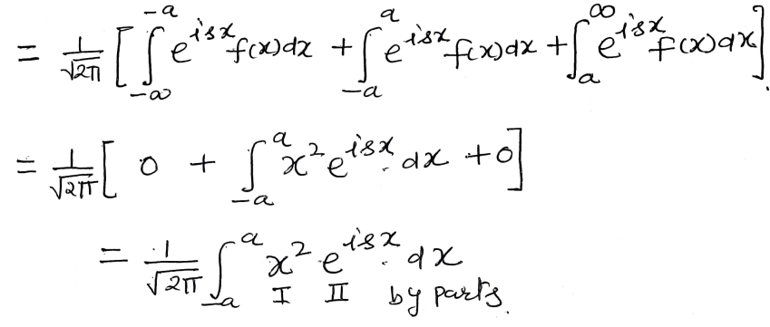
1

Slide 7
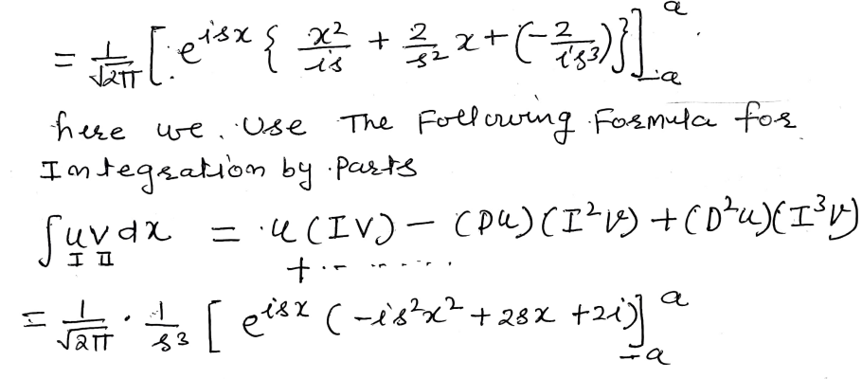
1

Slide 8
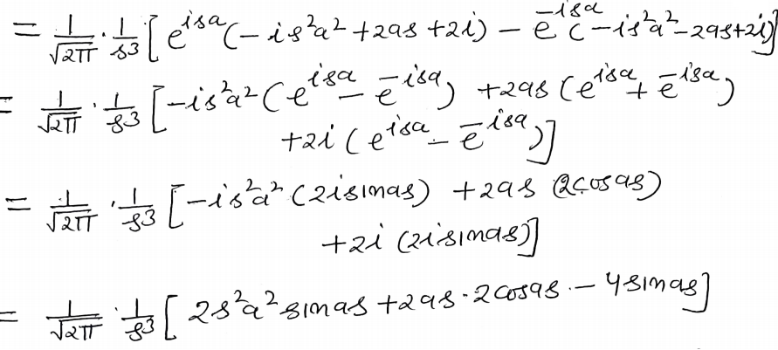
1

Slide 9
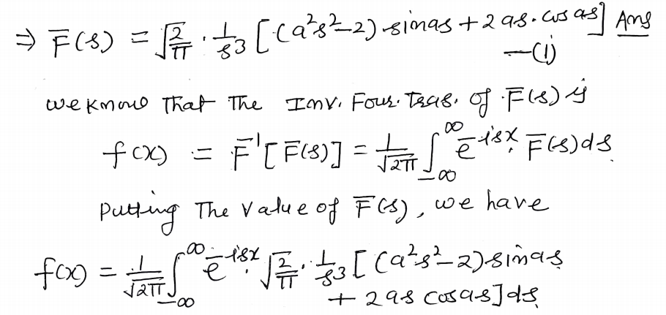
1

Slide 10
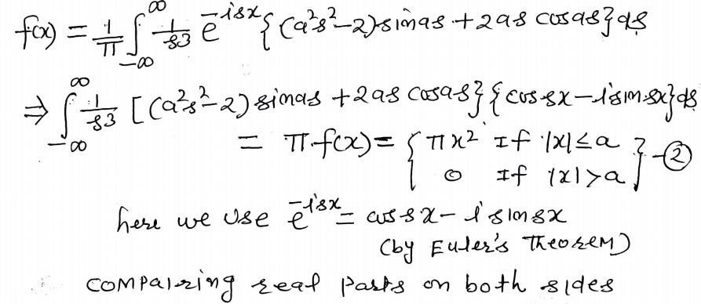
1

Slide 11
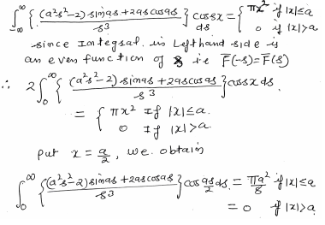
1

Slide 12
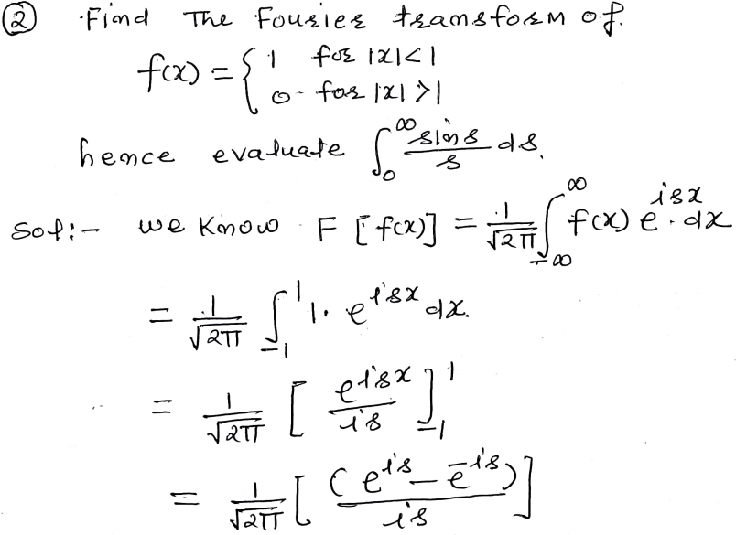
1

Slide 13
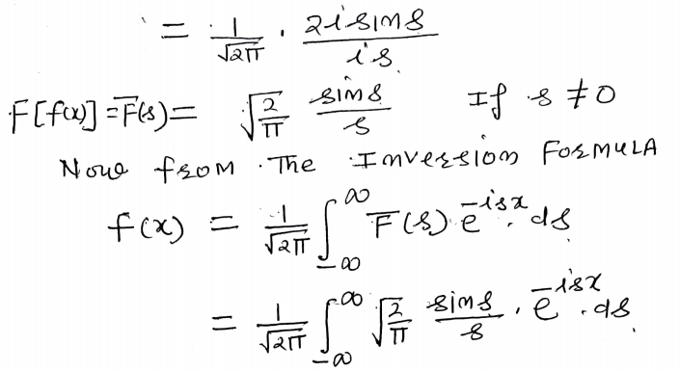
1

Slide 14
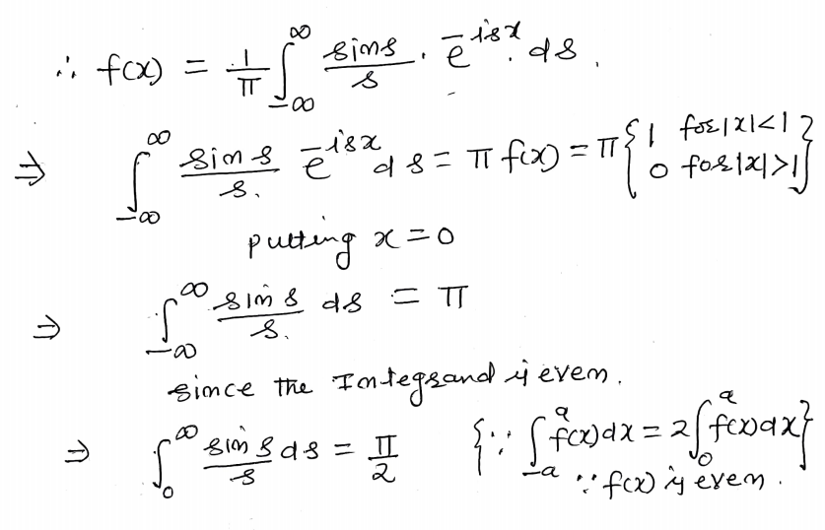
1

Slide 15
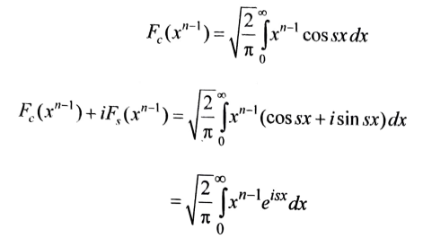
Sol. (a)
1

Slide 16
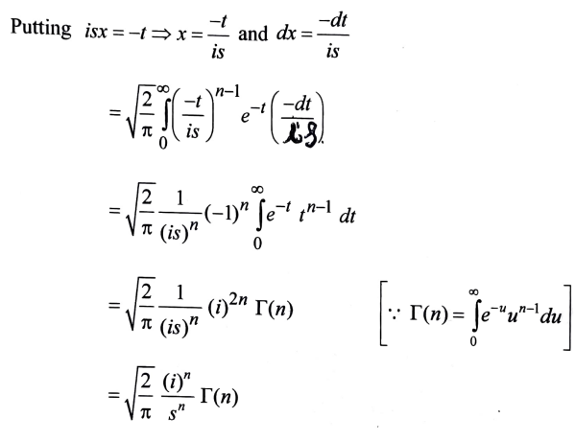
1

Slide 17
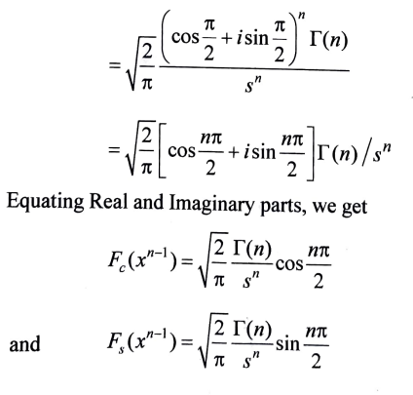
1

Slide 18
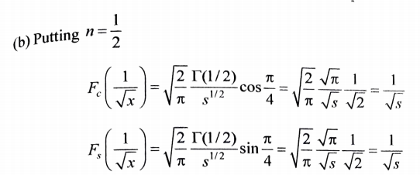
1

Slide 19
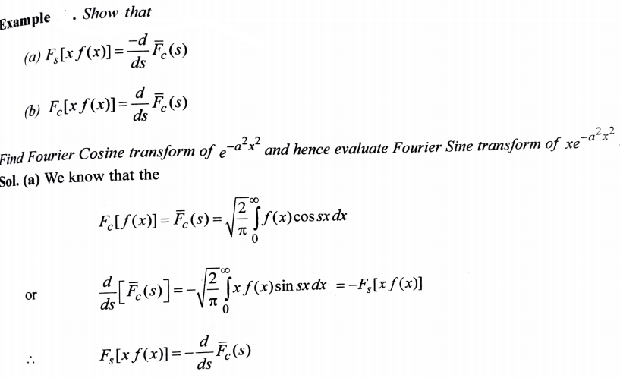
1

Slide 20
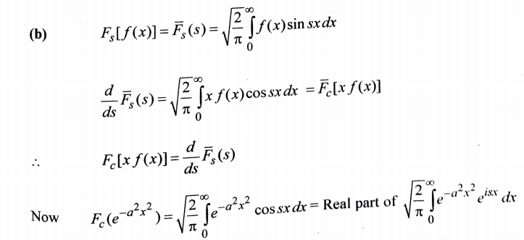
1

Slide 21
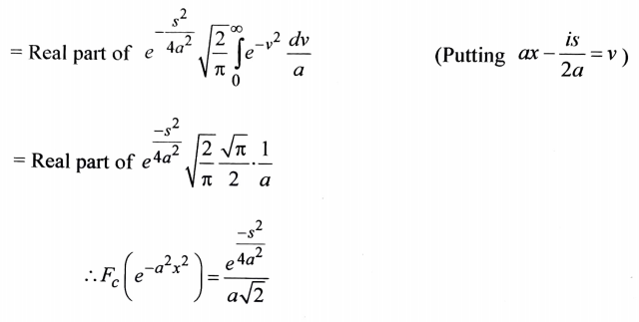
1

Slide 22
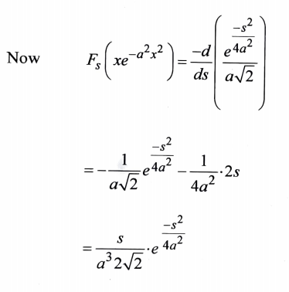
1

Slide 23
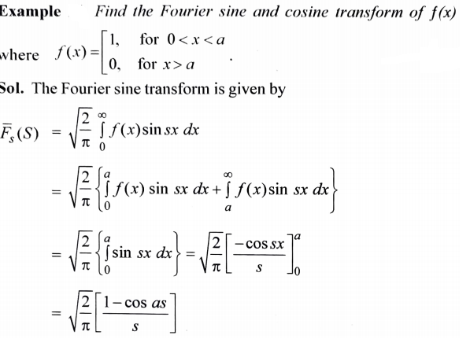
1

Slide 24
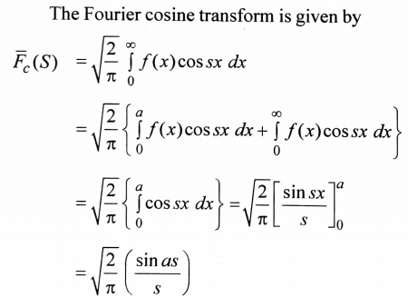
1

Slide 25
Refrences
1.Advanced Engineering Mathematics by Prof.ERWIN KREYSZIG (Ch.10,page no.557-580)
2. Advanced Engineering Mathematics by Prof.H.K Dass (Ch.14,page no.851-875)
3.Advanced Engineering Mathematics by B.V RAMANA (Ch.20,pageno.20.1.20.5)
4.NPTEL Lectures available on
http://www.infocobuild.com/education/audio-video-courses/m
athematics/TransformTechniquesForEngineers-IIT-Madras/lecture-47.html
1

Slide 26
Dr. Shivshankar Sharma (Associate Professor, Deptt. of Mathematics) , JECRC, JAIPUR

