Slide 1
JAIPUR ENGINEERING COLLEGE AND RESEARCH CENTRE
Year & Sem. – B. Tech I year, Sem.-I
Subject – Communication Skills
Syllabus and Course Plan
JAIPUR
1

Slide 2
VISION OF THE INSTITUTE
To become a renowned centre of outcome based learning, and work towards academic, professional, cultural and social enrichment of the lives of individuals and communities.
1

Slide 3
MISSION OF THE INSTITUTE
Focus on evaluation of learning outcomes and motivate students to inculcate research aptitude by project based learning.
Identify, based on informed perception of Indian, regional and global needs, the areas of focus and provide platform to gain knowledge and solutions.
Offer opportunities for interaction between academia and industry.
Develop human potential to its fullest extent so that intellectually capable and imaginatively gifted leaders may emerge.
1

Slide 4
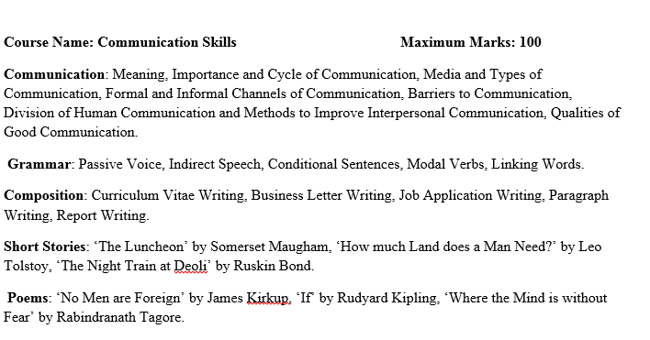
Introduction to Communication Skills Syllabus
1

Slide 5
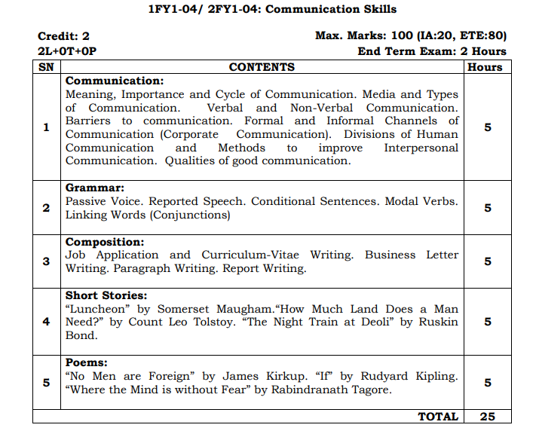
Lecture plan Communication skills
1

Slide 6
Department of English & Humanities
Subject: Communication Skills
2020-21
COURSE OUTCOMES
CO-PO MAPPING
Subject: Communication Skills (Theory)
COURSE OUTCOMES
Upon the successful completion of the course, the students will be:
CO-1.Able to express themselves better and use English for communicating in an effective manner both professionally and in real life situations.
CO-2-Able to write formal letters ,reports and proposals ,as well as speak fluently through correct usage of the various parts of speech.
CO-3.Able to get an exposure to the culture ,values, ethics and social norms reflected in the prose and poetry of authors from around the world and respond accordingly coupled with their imagination.
1

Slide 7
COURSE OUTCOMES | CO PO MAPPING
 | 1 | 2 | 3 | 4 | 5 | 6 | 7 | 8 | 9 | 10 | 11 | 12
I | 0 | 1 | 1 | 0 | 0 | 0 | 1 | 0 | 0 | 3 | 0 | 1
II | 0 | 1 | 1 | 0 | 0 | 0 | 2 | 0 | 0 | 3 | 0 | 1
III | 0 | 1 | 1 | 0 | 0 | 0 | 1 | 0 | 0 | 3 | 0 | 1
Average | 0 | 1 | 1 | 0 | 0 | 0 | 1.3 | 0 | 0 | 3 | 0 | 1
1

Slide 8
S.No | Topic to be discussed | Objective of the Lecture | Outcome of the lecture | Books referred | From Page
1 | Meaning & importance of communication | Focus on communication skills as per eng point | Professional understanding of the subj | Comm skills by shalini Bhargava | 1-Jul
2 | Media and types of Communication | To provide them knowledge of formal and informal | exposure to practical use | Comm skills by shalini Bhargava | Aug-13
3 | Formal and informal Channels | Giving them knowledge of the channels in org | exposure to industry | Comm skills by shalini Bhargava | 14-18
4 | Barriers and qualities of comm | to amke them proficient in communication | practice for the practical use | Comm skills by shalini Bhargava | 19-28
5 | Human comm verbal oral written and interpersonal | helping them in effective communication | practice for effective comm | Comm skills by shalini Bhargava | 29-48
6 | Grammar Active and passive | Speak fluently through its usage | speak fluently through correct usage of the various parts of speech. | Comm skills by shalini Bhargava | 51-60
7 | Indirect Speech | help them to communicate in an effective manner | To teach them correct usage and structure | Comm skills by shalini Bhargava | 61-68
8 | Conditional sentences | help them to use the proper conditional | To teach them correct usage and structure | Comm skills by shalini Bhargava | 69-72
9 | Modal verbs | Define and identify the correct usage | widens range of speaking in communication | Comm skills by shalini Bhargava | 73-82
1

Slide 9
10 | Linking words (conjunction ) | students will able to repair and run on sentences | The students will be more formal | Comm skills by shalini Bhargava | 83-96
11 | Cv /resume | help them to write error free | Its is an add on for their internship | Comm skills by shalini Bhargava | 99-114
12 | Composition Bussiness letter (leave, sales, joining ) | to teach them prof etiquetties of buss letter | becomes easier for day to day working in industry | Comm skills by shalini Bhargava | 115-128
13 | Paragraph writing | writing skills will be enhanced | wthe students will learn to frame well structured text. | Comm skills by shalini Bhargava | 129-137
14 | Report Writing | teach them how to write buss reports | help then to create organzational reports | Comm skills by shalini Bhargava | 138-148
15 | Report Writing | teach them how to write buss reports | help then to create organzational reports | Comm skills by shalini Bhargava | 138-148
16 | Short stories -"The luncheon " | an exposure to the culture, values, ethics and social norms | Know our culture and norms | Comm Skills Rajesh K Lidiya | 106-112
17 | How Much Land Does a Man Need? | Response to culture and norms | Know our culture and norms | Comm Skills Rajesh K Lidiya | 113-125
18 | How Much Land Does a Man Need? | Response to culture and norms | Know our culture and norms | Comm Skills Rajesh K Lidiya | 113-125
19 | "The Night Train at Deoli " | Giving them knowledge of thepast culture | will enhance their reading skills | Comm Skills Rajesh K Lidiya | 126-131
20 | "The Night Train at Deoli " | Giving them knowledge of thepast culture | will enhance their reading skills | Comm Skills Rajesh K Lidiya | 126-131
21 | No men are Foreign | enhance their vocabulary and generate interest | will enhance their reading skills | Comm Skills Rajesh K Lidiya | 132-135
22 | If ' Kipling | generate interest to culture and norms | enhancement to explore our culture | Comm Skills Rajesh K Lidiya | 136-139
23 | If ' Kipling | generate interest to culture and norms | enhancement to explore our culture | Comm Skills Rajesh K Lidiya | 136-139
24 | Where the Mind is without fear | Response to culture and norms | motivate them by beatiful messg | Comm Skills Rajesh K Lidiya | 140
25 | Revision of Syllabus
1

Slide 10
List of experiments of Language Lab
Phonetics symbols and transcriptions
Extempore
Group Discussion
Dialog Writing
Listening Comprehension
1

Slide 11
DR. NEELU JAIN, Asst. Prof, Dept. of E & H.) JECRC, JAIPUR

