Slide 1
JAIPUR ENGINEERING COLLEGE AND RESEARCH CENTRE
Presentation on types of boilers
Subject: Basic Mechanical Engineering
Second Semester(2019-20)
Prepared by :
Dilip Kumar Prajapati
Mechanical Department

Slide 2
Introduction
What is a Boiler?
Vessel that heats water to become hot water or steam
At atmospheric pressure water volume increases 1,600 times
Hot water or steam used to transfer heat to a process

Slide 3
PRINCIPLE OF OPERATION
The boiler is essentially a closed vessel inside which water is stored. Fuel (generally coal) is bunt in a furnace and hot gasses are produced.
These hot gasses come in contact with water vessel where the heat of these hot gases transfer to the water and consequently steam is produced in the boiler.
This steam is piped to the turbine of thermal power plant.

Slide 4
TYPES OF BOILERS
Horizontal, vertical or inclined
Fire tube and Water tube
Externally fired and internally fired
Forced circulation and natural circulation
High pressure and low pressure boilers
Stationary and portable
Single tube and multi-tube boilers
Fluidized bed boiler
Pulverized fuel boiler

Slide 5
Horizontal, vertical or inclined boilers:-
If the axis of the boiler is horizontal, the boiler is called horizontal, if the axis is vertical it is called vertical boiler and if the axis is inclined it is called inclined boiler.
Part of the horizontal boiler can be inspected and repair easily but it occupies more space.
The vertical boiler occupies less floor area.

Slide 6
FIRE TUBE AND WATER TUBE
In the fire tube boilers, the hot gases are inside the tube and water surrounds the tubes. for ex- cochran, lancashire and locomotive boilers.
In the water tube boilers, the water is inside the tubes and hot gases surrounds them. For ex- Babcock and Wilcox, Stirling, Yarrow boiler etc.

Slide 7
FIRE TUBE BOILER
Relatively small steam capacities (12,000 kg/hour).
Low to medium steam
pressures (18 kg/cm2).
Operates with oil, gas or solid fuels.

Slide 8
The advantage of fire tube boiler:-
It is quite compact in construction.
Fluctuation of steam demand can be met easily.
It is also quite cheap.
The disadvantage of fire tube boiler:-
As the water required for operation of the boiler is quite large, it requires long time for rising steam at desired pressure.
As the water and steam are in same vessel the very high pressure of steam is not possible
The steam received from fire tube boiler is not very dry.

Slide 9
WATER TUBE BOILER
Used for high steam demand and pressure requirements.
Capacity range of 4,500
– 120,000 kg/hour.
Combustion efficiency enhanced by induced draft provisions.

Slide 10
Advantages of water tube boiler:-
Larger heating surface can be achieved by using more numbers of water tubes.
Due to convectional flow, movement of water is much faster
than that of fire tube boiler; hence rate of heat transfer is high which results into higher efficiency.
Very high pressure in order of 140 kg/cm² can be obtained smoothly.
Disadvantage of water tube boiler
The main disadvantage of water tube boiler is that it is not compact in construction.
Its cost is not cheap.
Size is a difficulty for transportation and construction.

Slide 11
COMPARISON BETWEEN FIRE AND WATER TUBE BOILER
FIRE TUBE BOILER
Hot gases inside the tube and water outside the tubes.
Generally internally fired .
Operating pressure limited to 16
bar.
Rate of steam production is lower.
Not suitable for large power plant.
It occupies more floor area.
Water treatment is not so necessary.
WATER TUBE BOILER
Water inside the tubes and hot gases outside the tubes.
Externally fired.
Can work under as high pressure
as 100 bar.
Rate of steam production is higher.
It is suitable for large power plant.
It occupies less floor area.
Water treatment is more necessary.

Slide 12
EXTERNALLY AND INTERNALLY FIRED
The boiler is known as externally fired if the fired is outside the shell. For ex-Babcock and Wilcox boiler, Stirling boiler.
In case of internally fired boilers, the furnace is located inside the boiler shell. For ex- cochran, lancashire boiler etc.

Slide 13
FORCED AND NATURAL CIRCULATION
In forced circulation type of boiler, circulation of water is done by a forced pump. For ex- Velox, Lamont, Benson boiler etc.
In natural circulation type of boiler, circulation of water in the boiler takes place due to natural convention currents produce by application of heat. For ex- Lancashire, Babcock and Wilcox boiler etc.

Slide 14
HIGH AND LOW PRESSURE BOILERS
The boilers which produce steam at pressure of 80 bar and above are called high pressure boilers. For ex- Babcock and Wilcox, Velox, Lamount, Benson boilers etc.
The boiler which produce steam at pressure below 80 bar are called low pressure boiler. for ex- Cochran, Cornish, Lancashire and locomotive boilers etc.

Slide 15
STATIONARY AND PORTABLE
Stationary boilers are used for power plant steam, for central station utility power plant, for plant process steam etc.
Portable boiler include locomotive type, and other small units for temporary use at sites.

Slide 16
SINGLE AND MULTI – TUBE BOILER
These are basically types of fire tube boilers.
If single tube is used to pass hot gases then it is called single tube boiler. For ex- Cornish boiler.
If many tubes are used to pass hot gases then it is called multi-tube boiler. For ex- Lancashire, Babcock and Wilcox etc.

Slide 17
FLUIDIZED BED BOILER
Particles (e.g. sand) are suspended in high velocity air stream: bubbling fluidized bed.
Combustion at 840° – 950° C.
Capacity range 0.5 T/hr to 100 T/hr.
Fuels: coal, washery rejects, rice husk, bagasse and agricultural wastes.

Slide 18
PULVERIZED FUEL BOILER
Pulverized coal powder blown with combustion air into boiler through burner nozzles.
Combustion temperature at 1300 - 1700 °C.
Benefits: varying coal quality coal, quick response to load changes and high pre- heat air temperatures.

Slide 19
SELECTION OF A BOILER
Working pressure and quality of steam.
Steam generation rate.
Floor area available
Accessibility for repair and inspection .
Comparative initial cost.
Probable load factor.
The fuel and water available.
Operating and maintenance cost.

Slide 20
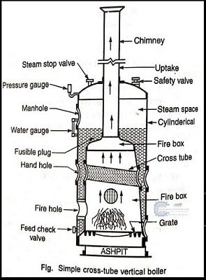
Simple Vertical Boiler

Slide 21
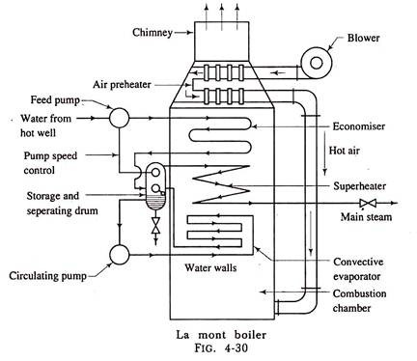
Lamont Boiler

Slide 22
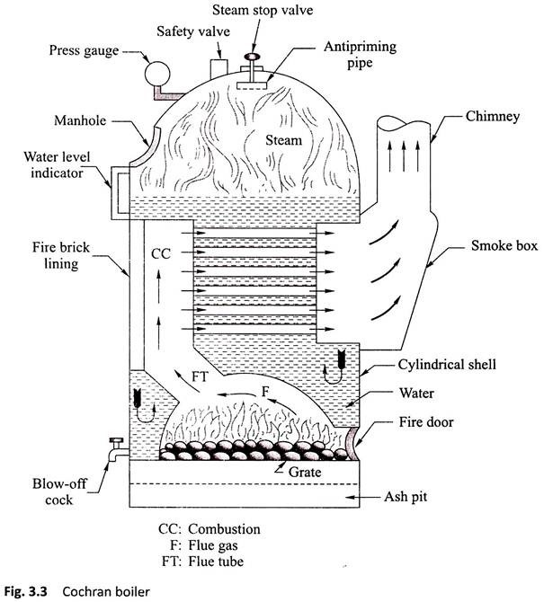
Cochran Boiler

Slide 23
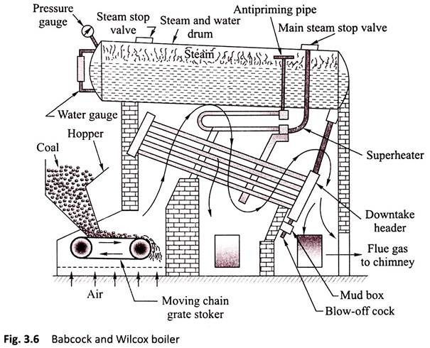
Babcock and Wilcox Boiler

Slide 24
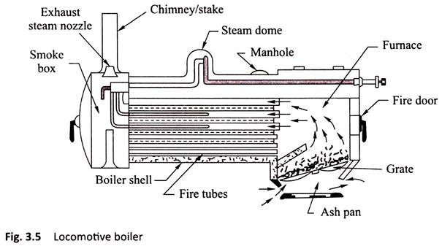
Locomotive Boiler

Slide 25
THANK YOU

