Slide 1
JAIPUR ENGINEERING COLLEGE AND RESEARCH CENTRE
Year & Sem – I & I
Subject – Computer aided Engineering graphics
Presented by – Hukam chand nagar (HCN) (Asst. Prof., ME)
1

Slide 2
VISSION AND MISSION OF INSTITUTE
To become a renowned centre of outcome based learning and work toward academic, professional, cultural and social enrichment in the lives of individuals and communities.
M1. Focus on evaluation of learning outcomes and motivate students to inculcate research aptitude by project based learning.
M2. Identify, based on informed perception of Indian, regional and global needs, areas of focus and provide platform to gain knowledge and solutions.
M3. Offer opportunities for interaction between academia and industry.
M4. Develop human potential to its fullest extent so that intellectually capable and imaginatively gifted leaders can emerge in a range of professions.
HUKAM CHAND NAGAR
(Assistant Professor, Department of mechanical engineering) JECRC, JAIPUR
1

Slide 3
VISSION AND MISSION OF DEPARTMENT
The Mechanical Engineering Department strives to be recognized globally for outcome based technical knowledge and to produce quality human resource, who can manage the advance technologies and contribute to society.
M1. To impart quality technical knowledge to the learners to make them globally competitive mechanical engineers.
M2. To provide the learners ethical guidelines along with excellent academic environment for a long productive career.
M3. To promote industry-institute relationship
1

Slide 4
Engineering Drawings
• Engineering drawing is a formal and precise way of communicating information about the shape, size, features and precision of physical objects.
• Drawing is the universal language of engineering.

Slide 5
CONTENT OF CAEG
SCALE DRAWING
PROJECTION OF POINT
PROJECTION OF STRAIGHT LINE
PROJECTION OF PLANE
PROJECTION OF SOLID

Slide 6
SCALES
DIMENSIONS OF LARGE OBJECTS MUST BE REDUCED TO ACCOMMODATE ON STANDARD SIZE DRAWING SHEET.THIS REDUCTION CREATES A SCALE OF THAT REDUCTION RATIO, WHICH IS GENERALLY A FRACTION..
SUCH A SCALE IS CALLED REDUCING SCALE AND
THAT RATIO IS CALLED REPRESENTATIVE FRACTION
FOR FULL SIZE SCALE R.F.=1 OR ( 1:1 ) MEANS DRAWING
& OBJECT ARE OF SAME SIZE.
Other RFs are described as
SIMILARLY IN CASE OF TINY OBJECTS DIMENSIONS MUST BE INCREASED FOR ABOVE PURPOSE. HENCE THIS SCALE IS CALLED ENLARGING SCALE. HERE THE RATIO CALLED REPRESENTATIVE FACTOR IS MORE THAN UNITY.
1:10,
1:1000,
1:100,
1:1,00,000
USE FOLLOWING FORMULAS FOR THE CALCULATIONS IN THIS TOPIC.
₌ LENGTH OF DRAWING in cm
A REPRESENTATIVE FRACTION (R.F.)
ACTUAL LENGTH in cm
=
AREA OF DRAWING in cm²
V ACTUAL AREA in cm²
=
VOLUME AS PER DRWG in cm³.
3
ACTUAL VOLUME in cm³
V
B
LENGTH OF SCALE (in cm) = R.F. X
MAX. LENGTH TO BE MEASURED in cm.

Slide 7
Area
1HECTARE = 10000 m²
BE FRIENDLY WITH THESE UNITS.
1 KILOMETRE
1 HECTOMETRE
1 DECAMETRE
1 METRE
1 DECIMETRE
1 CENTIMETRE
= 10 HECTOMETRES =10⁵cm
= 10 DECAMETRES = 10⁴cm
= 10 METRES = 10³ cm
= 10 DECIMETRES = 10² cm
= 10 CENTIMETRES = 10 cm
= 10 MILIMETRES
1m²= 10⁴ cm²
Volume
1m³= 10⁶ cm³
TYPES OF SCALES:
PLAIN SCALES
DIAGONAL SCALES
VERNIER SCALES
COMPARATIVE SCALES ( FOR COMPARING TWO DIFFERENT UNITS)
SCALE OF CHORDS ( FOR MEASURING/CONSTRUCTING ANGLES)
( FOR DIMENSIONS UP TO SINGLE DECIMAL) ( FOR DIMENSIONS UP TO TWO DECIMALS)
( FOR DIMENSIONS UP TO TWO DECIMALS)

Slide 8
Problem 6: A 3.2 cm long line represents a length of 4 metres. Extend this line to measure lengths up to 25 metres and show on it units of metre and 5 metres. Show the length of 17 metre on this line.
Length on drawing in cm 3.2 cm 3.2 cm 8 1
R.F= = = = =
Actual length of object in cm
4 m
4 x100cm
1000 125
L.O.S.= R.F.x Max. Length in cm
1
=
X 25X100 cm = 20 cm
125
0
5
10
15
20
METRE
5
4
3
2 1

Slide 9
PLAIN SCALE:-This type of scale represents two units or a unit and it’s sub-division.
PROBLEM NO.1:- Draw a scale 1 cm = 1m to read decimeters, to measure maximum distance of 6 m. Show on it a distance of 4 m and 6 dm.
CONSTRUCTION:-
a) Calculate R.F.=
DIMENSION OF DRAWING
DIMENSION OF OBJECT
R.F.= 1cm/ 1m = 1/100
PLAIN SCALE
Length of scale = R.F. X max. distance
= 1/100 X 600 cm
= 6 cms
Draw a line 6 cm long and divide it in 6 equal parts. Each part will represent larger division unit.
Sub divide the first part which will represent second unit or fraction of first unit.
Place ( 0 ) at the end of first unit. Number the units on right side of Zero and subdivisions on left-hand side of Zero. Take height of scale 5 to 10 mm for getting a look of scale.
After construction of scale mention it’s RF and name of scale as shown.
Show the distance 4 m 6 dm on it as shown.
4 M 6 DM
10
DECIMETERS
0
1
2
R.F. = 1/100
3
4
5 METERS
PLANE SCALE SHOWING METERS AND DECIMETERS.

Slide 10
PROBLEM NO.2:- In a map a 36 km distance is shown by a line 45 cms long. Calculate the R.F. and construct a plain scale to read kilometers and hectometers, for max. 12 km. Show a distance of 8.3 km on it.
CONSTRUCTION:-
a) Calculate R.F.
PLAIN SCALE
R.F.= 45 cm/ 36 km = 45/ 36 . 1000 . 100 = 1/ 80,000
Length of scale = R.F. max. distance
= 1/ 80000 12 km
= 15 cm
Draw a line 15 cm long and divide it in 12 equal parts. Each part will represent larger division unit.
Sub divide the first part which will represent second unit or fraction of first unit.
Place ( 0 ) at the end of first unit. Number the units on right side of Zero and subdivisions on left-hand side of Zero. Take height of scale 5 to 10 mm for getting a look of scale.
After construction of scale mention it’s RF and name of scale as shown.
Show the distance 8.3 km on it as shown.
8KM 3HM
10
5
0
1
2 3 4 5 6 7 8 9
R.F. = 1/80,000
PLANE SCALE SHOWING KILOMETERS AND HECTOMETERS
10
11
KILOMETERS
HECTOMETERS

Slide 11
DIAGONAL SCALE
We have seen that the plain scales give only two dimensions, such as a unit and it’s subunit or it’s fraction.
The diagonal scales give us three successive dimensions that is a unit, a subunit and a subdivision of a subunit.
The principle of construction of a diagonal scale is as follows.
Let the XY in figure be a subunit.
From Y draw a perpendicular YZ to a suitable height. Join XZ. Divide YZ in to 10 equal parts.
Draw parallel lines to XY from all these divisions and number them as shown.
From geometry we know that similar triangles have their like sides proportional.
X
Y
10
9
8
7
6
5
4
3
2
1
10’
9’
8’
7’
6’
Consider two similar triangles XYZ and 7’ 7Z,
we have 7Z / YZ = 7’7 / XY (each part being one unit) Means 7’ 7 = 7 / 10. x X Y = 0.7 XY
:.
Similarly
1’ – 1 = 0.1 XY
2’ – 2 = 0.2 XY
Thus, it is very clear that, the sides of small triangles, which are parallel to divided lines, become progressively shorter in length by 0.1 XY.
5’
4’
3’
2’
1’
Z
The solved examples ON NEXT PAGES will make the principles of diagonal scales clear.

Slide 12
Problem 7: Construct a diagonal scale of R.F. = 1/6250 to read up to 1 kilometre and to read metres on it. Show a length of 653 metre on it.
1
,
R.F =
Max. Length = 1 km
6250
1
L.O.S.= R.F.x Max. Length in cm
=
X 1X 10⁵ cm
= 16 cm
6250
Hint: As the maximum length is 1 km, the line should be divided in to 10 equal parts, so as to represent a division of 100 m
10
8
6
4
653
2
100 50
0
100
200 300
400 500 600 700 800
900
METRE

Slide 13
Problem 8: On a map, the distance between two points is 14 cm. The real distance between them is 20 km. draw the diagonal scale of this map to read kilometre and hectametres, and to measure up to 25 kilometre. Show a distance of 17.6 kilometre on this scale.
Length on drawing in cm 14 cm
14 cm 7
R.F=
= = =
Actual length of object in cm 20 km 20X10⁵ cm 10⁶
L.O.S.= R.F.x Max. Length in cm
7
=
X 25X10⁵ cm = 17.5 cm
10⁶
6
4
 |  | 17.6 km
HECTOMETRE
2
5 4 3 2 1 0
5
10
15
20
KILOMETRE

Slide 14
Problem 8: On a map, the distance between two points is 14 cm. The real distance between them is 20 km. draw the diagonal scale of this map to read kilometre and hectametres, and to measure up to 25 kilometre. Show a distance of 17.6 kilometre on this scale.
Length on drawing in cm 14 cm
14 cm 7
R.F=
= = =
Actual length of object in cm 20 km 20X10⁵ cm 10⁶
L.O.S.= R.F.x Max. Length in cm
7
=
X 25X10⁵ cm = 17.5 cm
10⁶
6
4
 |  | 17.6 km
HECTOMETRE
2
5 4 3 2 1 0
5
10
15
20
KILOMETRE

Slide 15
Problem 8: A rectangular plot of land measuring 1.28 hectors is represented on a map by a similar rectangle of 8 sq.cm. Calculate RF of the scale. Draw a diagonal scale to read single meter. Show a distance of 438 m on it. 1 hector = 10⁴ m²
Area on drawing in cm² 8 cm²
4 ₌ 64X10⁶
1
R.F=
=
=
Actual area of object in cm² 1.28X10⁴x10⁴ cm²
4000
L.O.S.= R.F.x Max. Length in cm
1
= X 500 X 100 cm = 12.5 cm
Here maximum length is not gi⁴v⁰e⁰n⁰. But we have to show a distance of 438 m on the scale. That will be possible only when maximum length is ₁ta₀ ken as 500 m
8
6
4
2
 |  | 438 m
100
50
0
100
200
300
400
METRE

Slide 16
PROBLEM NO.3:- The distance between two stations is 210 km. A passenger train covers this distance
in 7 hours. Construct a plain scale to measure time up to a single minute. RF is 1/200,000 Indicate the distance traveled by train in 29 minutes.
CONSTRUCTION:-
a) 210 km in 7 hours. Means speed of the train is 30 km per hour ( 60 minutes)
PLAIN SCALE
Length of scale = R.F. max. distance per hour
= 1/ 2,00,000 30km
= 15 cm
15 cm length will represent 30 km and 1 hour i.e. 60 minutes.
Draw a line 15 cm long and divide it in 6 equal parts. Each part will represent 5 km and 10 minutes.
Sub divide the first part in 10 equal parts,which will represent second unit or fraction of first unit. Each smaller part will represent distance traveled in one minute.
Place ( 0 ) at the end of first unit. Number the units on right side of Zero and subdivisions on left-hand side of Zero. Take height of scale 5 to 10 mm for getting a proper look of scale.
Show km on upper side and time in minutes on lower side of the scale as shown. After construction of scale mention it’s RF and name of scale as shown.
Show the distance traveled in 29 minutes, which is 14.5 km, on it as shown.
DISTANCE TRAVELED IN 29 MINUTES.
14.5 KM
KM
5 2.5 0 5
10
15
20
25 KM
MIN
10
0
10
20
R.F. = 1/100
30
40
50 MINUTES
PLANE SCALE SHOWING METERS AND DECIMETERS.

Slide 17
PROBLEM NO. 4 : The distance between Delhi and Agra is 200 km.
In a railway map it is represented by a line 5 cm long. Find it’s R.F. Draw a diagonal scale to show single km. And maximum 600 km.
Indicate on it following distances. 1) 222 km 2) 336 km 3) 459 km 4) 569 km
DIAGONAL SCALE
SOLUTION STEPS:
RF = 5 cm / 200 km = 1 / 40, 00, 000
Length of scale = 1 / 40, 00, 000 X 600 X 10⁵ = 15 cm
Draw a line 15 cm long. It will represent 600 km.Divide it in six equal parts.( each will represent 100 km.)
Divide first division in ten equal parts.Each will represent 10 km.Draw a line upward from left end and
mark 10 parts on it of any distance. Name those parts 0 to 10 as shown.Join 9th sub-division of horizontal scale with 10th division of the vertical divisions. Then draw parallel lines to this line from remaining sub divisions and complete diagonal scale.
569 km
459 km
336 km
222 km
10
9
8
7
6
5
4
3
2
1
KM
0
50
200
R.F. = 1 / 40,00,000
^{KM} 100
0
100
300
400
500 KM
DIAGONAL SCALE SHOWING KILOMETERS.

Slide 18
DIAGONAL
PROBLEM NO.5: A rectangular plot of land measuring 1.28 hectors is represented on a map by a similar rectangle of 8 sq. cm. Calculate RF of the scale. Draw a diagonal scale to read single meter. Show a distance of 438 m on it.
SOLUTION :
1 hector = 10, 000 sq. meters
1.28 hectors = 1.28 X 10, 000 sq. meters
= 1.28 X 10⁴ X 10⁴ sq. cm
8 sq. cm area on map represents
= 1.28 X 10⁴ X 10⁴ sq. cm on land 1 cm sq. on map represents
= 1.28 X 10 ⁴ X 10⁴ / 8 sq cm on land 1 cm on map represent
SCALE
Draw a line 15 cm long.
It will represent 600 m.Divide it in six equal parts. ( each will represent 100 m.)
Divide first division in ten equal parts.Each will represent 10 m.
Draw a line upward from left end and mark 10 parts on it of any distance.
Name those parts 0 to 10 as shown.Join 9th sub-division
=
1.28 X 10 ⁴ X 10⁴ / 8 cm
= 4, 000 cm
of horizontal scale with 10th division of the vertical divisions.
1 cm on drawing represent 4, 000 cm, Means RF = 1 / 40T₀h₀en draw parallel lines to this line from remaining sub divisions
Assuming length of scale 15 cm, it will represent 600 m.and complete diagonal scale.
438 meters
10
9
8
7
6
5
4
3
2
1
0
M
M 100
50
0
100
200
R.F. = 1 / 4000
300
400
500 M
DIAGONAL SCALE SHOWING METERS.

Slide 19
PROBLEM NO.6:. Draw a diagonal scale of R.F. 1: 2.5, showing centimeters and millimeters and long enough to measure up to 20 centimeters.
SOLUTION STEPS:
R.F. = 1 / 2.5
Length of scale = 1 / 2.5 X 20 cm.
= 8 cm.
Draw a line 8 cm long and divide it in to 4 equal parts. (Each part will represent a length of 5 cm.)
Divide the first part into 5 equal divisions. (Each will show 1 cm.)
At the left hand end of the line, draw a vertical line and on it step-off 10 equal divisions of any length.
Complete the scale as explained in previous problems.
Show the distance 13.4 cm on it.
DIAGONAL SCALE
13 .4 CM
10
9
8
7
6
5
4
3
2
1
0
MM
CM
5 4 3 2 1 0 5 10
R.F. = 1 / 2.5
DIAGONAL SCALE SHOWING CENTIMETERS.
15
CENTIMETRES

Slide 20
COMPARATIVE SCALES:
EXAMPLE NO. 7 :
These are the Scales having same R.F. but graduated to read different units.
These scales may be Plain scales or Diagonal scales
and may be constructed separately or one above the other.
A distance of 40 miles is represented by a line
8 cm long. Construct a plain scale to read 80 miles. Also construct a comparative scale to read kilometers upto 120 km ( 1 m = 1.609 km )
OLUTION STEPS:
cale of Miles:
CONSTRUCTION:
Take a line 16 cm long and divide it into 8 parts. Each will represent 10 miles. Subdivide the first part and each sub-division will measure single mile.
0 miles are represented = 8 cm
80 miles = 16 cm
.F. = 8 / 40 X 1609 X 1000 X 100
= 1 / 8, 04, 500
Scale of Km:
Length of scale
= 1 / 8,04,500 X 120 X 1000 X 100
= 14. 90 cm
CONSTRUCTION:
On the top line of the scale of miles cut off a distance of 14.90 cm and divide it into 12 equal parts. Each part will represent 10 km.
Subdivide the first part into 10 equal parts. Each subdivision will show single km.
10
0
10
20
30
40
50
60
70
80
90
100
110 KM
5
10
5
0
10
20
30
40
50
60
70 MILES
R.F. = 1 / 804500
COMPARATIVE SCALE SHOWING MILES AND KILOMETERS

Slide 21
SOLUTION STEPS:
COMPARATIVE SCALE:
Scale of km.
length of scale = RF X 60 km
= 1 / 4,00,000 X 60 X 10⁵
= 15 cm.
EXAMPLE NO. 8 :
A motor car is running at a speed of 60 kph.
On a scale of RF = 1 / 4,00,000 show the distance traveled by car in 47 minutes.
CONSTRUCTION:
Draw a line 15 cm long and divide it in 6 equal parts.
( each part will represent 10 km.)
Subdivide 1st part in `0 equal subdivisions.
( each will represent 1 km.)
Time Scale:
Same 15 cm line will represent 60 minutes. Construct the scale similar to distance scale.
It will show minimum 1 minute & max. 60min.
47 MINUTES
10
MIN.
5
0
10
20
30
40
50 MINUTES
KM ₁₀
5
0
10
20
30
40
50 KM
47 KM
R.F. = 1 / 4,00,000
COMPARATIVE SCALE SHOWING MINUTES AND KILOMETERS

Slide 22
EXAMPLE NO. 9 :
A car is traveling at a speed of 60 km per hour. A 4 cm long line represents the distance traveled by the car in two hours. Construct a suitable comparative scale up to 10 hours. The scale should be able to read the distance traveled in one minute.
Show the time required to cover 476 km and also distance in 4 hours and 24 minutes.
SOLUTION:
4 cm line represents distance in two hours , means for 10 hours scale, 20 cm long line is required, as length of scale.This length of scale will also represent 600 kms. ( as it is a distance traveled in 10 hours) CONSTRUCTION:
Distance Scale ( km)
Draw a line 20 cm long. Divide it in TEN equal parts.( Each will show 60 km) Sub-divide 1st part in SIX subdivisions.( Each will represent 10 km)
At the left hand end of the line, draw a vertical line and on it step-off 10 equal divisions of any length. And complete the diagonal scale to read minimum ONE km.
Time scale:
COMPARATIVE SCALE:
Draw a line 20 cm long. Divide it in TEN equal parts.( Each will show 1 hour) Sub-divide 1st part in SIX subdivisions.( Each will represent 10 minutes) At the left hand end of the line, draw a vertical line and on it step-off 10 equal divisions of any length.
And complete the diagonal scale to read minimum ONE minute.
TIME SCALE TO MEASURE MIN 1 MINUTE.
10
5
MIN.₀
60
0
1 2
4 hrs 24 min. ( 264 kms )
3 4
476 kms ( 7 hrs 56 min.)
5
6
7
8
9
HOURS
10
kM
5
kM ₆⁰₀
0
60
120 180 240 300
DISTANCE SCALE TO MEASURE MIN 1 KM
360
420
480 540
KILOMETERS

Slide 23
Scale of Chords
The scale of chords is drawn to measure angle or draw an angle of given measurement without using a protractor,
Draw a straight line PQ of any length and mark a point O on its centre.
Draw a semicircle on the line PQ, with O as centre and OA as radius to intersect PQ at AB.
With A as centre and OA as radius, cut an arc on the semicircle.
Similarly with B as centre and OA as radius, cut an arc on the semicircle.
Now with these new points of intersections as centers, draw two arcs to intersect each other above O.
Join this point with O to get perpendicular at O

Slide 24
Scale of Chords
The scale of chords is drawn to measure angle or draw an angle of given measurement without using a protractor,
80
90
70
60
50
40
30
20
10
P
10 20 30 40 50 60
70 80 90
Q
A
B
O
Join this point with O to get perpendicular at O other above O.
Draw a straight line PQ of any length and mark a point O on its centre.
Draw a semicircle on the line PQ, with O as centre and OA as radius to intersect PQ at
Now with these new points of intersections as centers, draw two arcs to intersect each
With A as centre and OA as radius, cut an arc on the semicircle.
Similarly with B as centre and OA as radius, cut an arc on the semicircle. AB.

Slide 25
80⁰
90⁰
70⁰
SCALE OF CORDS
60⁰
50⁰
40⁰
30⁰
20⁰
10⁰
₀0
A
O
0
10
20 30 40 50 60 70 80
90
CONSTRUCTION:
DRAW SECTOR OF A CIRCLE OF 90⁰ WITH ‘OA’ RADIUS.
( ‘OA’ ANY CONVINIENT DISTANCE )
DIVIDE THIS ANGLE IN NINE EQUAL PARTS OF 10 ⁰ EACH.
NAME AS SHOWN FROM END ‘A’ UPWARDS.
FROM ‘A’ AS CENTER, WITH CORDS OF EACH ANGLE AS RADIUS DRAW ARCS DOWNWARDS UP TO ‘AO’ LINE OR IT’S EXTENSION AND FORM A SCALE WITH PROPER LABELING AS SHOWN.
AS CORD LENGTHS ARE USED TO MEASURE & CONSTRUCT DIFERENT ANGLES IT IS CALLED SCALE OF CORDS.

Slide 26
PROBLEM 12: Construct any triangle and measure it’s angles by using scale of cords.
CONSTRUCTION: |  |  |  | SCALE OF CORDS
First prepare Scale of Cords for the problem. Then construct a triangle of given sides. ( You are supposed to measure angles x, y and z) |  |  |  | ₈₀0 90⁰
To measure angle at x: |  |  |  | 60⁰
Take O-A distance in compass from cords scale and mark it on lower side of triangle as shown from corner x. Name O & A as shown. Then O as center, O-A radius draw an arc upto upper adjacent side.Name the point B. |  | 40⁰ | 50⁰
Take A-B cord in compass and place on scale of cords from Zero. | 30⁰
It will give value of angle at x To measure angle at y: | 20⁰
Repeat same process from O_{1.} Draw arc with radius O₁A_{1.} Place Cord A₁B₁ on scale and get angle at y. To measure angle at z: | 10⁰ A |  |  | O
Subtract the SUM of these two angles from 180⁰ to get angle at z. | 0 | 10 | 20 | 30 40 50 60 70 80 90
70⁰
90
₀0
80
60 70
B₁
z
0
10
40 50
20
B
30
30
20
y
55⁰
40
10
30⁰
x
O₁
A₁
A
0
O
50 60 70
80
90
Angle at z = 180 – ( 55 + 30 ) = 95⁰

Slide 27
PROBLEM 12: Construct 25⁰ and 115⁰ angles with a horizontal line , by using scale of cords.
CONSTRUCTION: |  |  |  | SCALE OF CORDS
First prepare Scale of Cords for the problem. Then Draw a horizontal line. Mark point O on it. |  |  |  | 0 70⁰
To construct 25⁰ angle at O. |  |  |  | 60⁰
Take O-A distance in compass from cords scale and mark it on on the line drawn, from O Name O & A as shown. Then O as center, O-A radius draw an arc upward.. Take cord length of 25⁰ angle from scale of cords in compass and from A cut the arc at point B.Join B with O. The angle AOB is thus 25⁰ | 30⁰ | 40⁰ | 50⁰
To construct 115⁰ angle at O. This scale can measure or construct angles upto 90⁰ only directly. | 20⁰
Hence Subtract 115⁰ from 180^{0.}We get 75⁰ angle , which can be constructed with this scale. Extend previous arc of OA radius and taking cord length of 75⁰ in compass cut this arc at B₁ with A as center. Join B₁ with O. Now angle AOB₁ is 75⁰ and angle COB₁ is 115⁰. | 10⁰ A 0 | 10 | 20 | O 30 40 50 60 70 80 90
80⁰
90
₀0
B
0
B₁
0
10
10
20
20
30
A
25⁰
O
30
75⁰
40 50 60 70 80 90
105⁰
40 50
A
O
C
60 70
To construct 25⁰ angle at O.
To construct 115⁰ angle at O.
80
90

Slide 28
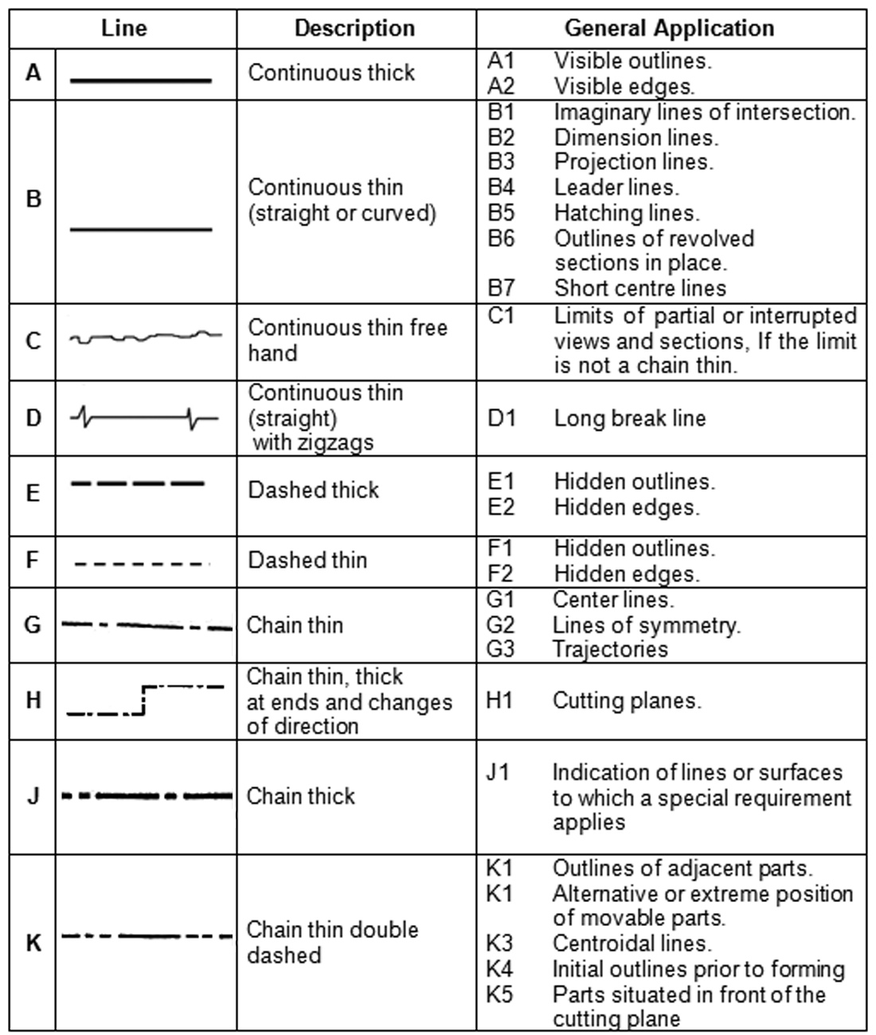

Slide 29
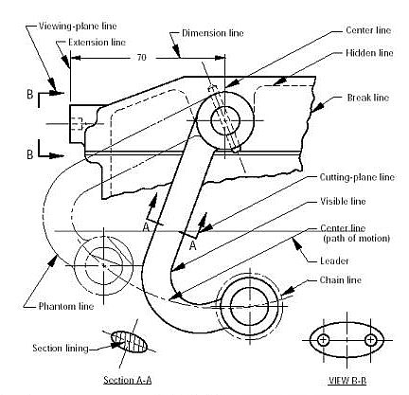
Viewing-plane line
1
Dimension Line
4
3
Center Line
Extension line
2
Hidden Line
5
6
Break Line
Cutting-plane Line
7
8
Visible Line
Center Line (of motion)
9
10
Leader
Phantom Line
14
13
Section Line
11
12
VIEW B-B
SECTION A-A
Source: http://www.genium.com/pdf/dmpc.pdf

Slide 30
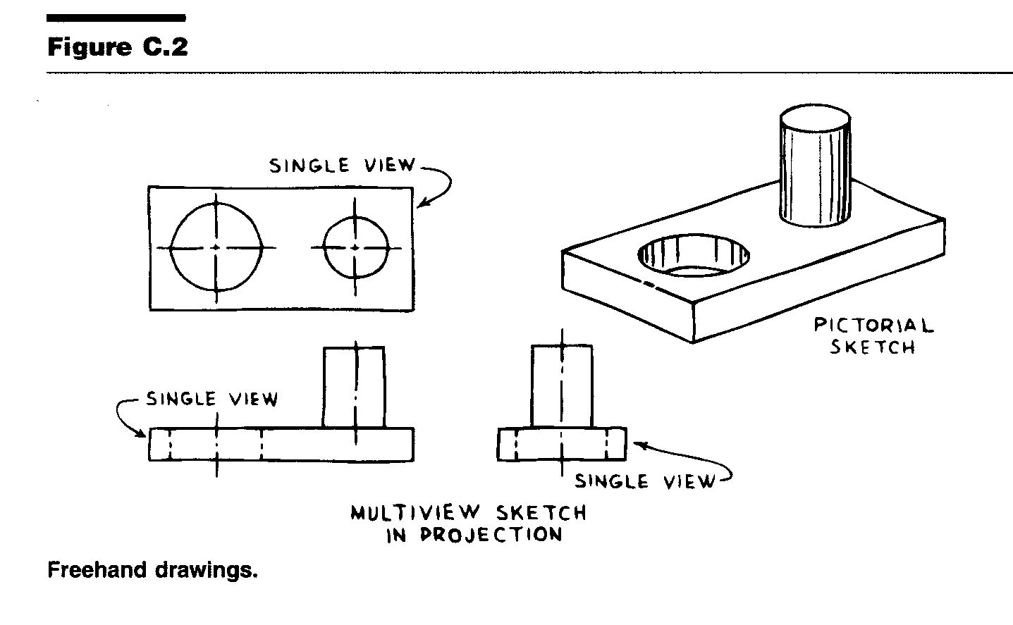
Sketching
Drawings made without mechanical drawing tools
Free-Hand

Slide 31
Projection of points
In 1st quadrant
In 2nd quadrant
In 3rd quadrant
In 4th quadrant

Slide 32
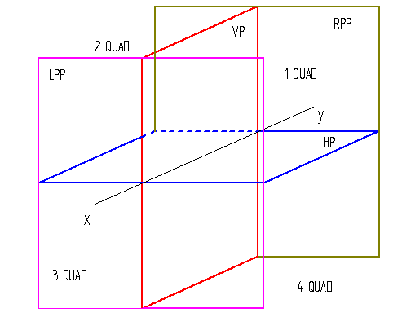
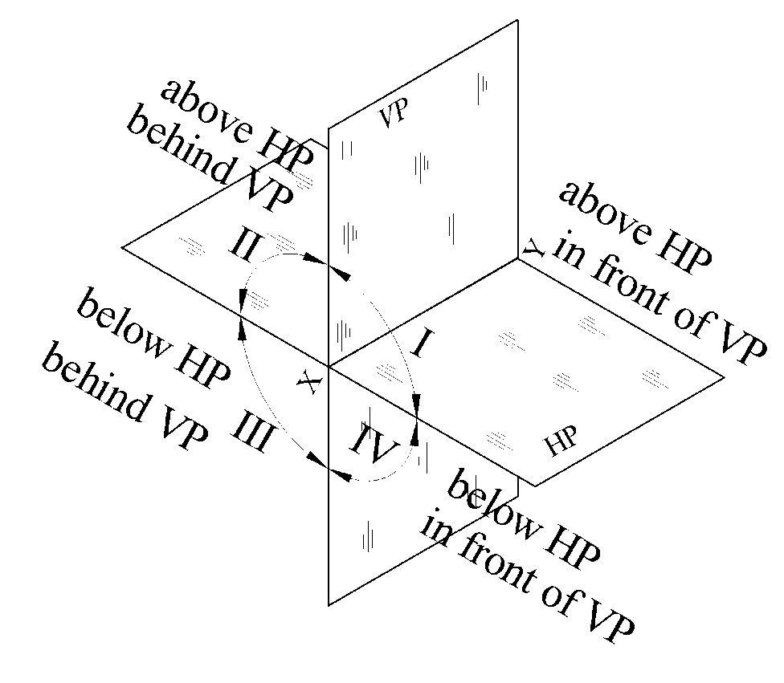
Quadrants

Slide 33
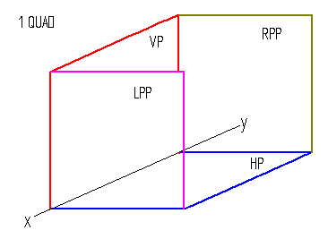
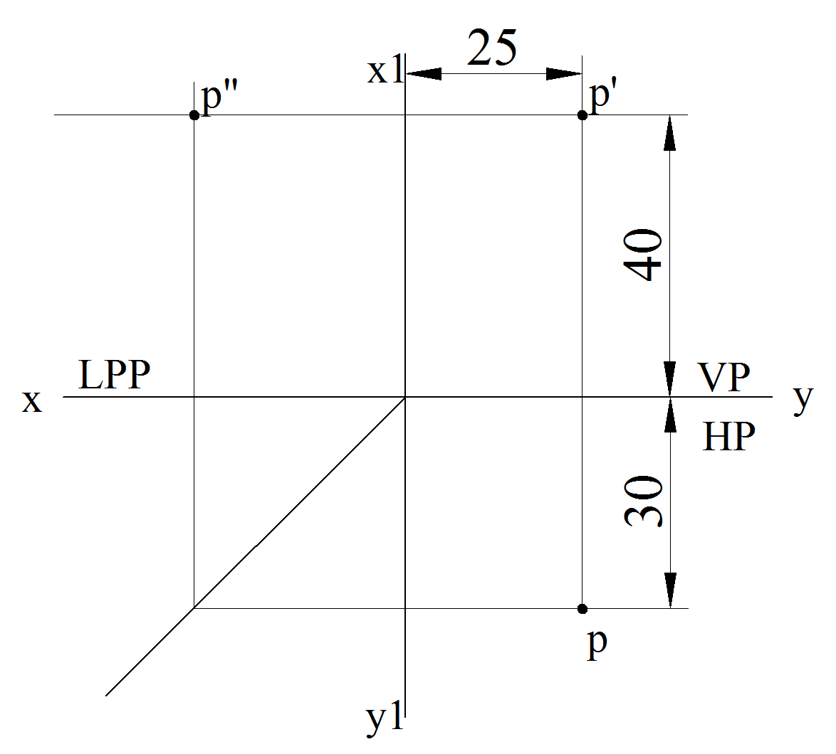
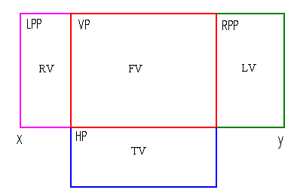
Projection of points In 1st quadrant
Above HP
In front of VP
A point is 30 mm in front of VP, 40 mm above HP and 25 mm in front of left profile plane. Draw its projections.

Slide 34
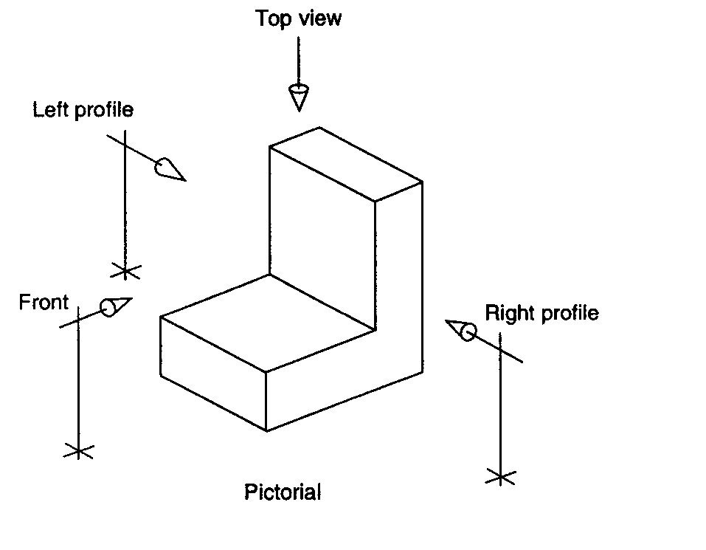

Slide 35
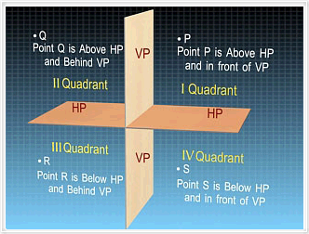
Projection of Points
In 1st quadrant
In 2nd quadrant
In 3rd quadrant
In 4th quadrant

Slide 36
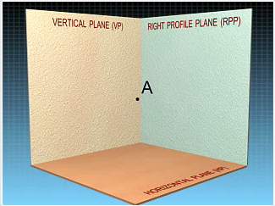
Projection of point – I quadrant

Slide 37
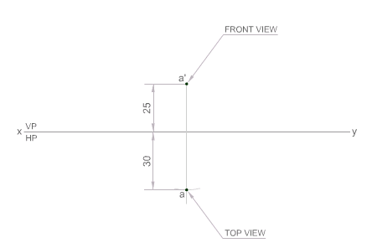
Projection of points In 1st quadrant
Above HP
In front of VP
A point is 30 mm in front of VP, 25 mm above HP. Draw its projections.

Slide 38
Projection of points In 1st quadrant
2. Draw the projection of a point P that is 30 mm in front of VP, 50 mm above HP and 35 mm in front of right profile plane

Slide 39
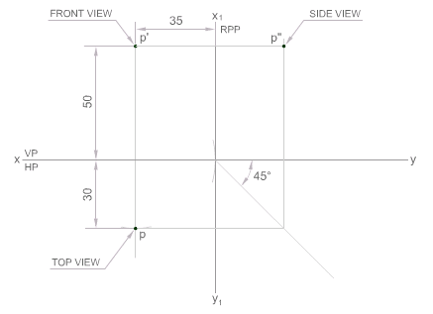
Solution

Slide 40
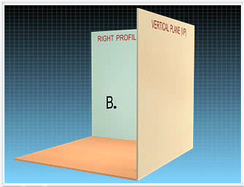
Projection of point – II quadrant

Slide 41
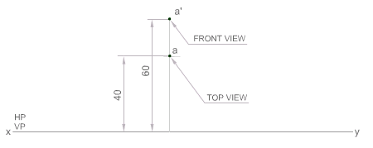
Projection of point – II quadrant
Draw the projection of a point A lying 60mm above HP and 40mm behind VP

Slide 42
Projection of point – II quadrant
A point is 20 mm above HP, 45 mm behind VP and 25 mm in front of RPP. Draw its projections.

Slide 43
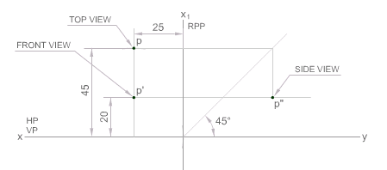
Solution

Slide 44
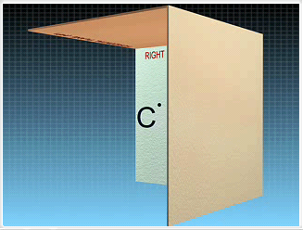
Projection of point – III quadrant

Slide 45
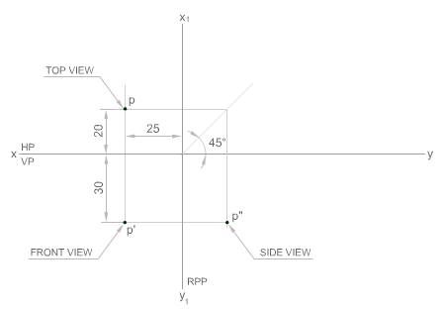
Projection of point – III quadrant
A point P is 30 mm below HP, 20 mm behind VP and 25 mm behind RPP. Draw the projections of the point.

Slide 46
Projection of point – III quadrant
Problem 2.
Draw the projection of a point P that is lying in HP, 20 mm behind VP and 30 mm behind RPP

Slide 47
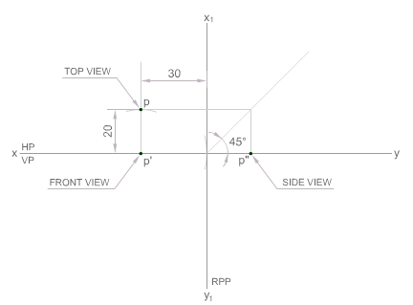
Solution

Slide 48
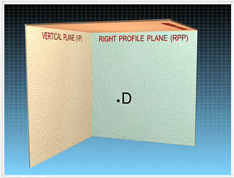
Projection of point – IV quadrant

Slide 49
Projection of point – IV quadrant

Slide 50
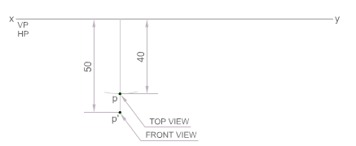
Projection of point – IV quadrant
A point P is lying 50 mm below HP and 40 mm in front of VP. Draw its projection.

Slide 51
Projection of point – IV quadrant
Problem 2
Draw the top, front and profile view of a point A 40 mm in front of VP, 30 mm below HP and 25 mm in front of LPP

Slide 52
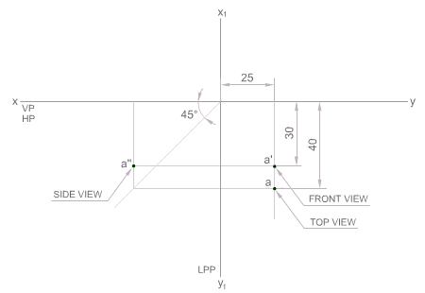
Solution

Slide 53
Projection of Lines
Straight line: Defined as the locus of a point, which moves linearly.
Or – Shortest distance between any two given points.
Straight line is one dimensional object.
Projection of Line: is obtained by placing the straight line in space and projecting the end points of the line on the principal planes of projection (HP, VP, PP) and connecting the points.
From now on we look at the projections with respect to First quadrant only.

Slide 54
Projection of Lines
A line may be held in space with reference to HP,VP and PP in infinite number of positions.
Parallel to both the planes
Parallel to one plane and perpendicular to the other
Parallel to one plane and inclined to the other
Inclined to both the planes

Slide 55
Parallel to both the planes

Slide 56
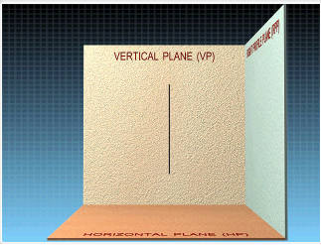
Parallel to one plane and perpendicular to the other

Slide 57
Parallel to one plane and inclined to the other

Slide 58
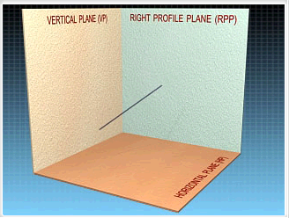
Inclined to both the planes

Slide 59
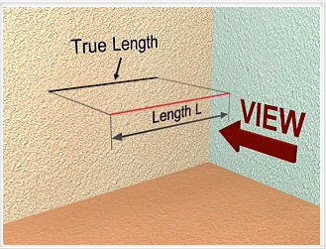
True length
If a line is parallel to any one of the planes, its projection on that plane will give true length

Slide 60
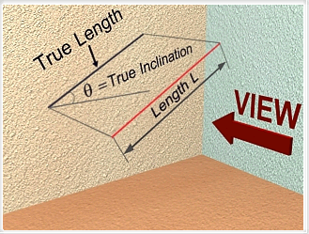
True length and true inclination
If a line is inclined to one principal plane and is parallel to the other plane, its projection on that plane gives true length and true inclination.

Slide 61
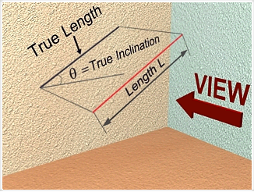
If a line is parallel to VP and inclined at θ to HP, the front view will be true length and at true inclination θ

Slide 62
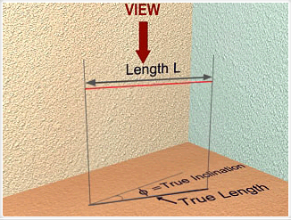
If a line is parallel to HP and inclined at ø to VP, the top view will be true length and true inclination ø.

Slide 63
θ is the inclination always measured with respect to object and HP
ø is the inclination always measured with respect to object and VP

Slide 64
Parallel to both the planes

Slide 65
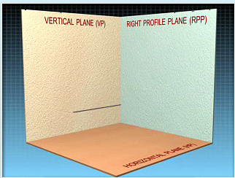
Problem 1
Draw the projections of a line 70 mm long when it is parallel to both HP and VP. The line is 20 mm from both HP and VP.

Slide 66
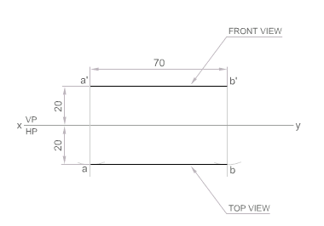
Solution :

Slide 67
Parallel to one plane and perpendicular to the other

Slide 68
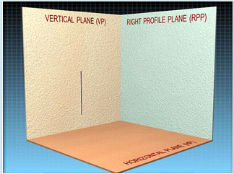
Problem :

Slide 69
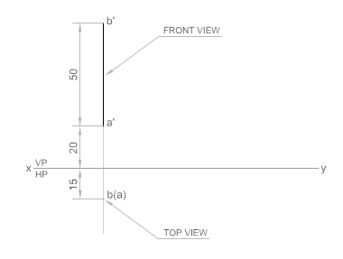
Solution :

Slide 70
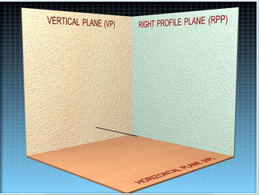

Slide 71
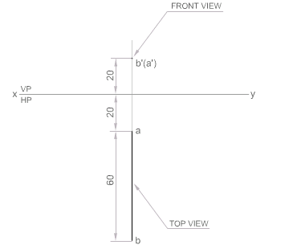
Solution :

Slide 72
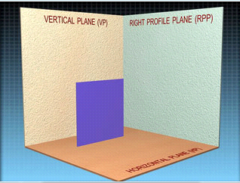
Projection of Planes

Slide 73
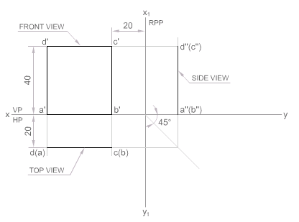
Solution

Slide 74
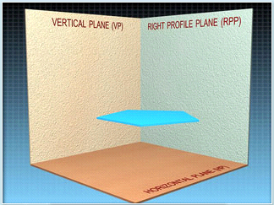
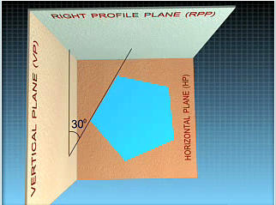

Slide 75
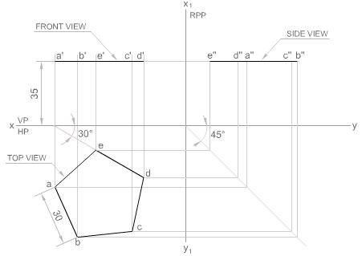
Solution

Slide 76
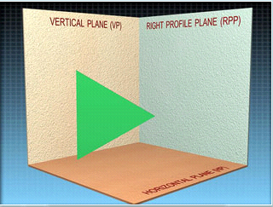

Slide 77
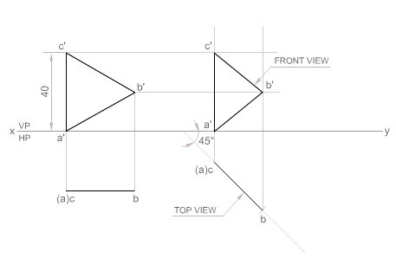
Solution

Slide 78
Projection of Solids
What is solid:
A solid may be defined as a three dimensional object having length, breadth and thickness bonded by surfaces.
Solids may be classified under two headings
1. Polyhedron
2. Solids of revolution

Slide 80
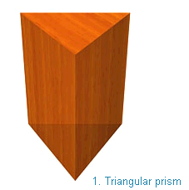
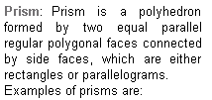
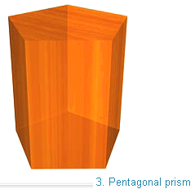
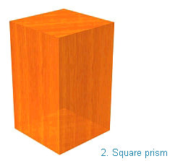
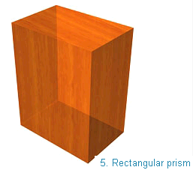

Slide 81
