Slide 1
JAIPUR ENGINEERING COLLEGE AND RESEARCH CENTER
Year & Sem. – I Year & I SEM
Subject –Basic Mechanical Engineering ( 1FY3-07)
Unit– 3
Coordinators– Nitin Chhabra, Dilip kumar Prajapati
(Assistant Professor)
Nitin Chhabra (Assistant Professor) , JECRC, JAIPUR
1
1

Slide 2
VISION AND MISSION OF INSTITUTE
VISION OF INSTITUTE
To became a renowned centre of outcome based learning and work towards academic professional ,cultural and social enrichment of the lives of individuals and communities .
MISSION OF INSTITUTE
Focus on evaluation of learning ,outcomes and motivate students to research aptitude by project based learning.
Identify based on informed perception of Indian ,regional and global needs ,the area of focus and provide platform to gain knowledge and solutions.
Offer opportunities for interaction between academic and industry .
Develop human potential to its fullest extent so that intellectually capable and imaginatively gifted leaders may emerge.
Nitin Chhabra(Assistant Professor) JECRC JAIPUR
2
1
Notes:
2

Slide 3
VISION AND MISSION OF DEPARTMENT
Vision
The Mechanical Engineering Department strives to be recognized globally for excellent technical knowledge and to produce quality human resource, who can manage the advance technologies and contribute to society through entrepreneurship and leadership.
Mission
1) To impart highest quality technical knowledge to the learners to make them globally competitive
mechanical engineers.
2) To provide the learners ethical guidelines along with excellent academic environment for a long productive career.
3)To promote industry-institute linkage.
Nitin Chhabra(Assistant Professor) JECRC Jaipur
3
1

Slide 4
Course Outcomes of BME
To describe the importance of mechanical engineering in any industry and to apply the various concepts in thermal based industry.
To understand the various machines and power transmission related to it and also the effect of parameters on a job.
To relate the industrial issues with the environment and to consider key concepts in in engineering materials.
To come across new practices and researches going in mechanical engineering line CAD, CAM etc.
Nitin Chhabra(ASSISTANT PROFESSOR )JECRC Jaipur
4
1
Notes:
4

Slide 5
Contents of UNIT-3
Introduction to Refrigeration
Terminology of Refrigeration.
Vapor Compression Refrigeration System.
Vapor Absorption Refrigeration System.
Air Conditioning.
Nitin Chhabra (ASSISTANT PROFESSOR) , JECRC, JAIPUR
5
1

Slide 6
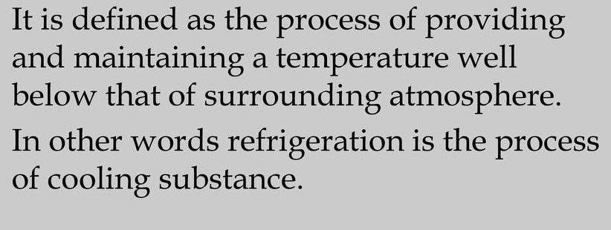
Nitin Chhabra (ASSISTANT PROFESSOR) , JECRC, JAIPUR
6
1

Slide 7
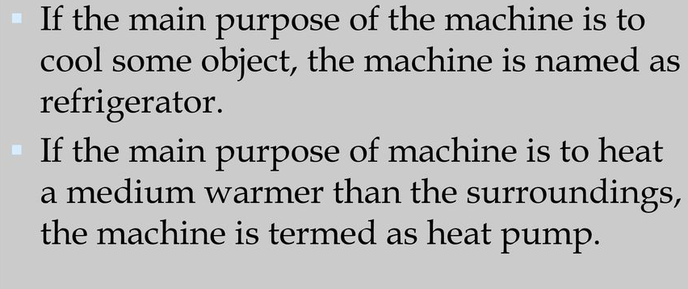
Nitin Chhabra (ASSISTANT PROFESSOR) , JECRC, JAIPUR
7
1

Slide 8
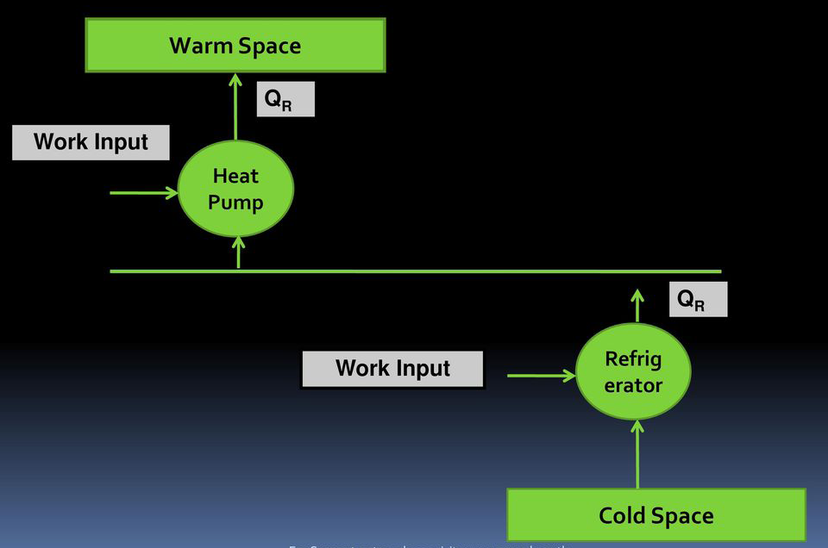
Nitin Chhabra (ASSISTANT PROFESSOR) , JECRC, JAIPUR
8
1

Slide 9
Nitin Chhabra (ASSISTANT PROFESSOR) , JECRC, JAIPUR
9
1

Slide 10
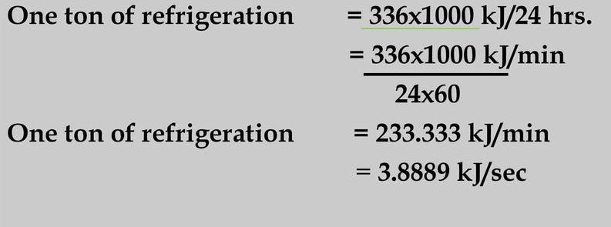
Nitin Chhabra (ASSISTANT PROFESSOR) , JECRC, JAIPUR
10
1

Slide 11
Nitin Chhabra (ASSISTANT PROFESSOR) , JECRC, JAIPUR
11
1

Slide 12
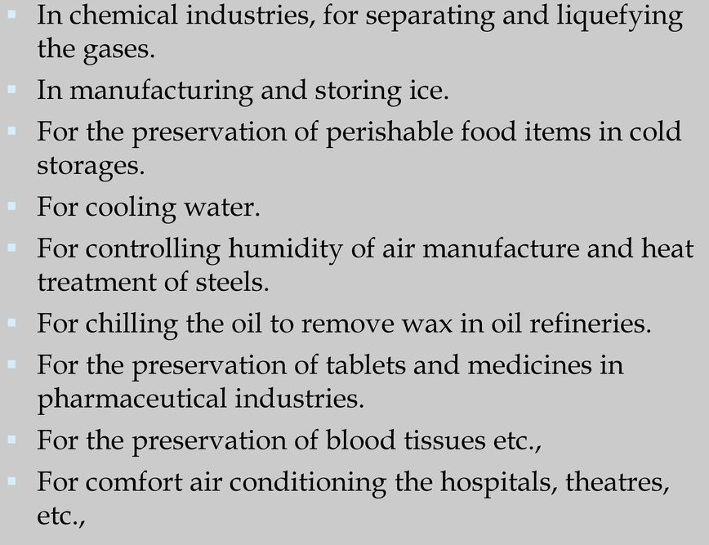
Nitin Chhabra (ASSISTANT PROFESSOR) , JECRC, JAIPUR
12
1

Slide 13
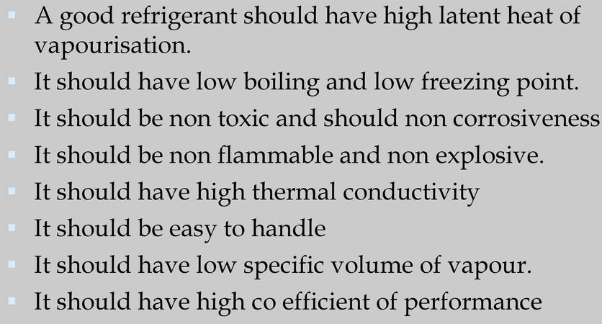
Nitin Chhabra (ASSISTANT PROFESSOR) , JECRC, JAIPUR
13
1

Slide 14
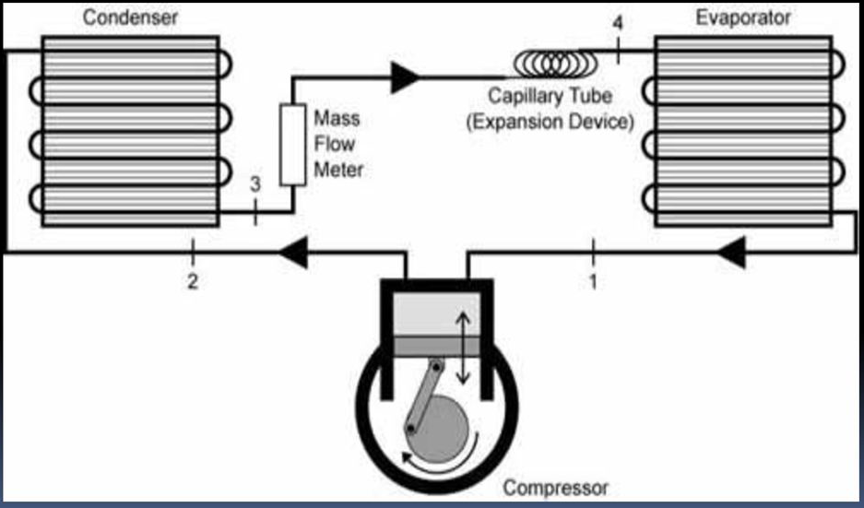
Nitin Chhabra (ASSISTANT PROFESSOR) , JECRC, JAIPUR
14
1

Slide 15
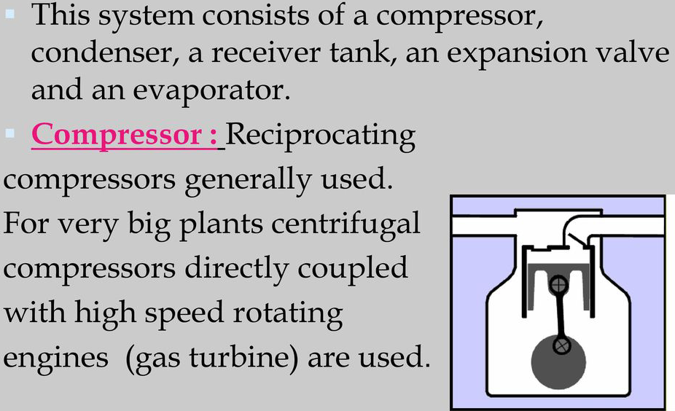
Nitin Chhabra (ASSISTANT PROFESSOR) , JECRC, JAIPUR
15
1

Slide 16
Nitin Chhabra (ASSISTANT PROFESSOR) , JECRC, JAIPUR
16
1

Slide 17
Nitin Chhabra (ASSISTANT PROFESSOR) , JECRC, JAIPUR
17
1

Slide 18
Nitin Chhabra (ASSISTANT PROFESSOR) , JECRC, JAIPUR
18
1

Slide 19
Nitin Chhabra (ASSISTANT PROFESSOR) , JECRC, JAIPUR
19
1

Slide 20
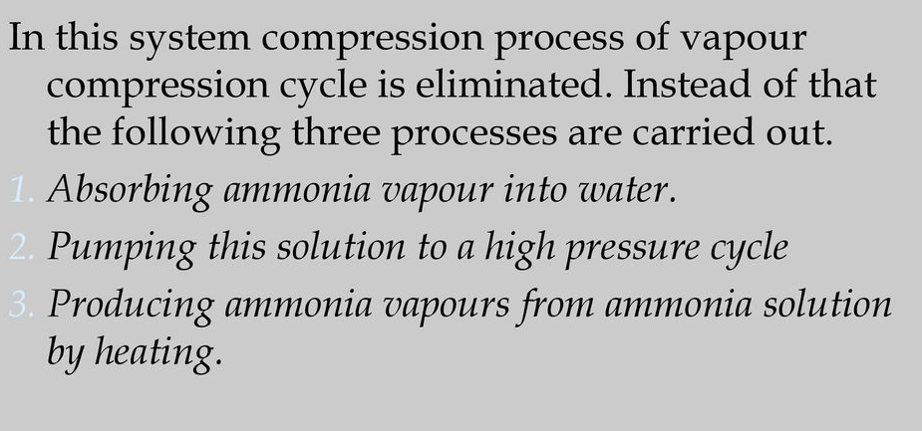
Nitin Chhabra (ASSISTANT PROFESSOR) , JECRC, JAIPUR
20
1

Slide 21
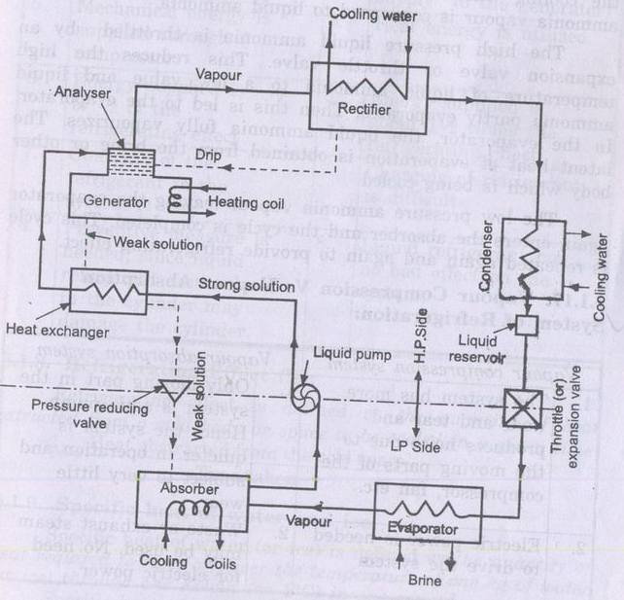
Nitin Chhabra (ASSISTANT PROFESSOR) , JECRC, JAIPUR
21
1

Slide 22
Nitin Chhabra (ASSISTANT PROFESSOR) , JECRC, JAIPUR
22
1

Slide 23
Nitin Chhabra (ASSISTANT PROFESSOR) , JECRC, JAIPUR
23
1

Slide 24
Nitin Chhabra (ASSISTANT PROFESSOR) , JECRC, JAIPUR
24
1

Slide 25
Nitin Chhabra (ASSISTANT PROFESSOR) , JECRC, JAIPUR
25
1

Slide 26
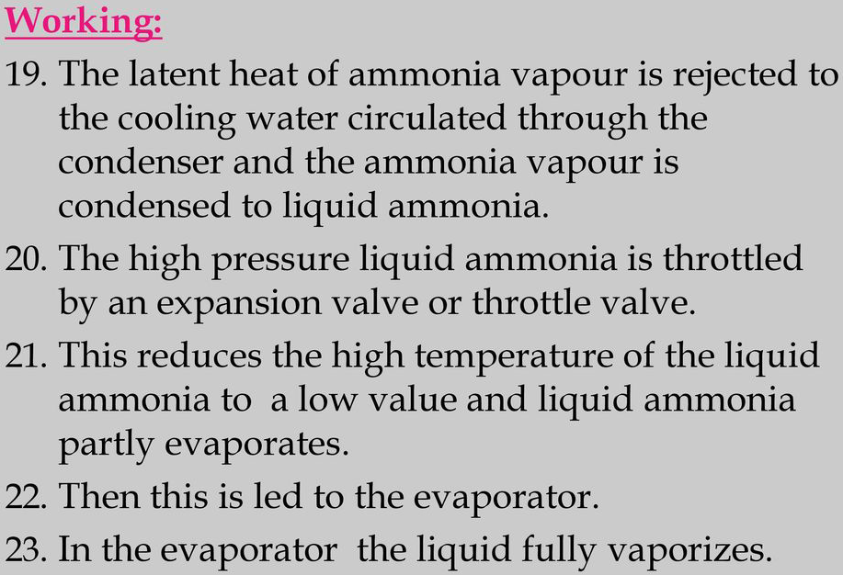
Nitin Chhabra (ASSISTANT PROFESSOR) , JECRC, JAIPUR
26
1

Slide 27
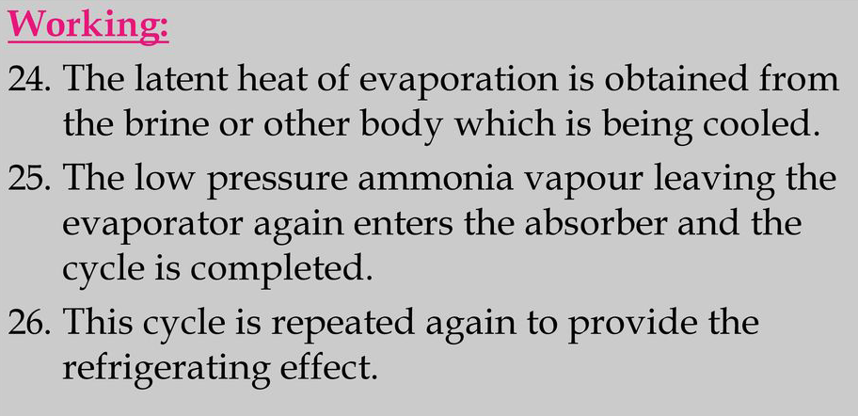
Nitin Chhabra (ASSISTANT PROFESSOR) , JECRC, JAIPUR
27
1

Slide 28
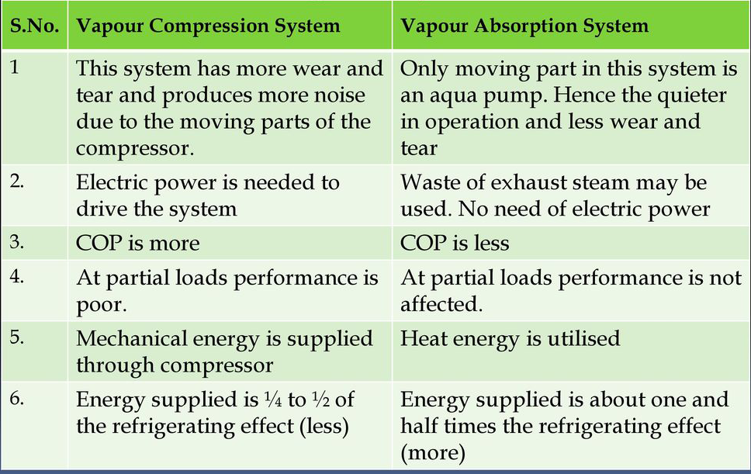
Nitin Chhabra (ASSISTANT PROFESSOR) , JECRC, JAIPUR
28
1

Slide 29
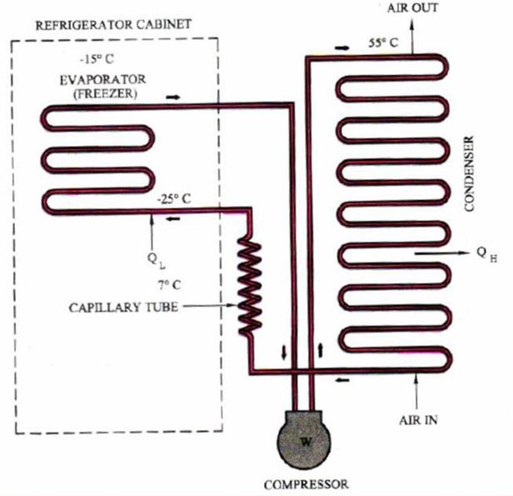
LAYOUT OF DOMESTIC REFRIGERATOR
Nitin Chhabra (ASSISTANT PROFESSOR) , JECRC, JAIPUR
29
1

Slide 30
DOMESTIC REFRIGERATOR
Nitin Chhabra (ASSISTANT PROFESSOR) , JECRC, JAIPUR
30
1

Slide 31
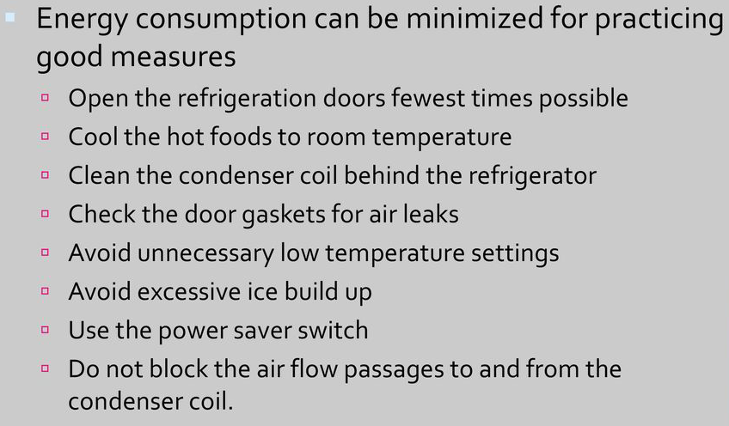
DOMESTIC REFRIGERATOR
Nitin Chhabra (ASSISTANT PROFESSOR) , JECRC, JAIPUR
31
1

Slide 32
Nitin Chhabra (ASSISTANT PROFESSOR) , JECRC, JAIPUR
32
1

Slide 33
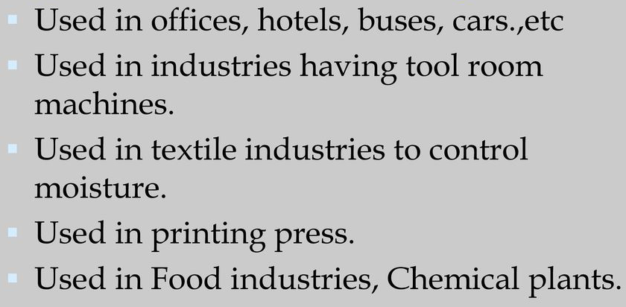
Nitin Chhabra (ASSISTANT PROFESSOR) , JECRC, JAIPUR
33
1

Slide 34
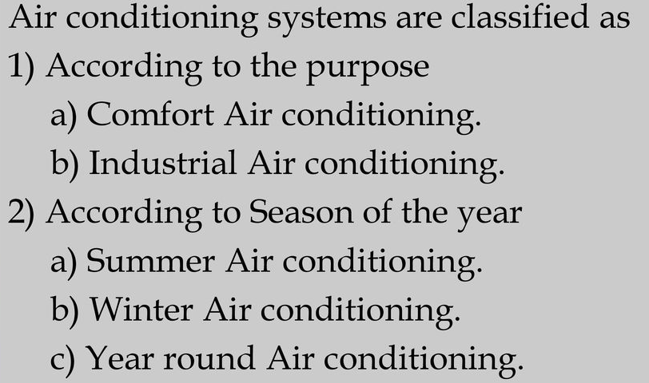
Nitin Chhabra (ASSISTANT PROFESSOR) , JECRC, JAIPUR
34
1

Slide 35
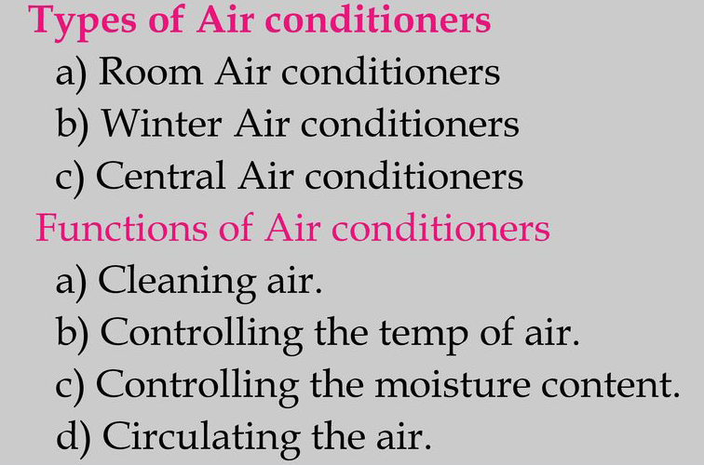
Nitin Chhabra (ASSISTANT PROFESSOR) , JECRC, JAIPUR
35
1

Slide 36
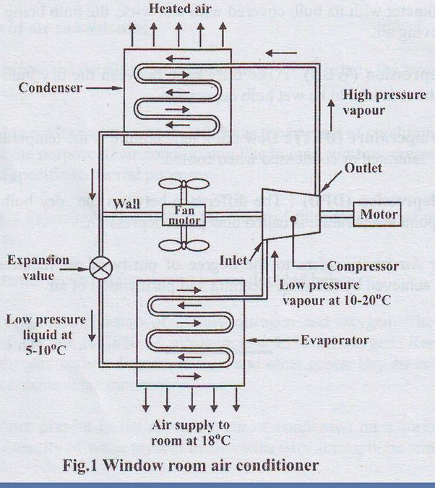
Nitin Chhabra (ASSISTANT PROFESSOR) , JECRC, JAIPUR
36
1

Slide 37
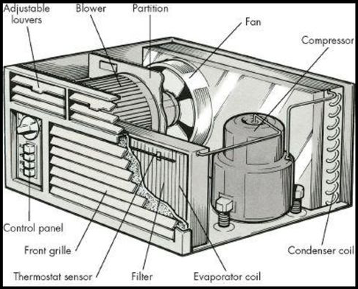
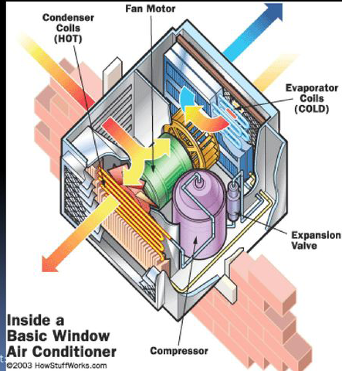
Nitin Chhabra (ASSISTANT PROFESSOR) , JECRC, JAIPUR
37
1

Slide 38
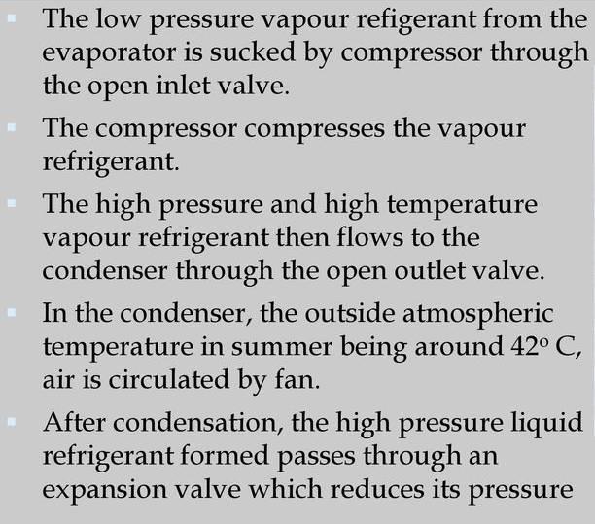
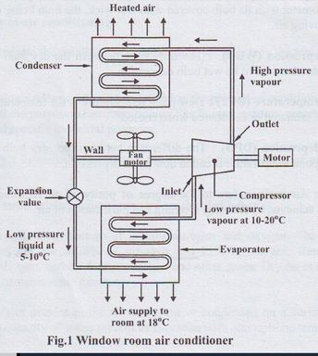
Nitin Chhabra (ASSISTANT PROFESSOR) , JECRC, JAIPUR
38
1

Slide 39
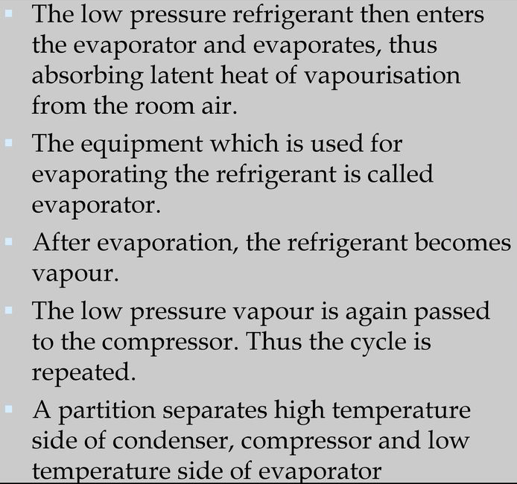
Nitin Chhabra (ASSISTANT PROFESSOR) , JECRC, JAIPUR
39
1

Slide 40
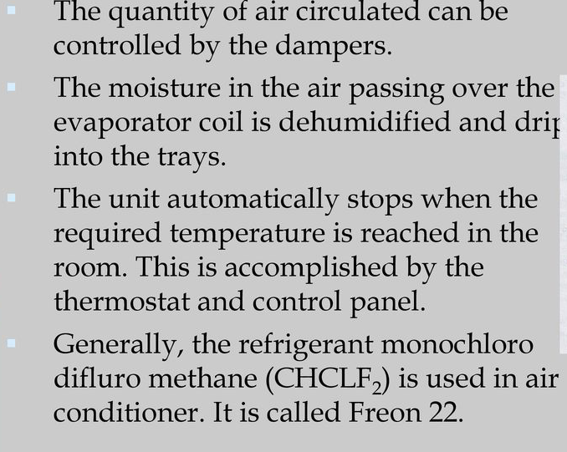
Nitin Chhabra (ASSISTANT PROFESSOR) , JECRC, JAIPUR
40
1

Slide 41
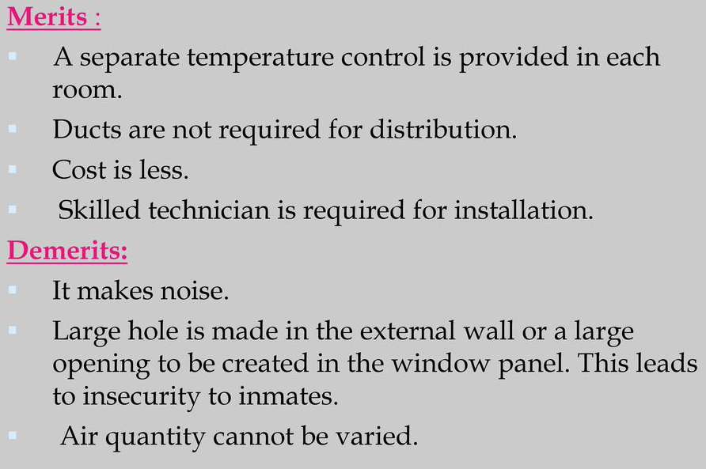
Nitin Chhabra (ASSISTANT PROFESSOR) , JECRC, JAIPUR
41
1

Slide 42
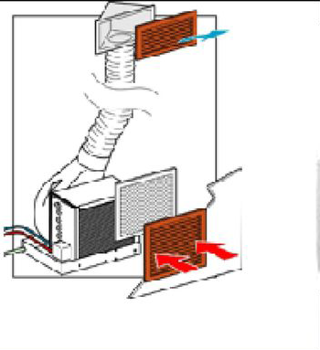
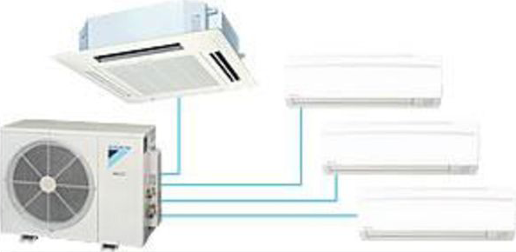
Nitin Chhabra (ASSISTANT PROFESSOR) , JECRC, JAIPUR
42
1

Slide 43
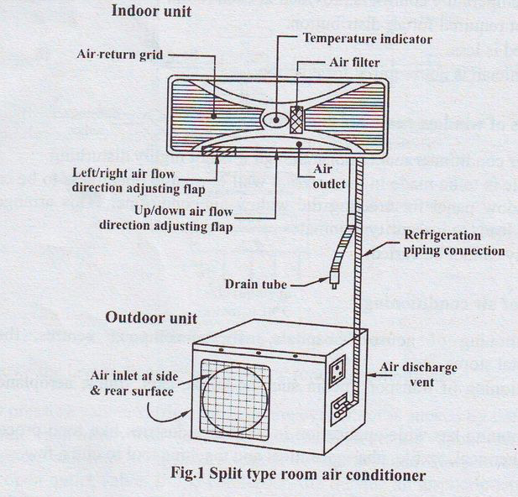
Nitin Chhabra (ASSISTANT PROFESSOR) , JECRC, JAIPUR
43
1

Slide 44
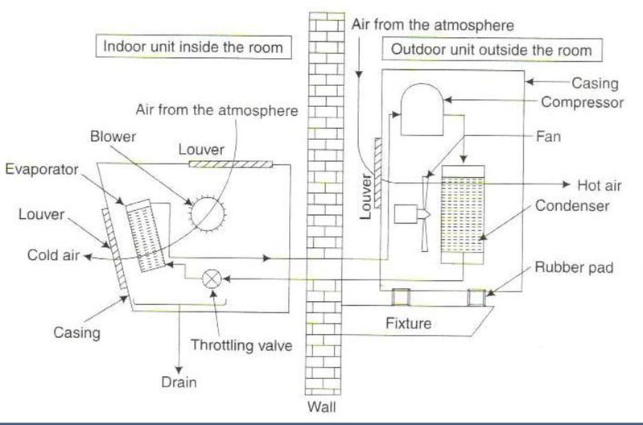
Nitin Chhabra (ASSISTANT PROFESSOR) , JECRC, JAIPUR
44
1

Slide 45
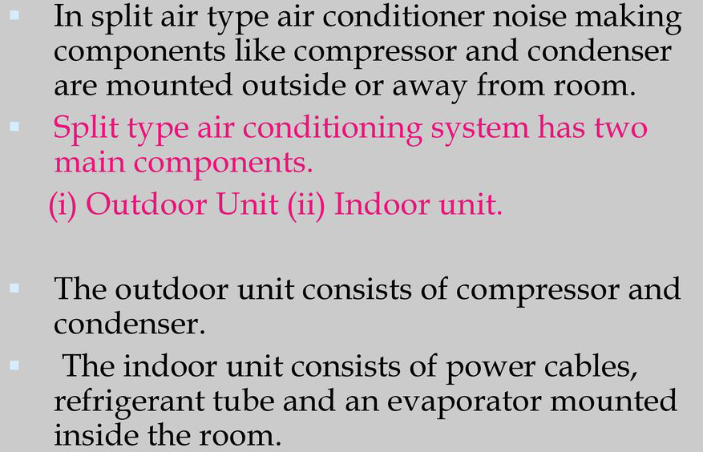
Nitin Chhabra (ASSISTANT PROFESSOR) , JECRC, JAIPUR
45
1

Slide 46
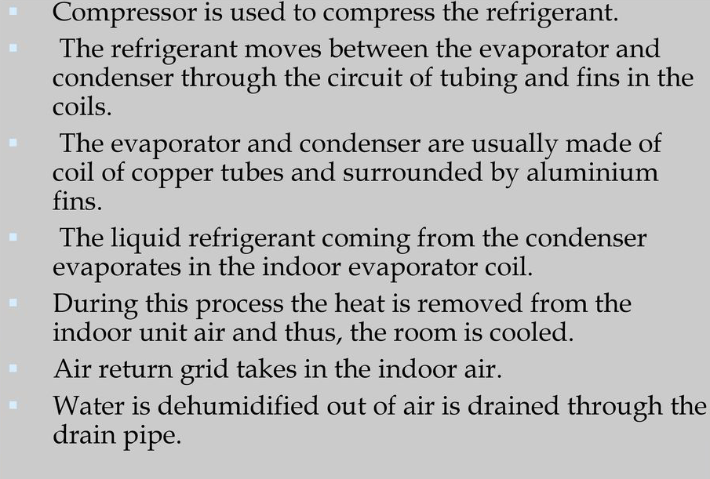
Nitin Chhabra (ASSISTANT PROFESSOR) , JECRC, JAIPUR
46
1

Slide 47
Nitin Chhabra (ASSISTANT PROFESSOR) , JECRC, JAIPUR
47
1

Slide 48
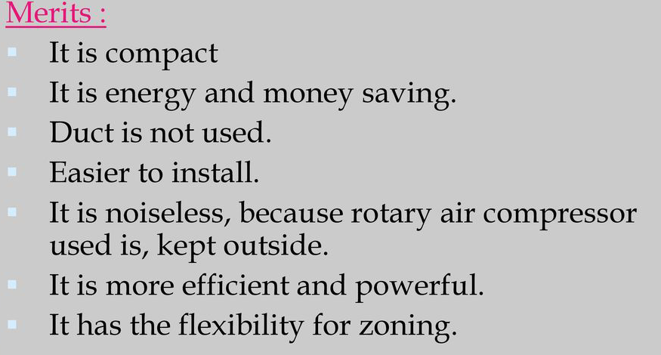
Nitin Chhabra (ASSISTANT PROFESSOR) , JECRC, JAIPUR
48
1

Slide 49
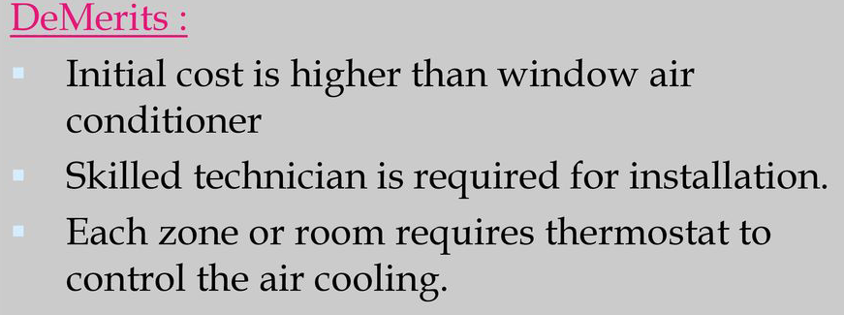
Nitin Chhabra (ASSISTANT PROFESSOR) , JECRC, JAIPUR
49
1

Slide 50
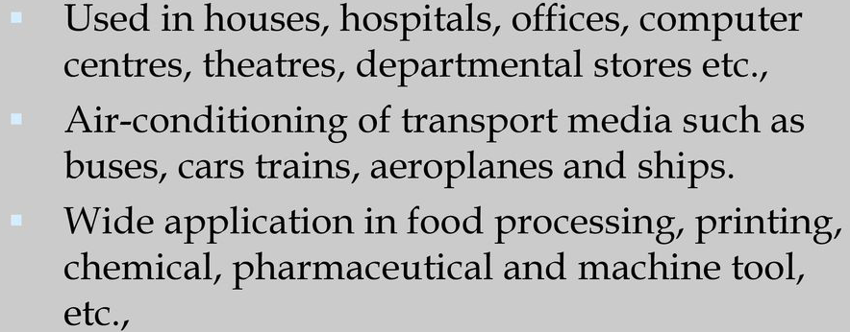
Nitin Chhabra (ASSISTANT PROFESSOR) , JECRC, JAIPUR
50
1

Slide 51
References
https://nptel.ac.in/courses/112/105/112105129/
https://en.wikipedia.org/wiki/Air_conditioning
https://www.slideshare.net/wapakununkguy/refrigeration-andairconditioningnotes
www.phac-aspc.gc.ca/.../section3-eng.php
Ramamrutham. S, “Basic Civil Engineering” , Dhanpat Rai Publishing Co.(I) Ltd.(1999).
Seetharaman S, “Basic Civil Engineering” , Anuradha Agencies, (2005).
Venugopal K and Prabhu Raja V, “Basic Mechanical Engineering”, Anuradha Publishers (2000).
Nitin Chhabra (ASSISTANT PROFESSOR) , JECRC, JAIPUR
51
1
Notes:
51

Slide 52
Nitin Chhabra (ASSISTANT PROFESSOR) , JECRC, JAIPUR
52

