Slide 1
JAIPUR ENGINEERING COLLEGE AND RESEARCH CENTER
Year & Sem. – I Year & I SEM
Subject –Basic Mechanical Engineering ( 1FY3-07)
Unit– 2
Presented by – Jitendra Kumar Gupta (Assistant Professor)
1
Jitendra Kumar Gupta(Assistant Professor) , JECRC, JAIPUR
1

Slide 2
VISION AND MISSION OF INSTITUTE
VISION OF INSTITUTE
To became a renowned centre of outcome based learning and work towards academic professional ,cultural and social enrichment of the lives of individuals and communities .
MISSION OF INSTITUTE
Focus on evaluation of learning ,outcomes and motivate students to research aptitude by project based learning.
Identify based on informed perception of Indian ,regional and global needs ,the area of focus and provide platform to gain knowledge and solutions.
Offer opportunities for interaction between academic and industry .
Develop human potential to its fullest extent so that intellectually capable and imaginatively gifted leaders may emerge.
2
Jitendra Kumar Gupta (Assistant Professor) , JECRC, JAIPUR
1
Notes:
2

Slide 3
VISION AND MISSION OF DEPARTMENT
Vision
The Mechanical Engineering Department strives to be recognized globally for excellent technical knowledge and to produce quality human resource, who can manage the advance technologies and contribute to society through entrepreneurship and leadership.
Mission
1) To impart highest quality technical knowledge to the learners to make them globally competitive
mechanical engineers.
2) To provide the learners ethical guidelines along with excellent academic environment for a long productive career.
3)To promote industry-institute linkage.
3
Jitendra Kumar Gupta (Assistant Professor) , JECRC, JAIPUR
1

Slide 4
Course Outcomes of BME
To describe the importance of mechanical engineering in any industry and to apply the various concepts in thermal based industry.
To understand the various machines and power transmission related to it and also the effect of parameters on a job.
To relate the industrial issues with the environment and to consider key concepts in in engineering materials.
To come across new practices and researches going in mechanical engineering line CAD, CAM etc.
4
Jitendra Kumar Gupta (Assistant Professor) , JECRC, JAIPUR
1
Notes:
4

Slide 5
Contents of UNIT-2
Introduction of IC Engines.
Classification of IC Engines.
Main Components of IC Engines.
Working of IC Engines and its components.
5
Jitendra Kumar Gupta(Assistant Professor) , JECRC, JAIPUR
1

Slide 6
Introduction
In 1876 four stroke engine based on Otto cycle was developed by a German engineer Nikolous Otto. Diesel Engine was developed by another German engineer Rudolf Diesel in the year 1892.
Engine refers as “Heat engine is a device which converts chemical energy of fuel into Heat energy and this Heat energy further convert into mechanical work”.
Based on where the combustion of fuel take place. Whether outside the working cylinder or inside the working cylinder
(a) External combustion engines (E.C.ENGINES), (b) Internal combustion engines (I.C.ENGINES)
6
Jitendra Kumar Gupta(Assistant Professor) , JECRC, JAIPUR
1

Slide 7
Classification of Heat Engines
Internal Combustion Engines (IC Engines)
In IC engines, combustion of fuel takes place inside the engine cylinder.
Examples: Diesel Engines, Petrol Engines, Gas engines.
External Combustion Engines (EC Engines)
In EC engines, combustion of fuel takes place outside the working cylinder.
Examples: Steam Engines and Steam turbines
7
Jitendra Kumar Gupta(Assistant Professor) , JECRC, JAIPUR
1

Slide 8
I. C. ENGINES | E. C. ENGINES
Fuel combustion take place inside the cylinder. | Fuel combustion take place outside the cylinder.
Compact in size and more efficient. | Larger in size and less efficient.
Low initial cost. | More initial cost.
Working fluid is mixture of air and fuel. | Working fluid is steam.
Easier and quick starting of these engines. | Starting is difficult and more time is required.
Costly fuels are required like petrol and diesel. | Cheaper fuel may be used like coal.
More suitable for mobile applications. | Less suitable for mobile applications.
8
Jitendra Kumar Gupta(Assistant Professor) , JECRC, JAIPUR
1

Slide 9
Classification of IC Engines
IC Engines are classified into:-
(1) Cycle of operation (No of Strokes per cycle)
Two Stroke cycle Engines
Four Stroke Cycle Engines
(2) Thermodynamic Cycle or Method of Heat addition:
Otto Cycle Engines (Combustion at constant volume)
Diesel Cycle Engines (Combustion at constant Pressure)
Semi Diesel Engines (Dual Combustion Engines)
9
Jitendra Kumar Gupta(Assistant Professor) , JECRC, JAIPUR
1

Slide 10
(3) Types of Fuel Used : -
Petrol Engines
Diesel Engines
Gas Engines
(4) Ignition Method :-
Spark Ignition (SI)
Compression Ignition (CI)
(5) Cooling System:-
Air cooled Engines
Water Cooled Engines
10
Jitendra Kumar Gupta(Assistant Professor) , JECRC, JAIPUR
1

Slide 11
(6) Valves Location :
L head (Side valve) engine
T Head (Side valve) engine
I head (over head valve) engine
F head (over head inlet and side exhaust) engine
11
Jitendra Kumar Gupta(Assistant Professor) , JECRC, JAIPUR
1

Slide 12
I.C ENGINE TERMINOLGOGY
The standard terms used in I.C Engines are
Bore: Inside diameter of the cylinder is termed as Bore.
Top Dead Center (TDC): The extreme position reached by the piston at the top of the cylinder in the vertical engine is called Top Dead center.
Bottom Dead Center (BDC): The extreme position reached by the piston at the Bottom of the cylinder in the vertical engine is called Bottom Dead center.
Stroke: The nominal distance travelled by the piston in the cylinder between the extreme upper and lower positions of the piston (TDC &BDC) is termed as stroke.
12
Jitendra Kumar Gupta(Assistant Professor) , JECRC, JAIPUR
1

Slide 13
Compression ratio (r): It is the ratio of Maximum cylinder volume to the Clearance volume.
Cylinder volume (v): It is the sum of swept volume and the Clearance volume.
V = Vs + Vc
Swept volume (Vs): It is the volume of space generated by the movement of piston from one dead center to another dead center.
Clearance Volume( Vc): It is the space in the cylinder, when the piston is at Top Dead Center
13
Jitendra Kumar Gupta(Assistant Professor) , JECRC, JAIPUR
1

Slide 14
14
Jitendra Kumar Gupta(Assistant Professor) , JECRC, JAIPUR
1

Slide 15
Main Components of IC Engines
Cylinder Block:
It is the main block of the engine.
It contains cylinders accurately finished to accommodate pistons
The cylinder block houses crank, camshaft, piston and other engine parts.
In water cooled engines, the cylinder block is provided with water jackets for the circulating cooling water.
The materials used for cylinder are grey cast iron, aluminium alloys etc.,
It is usually made of a single casting
15
Jitendra Kumar Gupta(Assistant Professor) , JECRC, JAIPUR
1

Slide 16
Cylinder block of motor cycle
Cylinder block of Car
16
Jitendra Kumar Gupta(Assistant Professor) , JECRC, JAIPUR
1

Slide 17
Cylinder Head:
The cylinder head is bolted to the cylinder Block by means of studs.
The water jackets are provided for cooling water circulation.
The materials used for cylinder head are cast iron, aluminium alloy etc.,
This is also generally made of single cast iron.
17
Jitendra Kumar Gupta(Assistant Professor) , JECRC, JAIPUR
1

Slide 18
Cylinder Liners:
The liner is a sleeve which is fitted into the cylinder bore.
It provides wear resisting surface for the cylinder bores.
Liners are classified into
(a) Wet liner (b) Dry liner
18
Jitendra Kumar Gupta(Assistant Professor) , JECRC, JAIPUR
1

Slide 19
Cylinder Liners
Wet Liner : These liners are surrounded or wetted by cooling water.
It provides wear resisting
surface for the piston to reciprocate. Also it acts as a seal for the water jacket.
19
Jitendra Kumar Gupta(Assistant Professor) , JECRC, JAIPUR
1

Slide 20
Dry Liner :Dry liners have metal to metal contact with the cylinder block. They are not directly in touch with the cooling water.
Liner Materials:
Liner material should withstand abrasive wear and corrosive.
Chromium plated mild steel tubes are used as liners.
20
Jitendra Kumar Gupta(Assistant Professor) , JECRC, JAIPUR
1

Slide 21
Crankcase :
It may be cast integral with the cylinder block.
Some times, it is cast separately and then attached to the block.
These materials are used for crank case are cast iron, aluminium alloys or alloy steels.
21
Jitendra Kumar Gupta(Assistant Professor) , JECRC, JAIPUR
1

Slide 22
Oil pan or oil sump: Oil sump is the bottom part of the engine.
It contains lubricating oil.
A drain plug is provided the oil sump to drain out the oil.
It is made of the pressed sheet.
22
Jitendra Kumar Gupta(Assistant Professor) , JECRC, JAIPUR
1

Slide 23
Piston :
The piston serves the following purposes
It acts as a movable gas tight seal to keep the gases inside the cylinder
It transmits the force of explosion in the cylinder to the crankshaft through the connecting rod.
Some of the materials used for
piston are cast iron, aluminium alloy,
chrome nickel alloy, nickel iron alloy and cast steel.
23
Jitendra Kumar Gupta(Assistant Professor) , JECRC, JAIPUR
1

Slide 24
Piston rings :
Piston rings are inserted in the grooves provided in the piston. Two types of piston rings are used in the piston.
Compression rings
Oil rings or oil control rings.
24
Jitendra Kumar Gupta(Assistant Professor) , JECRC, JAIPUR
1

Slide 25
Compression rings :
Compression rings provide an effective seal for the high pressure gases inside the cylinder. They prevent the leakage of high pressure gases from the combustion chamber into the crank case.
Each piston is provided with atleast two compression rings.
25
Jitendra Kumar Gupta(Assistant Professor) , JECRC, JAIPUR
1

Slide 26
Oil rings :
The materials used for piston rings should be wear resistant.
Normally piston rings are made of alloy steel iron containing silicon, manganese alloy steels etc.,
26
Jitendra Kumar Gupta(Assistant Professor) , JECRC, JAIPUR
1

Slide 27
Connecting Rod:
It connects the piston and crank shaft.
It transmits the force of explosion during power stroke to the crankshaft.
The connecting rod has bearings at both ends.
The small end of the connecting has a solid or split eye and contains a bush.
This end is connected to the piston by means of a gudgeon pin. The other end is called as big end of the connecting rod.
The connecting rods must withstand heavy thrusts. Hence it must have strength and rigidity.
They are usually drop forged I sections.
The materials used are plain carbon steel, aluminium alloys, nickel alloy steels etc,
27
Jitendra Kumar Gupta(Assistant Professor) , JECRC, JAIPUR
1

Slide 28
Crank Shaft :
It is the main rotating shaft of the engine. Power is obtained from the crank shaft.
The crank shaft is combination with connecting rod converts reciprocating motion of the piston into rotary motion.
The crank shaft is held in position by the main bearings. There are two main bearings to support the crank shaft.
The materials used for crank shaft are billet steel, carbon steel, nickel chrome and other heat treated alloy steels.
28
Jitendra Kumar Gupta(Assistant Professor) , JECRC, JAIPUR
1

Slide 29
Camshaft:
Camshaft contains number of cams.
It is used to convert rotary motion into linear or straight line motion.
It has so many cams as the number of valves in an engine. An additional cam is also provided to drive the fuel pump.
A gear is provided in the cam shaft to drive the distributor or oil pump.
The opening and closing of the engine valves are controlled by the cams provided on the cam shaft.
29
Jitendra Kumar Gupta(Assistant Professor) , JECRC, JAIPUR
1

Slide 30
Petrol Engines
Classification of Petrol Engines
Two Stroke cycle Petrol Engines
Four Stroke cycle petrol Engines
30
Jitendra Kumar Gupta(Assistant Professor) , JECRC, JAIPUR
1

Slide 31
Four stroke cycle Petrol Engines :-
Construction :
A piston reciprocates inside the cylinder
The piston is connected to the crank shaft by means of a connecting rod and crank.
The inlet and exhaust valves are Mounted on the cylinder head.
A spark is provided on the cylinder Head.
The fuel used is petrol
31
Jitendra Kumar Gupta(Assistant Professor) , JECRC, JAIPUR
1

Slide 32
Four Stroke Petrol Engine- Working :-
32
Jitendra Kumar Gupta(Assistant Professor) , JECRC, JAIPUR
1

Slide 33
(a) Suction Stroke (First Stroke of the Engine)
Piston moves down from TDC to BDC
Inlet valve is opened and the exhaust valve is closed.
Pressure inside the cylinder is reduced below the atmospheric pressure.
The mixture of air fuel is sucked into the cylinder through the inlet valve
33
Jitendra Kumar Gupta(Assistant Professor) , JECRC, JAIPUR
1

Slide 34
(b) Compression Stroke : (Second Stroke of the piston)
Piston moves up from BDC to TDC
Both inlet and exhaust valves are Closed.
The air fuel mixture in the cylinder is compressed.
34
Jitendra Kumar Gupta(Assistant Professor) , JECRC, JAIPUR
1

Slide 35
(c) Working or Power or Expansion Stroke: (Third Stroke of the Engine)
The burning gases expand rapidly. They exert an impulse (thrust or force) on the piston. The piston is pushed from TDC to BDC
This movement of the piston is converted into rotary motion of the crankshaft through connecting rod.
Both inlet and exhaust valves are closed.
35
Jitendra Kumar Gupta(Assistant Professor) , JECRC, JAIPUR
1

Slide 36
(d) Exhaust Stroke (Fourth stroke of the piston)
Piston moves upward from BDC
Exhaust valve is opened and the inlet valve is closed.
The burnt gases are forced out to the atmosphere through the exhaust valve (Some of the burnt gases stay in the clearance volume of the cylinder)
The exhaust valve closes shortly after TDC.
The inlet valve opens slightly before TDC and the cylinder is ready to receive fresh charge to start a new cycle.
36
Jitendra Kumar Gupta(Assistant Professor) , JECRC, JAIPUR
1

Slide 37
Four Stroke Petrol Engine – Working :-
Summary :
Compression ratio varies from 5 to 8
The pressure at the end of compression is about 6 to 12 bar.
The temperature at the end of the compression reaches 250º C to 350º C.
37
Jitendra Kumar Gupta(Assistant Professor) , JECRC, JAIPUR
1

Slide 38
Four Stroke Diesel Engine :-
38
Jitendra Kumar Gupta(Assistant Professor) , JECRC, JAIPUR
1

Slide 39
Four Stroke Diesel Engine :-
Construction:
A piston reciprocates inside the cylinder
The piston is connected to the crankshaft by means of a connecting rod and crank.
The inlet and exhaust valves are mounted on the cylinder head.
A fuel injector is provided on the cylinder head
The fuel used is diesel.
39
Jitendra Kumar Gupta(Assistant Professor) , JECRC, JAIPUR
1

Slide 40
Four Stroke Diesel Engine Working:-
(a) Suction Stroke (First Stroke of the piston)
Piston moves from TDC to BDC
Inlet valve is opened and the exhaust valve is closed.
The pressure inside the cylinder is reduced below the atmospheric pressure.
Fresh air from the atmosphere is sucked into the engine cylinder through air cleaner and inlet valve.
40
Jitendra Kumar Gupta(Assistant Professor) , JECRC, JAIPUR
1

Slide 41
Four Stroke Diesel Engine Working:-
(b) Compression stroke (Second stroke of the piston)
Piston moves from BDC to TDC
Both inlet and exhaust valves are closed.
The air is drawn during suction stroke is compressed to a high pressure and temperature
41
Jitendra Kumar Gupta(Assistant Professor) , JECRC, JAIPUR
1

Slide 42
Four Stroke Diesel Engine Working:-
(c) Working or power or expansion stroke (Third stroke of the piston)
The burning gases (products of combustion) expand rapidly.
The burning gases push the piston move downward from TDC to BDC
This movement of piston is converted into rotary motion of the crank shaft through connecting rod.
Both inlet and exhaust valves are closed.
42
Jitendra Kumar Gupta(Assistant Professor) , JECRC, JAIPUR
1

Slide 43
Four Stroke Diesel Engine Working:-
(d) Exhaust Stroke (Fourth stroke of the piston)
Piston moves from BDC to TDC
Exhaust valve is opened the inlet valve is closed.
The burnt gases are forced out to the atmosphere through the exhaust valve. (some of the burnt gases stay in the clearance volume of the cylinder)
The exhaust valve closes shortly after TDC
The inlet valve opens slightly before TDC and the cylinder is ready to receive fresh air to start a new cycle.
43
Jitendra Kumar Gupta(Assistant Professor) , JECRC, JAIPUR
1

Slide 44
Two Stroke cycle Petrol Engines :-
44
Jitendra Kumar Gupta(Assistant Professor) , JECRC, JAIPUR
1

Slide 45
Two Stroke cycle Petrol Engines working :-
45
Jitendra Kumar Gupta(Assistant Professor) , JECRC, JAIPUR
1

Slide 46
Two Stroke Cycle Petrol Engine - Construction :-
Construction :
A piston reciprocates inside the cylinder
It is connected to the crankshaft by means of connecting rod and crank.
There are no valves in two stroke engines, instead of valves ports are cut on the cylinder walls.
There are three ports, namely inlet, exhaust and transfer ports.
The closing and opening of the ports are obtained by the movement of piston. The crown of piston is made in to a shape to perform this.
A spark plug is also provided.
46
Jitendra Kumar Gupta(Assistant Professor) , JECRC, JAIPUR
1

Slide 47
Two stroke cycle Petrol Engines – Working :-
First Stroke : (Compression, ignition and inductance) (Upward stroke of piston) (a)compression:
The piston moves up from Bottom Dead Centre (BDC) to Top Dead Centre (TDC) Both transfer and exhaust ports are covered by the piston.
Air fuel mixture which is transferred already into the engine cylinder is compressed by moving piston.
The pressure and temperature increases at the end of compression.
47
Jitendra Kumar Gupta(Assistant Professor) , JECRC, JAIPUR
1

Slide 48
Two stroke cycle Petrol Engines – Working :-
First Stroke : (Compression, ignition and inductance) (Upward stroke of piston)
(b) Ignition and Inductance:
Piston almost reaches the top dead centre
The air fuel mixture inside the cylinder is ignited by means of an electric spark produced by a spark plug
At the same time, the inlet pois rt uncovered by the plane.
Fresh air fuel mixture enters the crankcase through the inlet port.
48
Jitendra Kumar Gupta(Assistant Professor) , JECRC, JAIPUR
1

Slide 49
Two stroke cycle Petrol Engines – Working :-
Second Stroke: (Downward Stroke of the engine) : (c)Expansion and Crankcase compression
The burning gases expand in the cylinder
The burning gases force the piston to move down. Thus useful work is obtained.
When the piston moves down, the air fuel mixture in the crankcase is partially compressed.
This compression is known as Crank case compression.
49
Jitendra Kumar Gupta(Assistant Professor) , JECRC, JAIPUR
1

Slide 50
Two stroke cycle Petrol Engines – Working :-
Second Stroke: (Downward Stroke of the engine) : (d) Exhaust and transfer:
At the end of expansion, exhaust port is uncovered.
Burnt gases escape to the atmosphere.
Transfer port is also opened. The partially compressed air fuel mixture enters the cylinder through the transfer port.
The crown of the piston is made of a deflected shape. So the fresh charge entering the cylinder is deflected upwards in the cylinder.
Thus the escape of fresh charge along with the exhaust gases is reduced.
50
Jitendra Kumar Gupta(Assistant Professor) , JECRC, JAIPUR
1

Slide 51
Two stroke cycle Diesel Engines- Construction :-
Construction :
Two stroke cycle diesel engines require air supply
This air is used to blow out the exhaust gases and to fill the cylinder with clean air
This air is supplied by a blower or air compressor which is driven by engine itself.
These engines may be valve or port type.
A plate is provided in the crank case to admit air into the crank case.
Transfer and exhaust ports are provided in the cylinder.
These ports are covered and uncovered by the moving piston.
51
Jitendra Kumar Gupta(Assistant Professor) , JECRC, JAIPUR
1

Slide 52
Two stroke cycle Diesel Engines- Working
First Stroke (Upward Stroke of the piston)
(a) Compression and inductance:
The piston moves upwards from Bottom Dead Centre (BDC) to Top Dead Centre (TDC).
Both transfer and exhaust ports are covered.
Air which is transferred already into the engine cylinder is compressed by moving piston.
The pressure and temperature of the air increases.
At the same time, fresh air is admitted into the crankcase through the plate valve (reed valve)
52
Jitendra Kumar Gupta(Assistant Professor) , JECRC, JAIPUR
1

Slide 53
Two stroke cycle Diesel Engines- Working
First Stroke (Upward Stroke of the piston) (b) Ignition and inductance.
Piston almost reaches the top dead centre.
The fuel is injected into the hot compressed air inside the cylinder. The fuel mixed with hot air and burns.
The admission of fresh air into the crankcase continues till the piston reaches the top centre.
53
Jitendra Kumar Gupta(Assistant Professor) , JECRC, JAIPUR
1

Slide 54
Two stroke cycle Diesel Engines- Working
Second Stroke (Downward Stroke of the piston) (c) Expansion and crank case compression:
The burning gases expand in the cylinder.
Burning gases force the piston to move down. Thus useful work is obtained.
At the same time, the air in the crank case is compressed by the movement of the piston.
All the ports and the plate valve are in closed position
54
Jitendra Kumar Gupta(Assistant Professor) , JECRC, JAIPUR
1

Slide 55
Two stroke cycle Diesel Engines- Working
Second Stroke (Downward Stroke of the piston) (d) Exhaust and Transfer:
At the end of expansion, the exhaust port is uncovered.
The burnt escape to the atmosphere through the exhaust port.
Transfer port is also uncovered shortly after the exhaust port is opened.
The partially compressed air from crank case enters the cylinder the transfer port.
This air is deflected upwards by the deflected shape of the piston.
Thus the entering air helps in forcing out the combustion products from the cylinder
The plate valve remains during this period.
55
Jitendra Kumar Gupta(Assistant Professor) , JECRC, JAIPUR
1

Slide 56
Scavenging
Scavenging :
It is the process of forcing out the burnt exhaust gases from the cylinder for admitting the fresh charge into the cylinder.
This action takes place in the two stroke cylinder.
56
Jitendra Kumar Gupta(Assistant Professor) , JECRC, JAIPUR
1

Slide 57
The charge (air fuel mixture or air) enters the engine cylinder from the crank case at a pressure higher than the exhaust gases.
This fresh charge forces the exhaust gases to the atmosphere through the exhaust port.
During the period both the transfer and exhaust ports are kept open for a short period.
Hence there is a possibility of the fresh charge escaping out with the burnt gases.
This is over come by designing the piston to have a deflected shape.
This shape of piston deflects the fresh charge upward in the engine cylinder.
It also helps out in forcing out the exhaust gases to atmosphere.
This process is known as Scavenging.
57
Jitendra Kumar Gupta(Assistant Professor) , JECRC, JAIPUR
1

Slide 58
58
Jitendra Kumar Gupta(Assistant Professor) , JECRC, JAIPUR
1

Slide 59
Animation of Crank shaft , connecting rod and piston
59
Jitendra Kumar Gupta(Assistant Professor) , JECRC, JAIPUR
1

Slide 60
Disassembly of IC Engine :-
Engine removal
Engine removal
Disconnect battery cables
Remove the hood
Remove air cleaner
Label all wires and vacuum lines
Drain coolant and oil
Remove the radiator
Remove the distributor and spark plug wiring
60
Jitendra Kumar Gupta(Assistant Professor) , JECRC, JAIPUR
1

Slide 61
61
Jitendra Kumar Gupta(Assistant Professor) , JECRC, JAIPUR
1

Slide 62
62
Jitendra Kumar Gupta(Assistant Professor) , JECRC, JAIPUR
1

Slide 63
Engine Disassembly :-
Important steps
Remove clutch parts
Remove hybrid armature (puller required)
Mount engine to a stand
Remove coolant pump
Remove oil pan
Remove valve covers
63
Jitendra Kumar Gupta(Assistant Professor) , JECRC, JAIPUR
1

Slide 64
OTTO CYCLE
The Otto cycle is very similar to that of the Diesel cycle in that both of these are closed cycles
commonly used to model internal combustion engines.
The difference between these two is that the Otto cycle is a spark-ignition cycle while the Diesel cycle consists of a compression-ignition cycle.
A spark-ignition cycle is designed to use fuels that require a spark to begin combustion.
When discussing engines, we must consider both the mechanical operation of the machine as well as the thermodynamic processes that enable the machine to produce useful work.
64
Jitendra Kumar Gupta(Assistant Professor) , JECRC, JAIPUR
1

Slide 65
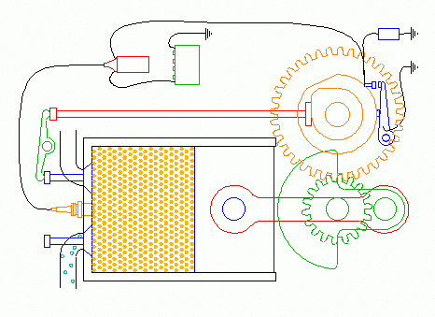
OTTO ENGINE
The Otto engine consists of many parts and each part is essential for the four-stroke cycle to occur.
The main parts of a four-stroke cycle engine are the intake valve, the exhaust valve, the piston, the piston rings, the combustion chamber, the connection rod, the crankshaft, and the spark plug. These parts play an important role in the operation of this engine.
65
Jitendra Kumar Gupta(Assistant Professor) , JECRC, JAIPUR
1

Slide 66
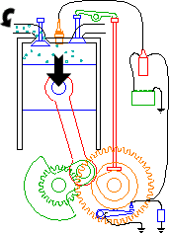
OPERATION OTTO CYCLE
INTAKE STROKE:
# Intake valve starts opening # Air-fuel mixture is sucked in the cylinder through the opened intake valve by the
piston moving towards the crank shaft
# Exhaust valve remains closed
# No ignition is given by the spark plug
66
Jitendra Kumar Gupta(Assistant Professor) , JECRC, JAIPUR
1

Slide 67
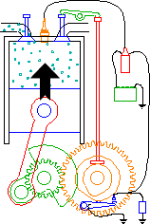
OPERATION OTTO CYCLE
COMPRESSION STROKE:
# intake valve closes # air-fuel mixture is compressed in the cylinder by the piston sliding away from the crank shaft
# Exhaust valve remains closed
# No ignition is given by the spark plug till the piston reaches TDC.
67
Jitendra Kumar Gupta(Assistant Professor) , JECRC, JAIPUR
1

Slide 68
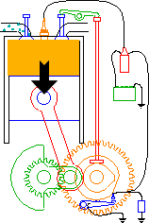
OPERATION OTTO CYCLE
IGNITION/POWER STROKE:
# Intake valve and exhaust valve remain closed
# Ignition is given by the spark plug when the piston reaches TDC
# Compressed air-fuel mixture ignited by the spark starts burning
# The gas expands in the cylinder pushing the piston towards the crankshaft generating rotary power at the crankshaft
68
Jitendra Kumar Gupta(Assistant Professor) , JECRC, JAIPUR
1

Slide 69
OPERATION OTTO CYCLE
EXHAUST STROKE:
# Exhaust valve starts opening
# Burnt gas is pushed out of the cylinder through the opened exhaust valve by the piston moving away from the crankshaft
# Intake valve remains closed till the piston reaches TDC
69
Jitendra Kumar Gupta(Assistant Professor) , JECRC, JAIPUR
1

Slide 70
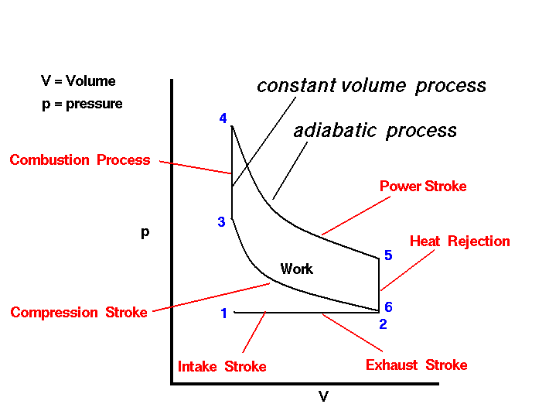
THERMODYNAMIC PROCESSES OTTO CYCLE (p-v DIAGRAM)
70
Jitendra Kumar Gupta(Assistant Professor) , JECRC, JAIPUR
1

Slide 71
OPERATION OTTO CYCLE
Stage 1 It is the beginning of the INTAKE STROKE of the engine. The pressure is near atmospheric pressure and the gas volume is at a minimum. Between Stage 1 and Stage 2 the piston is pulled out of the cylinder with the intake valve open. The pressure remains constant, and the gas volume increases as fuel/ air mixture is drawn into the cylinder through the intake valve.
Stage 2 Begins the COMPRESSION STROKE of the engine with the closing of the intake valve. Between Stage 2 and Stage 3, the piston moves back into the cylinder, the gas volume decreases, and the pressure increases because WORK IS DONE on the gas by the piston.
Stage 3 is the beginning of the COMBUSTION of the fuel/air mixture. The combustion occurs very quickly and the volume remains constant. HEAT is released during combustion which increases both the TEMPERATURE and the pressure, according to the EQUATION OF STATE.
71
Jitendra Kumar Gupta(Assistant Professor) , JECRC, JAIPUR
1

Slide 72
OPERATION OTTO CYCLE
Stage 4 Here begins the POWER STROKE of the engine. Between Stage 4 and Stage 5, the piston
is driven towards the crankshaft, the volume in increased, and the pressure falls as WORK IS DONE by the gas on the piston.
Stage 5 Now the exhaust valve is opened and the residual heat in the gas is EXCHANGED with the surroundings. The volume remains constant and the pressure adjusts back to atmospheric conditions.
72
Jitendra Kumar Gupta(Assistant Professor) , JECRC, JAIPUR
1

Slide 73
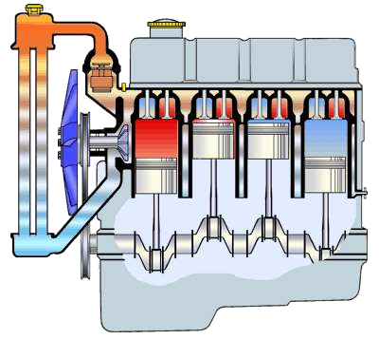
Cooling System of IC Engine
An automobile's cooling system is the collection of parts and substances (coolants) that work together to maintain the engine's temperature at optimal levels. Comprising many different components such as water pump, coolant,
a thermostat etc. the system enables smooth and efficient functioning of the engine at the same time protecting it from damage
73
Jitendra Kumar Gupta(Assistant Professor) , JECRC, JAIPUR
1

Slide 74
Types of cooling system
In order to cool the engine a cooling medium is required. On the basis of medium ,in general use for cooling I.C. engine ,types of cooling system are
liquid or indirect cooling system.
air or direct cooling system.
74
Jitendra Kumar Gupta(Assistant Professor) , JECRC, JAIPUR
1

Slide 75
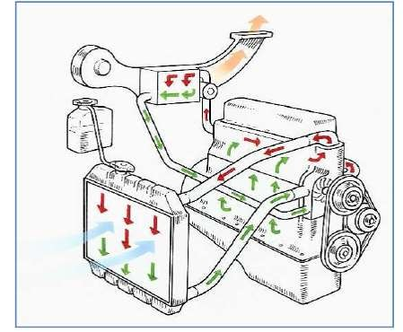
Liquid Cooled System
A liquid is circulated around the cylinders and absorb heat from the cylinder walls and cylinder head.
Coolant absorbs heat as it passes through the engine and also lubricates the water pump.
Hot coolant enters the radiator in which the heat is passed on to air that is flowing through the radiator.
75
Jitendra Kumar Gupta(Assistant Professor) , JECRC, JAIPUR
1

Slide 76
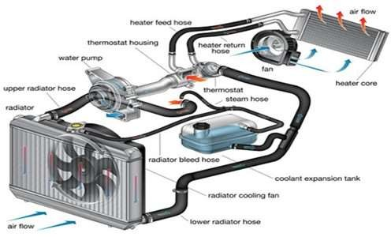
76
Jitendra Kumar Gupta(Assistant Professor) , JECRC, JAIPUR
1

Slide 77
Advantages of liquid Cooling System
Uniform cooling of cylinder, cylinder head and valves.
Specific fuel consumption of engine improves by using water cooling system.
If we employ water cooling system, then engine need not be provided at the front end of moving vehicle.
Engine is less noisy as compared with air cooled engines, as it has water for damping noise.
77
Jitendra Kumar Gupta(Assistant Professor) , JECRC, JAIPUR
1

Slide 78
Disadvantage of liquid Cooling System
It depends upon the supply of water.
The water pump which circulates water absorbs considerable power.
If the water cooling system fails then it will result in severe damage of engine.
The water cooling system is costlier as it has more number of parts. Also it requires more maintenance and care for its parts.
78
Jitendra Kumar Gupta(Assistant Professor) , JECRC, JAIPUR
1

Slide 79
Air Cooled System
In air cooled system a current of air made to flow past the outside of the cylinder barrel ,outer surface area which has been considerably increased by providing cooling fins.
The amount of heat dissipated to air depends upon :
Amount of air flowing through the fins.
Fin surface area.
Thermal conductivity of metal used for fins.
79
Jitendra Kumar Gupta(Assistant Professor) , JECRC, JAIPUR
1

Slide 80
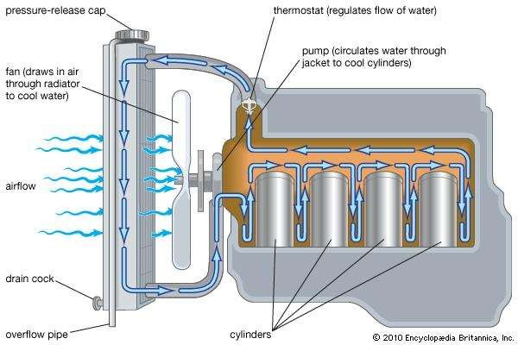
80
Jitendra Kumar Gupta(Assistant Professor) , JECRC, JAIPUR
1

Slide 81
Advantages of air Cooling System
Radiator/pump is absent hence the system is light.
In case of water cooling system there are leakages, but in this case here are no leakages.
Coolant and antifreeze solutions are not required.
This system can be used in cold climates, where if water is used it may freeze.
81
Jitendra Kumar Gupta(Assistant Professor) , JECRC, JAIPUR
1

Slide 82
Disadvantages of air Cooling System
Comparatively it is less efficient.
It is used in aero planes and motorcycle engines where the engines are exposed to air directly.
82
Jitendra Kumar Gupta(Assistant Professor) , JECRC, JAIPUR
1

Slide 83
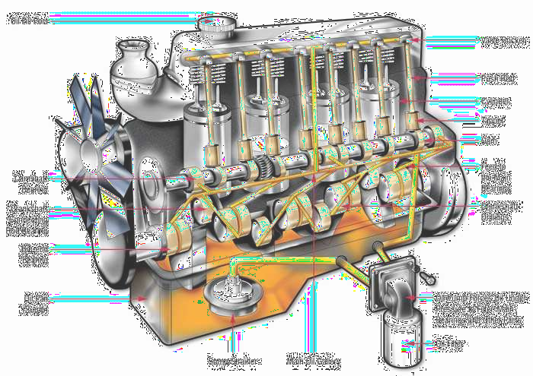
LUBRICATION SYSTEM IN IC ENGINES
83
Jitendra Kumar Gupta(Assistant Professor) , JECRC, JAIPUR
1

Slide 84
Definition of lubrication
Lubrication is the action of applying a substance such as oil or grease to an engine or component so as to minimize friction and allow smooth movement.
Lubrication System
Lubricating system is a mechanical system of lubricating internal combustion engines in which a pump forces oil into the engine bearings.
84
Jitendra Kumar Gupta(Assistant Professor) , JECRC, JAIPUR
1

Slide 85
PURPOSE OF LUBRICATION
To reduce the friction between moving parts
To increase the efficiency
To minimize the vibrations
To reduce the corrosion and carbon deposits
To reduce the heat of moving parts
To minimize power loss due to friction
To reduce the noise created by moving parts
To provide cooling to the engine
85
Jitendra Kumar Gupta(Assistant Professor) , JECRC, JAIPUR
1

Slide 86
TYPES OF LUBRICANTS
SOLID LUBRICANTS
e.g. graphite ,molybdenum ,mica
SEMI-SOLID LUBRICANTS
e.g. heavy greases
LIQUID LUBRICANTS
e.g. mineral oil obtained by refining petroleum oil,vegetable oils obtained from olive,linseed,caster and animal oil
86
Jitendra Kumar Gupta(Assistant Professor) , JECRC, JAIPUR
1

Slide 87
PROPERTIES OF LUBRICANTS
Viscosity
It is a measure of the resistance to flow of an oil
It is measured in saybolt uniuniversal seconds (SUS)
It is expressed in centistokes ,centipoises and redwood seconds
Viscosity Index
viscosity of oil decreases with increase in temperature
Cloud point
If an oil is cooled , it will start solidifying at some time .
Temperature at which oil starts solidifying , is called cloud point
87
Jitendra Kumar Gupta(Assistant Professor) , JECRC, JAIPUR
1

Slide 88
PROPERTIES OF LUBRICANTS
Pour point
It is temperature just above which the oil sample will not flow under certain prescribed conditions
this property is important for operation of engines and substances at low temperature conditions
Flash point and Fire point
The temperature at which vapour of an oil flash when subjected to a naked flame is called flash point
Fire point is the temperature at which the oil ,it once lit with flame ,will burnt steadily at least
for 5 seconds
Specific Gravity
It varies between 0.85 to 0.96
88
Jitendra Kumar Gupta(Assistant Professor) , JECRC, JAIPUR
1

Slide 89
PROPERTIES OF LUBRICANTS
Acidity
Oil must have low acidity
Carbon residue
It is quantity of carbaneous residues which remains after evaporation of a sample
oil under specific conditions
Oiliness
It is property of oil to cling to the metal surface by molecular action and then to provide a very thin film under lubrication conditions
This property affects start of engines
89
Jitendra Kumar Gupta(Assistant Professor) , JECRC, JAIPUR
1

Slide 90
ADDITIVES
Additives are the compound added to the oils to provide and improve their desired properties ,some of additives are :
1] VISCOSITY INDEX IMPROVERS
They are additives which improves the viscosity to work over wide range of temperatures
2] ANTIOXIDANTS
They reduce oxidation of lubricating oil
3] ANTIWEAR AND DETERGENT
Both serves to cleanse and prevent sticking of piston rings
90
Jitendra Kumar Gupta(Assistant Professor) , JECRC, JAIPUR
1

Slide 91
ENGINE PARTS THAT REQUIRE FREQUENT LUBRICATION
CYLINDER PISTON AND PISTON RINGS
MAIN BEARING
CRANKSHAFT
CRANK PIN AND PISTON PIN
BIG END AND SMALL END CONNECTING ROD
CAMSHAFT
VALVES
TIMING GEARS
91
Jitendra Kumar Gupta(Assistant Professor) , JECRC, JAIPUR
1

Slide 92
TYPES OF LUBRICATION SYSTEM
MIST LUBRICATION SYSTEM
WET SUMP LUBRICATION SYSTEM
DRY LUBRICATION SYSTEM
92
Jitendra Kumar Gupta(Assistant Professor) , JECRC, JAIPUR
1

Slide 93
93
Jitendra Kumar Gupta(Assistant Professor) , JECRC, JAIPUR
1

Slide 94
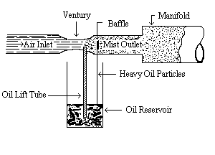
MIST OR PETROIL |PETROL PLUS OIL| LUBRICATION SYSTEM
This system is used in 2 stroke cycle engines
The lubrication oil (2% to 3%) is mixed with the petrol in the fuel tank
The oil and the fuel mixture is inducted through carburetor.
The optimum fuel oil ratio used is 50:1
Petrol gets evaporated and the oil lubricates the main parts of cylinder.
Fuel oil ratio used is important for the good performance of engine.
94
Jitendra Kumar Gupta(Assistant Professor) , JECRC, JAIPUR
1

Slide 95
ADVANTAGES of mist lubrication
separate lubricating system is not required.
No maintenance cost for lubrication system
Weight of engine is reduced by avoiding separate lubricating system
DISADVANTAGES of mist lubrication system
If oil is less then there is chance of seizure of the engine
More oil makes excess air in the exhaust
95
Jitendra Kumar Gupta(Assistant Professor) , JECRC, JAIPUR
1

Slide 96
WET SUMP LUBRICATION SYSTEM
In this system a big oil sump is provided at the base of crank case.
From the sump oil is pumped to different parts of the engine
The main types of Wet sump lubrication system are:
splash lubrication system
pressure lubrication system
Splash and pressure lubrication system
96
Jitendra Kumar Gupta(Assistant Professor) , JECRC, JAIPUR
1

Slide 97
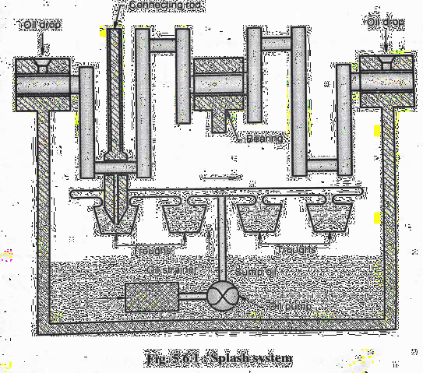
SPLASH LUBRICATION SYSTEM
The lubricating oil is filled in the sump
Scoop are attached to the end of connecting rod
When system moves to Bottom Dead Centre (BDC) scoop splashes lubricating oil to the piston ,cylinder ,big end of connecting rod ,main bearing and cam shaft bearing
The splashed oil settles on engine parts and then to sump again
97
Jitendra Kumar Gupta(Assistant Professor) , JECRC, JAIPUR
1

Slide 98
98
Jitendra Kumar Gupta(Assistant Professor) , JECRC, JAIPUR
1

Slide 99
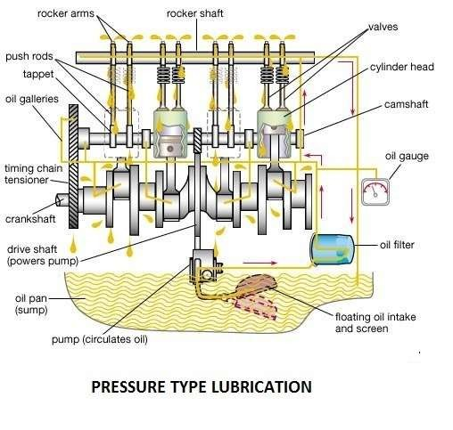
PRESSURE LUBRICATION SYSTEM
In this system , lubrication is done with the help of pressure pump which is submerged in the sump
With the help of pressure pump after filtration, oil is forced under pressure to different parts of the engine through oil tubes
From the bearing oil floats to connecting rod through oil holes between connecting rod and cam shaft
Then this oil flows to piston pin through oil holes and sprayed over piston ,piston rings , cylinder valves and other parts
99
Jitendra Kumar Gupta(Assistant Professor) , JECRC, JAIPUR
1

Slide 100
SPLASH AND PRESSURE LUBRICATION SYSTEM
Splash system is not sufficient when bearing Aare higher hence lubricating oil under pressure is supplied by oil pump to main and crankshaft bearings
Oil pump also supplies oil under pressure to pipes which directs a stream of oil against the dippers (scoop) on the connecting rod bearing cups
Other parts are lubricated by splash of oil by scoop.
100
Jitendra Kumar Gupta(Assistant Professor) , JECRC, JAIPUR
1

Slide 101
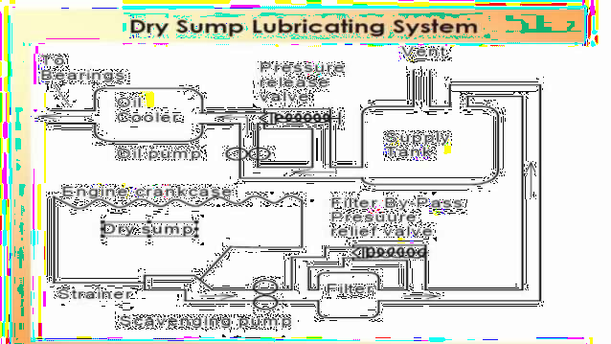
DRY SUMP LUBRICATION SYSTEM
In dry sump , extra oil is stored in a tank
outside the engine rather than oil pan
In this system ,the lubrication oil is passed through the pipes using scavenging pumps
After lubrication ,the oil is again collected by special connecting sections and passed to heat exchanger for cooling
Scavenging pump has greater capacity than oil feed pump and it is placed externally to sump
101
Jitendra Kumar Gupta(Assistant Professor) , JECRC, JAIPUR
1

Slide 102
ADVANTAGES OF DRY SUMP LUBRICATION SYSTEM
Improvements to vehicle handling and stability. The vehicle's center of gravity can be lowered by mounting the engine lower in the chassis due to a shallow sump profile. A vehicle's overall weight distribution can be modified by locating the external oil reservoir away from the engine
Improved engine reliability due to consistent oil pressure. This is the reason why dry-sumps were invented
Increased oil capacity, by using a larger external reservoir than would be practical in a wet-sump system
Having the pumps external to the engine makes them easier to maintain or replace.
102
Jitendra Kumar Gupta(Assistant Professor) , JECRC, JAIPUR
1

Slide 103
DISADVANTAGES OF DRY SUMP LUBRICATION SYSTEM
Dry-sump systems add cost, complexity, and weight.
The extra pumps and lines in dry-sump engines require additional oil and maintenance.
The large external reservoir and pumps can be tricky to position around the engine and within the engine bay due to their size.
Inadequate upper valvetrain lubrication can also become an issue if too much oil vapor is being pulled out from the area, especially with multi-staged pumps.
103
Jitendra Kumar Gupta(Assistant Professor) , JECRC, JAIPUR
1

Slide 104
Jitendra Kumar Gupta (Assistant Professor) , JECRC, JAIPUR
104

