Slide 1
JAIPUR ENGINEERING COLLEGE AND RESEARCH CENTRE
DEPARTMENT OF MECHANICAL ENGINEERING
Year & Sem. – I Year & I SEM
Presented by- Nitin Chhabra
(Assistant Professor)
Nitin Chhabra (Assistant Professor) , JECRC, JAIPUR
1
1

Slide 2
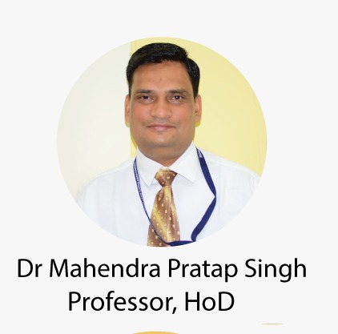
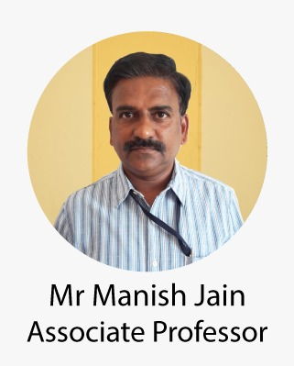
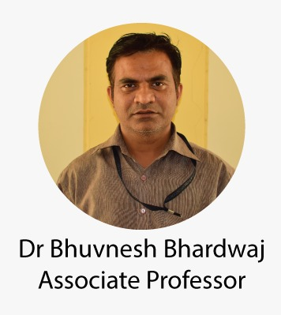
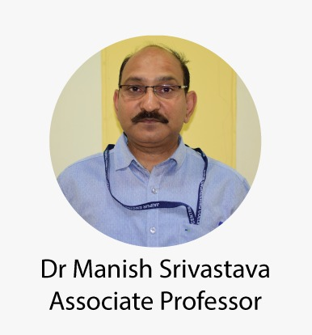
Department of Mechanical Engineering
Nitin Chhabra (ASSISTANT PROFESSOR) , JECRC, JAIPUR
2
1

Slide 3
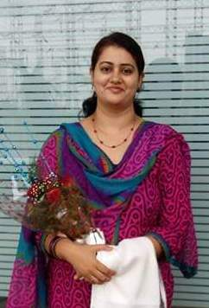
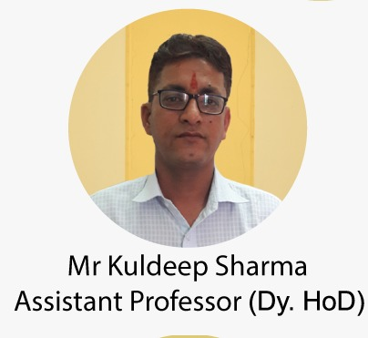
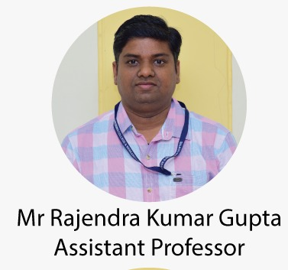
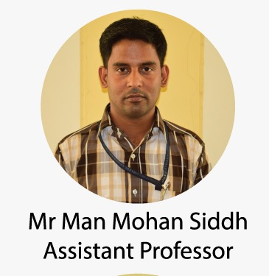
Department of Mechanical Engineering
Dr.Fauzia siddiqui
Associate Professor
Nitin Chhabra (ASSISTANT PROFESSOR) , JECRC, JAIPUR
3
1

Slide 4
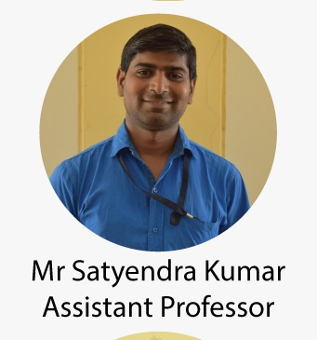
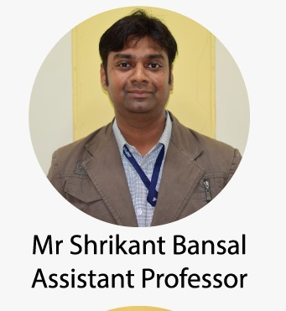
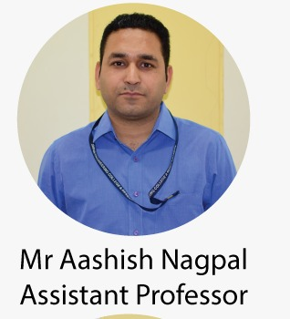
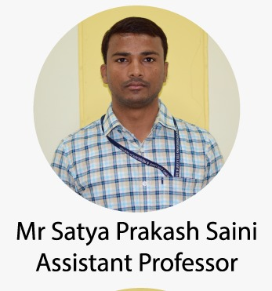
Department of Mechanical Engineering
Nitin Chhabra (ASSISTANT PROFESSOR) , JECRC, JAIPUR
4
1

Slide 5
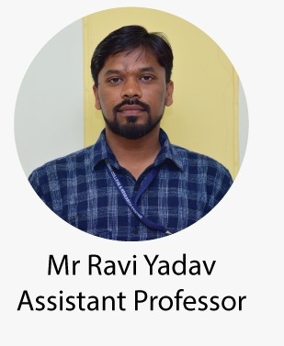
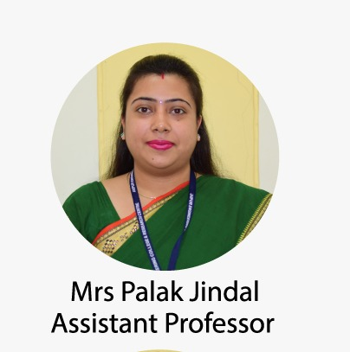
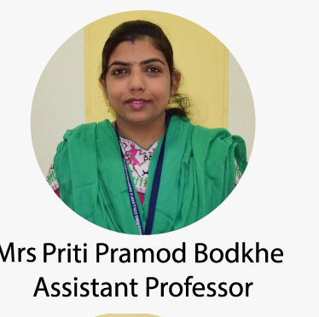
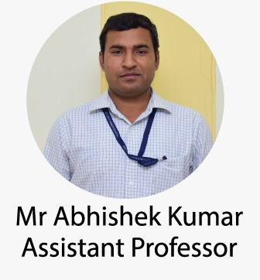
Department of Mechanical Engineering
Nitin Chhabra (ASSISTANT PROFESSOR) , JECRC, JAIPUR
5
1

Slide 6
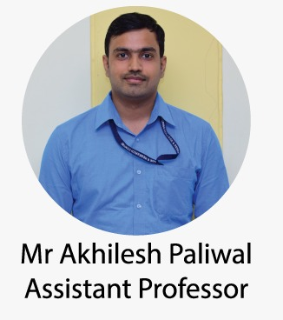
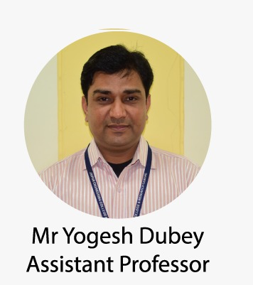
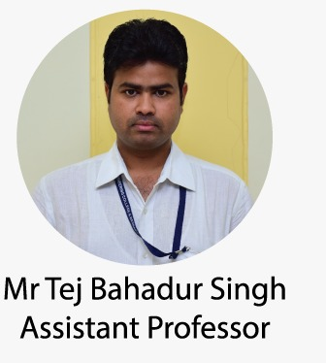
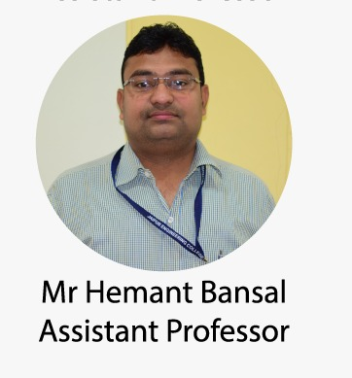
Department of Mechanical Engineering
Nitin Chhabra (ASSISTANT PROFESSOR) , JECRC, JAIPUR
6
1

Slide 7
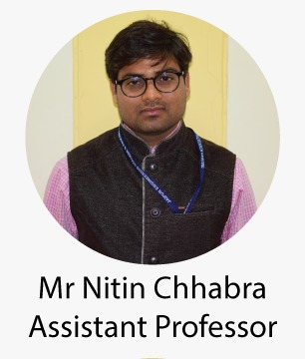
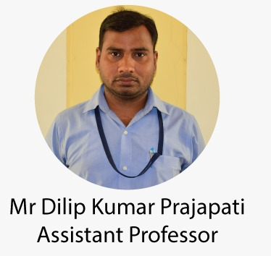
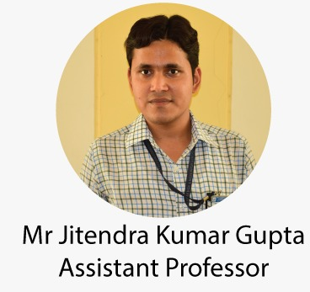
Department of Mechanical Engineering
Nitin Chhabra (ASSISTANT PROFESSOR) , JECRC, JAIPUR
7
1

Slide 8
VISION AND MISSION OF INSTITUTE
VISION OF INSTITUTE
To became a renowned centre of outcome based learning and work towards academic professional ,cultural and social enrichment of the lives of individuals and communities .
MISSION OF INSTITUTE
Focus on evaluation of learning ,outcomes and motivate students to research aptitude by project based learning.
Identify based on informed perception of Indian ,regional and global needs ,the area of focus and provide platform to gain knowledge and solutions.
Offer opportunities for interaction between academic and industry .
Develop human potential to its fullest extent so that intellectually capable and imaginatively gifted leaders may emerge
Nitin Chhabra (ASSISTANT PROFESSOR) , JECRC, JAIPUR
8
1

Slide 9
Introduction of Mechanical Engineering
Mechanical engineering is an engineering branch that combines engineering physics and mathematics principles with materials science to design, analyze, manufacture, and maintain mechanical systems.
Nitin Chhabra (ASSISTANT PROFESSOR) , JECRC, JAIPUR
9
1

Slide 10
SUBJECTS INCLUDED IN FIRST YEAR SYLLABUS
BASIC MECHANICAL ENGINEERING (BME)
COMPUTER AIDED MACHINE DRAWING (CAMD)
MANUFACTURING PRACTICES WORKSHOP (MPWS)
Nitin Chhabra (ASSISTANT PROFESSOR) , JECRC, JAIPUR
10
1

Slide 11
BME
(1FY3-07)
Nitin Chhabra (ASSISTANT PROFESSOR) , JECRC, JAIPUR
11
1

Slide 12
Introduction of Basic Mechanical Engineering
Basic Mechanical Engineering is an engineering subject that involve the production and usage of heat and mechanical power for design, production and operation of machines and tools.
Nitin Chhabra (ASSISTANT PROFESSOR) , JECRC, JAIPUR
12
1

Slide 13
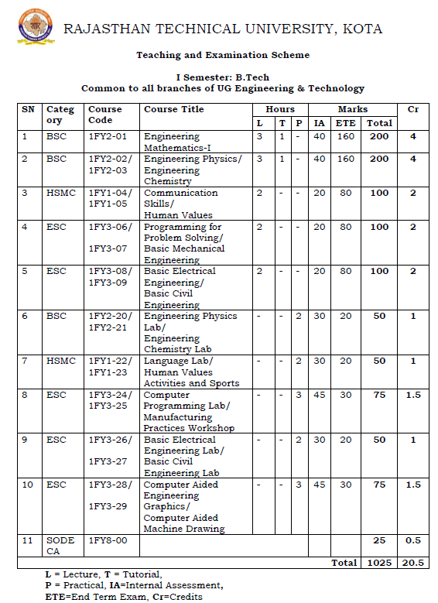
Nitin Chhabra (ASSISTANT PROFESSOR) , JECRC, JAIPUR
13
1

Slide 14
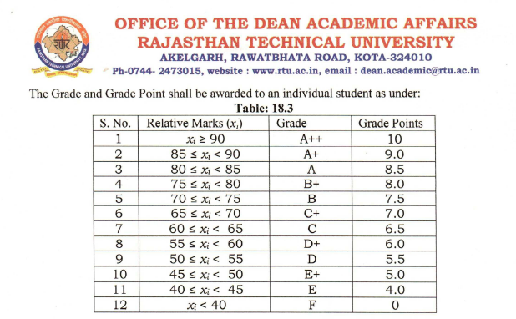
Nitin Chhabra (ASSISTANT PROFESSOR) , JECRC, JAIPUR
14
1

Slide 15
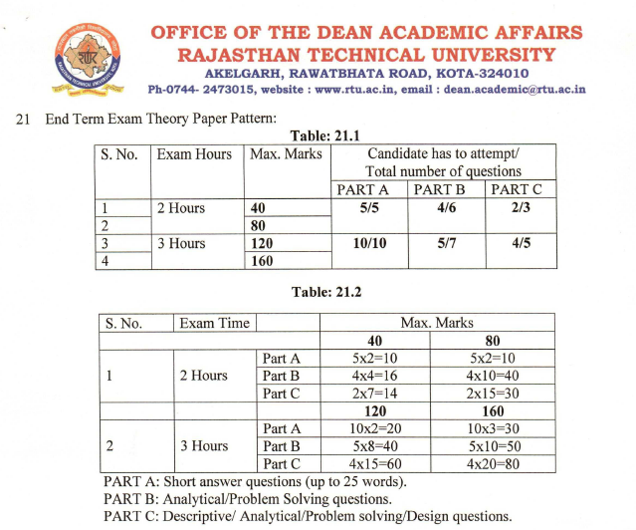
Nitin Chhabra (ASSISTANT PROFESSOR) , JECRC, JAIPUR
15
1

Slide 16
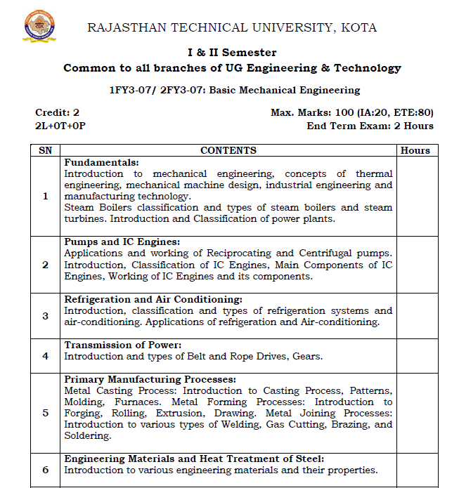
Nitin Chhabra (ASSISTANT PROFESSOR) , JECRC, JAIPUR
16
1

Slide 17
Nitin Chhabra (ASSISTANT PROFESSOR) , JECRC, JAIPUR
17
1

Slide 18
DISTRIBUTION OF MARKS
TOTAL MARKS(100)
INTERNAL
(20)
MTT-1
(20)
MTT-2
(20)
EXTERNAL
(80)
Nitin Chhabra (ASSISTANT PROFESSOR) , JECRC, JAIPUR
18
1

Slide 19
CAMD
(1FY3-29)
Nitin Chhabra (ASSISTANT PROFESSOR) , JECRC, JAIPUR
19
1

Slide 20
Introduction of Machine Drawing
Machine drawing may be defined as the representation of a machine component or machine by lines according to certain set rules. A machine drawing generally gives all the external and internal details of the machine component from which it can be manufactured.
Nitin Chhabra (ASSISTANT PROFESSOR) , JECRC, JAIPUR
20
1

Slide 21
Nitin Chhabra (ASSISTANT PROFESSOR) , JECRC, JAIPUR
21
1

Slide 22
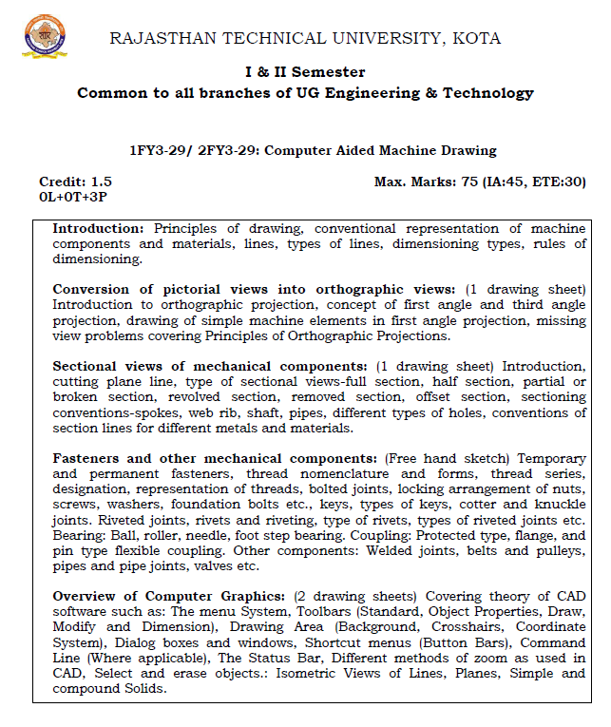
Nitin Chhabra (ASSISTANT PROFESSOR) , JECRC, JAIPUR
22
1

Slide 23
Nitin Chhabra (ASSISTANT PROFESSOR) , JECRC, JAIPUR
23
1

Slide 24
LIST OF INSTRUMENTS REQUIRED FOR CAMD
List of Instruments: |  |  | Qty.
1. Mini Drafter(Omega) |  |  | 1
2. Compass with interchangable pencil |  |  | 1
3. Scale (12") |  |  | 1
4. Protactor (360⁰ & 180⁰) |  |  | 1 Each
5. Drawing Pencils (HB,H,2H,3H )Kohinoor make |  |  | 1 Each
6. Eraser (non dust) |  |  | 1
7. Paper cutter |  |  | 1
8. Sand Paper (Grade 00) |  |  | 1
9. Drawing Clips |  |  | 1 set of 4
10. Circle Master |  |  | 1
11. Drawing Sheets(Off-white) A1 size |  |  | 5
12.Sketch file A3 size (Classmate) |  |  | 1
13.Sheet Holder |  |  | 1
14.Clean Handkerchief |  |  | 1
15.Sharpner |  |  | 1
Nitin Chhabra (ASSISTANT PROFESSOR) , JECRC, JAIPUR
24
1

Slide 25
MPWS
(1FY3-25)
Nitin Chhabra (ASSISTANT PROFESSOR) , JECRC, JAIPUR
25
1

Slide 26
Introduction of Manufacturing practices workshop
Mechanical Engineering Workshop is a place where students acquire knowledge on the operation of various processes involved in manufacturing and production.
Nitin Chhabra (ASSISTANT PROFESSOR) , JECRC, JAIPUR
26
1

Slide 27
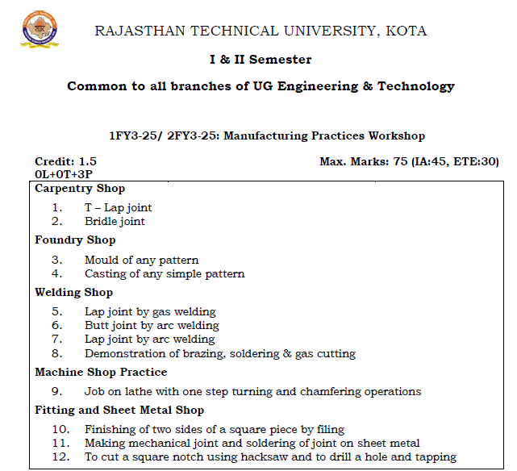
Nitin Chhabra (ASSISTANT PROFESSOR) , JECRC, JAIPUR
27
1

Slide 28
Distribution of Marks
TOTAL MARKS (75)
PERFORMANCE
(15)
INTERNAL EXTERNAL
45 30
VIVA
(15)
Attendance
(10)
Assignment Sheets viva
(10) (15) (10)
Nitin Chhabra (ASSISTANT PROFESSOR) , JECRC, JAIPUR
28
1

Slide 29
TEXT BOOKS
BME
AUTHER PUBLICATION
G SHANMUGAM TMH
A.K.RAJVANSHI GENIUS PUBLICATION
ARYA N.K.PUBLICATIONS
CAMD
LAXMINARAYANAN &MATHUR JAIN BROTHERS,NEW DELHI
MPWS
HAJRA CHOUDHARY MEDIA PROMOTERS AND PUBLICATIONS
Nitin Chhabra (ASSISTANT PROFESSOR) , JECRC, JAIPUR
29
1

Slide 30
Nitin Chhabra (ASSISTANT PROFESSOR) , JECRC, JAIPUR
30

