Slide 1
JAIPUR ENGINEERING COLLEGE AND RESEARCH CENTRE
Year & Sem – II year, III sem
Subject – Obejct Oriented Programming
Unit – 3
Presented by – Priya Gupta (AP, IT)
1

Slide 2
VISION AND MISSION OF INSTITUTE
Vision: “ To become renowned Centre of outcome based learning and work towards academic, professional, cultural and social enrichments of the lives of individual and communities”
Mission:
1. Focus on evaluation of learning outcomes and motivate students to inculcate research aptitude by project based learning.
2. Identify areas of focus and provide platform to gain knowledge and solutions based on informed perception of Indian, regional and global needs.
3. Offer opportunities for interaction between academia and industry.
4. Develop human potential to its fullest extent so that intellectually capable and imaginatively gifted leaders can emerge in a range of professions.
1

Slide 3
VISION AND MISSION OF DEPARTMENT
VISION
“The vision of our institute is to provide the professional and active learners to the IT challenging world. By providing the technical surroundings and scientific excellence environment, we serve as a valuable resource for industry and society.”
MISSION
To generate the adequate knowledge by promoting the extracurricular activities and technical education.
To provide the graduates best technology services to fulfill its commitment of technical and education of the highest quality.
To anticipate and meet the information technology needs of alumni, graduates, faculty and staff as they pursue their educational and professional goals
1

Slide 4
Topics to be covered under UNIT 3
Inheritance
Types of inheritance
Multiple inheritance
Virtual base class
Function overriding
Abstract class and pure virtual function
1

Slide 5
Inheritance
In C++, inheritance is a process in which one object acquires all the properties and behaviours of its parent object automatically.
It is possible to inherit attributes and methods from one class to another.
It allows user to create a new class (derived class) from an existing class(base class).
We group the "inheritance concept" into two categories:
derived class (child) - the class that inherits from another class
base class (parent) - the class being inherited from
To inherit from a class, use the : symbol.
1

Slide 6
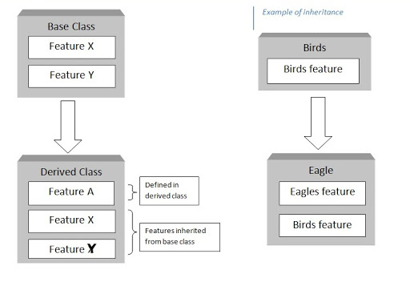
1

Slide 7
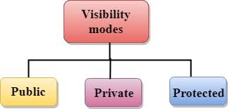
When creating a class, instead of writing completely new data members and member functions, the programmer can designate that the new class should inherit the members of an existing class. This existing class is called the base class, and the new class is referred to as the derived class.
class derived-class: access-specifier base-class
{
//body of derived class
}
1

Slide 8
Why inheritance needed?
In each of the classes, you would be copying the same code for walk and talk for each character.
1

Slide 9
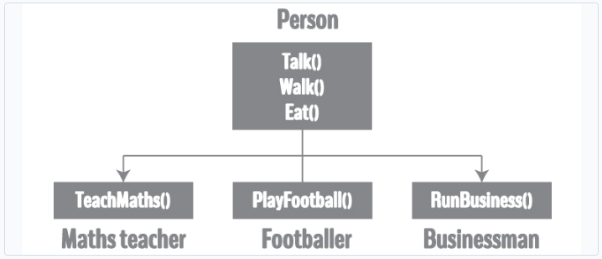
Using inheritance, now you don't implement the same code for walk and talk for each class. You just need to inherit them.
1

Slide 10
class Person // Base class
{
... .. ...
};
class MathsTeacher : public Person //derived class 1
{
... .. ...
};
class Footballer : public Person // derived class 2
{
.... .. ...
};
1

Slide 11
#include <iostream.h>
class Person
{
public:
string profession;
int age;
Person()
{
profession="unemployed”;
Age=16;
}
void display()
{
cout << "My profession is: " << profession << endl;
cout << "My age is: " << age << endl;
walk();
talk();
}
void walk() { cout << "I can walk." << endl; }
void talk() { cout << "I can talk." << endl; }
};
1

Slide 12
// MathsTeacher class is derived from base class Person.
class MathsTeacher : public Person
{
public:
void teachMaths()
{
cout << "I can teach Maths." << endl;
}
};
// Footballer class is derived from base class Person.
class Footballer : public Person
{
public:
void playFootball()
{
cout << "I can play Football." << endl;
}
};
1

Slide 13
int main()
{
MathsTeacher teacher;
teacher.profession = "Teacher";
teacher.age = 23;
teacher.display();
teacher.teachMaths();
Footballer footballer;
footballer.profession = "Footballer";
footballer.age = 19;
footballer.display();
footballer.playFootball();
return 0;
}
1

Slide 14
OUTPUT:
My profession is: Teacher
My age is: 23
I can walk.
I can talk.
I can teach Maths.
My profession is: Footballer
My age is: 19
I can walk.
I can talk.
I can play Football.
1

Slide 15
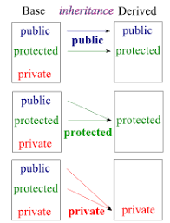
ACCESS SPECIFIER
1

Slide 16
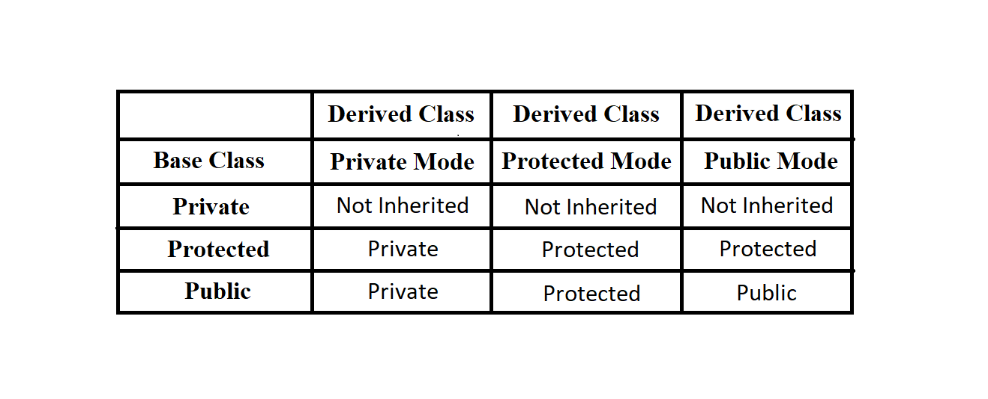
ACCESS SPECIFIER
1

Slide 17
Types of Inheritance
Single inheritance.
Multi-level inheritance.
Multiple inheritance.
Hierarchical Inheritance.
Hybrid Inheritance.
Multipath inheritance.
1

Slide 18
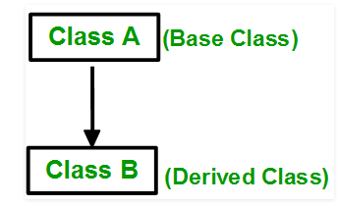
1. Single inheritance
In this inheritance, a derived class is created from a single base class.
In the given example, Class A is the parent class and Class B is the child class since Class B inherits the features and behavior of the parent class A.
Syntax:
class subclass_name : access_mode base_class
{
//body of subclass
};
1

Slide 19
#include <iostream.h>
// base class
class Vehicle {
public:
Vehicle()
{
cout << "This is a Vehicle" << endl;
}
};
// sub class derived from base classes
class Car: public Vehicle
{
};
int main()
{
// creating object of sub class will invoke the constructor of base classes
Car obj;
return 0;
}
Output:
This is a vehicle
1

Slide 20
2. Multiple Inheritance
Multiple Inheritance is a feature where a class can inherit from more than one classes. i.e one sub class is inherited from more than one base classes.
class subclass_name : access_mode base_class1, access_mode base_class2, ....
{
//body of subclass
};
1

Slide 21
#include <iostream.h>
// first base class
class Vehicle {
public:
Vehicle()
{
cout << "This is a Vehicle" << endl;
}
};
// second base class
class FourWheeler {
public:
FourWheeler()
{
cout << "This is a 4 wheeler Vehicle" << endl;
}
};
1

Slide 22
// sub class derived from two base classes
class Car: public Vehicle, public FourWheeler
{
};
// main function
int main()
{
// creating object of sub class will invoke the constructor of base classes
Car obj;
return 0;
}
Output:
This is a Vehicle
This is a 4 wheeler Vehicle
1

Slide 23
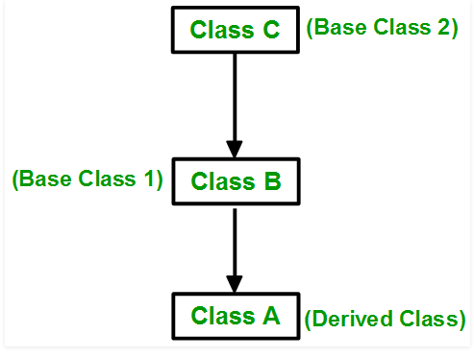
3. Multilevel Inheritance
In this type of inheritance, a derived class is created from another derived class.
1

Slide 24
#include <iostream.h>
// base class
class Vehicle
{
public:
Vehicle()
{
cout << "This is a Vehicle" << endl;
}
};
class fourWheeler: public Vehicle
{
public:
fourWheeler()
{
cout<<"Objects with 4 wheels are vehicles"<<endl;
}
};
1

Slide 25
// sub class derived from two base classes
class Car: public fourWheeler
{
public:
car()
{
cout<<"Car has 4 Wheels"<<endl;
}
};
// main function
int main()
{
//creating object of sub class will invoke the constructor of base classes
Car obj;
return 0;
}
Output:
This is a Vehicle
Objects with 4 wheels are vehicles
Car has 4 Wheels
1

Slide 26
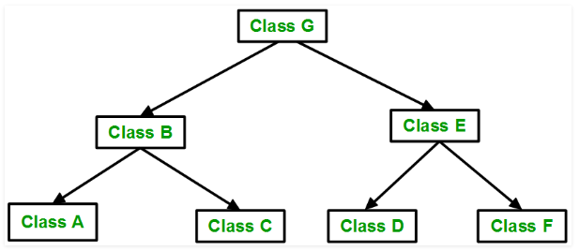
4. Hierarchical Inheritance
In this type of inheritance, more than one sub class is inherited from a single base class. i.e. more than one derived class is created from a single base class
1

Slide 27
#include <iostream.h>
// base class
class Vehicle
{
public:
Vehicle()
{
cout << "This is a Vehicle" << endl;
}
};
// first sub class
class Car: public Vehicle
{
};
1

Slide 28
// second sub class
class Bus: public Vehicle
{
};
// main function
int main()
{
// creating object of sub class will invoke the constructor of base class
Car obj1;
Bus obj2;
return 0;
}
Output:
This is a Vehicle
This is a Vehicle
1

Slide 29
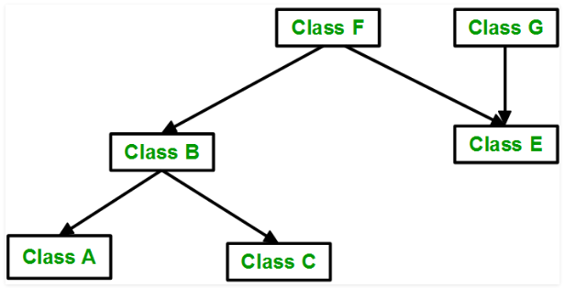
5. Hybrid Inheritance
Hybrid Inheritance is implemented by combining more than one type of inheritance.
For example: Combining Hierarchical inheritance and Multiple Inheritance.
Below image shows the combination of hierarchical and multiple inheritance:
1

Slide 30
#include <iostream.h>
// base class
class Vehicle
{
public:
Vehicle()
{
cout << "This is a Vehicle" << endl;
}
};
//base class
class Fare
{
public:
Fare()
{
cout<<"Fare of Vehicle\n";
}
};
1

Slide 31
// first sub class
class Car: public Vehicle
{
};
// second sub class
class Bus: public Vehicle, public Fare
{
};
// main function
int main()
{
// creating object of sub class will
// invoke the constructor of base class
Bus obj2;
return 0;
}
Output:
This is a Vehicle
Fare of Vehicle
1

Slide 32
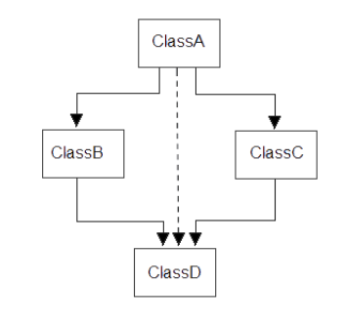
6. A special case of hybrid inheritance : Multipath inheritance
A derived class with two base classes and these two base classes have one common base class is called multipath inheritance. An ambiguity can arise in this type of inheritance.
1

Slide 33
#include<iostream.h>
class ClassA
{
public:
int a;
};
class ClassB : public ClassA
{
public:
int b;
};
class ClassC : public ClassA
{
public:
int c;
};
class ClassD : public ClassB, public ClassC
{
public:
int d;
};
1

Slide 34
void main()
{
ClassD obj;
//obj.a = 10; //Statement 1, Error
//obj.a = 100; //Statement 2, Error
obj.ClassB::a = 10; //Statement 3
obj.ClassC::a = 100; //Statement 4
obj.b = 20;
obj.c = 30;
obj.d = 40;
cout<< "\n A from ClassB : "<< obj.ClassB::a;
cout<< "\n A from ClassC : "<< obj.ClassC::a;
cout<< "\n B : "<< obj.b;
cout<< "\n C : "<< obj.c;
cout<< "\n D : "<< obj.d;
}
1

Slide 35
Note:
If we need to access the data member a of ClassA through the object of ClassD, we must specify the path from which a will be accessed, whether it is from ClassB or ClassC, bco’z compiler can’t differentiate between two copies of ClassA in ClassD.
There are 2 ways to avoid this ambiguity:
Use scope resolution operator
Use virtual base class
1

Slide 36
Avoiding ambiguity using scope resolution operator:
Using scope resolution operator we can manually specify the path from which data member a will be accessed, as shown in statement 3 and 4, in the above example.
obj.ClassB::a = 10; //Statement 3
obj.ClassC::a = 100; //Statement 4
Note: Still, there are two copies of ClassA in ClassD.
1

Slide 37
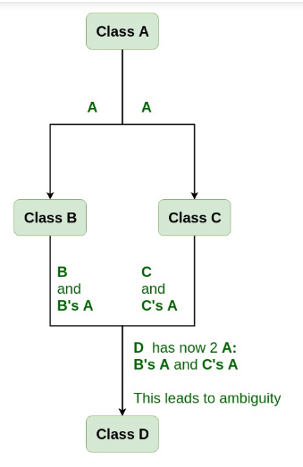
A special case of hybrid inheritance : Multipath inheritance A derived class with two base classes and these two base classes have one common base class is called multipath inheritance. An ambiguity can arise in this type of inheritance.
1

Slide 38
Note:
If we need to access the data member a of ClassA through the object of ClassD, we must specify the path from which a will be accessed, whether it is from ClassB or ClassC, bco’z compiler can’t differentiate between two copies of ClassA in ClassD.
There are 2 ways to avoid this ambiguity:
Use scope resolution operator
Use virtual base class
1

Slide 39
Virtual Base Class
How to resolve this issue? To resolve this ambiguity when class A is inherited in both class B and class C, it is declared as virtual base class by placing a keyword virtual as :
Syntax :
class B : virtual public A
{
};
Syntax 2:
class C : public virtual A
{
};
1

Slide 40
#include <iostream.h>
class A {
public:
void show()
{
cout << "Hello from A \n";
}
};
class B : public virtual A {
};
class C : public virtual A {
};
class D : public B, public C {
};
int main()
{
D object;
object.show();
}
1

Slide 41
The virtual base class is used when a derived class has multiple copies of the base class.
Student
Sports
Test
Result
1

Slide 42
#include<iostream.h>
#include<conio.h>
class student //Base class
{
int rno;
public:
void getnumber() {
cout << "Enter Roll No:";
cin>>rno;
}
void putnumber() {
cout << "\n\n\tRoll No:" << rno << "\n";
}
};
1

Slide 43
class test : virtual public student //2nd derived class
{
public:
int part1, part2;
void getmarks() {
cout << "Enter Marks\n";
cout << "Part1:";
cin>>part1;
cout << "Part2:";
cin>>part2;
}
void putmarks() {
cout << "\tMarks Obtained\n";
cout << "\n\tPart1:" << part1;
cout << "\n\tPart2:" << part2;
}
};
1

Slide 44
class sports : public virtual student //1st derived class
{
public:
int score;
void getscore()
{
cout << "Enter Sports Score:";
cin>>score;
}
void putscore()
{
cout << "\n\tSports Score is:" << score;
}
};
1

Slide 45
class result : public test, public sports //last derived class
{
int total;
public:
void display() {
total = part1 + part2 + score;
putnumber();
putmarks();
putscore();
cout << "\n\tTotal Score:" << total;
}
};
void main() {
result obj;
clrscr();
obj.getnumber();
obj.getmarks();
obj.getscore();
obj.display();
getch();
}
1

Slide 46
Enter Roll No: 200 Enter Marks Part1: 90 Part2: 80 Enter Sports Score: 80 Roll No: 200 Marks Obtained Part1: 90 Part2: 80 Sports Score is: 80 Total Score is: 250
OUTPUT:
Enter Roll No: 200
Enter Marks
Part1: 90
Part2: 80
Enter Sports Score: 80
Roll No: 200
Marks Obtained
Part1: 90
Part2: 80
Sports Score is: 80
Total Score is: 250
1

Slide 47
Function Overriding
Function overriding is a feature that allows us to have a same function in child class which is already present in the parent class.
A child class inherits the data members and member functions of parent class, but when you want to override a functionality in the child class then you can use function overriding.
It is like creating a new version of an old function, in the child class.
1

Slide 48
Inheritance is a feature of OOP that allows us to create derived classes from a base class. The derived classes inherit features of the base class.
Suppose, the same function is defined in both the derived class and the based class. Now if we call this function using the object of the derived class, the function of the derived class is executed.
This is known as function overriding in C++.
The function in derived class overrides the function in base class.
1

Slide 49
#include <iostream.h>
class Base {
public:
void print() {
cout << "Base Function" << endl;
}
};
class Derived : public Base {
public:
void print() {
cout << "Derived Function" << endl;
}
};
int main() {
Derived derived1;
derived1.print();
return 0;
}
Output: Derived function
1

Slide 50
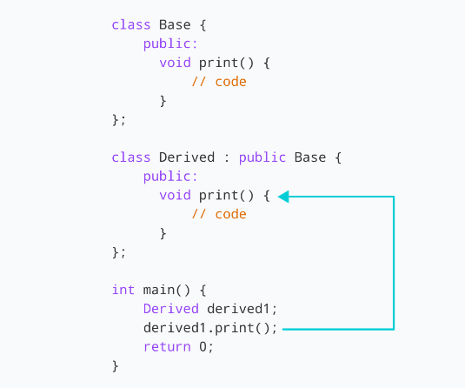
1

Slide 51
Access Overridden Function in C++
To access the overridden function of the base class, we use the scope resolution operator ::
We can also access the overridden function by using a pointer of the base class to point to an object of the derived class and then calling the function from that pointer.
1

Slide 52
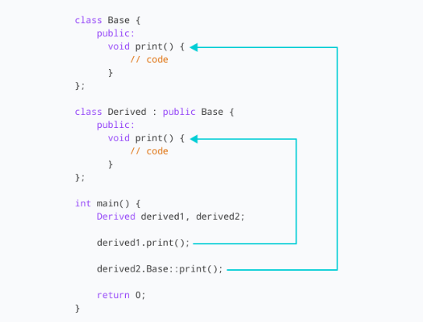
1

Slide 53
#include <iostream.h>
class Base {
public:
void print() {
cout << "Base Function" << endl;
}
};
class Derived : public Base {
public:
void print() {
cout << "Derived Function" << endl;
}
};
1

Slide 54
int main() {
Derived derived1;
// pointer of Base type that points to derived1
Base* ptr = &derived1;
// call function of Base class using ptr
ptr->print();
return 0;
}
OUTPUT: Base Function
1

Slide 55
VIRTUAL FUNCTIONS
A virtual function is a member function which is declared within a base class and is re-defined (Overridden) by a derived class.
Virtual functions ensure that the correct function is called for an object, regardless of the type of reference (or pointer) used for function call.
They are mainly used to achieve Runtime polymorphism
Functions are declared with a virtual keyword in base class.
1

Slide 56
Rules for Virtual Functions
Virtual functions cannot be static and also cannot be a friend function of another class.
Virtual functions should be accessed using pointer or reference of base class type to achieve run time polymorphism.
The prototype of virtual functions should be same in base as well as derived class.
They are always defined in base class and overridden in derived class. It is not mandatory for derived class to override (or re-define the virtual function), in that case base class version of function is used.
A class may have virtual destructor but it cannot have a virtual constructor.
1

Slide 57
#include <iostream.h>
class base
{
public:
virtual void print()
{
cout << "print base class" << endl;
}
void show()
{
cout << "show base class" << endl;
}
};
1

Slide 58
class derived : public base
{
public:
void print()
{
cout << "print derived class" << endl;
}
void show()
{
cout << "show derived class" << endl;
}
};
1

Slide 59
int main()
{
base* bptr;
derived d;
bptr = &d;
// virtual function, binded at runtime
bptr->print();
// Non-virtual function, binded at compile time
bptr->show();
}
Output:
print derived class
show base class
1

Slide 60
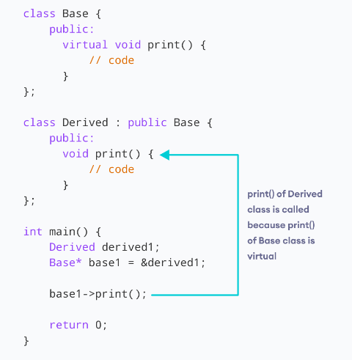
1

Slide 61
#include <iostream>
{
public:
virtual void display()
{
cout << "Base class is invoked"<<endl;
}
};
class B:public A
{
public:
void display()
{
cout << "Derived Class is invoked"<<endl;
}
};
1

Slide 62
int main()
{
A* a; //pointer of base class
B b; //object of derived class
a = &b;
a->display(); //Late Binding occurs
}
Output:
Derived Class is invoked
1

Slide 63
Enter Roll No: 200 Enter Marks Part1: 90 Part2: 80 Enter Sports Score: 80 Roll No: 200 Marks Obtained Part1: 90 Part2: 80 Sports Score is: 80 Total Score is: 250
Pure Virtual Function
A virtual function is not used for performing any task. It only serves as a placeholder.
When the function has no definition, such function is known as "do-nothing" function.
The "do-nothing" function is known as a pure virtual function.
A pure virtual function is a function declared in the base class that has no definition relative to the base class.
virtual void display() = 0;
1

Slide 64
#include <iostream.h>
class Base
{
public:
virtual void show() = 0;
};
class Derived : public Base
{
public:
void show()
{
std::cout << "Derived class is derived from the base class." << std::endl;
}
};
1

Slide 65
int main()
{
Base *bptr;
//Base b;
Derived d;
bptr = &d;
bptr->show();
return 0;
}
Output:
Derived class is derived from the base class.
1

Slide 66
ABSTRACT CLASS
A class containing the pure virtual function cannot be used to declare the objects of its own, such classes are known as abstract base classes.
An abstract class in C++ is a class that has at least one pure virtual function (i.e., a function that has no definition). The classes inheriting the abstract class must provide a definition for the pure virtual function; otherwise, the subclass would become an abstract class itself.
Abstract classes are essential to providing an abstraction to the code to make it reusable and extendable
1

Slide 67
Characteristics of Abstract Class
Abstract class cannot be instantiated, but pointers and refrences of Abstract class type can be created.
Abstract class can have normal functions and variables along with a pure virtual function.
Abstract classes are mainly used for Upcasting, so that its derived classes can use its interface.
Classes inheriting an Abstract Class must implement all pure virtual functions, or else they will become Abstract too.
1

