Slide 1
JAIPUR ENGINEERING COLLEGE AND RESEARCH CENTRE
Year & Sem – II year, III sem
Subject – Obejct Oriented Programming
Unit – 2
Presented by – Priya Gupta (AP, IT)
1

Slide 2
VISION AND MISSION OF INSTITUTE
Vision: “ To become renowned Centre of outcome based learning and work towards academic, professional, cultural and social enrichments of the lives of individual and communities”
Mission:
1. Focus on evaluation of learning outcomes and motivate students to inculcate research aptitude by project based learning.
2. Identify areas of focus and provide platform to gain knowledge and solutions based on informed perception of Indian, regional and global needs.
3. Offer opportunities for interaction between academia and industry.
4. Develop human potential to its fullest extent so that intellectually capable and imaginatively gifted leaders can emerge in a range of professions.
1

Slide 3
VISION AND MISSION OF DEPARTMENT
VISION
“The vision of our institute is to provide the professional and active learners to the IT challenging world. By providing the technical surroundings and scientific excellence environment, we serve as a valuable resource for industry and society.”
MISSION
To generate the adequate knowledge by promoting the extracurricular activities and technical education.
To provide the graduates best technology services to fulfill its commitment of technical and education of the highest quality.
To anticipate and meet the information technology needs of alumni, graduates, faculty and staff as they pursue their educational and professional goals
1

Slide 4
Topics to be covered under UNIT 2
Dynamic memory allocation using new and delete operators
Passing object as argument
Inline functions
Function overloading
Function with default arguments
Constructors and destructors
Friend function and classes
Using this pointer
1

Slide 5
Dynamic Memory Allocation In C
Sometimes the size of the array you declared may be insufficient. To solve this issue, you can allocate memory manually during run-time. This is known as dynamic memory allocation in C programming.
To allocate memory dynamically, library functions :
malloc()
calloc()
realloc()
free()
1

Slide 6
1) C malloc()
The name "malloc" stands for memory allocation.
The malloc() function reserves a block of memory of the specified number of bytes. And, it returns a pointer of void which can be casted into pointers of any form.
Syntax:
ptr = (castType*) malloc(size);
1

Slide 7
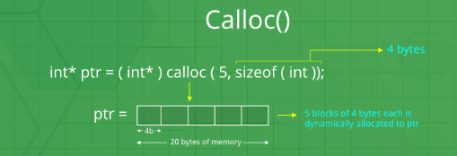
2) C calloc()
The name "calloc" stands for contiguous allocation.
The malloc() function allocates memory and leaves the memory uninitialized. Whereas, the calloc() function allocates memory and initializes all bits to zero.
Syntax:
ptr = (castType*)calloc(n, size);
1

Slide 8
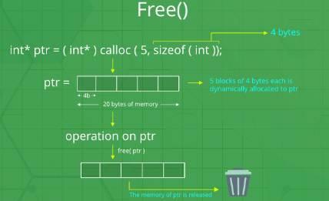
3) C free()
Dynamically allocated memory created with either calloc() and malloc() doesn't get freed on their own. You must explicitly use free() to release the space.
Syntax:
free(ptr);
1

Slide 9
4) C realloc()
If the dynamically allocated memory is insufficient or more than required, you can change the size of previously allocated memory using the realloc() function.
Syntax:
ptr = realloc(ptr, x);
1

Slide 10
Dynamic Memory Allocation In C++
C++ introduces two new operators which are more efficient to manage the dynamic memory.
These are ‘new’ operator for allocating memory and ‘delete’ operator for de-allocating memory.
These operators allocate memory for objects from a pool called the free store
1

Slide 11
The new operator
The new operator requests for the memory allocation from free storage.
If the sufficient memory is available, it initializes the memory to the pointer variable and returns its address.
Syntax of new operator:
pointer_variable = new datatype;
syntax to initialize the memory,
pointer_variable = new datatype(value);
syntax to allocate a block of memory,
pointer_variable = new datatype[size];
1

Slide 12
The delete operator
The delete operator is used to deallocate the memory.
User has privilege to deallocate the created pointer variable by this delete operator.
Syntax of delete operator
delete pointer_variable;
Syntax to delete the block of allocated memory,
delete[ ] pointer_variable;
1

Slide 13
#include <iostream.h>
Class array
{
int *p, size;
public:
void setsize(int);
void read();
void show();
void destroy();
};
void array :: setsize(int s)
{
size = s; // dynamic memory allocation
p=new int[size];
}
1

Slide 14
void array :: read()
{
cout<<“Enter elements:”<< endl;
for(int i=0; i<size; i++)
cin>> p[i]
}
Void array :: show()
{
cout<<“Array contains..”<<endl;
for(int i=0; i<size; i++)
cout<<p[i]<<endl;
}
void array :: destroy()
{
delete p; //destroy dynamically allocated memory
}
1

Slide 15
int main()
{
Array a;
int count;
cout<<“Enter size of array:”;
cin>>count;
a.setsize(count);
a.read();
a.show();
a.destroy();
return 0;
}
1

Slide 16
OUTPUT:
Enter size of array: 4
Enter elements:
14
15
16
17
Array contains..
14
15
16
17
1

Slide 17
FUNCTION OVERLOADING
It allows us to have more than one function having same name but different parameter list.
when I say parameter list, it means the data type and sequence of the parameters.
for example:
parameters list of a function myfuncn(int a, float b) is (int,float) which is different from the function myfuncn(float a, int b) parameter list (float, int).
1

Slide 18
Function overloading is a compile-time polymorphism.
The parameters should qualify any one or more of the following conditions, they should have different :
Type of parameters,
Number of parameters
Sequence of parameters
1

Slide 19
For example:
These two functions have different parameter type:
sum(int num1, int num2)
sum(double num1, double num2)
2. These two have different number of parameters:
sum(int num1, int num2)
sum(int num1, int num2, int num3)
3. These two have different sequence of parameters:
sum(int num1, double num2)
sum(double num1, int num2)
1

Slide 20
NOTE:
int sum(int, int)
double sum(int, int)
This is not allowed as the parameter list is same.
Even though they have different return types, its not valid.
1

Slide 21
#include <iostream.h>
class Addition
{
public:
int sum(int num1,int num2)
{
return num1+num2;
}
int sum(int num1,int num2, int num3)
{
return num1+num2+num3;
}
};
1

Slide 22
int main(void)
{
Addition obj;
cout<<obj.sum(20, 15)<<endl;
cout<<obj.sum(81, 100, 10);
return 0;
}
OUTPUT:
35
191
1

Slide 23
// Program to compute absolute value
// Works for both int and float
#include <iostream.h>
// function with float type parameter
float absolute(float var)
{
if (var < 0.0)
var = -var;
return var;
}
// function with int type parameter
int absolute(int var)
{
if (var < 0)
var = -var;
return var;
}
1

Slide 24
int main()
{
// call function with int type parameter
cout << "Absolute value of -5 = " << absolute(-5) << endl;
// call function with float type parameter
cout << "Absolute value of 5.5 = " << absolute(5.5f) << endl;
return 0;
}
OUTPUT:
Absolute value of -5 = 5
Absolute value of 5.5 = 5.5
1

Slide 25
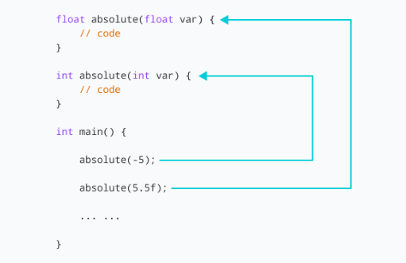
1

Slide 26
Advantages of Function overloading
The main advantage of function overloading is to the improve the code readability and allows code reusability.
1

Slide 27
CONSTRUCTOR
A constructor is a special type of member function that initialises an object automatically when it is created.
Compiler identifies a given member function is a constructor by its name and the return type.
Constructor has the same name as that of the class and it does not have any return type, not even void.
Also, the constructor is always public.
1

Slide 28
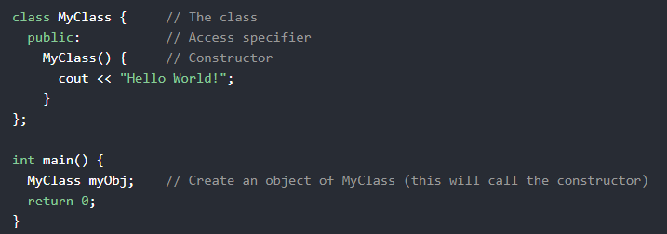
It is special method that is automatically called when an object of a class is created.
To create a constructor, use the same name as the class, followed by parentheses ():
1

Slide 29
Characteristics of constructor
Called automatically whenever the object of its class is created
Must be defined in public part of class
Do not have any return type(not even void), so they cannot return any value
Can have default arguments
Have same name as their class.
1

Slide 30
Use of Constructor
Suppose you are working on 100's of Person objects and the default value of a data member age is 0. Initialising all objects manually will be a very tedious task.
Instead, you can define a constructor that initialises age to 0. Then, all you have to do is create a Person object and the constructor will automatically initialise the age.
These situations arise frequently while handling array of objects.
Also, if you want to execute some code immediately after an object is created, you can place the code inside the body of the constructor.
1

Slide 31
Constructor vs Member function
1) Constructor doesn’t have a return type. Member function has a
return type. 2) Constructor is automatically called when we create the object of the class. Member function needs to be called explicitly using object of class. 3) When we do not create any constructor in our class, C++ compiler generates a default constructor and insert it into our code. The same does not apply to member functions.
1

Slide 32
class XYZ
{
....
XYZ()
{
//Empty no code
}
};
1

Slide 33
Types of Constructor
There are two types of constructor
Default constructor
Parameterized constructor
1

Slide 34
1) Default Constructor
A default constructor doesn’t have any arguments (or parameters)
#include <iostream.h>
class Website
{
public:
//Default constructor
Website()
{
cout<<"Welcome to IT Dept."<<endl;
}
};
1

Slide 35
int main(void)
{
/*creating two objects of class Website.
*This means that the default constructor
*should have been invoked twice. */
Website obj1;
Website obj2;
return 0;
}
OUTPUT:
Welcome to IT Dept.
Welcome to IT Dept.
1

Slide 36
2) Parameterized Constructor
Constructors with parameters are known as Parameterized constructors.
These type of constructor allows us to pass arguments while object creation.
XYZ(int a, int b)
{
}
...
XYZ obj(10, 20);
1

Slide 37
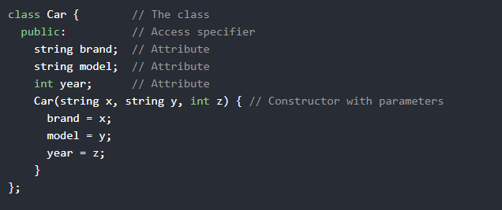
1

Slide 38
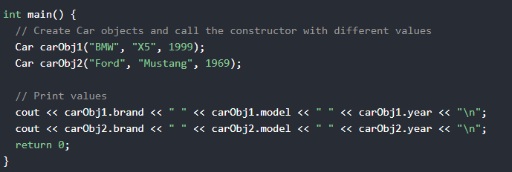
OUTPUT:
1

Slide 39
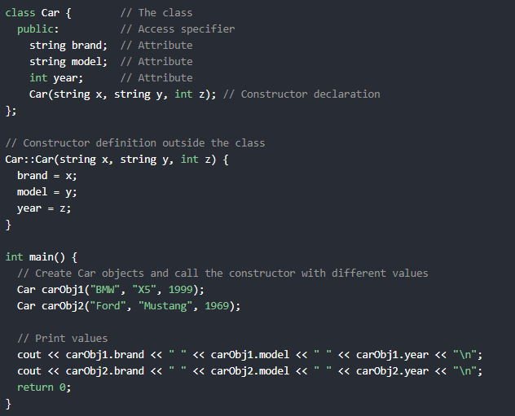
1

Slide 40
Constructor Overloading
Constructor can be overloaded in a similar way as function overloading.
Overloaded constructors have the same name (name of the class) but different number of arguments.
Depending upon the number and type of arguments passed, specific constructor is called.
Since, there are multiple constructors present, argument to the constructor should also be passed while creating an object.
1

Slide 41
#include <iostream.h>
class Account
{
int ano;
float bal;
public:
// Constructor with no arguments
Account()
{
ano=0;
bal=0.0;
}
// Constructor with one arguments
Account(int a)
{
ano=a;
bal=0.0;
}
1

Slide 42
// Constructor with two arguments
Account(int a, float b)
{
ano=a;
bal=b;
}
void show()
{
cout<<“Account no:”<<ano<<endl;
cout<<“Balance:”<<bal<<endl;
}
void moneytransfer(Account &);
};
Void account :: moneytransfer(account &acc)
{
float amt;
cout<<“How much money you want to transfer?”;
cin>> amt;
bal=bal-amt; //deduct money from acc1
acc.bal=acc.bal+amt // add money to acc2
}
1

Slide 43
int main()
{
account acc1(11,500);
account acc2(12,1000);
account acc3;
account acc4(13);
// transfer amount from acc1 to acc2
acc1.moneytramsfer(acc2);
cout<<“updated information of accounts:”<<endl;
acc1.show();
acc2.show();
acc3.show();
acc4.show();
return 0;
}
1

Slide 44
OUTPUT:
How much money you want to transfer? 200
Updated information of accounts:
Account no.= 11
Balance= 300
Account no.= 12
Balance= 1200
Account no.= 0
Balance= 0.0
Account no.= 113
Balance= 0.0
1

Slide 45
DESTRUCTORS
Destructors are members functions in a class that delete an object.
They are called when the class object goes out of scope such as when the function ends, the program ends, a delete variable is called etc
Destructors are different from normal member functions as they don’t take any argument and don’t return anything
1

Slide 46
destructors have the same name as their class and their name is preceded by a tilde(~).
Syntax:
~class_name()
{
//Some code
}
1

Slide 47
When does the destructor get called?
A destructor is automatically called when: 1) The program finished execution. 2) When a scope (the { } parenthesis) containing local variable ends. 3) When you call the delete operator.
1

Slide 48
#include <iostream.h>
class HelloWorld
{
public:
HelloWorld() //Constructor
{
cout<<"Constructor is called"<<endl;
}
~HelloWorld() //Destructor
{
cout<<"Destructor is called"<<endl;
}
void display() //Member function
{
cout<<"Hello World!"<<endl;
}
};
1

Slide 49
int main()
{
//Object created
HelloWorld obj;
//Member function called
obj.display();
return 0;
}
OUTPUT:
Constructor is called
Hello World!
Destructor is called
1

Slide 50
Destructor rules
1) Name should begin with tilde sign(~) and must match class name. 2) There cannot be more than one destructor in a class. 3) Unlike constructors that can have parameters, destructors do not allow any parameter. 4) They do not have any return type, just like constructors. 5) When you do not specify any destructor in a class, compiler generates a default destructor and inserts it into your code.
1

Slide 51
Friend Function
In object-oriented programming, a friend function, that is a "friend" of a given class, is a function that is given the same access as methods to private and protected data.
A friend function of a class is defined outside that class' scope but it has the right to access all private and protected members of the class.
Even though the prototypes for friend functions appear in the class definition, friends are not member functions.
1

Slide 52
A friend function in C++ is a function that is preceded by the keyword “friend”.
When the function is declared as a friend, then it can access the private and protected data members of the class.
class className
{ ……
friend returnType functionName(arg list);
};
1

Slide 53
One of the important concepts of OOP is data hiding, i.e., a nonmember function cannot access an object's private or protected data.
The complier knows a given function is a friend function by the use of the keyword friend.
For accessing the data, the declaration of a friend function should be made inside the body of the class (can be anywhere inside class either in private or public section) starting with keyword friend.
1

Slide 54
There are some points to remember while implementing friend functions in our program:
A friend function can be declared in the private or public section of the class.
It can be called like a normal function without using the object.
A friend function can be member of more than one class, its scope is not limited to one class.
A friend function is not invoked using the class object as it is not in the scope of the class.
A friend function cannot access the private and protected data members of the class directly. It needs to make use of a class object and then access the members using the dot operator.
A friend function can be a global function or a member of another class.
It violates the rule of data hiding.
1

Slide 55
#include <iostream.h>
class Second; →Forward class declaration
Class First
{
private:
int x;
public:
void read()
{
cout<<“ Enter a number:”
cin>>x;
}
friend void max(First ,Second); //Friend function
};
1

Slide 56
Class Second
{
int y;
public:
void read()
{
cout<<“Enter a number:”;
cin>>y;
}
friend void max(First ,Second); //Friend function
};
1

Slide 57
void max(First f, Second s) //definition of friend function
{
if (f.x>s.y)
cout<<“ First is maximum”;
else
cout<<“Second is maximum”
}
int main()
{
First obj1;
Second obj2;
obj1.read();
obj2.read();
max(obj1,obj2);
return 0;
}
1

Slide 58
OUTPUT:
Enter a number: 5
Enter a number: 10
Second is maximum
1

Slide 59
Friend Class
A friend class can access private and protected members of other class in which it is declared as friend.
It is sometimes useful to allow a particular class to access private members of other class.
1

Slide 60
Friend Class
A friend class can access private and protected members of other class in which it is declared as friend.
When a class is made a friend class, all the member functions of that class becomes friend functions
class B;
class A
{
// class B is a friend class of class A
friend class B;
... .. ...
};
class B
{
... .. ...
};
now all the member functions of class B became friend functions of class A.
1

Slide 61
For eg.
#include <iostream.h>
class Square
{
friend class Rectangle; // declaring Rectangle as friend class
int side;
public:
Square ( int s )
{
side = s;
}
};
1

Slide 62
class Rectangle
{
int length;
int breadth;
public:
int getArea()
{
return length * breadth;
}
void shape( Square a )
{
length = a.side;
breadth = a.side;
}
};
1

Slide 63
int main()
{
Square square(5);
Rectangle rectangle;
rectangle.shape(square);
cout << rectangle.getArea() << endl;
return 0;
}
OUTPUT:
25
NOTE: We declared Rectangle as a friend class of Square. Thus now, all the functions of Rectangle can directly access any private member of Square.
1

