Slide 1
JAIPUR ENGINEERING COLLEGE AND RESEARCH CENTRE
Year & Sem – II year, III sem
Subject – Obejct Oriented Programming
Unit – 1
Presented by – Priya Gupta (AP, IT)
1

Slide 2
VISION AND MISSION OF INSTITUTE
Vision: “ To become renowned Centre of outcome based learning and work towards academic, professional, cultural and social enrichments of the lives of individual and communities”
Mission:
1. Focus on evaluation of learning outcomes and motivate students to inculcate research aptitude by project based learning.
2. Identify areas of focus and provide platform to gain knowledge and solutions based on informed perception of Indian, regional and global needs.
3. Offer opportunities for interaction between academia and industry.
4. Develop human potential to its fullest extent so that intellectually capable and imaginatively gifted leaders can emerge in a range of professions.
1

Slide 3
VISION AND MISSION OF DEPARTMENT
VISION
“The vision of our institute is to provide the professional and active learners to the IT challenging world. By providing the technical surroundings and scientific excellence environment, we serve as a valuable resource for industry and society.”
MISSION
To generate the adequate knowledge by promoting the extracurricular activities and technical education.
To provide the graduates best technology services to fulfill its commitment of technical and education of the highest quality.
To anticipate and meet the information technology needs of alumni, graduates, faculty and staff as they pursue their educational and professional goals
1

Slide 4
CONTENTS (TO BE COVERED)
Introduction to Different Programming paradigm
Characteristics of OOPS
Class & Object
Data member
Member function
Different access specifier
1

Slide 5
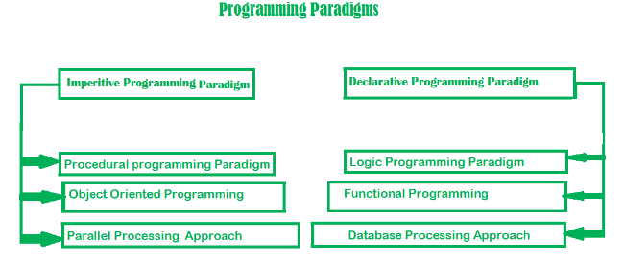
DIFFERENT PROGRAMMING PARADIGM
Programming paradigm is an approach to solve problem using some programming language or also we can say it is a method to solve a problem using tools and techniques that are available to us following some approach.
1

Slide 6
Imperitive Programming Paradigm:
One of the oldest programming paradigm
Perform step by step task
Main focus is on how to achieve the goal
Very simple to implement
It contains loops, variables etc.
Disadvantage: i) Complex programs cannot be solved.
ii) Less efficient & less productive
OOP:
Program is written as a collection of classes & object which are meant for communication.
Advantages: i) Data security
ii) Inheritance
iii) Code Reusability
iv) Flexible & abstraction is also present
eg. JAVA, C++, .NET, Python etc.
1

Slide 7
Declarative Programming Paradigm:
Divided as logic, functional & database
Style of building programs that expresses logic of computation without talking about its control flow
Focus is on what needs to be done rather than how it should be done basically emphasize on what code is actually doing.
1

Slide 8
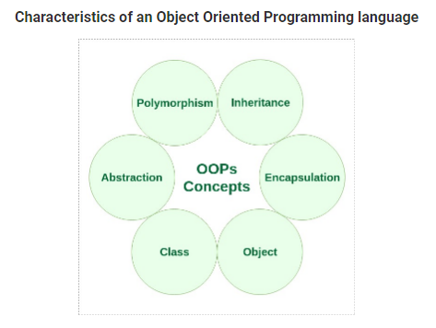
CHARACTERISTICS OF OOP
1

Slide 9
CHARACTERISTICS OF OOP
Class – Basic building blocks OOP and a single entity which has data and operations on data together
Objects – The instances of a class which are used in real functionality – its variables and operations
Abstraction – Specifying what to do but not how to do ; a flexible feature for having a overall view of an object’s functionality.
Encapsulation – Binding data and operations of data together in a single unit – A class adhere this feature
Inheritance and class hierarchy – Reusability and extension of existing classes
Polymorphism – Multiple definitions for a single name - functions with same name with different functionality; saves time in investing many function names Operator and Function overloading
Message passing – Objects communicates through invoking methods and sending data to them. This feature of sending and receiving information among objects through function parameters is known as Message Passing.
1

Slide 10
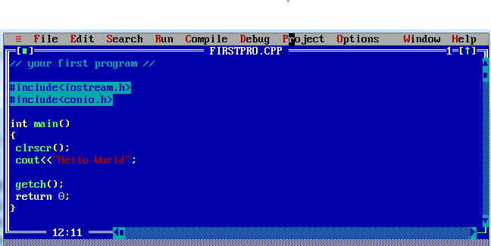
1

Slide 11
1

Slide 12
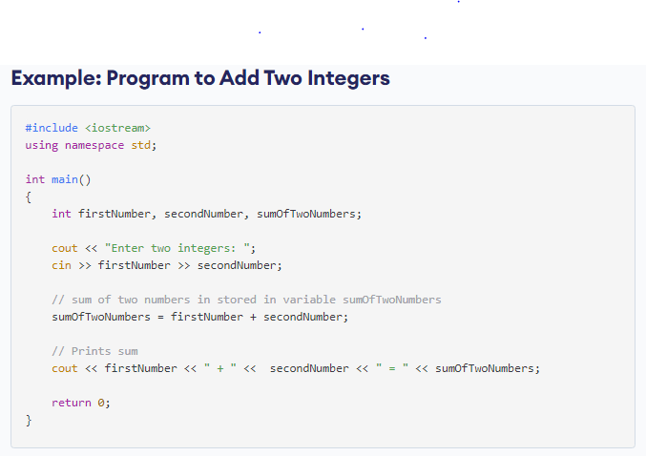
1

Slide 13
1

Slide 14
CLASS & OBJECT
Class: A class is the building block, that leads to Object-Oriented programming.
It is a user-defined data type, which holds its own data members and member functions, which can be accessed and used by creating an instance of that class.
It is like a blueprint for an object.
For Example: Consider the Class of Cars. There may be many cars with different names and brand but all of them will share some common properties like all of them will have 4 wheels, Speed Limit, Mileage range etc. So here, Car is the class and wheels, speed limits, mileage are their properties.
A Class is a user defined data-type which has data members and member functions.
Data members are the data variables and member functions are the functions used to manipulate these variables and together these data members and member functions defines the properties and behavior of the objects in a Class.
1

Slide 15
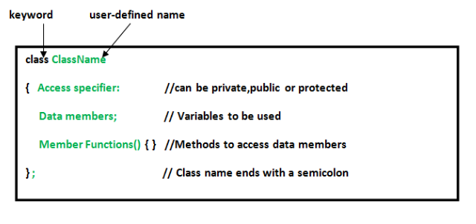
Defining Class and Declaring Objects:
A class is defined in C++ using keyword class followed by the name of class. The body of class is defined inside the curly brackets and terminated by a semicolon at the end.
1

Slide 16
OBJECT:
An Object is an instance of a Class. When a class is defined, no memory is allocated but when it is instantiated (i.e. an object is created) memory is allocated.
Declaring Objects: When a class is defined, only the specification for the object is defined; no memory or storage is allocated.
To use the data and access functions defined in the class, you need to create objects.
Syntax:
ClassName ObjectName;
1

Slide 17
DATA MEMBERS AND MEMBER FUNCTIONS
The variables which are declared in any class by using any fundamental data types (like int, char, float etc) or derived data type (like class, structure, pointer etc.) are known as Data Members. And the functions which are declared either in private section or public section are known as Member functions.
There are two types of data members/member functions in C++:
Private members
Public members
1) Private members
The members which are declared in private section of the class (using private access modifier) are known as private members. Private members can also be accessible within the same class in which they are declared.
2) Public members
The members which are declared in public section of the class (using public access modifier) are known as public members. Public members can access within the class and outside of the class by using the object name of the class in which they are declared.
1

Slide 18
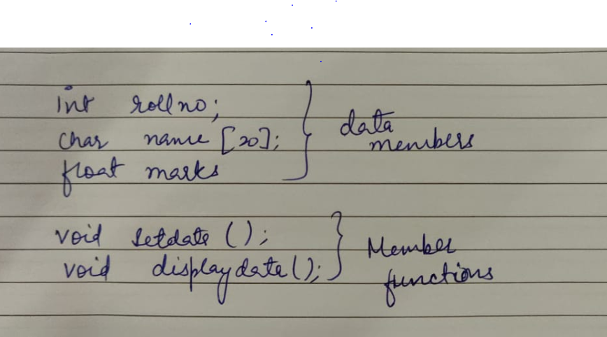
1

Slide 19
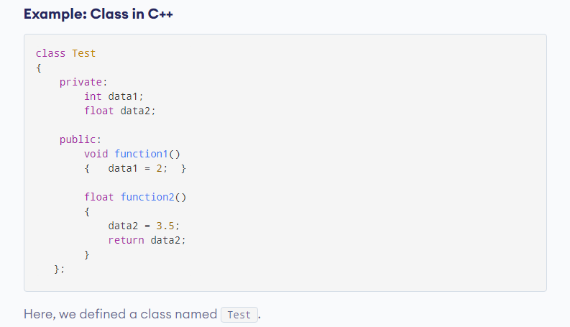
1

Slide 20
ACCESS SPECIFIER
Access specifiers define how the members (attributes and methods) of a class can be accessed.
It define the accessibility or visibility level of class members.
Types Of ACCESS SPECIFIER
private access specifier
protected access specifier
public access specifier
1

Slide 21
Private access specifier
The members declared as private are only visible to the members of the class or we cay say that inside the boundaries of the class.
2) Protected access specifier
The members declared as protected are accessible within the class as well as by the members of derived class.
3) Public access specifier
The members declared under the access specifier public are accessible inside the class, in derived class and outside the class by object’s of the class
1

Slide 22
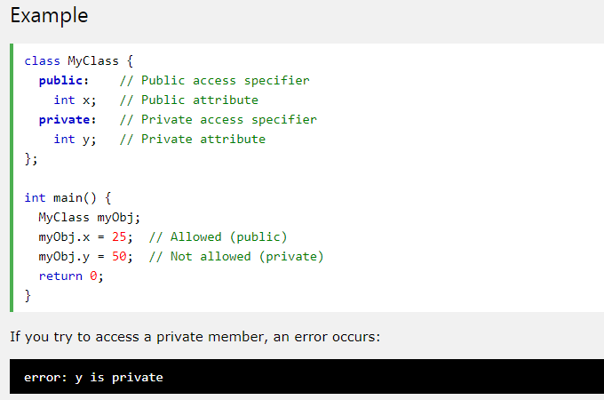
In C++, there are three access specifiers:
public - members are accessible from outside the class
private - members cannot be accessed (or viewed) from outside the class
protected - members cannot be accessed from outside the class, however, they can be accessed in inherited classes.
1

