Slide 1
JAIPUR ENGINEERING COLLEGE AND RESEARCH CENTRE
B. Tech I Year, Sem.-I & II
Subject –Engineering Chemistry
Syllabus & Lecture Plan
1

Slide 2
VISION OF INSTITUTE
To become a renowned centre of outcome based learning, and work towards academic, professional, cultural and social enrichment of the lives of individuals and communities.
1

Slide 3
MISSION OF INSTITUTE
Focus on evaluation of learning outcomes and motivate students to inculcate research aptitude by project based learning.
Identify, based on informed perception of Indian, regional and global needs, the areas of focus and provide platform to gain knowledge and solutions.
Offer opportunities for interaction between academia and industry.
Develop human potential to its fullest extent so that intellectually capable and imaginatively gifted leaders may emerge.
1

Slide 4
Engineering Chemistry: Course Outcomes
Students will be able to:
CO1: Explain the impurities of water (mainly hardness) and boiler troubles.
CO2: Describe processing technologies of fuel with numerical aspects of combustion of fuel.
CO3: Describe the engineering material (cement, glass and lubricant) with respect to their manufacturing, composition, classification & properties.
CO4: Explain corrosion with its controlling measures, organic reaction mechanism and synthesis of drugs (Aspirin & Paracetamol) with their properties and uses.
1

Slide 5
Engineering Chemistry: CO-PO Mapping
Subject Code | COs | Program Outcomes (POs)
 |  | PO-1 | PO-2 | PO-3 | PO-4 | PO-5 | PO-6 | PO-7 | PO-8 | PO-9 | PO-10 | PO-11 | PO-12
(1FY2-03)/ 2FY2-03 | CO-1 | 2 | 1 | 1 | 1 | - | 1 | 1 | - | - | 1 | - | -
 | CO-2 | 2 | 1 | - | - | - | - | - | - | - | - | - | -
 | CO-3 | 2 | 1 | 1 | 1 | - | - | 1 | - | - | 1 | - | -
 | CO-4 | 2 | 1 | 1 | - | - | 2 | 1 | - | - | 1 | - | -
1

Slide 6
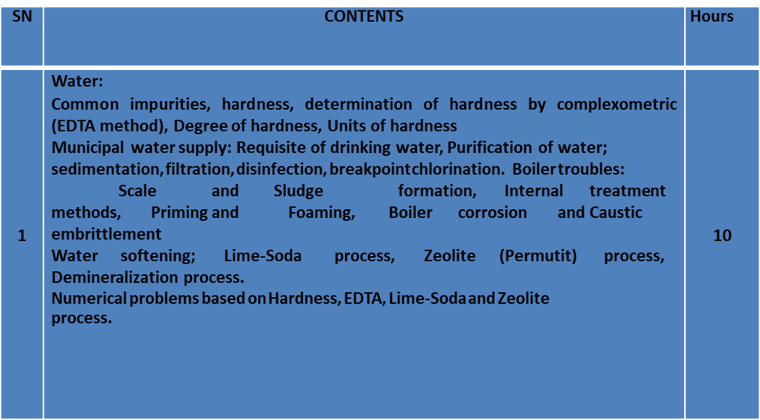
Common to all branches of UG Engineering & Technology 1FY2-03/ 2FY2-03: Engineering Chemistry Credit: 4 Max. Marks: 200 (IA:40, ETE:160) 3L+1T+0P End Term Exam: 3 Hours
1

Slide 7
2 | Organic Fuels: Solid fuels: Coal, Classification of Coal, Proximate and Ultimate analyses of coal and its significance, Gross and Net Calorific value, Determination of Calorific value of coal by Bomb Calorimeter. Metallurgical coke, Carbonization processes; Otto-Hoffmann by- product oven method. Liquid fuels : Advantages of liquid fuels, Mining, Refining and Composition of petroleum, Cracking, Synthetic petrol, Reforming, Knocking, Octane number, Anti-knocking agents, Cetane number Gaseous fuels; Advantages, manufacturing, composition and Calorific value of coal gas and oil gas, Determination of calorific value of gaseous fuels by Junker‟s calorimeter Numerical problems based on determination of calorific value (bomb calorimeter/Junkers calorimeter/Dulongs formula, proximate analysis & ultimate and combustion of fuel. | 10
Department of Applied Science JECRC, JAIPUR
1

Slide 8
3 | Corrosion and its control: Definition and significance of corrosion, Mechanism of chemical (dry) and electrochemical (wet) corrosion, galvanic corrosion, concentration corrosion and pitting corrosion. Protection from corrosion; protective coatings-galvanization and tinning, cathodic protection, sacrificial anode and modifications in design. | 3
4 | Engineering Materials: Portland Cement; Definition, Manufacturing by Rotary kiln. Chemistry of setting and hardening of cement. Role of Gypsum. Glass: Definition, Manufacturing by tank furnace, significance of Lubricants: Classification, Mechanism, Properties; Viscosity and viscosity index, flash and fire point, cloud and pour point. Emulsification and steam emulsion number | 10
 | annealing, Types and properties of soft glass, hard glass, borosilicate glass, glass wool, safety glass Lubricants: Classification, Mechanism, Properties; Viscosity and viscosity index, flash and fire point, cloud and pour point. Emulsification and steam emulsion number.
Department of Applied Science JECRC, JAIPUR
1

Slide 9
5 | Organic reaction mechanism and introduction of drugs: Organic reaction mechanism: Substitution; SN1, SN2, Elecrophilic aromatic substitution in benzene, free radical halogenations of alkanes, Elimination; elimination in alkyl halides, dehydration of alcohols, Addition: electrophilic and free radical addition in alkenes, nucleophilic addition in aldehyde and ketones, Rearrangement; Carbocation and free radical rearrangements Drugs : Introduction, Synthesis, properties and uses of Aspirin, Paracetamol | 7
TOTAL |  | 40
1

Slide 10
JECRC
Department of Applied Sciences
Lecture Plan (Session- 2020-2021)
Course Name: Engineering Chemistry Year/Semester: 1st Year/ Semester- I
Course code: 1FY2-03 No. of Lecture Req. /(Avl.): /(40/44 )
Semester starting: 21 Sept. 2020 Semester Ending: 24 Dec. 2020
Unit No./ Total Lect. Req. | Topics | Lect. No. | Book Referred | Pg. No.
Unit-I 10 | Introduction to syllabus, Common natural impurities, hardness, Degree of hardness, | 1 | Engg. Chemistry (New Age International) | 2-12
 | Units of hardness, Determination of hardness by complexometric (EDTA method). | 2 | Engg. Chemistry (Jain & Jain) | 15-30
 | Municipal water supply, Requisite of drinking water, purification of water, Sedimentation, | 3 | Engg. Chemistry (Jain & Jain)
 | Filtration, disinfection, Breakpoint chlorination. | 4 | Engg. Chemistry (Jain & Jain)
 | Boiler troubles: Scale and Sludge formation, Internal treatment Methods | 5 | Engg. Chemistry (Jain & Jain) Engg. Chemistry (Jain & Jain)
 | Priming and Foaming, Boiler corrosion and caustic embrittlement | 6
 | Water softening: Lime-Soda process | 7
 | Water softening: Zeolite (Permutit) process, Demineralization process. | 8
 | Numerical problems based on Hardness, EDTA, | 9
 | Numerical problems based on Lime-Soda and Zeolite process. | 10

Slide 11
Unit-II 10 | 2.Organic Fuels: Solids fuels: Coal, Classification of Coal, Proximate analysis of coal and its significance | 11 | Engg. Chemistry (Jain & Jain) | 116-117
 | Ultimate analysis of coal and its significance, | 12 | Engg. Chemistry (Jain & Jain) | 117-118
 | Gross and Net Calorific value, Determination of Calorific value of coal by Bomb Calorimeter. | 13 | Engg. Chemistry (Jain & Jain) | 200-209
 | Metallurgical coke, Carbonization processes; Otto-Hoffmann byproduct oven method. | 14 | Engg. Chemistry (Jain & Jain) | 210-225
 | Liquid fuels : Advantages of liquid fuels, Mining, Refining and Composition of petroleum, Cracking | 15 | Engg. Chemistry (Jain & Jain) | 226-238
 | Synthetic petrol, Reforming, Knocking, Octane number, Anti-knocking agents, Cetane number | 16 | Engg. Chemistry (Jain & Jain) | 239-245
 | Gaseous fuels; Advantages, manufacturing, composition and Calorific value of coal gas and oil gas | 17 | Engg. Chemistry (Jain & Jain) | 246-262
 | Determination of calorific value of gaseous fuels by Junker’s calorimeter, Numerical problems based on Junkers calorimeter | 18 | Engg. Chemistry (Jain & Jain) | 268-275
 | Numerical problems based on determination of calorific value bomb calorimeter, /Dulongs formula, proximate & ultimate Analysis. | 19 | Engg. Chemistry (Jain & Jain) | 276-289
 | Numerical problems based on combustion of fuel. | 20 | Engg. Chemistry (Jain & Jain) | 290-295
1

Slide 12
Unit-III 3 | 3.Corrosion and its control: Definition and significance of corrosion, Mechanism of chemical (dry) corrosion | 21 | Engg. Chemistry (Jain & Jain) | 300-310
 | Mechanism of electrochemical (wet) corrosion, galvanic corrosion, concentration corrosion and pitting corrosion. | 22 | Engg. Chemistry (Jain & Jain) | 311-319
 | Protection from corrosion; protective coatings-galvanization and tinning, cathodic protection, sacrificial anode and modifications in design. | 23 | Engg. Chemistry (Jain & Jain) | 320-332
1

Slide 13
Unit-IV 10 | 4.Engineering Materials: Portland Cement; Definition, Manufacturing by Rotary kiln. | 24 | Engg. Chemistry (Jain & Jain) | 333-342
 | Chemistry of setting and hardening of cement. Role of Gypsum. | 25 | Engg. Chemistry (Jain & Jain) | 343-351
 | Glass: Definition, Manufacturing by tank furnace, significance of Annealing | 26 | Engg. Chemistry (Jain & Jain) | 352-365
 | Types and properties of soft glass, hard glass | 27 | Engg. Chemistry (Jain & Jain) | 368-371
 | Borosilicate glass, glass wool, safety glass. | 28 | Engg. Chemistry (Jain & Jain) | 372-380
 | Lubricants: Classification | 29 | Engg. Chemistry (Jain & Jain) | 381-383
 | Lubricants: Mechanism | 30 | Engg. Chemistry (Jain & Jain) | 384-393
 | Properties; Viscosity and viscosity index | 31 | Engg. Chemistry (Jain & Jain) | 394-399
 | Flash and fire point, cloud and pour point. | 32 | Engg. Chemistry (Jain & Jain) | 400-406
 | Emulsification and steam emulsion number. | 33 | Engg. Chemistry (Jain & Jain) | 407-410
1

Slide 14
Unit-V 7 | 5. Organic reaction mechanism and introduction of drugs: Organic reaction mechanism: Substitution; SN1, SN2. | 34 | Engg. Chemistry (Jain & Jain)
 | Electrophilic aromatic substitution in benzene, free radical halogenations of alkanes, | 35 | Engg. Chemistry (Jain & Jain) | 411-419
 | Elimination: elimination in alkyl halides, dehydration of alcohols, | 36 | Engg. Chemistry (Jain & Jain) | 420-424
 | Addition: electrophilic and free radical addition in alkenes, nucleophilic addition in aldehyde and ketones | 37 | Engg. Chemistry (Jain & Jain) | 425-429
 | Rearrangement: Carbocation and free radical rearrangements | 38 | Engg. Chemistry (Jain & Jain) | 430--435
 | Drugs : Introduction, Synthesis, properties and uses of Aspirin | 39 | Engg. Chemistry (Jain & Jain) | 436-440
 | Drugs : Introduction, Synthesis, properties and uses of Paracetamol, Revision | 40 | Engg. Chemistry (Jain & Jain) | 441-448
1

Slide 15
Department of Applied Science JECRC, JAIPUR
1

