Slide 1
Effect of finite register length in FIR filter design
Dr. Parul Tyagi(Asso. Prof.) & Dr. Neha Singh (Asst. Prof.)
Electronics and Communication Engg.
JECRC. Jaipur (Raj), India
Email:- parultyagi.ece@jecrc.ac.in , nehasingh.ece@jecrc.ac.in

Slide 2
Digital Signal Processing algorithms are realized either with special purpose hardware or general purpose digital computer.
• In both cases the numbers and coefficients are stored in finite length registers.
• The coefficients and numbers are quantized by truncation or rounding off when they are stored.
• The following errors arise due to quantization of numbers
. – Input quantization error – Product quantization error – Coefficient quantization error

Slide 3
Review of number systems
• It is a system in which quantities are expressed in numeric symbols. • Numerous number systems are available
. • Knowledge of number system is the most essential requirement for understanding and designing the digital circuits
. • Generally number has 2 parts
• Integer • Fractional, set apart by radix point 5 Most Common Number

Slide 4
Most Common Number systems
• Decimal system - (0 to 9) -------()10
• Binary system – 0,1 ------()2
• Octal system – (0 to 7) ---------()8
• Hexadecimal system - 0 to 15 – 0,1,2,3,4,5,6,7,8,9,A,B,C,D,E,F • ----------()16

Slide 5
Decimal system
• Most common number system used in day to day life.
• It is also known as base 10 system. • Decimal to -------?------- ( Binary or Octal or Hexadecimal)
• Binary to -------?------- (Decimal or Octal or Hexadecimal)
• Octal to -------?------- (Decimal or Binary or Hexadecimal)
• Hexadecimal to -------?------- (Decimal or Binary or Octal)

Slide 6
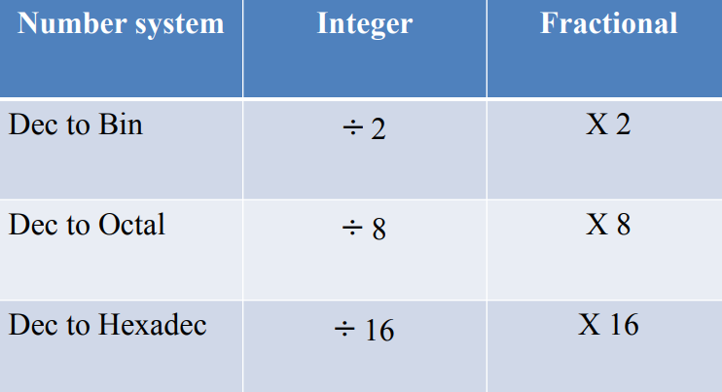
(Decimal) to (??)

Slide 7
(Binary) to (??)

Slide 8
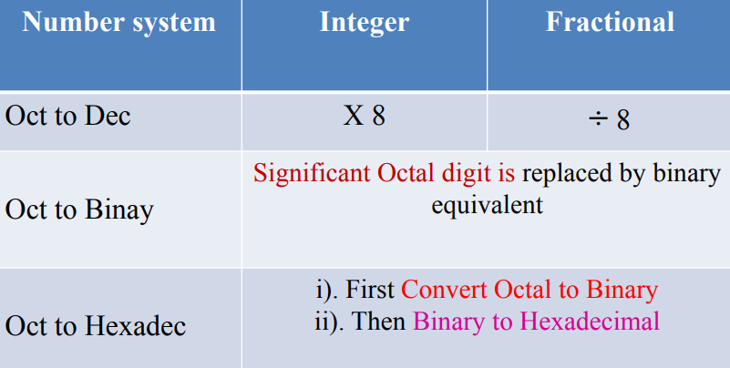
(Octal) to (??)

Slide 9
(Hexadecimal) to (??)

Slide 10
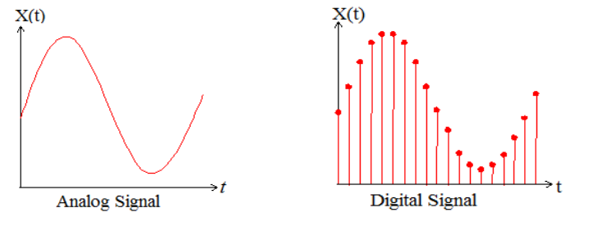
Analog and Digital Signal
• Analog system – The physical quantities or signals may vary continuously over a specified range.
• Digital system – The physical quantities or signals can assume only discrete values. • Greater accuracy

Slide 11
Number System
• The decimal number system is commonly used.
• Any number is possible to express in any base or radix “r”.
• In general, any number with radix r, having m digits to the left and n digits to the right of the decimal point, can be expressed as
Where am is the digit in mth position.
• The coefficient am is termed as Most Significant Digit(MSD)
• bn is termed as Least Significant Digit(LSD)

Slide 12
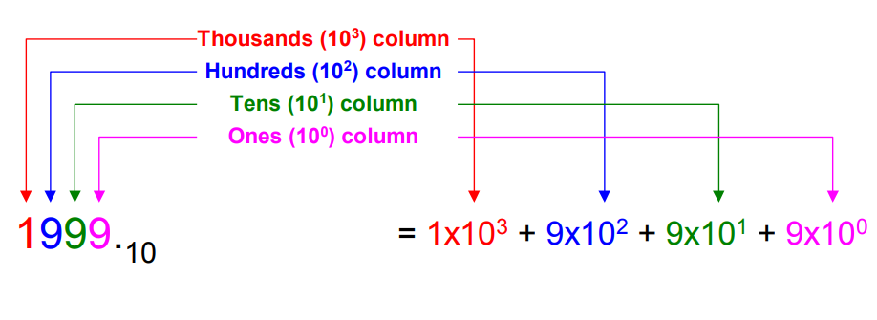
Base-10 (decimal) arithmetic
• Uses the ten numbers from 0 to 9
• Each column represents a power of 10

Slide 13
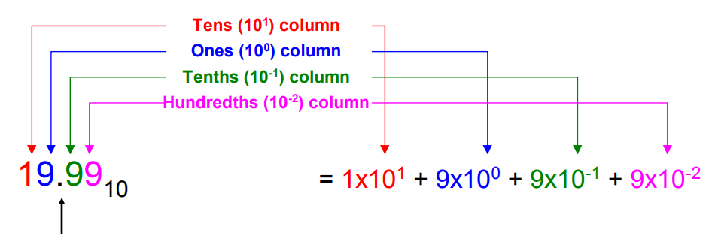
Base-10 (decimal) arithmetic
• Uses the ten numbers from 0 to 9
• Each column represents a power of 10

Slide 14
Decimal Number System
Base (also called radix) = 10
– 10 digits { 0, 1, 2, 3, 4, 5, 6, 7, 8, 9 }
• Digit Position – Integer & fraction
• Digit Weight – Weight = (Base) Position
• Magnitude – Sum of “Digit x Weight”
• Formal Notation

Slide 15
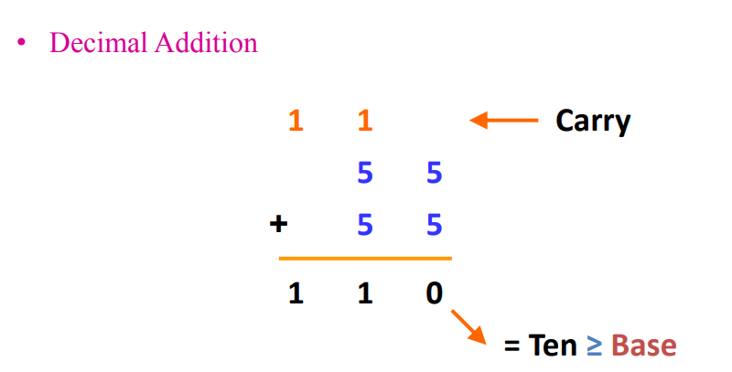
Addition

Slide 16
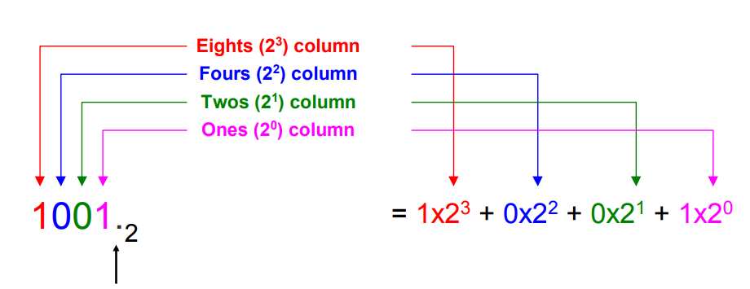
Standard binary representation
Uses the two numbers from 0 to 1
• Every column represents a power of 2

Slide 17
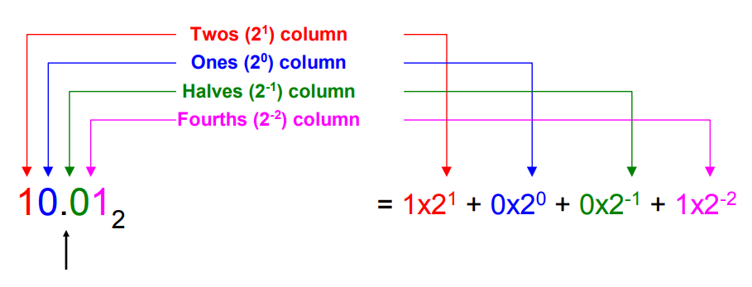
Fixed-point representation
• Uses the two numbers from 0 to 1
• Every column represents a power of 2

Slide 18
Binary Number System
Base = 2 – 2 digits { 0, 1 }, called binary digits or “bits”
Weights – Weight = (Base) Position
• Magnitude – Sum of “Bit x Weight”
• Formal Notation
• Groups of bits 4 bits = Nibble 8 bits = Byte

Slide 19
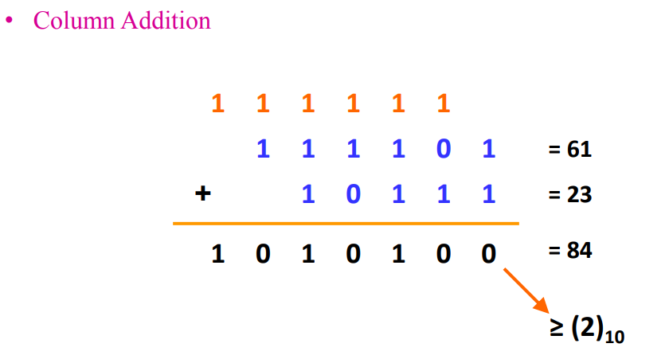
Binary Addition

Slide 20
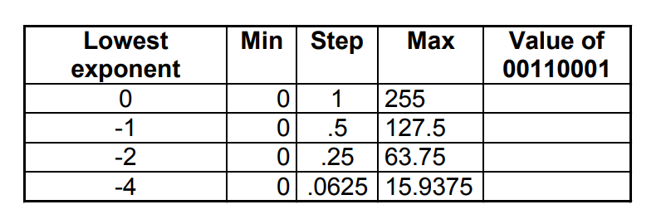
Range of values in a byte

Slide 21
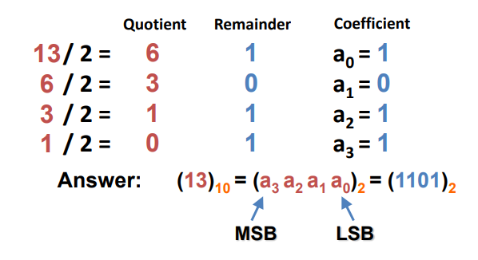
Decimal (Integer) to Binary Conversion
Divide the number by the „Base‟ (=2)
• Take the remainder (either 0 or 1) as a coefficient
• Take the quotient and repeat the division

Slide 22
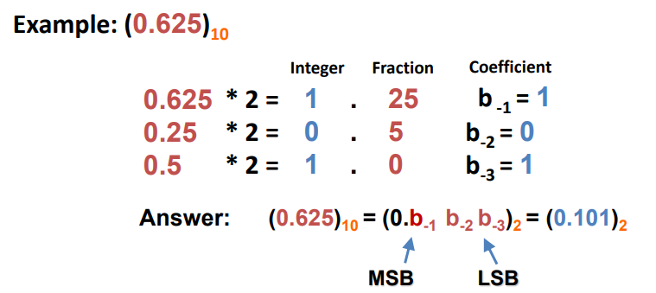
Decimal (Fraction) to Binary Conversion
• Multiply the number by the „Base‟ (=2)
• Take the integer (either 0 or 1) as a coefficient
• Take the resultant fraction and repeat the division

Slide 23
Types of Number Representation
There are 3 types
• These are used to represent the numbers in digital computer or any other digital hardware.
• Fixed Point Representation
• Floating Point Representation
• Block Floating Point Representation

Slide 24
Fixed Point Representation
• In this arithmetic the position of the binary point is fixed.
• The bit to the right represent --Fractional part
• The bit to the left represent -- Integer Part (eg) The binary number 01.1100 has the value 1.75 in decimal
• The negative numbers are represented gives three different forms for fixed point arithmetic
• Sign-Magnitude form
• One‟s complement form
• Two‟s complement form

Slide 25
Sign-Magnitude form
The most significant digit is set to 1 to represent the negative sign.
(eg)
• The decimal number -1.75 is represented as 11.110000
• 1.75 is represented as 01.110000

Slide 26
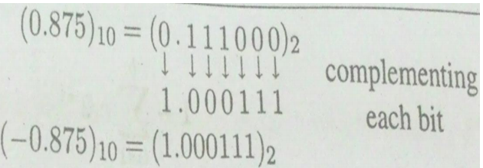
One’s complement form
• Here the positive number is represented as in the sign-magnitude notation
. • The negative number is obtained by complementing all the bits of the positive number. (0.875)10 = (0.111000)2 (-0.875)10 = (1.000111)2

Slide 27
Two’s complement form
Here the positive numbers are represented as in the sign-magnitude and one‟s complement.
• The negative number is obtained by complementing all the bits of the positive number and adding one to the least significant bit.

Slide 28
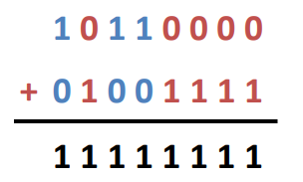
Complements
1’s Complement (Diminished Radix Complement)
– All ‘0’s become ‘1’s
– All ‘1’s become ‘0’s
Example (10110000)2
(01001111)2 If you add a number and its 1’s complement …

Slide 29
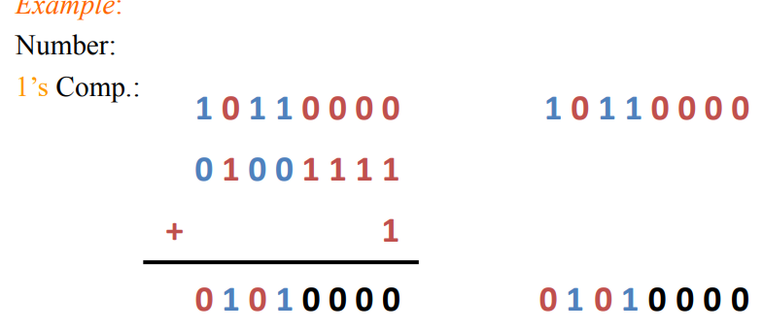
Complements
• 2‟s Complement (Radix Complement) – Take 1‟s complement then add 1
– Toggle all bits to the left of the first „1‟ from the right

Slide 30
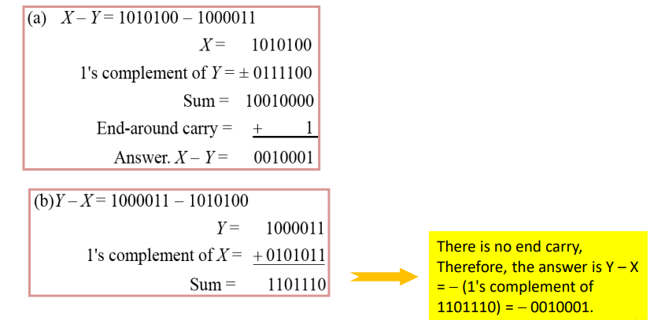
Complements
Subtraction of unsigned numbers can also be done by means of the (r - 1)'s complement.
• using 1's complement

Slide 32
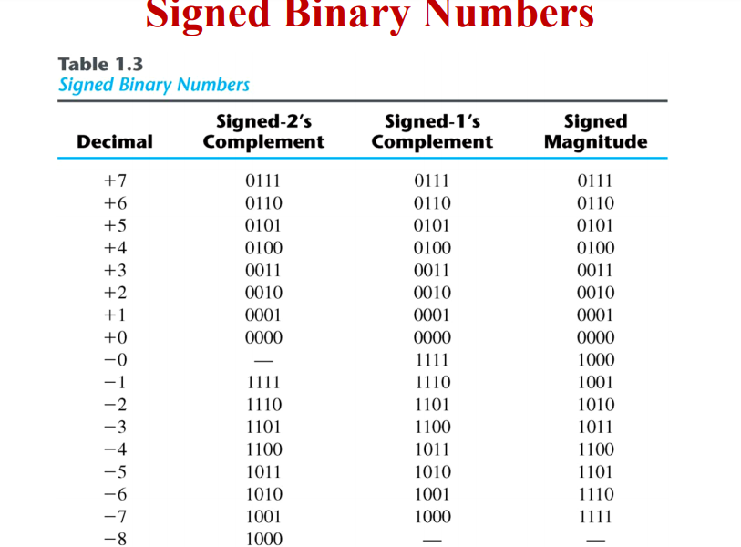

Slide 33
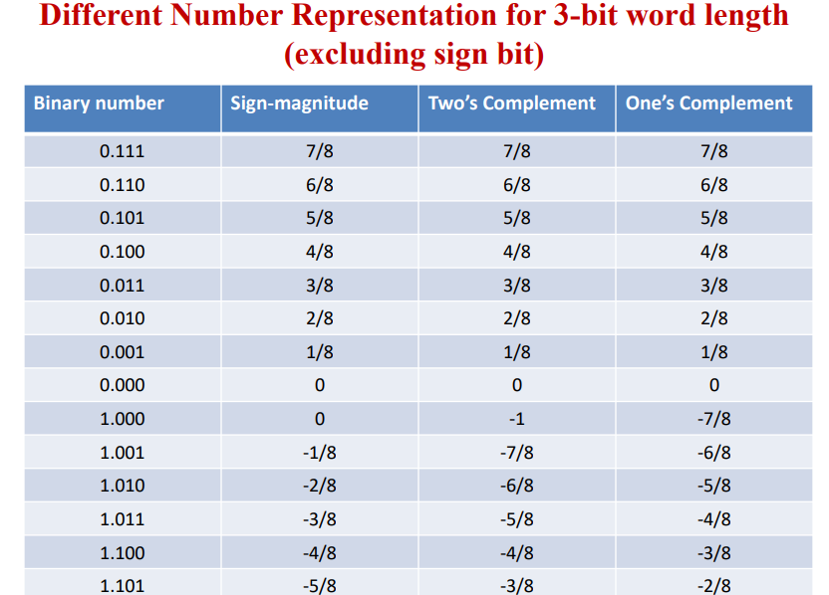

Slide 35
■

Slide 41
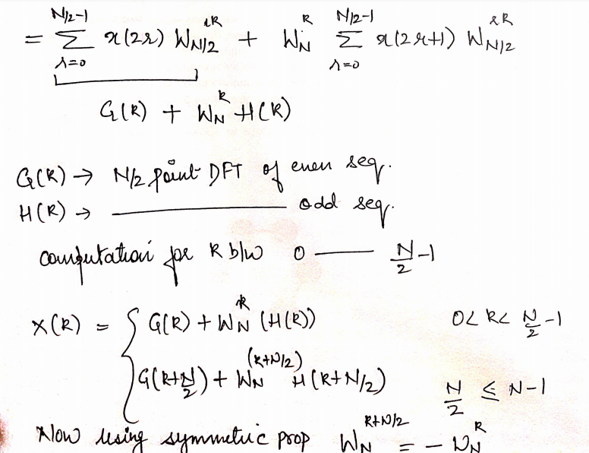

Slide 42
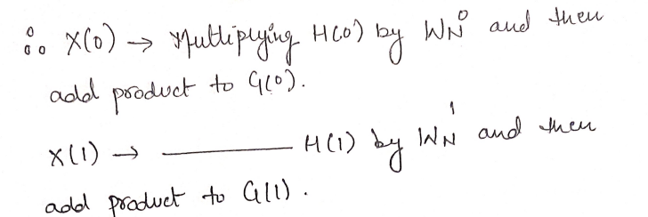

Slide 43
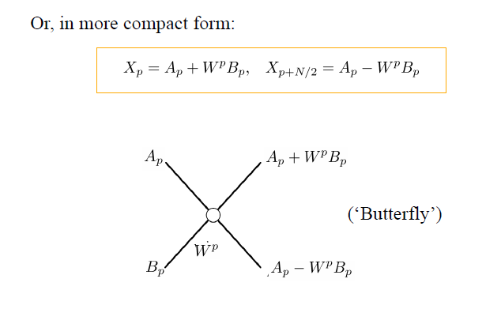
FFT Derivation - Butterfly

Slide 44
FFT algorithm provides speed increase factors, when compared with direct computation of the DFT, of approximately 64 and 205 for 256 point and 1024 point transforms respectively.
■ The number of multiplications and additions required to compute N-point DFT using radix-2 FFT are Nlog2N and N/2 log2N respectively.

Slide 47
Decimation in time
DIT algorithm is used to calculate the DFT of a N-point sequence.
■ The idea is to break the N-point sequence into two sequences, the DFTs of which can be obtained to give the DFT of the original N-point sequence.
■ Initially the N-point sequence is divided into N/2-point sequences xe(n) and x0(n) , which have even and odd numbers of x(n) respectively.

Slide 48
Decimation-In-Time

Slide 49
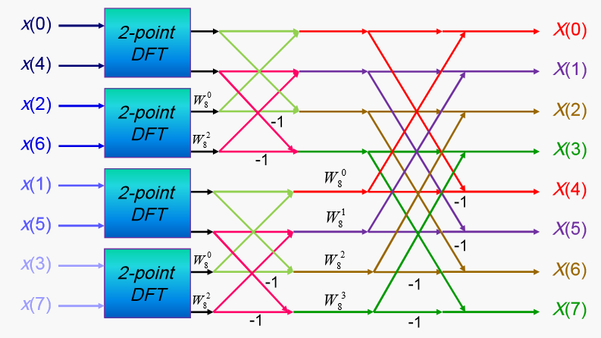

Slide 50
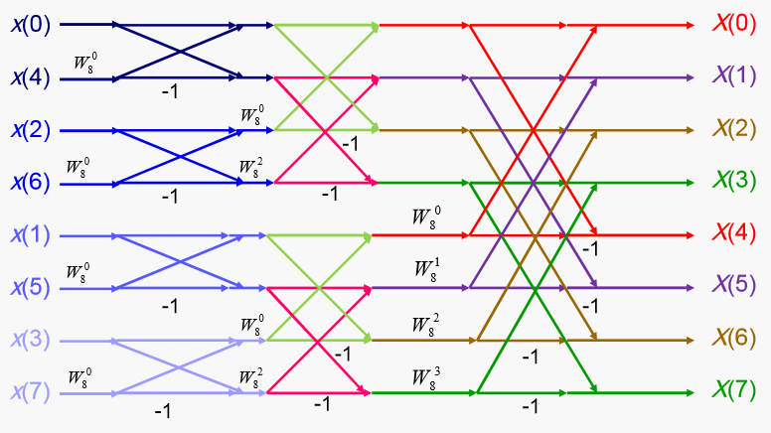

Slide 51
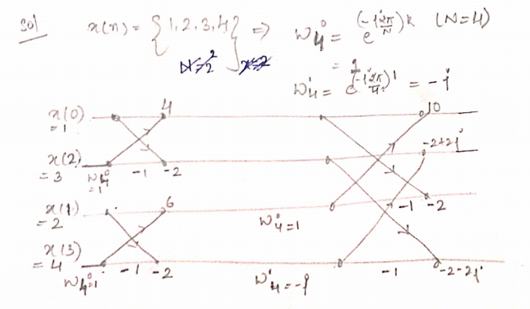

Slide 52
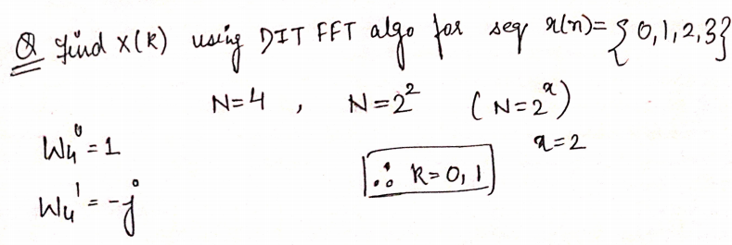
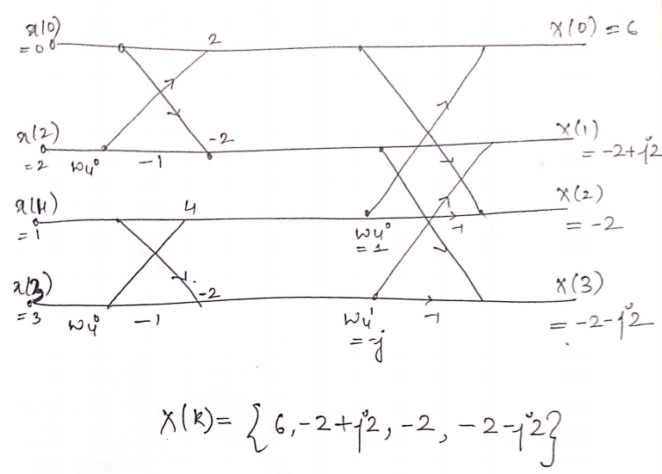

Slide 53
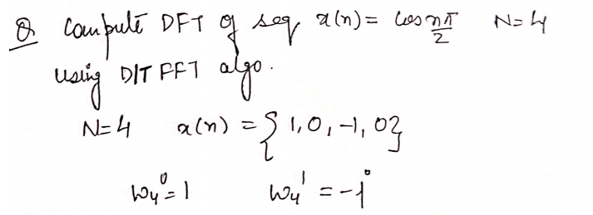

Slide 54
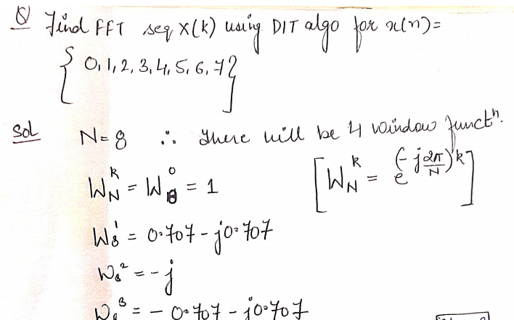

Slide 55
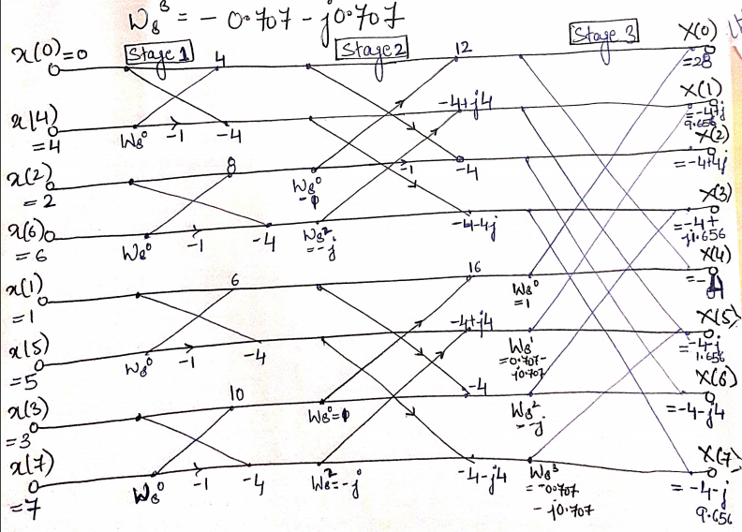

Slide 56
Numerical on 8 point FFT(DIT)
Given x(n)={1,2,3,4,4,3,2,1}, find X(k) using DIT algorithm

Slide 57
Decimation-In-Frequency
It is a popular form of FFT algorithm.
■ In this the output sequence x(k) is divided into smaller and smaller subsequences, that is why the name decimation in frequency,
■ Initially the input sequence x(n) is divided into two sequences x1(n) and x2(n) consisting of the first n/2 samples of x(n) and the last n/2 samples of x(n) respectively

Slide 58
Radix-2 DIF- FFT Algorithm

Slide 59
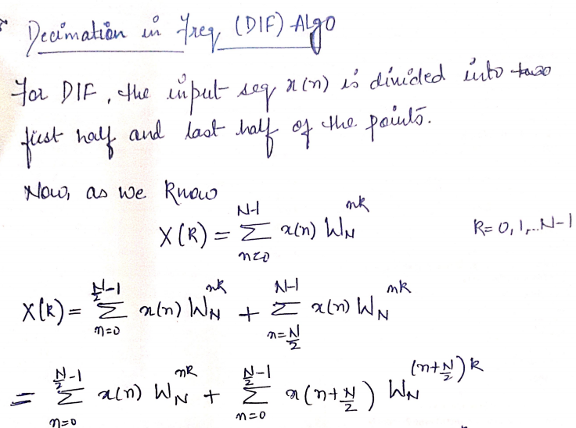

Slide 60
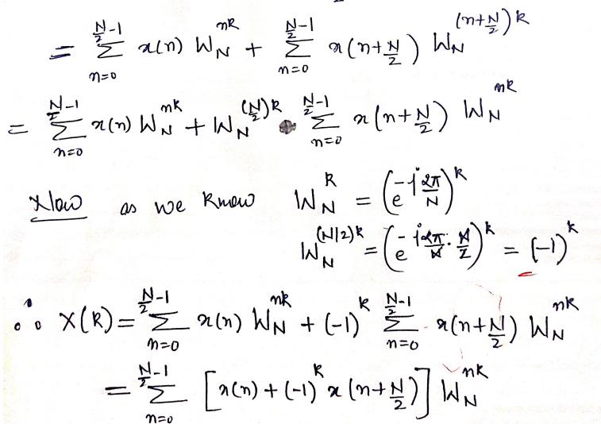

Slide 61
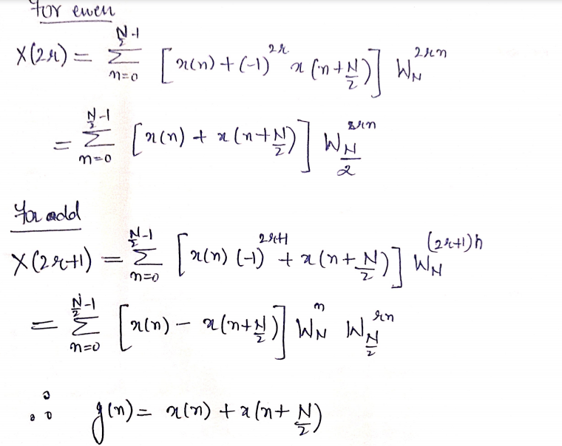

Slide 63
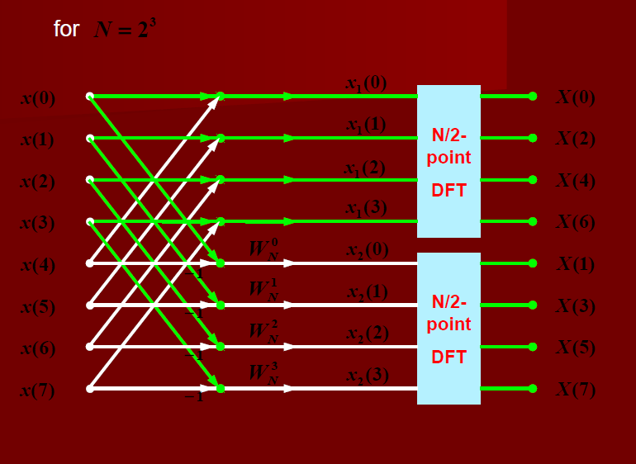

Slide 64
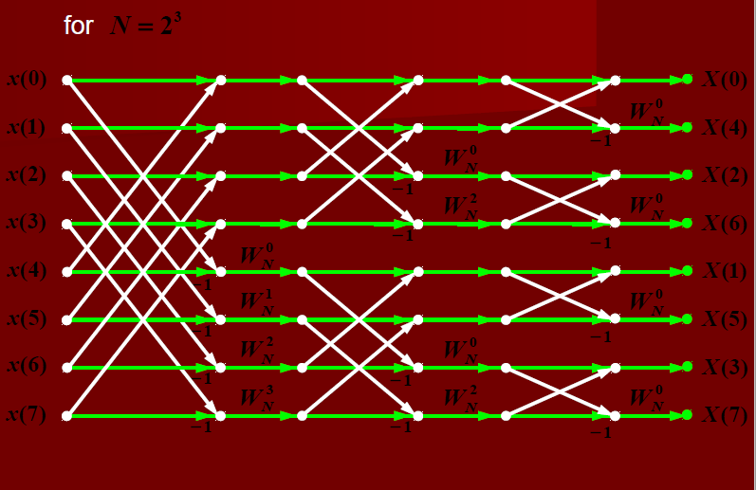

Slide 65
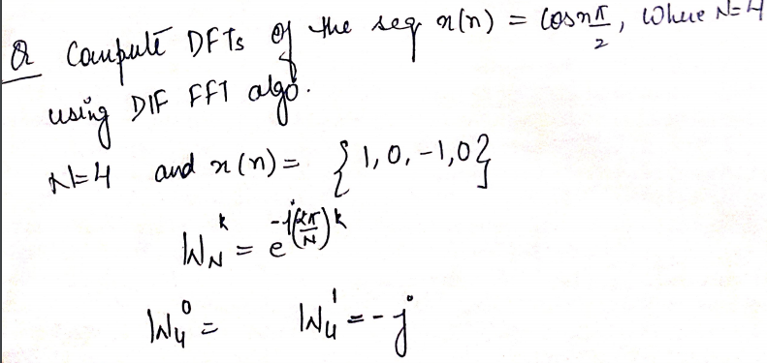
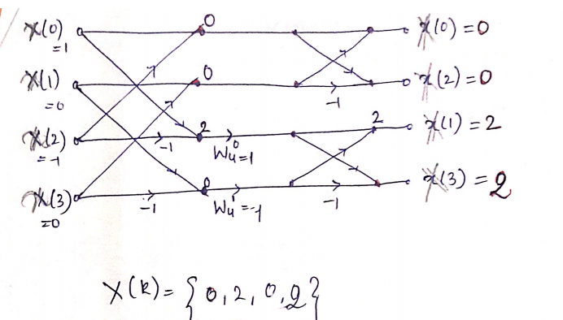

Slide 66
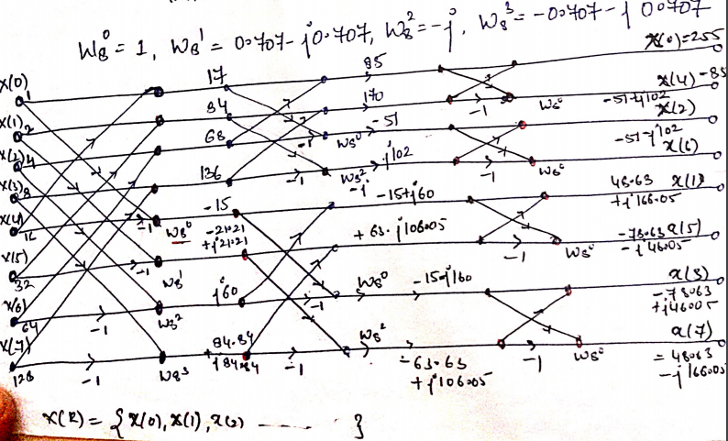

Slide 67
Radix-2 DIF- FFT Algorithm
The comparison of DIT and DIF
● The order of samples
DIT-FFT: the input is bit- reversed order and the output is natural order
DIF-FFT: the input is natural order and the output is bit reversed order
● The butterfly computation
DIT-FFT: multiplication is done before additions
DIF-FFT: multiplication is done after additions

Slide 68
Radix-2 DIF- FFT Algorithm
Both DIT-FFT and DIF-FFT have the identical computation complexity. i.e. for , there are total L stages and each has N/2 butterfly computation. Each butterfly computation has 1 multiplication and 2 additions.
● Both DIT-FFT and DIF-FFT have the characteristic of in-place computation.
● A DIT-FFT flow graph can be transposed to a DIFFFT flow graph and vice versa.

Slide 71
Thank you!

