Slide 1
ANALOG CIRCUITS (4ECU2) IV-Semester (ECE) UNIT-III
Dr. Vinita Mathur (Asso. Prof.)
Electronics and Communication Engg.
JECRC. Jaipur (Raj), India
Email:- vinitamathur.ece@jecrc.ac.in

Slide 2
Vision of JECRC
To become a renowned center of outcome based learning, and work towards academic, professional, cultural and social enrichment of the lives of individuals and communities.
Mission of JECRC
Focus on evaluation of learning outcomes and motivate students to inculcate research aptitude by project based learning.
Identify, based on informed perception of Indian, regional and global needs, areas of focus and provide platform to gain knowledge and solutions.
Offer opportunities for interaction between academia and industry.
Develop human potential to its fullest extent so that intellectually capable and imaginatively gifted leaders can emerge in a range of professions.

Slide 3
Vision of the Department
To contribute to the society through excellence in scientific and technical education, teaching and research aptitude in Electronics and Communication Engineering to meet the needs of Global Industry.
Mission of the Department
M1: To equip the students with strong foundation of basic sciences and domain knowledge of ECE, so that they are able to creatively their knowledge to the solution of problems arising in their career path.
M2: To induce the habit of lifelong learning to continuously enhance overall performance.
M3: Students are able to communicate their ideas clearly and concisely so that they can work in team as well as an individual.
M4: To make the students responsive towards the ethical, social, environmental and in economic context for the society.

Slide 4
Course Outcomes
1. Understand the characteristics of diodes and transistors.
2. Design and analyze various rectifiers and amplifiers circuits.
3. Design sinusoidal and non-sinusoidal oscillators.
4. Understanding the functioning of OP-AMP and design OP-AMP based circuits.
5. Understanding the designing of ADCs and DACs.

Slide 5
Disclaimer
The contents used in this presentation are taken from the text books mentioned in the references. I do not hold any copyrights for the contents. It has been prepared to use in the class lectures, not for commercial purpose.

Slide 6
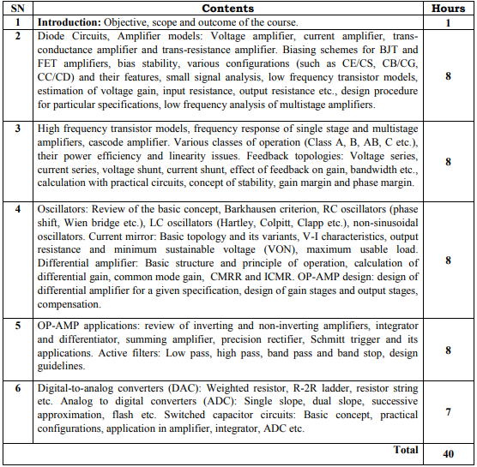

Slide 7
Text Books
Text Books: |  | T1: A.S. Sedra and K.C. Smith, Microelectronic Circuits, 5th Edition, Oxford University Press T2: R.L. Boylestad and L. Nashelsky, Electronic Devices and Circuit Theory, 9th Edition, Prentice Hall of India. T3: J. Millman and C.C. Halkias, Inegrated Electronics: Analog and Digital Circuts and Systems T4: R.A. Gayakwad, Op- amps and Linear Integrated Circuits, 4th Edition, Pearson.

Slide 8
What is an Oscillator
An oscillator provides a source of repetitive A.C. signal across its output terminals without needing any input (except a D.C. supply). The signal generated by the oscillator is usually of constant amplitude.
The wave shape and amplitude are determined by the design of the oscillator circuit and choice of component values.
The frequency of the output wave may be fixed or variable, depending on the oscillator design.

Slide 9
Definition:
An oscillator is basically a signal generator that produces a sinusoidal or non-sinusoidal signal of some particular frequency. Oscillators find their various applications as these are the fundamental component of any electrical and electronic circuits.
Continuous oscillations are the basis of working of an oscillator. Sometimes, an oscillator is said to be an amplifier with positive feedback. Or more specifically, a feedback amplifier with an open loop gain equal to or somewhat greater than 1.

Slide 10
At the time of defining, we say oscillators are generators. But more specifically, oscillators are energy converter that transforms dc energy into equivalent ac energy. The frequency ranges of the ac signal at the output of oscillator ranges from a few Hz to several GHz.
We are already aware of the fact that an amplifier needs ac input signal that is amplified and achieved at the output of the amplifier. However, oscillator simply requires dc voltage in order to produce ac signal of desired frequency.

Slide 11
The oscillator is mainly classified on the basis of the signal generated at its output:
Sinusoidal or Harmonic Oscillator: Here the achieved signal at the output of oscillator shows continuous sinusoidal variation as a function of time.
Non-sinusoidal or Relaxation Oscillator: In this case, the achieved signal at the output of oscillator shows a quick rise and fall at different voltage levels. Thereby generating waveforms such as a square wave, sawtooth wave etc.

Slide 12
Principle of Oscillators
The oscillator converts the direct current from the power supply to an alternating current and they are used in many of the electronic devices. The signals used in the oscillators are a sine wave and the square wave. The some of the examples are the signals are broadcasted by the radio and television transmitter, clocks which are used in the computers and in the video games.

Slide 13
Types of Oscillators
There are two types of electronic oscillator’s they are linear and nonlinear oscillators.
The linear oscillators give the sinusoidal input. The linear oscillators consist a mass m and its force in the linear in equilibrium.
The different types of oscillators are mentioned below and some of them are explained.
Phase Shift Oscillator
Wine Bridge Oscillator
Armstrong Oscillator
Crystal Oscillator
Hartley oscillator
Cross-Coupled Oscillator
Dynatron Oscillator
Meissner Oscillator
Optoelectronic Oscillator
Robinson Oscillator
Tri-Tet Oscillator

Slide 15
The amplifier basically changes the dc voltage provided by the supply into ac power. This ac signal is then given to the tank circuit through a feedback path. Further, the oscillations of the tank circuit are fed to the amplifier.
Since the amplifier amplifies the applied input at its terminal. Thus, at the output of the amplifier, amplified oscillations are achieved because of the applied dc voltage.
As we know that we have employed a positive feedback circuit over here. The reason for this is that feedback provides a part of the output to the oscillatory circuit in the correct phase so as to have sustained oscillations.

Slide 17
Suppose, V_{i} is the input applied at the terminal of the amplifier having gain A.
Also, a feedback network is used. This feedback network has the feedback fraction β.
The output of the amplifier is V_{o} and that of the feedback network is V_{f}.
Here β basically defines the fraction of output which is provided as feedback to the input.
Initially, V_{i} is applied at the terminal of the amplifier with gain A. So, at the output of the amplifier we get,

Slide 18
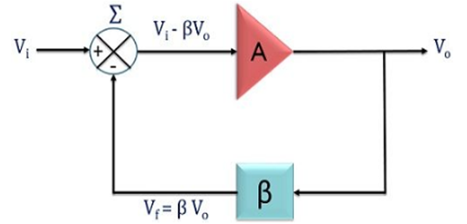
This voltage is then provided to the feedback network which is basically a resonant circuit in order to have the highest feedback at a frequency.
So, the signal achieved at the output of the feedback amplifier is given as,
Since, V_{f} = βV_{o} and V_{o} = AV_{i}
If the amplifier and feedback circuit introduces 0° phase shift. Then both feedback signal, as well as the input signal, will be in phase with each other.

Slide 19
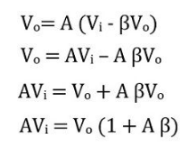
Now, when the output of the feedback circuit is provided to the amplifier along with the input.
Then, the signal at the output of the amplifier will be given as,
So, we can write, the closed loop gain of the oscillator with feedback,

Slide 20
Suppose, we provide only the output of the feedback circuit at the input of the amplifier and remove the originally applied input signal.
After the removal of V_{i}, the loop gain of the oscillator is responsible for sustained oscillations.
If the open loop gain is less than one i.e., Aβ < 1. Then after some period of time, the output will die out.
This is so because, here AβV_{i} serves as input to the amplifier, so this will be less than V_{i} and Aβ will be less than unity.

Slide 21
Hence, each time after passing the loop the amplitude of the signal will get reduced. Resultantly, oscillations will die out.
If loop gain is more than one i.e., Aβ > 1. Then it causes the output to get built up. Thus, each time on passing the loop, increase in the amplitude of the oscillations is noticed.
Now, if the loop gain is equal to one i.e., Aβ = 1. Then it causes V_{f} to be equal to V_{i}. Thus at the output, the signal will be a continuous sinusoidal waveform. In this way, the input is itself provided by the circuit and hence a sinusoidal output is achieved.

Slide 22
It is to be noted here that, initially, the loop gain is always more than 1 in order to build up the oscillations. But, once a certain voltage is reached by the signal then the loop gain now becomes 1.
This is due to the non-linear behaviour of the feedback amplifier circuit.

Slide 23
What is Barkhausen Criteria?
Barkhausen criteria state the two conditions to achieve sustained oscillations. These are given below:
1. The open loop gain which we have recently discussed must be slightly more than or equal to 1. This means Aβ ≥ 1.
2. The overall phase shift of the circuit must be 0. So, that the input and output signal will be in phase with each other.
These two conditions will provide sustained oscillations at the output of the amplifier. This is termed as Barkhausen Criteria.

Slide 24
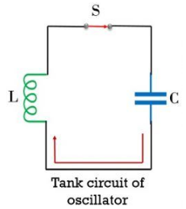
Significance of Oscillatory Circuit
Oscillatory circuit is formed by LC network, RC circuit or quartz crystal etc. In the figure here a tank circuit is represented by the parallel connection of an inductor and capacitor:

Slide 25
In the open switch condition, the operation of the circuit will not proceed. However, once the switch is closed, then the operation of the circuit starts.
When the switch gets closed then the capacitor in the circuit begins discharging. Due to discharging of the charged capacitor, electrons start moving through the circuit. The flow of electrons generates current in the circuit but in the direction opposite to the movement of electron flow.

Slide 26
Due to this flow of current through the inductor, flux linkage is noticed. This resultantly produces magnetic field near inductor. Thereby storing power/energy in the inductor as a magnetic field. This stored energy in the inductor generates emf.
Due to the generated emf, current will again begin to flow through the circuit. Thus, charges will flow and the capacitor will ultimately get charged and holds energy in the form of the electrostatic field.

Slide 27
This alternate charging and discharging of capacitor and inductor will produce continuous oscillations.
It is to be noted here that the circuit generates damped oscillations. The figure below shows the waveform in case of damped oscillations:

Slide 28
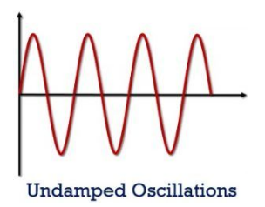
Here, we can see that the amplitude of the sinusoidal oscillations is not equal. This is due to the presence of losses in the inductor and capacitor.
The figure below shows the waveform for Undamped oscillations:
Basically, the oscillator is supposed to provide such oscillations but this does not happen exactly.

Slide 29
Frequency of the Oscillator circuit
It is also called as Resonant frequency. It is basically defined as the frequency of oscillations. Usually, the particular frequency at which the oscillator is set initially is not maintained over the entire cycle of oscillations.
This is so because, these resistor, inductor and capacitor show variation with the increase in circuit temperature.

Slide 30
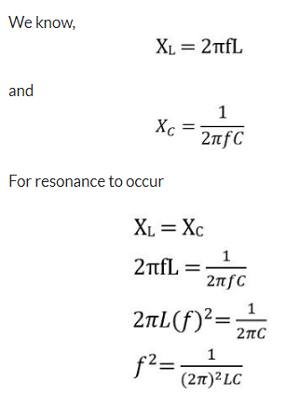
Therefore, there exists a formula for the resonant frequency of oscillator:
The expression for the resonant frequency of a tuned LC circuit

Slide 31
Advantages of Oscillator
An oscillator is durable equipment. As it does not rotate and hence there are chances of fewer damages to get introduced.
The oscillating frequency is easily adjustable.
The frequency of oscillation exhibits stable behaviour.
It is less noisy.
It is a highly efficient device.

Slide 32
Applications of Oscillator
Oscillators are widely used in numerous circuits like in amplitude and frequency modulating circuits, in super heterodyne receivers etc. These are used to produce clock signals.

Slide 34
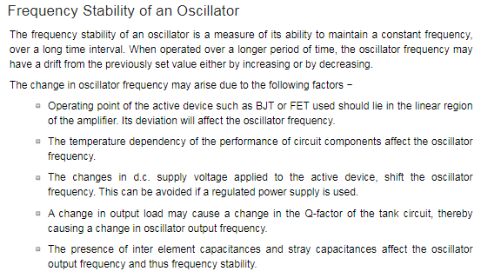

Slide 36
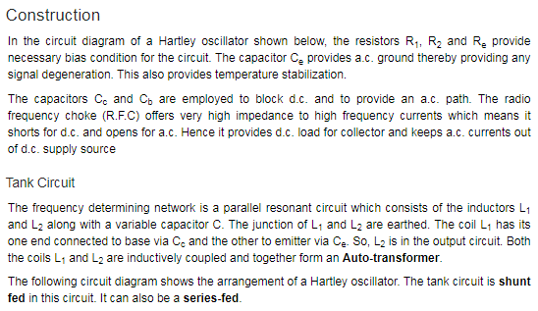

Slide 37
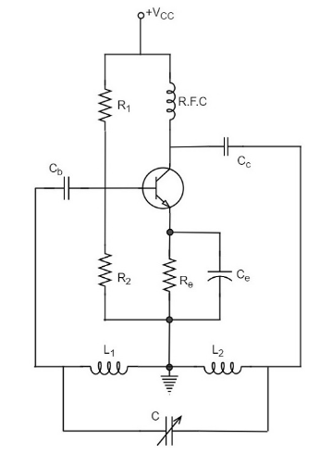

Slide 38
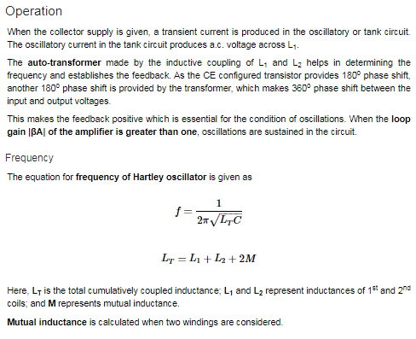

Slide 39
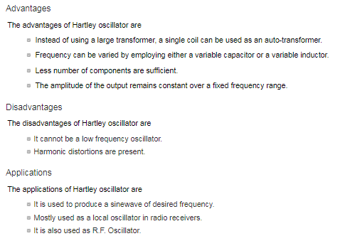

Slide 40
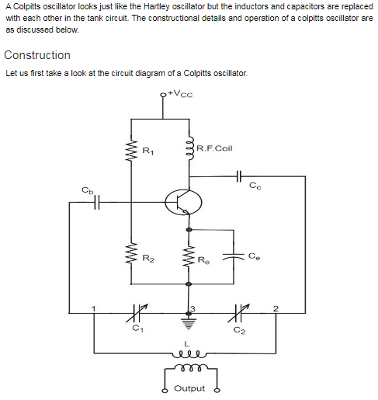

Slide 41
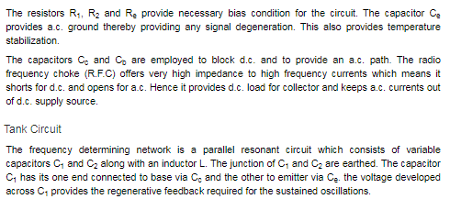
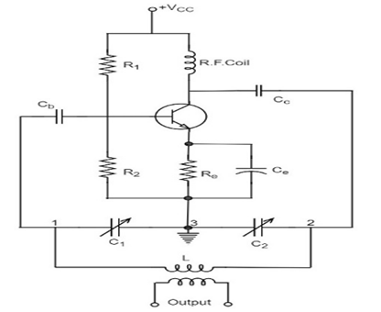

Slide 42
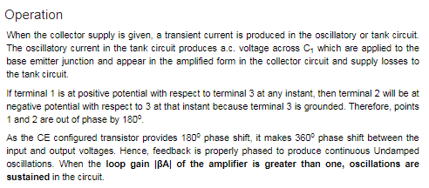

Slide 43
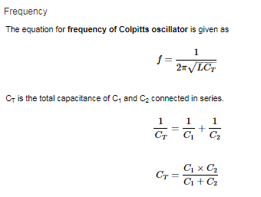

Slide 44
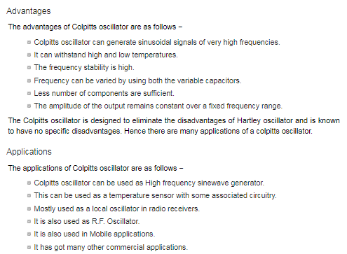

Slide 45
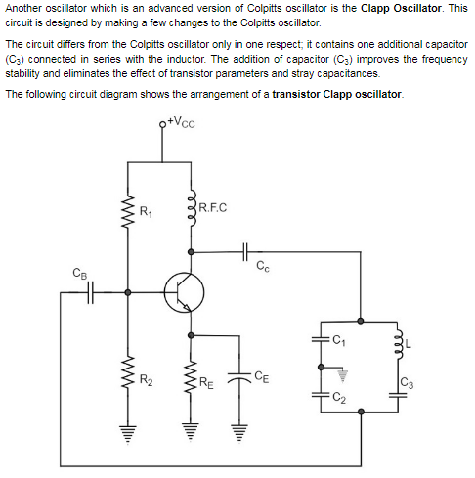

Slide 46
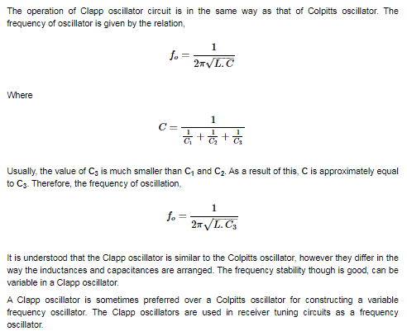

Slide 48
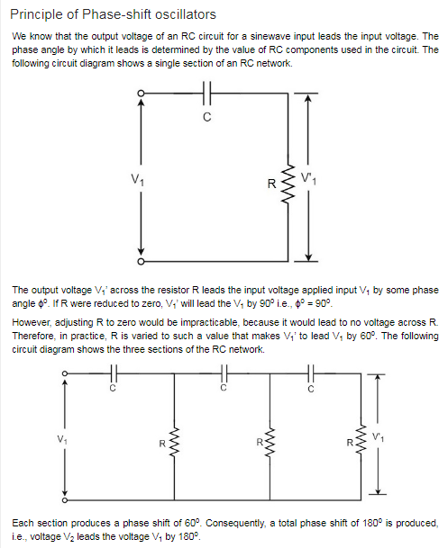

Slide 49
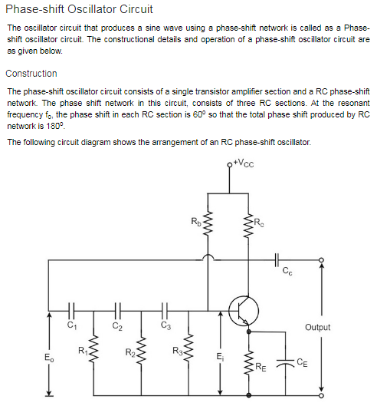

Slide 50
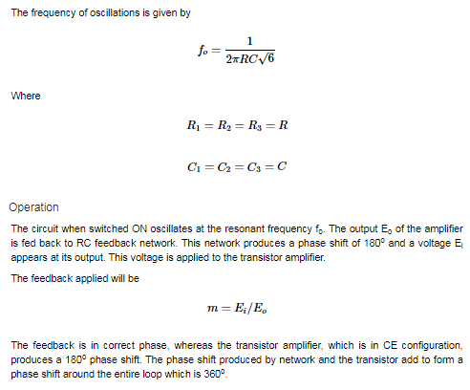

Slide 51
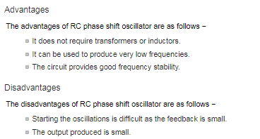

Slide 53
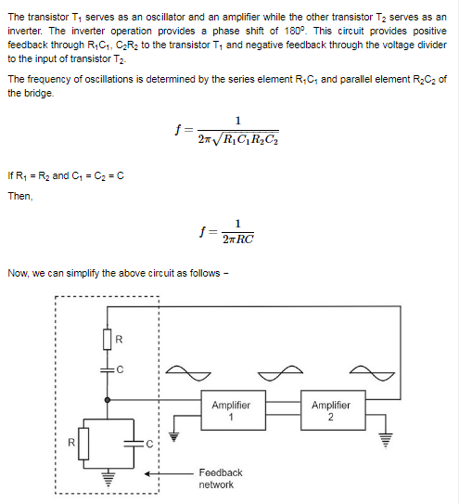

Slide 54
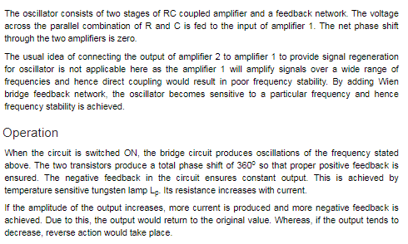

Slide 55
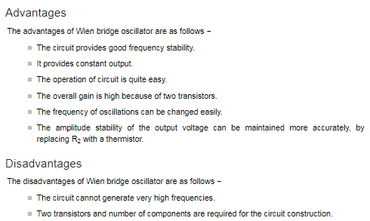

Slide 56
https://www.youtube.com/watch?v=VKtEzKcg6_s
https://www.apogeeweb.net/article/147.html
https://www.instructables.com/How-to-Make-a-Signal-Generator-Learn-to-Generate-E/
https://www.instructables.com/Function-Generator/

Slide 57
Current Mirror
The Current Mirror is a widely popular technique for monolithic IC design.
In this technique, the circuit is designed in such a way that it copies the current through one active device to another active device with current control feature.
In this, the current is flowing through one device can be copied into another device but in inverting form.
If the current of the first device is changed, the mirrored current output of the other device will also change. So by controlling the current in one device, the current in another device can also be controlled.
Thus the current mirror circuit is often referred to a Current Controlled Current Source or CCCS.

Slide 58
Characteristic and Dependency of Current Mirror Circuit
A current mirror circuit has lots of primary and secondary dependencies and that is the main concern to characterize current mirror circuit.
A proper current mirror circuit can be characterized using three specifications.
1. Current Transfer Ratio
A current mirror circuit, mirror or copy the input current of one active device to the other active devices output. An ideal current mirror circuit is an ideal current amplifier with the inverting configuration that can reverse the current direction. Therefore, for an ideal current amplifier, the current transfer ratio is an important parameter.
2. AC output resistance
Resistance has a voltage-current relationship as per the ohms law. Thus, AC output resistance plays a major role in the stability of output current with respect to voltage changes.

Slide 59
3. Voltage drop
A proper working mirror circuit has a low voltage drop across the output. A voltage range in which a Current Mirror Circuit can work is called compliance range, and the minimum to maximum supported voltage in this compliances range is called as compliance voltage. A minimum voltage is required to keep the transistor in active mode, so the minimum voltage depends on the transistor specifications.

Slide 60
Limitations in Real Current Mirror Circuits
The ideal circuit and the real circuit, these two are completely different. In the real world, there is nothing called perfect or ideal. However, before understanding the limitations of current mirror circuits with respect of real-world applications, one needs to understand the voltage and current source and their ideal and actual behaviors.

Slide 61
A voltage source is a device which is capable to provide fixed and stable voltage to the load.
In ideal terminology, the voltage source will provide a fixed voltage constantly without being dependent on the load current. Therefore, we can connect any load resistance across the ideal voltage source and get a stable and fixed voltage every time.
This is not the case in real-world voltage source. In the real world, voltage sources like batteries, power supplies etc could not provide unlimited or infinite current to the loads.
Same as like the ideal voltage source, irrespective of the terminal voltage the current source can deliver or accept currents. But in the real world, the voltage also affects the constant current delivery process.

Slide 62
In the case of current mirror circuits, the voltage and current sources are ideal.
But in a real scenario they have noises, tolerance, ripples thus the output voltage varies. This all affects the current mirror output.
Not only this, but theoretically in ideal current mirror circuits, the AC impedance is accepted as infinite, but this is not the case in real world scenario.
The current mirror circuit in the practical world has finite impedance which affects the current delivery process. Also the circuit implementation creates parasitic capacitance which results in frequency limitation.

Slide 63
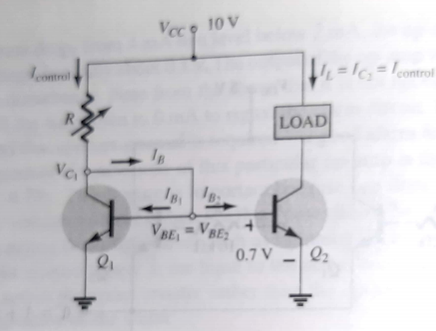

Slide 64
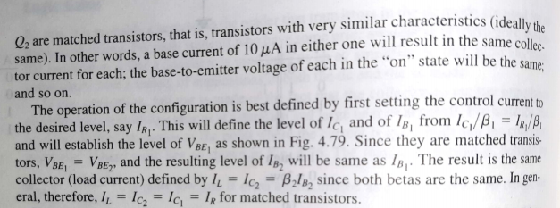

Slide 66
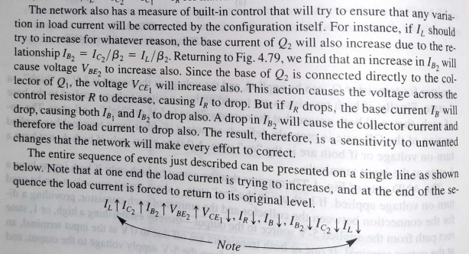

Slide 67
Differential Amplifiers

Slide 68
Definition: Differential Amplifier is a device that is used to amplify the difference in voltage of the two input signals. Differential Amplifier is an important building block in integrated circuits of analog system.
It typically forms input stages of operational amplifiers. In simple words, we can say It is a device that amplifies the difference of 2 input signals.

Slide 69
Where
V₀ is the output voltage
V₁ and V₂ are the input voltages
A_{d} is the gain of the amplifier (i.e. the differential amplifier gain)

Slide 70
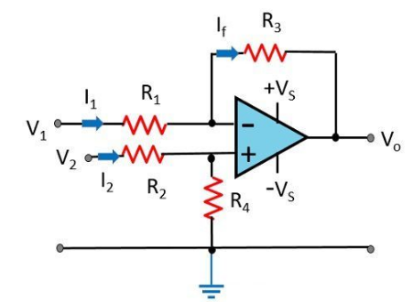
Here, the voltage difference present at the inverting and non-inverting terminal gets amplified and thus an amplified output is received. Because of input configuration, all op-amps are considered to be differential amplifiers.
When two inputs are applied at the two terminals the voltage difference produced resultantly will be proportional to the difference of the two applied input signals.
Differential amplifier behaves as subtractor circuit, that basically subtracts the two input signal.
The differential amplifier can be constructed by making use of BJTs and FETs.

Slide 71
There are two different types of differential amplifier circuits:
BJT Differential Amplifier – This is a differential amplifier built using transistors, either Bipolar Junction Transistors(BJTs) or Field Effect Transistors (FETs)
Opamp Differential amplifiers built using Operational Amplifiers

Slide 72
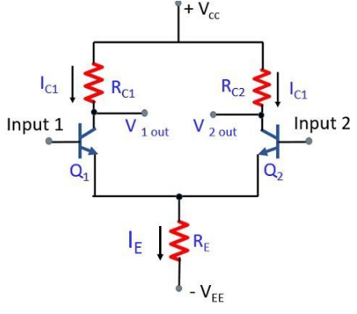
Circuit of Differential Amplifier
As we can see in the circuit diagram there are two inputs and two outputs are used. Here, two separate transistor Q₁ and Q₂ are employed so as to apply separate inputs at the base of both the transistor.

Slide 73
The two separate transistors possess similar characteristics ideally. Common emitter resistor R_{E}, common positive supply V_{CC} and common negative supply V_{EE} is shared by both the transistors.
Now, the thing that comes to our mind is how can we apply signals at the input and get the output.

Slide 74
There are mainly four configurations:
Dual Input Balanced Output- In this configuration two inputs are given an output is taken from both the transistors.
Dual Input Unbalanced Output- The input is given to both the transistors but the output is taken from a single transistor.
Single Input Balanced Output- Here, by providing single input we take the output from two separate transistors.
Single Input Unbalance Output- It is a type of configuration in which a single input is given an output is taken from only a single transistor.

Slide 75
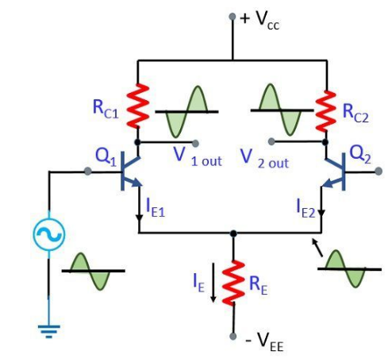
Working of Differential Amplifier
Let us see the First case where
A signal is applied at the base of transistor Q₁ and no any signal is applied at the base of transistor Q_{2.}

Slide 76
Here, Q₁ acts in two ways: firstly, as common emitter amplifier, by which applied input at Q₁ will provide an amplified inverted signal at output 1.
Secondly, as common collector amplifier, in which the signal appears at the emitter of Q₁ which is in phase with the input and slightly smaller.
So, the input signal at the base of Q₁ drives the transistor i.e., Q₁ turns ON by the positive input signal. The voltage drop across R_{C1} will be more resulting the collector of Q₁ to be less positive.
When the input signal is negative, transistor Q₁ will get OFF resulting in less voltage drop across R_{C1} causing collector of Q₁ to be more positive.

Slide 77
In this way, an inverted output appears at the collector of Q₁ by applying the signal at input 1.
At the time when Q₁ gets ON by positive half of input, the current through R_{E} will increase as we know I_{C} ≈ I_{E}. So, the voltage drop at R_{E} will be more thus causing the emitters of both the transistors to go in the positive direction.
This Q₂ emitter positive will cause the base of Q₂ to be negative. This negative half will cause less current in Q₂. Resultantly voltage drop at R_{C2} will also be less thus the collector goes in the positive direction.
In this way, we will have a non-inverting output at the collector of Q₂ for positive input at the base of Q₁.

Slide 78
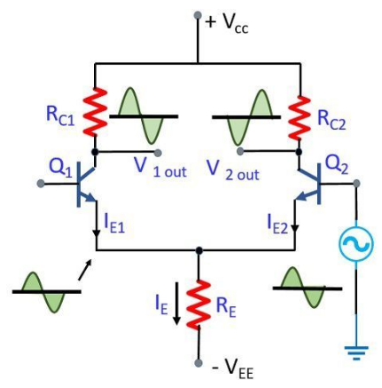
Now, moving further to our Second case-
Suppose the signal is now applied to the base of transistor Q₂ and transistor Q₁ is grounded.
So, in this condition the above-discussed case will get interchanged i.e., now Q₂ will behave as common emitter and common amplifier and Q₁ will act as a common base amplifier.
Hence, an inverted and amplified output will be received at the output of Q₁ and at the output of Q₂ we will have a non-inverted amplified output.

Slide 79
What are Common-Mode Signals?
In a differential amplifier, the voltage generated at the output is proportional to the difference of the two input signals. So, when the two applied inputs are equal i.e., there is no difference between the two input voltage the resulting output voltage will be 0.
But practically when two similar inputs are applied at both the input terminal, the output does not exactly equal to 0.
The output in case of common mode signal is of the order of several 100 µV.

Slide 80
Important Key terms
Voltage Gain: When we talk about common mode gain
Here, V_{c} is the value of common input applied at both the input terminal and Vo is the output signal.
CMMR: CMMR stands for Common Mode Rejection Ratio, it is given as the ratio of differential mode gain to the common mode gain.
In dB

Slide 81
For an ideal amplifier CMMR should be practically infinite but in actual practice, it is not so and has a finite value.
It is defined as the ratio of the desired signal to the undesired signal. The larger the CMMR the better is the amplifier.
Differential amplifier provides excellent bias stability because of use of emitter current bias.

Slide 82
Advantages of Differential Amplifier
Noise immunity: When we use a differential amplifier, it responds to the only difference signal between input terminals and ignores all common mode signals such as noise pick-up and ground voltages.
Drift Immunity: One major problem that arises in amplifiers is the change in voltage levels or value by the effect of temperature. These changes occur slowly and are known as drift. Differential amplifiers exhibit tremendous ability to eliminate the problem of drift.

