Slide 1
ANALOG CIRCUITS (4ECU2) IV-Semester (ECE) Unit II
Dr. Vinita Mathur (Asso. Prof.)
Electronics and Communication Engg.
JECRC. Jaipur (Raj), India
Email:- vinitamathur.ece@jecrc.ac.in

Slide 2
Vision of JECRC
To become a renowned center of outcome based learning, and work towards academic, professional, cultural and social enrichment of the lives of individuals and communities.
Mission of JECRC
Focus on evaluation of learning outcomes and motivate students to inculcate research aptitude by project based learning.
Identify, based on informed perception of Indian, regional and global needs, areas of focus and provide platform to gain knowledge and solutions.
Offer opportunities for interaction between academia and industry.
Develop human potential to its fullest extent so that intellectually capable and imaginatively gifted leaders can emerge in a range of professions.

Slide 3
Vision of the Department
To contribute to the society through excellence in scientific and technical education, teaching and research aptitude in Electronics and Communication Engineering to meet the needs of Global Industry.
Mission of the Department
M1: To equip the students with strong foundation of basic sciences and domain knowledge of ECE, so that they are able to creatively their knowledge to the solution of problems arising in their career path.
M2: To induce the habit of lifelong learning to continuously enhance overall performance.
M3: Students are able to communicate their ideas clearly and concisely so that they can work in team as well as an individual.
M4: To make the students responsive towards the ethical, social, environmental and in economic context for the society.

Slide 4
Course Outcomes
1. Understand the characteristics of diodes and transistors.
2. Design and analyze various rectifiers and amplifiers circuits.
3. Design sinusoidal and non-sinusoidal oscillators.
4. Understanding the functioning of OP-AMP and design OP-AMP based circuits.
5. Understanding the designing of ADCs and DACs.

Slide 5
Disclaimer
The contents used in this presentation are taken from the text books mentioned in the references. I do not hold any copyrights for the contents. It has been prepared to use in the class lectures, not for commercial purpose.

Slide 6
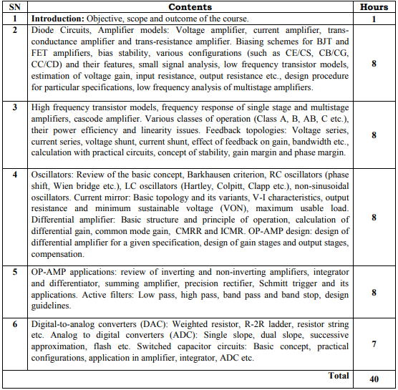

Slide 7
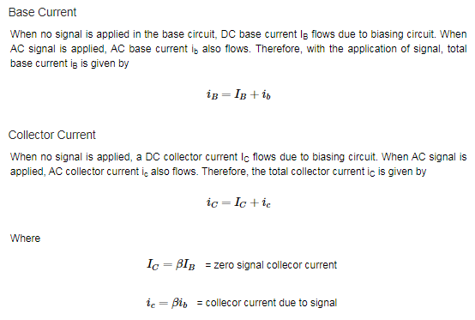
Various Circuit currents

Slide 8
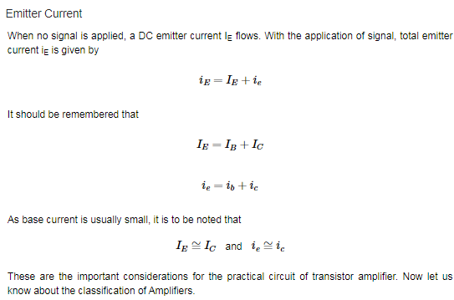

Slide 9
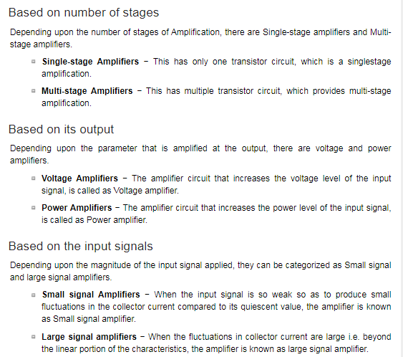

Slide 10
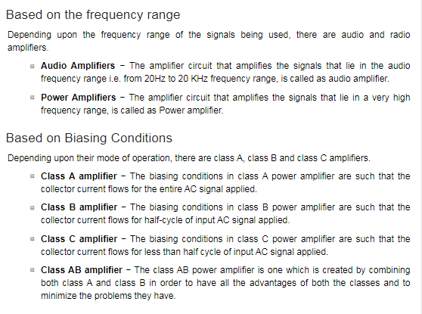

Slide 11
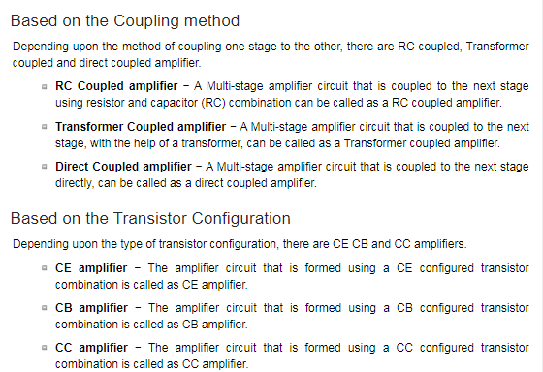

Slide 12
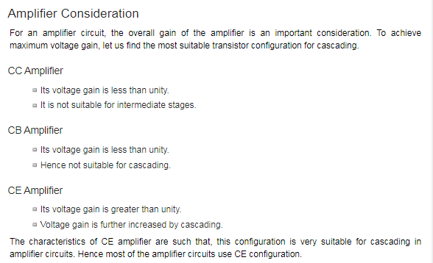

Slide 13
Amplifiers
An electronic signal contains some information which cannot be utilized if doesn’t have proper strength.
The process of increasing the signal strength is called as Amplification.
Almost all electronic equipment must include some means for amplifying the signals. We find the use of amplifiers in medical devices, scientific equipment, automation, military tools, communication devices, and even in household equipment.
Amplification in practical applications is done using Multi-stage amplifiers. A number of single-stage amplifiers are cascaded to form a Multi-stage amplifier.

Slide 14
Single-stage Transistor Amplifier
When only one transistor with associated circuitry is used for amplifying a weak signal, the circuit is known as single-stage amplifier.
Analyzing the working of a Single-stage amplifier circuit, makes us easy to understand the formation and working of Multi-stage amplifier circuits.
A Single stage transistor amplifier has one transistor, bias circuit and other auxiliary components. The following circuit diagram shows how a single stage transistor amplifier looks like.

Slide 15
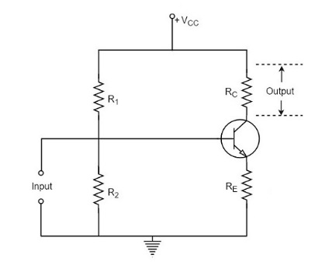
When a weak input signal is given to the base of the transistor as shown in the figure, a small amount of base current flows. Due to the transistor action, a larger current flows in the collector of the transistor. (As the collector current is β times of the base current which means I_{C} = βI_{B}). Now, as the collector current increases, the voltage drop across the resistor R_{C} also increases, which is collected as the output.
Hence a small input at the base gets amplified as the signal of larger magnitude and strength at the collector output. Hence this transistor acts as an amplifier.

Slide 16
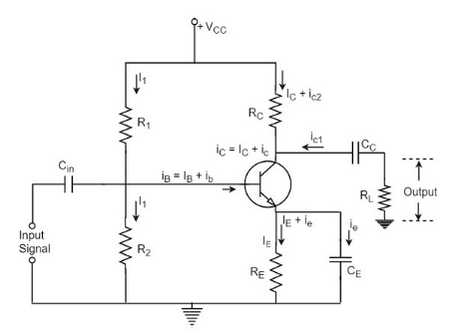
Practical Circuit of a Transistor Amplifier
The various prominent circuit elements and their functions are as described below.
Biasing Circuit
The resistors R₁, R₂ and R_{E} form the biasing and stabilization circuit, which helps in establishing a proper operating point.
Input Capacitor C_{in}
This capacitor couples the input signal to the base of the transistor. The input capacitor C_{in} allows AC signal, but isolates the signal source from R₂. If this capacitor is not present, the input signal gets directly applied, which changes the bias at R₂.

Slide 17
Coupling Capacitor C_{C}
This capacitor is present at the end of one stage and connects it to the other stage. As it couples two stages it is called as coupling capacitor. This capacitor blocks DC of one stage to enter the other but allows AC to pass. Hence it is also called as blocking capacitor.
Due to the presence of coupling capacitor C_{C}, the output across the resistor R_{L} is free from the collector’s DC voltage. If this is not present, the bias conditions of the next stage will be drastically changed due to the shunting effect of R_{C}, as it would come in parallel to R₂ of the next stage.
Emitter by-pass capacitor C_{E}
This capacitor is employed in parallel to the emitter resistor R_{E}. The amplified AC signal is by passed through this. If this is not present, that signal will pass through R_{E} which produces a voltage drop across R_{E} that will feedback the input signal reducing the output voltage.
The Load resistor R_{L}
The resistance R_{L} connected at the output is known as Load resistor. When a number of stages are used, then R_{L} represents the input resistance of the next stage.

Slide 18
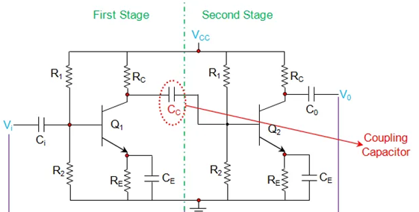
Construction of Two Stage RC Coupled Amplifier
A Resistance Capacitance (RC) Coupled Amplifier is basically a multi-stage amplifier circuit extensively used in electronic circuits. Here the individual stages of the amplifier are connected together using a resistor–capacitor combination due to which it bears its name as RC Coupled.
Figure shows such a two-stage amplifier whose individual stages are nothing but the common emitter amplifiers.

Slide 19
Hence the design of individual stages of the RC coupled amplifiers is similar to that in the case of common emitter amplifiers in which:
R₁ and R₂ form the biasing network
Emitter resistor R_{E} form the stabilization network.
C_{E} is also called bypass capacitor which passes only AC while restricting DC, which causes only DC voltage to drop across R_{E} while the entire AC voltage will be coupled to the next stage.
coupling capacitor C_{C} also increases the stability of the network as it blocks the DC while offers a low resistance path to the AC signals, thereby preventing the DC bias conditions of one stage affecting the other.

Slide 20
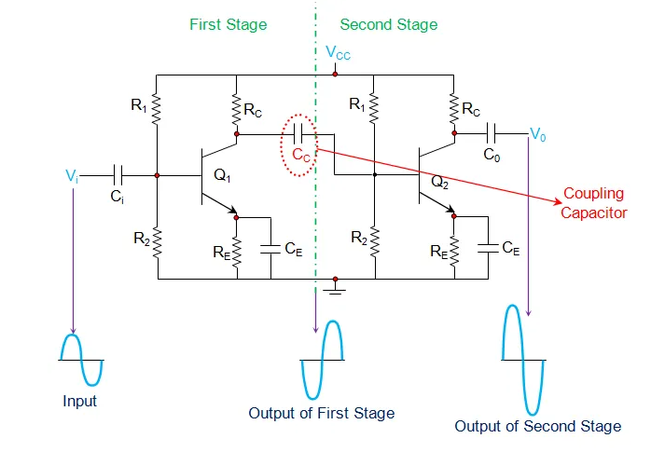

Slide 21
Working
Further, the In addition, in this circuit, the voltage drop across the collector-emitter terminal is chosen to be 50% of the supply voltage V_{CC} in order to ensure appropriate biasing point.
In this kind of amplifier, the input signal applied at the base of the transistor in stage 1 (Q₁) is amplified and appears at its collector terminal with a phase-shift of 180º.

Slide 22
The AC component of this signal is coupled to the second stage of the RC coupled amplifier through the coupling capacitor C_{C} and thus appears as an input at the base of the second transistor Q₂.
This is further amplified and is passed-on as an output of the second stage and is available at the collector terminal of Q₂ after being shift by 180º in its phase.
This means that the output of the second stage will be 360º out-of-phase with respect to the input, which in turn indicates that the phase of the input signal and the phase of the output signal obtained at stage II will be identical.

Slide 23
Further it is to be noted that the cascading of individual amplifier stages increases the gain of the overall circuit as the net gain will be the product of the gain offered by the individual stages.
In addition, it is important to note that by following the pattern exhibited by Figure, one can cascade any number of common emitter amplifiers but by keeping in mind that when the number of stages are even, the output will be in-phase with the input while if the number of stages are odd, then the output and the input will be out-of-phase.

Slide 24
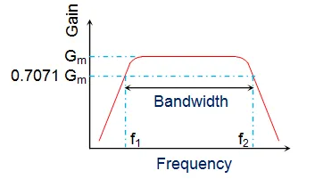
The frequency response of a RC coupled amplifier (a curve of amplifier’s gain v/s frequency), shown by Figure, indicates that the gain of the amplifier is constant over a wide range of mid-frequencies while it decreases considerably both at low and high frequencies.
This is because, at low frequencies, the reactance of coupling capacitor C_{C} is high which causes a small part of the signal to couple from one stage to the other. Moreover for the same case, even the reactance of the emitter capacitor C_{E} will be high due to which it fails to shunt the emitter resistor R_{E} effectively which in turn reduces the voltage gain.

Slide 25
On the other hand, at high frequencies, the reactance of C_{C} will be low which causes it to behave like a short circuit. This results in an increase in the loading effect of the next stage and thus reduces the voltage gain. In addition to this, for this case, the capacitive reactance of the base-emitter junction will be low.
This results in a reduced voltage gain as it causes the base current to increase which in turn decreases the current amplification factor β.
However, in mid-frequency range, as the frequency increases, the reactance of C_{C} goes on decreasing which would lead to the increase in gain if not compensated by the fact that the reduction in reactance leads to an increase in the loading effect. Due to this reason, the gain of the amplifier remains uniform/constant throughout the mid-frequency band.

Slide 26
The advantages of a RC coupled amplifier include:
1. Cheap, economical and compact as it uses only resistors and capacitors.
2. Offers a constant gain over a wide frequency band.
Disadvantages of RC Coupled Amplifier
1. Unsuitable for low-frequency amplification.
2. Low voltage and power gain as the effective load resistance (and hence the gain) is reduced due to the fact that the input of each stage presents a low resistance to its next stage.
3. Moisture-sensitive, making them noisy as time elapses.
4. Poor impedance matching as it has the output impedance several times larger than the device at its end-terminal (for example, a speaker in the case of a public address system).
5. Narrow bandwidth when compared to JFET amplifier.

Slide 27
Applications of RC Coupled Amplifier
The applications of a RC coupled amplifier include:
1. RF Communications.
2. Optical Fiber Communications.
3. Public address systems as pre-amplifiers.
4. Controllers.
5. Radio or TV Receivers as small signal amplifiers.

Slide 28
We have observed that the main drawback of RC coupled amplifier is that the effective load resistance gets reduced. This is because, the input impedance of an amplifier is low, while its output impedance is high.
When they are coupled to make a multistage amplifier, the high output impedance of one stage comes in parallel with the low input impedance of next stage. Hence, effective load resistance is decreased. This problem can be overcome by a transformer coupled amplifier.
In a transformer-coupled amplifier, the stages of amplifier are coupled using a transformer. Let us go into the constructional and operational details of a transformer coupled amplifier.

Slide 29
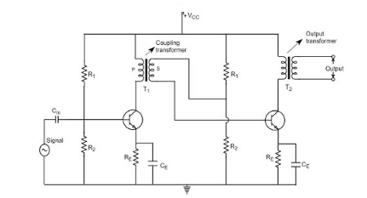
Construction of Transformer Coupled Amplifier
The amplifier circuit in which, the previous stage is connected to the next stage using a coupling transformer, is called as Transformer coupled amplifier.

Slide 30
The coupling transformer T₁ is used to feed the output of 1st stage to the input of 2nd stage.
The collector load is replaced by the primary winding of the transformer.
The secondary winding is connected between the potential divider and the base of 2nd stage, which provides the input to the 2nd stage.
Instead of coupling capacitor like in RC coupled amplifier, a transformer is used for coupling any two stages, in the transformer coupled amplifier circuit.
The potential divider network R₁ and R₂ and the resistor R_{e} together form the biasing and stabilization network.

Slide 31
The emitter by-pass capacitor C_{e} offers a low reactance path to the signal.
The resistor R_{L} is used as a load impedance. The input capacitor C_{in} present at the initial stage of the amplifier couples AC signal to the base of the transistor.
The capacitor C_{C} is the coupling capacitor that connects two stages and prevents DC interference between the stages and controls the shift of operating point.

Slide 32
Operation of Transformer Coupled Amplifier
When an AC signal is applied to the input of the base of the first transistor then it gets amplified by the transistor and appears at the collector to which the primary of the transformer is connected.
The transformer which is used as a coupling device in this circuit has the property of impedance changing, which means the low resistance of a stage (or load) can be reflected as a high load resistance to the previous stage.
Hence the voltage at the primary is transferred according to the turns ratio of the secondary winding of the transformer.
This transformer coupling provides good impedance matching between the stages of amplifier. The transformer coupled amplifier is generally used for power amplification.

Slide 33
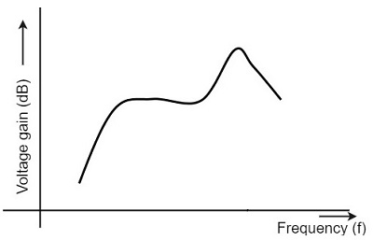
Frequency Response of Transformer Coupled Amplifier
The figure below shows the frequency response of a transformer coupled amplifier. The gain of the amplifier is constant only for a small range of frequencies. The output voltage is equal to the collector current multiplied by the reactance of primary.
At low frequencies, the reactance of primary begins to fall, resulting in decreased gain. At high frequencies, the capacitance between turns of windings acts as a bypass condenser to reduce the output voltage and hence gain.
So, the amplification of audio signals will not be proportionate and some distortion will also get introduced, which is called as Frequency distortion.

Slide 34
Advantages of Transformer Coupled Amplifier
The following are the advantages of a transformer coupled amplifier −
An excellent impedance matching is provided.
Gain achieved is higher.
There will be no power loss in collector and base resistors.
Efficient in operation.
Disadvantages of Transformer Coupled Amplifier
The following are the disadvantages of a transformer coupled amplifier −
Though the gain is high, it varies considerably with frequency. Hence a poor frequency response.
Frequency distortion is higher.
Transformers tend to produce hum noise.
Transformers are bulky and costly.
Applications
The following are the applications of a transformer coupled amplifier −
Mostly used for impedance matching purposes.
Used for Power amplification.
Used in applications where maximum power transfer is needed.

Slide 35
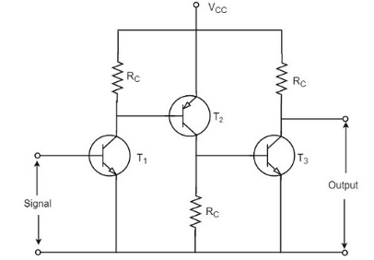
The other type of coupling amplifier is the direct coupled amplifier, which is especially used to amplify lower frequencies, such as amplifying photo-electric current or thermo-couple current or so.
Direct Coupled Amplifier
As no coupling devices are used, the coupling of the amplifier stages is done directly and hence called as Direct coupled amplifier.
Construction
The figure below indicates the three stage direct coupled transistor amplifier. The output of first stage transistor T₁ is connected to the input of second stage transistor T₂.

Slide 36
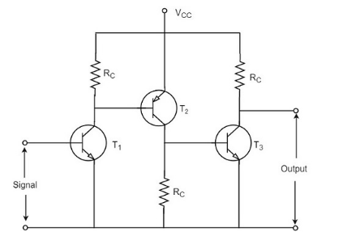

Slide 37
The transistor in the first stage will be an NPN transistor, while the transistor in the next stage will be a PNP transistor and so on. This is because, the variations in one transistor tend to cancel the variations in the other. The rise in the collector current and the variation in β of one transistor gets cancelled by the decrease in the other.
Operation
The input signal when applied at the base of transistor T₁, it gets amplified due to the transistor action and the amplified output appears at the collector resistor R_{c} of transistor T₁.
This output is applied to the base of transistor T₂ which further amplifies the signal. In this way, a signal is amplified in a direct coupled amplifier circuit.

Slide 38
Advantages
The circuit arrangement is simple because of minimum use of resistors.
The circuit is of low cost because of the absence of expensive coupling devices.
Disadvantages
It cannot be used for amplifying high frequencies.
The operating point is shifted due to temperature variations.
Applications
Low frequency amplifications.
Low current amplifications.

Slide 39
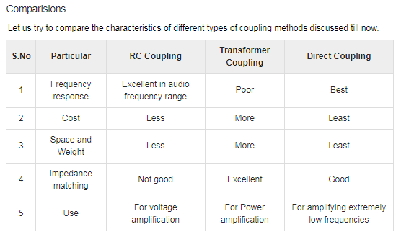

Slide 40
In practice, any amplifier consists of few stages of amplification. If we consider audio amplification, it has several stages of amplification, depending upon our requirement.
Power Amplifier
After the audio signal is converted into electrical signal, it has several voltage amplifications done, after which the power amplification of the amplified signal is done just before the loud speaker stage. This is clearly shown in the below figure.
While the voltage amplifier raises the voltage level of the signal, the power amplifier raises the power level of the signal. Besides raising the power level, it can also be said that a power amplifier is a device which converts DC power to AC power and whose action is controlled by the input signal.

Slide 41
The DC power is distributed according to the relation,
DC power input = AC power output + losses
Power Transistor
For such Power amplification, a normal transistor would not do. A transistor that is manufactured to suit the purpose of power amplification is called as a Power transistor.
A Power transistor differs from the other transistors, in the following factors.
It is larger in size, in order to handle large powers.
The collector region of the transistor is made large and a heat sink is placed at the collector-base junction in order to minimize heat generated.
The emitter and base regions of a power transistor are heavily doped.
Due to the low input resistance, it requires low input power.

Slide 42
Difference between Voltage and Power Amplifiers
Voltage Amplifier
The function of a voltage amplifier is to raise the voltage level of the signal. A voltage amplifier is designed to achieve maximum voltage amplification.
The voltage gain of an amplifier is given by

Slide 43
The characteristics of a voltage amplifier are as follows −
The base of the transistor should be thin and hence the value of β should be greater than 100.
The resistance of the input resistor R_{in} should be low when compared to collector load R_{C}.
The collector load R_{C} should be relatively high. To permit high collector load, the voltage amplifiers are always operated at low collector current.
The voltage amplifiers are used for small signal voltages.

Slide 44
Power Amplifier
The function of a power amplifier is to raise the power level of input signal. It is required to deliver a large amount of power and has to handle large current.
The characteristics of a power amplifier are as follows −
The base of transistor is made thicken to handle large currents. The value of β being (β > 100) high.
The size of the transistor is made larger, in order to dissipate more heat, which is produced during transistor operation.
Transformer coupling is used for impedance matching.
Collector resistance is made low.

Slide 45
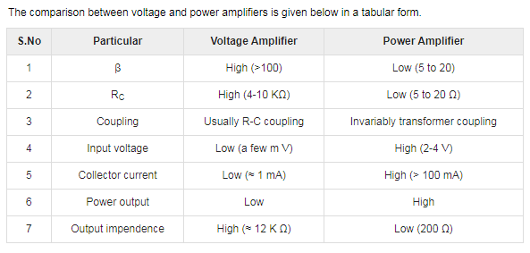

Slide 46
INTRODUCTION
Not all amplifiers are the same and there is a clear distinction made between the way their output stages are configured and operate.
The main operating characteristics of an ideal amplifier are linearity, signal gain, efficiency and power output but in real world amplifiers there is always a trade off between these different characteristics.
Generally, large signal or power amplifiers are used in the output stages of audio amplifier systems to drive a loudspeaker load. A typical loudspeaker has an impedance of between 4Ω and 8Ω, thus a power amplifier must be able to supply the high peak currents required to drive the low impedance speaker.
https://www.youtube.com/watch?v=e3c9OyG_luE

Slide 47
One method used to distinguish the electrical characteristics of different types of amplifiers is by “class”, and as such amplifiers are classified according to their circuit configuration and method of operation. Then Amplifier Classes is the term used to differentiate between the different amplifier types.
Amplifier Classes represent the amount of the output signal which varies within the amplifier circuit over one cycle of operation when excited by a sinusoidal input signal.
The classification of amplifiers range from entirely linear operation (for use in high-fidelity signal amplification) with very low efficiency, to entirely non-linear (where a faithful signal reproduction is not so important) operation but with a much higher efficiency, while others are a compromise between the two.

Slide 48
Amplifier classes are mainly lumped into two basic groups. The first are the classically controlled conduction angle amplifiers forming the more common amplifier classes of A, B, AB and C, which are defined by the length of their conduction state over some portion of the output waveform, such that the output stage transistor operation lies somewhere between being “fully-ON” and “fully-OFF”.
The second set of amplifiers are the newer so-called “switching” amplifier classes of D, E, F, G, S, T etc, which use digital circuits and pulse width modulation (PWM) to constantly switch the signal between “fully-ON” and “fully-OFF” driving the output hard into the transistors saturation and cut-off regions.
The most commonly constructed amplifier classes are those that are used as audio amplifiers, mainly class A, B, AB and C and to keep things simple, it is these types of amplifier classes we will look at here in more detail.

Slide 49
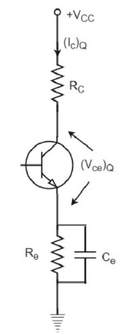
Class A Power Amplifier
A Class A power amplifier is one in which the output current flows for the entire cycle of the AC input supply. Hence the complete signal present at the input is amplified at the output.
From the above figure, it can be observed that the transformer is present at the collector as a load. The use of transformer permits the impedance matching, resulting in the transference of maximum power to the load e.g. loud speaker.

Slide 50
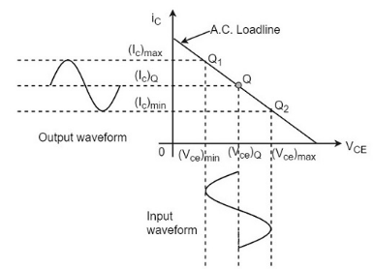
The operating point of this amplifier is present in the linear region. It is so selected that the current flows for the entire ac input cycle. The below figure explains the selection of operating point.
Here (I_{c})_{Q} and (V_{ce})_{Q} represent no signal collector current and voltage between collector and emitter respectively. When signal is applied, the Q-point shifts to Q₁ and Q₂. The output current increases to (I_{c})_{max} and decreases to (I_{c})_{min}. Similarly, the collector-emitter voltage increases to (V_{ce})_{max} and decreases to (V_{ce})_{min}.

Slide 51
Class A Amplifier
Class A Amplifiers are the most common type of amplifier topology as they use just one output switching transistor (Bipolar, FET, IGBT, etc) within their amplifier design.
This single output transistor is biased around the Q-point within the middle of its load line and so is never driven into its cut-off or saturation regions thus allowing it to conduct current over the full 360 degrees of the input cycle.
Then the output transistor of a class-A topology never turns “OFF” which is one of its main disadvantages.

Slide 52
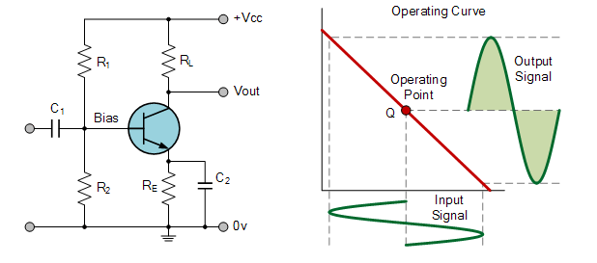
Class “A” amplifiers are considered the best class of amplifier design due mainly to their excellent linearity, high gain and low signal distortion levels when designed correctly.
Although seldom used in high power amplifier applications due to thermal power supply considerations, class-A amplifiers are probably the best sounding of all the amplifier classes mentioned here and as such are used in high-fidelity audio amplifier designs.

Slide 53
However, as the output device is “ON” at all times, it is constantly carrying current, which represents a continuous loss of power in the amplifier.
Due to this continuous loss of power class A amplifiers create tremendous amounts of heat adding to their very low efficiency at around 30%, making them impractical for high-power amplifications. Also due to the high idling current of the amplifier, the power supply must be sized accordingly and be well filtered to avoid any amplifier hum and noise. Therefore, due to the low efficiency and over heating problems of Class A amplifiers, more efficient amplifier classes have been developed.

Slide 54
Advantages of Class A Amplifiers
The advantages of Class A power amplifier are as follows −
The current flows for complete input cycle
It can amplify small signals
The output is same as input
No distortion is present
Disadvantages of Class A Amplifiers
The disadvantages of Class A power amplifier are as follows −
Low power output
Low collector efficiency

Slide 55
Class B Amplifier
Class B amplifiers were invented as a solution to the efficiency and heating problems associated with the previous class A amplifier.
The basic class B amplifier uses two complimentary transistors either bipolar of FET for each half of the waveform with its output stage configured in a “push-pull” type arrangement, so that each transistor device amplifies only half of the output waveform.
In the class B amplifier, there is no DC base bias current as its quiescent current is zero, so that the dc power is small and therefore its efficiency is much higher than that of the class A amplifier. However, the price paid for the improvement in the efficiency is in the linearity of the switching device.

Slide 56
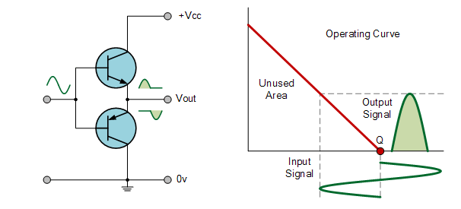
When the input signal goes positive, the positive biased transistor conducts while the negative transistor is switched “OFF”. Likewise, when the input signal goes negative, the positive transistor switches “OFF” while the negative biased transistor turns “ON” and conducts the negative portion of the signal. Thus the transistor conducts only half of the time, either on positive or negative half cycle of the input signal.

Slide 57
Then we can see that each transistor device of the class B amplifier only conducts through one half or 180 degrees of the output waveform in strict time alternation, but as the output stage has devices for both halves of the signal waveform the two halves are combined together to produce the full linear output waveform.
This push-pull design of amplifier is obviously more efficient than Class A, at about 50%, but the problem with the class B amplifier design is that it can create distortion at the zero-crossing point of the waveform due to the transistors dead band of input base voltages from -0.7V to +0.7.
We remember from the Transistor tutorial that it takes a base-emitter voltage of about 0.7 volts to get a bipolar transistor to start conducting. Then in a class B amplifier, the output transistor is not “biased” to an “ON” state of operation until this voltage is exceeded.

Slide 58
This means that the the part of the waveform which falls within this 0.7 volt window will not be reproduced accurately making the class B amplifier unsuitable for precision audio amplifier applications.
To overcome this zero-crossing distortion (also known as Crossover Distortion) class AB amplifiers were developed.

Slide 59
Class AB Amplifier
As its name suggests, the Class AB Amplifier is a combination of the “Class A” and the “Class B” type amplifiers we have looked at above.
The AB classification of amplifier is currently one of the most common used types of audio power amplifier design.
The class AB amplifier is a variation of a class B amplifier as described above, except that both devices are allowed to conduct at the same time around the waveforms crossover point eliminating the crossover distortion problems of the previous class B amplifier.

Slide 60
The two transistors have a very small bias voltage, typically at 5 to 10% of the quiescent current to bias the transistors just above its cut-off point.
Then the conducting device, either bipolar of FET, will be “ON” for more than one half cycle, but much less than one full cycle of the input signal.
Therefore, in a class AB amplifier design each of the push-pull transistors is conducting for slightly more than the half cycle of conduction in class B, but much less than the full cycle of conduction of class A.
In other words, the conduction angle of a class AB amplifier is somewhere between 180º and 360º depending upon the chosen bias point as shown.

Slide 61
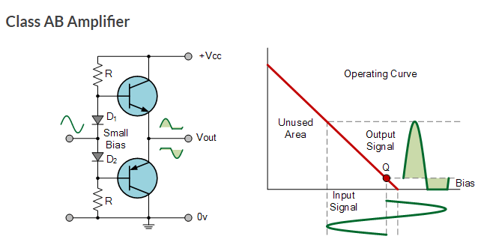
The advantage of this small bias voltage, provided by series diodes or resistors, is that the crossover distortion created by the class B amplifier characteristics is overcome, without the inefficiencies of the class A amplifier design. So the class AB amplifier is a good compromise between class A and class B in terms of efficiency and linearity, with conversion efficiencies reaching about 50% to 60%.

Slide 62
Class C Amplifier
The Class C Amplifier design has the greatest efficiency but the poorest linearity of the classes of amplifiers mentioned here. The previous classes, A, B and AB are considered linear amplifiers, as the output signals amplitude and phase are linearly related to the input signals amplitude and phase.
However, the class C amplifier is heavily biased so that the output current is zero for more than one half of an input sinusoidal signal cycle with the transistor idling at its cut-off point. In other words, the conduction angle for the transistor is significantly less than 180 degrees, and is generally around the 90 degrees area.
While this form of transistor biasing gives a much improved efficiency of around 80% to the amplifier, it introduces a very heavy distortion of the output signal. Therefore, class C amplifiers are not suitable for use as audio amplifiers.

Slide 63
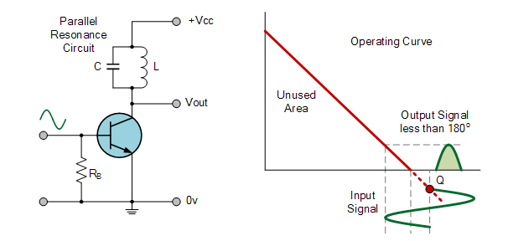
Due to its heavy audio distortion, class C amplifiers are commonly used in high frequency sine wave oscillators and certain types of radio frequency amplifiers, where the pulses of current produced at the amplifiers output can be converted to complete sine waves of a particular frequency by the use of LC resonant circuits in its collector circuit.

Slide 64
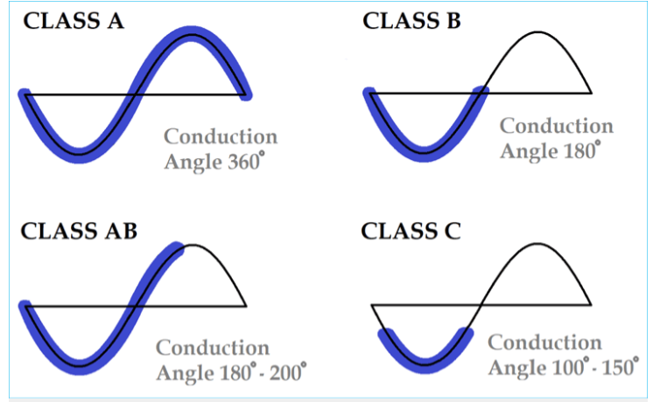

Slide 65
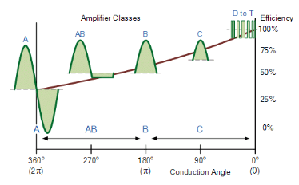

Slide 66
Introduction
The analysis thus far has been limited to a particular frequency.
For the amplifier , it was a frequency that normally permitted ignoring the effects of the capacitive elements, reducing the analysis to one that included only resistive elements and sources of the independent and controlled variety.
We will now investigate the frequency effects introduced by the larger capacitive elements of the network at low frequencies and the smaller capacitive elements of the active device at the high frequencies.

Slide 67
Since the analysis will extend through a wide frequency range, the logarithmic scale will be defined and used throughout the analysis.
In addition, since industry typically uses a decibel scale on its frequency plots, the concept of the decibel is introduced in some detail.
The similarities between the frequency response analyses of both BJTs and FETs permit a coverage of each in the same chapter.

Slide 68
Frequency Response of an electric or electronics circuit allows us to see exactly how the output gain (known as the magnitude response) and the phase (known as the phase response) changes at a particular single frequency, or over a whole range of different frequencies from 0Hz, (d.c.) to many thousands of mega-hertz.

Slide 70
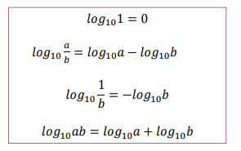

Slide 72
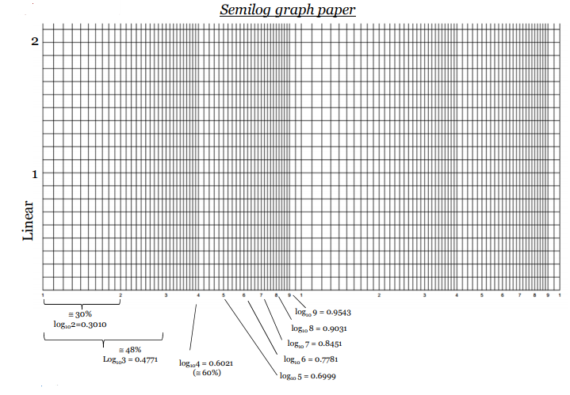

Slide 73
Semi-log paper has one arithmetic and one logarithmic axis.
If you want to plot something in semi-log graph, first of all, you need to convert the decimal numbers into log scale. Suppose you are plotting frequency from 100 Hz to 10,000 Hz. Now you need to convert these frequency into log scale.
Semi-Log graph is a common method of plotting data where in one axis there are small amount of data to be plotted and in other axis a lot of data to be plotted. ... In this case it is not possible to plot the frequency response using normal graphing scale. Semi-log graph scale must be used in this case.

Slide 74
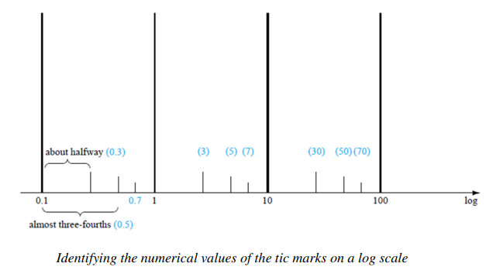

Slide 75
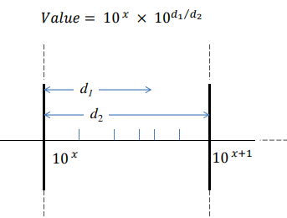

Slide 76
Decibels
The decibel (dB) is a logarithmic unit used to measure sound level. It is also widely used in electronics, signals and communication. The dB is a logarithmic way of describing a ratio. The ratio may be power, sound pressure, voltage or intensity or several other things.
The frequency or amount of air pressure change vibration is measured in Hertz. ... The resulting change in air pressure created through the vibrating object is measured in decibels. Decibels, in effect, measure the loudness of a sound and Hertz measures the frequency of the sound.

Slide 77
dB and frequency are terms to describe sound level and the number of cycles of a sound wave in one second.
Sound is measured in decibels (dB). A whisper is about 30 dB, normal conversation is about 60 dB, and a motorcycle engine running is about 95 dB. Noise above 70 dB over a prolonged period of time may start to damage your hearing. Loud noise above 120 dB can cause immediate harm to your ears.

Slide 78
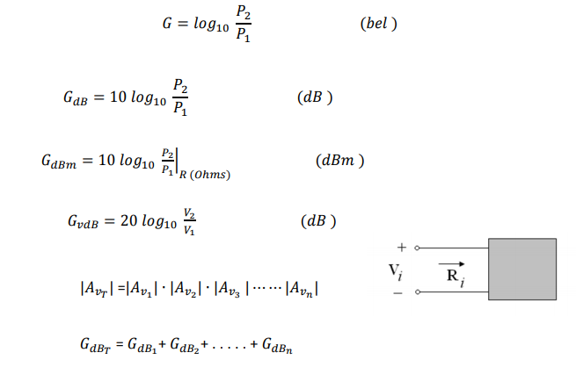

Slide 79
Bell believed that he could solve the problem of sending a human voice over a wire. He figured out how to transmit a simple current first, and received a patent for that invention on March 7, 1876.
Stranger is the story that telephone inventor Alexander Graham Bell chose hello as a phone greeting because it was the name of his girlfriend, one Margaret Hello. (She never existed — Bell developed the telephone while he was engaged to Mabel Hubbard, and she would be his wife until his death in 1922.)
Hello might be derived from an older spelling variant, hullo, which the American Merriam-Webster dictionary describes as a "chiefly British variant of hello", and which was originally used as an exclamation to call attention, an expression of surprise, or a greeting.

Slide 83
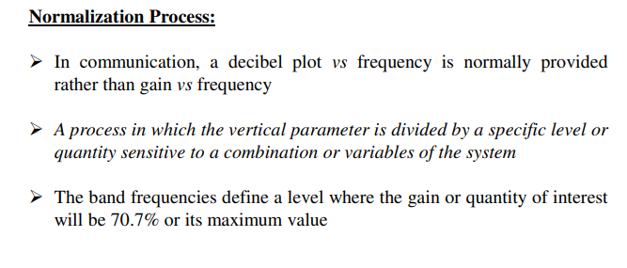

Slide 84
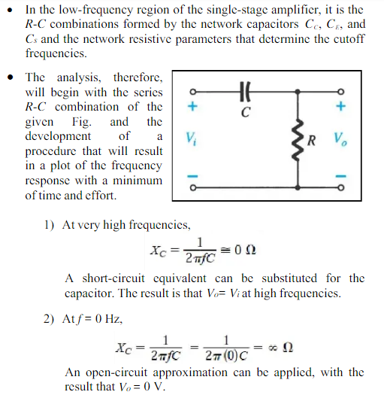

Slide 85
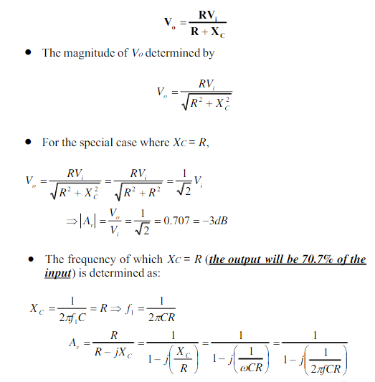

Slide 86
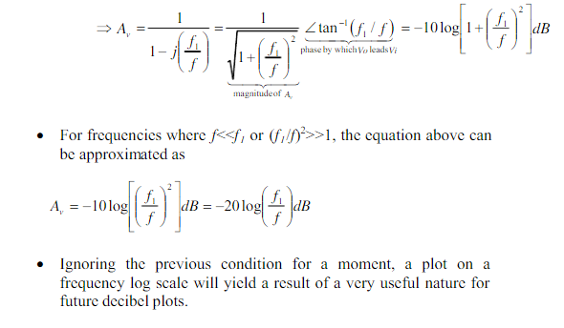

Slide 87
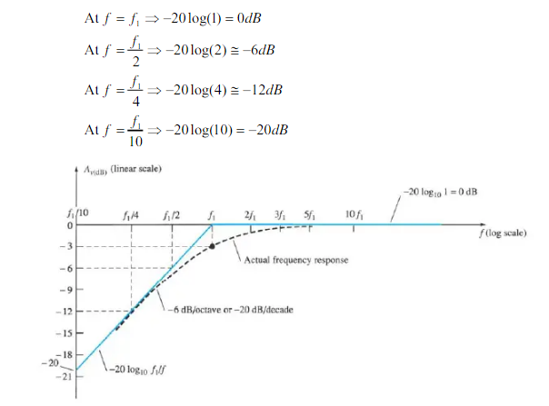

Slide 88
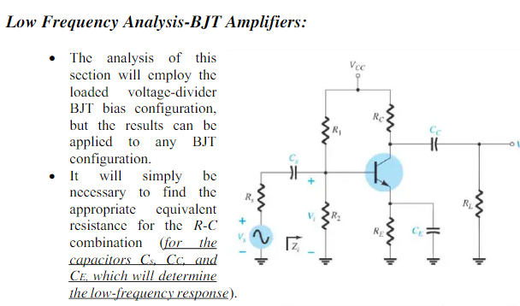

Slide 89
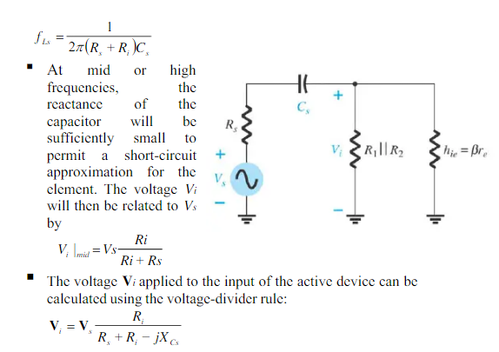

Slide 90
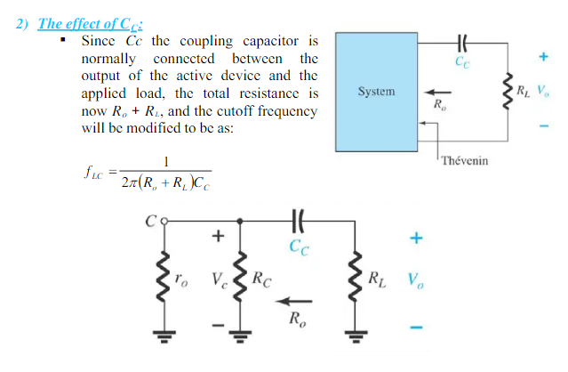

Slide 91
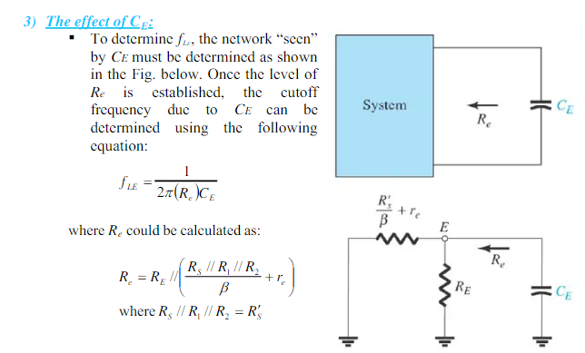

Slide 92
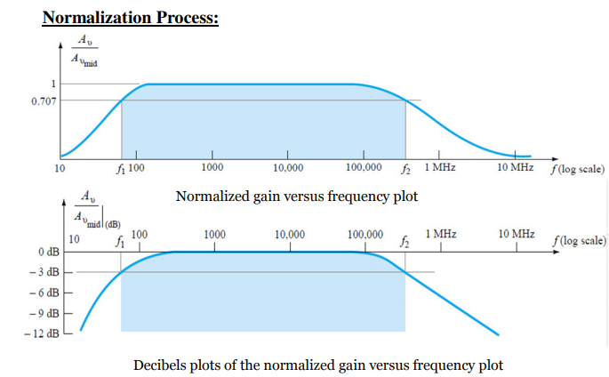

Slide 93
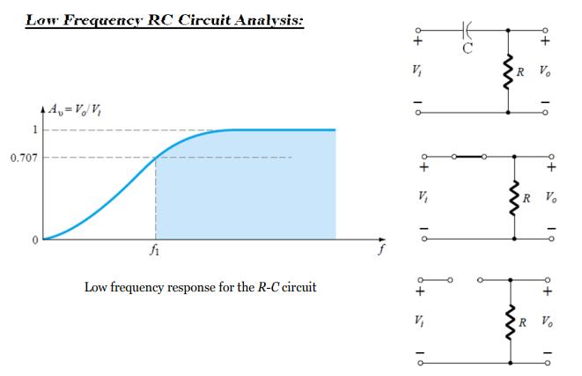

Slide 94
The result is essentially a combination of three high-pass filter networks that allow signals having frequencies greater than the cutoff frequency of the dominant network to pass through while attenuating all others. ... This frequency is the so-called 3-dB point.
When the frequencies are lower, the resistance between the emitter and the ground is no longer only r_{e} but R_{E}+r_{e} and therefore the voltage gain decreases to A_{V}=(R_{C}//R_{L})/(R_{E}+r_{e}). ... Indeed, if the frequency is low, C_{BC} and C_{BE} act as an open circuit and the transistor is not affected at all.
The gain of capacitor goes low at lower frequencies due to the reactance that is offered by Capacitor that is present in the coupling at this frequency in the circuit. The gain throughout the range remains static and regular, changes occur only at low and high frequency.

Slide 95
3db is the power level, its the frequency at which the power is at 3db below the maximum value and 3db means in normal unit its half the maximum power so 3db frequency means the frequency at which the power is half the maximum value so its decided the cuttoff frequency.
Improving high-frequency response can be achieved by reducing the small capacitances to ground or reducing the total circuit resistance to ground.
At low frequencies, X_{c} increases. This increase in X_{c} drops the signal voltage across the capacitor and reduces the circuit gain. As signal frequencies decrease, capacitor reactance increase and gain continues to fall, reducing the output voltage.

Slide 96
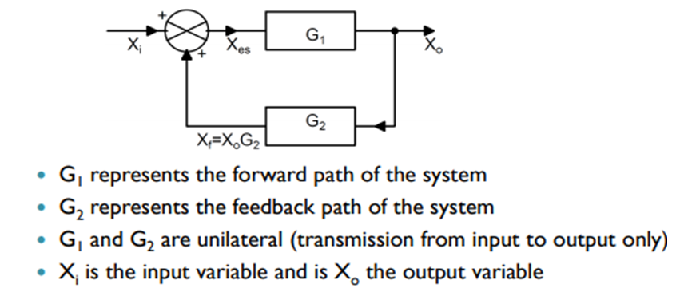
What is Feedback?

Slide 98
Basic elements of feedback amplifier
Input Signal: The signal source is modeled either by a voltage source Vs in series with a resistance Rs , or by a current source Is in parallel with a resistance Rs.
Output Signal: The output can either be the voltage across the load resistance or the current through it. It is the output signal that is desired to be independent of the load and insensitive to parameter variations in the basic amplifier.
Sampling Network: The function of the sampling network is to provide a measure of the output signal, i.e., a signal that is proportional to the output. This configuration is called shunt connection.

Slide 99
Feedback Amplifier
Feedback is one of the fundamental processes in electronics.
It is defined as the process whereby a portion of the output signal is fed to the input signal in order to form a part of the system-output control.
Feedback is used to make the operating point of a transistor insensitive to both manufacturing variations in as well as temperature.
There is another type of feedback called positive or regenerative feedback in which the overall gain of the amplifier is increased.

Slide 100
Positive feedback is useful in oscillators and while establishing the two stable states of flip-flop.
The feedback system has many advantages especially in the control of impedance levels, bandwidth improvement, and in rendering the circuit performance relatively insensitive to manufacturing as well as to environmental changes.
These are the advantages of negative or degenerative feedback in which the signal feedback from output to input is 180 out of phase with the applied excitation.
It increases bandwidth and input impedance, and lowers the output impedance.

Slide 102
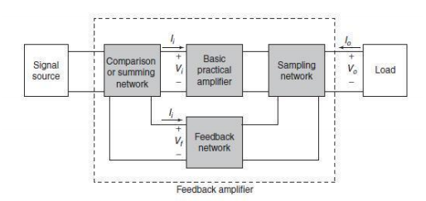
Block diagram of a basic feedback amplifier

Slide 103
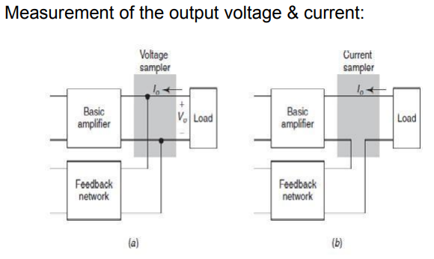

Slide 105
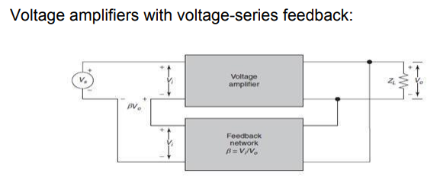

Slide 106
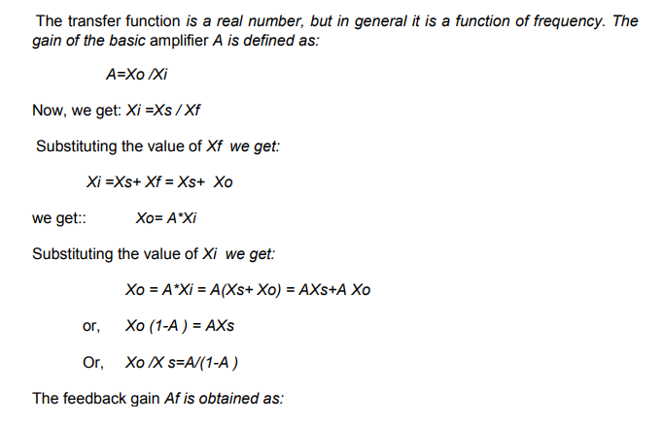
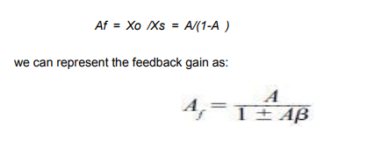

Slide 108
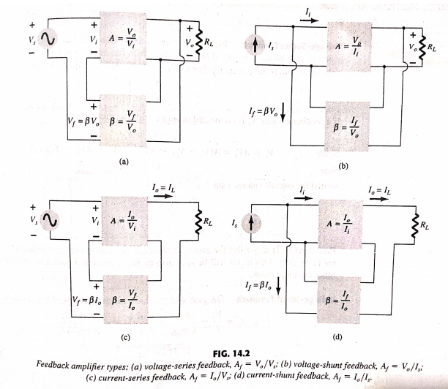

Slide 110
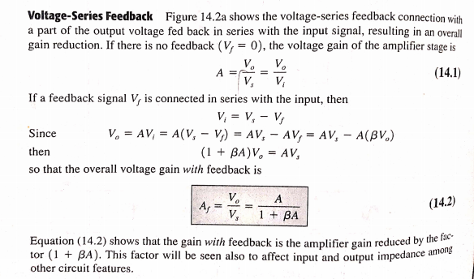

Slide 119
http://vlabs.iitkgp.ernet.in/be/exp13/ceamp.html

