Slide 1
ANALOG CIRCUITS (4ECU2) IV-Semester (ECE)
Dr. Vinita Mathur (Asso. Prof.)
Electronics and Communication Engg.
JECRC. Jaipur (Raj), India
Email:- vinitamathur.ece@jecrc.ac.in

Slide 2
Vision of JECRC
To become a renowned center of outcome based learning, and work towards academic, professional, cultural and social enrichment of the lives of individuals and communities.
Mission of JECRC
Focus on evaluation of learning outcomes and motivate students to inculcate research aptitude by project based learning.
Identify, based on informed perception of Indian, regional and global needs, areas of focus and provide platform to gain knowledge and solutions.
Offer opportunities for interaction between academia and industry.
Develop human potential to its fullest extent so that intellectually capable and imaginatively gifted leaders can emerge in a range of professions.

Slide 3
Vision of the Department
To contribute to the society through excellence in scientific and technical education, teaching and research aptitude in Electronics and Communication Engineering to meet the needs of Global Industry.
Mission of the Department
M1: To equip the students with strong foundation of basic sciences and domain knowledge of ECE, so that they are able to creatively their knowledge to the solution of problems arising in their career path.
M2: To induce the habit of lifelong learning to continuously enhance overall performance.
M3: Students are able to communicate their ideas clearly and concisely so that they can work in team as well as an individual.
M4: To make the students responsive towards the ethical, social, environmental and in economic context for the society.

Slide 4
Course Outcomes
1. Understand the characteristics of diodes and transistors.
2. Design and analyze various rectifiers and amplifiers circuits.
3. Design sinusoidal and non-sinusoidal oscillators.
4. Understanding the functioning of OP-AMP and design OP-AMP based circuits.
5. Understanding the designing of ADCs and DACs.

Slide 5
Disclaimer
The contents used in this presentation are taken from the text books mentioned in the references. I do not hold any copyrights for the contents. It has been prepared to use in the class lectures, not for commercial purpose.

Slide 7
Text Books
Text Books: |  | T1: A.S. Sedra and K.C. Smith, Microelectronic Circuits, 5th Edition, Oxford University Press T2: R.L. Boylestad and L. Nashelsky, Electronic Devices and Circuit Theory, 9th Edition, Prentice Hall of India. T3: J. Millman and C.C. Halkias, Inegrated Electronics: Analog and Digital Circuts and Systems T4: R.A. Gayakwad, Op- amps and Linear Integrated Circuits, 4th Edition, Pearson.

Slide 8
Recap
Intrinsic and extrinsic materials
Doping
Semiconductor materials
Diode
Forward and reverse bias
Linear device
Non linear device

Slide 9
Diode Circuits
In the field of electronics, the simplest and the most fundamental non-linear circuit element is the diode.
Among the many applications of diodes, their use in the design of rectifiers, which convert ac to dc, is the most common.
The piecewise linear model is used in certain applications of diodes, namely clippers, rectifiers and comparators.
Many more such circuits are possible with one or more diodes being implemented in them.
Notes:
Simply we can say that the linear circuit is an electric circuit and the parameters of this circuit are resistance, capacitance, inductance and etc are constant. Or we can say the parameters of the circuits are not changed with respect to the voltage and current is called the linear circuit.
The non-linear circuit is also an electric circuit and the parameters of this circuit differ with respect to the current and the voltage. Or in the electric circuit, the parameters like waveforms, resistance, inductance and etc are not constant is called as Non- linear circuit.

Slide 10
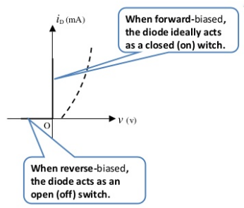
Diode Circuits
An electronic component made of semiconductor material that allows conduction of current in only one direction is termed as a Diode. It is a two-terminal device normally formed by fusing p and n-type semiconductor materials each having majority and minority carriers.
The vertical line in the diode symbol represents the cathode (n-side) and the opposite end represents the anode (p-side).
The diodes are used for various purposes such as:
Rectifier
Voltage Regulator
Switches
Oscillators
Signal limiters, modulators and demodulators.

Slide 11
ANALYSIS OF DIODE CIRCUITS
The basic diode circuit consists of a voltage source in series with a resistor and a diode.
The circuit might be analyzed properly to obtain the instantaneous current and diode voltage.
For such an analysis to be done, the concept of load line and its effective use in various circuits has to be thoroughly understood.

Slide 12
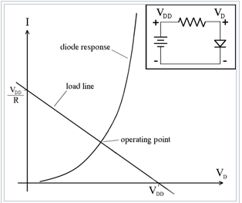
LOAD LINE and Q-POINT
A load line is a line drawn on the characteristic curve, a graph of the current vs. the voltage in a nonlinear device like a diode or transistor.
The points where the characteristic curve and the load line intersect are the possible operating point(s) (Q points) of the circuit; at these points the current and voltage parameters of both parts of the circuit match.

Slide 13
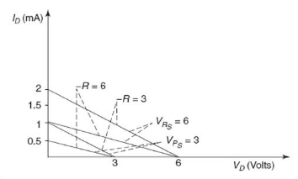
The intersection of the load line with the characteristics will determine the point of operation of the system. Physically, this point of operation mainly determines the conditions under which the device is to be operated in a circuit.

Slide 14
Electronic devices are very sensitive to voltage. If a large amplitude voltage is applied, it may permanently destroy the device. So, it is essential to protect the electronics devices.
The protection of the electronic devices can be achieved by using the clipper circuits.

Slide 15
FACT 1
Why Can Birds Sit Safely on Power Lines?

Slide 16
Electrons need in order to move is a difference in what’s called electrical potential.
When a bird is perched on a single wire, its two feet are at the same electrical potential, so the electrons in the wires have no motivation to travel through the bird’s body. No moving electrons means no electric current. Our bird is safe, for the moment anyway… If that bird stretches out a wing or a leg and touches a second wire, especially one with a different electrical potential, it will open a path for the electrons — right through the bird’s body.

Slide 17
CLIPPER CIRCUITS
A clipper is a device that removes either the positive half (top half) or negative half (bottom half), or both positive and negative halves of the input AC signal.
In other words, a clipper is a device that limits the positive amplitude or negative amplitude or both positive and negative amplitudes of the input AC signal.

Slide 18
The clipper circuit does not contain energy storage elements such as capacitor but contains both linear and non-linear elements.
The linear elements used in the clippers include resistors and the non-linear elements used in the clippers include diodes or transistors.
Depending on the orientation of the diode, the positive or negative region of the input signal is “clipped” off.

Slide 19
The half-wave rectifier is an example of the simplest form of diode clipper—one resistor and a diode.
A half wave rectifier removes either the positive half cycle or negative half cycle of the input AC signal and allows the remaining half cycle of the input AC signal. Thus, a half wave rectifier acts as a clipper circuit.

Slide 20
Types of clippers
The clipper circuits are generally categorized into three types:
Series clippers,
Shunt clippers and
Dual (combination) clippers.
In series clippers, the diode is connected in series with the output load resistance. In shunt clippers, the diode is connected in parallel with the output load resistance.

Slide 21
The various types of clippers are as follows:
1. Series positive clipper
2. Series positive clipper with bias
3. Series negative clipper
4. Series negative clipper with bias
5. Shunt positive clipper
6. Shunt positive clipper with bias
7. Shunt negative clipper
8. Shunt negative clipper with bias
9. Dual (combination) clipper

Slide 22
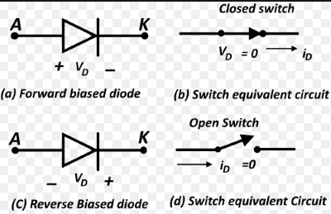
Diode as a SWITCH
The vertical line in the diode symbol represents the cathode (n-side) and the opposite end represents the anode (p-side).

Slide 23
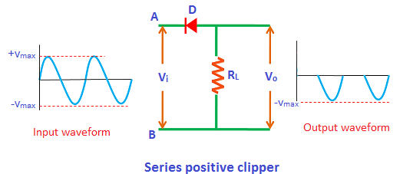
1. Series Positive Clipper
In series positive clipper, the positive half cycles of the input AC signal is removed.
If the diode is arranged in such a way that the arrowhead of the diode points towards the input and the diode is in series with the output load resistance, then the clipper is said to be a series positive clipper.

Slide 24
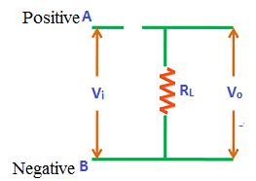
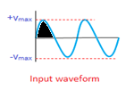
1(a)During positive half cycle:
During the positive half cycle, terminal A is positive and terminal B is negative. That means the positive terminal A is connected to n-side and the negative terminal B is connected to p-side of the diode. As we already know that if the positive terminal is connected to n-side and the negative terminal is connected to p-side then the diode is said to be reverse biased. Therefore, the diode D is reverse biased during the positive half cycle.
During reverse biased condition, no current flows through the diode. So the positive half cycle is blocked or removed at the output.

Slide 25
1 (b) During negative half cycle:
During the negative half cycle, terminal A is negative and terminal B is positive. That means the negative terminal A is connected to n-side and the positive terminal B is connected to p-side of the diode. As we already know that if the negative terminal is connected to n-side and the positive terminal is connected to p-side then the diode is said to be forward biased. Therefore, the diode D is forward biased during the negative half cycle.
During forward biased condition, electric current flows through the diode. So the negative half cycle is allowed at the output.

Slide 26
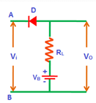
2. Series positive clipper with bias
Sometimes it is desired to remove a small portion of positive or negative half cycles. In such cases, the biased clippers are used.
The construction of the series positive clipper with bias is almost similar to the series positive clipper. The only difference is an extra element called battery is used in series positive clipper with bias.

Slide 27
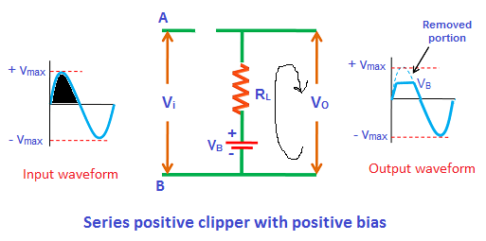
2 (a) Series positive clipper with positive bias
During positive half cycle:
During the positive half cycle, terminal A is positive and terminal B is negative. That means the positive terminal is connected to n-side and the negative terminal is connected to p-side. As we already know that if the positive terminal is connected to n-side and the negative terminal is connected to p-side then the diode is said to be reverse biased. Therefore, the diode is reverse biased by the input supply voltage V_{i}.

Slide 28
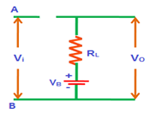
However, we are supplying the voltage from another source called battery. As shown in the figure, the positive terminal of the battery is connected to p-side and the negative terminal of the battery is connected to n-side of the diode. Therefore, the diode is forward biased by the battery voltage V_{B}.
That means the diode is reverse biased by the input supply voltage (V_{i}) and forward biased by the battery voltage (V_{B}).

Slide 29
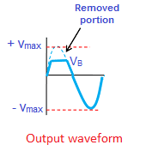
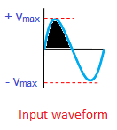
Initially, the input supply voltage V_{i} is less than the battery voltage V_{B} (V_{i} < V_{B}). So the battery voltage dominates the input supply voltage. Hence, the diode is forward biased by the battery voltage and allows electric current through it. As a result, the signal appears at the output.
When the input supply voltage V_{i} becomes greater than the battery voltage V_{B}, the diode D is reverse biased. So no current flows through the diode. As a result, input signal does not appear at the output.
Thus, the clipping (removal of a signal) takes place during the positive half cycle only when the input supply voltage becomes greater than the battery voltage.

Slide 30
During negative half cycle:
During the negative half cycle, terminal A is negative and terminal B is positive. That means the diode D is forward biased due to the input supply voltage. Furthermore, the battery is also connected in such a way that the positive terminal is connected to p-side and the negative terminal is connected to n-side. So the diode is forward biased by both battery voltage V_{B} and input supply voltage V_{i}.
That means, during the negative half cycle, it doesn’t matter whether the input supply voltage is greater or less than the battery voltage, the diode always remains forward biased. So the complete negative half cycle appears at the output.

Slide 31
Recap
Diode forward and reverse biased
Diode as a switch
Linear device
Non linear device
Load line
Q point
Clipper
Use of clipper
Components of clipper circuit
Types of clipper
KVL
Series positive clipper
Series positive clipper with bias

Slide 32
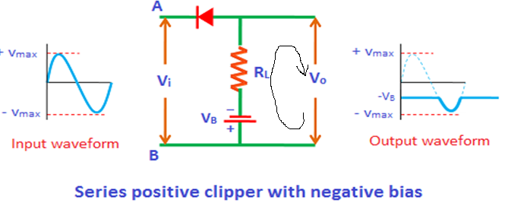
2 (b) Series positive clipper with negative bias
During positive half cycle:
During the positive half cycle, the diode D is reverse biased by both input supply voltage V_{i} and battery voltage V_{B}. So no signal appears at the output during the positive half cycle. Therefore, the complete positive half cycle is removed.

Slide 33
During negative half cycle:
During the negative half cycle, the diode is forward biased by the input supply voltage V_{i} and reverse biased by the battery voltage V_{B}. However, initially, the battery voltage V_{B} dominates the input supply voltage V_{i}. So the diode remains to be reverse biased until the V_{i} becomes greater than V_{B}. When the input supply voltage V_{i} becomes greater than the battery voltage V_{B}, the diode is forward biased by the input supply voltage V_{i}. So the signal appears at the output.

Slide 34
3. Series negative clipper
In series negative clipper, the negative half cycles of the input AC signal is removed at the output. The circuit construction of the series negative clipper is shown in the figure.
If the diode is arranged in such a way that the arrowhead of the diode points towards the output and the diode is in series with the output load resistance, then the clipper is said to be a series negative clipper.

Slide 35
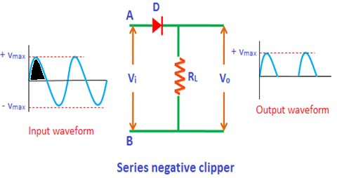
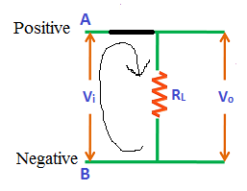
During positive half cycle:
During the positive half cycle, terminal A is positive and terminal B is negative. That means the positive terminal A is connected to p-side and the negative terminal B is connected to n-side of the diode, then the diode is said to be forward biased. Therefore, the diode D is forward biased during the positive half cycle.

Slide 36
During negative half cycle:
During the negative half cycle, the terminal A is negative and the terminal B is positive. That means the negative terminal A is connected to p-side and the positive terminal B is connected to n-side of the diode, then the diode is said to be reverse biased. Therefore, the diode D is reverse biased during the negative half cycle.
During reverse biased condition, no current flows through the diode. So the negative half cycle is completely blocked or removed at the output.
In other words, a series of negative half cycles are removed at the output.

Slide 37
4. Series negative clipper with bias
Sometimes it is desired to remove a small portion of positive or negative half cycles of the input AC signal. In such cases, the biased clippers are used.
The construction of the series negative clipper with bias is almost similar to the series negative clipper. The only difference is an extra element called battery is used in series negative clipper with bias.

Slide 38
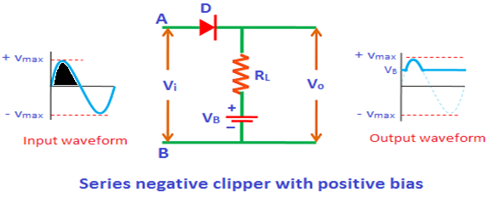
4 (a) Series negative clipper with positive bias During positive half cycle:
During the positive half cycle, terminal A is positive and terminal B is negative, then the diode is said to be forward biased.
However, we are also supplying the voltage from another source called battery. As shown in the figure, the positive terminal of the battery is connected to n-side and the negative terminal of the battery is connected to p-side of the diode.

Slide 39
That means the diode is forward biased by input supply voltage V_{i} and reverse biased by battery voltage V_{B}.
Initially, the battery voltage is greater than the input supply voltage. Hence, the diode is reverse biased and does not allow electric current. Therefore, no signal appears at the output.
When the input supply voltage V_{i} becomes greater than the battery voltage V_{B}, the diode is forward biased and allows electric current. As a result, the signal appears at the output.

Slide 40
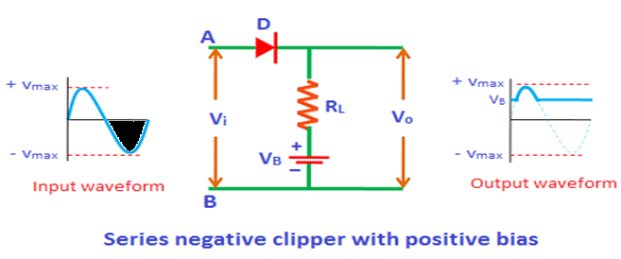
During negative half cycle:
During the negative half cycle, the diode is reverse biased by both input supply voltage V_{i} and battery voltage V_{B}. So it doesn’t matter whether the input supply voltage is greater or less than the battery voltage V_{B}, the diode always remains reverse biased. Therefore, during the negative half cycle, no signal appears at the output.

Slide 41
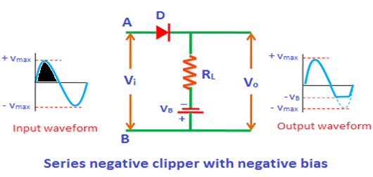
4 (b)Series negative clipper with negative bias
During positive half cycle:
During the positive half cycle, the diode D is forward biased by both input supply voltage V_{i} and the battery voltage V_{B}. So it doesn’t matter whether the input supply voltage is greater or less than battery voltage V_{B}, the diode always remains forward biased. Therefore, during the positive half cycle, the signal appears at the output.

Slide 42
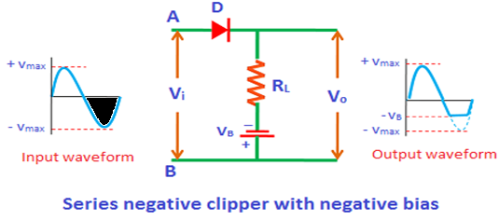
During negative half cycle:
During the negative half cycle, the diode D is reverse biased by the input supply voltage V_{i} and forward biased by the battery voltage V_{B}.
Initially, the input supply voltage V_{i} is less than the battery voltage V_{B}. So the diode is forward biased by the battery voltage V_{B}. As a result, the signal appears at the output.
When the input supply voltage V_{i} becomes greater than the battery voltage V_{B}, the diode will become reverse biased. As a result, no signal appears at the output.

Slide 43
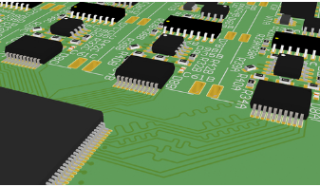
Facts about PCB’s
Why are they green?
How are they designed?

Slide 44
Why are they green?
The green color that you see on the PCB is actually just the color of the solder masks
Solder mask is a protective layer of liquid applied on the top and bottom side of a Printed Circuit Board. The function of the Solder mask is to protect the copper, from: Oxidation,, Environmental influences like dust and other contaminations that may create shorts in the long run.
The Solder mask is first printed or sprayed on to the production panel and then UV-exposed with the correct solder mask pattern, developed and dried. Solder mask is usually green but can also be applied as: black, blue, white, red, clear, etc.

Slide 45
How are they designed?
First, you will have a layout design of your PCB. This is normally done by CAD (Computer Aided Design). This is needed in order to make the schematic and design the layout of the PCB before they are manufactured. Any possible errors can then be detected beforehand as the traces and the position of all corresponding components are tested and checked before being used to manufacture the PCB.

Slide 46
Recap
Diode forward and reverse biased
Diode as a switch
Linear device
Non linear device
Load line
Q point
Clipper
Use of clipper
Components of clipper circuit
Types of clipper
KVL
Series positive clipper
Series positive clipper with bias

Slide 47
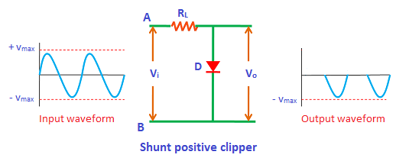
5. Shunt positive clipper
In shunt clipper, the diode is connected in parallel with the output load resistance. The operating principles of the shunt clipper are nearly opposite to the series clipper.
The shunt clipper on the other hand passes the input signal to the output load when the diode is reverse biased and blocks the input signal when the diode is forward biased.

Slide 48
In shunt positive clipper, during the positive half cycle the diode is forward biased and hence no output is generated.
On the other hand, during the negative half cycle the diode is reverse biased and hence the entire negative half cycle appears at the output.

Slide 49
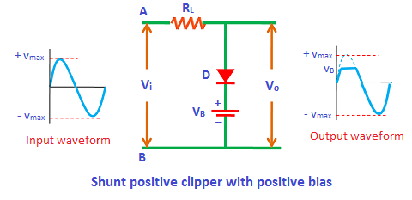
6. Shunt positive clipper with bias
Shunt positive clipper with positive bias
During the positive half cycle, the diode is forward biased by the input supply voltage V_{i} and reverse biased by the battery voltage V_{B}. However, initially, the input supply voltage V_{i} is less than the battery voltage V_{B}. Hence, the battery voltage V_{B} makes the diode to be reverse biased. Therefore, the signal appears at the output. However, when the input supply voltage V_{i} becomes greater than the battery voltage V_{B}, the diode D is forward biased by the input supply voltage V_{i}. As a result, no signal appears at the output.

Slide 50
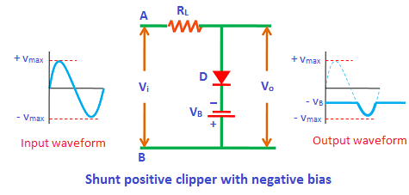
Shunt positive clipper with negative bias
During the positive half cycle, the diode is forward biased by both input supply voltage V_{i} and battery voltage V_{B}. Therefore, no signal appears at the output during the positive half cycle.
During the negative half cycle, the diode is reverse biased by the input supply voltage and forward biased by the battery voltage. However, initially, the input supply voltage V_{i} is less than the battery voltage V_{B}. So the battery voltage makes the diode to be forward biased. As a result, no signal appears at the output. However, when the input supply voltage V_{i} becomes greater than the battery voltage V_{B}, the diode is reverse biased by the input supply voltage V_{i}. As a result, the signal appears at the output.

Slide 51
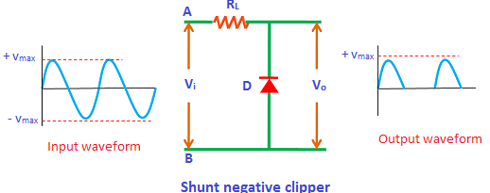
7. Shunt negative clipper
In shunt negative clipper, during the positive half cycle the diode is reverse biased and hence the entire positive half cycle appears at the output. On the other hand, during the negative half cycle the diode is forward biased and hence no output signal is generated.

Slide 52
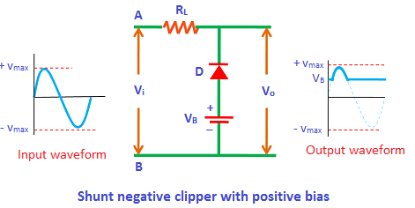
8. Shunt negative clipper with bias
Shunt negative clipper with positive bias
During the positive half cycle, the diode is reverse biased by the input supply voltage V_{i} and forward biased by the battery voltage V_{B}. However, initially, the input supply voltage is less than the battery voltage. So the diode is forward biased by the battery voltage. As a result, no signal appears at the output. However, when the input supply voltage becomes greater than the battery voltage then the diode is reverse biased by the input supply voltage. As a result, the signal appears at the output.

Slide 53
During the negative half cycle, the diode is forward biased by both input supply voltage V_{i} and battery voltage V_{B}. So the complete negative half cycle is removed at the output.

Slide 54
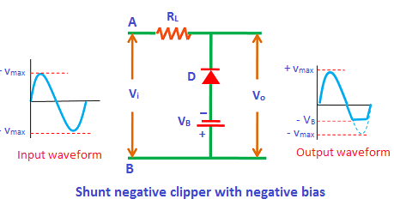
Shunt negative clipper with negative bias
During the positive half cycle, the diode is reverse biased by both input supply voltage V_{i} and battery voltage V_{B}. As a result, the complete positive half cycle appears at the output.

Slide 55
During the negative half cycle, the diode is forward biased by the input supply voltage V_{i} and reverse biased by the battery voltage V_{B}. However, initially, the input supply voltage is less than the battery voltage. So the diode is reverse biased by the battery voltage. As a result, the signal appears at the output. However, when the input supply voltage becomes greater than the battery voltage, the diode is forward biased by the input supply voltage. As a result, the signal does not appear at the output.

Slide 56
FACTS
The word engineer comes from a Latin word meaning ‘cleverness’.
220 million tons of old computers and other technological hardware are trashed in the United States each year.
There are around 250 billion emails sent every day.
Around 20 hours of video are uploaded to YouTube every minute.
Fiber optics are good because they use less energy and are better for the environment than electrical wires. ...

Slide 57
Dual (combination) clipper
Sometimes it is desired to remove a small portion of both positive and negative half cycles. In such cases, the dual clippers are used.
The dual clippers are made by combining the biased shunt positive clipper and biased shunt negative clipper.
Let us consider a dual clipper circuit in which a sinusoidal ac voltage is applied to the input terminals of the circuit.

Slide 58
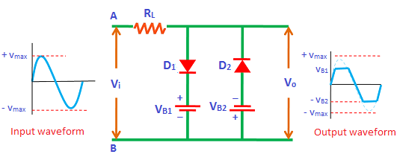
During positive half cycle:
During the positive half cycle, the diode D₁ is forward biased by the input supply voltage V_{i} and reverse biased by the battery voltage V_{B1}. On the other hand, the diode D₂ is reverse biased by both input supply voltage V_{i} and battery voltage V_{B2.}
Initially, the input supply voltage is less than the battery voltage. So the diode D₁ is reverse biased by the battery voltage V_{B1}. Similarly, the diode D₂ is reverse biased by the battery voltage V_{B2}. As a result, the signal appears at the output. However, when the input supply voltage V_{i} becomes greater than the battery voltage V_{B1}, the diode D₁ is forward biased by the input supply voltage. As a result, no signal appears at the output.

Slide 59
During negative half cycle:
During the negative half cycle, the diode D₁ is reverse biased by both input supply voltage V_{i} and battery voltage V_{B1}. On the other hand, the diode D₂ is forward biased by the input supply voltage V_{i} and reverse biased by the battery voltage V_{B2}.
Initially, the battery voltage is greater than the input supply voltage. Therefore, the diode D₁ and diode D₂ are reverse biased by the battery voltage. As a result, the signal appears at the output.
When the input supply voltage becomes greater than the battery voltage V_{B2}, the diode D₂ is forward biased. As a result, no signal appears at the output.

Slide 60
Applications of clippers
Clippers are commonly used in power supplies.
They are employed for different wave generation such as square, rectangular, or trapezoidal waves.
Series clippers are used as noise limiters in FM transmitters.
Clippers are often referred to as voltage limiters, current limiters, slicers, or amplitude selectors.
Clipper circuits are extensively used in digital computers, radars, television receivers, radio receivers and other electronic systems for removing unwanted portion of the input AC signal.

Slide 61
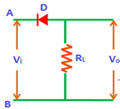
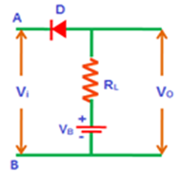
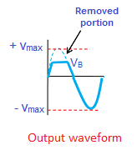
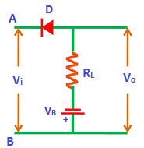
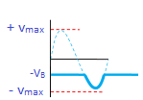
 | Type of Clipper | Output Waveform | Remark
1 |  |  | Series positive clipper removes the series of positive half cycles.
2 |  |  | Thus, the series positive clipper with positive bias removes a small portion of positive half cycles.
3 |  |  | Series positive clipper with negative bias

Slide 62
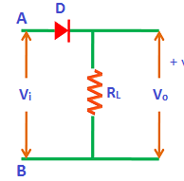
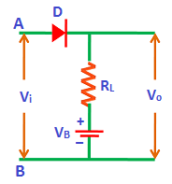
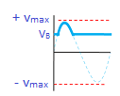
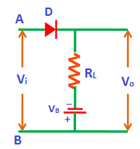
 | Type of Clipper | Output Waveform | Remark
4 |  |  | Thus, the series negative clipper removes the series of negative half cycles.
5 |  |  | When the input supply voltage V_{i} becomes greater than the battery voltage V_{B}, the diode is forward biased and allows electric current. As a result, the signal appears at the output. During the negative half cycle, no signal appears at the output.
6 |  |  | During the positive half cycle, the diode D is forward biased by both input supply voltage V_{i} and the battery voltage V_{B}.

Slide 63
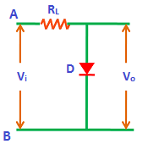
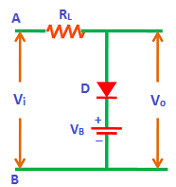
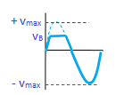
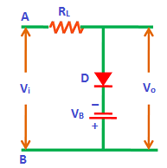
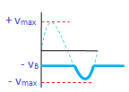
 | Type of clipper | Output Waveform | Remarks
7 |  |  | The shunt clipper passes the input signal to the output load when the diode is reverse biased and blocks the input signal when the diode is forward biased.
8 |  |  | Shunt positive clipper with positive bias
9 |  |  | Shunt positive clipper with negative bias

Slide 64
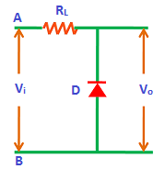
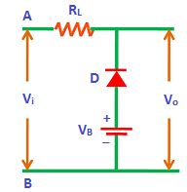
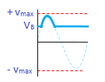
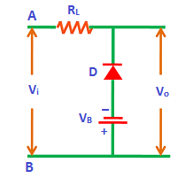
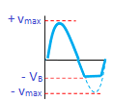
10 |  |  | Shunt negative clipper
11 |  |  | Shunt negative clipper with positive bias
12 |  |  | Shunt negative clipper with negative bias

Slide 65
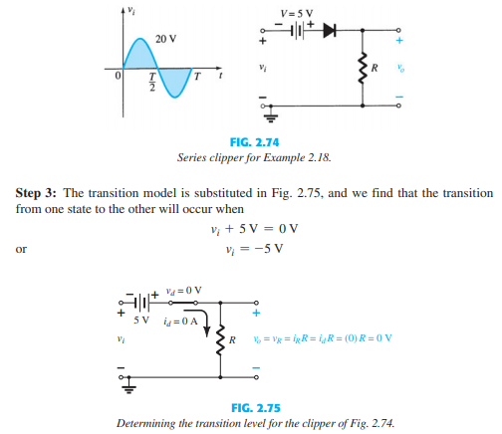
Numerical

Slide 66
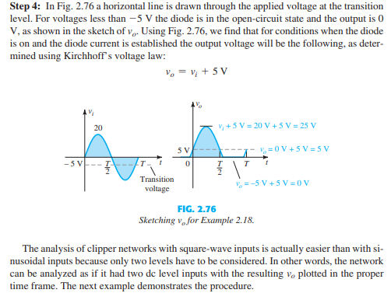

Slide 67
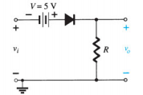
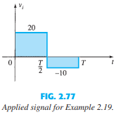

Slide 70
Clamper circuits
A clamper is an electronic circuit that changes the DC level of a signal to the desired level without changing the shape of the applied signal.
In other words, the clamper circuit moves the whole signal up or down to set either the positive peak or negative peak of the signal at the desired level.

Slide 71
The dc component is simply added to the input signal or subtracted from the input signal.
A clamper circuit adds the positive dc component to the input signal to push it to the positive side.
Similarly, a clamper circuit adds the negative dc component to the input signal to push it to the negative side.

Slide 72
The construction of the clamper circuit is almost similar to the clipper circuit. The only difference is the clamper circuit contains an extra element called capacitor. A capacitor is used to provide a dc offset (dc level) from the stored charge.
A typical clamper is made up of a capacitor, diode, and resistor.
Some clampers contain an extra element called DC battery. The resistors and capacitors are used in the clamper circuit to maintain an altered DC level at the clamper output.
The clamper is also referred to as a DC restorer, clamped capacitors, or AC signal level shifter.

Slide 73
The chosen resistor and capacitor of the network must be chosen such that the time constant determined by
is sufficiently large to ensure that the voltage across the capacitor does not discharge significantly during the interval the diode is non conducting.
We assume that for all practical purposes the capacitor fully charges or discharges in five time constant.

Slide 74
Types of clampers
Clamper circuits are of three types:
Positive clampers
Negative clampers
Biased clampers

Slide 75
Steps to analyze clamper circuits
1. Start the analysis by examining the response of the portion of the input signal that will forward bias the diode.
2. During the period that the diode is in the “on” state, assume that the capacitor will charge up instantaneously to a voltage level determined by the surrounding network.

Slide 76
3. Assume that during the period when the diode is in the “off” state the capacitor holds on to its established voltage level.
4. Through out the analysis, maintain a continual awareness of the location and defined polarity for Vo to ensure that the proper levels are obtained.
5. Check that the total swing of the output matches that of the input.

Slide 77
Negative Clamper Positive cycle
For the network shown in Figure(a) the diode will be forward biased for the positive portion of the applied signal.
For the interval 0 to T/2 the network will appear as shown in Figure (b)
The short circuit equivalent for the diode will result in Vo=0V for this interval.

Slide 78
During the same interval of time, the time constant determined by is very small because the resistor R has been effectively “shorted out” by the conducting diode and the only resistance present is the inherent (contact, wire) resistance of the network.
The result is that the capacitor will quickly charge to the peak value of V volts with the polarity indicated.

Slide 79
Negative Cycle
When the input switches to the –V state, the network will appear as shown.
With the open-circuit equivalent for the diode determined by the applied signal and stored voltage across the capacitor both pressuring current through the diode from cathode to anode.
Now that R is back in the network the time constant determined by the RC product is sufficiently large to establish a discharge period 5ς, much greater than the period T/2 to T

Slide 80
It is assumed on an approximate basis that capacitor holds onto all its charge and, therefore voltage (since V=Q/C) during this period.
Since Vo Is in parallel with the diode and resistor, it can also be drawn as shown. Applying KVL around the input loop results in
-V – V - Vo = 0
Vo = - 2V

Slide 81
The negative sign results from the fact that the polarity of 2V is opposite to the polarity defined for V0.
The output is clamped to 0V for the interval 0 to T/2 but maintains the same total swing (2V) as the input.

Slide 85
Numerical
Determine Vo for the network
Solution : Frequency is 1000 Hz resulting in a period of 1ms and an interval of 0.5 ms between levels.
Analysis will begin with the period t1 to t2 of the input signal since the diode is in its short-circuit state.
For this interval the network will appear as shown

Slide 86
The output is across R, but it is also directly across the 5 V battery, therefore Vo = 5V.
Applying KVL around the input loop results in
-20 + Vc -5 = 0
Vc = 25 V
The capacitor will therefore charge up to 25 V.

Slide 87
For the period t2 to t3 the network will appear as shown
The open circuit equivalent for the diode removes the 5V battery from having any effect on Vo and applying KVL around the outside loop of the network results in
10 + 25 – Vo = 0
Vo = 35 V

Slide 88
The time constant of the discharging network is determined by the product of RC and has the magnitude
ς= RC = (100 K ) (0.1 μ F) = 0.01 s = 10ms
The total discharge time is therefore
5 ς = 5 (10ms) = 50ms

Slide 89
2. Repeat previous example using a silicon diode with Vt = 0.7 V

Slide 90
Comparison Chart

Slide 91
TRANSISTORS

Slide 92
Your brain contains around 100 billion cells called neurons—the tiny switches that let you think and remember things. Computers contain billions of miniature "brain cells" as well. They're called transistors and they're made from silicon, a chemical element commonly found in sand. Transistors have revolutionized electronics since they were first invented over half a century ago by John Bardeen, Walter Brattain, and William Shockley.
But what are they—and how do they work?

Slide 93
Types of Transistor

Slide 94
Why Do We Need Transistors?
Suppose that you have a FM receiver which grabs the signal you want. The received signal will obviously be weak due to the disturbances it would face during its journey. Now if this signal is read as it is, you cannot get a fair output. Hence we need to amplify the signal. Amplification means increasing the signal strength.
This is just an instance. Amplification is needed wherever the signal strength has to be increased. This is done by a transistor. A transistor also acts as a switch to choose between available options. It also regulates the incoming current and voltage of the signals.

Slide 95
Bipolar Junction Transistor
After knowing the details about a single PN junction, or simply a diode, let us try to go for the two PN junction connection.
If another P-type material or N-type material is added to a single PN junction, another junction will be formed. Such a formation is simply called as a Transistor.
A Transistor is a three terminal semiconductor device that regulates current or voltage flow and acts as a switch or gate for signals.

Slide 96
The first stage of making a transistor is the process of changing the semiconductor conducting properties by introducing impurities into its structure. This conduction change process is referred to as Doping.
Simply stated, a P slice of the sandwich is more positive and an N slice of the sandwich is more negative because of Doping.

Slide 97
Constructional Details of a Transistor
The Transistor is a three terminal solid state device which is formed by connecting two diodes back to back.
Hence it has got two PN junctions.
Three terminals are drawn out of the three semiconductor materials present in it. This type of connection offers two types of transistors.
They are PNP and NPN which means an N-type material between two P types and the other is a P-type material between two N-types respectively.

Slide 98
Bipolar Transistor Construction

Slide 99
A bipolar junction transistor is a three-terminal semiconductor device consisting of two p-n junctions which are able to amplify or magnify a signal. It is a current controlled device.
The three terminals of the BJT are the base, the collector and the emitter.
Transfer + Resistor ⇒ Transistor
It can be used either as an amplifier or as a switch. The basic amplify action is produced by transferring a current from low resistance to high resistance.
It is a bipolar device because currents flow due to both majority and minority carriers.

Slide 100
BJT is more sensitive to the temperature or thermally unstable.
BJT has greater gain-bandwidth product. And therefore it is more preferred in high-frequency amplification over FET.
BJT has better switching action in digital circuits.
The emitter is heavily doped so that it can emit or supply a large number of carriers.
The base region is lightly doped to improve emitter injunction efficiency (Thus less number of recombination take place).
If Collector is lightly doped, its conductivity becomes smaller and Collector region will not be able to pass higher current which is undesired.
If Collector is heavily doped, the breakdown voltage of Collector junction becomes smaller which is also undesired.

Slide 101
Uses of a transistor
A transistor acts as an Amplifier, where the signal strength has to be increased.
A transistor also acts as a switch to choose between available options.
It also regulates the incoming current and voltage of the signals.

Slide 102
The 3 terminals of the transistor are explained briefly:
(i) Emitter: It is a heavily doped terminal through which electrons enter. It is always forward biased w.r.t. base so that it can supply a large number of majority carriers. As shown in the figure above, the emitter of PNP transistor (right side figure) is forward biased and supplies hole charges to its junction with the base while the emitter of NPN transistor (left side figure) supplies electron charges to its junction.

Slide 103
(ii) Base: It is lightly doped terminal through which electrons pass from the emitter to collector. The base-emitter junction is forward biased and allows low resistance to the emitter circuit while the base-collector junction is reverse biased and provides high resistance in the collector circuit. The Depletion layer is formed in the base junction of the transistor.
(iii) Collector: It is a moderately doped terminal which basically collects electron. The collector is always reverse biased and its function is to remove charges from its junction with the base. As shown in the figure above, the collector of the PNP transistor is reverse biased and receives hole charges that flow in the outer circuit while the collector of NPN transistor receives electron charges.

Slide 104
Transistor Biasing
As we know that a transistor is a combination of two diodes, we have two junctions here. As one junction is between the emitter and base, that is called as Emitter-Base junction and likewise, the other is Collector-Base junction.
Biasing is controlling the operation of the circuit by providing power supply. The function of both the PN junctions is controlled by providing bias to the circuit through some dc supply. The figure below shows how a transistor is biased.

Slide 105
By having a look at the above figure, it is understood that
The N-type material is provided negative supply and P-type material is given positive supply to make the circuit Forward bias.
The N-type material is provided positive supply and P-type material is given negative supply to make the circuit Reverse bias.
By applying the power, the emitter base junction is always forward biased as the emitter resistance is very small. The collector base junction is reverse biased and its resistance is a bit higher. A small forward bias is sufficient at the emitter junction whereas a high reverse bias has to be applied at the collector junction.
The direction of current indicated in the circuits above, also called as the Conventional Current, is the movement of hole current which is opposite to the electron current.

Slide 106
Operation NPN Transistor
Here emitter-base junction is forward biased and collector-base junction is reverse biased.
The voltage V_{EE} provides a negative potential at the emitter which repels the electrons in the N-type material and these electrons cross the emitter-base junction, to reach the base region. There a very low percent of electrons recombine with free holes of P-region. This provides very low current which constitutes the base current I_{B}. The remaining holes cross the collector-base junction, to constitute the collector current I_{C}.

Slide 107
As an electron reaches out of the collector terminal, and enters the positive terminal of the battery, an electron from the negative terminal of the battery V_{EE} enters the emitter region. This flow slowly increases and the electron current flows through the transistor.
Hence we can understand that −
The conduction in a NPN transistor takes place through electrons.
The collector current is higher than the emitter current.
The increase or decrease in the emitter current affects the collector current.

Slide 108
Operation PNP Transistor
Here emitter-base junction is forward biased and collector-base junction is reverse biased.
The voltage V_{EE} provides a positive potential at the emitter which repels the holes in the P-type material and these holes cross the emitter-base junction, to reach the base region. There a very low percent of holes recombine with free electrons of N-region. This provides very low current which constitutes the base current I_{B}. The remaining holes cross the collector-base junction, to constitute collector current I_{C}, which is the hole current.

Slide 109
As a hole reaches the collector terminal, an electron from the battery negative terminal fills the space in the collector. This flow slowly increases and the electron minority current flows through the emitter, where each electron entering the positive terminal of V_{EE}, is replaced by a hole by moving towards the emitter junction. This constitutes emitter current I_{E}.
Hence we can understand that −
The conduction in a PNP transistor takes place through holes.
The collector current is slightly less than the emitter current.
The increase or decrease in the emitter current affects the collector current.

Slide 110
Advantages of Transistor
Lower cost and smaller in size.
Smaller mechanical sensitivity.
Low operating voltage.
Extremely long life.
No power consumption.
Fast switching.
Better efficiency circuits can be developed.
Used to develop a single integrated circuit.
Limitations of Transistors
Transistors lack higher electron mobility.
Transistors can be easily damaged when electrical and thermal events arise. For example, electrostatic discharge in handling.
Transistors are affected by cosmic rays and radiation.

Slide 111
The three types of configurations are
Common Base,
Common Emitter and
Common Collector configurations.
In every configuration, the emitter junction is forward biased and the collector junction is reverse biased.

Slide 112
Common Base CB Configuration
The name itself implies that the Base terminal is taken as common terminal for both input and output of the transistor. The common base connection for both NPN and PNP transistors is as shown in the following figure.

Slide 113
For the sake of understanding, let us consider NPN transistor in CB configuration. When the emitter voltage is applied, as it is forward biased, the electrons from the negative terminal repel the emitter electrons and current flows through the emitter and base to the collector to contribute collector current. The collector voltage V_{CB} is kept constant throughout this.
In the CB configuration, the input current is the emitter current I_{E} and the output current is the collector current I_{C}.

Slide 114
Current Amplification Factor α
The ratio of change in collector current ΔIC to the change in emitter current ΔIE when collector voltage V_{CB} is kept constant, is called as Current amplification factor.
It is denoted by α.
α=ΔIC/ΔIE at constant Vcb

Slide 115
Expression for Collector current
Let us try to draw some expression for collector current.
Along with the emitter current flowing, there is some amount of base current Ib which flows through the base terminal due to electron hole recombination.
As collector-base junction is reverse biased, there is another current which is flown due to minority charge carriers. This is the leakage current which can be understood as I_{leakage}.
This is due to minority charge carriers and hence very small.
The emitter current that reaches the collector terminal is
αIE
Total collector current
IC=αIE + Ileakage

Slide 116
If the emitter-base voltage V_{EB} = 0, even then, there flows a small leakage current, which can be termed as I_{CBO} collector−base current with output open collector−base current with output open.
The collector current therefore can be expressed as

Slide 117
Hence the above derived is the expression for collector current. The value of collector current depends on base current and leakage current along with the current amplification factor of that transistor in use.

Slide 118
Characteristics of CB configuration
Characteristics of the transistor are the plots which can represent the relation between the current and the voltage of a transistor in a particular configuration.
There are two types of characteristics.
Input characteristics: It will give us the details about the change in input current with the variation in input voltage by keeping output voltage constant.
Output characteristics: It is a plot of output current with output voltage by keeping input current constant.
Current transfer Characteristics: This plot shows the variation of output current with the input current by keeping the voltage constant.

Slide 119
Input Characteristics
This chart will describe the variation of emitter current, I_{E} with base – Emitter voltage, V_{BE} keeping collector voltage constant, V_{CB}.

Slide 120
Output Characteristics
This chart shows the variation of collector current, I_{C} with V_{CB} by keeping emitter current I_{E} constant.

Slide 121
This configuration provides voltage gain but no current gain.
Being V_{CB} constant, with a small increase in the Emitter-base voltage V_{EB}, Emitter current I_{E} gets increased.
Emitter Current I_{E} is independent of Collector voltage V_{CB}.
Collector Voltage V_{CB} can affect the collector current I_{C} only at low voltages, when V_{EB} is kept constant.
The input resistance ri is the ratio of change in emitter-base voltage ΔVEB to the change in emitter current ΔIE at constant collector base voltage V_{CB}.

Slide 122
As the input resistance is of very low value, a small value of V_{EB} is enough to produce a large current flow of emitter current I_{E}.
The output resistance r_{o} is the ratio of change in the collector base voltage ΔVCB to the change in collector current ΔIC at constant emitter current I_{E}.
ro=ΔVCB/ΔIC at constant lE
As the output resistance is of very high value, a large change in V_{CB} produces a very little change in collector current I_{C}.
This Configuration provides good stability against increase in temperature.
The CB configuration is used for high frequency applications.

Slide 123
Common Emitter CE Configuration
The name itself implies that the Emitter terminal is taken as common terminal for both input and output of the transistor. The common emitter connection for both NPN and PNP transistors is as shown in the following figure.

Slide 124
Just as in CB configuration, the emitter junction is forward biased and the collector junction is reverse biased. The flow of electrons is controlled in the same manner. The input current is the base current I_{B} and the output current is the collector current I_{C} here.

Slide 125
Base Curent Amplification factor β
The ratio of change in collector current ΔIC to the change in base current ΔIB is known as Base Current Amplification Factor.
It is denoted by β
β=ΔIC/ΔIB

Slide 126
Relation between β and α
Let us try to derive the relation between base current amplification factor and emitter current amplification factor.

Slide 127
From the above equation, it is evident that, as α approaches 1, β reaches infinity.
Hence, the current gain in Common Emitter connection is very high. This is the reason this circuit connection is mostly used in all transistor applications.

Slide 128
Expression for Collector Current
In the Common Emitter configuration, I_{B} is the input current and I_{C} is the output current.
We know

Slide 129
If base circuit is open, i.e. if I_{B} = 0,
The collector emitter current with base open is I_{CEO}

Slide 130
Knee Voltage
In CE configuration, by keeping the base current I_{B} constant, if V_{CE} is varied, I_{C} increases nearly to 1v of V_{CE} and stays constant thereafter.
This value of V_{CE} up to which collector current I_{C} changes with V_{CE} is called the Knee Voltage.
The transistors while operating in CE configuration, they are operated above this knee voltage.

Slide 131
Input Characteristics
Here it shows the variation in I_{B} in accordance with V_{BE} by keeping V_{CE} constant.

Slide 132
Output Characteristics
Here it shows the variation in I_{C} with the changes in V_{CE} by keeping I_{B} constant.

Slide 133
Characteristics of CE Configuration
This configuration provides good current gain and voltage gain.
Keeping V_{CE} constant, with a small increase in V_{BE} the base current I_{B} increases rapidly than in CB configurations.
For any value of V_{CE} above knee voltage, I_{C} is approximately equal to βI_{B}.
The input resistance r_{i} is the ratio of change in base emitter voltage ΔVBE to the change in base current ΔIB at constant collector emitter voltage V_{CE}.
ri=ΔVBE/ΔIB at constant VCE
As the input resistance is of very low value, a small value of V_{BE} is enough to produce a large current flow of base current I_{B}.

Slide 134
The output resistance r_{o} is the ratio of change in collector emitter voltage ΔVCE to the change in collector current ΔIC at constant I_{B}.
ro=ΔVCE/ΔIC at constant IB
As the output resistance of CE circuit is less than that of CB circuit.
This configuration is usually used for bias stabilization methods and audio frequency applications.

Slide 135
Common Collector CC Configuration
The name itself implies that the Collector terminal is taken as common terminal for both input and output of the transistor. The common collector connection for both NPN and PNP transistors is as shown in the following figure.

Slide 136
Just as in CB and CE configurations, the emitter junction is forward biased and the collector junction is reverse biased. The flow of electrons is controlled in the same manner. The input current is the base current I_{B} and the output current is the emitter current I_{E} here.

Slide 139
Input
It shows the variation in I_{B} in accordance with V_{CB} with collector-emitter voltage V_{CE} keeping constant.

Slide 140
Output
This exhibit the variation in I_{E} against the changes in V_{CE} by keeping I_{B} constant.

Slide 141
Characteristics of CC Configuration
This configuration provides current gain but no voltage gain.
In CC configuration, the input resistance is high and the output resistance is low.
The voltage gain provided by this circuit is less than 1.
The sum of collector current and base current equals emitter current.
The input and output signals are in phase.
This configuration works as non-inverting amplifier output.
This circuit is mostly used for impedance matching. That means, to drive a low impedance load from a high impedance source.

Slide 142
For the sake of understanding, let us consider NPN transistor in CB configuration. When the emitter voltage is applied, as it is forward biased, the electrons from the negative terminal repel the emitter electrons and current flows through the emitter and base to the collector to contribute collector current. The collector voltage V_{CB} is kept constant throughout this.
In the CB configuration, the input current is the emitter current I_{E} and the output current is the collector current I_{C}.

Slide 143
BJT Biasing

Slide 144
Introduction – Biasing
The analysis or design of a transistor amplifier requires knowledge of both the dc and ac response of the system.
In fact, the amplifier increases the strength of a weak signal by transferring the energy from the applied DC source to the weak input ac signal.
The analysis or design of any electronic amplifier therefore has two components:
•The dc portion and
•The ac portion
During the design stage, the choice of parameters for the required dc levels will affect the ac response.

Slide 145
What is biasing circuit?
Biasing: Application of dc voltages to establish a fixed level of current and voltage.
Purpose of the DC biasing circuit
To turn the device “ON”
To place it in operation in the region of its characteristic where the device operates most linearly .
Proper biasing circuit which it operate in linear region and circuit have centered Q-point or midpoint biased
Improper biasing cause Improper biasing cause
Distortion in the output signal
Produce limited or clipped at output signal

Slide 146
Important basic relationship

Slide 147
Operating Point

Slide 148
DC Biasing Circuits
Fixed-bias circuit
Emitter-stabilized bias circuit
Collector-emitter loop
Voltage divider bias circuit
DC bias with voltage feedback

Slide 149
FIXED BIAS CIRCUIT
This is common emitter (CE) configuration
1st step: Locate capacitors and replace them with an open circuit
2nd step: Locate 2 main loops which;
BE loop (input loop)
CE loop(output loop)

Slide 150
1st step: Locate capacitors and replace them with an open circuit

Slide 151
2nd step: Locate 2 main loops

Slide 152
BE Loop Analysis

Slide 153
CE Loop Analysis
From KVL;
Note that does not affect the value of Ic

Slide 154
Disadvantage of Fixed Bias Circuit
Unstable – because it is too dependent on β and produce width change of Q-point
For improved bias stability , add emitter resistor to dc bias.

Slide 155
Load Line Analysis
A fixed bias circuit with given values of Vcc, Rc and Rb can be analyzed ( means, determining the values of IbQ, IcQ and VceQ) using the concept of load line also.
Here the input loop KVL equation is not used for the purpose of analysis, instead, the output characteristics of the transistor used in the given circuit and output loop KVL equation are made use of.

Slide 156
EMITTER-STABILIZED BIAS CIRCUIT
An emitter resistor, RE is added to improve stability
1st step: Locate capacitors and replace them with an open circuit
2nd step: Locate 2 main loops which;
BE loop
CE loop

Slide 157
1st step: Locate capacitors and replace them with an open circuit

Slide 158
2nd step: Locate 2 main loops.

Slide 159
BE Loop Analysis
Substitute for I_{E}

Slide 160
CE Loop Analysis

Slide 161
Improved Bias Stability
The addition of the emitter resistor to the dc bias of the BJT provides improved stability, that is, the dc bias currents and voltages remain closer to where they were set by the circuit when outside conditions, such as temperature, and transistor beta, change.
Note :it seems that beta in numerator canceled with beta in denominator

Slide 162
VOLTAGE DIVIDER BIAS CIRCUIT
Provides good Q-point stability with a single polarity supply voltage
This is the biasing circuit wherein, ICQ and VCEQ are almost independent of beta.
The level of IBQ will change with beta so as to maintain the values of ICQ and VCEQ almost same, thus maintaining the stability of Q point.
Two methods of analyzing a voltage divider bias circuit are:
Exact method : can be applied to any voltage divider circuit
Approximate method : direct method, saves time and energy,

Slide 163
1st step: Locate capacitors and replace them with an open circuit
2nd step: Simplified circuit using Thevenin Theorem
3rd step: Locate 2 main loops which;
BE loop
CE loop

Slide 164
2nd step: : Simplified circuit using Thevenin Theorem

Slide 165
2nd step: Locate 2 main loops.

Slide 166
BE Loop Analysis
From KVL
Recall,
Substitute for

Slide 167
CE Loop Analysis
Assume

Slide 168
DC Bias with Voltage Feedback
Another way to improve the stability of a bias circuit is to add a feedback path from collector to base.
In this bias circuit the Q-point is only slightly dependent on the transistor beta, β.

Slide 169
Base Emitter Loop
Where
Knowing IC= βIB and IE ≅ IC, the loop
equation becomes:

Slide 177
Field-Effect Transistors

Slide 178
FET stands for “Field Effect Transistor” it is a three terminal uni polar solid state device in which current is control by an electric field.
It can be fabricated with either n-channel or p-channel, for the fabrication of n-channel JFET first a narrow bar of n-type of semiconductor material is taken and then two p-type junction are defused on opposite sides of its middle part, called channel.
The two regions are internally connected to each other with a signal lead, which is called gate terminal.
One lead is called source terminal and the other is called drain terminal.

Slide 179
FET Types
JFET: Junction FET
MOSFET: Metal–Oxide–Semiconductor FET
D-MOSFET: Depletion MOSFET
E-MOSFET: Enhancement MOSFET

Slide 180
JFET Construction
There are two types of JFETs
•n-channel
•p-channel
The n-channel is more widely used.
There are three terminals:
Drain (D) and Source (S) are connected to the n-channel
Gate (G) is connected to the p-type material

Slide 181
Junction Field Effect Transistor
The functioning of Junction Field Effect Transistor depends upon the flow of majority carriers (electrons or holes) only.
Basically, JFETs consist of an N type or P type silicon bar containing PN junctions at the sides. Following are some important points to remember about FET −
Gate − By using diffusion or alloying technique, both sides of N type bar are heavily doped to create PN junction. These doped regions are called gate (G).
Source − It is the entry point for majority carriers through which they enter into the semiconductor bar.
Drain − It is the exit point for majority carriers through which they leave the semiconductor bar.
Channel − It is the area of N type material through which majority carriers pass from the source to drain.

Slide 182
Comparison of Connections between a JFET and a BJT
FETs vs. BJTs
The symbols and basic construction for both configurations of JFETs are shown below.

Slide 183
FETs vs. BJTs
Similarities:
• Amplifiers
• Switching devices
• Impedance matching circuits
Differences:
• FETs are voltage controlled devices. BJTs are current controlled devices.
• FETs have a higher input impedance. BJTs have higher gains.
• FETs are less sensitive to temperature variations and are more easily integrated on ICs.
• FETs are generally more static sensitive than BJTs.

Slide 184
JFET Operation: The Basic Idea
JFET operation can be compared to a water spigot.
The source of water pressure is the accumulation of electrons at the negative pole of the drain-source voltage.
The drain of water is the electron deficiency (or holes) at the positive pole of the applied voltage.
The control of flow of water is the gate voltage that controls the width of the n-channel and, therefore, the flow of charges from source to drain.

Slide 185
JFET Operating Characteristics`
There are three basic operating conditions for a JFET:
• V_{GS} = 0, V_{DS} increasing to some positive value
• V_{GS} < 0, V_{DS} at some positive value
• Voltage-controlled resistor

Slide 186
The semiconductor “channel” of the Junction Field Effect Transistor is a resistive path through which a voltage V_{DS} causes a current I_{D} to flow and as such the junction field effect transistor can conduct current equally well in either direction.
As the channel is resistive in nature, a voltage gradient is thus formed down the length of the channel with this voltage becoming less positive as we go from the Drain terminal to the Source terminal.

Slide 187
The result is that the PN-junction therefore has a high reverse bias at the Drain terminal and a lower reverse bias at the Source terminal. This bias causes a “depletion layer” to be formed within the channel and whose width increases with the bias.
The magnitude of the current flowing through the channel between the Drain and the Source terminals is controlled by a voltage applied to the Gate terminal, which is a reverse-biased.
In an N-channel JFET this Gate voltage is negative while for a P-channel JFET the Gate voltage is positive.

Slide 188
JFET Operating Characteristics: V_{GS} = 0 V
Three things happen when V_{GS} = 0 and V_{DS} is increased from 0 to a more positive voltage
The depletion region between p-gate and n-channel increases as electrons from n-channel combine with holes from p-gate.
Increasing the depletion region, decreases the size of the n-channel which increases the resistance of the n-channel.

Slide 189
3. Even though the n-channel resistance is increasing, the current (I_{D}) from source to drain through the n-channel is increasing. This is because V_{DS} is increasing.

Slide 190
JFET Operating Characteristics: Pinch Off
If V_{GS} = 0 and V_{DS} is further increased to a more positive voltage, then the depletion zone gets so large that it pinches off the n-channel.
This suggests that the current in the n-channel (I_{D}) would drop to 0A, but it does just the opposite–as V_{DS} increases, so does I_{D}.

Slide 191
JFET Operating Characteristics: Saturation
At the pinch-off point:
Any further increase in V_{GS} does not produce any increase in I_{D}. V_{GS} at pinch-off is denoted as Vp.
• I_{D} is at saturation or maximum. It is referred to as I_{DSS}.
• The ohmic value of the channel is maximum.

Slide 192
JFET Operating Characteristics
As V_{GS} becomes more negative, the depletion region increases.

Slide 193
JFET Operating Characteristics
As V_{GS} becomes more negative:
The JFET experiences pinch-off at a lower voltage (V_{P}).
I_{D} decreases (I_{D} < I_{DSS}) even though V_{DS} is increased.

Slide 194
Eventually I_{D} reaches 0 A. V_{GS} at this point is called Vp or V_{GS}(off).
Also note that at high levels of V_{DS} the JFET reaches a breakdown situation. I_{D} increases uncontrollably if V_{DS} > V_{DSmax}
.

Slide 195
JFET Operating Characteristics: Voltage-Controlled Resistor
The region to the left of the pinch-off point is called the ohmic region.
The JFET can be used as a variable resistor, where V_{GS} controls the drain-source resistance (rd). As V_{GS} becomes more negative, the resistance (r_{d} ) increases.

Slide 196
p-Channel JFETS
The p-channel JFET behaves the same as the n-channel JFET, except the voltage polarities and current directions are reversed.

Slide 197
p-Channel JFET Characteristics
As V_{GS} increases more positively
• The depletion zone increases
• I_{D} decreases (I_{D} < I_{DSS})
• Eventually I_{D} = 0 A
Also note that at high levels of V_{DS} the JFET reaches a breakdown situation: I_{D} increases uncontrollably if V_{DS} > V_{DSmax}

Slide 198
JFET Transfer Characteristics
The transfer characteristic of input-to-output is not as straightforward in a JFET as it is in a BJT.
In a BJT, β indicates the relationship between I_{B} (input) and I_{C} (output). I_{C} = βI_{B}
In a JFET, the relationship of V_{GS} (input) and I_{D} (output) is a little more complicated. This is defined by Shockley’s Equation

Slide 199
JFET Transfer Curve
This graph shows the value of I_{D} for a given value of V_{GS}.

Slide 200
https://www.youtube.com/watch?v=RWIk3_NT_jg
Working of FET https://www.youtube.com/watch?v=gYPQ_3lq4dI

Slide 201
MOSFET

Slide 202
Introduction
MOSFETs have characteristics similar to JFETs and additional characteristics that make then very useful.
There are two types of MOSFETs:
•Depletion-Type
•Enhancement-Type

Slide 203
Depletion-Type MOSFET Construction

Slide 204
Depletion-Type MOSFET : Basic Operation and Characteristics

Slide 205
Depletion-Type MOSFET : Basic Operation and Characteristics

Slide 206
Depletion-Type MOSFET :Basic Operation and Characteristics

Slide 207
Basic MOSFET Operation
A depletion-type MOSFET can operate in two modes:
•Depletion mode
•Enhancement mode

Slide 208
D-Type MOSFET in Depletion Mode

Slide 209
D-Type MOSFET in Enhancement Mode
Note that V_{GS} is now a positive polarity

Slide 210
p-Channel D-Type MOSFET

Slide 211
D-Type MOSFET Symbols
(a) n-channel depletion-type MOSFETs ,(b) p-channel depletion-type MOSFETs

Slide 212
Enhancement-Type MOSFET Construction

Slide 213
Enhancement-Type MOSFET Construction

Slide 214
Basic Operation of the E-Type MOSFET
The enhancement-type MOSFET operates only in the enhancement mode.

Slide 215
E-Type MOSFET Transfer Curve

Slide 216
E-Type MOSFET Transfer Curve

Slide 217
p-Channel E-Type MOSFETs

Slide 218
MOSFET Symbols

Slide 219
https://www.youtube.com/watch?v=stM8dgcY1CA
https://www.youtube.com/watch?v=AoXhq5nAGVs
https://www.youtube.com/watch?v=hleOUSrTCmY

Slide 220
FET Biasing

Slide 221
Introduction
For FET, the relationship between the input and output quantities is non-linear due to the squared term in Shockley’s equation.
This results in curves as obtained for the transfer characteristics of a JFET.
The non linear relationship between I_{D} and V_{GS} can complicate the mathematical approach to the dc analysis of FET configurations.
A graphical approach may limit solutions to tenths-place accuracy, but it is a quicker method for most FET amplifiers.

Slide 222
It is particularly important to realize that all of the equations above are for the device only!. They do not change with each network configuration so long as the device is in active region.

Slide 224
Fixed Bias Configuration
The simplest of biasing arrangements for the n-channel JFET.
It is one of the few configurations that can be solved just as directly using either a mathematical or a graphical approach.
It includes the ac levels V_{i} and V_{o} and the coupling capacitors (C₁ and C₂ ).
Coupling capacitors are “open circuits” for the dc analysis and low impedance (short circuits) for the ac analysis.

Slide 225
For the dc analysis
The zero-volt drop across R_{G} permits replacing R_{G} by a short-circuit equivalent, as appearing in the network redrawn for the dc analysis.
The fact that the negative terminal of the battery is connected directly to the defined positive potential of V_{GS} clearly reveals that the polarity of V_{GS} is directly opposite to that of V_{GG}. KVL in the clockwise direction will result in

Slide 226
Since V_{GG} is a fixed dc supply, the voltage V_{GS} is fixed in magnitude, resulting in the notation “fixed bias configuration”. The resulting level of drain current I_{D} is now controlled by Shockley’s equation.
Since V_{GS} is fixed quantity, its magnitude and sign can simply be substituted into Shockley’s equation and the resulting level of I_{D} calculated. Here, a mathematical solution to a FET configuration is quite direct.

Slide 227
On the other hand, graphical analysis would require a plot of Shockley’s equation.
Recall that choosing V_{GS}= V_{P}/2 will result in a drain current of I_{DSS}/4 when plotting the equation.
In this analysis, four points defined by I_{DSS}, V_{P} and intersection will be sufficient for plotting the curve.

Slide 231
Self Bias Configuration
For the dc analysis, the capacitors can again be replaced by “open circuits” and the resistor R_{G}
replaced by a short circuit equivalent since I_{G} = 0A.

Slide 243
35

Slide 266
FET Small Signal Model

Slide 292
BJT AC Analysis

Slide 293
Introduction
In sinusoidal ac analysis of transistor networks is the magnitude of the input signal.
It will determine whether small-signal or large-signal techniques should be applied.
There are three models commonly used in the small-signal ac analysis of transistor networks: the r_{e} model, the hybrid π model, and the hybrid equivalent model.

Slide 294
Introduction
A model is a combination of circuit elements, properly chosen, that best approximates the actual behavior of a semiconductor device under specific operating conditions.
The small signal analysis suggests that for a small signal, transistor behaves as a voltage controlled current source.
The input port of the controlled current source is between base and emitter and output port is in between collector and emitter.

Slide 295
Once the ac equivalent circuit is determined, the schematic symbol for the device can be replaced by this equivalent circuit and the basic methods of circuit analysis applied to determine the desired quantities of the network.

Slide 296
Model
An ac equivalent circuit that represents the ac characteristics of the transistor
Uses circuit elements that approximate the behaviour of the transistor

Slide 297
The BJT Transistor Models
Re model
Hybrid π model
Hybrid equivalent model

Slide 298
BJT Transistor Modeling

Slide 299
BJT Transistor Modeling
The ac equivalent of a transistor network is obtained by:
1. Setting all dc sources to zero and replacing them by a short -circuit equivalent
2. Replacing all capacitors by a short -circuit equivalent
3. Removing all elements bypassed by the short -circuit equivalents introduced by steps 1 and 2
4. Redrawing the network in a more convenient and logical form

Slide 304
THE re TRANSISTOR MODEL
The re model employs a diode and controlled current source to duplicate the behavior of a transistor in the region of interest.
In fact, in general: BJT transistor amplifiers are referred to as current-controlled devices.

Slide 305
Common- Base Configuration
The common-base BJT of Fig. has been replaced by the re model for this configuration.
The transistor action in this configuration has been replaced by a single diode between emitter and base terminals and a controlled current source between base and collector terminals.
This is a simple equivalent circuit for a device that might have appeared more complicated.

Slide 306
When one compares the p-n junction at the input of the CB transistor to the use of a p-n junction diode the equivalence on the input side seems appropriate.
Since α is typically very close to one, the controlled source is simply stating that the output collector current is approximately equal to the input emitter current.
There is an isolation between input and output sides limiting the interaction between I/P and O/P sections to the controlled source.
Any controlled source will employ the diamond shape, whereas all fixed dc current sources will continue to employ the circle representation.

Slide 307
For the ac response the diode can be replaced by its equivalent ac resistance.
AC resistance of a diode is determined by
Due to the isolation that exists between input and output circuit of Fig. , it should be obvious that input impedance Z_{i} for CB is simply r_{e}
For the common-base configuration, typical values of Zi range from a few ohms to a maximum of about 50 Ω.

Slide 308
For output impedance, if we set the signal to zero, then
Ie = 0A and Ic=αIe =0
Resulting in an open circuit equivalence at the output terminals
Zo = ∞
In actuality: For the common-base configuration, typical values of Zo are in the megohm range.
In general, for the common-base configuration the input impedance is relatively small and the output impedance quite high.

Slide 312
Common Emitter Configuration
For the CE configuration, the input terminals are the base and emitter terminals, but the output set is now the collector and emitter terminals.
In addition, the emitter terminal is now common between the input and output ports of the amplifier.
Substituting the r_{e} equivalent circuit for the npn transistor results in the configuration of Figure (Slide 16)
Controlled current source is still connected between the collector and base terminals and the diode between the base and emitter terminals.
Base current is input current, whereas the output current is still I_{C}

Slide 316
In essence this equation states that the input impedance for a situation is beta times the value of r_{e}
In other words, a resistive element in the emitter leg is reflected into the input circuit by a multiplying factor β.

Slide 317
The r_{e} model does not include an output impedance, but if available it can be included as shown
If the contribution due to is ignored as in the r_{e} model, the output impedance is defined by
For the common-emitter configuration, typical values of Zo are in the range of 40 to 50 kΩ.

Slide 318
The voltage gain for the CE configuration will now be determined for the configuration of figure using the assumption that
For the defined direction of Io and polarity of Vo,
The minus sign simply reflects the fact that the direction of
would establish a voltage Vo with the opposite polarity.
Minus sign for the voltage gain reveals that the output and input voltages are 180 out of phase.
I₀

Slide 319
The current gain for the configuration is given by

Slide 320
Improved BJT equivalent circuit

Slide 321
Re model for the CE transistor configuration including effects of ro

Slide 325
Hybrid Equivalent Model
The re model for a transistor is sensitive to the dc level of operation of the amplifier. The result is an input resistance that will vary with the dc operating point.
For the hybrid equivalent model to be described in this section, the parameters are defined at an operating point that may or may not reflect the actual operating conditions of the amplifier.
The re model has the advantage that the parameters are defined by the actual operating conditions,
The parameters of the hybrid equivalent circuit are defined in general terms for any operating conditions.

Slide 327
The parameters relating the four variables are called h-parameters from the word “hybrid.”
The term hybrid was chosen because the mixture of variables (V and I ) in each equation results in a “hybrid” set of units of measurement for the h-parameters.
Hybrid parameters (also known as h parameters) are known as ‘hybrid’ parameters as they use Z parameters, Y parameters, voltage ratio, and current ratios to represent the relationship between voltage and current in a two port network.
H parameters are useful in describing the input-output characteristics of circuits where it is hard to measure Z or Y parameters (such as in a transistor).

Slide 328
To draw h parameter equivalent network of a two port network, first we have to write the equation of voltages and currents using h parameters. These are:
Equation (i) can be represented as a circuit based on Kirchhoff Voltage Law:
Equation (ii) can be represented as a circuit based on Kirchhoff Current Law:

Slide 329
Combining these two parts of the network we get:

Slide 330
Our description of the hybrid equivalent model will begin with the general two port system of Fig. The following set of equations is only one of a number

Slide 331
If we arbitrarily set Vo= 0 (short circuit the output terminals) and solve for h11 in Eq., the following will result:
Since it is the ratio of the input voltage to the input current with the output terminals shorted, it is called the short-circuit input-impedance parameter. The subscript 11 of h₁₁ defines the fact that the parameter is determined by a ratio of quantities measured at the input terminals.

Slide 332
If Ii is set equal to zero by opening the input leads, the following will result for h12:
It has no units since it is a ratio of voltage levels and is called the open-circuit reverse transfer voltage ratio parameter. The subscript 12 of h12 reveals that the parameter is a transfer quantity determined by a ratio of input to output measurements.

Slide 333
The first integer of the subscript defines the measured quantity to appear in the numerator; the second integer defines the source of the quantity to appear in the denominator. The term reverse is included because the ratio is an input voltage over an output voltage rather than the reverse ratio typically of interest.
If in Eq. (7.23b) Vo is equal to zero by again shorting the output terminals, the following will result for h21:
It is formally called the short-circuit forward transfer current ratio parameter. The subscript 21 again indicates that it is a transfer parameter with the output quantity in the numerator and the input quantity in the denominator.

Slide 334
The last parameter, h22, can be found by again opening the input leads to set I1 = 0 and solving for h22 in Eq. (7.23b):
It is called the open-circuit output admittance parameter. The subscript 22 reveals that it is determined by a ratio of output quantities.

Slide 335
Notations used in transistor amplifier for the three configurations

Slide 344
Bias Stabilization
The stability of a system is a measure of the sensitivity of a network to variations in its parameters.
In any amplifier employing a transistor the collector current IC is sensitive to each of the following parameters:

Slide 349
BJT small signal ac analysis
The transistor models introduced previously will now be used to perform a small signal ac analysis of a number of standard transistor network configurations.
COMMON-EMITTER FIXED-BIAS CONFIGURATION

