Slide 1
JAIPUR ENGINEERING COLLEGE AND RESEARCH CENTRE
Year & Sem – II Year & 3 Sem
Subject – Advanced Engineering Mathematics-I
Unit – III
Presented by – (Dr.U.K.Pareek, Professor)
1

Slide 2
VISION AND MISSION OF INSTITUTE
VISION OF INSTITUTE
To became a renowned centre of outcome based learning and work towards academic professional, cultural and social enrichment of the lives of individuals and communities .
MISSION OF INSTITUTE
Focus on evaluation of learning, outcomes and motivate students to research aptitude
by project based learning.
Identify based on informed perception of Indian, regional and global needs, the area of focus and provide platform to gain knowledge and solutions.
Offer opportunities for interaction between academic and industry .
Develop human potential to its fullest extent so that intellectually capable and imaginatively gifted leaders may emerge.
1

Slide 3
VISION AND MISSION OF DEPARTMENT
Vision
To be a place of academic excellence by imparting quality teaching, carrying out research and technology development in frontier areas of electronics and communication engineering.
Mission
To produce electronics and communication engineers having strong theoretical foundation, good practical knowledge and exposure to research and development.
To inculcate in students the sense of ethics, morality, professionalism, creativity, leadership, independent thinking, self confidence, good communication skills and prepare them to become successful engineers who can work worldwide in industries and research & development laboratories.
1

Slide 4
CONTENTS (TO BE COVERED)
Convolution Theorem
1

Slide 5
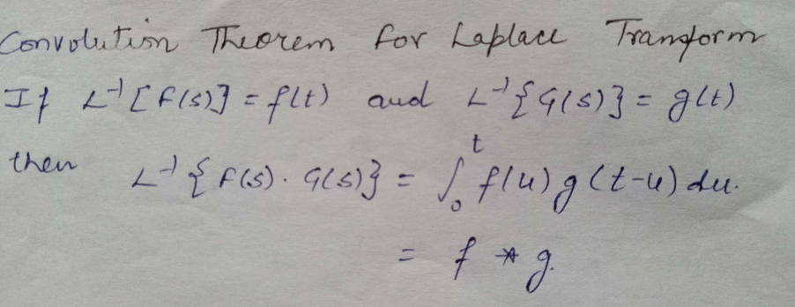
1

Slide 6
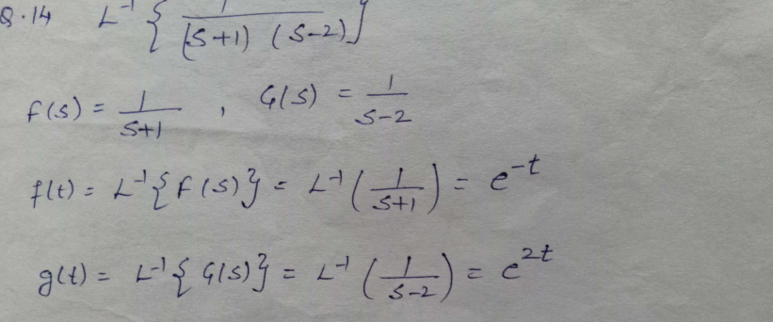
1

Slide 7
1

Slide 8
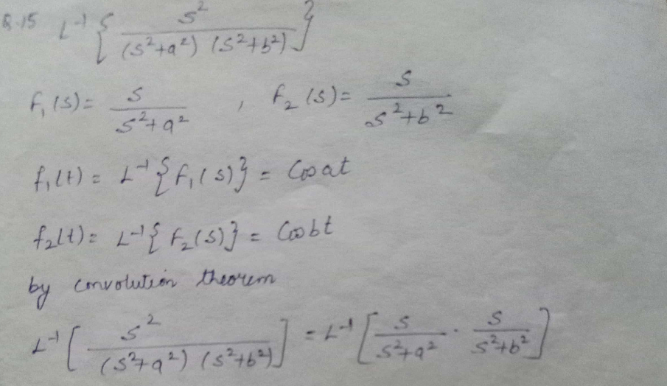
1

Slide 9
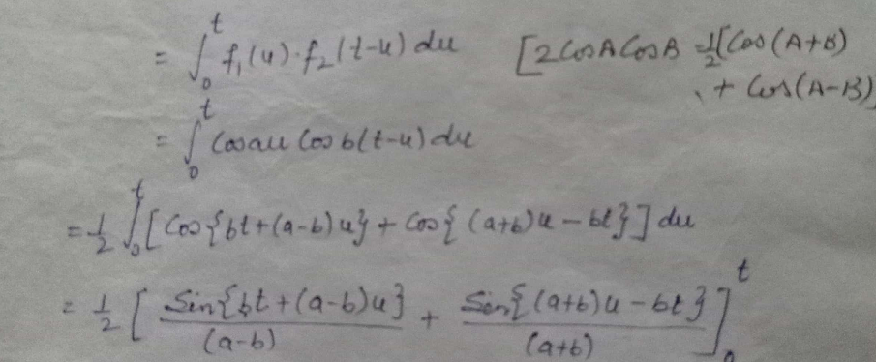
1

Slide 10
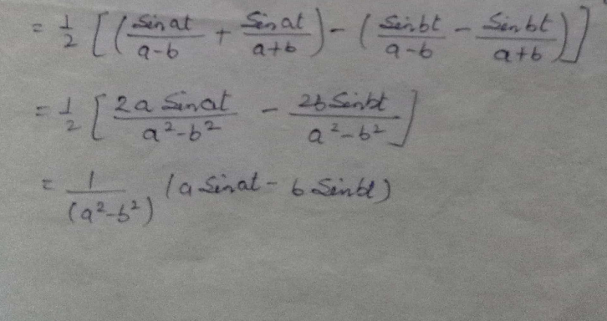
1

Slide 11
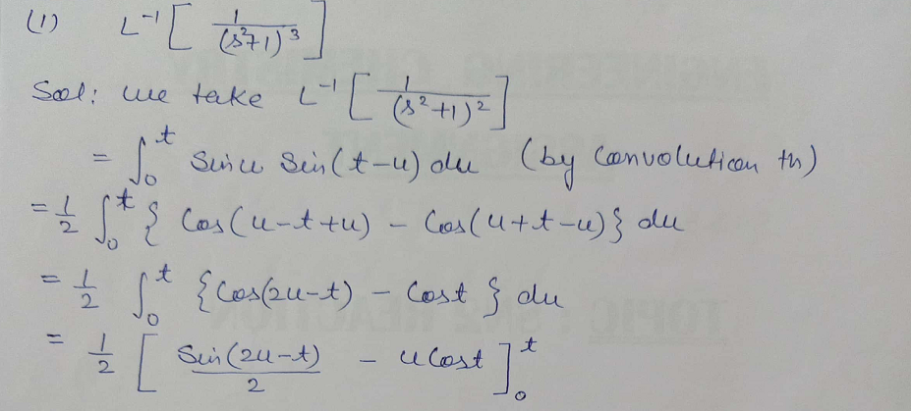
1

Slide 12
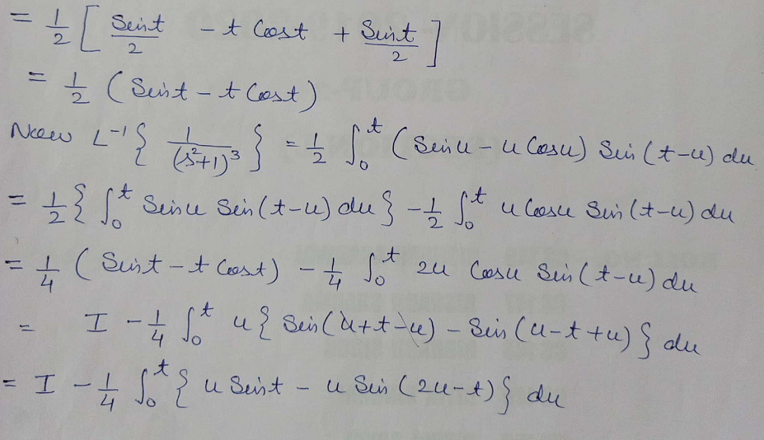
1

Slide 13
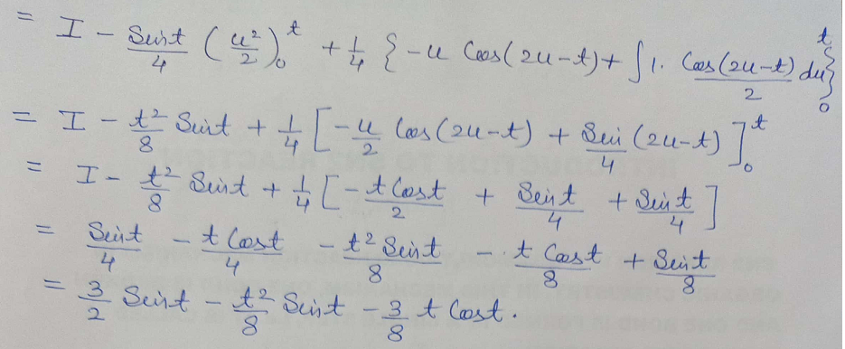
1

Slide 14
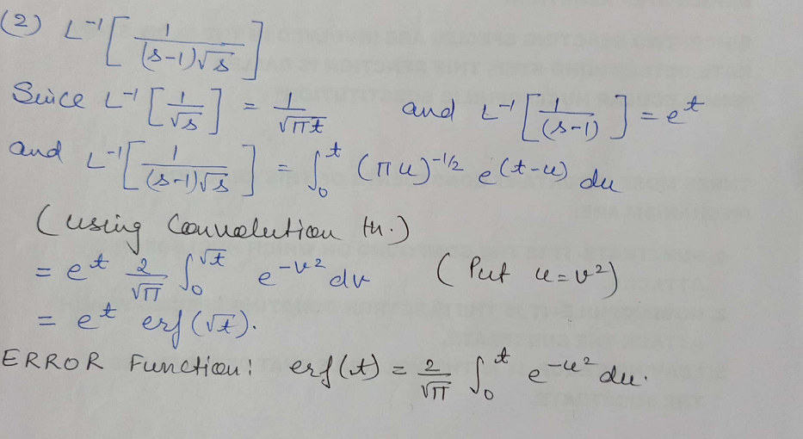
1

Slide 15
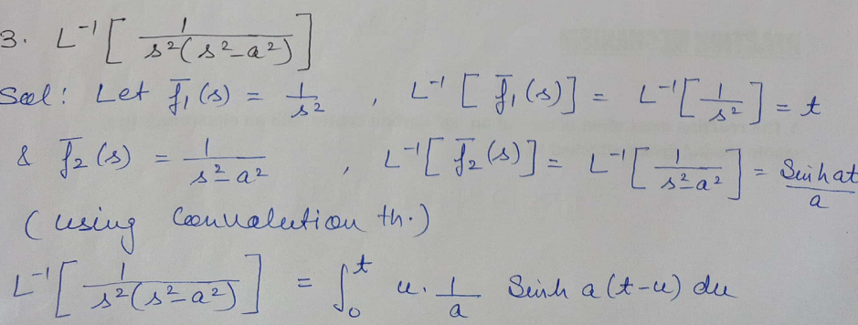
1

Slide 16
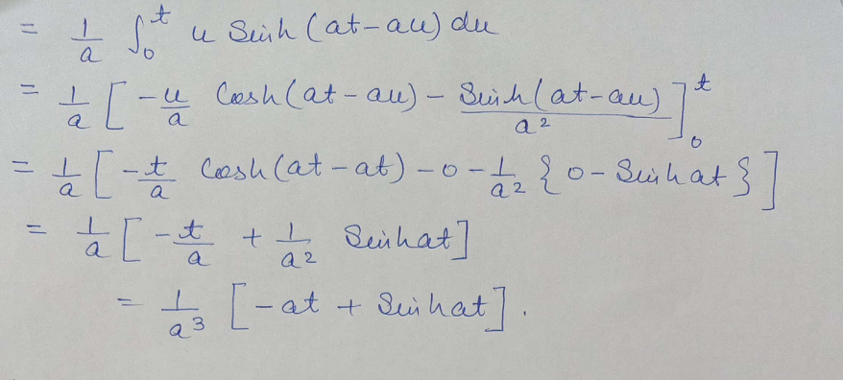
1

Slide 17
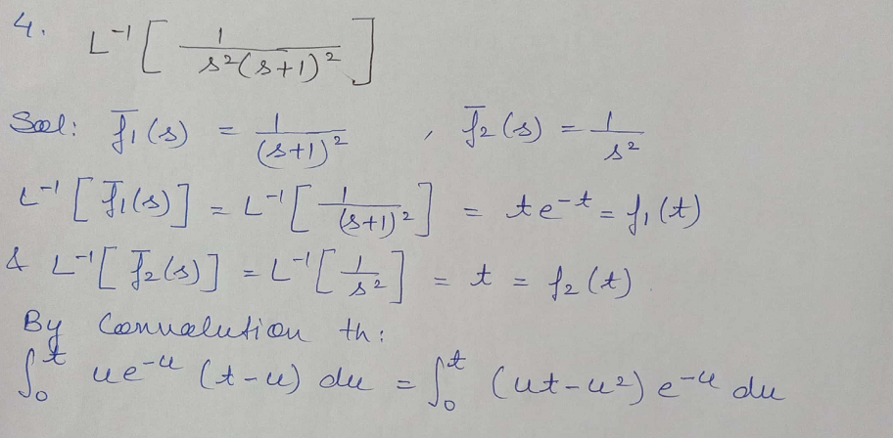
1

Slide 18
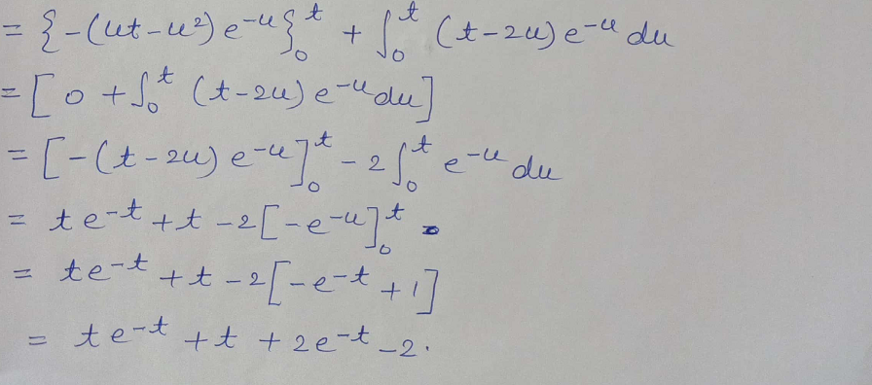
1

Slide 19
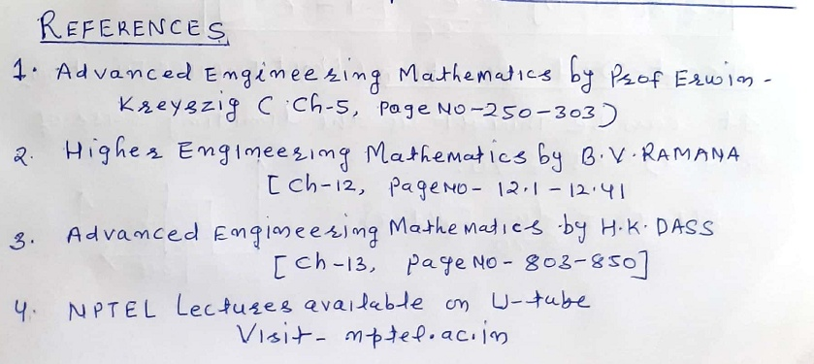
1

Slide 20
Dr. Vishal Saxena (Associate Professor, Deptt. of Mathematics) , JECRC, JAIPUR

