Slide 1
JAIPUR ENGINEERING COLLEGE AND RESEARCH CENTRE
Year & Sem - B.Tech III year, sem- VI
Subject – Power System-II
Unit - III
Presented by - Ms. Ritu Soni
Designation - Assistant Professor
Department- Electrical Engineering
1

Slide 2
Load Frequency control
Introduction
Reasons for constant frequency
Methods of Load frequency control
LFC problem in Single Area Power System
Load Frequency Control of Two Area System
Automatic Generation Control (AGC)

Slide 3
Introduction
In an electric power system, Load Frequency Control (LFC) is a system to maintain reasonably uniform frequency, to divide the load between the generators, and to control the tie-line interchange schedules.
The change in frequency is sensed when the rotor angle ∂ is changed.
The error signals are transformed into real power command signal, which is sent to prime mover to call for an increment in the torque.
The prime mover then brings change in the generator output by an amount which will change the values of within the specified tolerance.

Slide 4
Reasons for constant frequency
The speed of the alternating current motors depends on the frequency of the power supply. There are situations where speed consistency is expected to be of high order.
The accuracy of the electric clocks are dependent on the frequency
of the supply.
If the normal frequency is 50 Hertz and the system frequency falls below 47.5 Hertz or goes up above 52.5 Hertz then the blades of the turbine are likely to get damaged so as to prevent the failing of the generator.
Due to the subnormal frequency operation the blast of the ID and FD fans in the power stations get reduced and thereby reduce the generation power in the thermal plants.

Slide 5
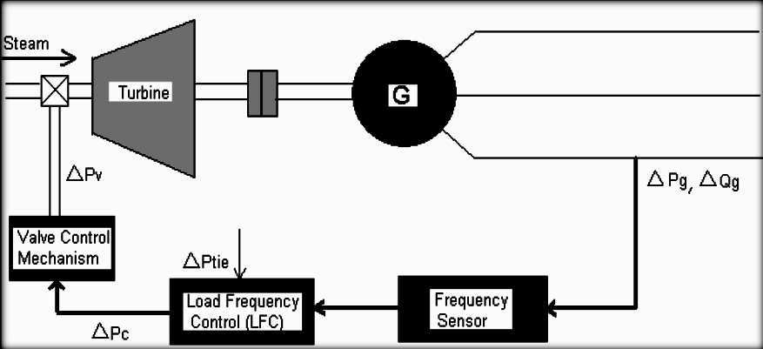
Fig. Schematic diagram of load frequency and excitation voltage regulators of a turbo- Generator

Slide 6
LFC problem in Single Area Power System
The load frequency control strategies have been suggested based on the conventional linear Control theory. These controllers may be unsuitable in some operating conditions due to the complexity of the power systems such as nonlinear load characteristics and variable operating points.
Under normal operating condition controller are set for small changes in load demand without voltage and frequency exceeding the pre specified limits. If the operating condition changes by any cause, the controller must be reset either manually or automatically. The objective of load frequency controller is to exert the control off frequency and at the same time real power exchange via outgoing transmission line.

Slide 7
Turbine Speed Governing System
The speed governor is the main primary tool for the load frequency
control (LFC).
Figure shows a schematic arrangement of a speed governing system used on steam turbines to control the output of the generator to maintain constant frequency.
The speed governing system consists of the following parts .
Speed governor
Linkage mechanism
Hydraulic amplifier
Speed changer

Slide 8
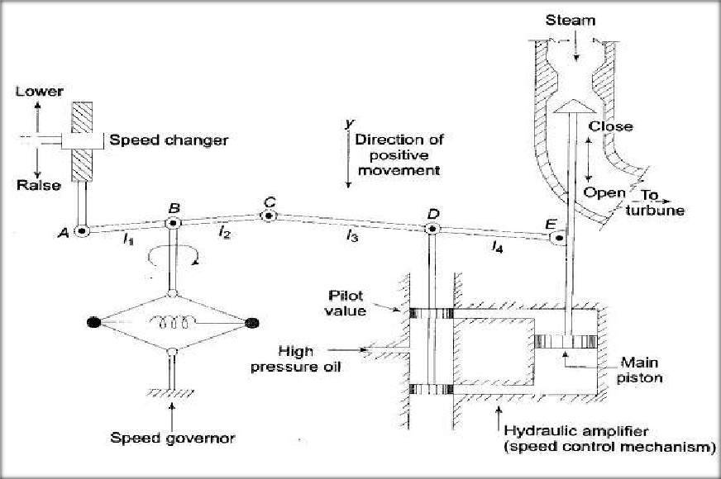
Fig. Turbine Speed Governing System

Slide 9
1.Fly ball speed governor
This is the heart of the system which senses the change in speed (frequency). As the speed increases the fly balls move outwards and the point B on linkage mechanism moves downwards. The reverse happens when the speed decreases.
2.Hydraulic amplifier
It comprises a pilot valve and main piston Low power level pilot valve movement is converted into high power level piston valve movement.
This is necessary in order to open or close the steam valve against high pressure steam.

Slide 10
4. Speed changer
3. Linkage mechanism
ABC is a rigid link pivoted at B and CDE is another rigid link pivoted at This link mechanism provides a movement to the control valve in proportion to change in speed.
It also provides a feedback from the steam valve movement
It provides a steady state power output setting for the turbine.
Its downward movement opens the upper pilot valve so that more steam is admitted to the turbine under steady conditions (hence more steady power output).
The reverse happens for upward movement of speed changer.

Slide 11
Model of Speed Governing System
Assume that the system is initially operating under steady conditions—the linkage mechanism stationary and pilot valve closed, steam valve opened by a definite magnitude, turbine running at constant speed with turbine power output balancing the generator load. Let the operating conditions be characterized by
We shall obtain a linear incremental model around these operating conditions.
Let the point A on the linkage mechanism be moved downwards by a small amount Δ_{yA}. It is a command which causes the turbine power output to change and can therefore be written as

Slide 12
….(1)
where ΔP_{C} is the commanded increase in power.
The command signal ΔP_{C} (i.e. Δ_{yE}) sets into motion a sequence of events—the pilot valve moves upwards, high pressure oil flows on to the top of the main piston moving it downwards; the steam valve opening consequently increases, the turbine generator speed increases,
i.e. the frequency goes up. Let us model these events mathematically.
Two factors contribute to the movement of C:
….(3)

Slide 13
The movement Δy_{D} depending upon its sign opens one of the ports of the pilot valve admitting high pressure oil into the cylinder thereby moving the main piston and opening the steam valve by Δy_{E}. Certain justifiable simplifying assumptions, which can be made at this stage, are:
Inertial reaction forces of main piston and steam valve are negligible compared to the forces exerted on the piston by high pressure oil.
Because of (i) above, the rate of oil admitted to the cylinder is proportional to port opening Δy_{D}.
The volume of oil admitted to the cylinder is thus proportional to the time integral of Δy_{D},. The movement Δy_{E} is obtained by dividing the oil volume by the area of the cross-section of the piston. Thus
….(4)

Slide 14
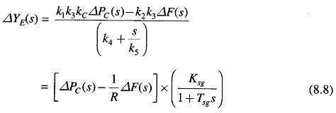
….(8)
It can be verified from the schematic diagram that a positive movement Δy_{D} causes negative (upward) movement Δy_{E} accounting for the negative sign used in above Eq.
Taking the Laplace transform of above Eqs. (2),(3), and (4) we get
….(5)
….(6)
….(7)
Eliminating ΔY_{C}(s) and ΔY_{D}(s), we can write

Slide 15
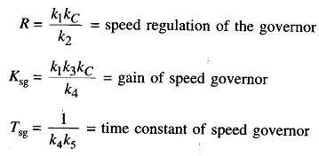
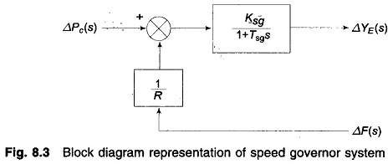
Where
Equation (8) is represented in the form of a block diagram in Fig.

Slide 16
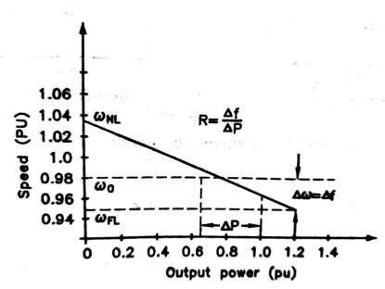
Adjustment of Governor Characteristics
The control of system frequency and load depends upon the
governor of the prime movers.
The below figure shows the characteristics of the speed governor system

Slide 17
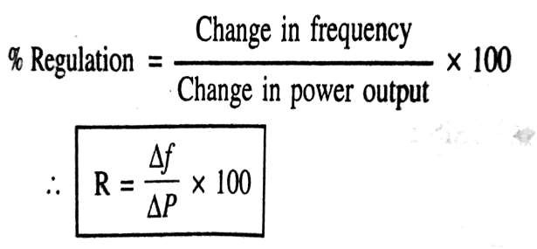
For stable operation of generator ,the governors are designed to permitt the speed to drop as the load is increased .
Then slop of the curve represent the speed regulation R.
Governors typically have a speed regulation of 5-6% from zero to full load.

Slide 18
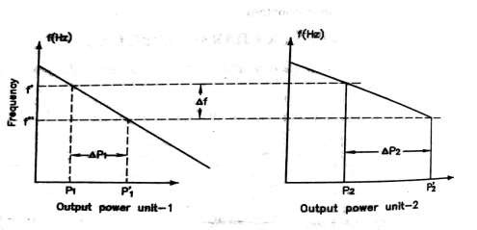
Where
_{ωNL}=Steady state speed at No-Load
^{ω}FL
=Steady state speed at full load
_{ω0} =Rated speed
If two or more alternators with droping govenor characteristics are connected to a power system there will be unique frequency at which they will share a load change.

Slide 19
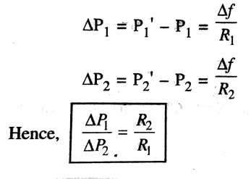
Assme ,two generator units with droping characteristics as
shown in above figure.
Let the initial frequency of both the unit is f with power output P1 and P2 when a load increases to P it causes the units to slow down/.
The governor increases the output until they reach a new common operating frequency f.

Slide 20
Load Frequency Control of Two Area System
An extended power system can be divided into a number of load frequency control areas interconnected by means of tie lines. Without loss of generality two area case connected by tie-line is considered. The control objectives are as follows:
Each control area as for as possible should supply its own load demand and power transfer through tie line should be on mutual agreement.
Both control areas should controllable to the frequency control.

Slide 21
A two area system consists of two single area systems connected through a power line called tie-line. Each area feeds its user pool, and the tie line allows electric power to flow between the areas, because both areas as well as the power flow on the tie-line. For the same reason, the control system of each area needs information about the transient situation in both areas to bring the local frequency back to its steady state value. Information about the local area is found in the tie line power fluctuations. Therefore, the tie-line power is sensed, and the resulting tie-line power signal is fed back into both areas. It is conveniently assumed that each control area can be represented by an equivalent turbine, generator and governor system.

Slide 22
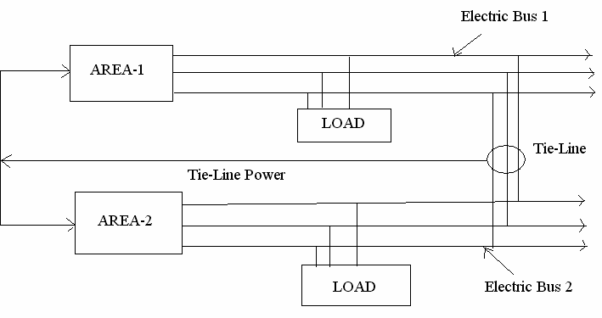

Slide 23
Automatic Generation Control
Sometimes, load on the system is increased suddenly then the turbine speed drops before the governor can adjust the input of the steam to the new load.
As the change in the value of speed diminishes, the error signal becomes smaller and the position of the governor get closer to the point required to maintain the constant speed.
One way to restore the speed or frequency to its nominal value is to add an integrator on the way.
As the load of the system changes continuously the generation is adjusted automatically to restore the frequency to the nominal value. This scheme is known as automatic generation control.
In an interconnected system consisting of several pools, the role of the AGC is to divide the load among the system, stations and generators so as to achieve maximum economy and reasonably uniform frequency.

Slide 24
Methods of Voltage Control

Slide 25
Contents
Introduction
Importance of voltage control
Methods of voltage control
Shunt compensation
Series capacitor
Synchronous condenser
Tap changing transformer
Auto transformer tap changing
Booster transformer

Slide 26
Introduction
Transmission of power from generating station to
consumers.
Constant voltage for satisfactory operation.
Variation cause unpredictable operation or mal functioning.
Cause : change in load at supply side.
Load , voltage due to voltage drop in alternator synchronous impedence, transmission impedence, transformer impedence, feeders and distributors.
Prescribe limits : +- 6% of declared voltage
Voltage regulating device at suitable places.

Slide 27
Importance of Voltage Control
Lighting load :
Lamp characterisic is very sensitive to change in voltage.
below limit → 20%
Above limit → 50%
in illumination power.
in life of lamp.
Induction motor :
in voltage → saturation of pole
in voltage → reduces starting torque.
Distribution Transformer :
Due to heating, rating reduces.

Slide 28
Location of voltage control Equipments
Used at more than one point due to
Desirable drop in transmission and distribution.
Dissimilar load characteristics.
Individual means of voltage control for each circuit.
Devices used at
Generating station
Transformer station
Feeders if drop exceeds the limit

Slide 29
Methods of Voltage Control
Shunt compensation
Series capacitor
Synchronous condenser
Tap changing transformer
Auto transformer tap changing

Slide 30
1. Shunt Compensation
Shunt Reactor :
Used to compensate effect line capacitance
limit voltage rise on open circuit or light load
increases effective Z_{C}
They are connected either:
directly to the lines at the ends
Tertiary windings → easily switched as VAR vary.
In long lines → to overcome ferranti effect.
Connected to bus bar without C.B for switching.

Slide 31
Shunt Capacitor :
Supply leading reactive power and boost the voltage as loading of current reduces.
Switching substation → inductive load → absorb
inductive current of lower P.F.
They are connected either:
H.V. bus
Tertiary winding of transformers
Advantage :
low cost and flexibility of installation.
Disadvantage :
Q is proportional to (voltage)^2. So output reduces.

Slide 32
2. Series Compensation
Series capacitor :
Connected in series with line.
Used to reduce inductive reactance of line so reduction of
I ²X loss
characteristic impedance Z_{C}
Reactive power produced increases with increasing power
transfer.
Application :
improve power transfer capacity.
voltage regulation

Slide 33
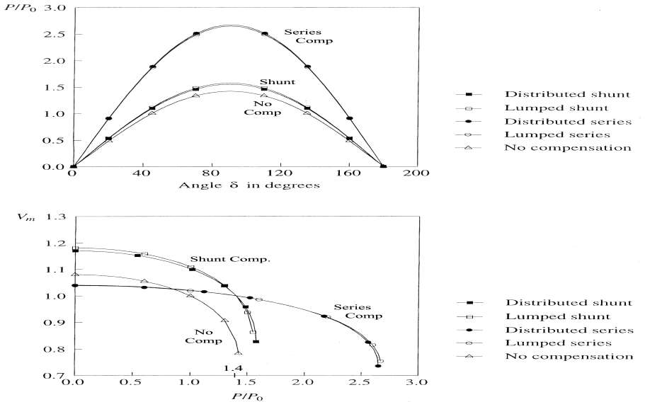
Performance of Shunt and Series Capacitors :

Slide 34
3. Synchronous Condenser
A synchronous machine running without a prime mover or a mechanical load
Depending on field excitation, it can either absorb or generate VARs
With a voltage regulator, it can automatically adjust VAR to maintain constant voltage
Started as an induction motor and then synchronized
Normally connected to tertiary windings of transformers
Unlike a SVC, a synchronous condenser has an internal voltage
Speed of response not as fast as that of an SVC

Slide 35
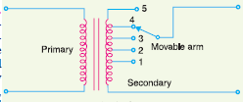
4. Tap Changing Transformer
Off load Tap changing transformer :
Position of tap → number of turns → output voltage.
Stud 1 : min value
Stud 5 : max value
Light load → primary voltage = alternator voltages and movable arm is placed at stud 1.
Load drop so movement of stud.

Slide 36
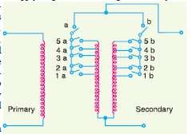
On load Tap changing transformer :
widely used so no interruption of supply voltage
Secondary divided into two parallel path so current divided.
Tap changing operation is performed one after other.
Disadvantages :
Voltage surge due to high voltage drop.
Num of tapings = 2 * voltage steps.

Slide 37
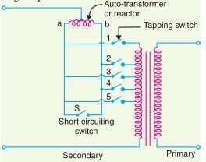
5. Auto Transformer
Mid tapped auto transformer is used.
Connected with one side of line, divided into two parts.
Odd switches and even switches
Normal operation → no drop
Tap changing → high drop → large circulating current flow →
control by reactor.

