Slide 1
JAIPUR ENGINEERING COLLEGE AND RESEARCH CENTRE
Year & Sem. – B. Tech III year, Sem.-V
Subject & Code–Power System-1 & 5EE4-02
Unit – III
Presented by – Mrs. Neha Agrawal
Designation - Associate Professor
Department - ELECTRICAL ENGINEERING
1

Slide 2
VISSION OF INSTITUTE
To become a renowned centre of outcome based learning, and work towards academic, professional, cultural and social enrichment of the lives of individuals and communities.
1

Slide 3
MISSION OF INSTITUTE
Focus on evaluation of learning outcomes and motivate students to inculcate research aptitude by project based learning.
Identify, based on informed perception of Indian, regional and global needs, the areas of focus and provide platform to gain knowledge and solutions.
Offer opportunities for interaction between academia and industry.
Develop human potential to its fullest extent so that intellectually capable and imaginatively gifted leaders may emerge.
1

Slide 4
Electrical Engineering : Course Outcomes
After completion of the subject the student shall demonstrate the ability to/ will be able to:
CO1: Identify the different parameters of transmission lines and understand the basic power system.
CO2: Analysis the overhead and underground transmission and distribution lines and identify the faults.
CO3: Design and analysis of over voltage generation and its protection in power system.
1

Slide 5
Introduction To Syllabus
1

Slide 6
Content
Over-voltages and Insulation Requirements Generation of Over-voltages: Lightning and Switching Surges. Protection against Overvoltage's, Insulation Coordination. Propagation of Surges. Voltages produced by traveling surges. Bewley Diagrams.
1

Slide 7
Lecture (Unit-IV Over-voltages and Insulation Requirements Generation of Over-voltages)
1

Slide 8
NATURAL CAUSES OF OVER VOLTAGES
Examination of over voltages on the power system includes a study of their magnitudes, shapes, durations, and frequency of occurrence. The study should be performed at all points along the transmission network to which the surges may travel
Types of Overvoltage
The voltage stresses on transmission network insulation are found to have a variety of Origins.
In normal operation AC (or DC) voltages do not stress the insulation severely.
Over voltage stressing a power system can be classified into two main types:
External overvoltage: generated by atmospheric disturbances of these disturbances, lightning is the most common and the most severe. Internal over voltages: generated by changes in the operating conditions of the network. Internal over voltages.
1

Slide 9
Lightning Over voltages Lightning is produced in an attempt by nature to maintain dynamic balance between the positively charged ionosphere and the negatively charged earth.
Over fair-weather areas there is a downward transfer of positive charges through the global air-earth current. This is then counteracted by thunderstorms, during which positive charges are transferred upward in the form of lightning. During thunderstorms, positive and negative charges are separated by the movements of air currents forming ice crystals in the upper layer of a cloud and rain in the lower part.
The cloud becomes negatively charged and has a larger layer of positive charge at its top. As the separation of charge proceeds in the cloud, the potential difference between the centers of charges ‗increases and the vertical electric field along the cloud also increases. The total potential difference between the two main charge centers may vary from l00 to 1000 MV. Only a part of the total charge-several hundred coulombs is released to earth by lightning; the rest is consumed in inter cloud discharges. The height of the thundercloud dipole above earth may reach 5 km in tropical regions.
1

Slide 10
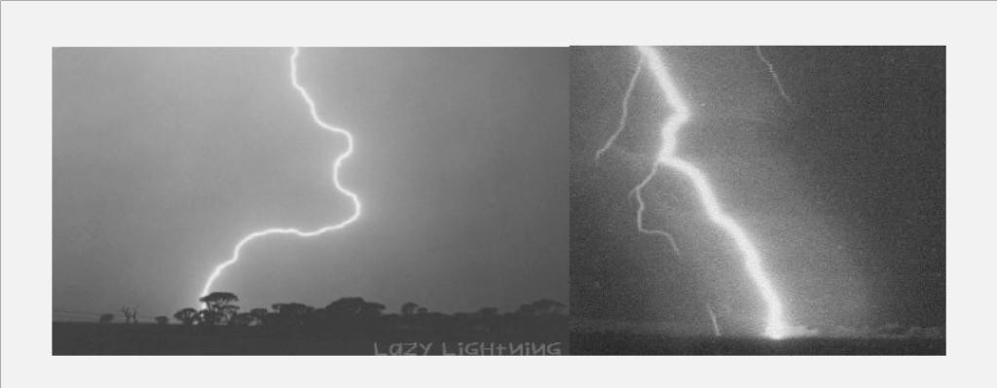
Overvoltage Due To Arcing Ground
1

Slide 11
The Lightning Discharge
The channel to earth is first established by a stepped discharge called a leader stroke. The leader is initiated by a breakdown between polarized water droplets at the cloud base caused by the high electric field, or a discharge between the negative charge mass in the lower cloud and the positive charge pocket below it. (Figure below) As the downward leader approaches the earth, an upward leader begins to proceed from earth before the former reaches earth. The upward leader joins the downward one at a point referred to as the striking point. This is the start of the return stroke, which progresses upward like a travelling wave on a transmission line
1

Slide 12
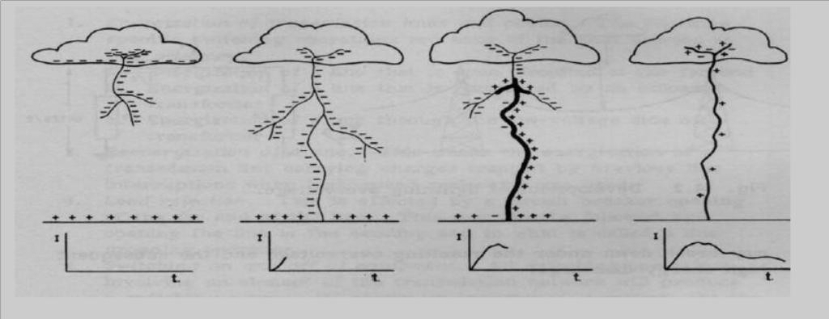
Developmental Stages of a Lighting Flash And The Corresponding Current Surge
1

Slide 13
LIGHTNING PHENOMENON
At the earthling point a heavy impulse current reaching the order of tens of kilo amperes occurs, which is responsible for the known damage of lightning. The velocity of progression of the return stoke is very high and may reach half the speed of light. The corresponding current heats its path to temperatures up to 20,000°C, causing the explosive air expansion that is heard as thunder. The current pulse rises to its crest in a few microseconds and decays over a period of tens or hundreds of microseconds.
Facts about Lightning
• A strike can average 100 million volts of electricity
• Current of up to 100,000 amperes
• Can generate 54,000
• Lightning strikes somewhere on the Earth every second
• Kills hundreds of people every year.
• Use The Five Second Rule Light travels at about 186,291 miles/second
• Sound travels at only 1,088 feet/second
• You will see the flash of lightning almostimmediately5280/1088= 4.9
• About 5 seconds for sound to travel 1 mile1 miles (statute) is equal to 1,609.34 meters.1 Feet are equal to 0.30 meters.
1

Slide 14
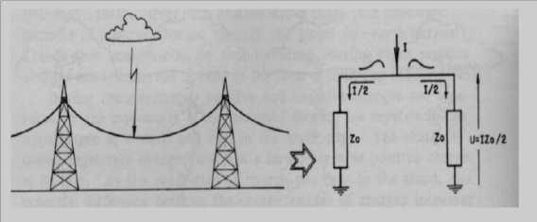
Lightning Voltage Surges
The most severe lightning stroke is that which strikes a phase conductor on the transmission line
It produces the highest overvoltage for a given stroke current.
The lightning stroke injects its current into a termination impedance Z, which in this case is half the line surge impedance Zo since the current will flow in both directions as shown In Figure4.3. Therefore, the voltage surge magnitude at the striking points = (F2) IZo The lightning current magnitude is rarely less than 10 kA. For typical overhead line surge impedance Zo of 300 Q, the lightning surge voltage will probably have a magnitude in excess of1500 kV.
Developmental Lighting over voltage
1

Slide 15
EFFECT OF LIGHTNING
The impedance of the lightning channel itself is much larger than 1/2Zo (it is believed to range from l00to 3000 Q).
• Lightning voltage surge will have the same shape characteristics.
• In practice the shapes and magnitudes of lightning surge waves get modified by their Reflections at points of discontinuity as they travel along transmission lines.
• Lightning strokes represent true danger to life, structures, power systems, and Communication networks.
• Lightning is always a major source of damage to power systems where equipment Insulation may break down, under the resulting overvoltage and the subsequent high- Energy discharge.
Lightning has been a source of wonder to mankind for thousands of years. Scotland points out that any real scientific search for the first time was made into the phenomenon of lightning by Franklin in18th century. Before going into the various theories explaining the charge formation in a thunder cloud and the mechanism of lightning, it is desirable to review some of the accepted facts concerning the thunder.
1

Slide 16
Cloud And The Associated Phenomenon.
• The height of the cloud base above the surrounding ground level may vary from 160 to 9,500m. The charged centers which are responsible for lightning are in the range of 300 to 1500 m.
• The maximum charge on a cloud is of the order of 10 coulombs which is built up exponentially
• over a period of perhaps many seconds or even minutes. The maximum potential of a cloud lies approximately within the range of 10 MV to 100 MV.
• The energy in a lightning stroke may be of the order of 250 kWhr.
• Raindrops:
1

Slide 17
Raindrops elongate and become unstable under an electric field, the limiting diameter being0.3 cm in a field of 100 kV/cm. A free falling raindrop attains a constant velocity with respect to the air depending upon its size. This velocity is 800 cms/sec. for drops of the size
0.25 cm dia. and is zero for spray. This means that in case the air currents are moving upwards with a velocity greater than 800 cm/sec, no rain drop can fall. Falling raindrops greater than 0.5 cm in dia become unstable and break up into smaller drops. When a drop is broken up by air currents, the water particles become positively charged and the air negatively charged. When ice crystal strikes with air currents, the ice crystal is negatively charged and the air positively charged.
1

Slide 18
Wilson’s Theory of Charge Separation Wilson‘s theory is based on the assumption that a large number of ions are present in the atmosphere. Many of these ions attach themselves to small dust particles and water particles. It also assumes that an electric field exists in the earth‘s atmosphere during fair weather which is directed downwards towards the earth (Figure Below). The intensity of the field is approximately 1 volt/cm at the surface of the earth and decreases gradually with height so that at 9,500 m it is only about 0.02 V/cm. A relatively large raindrop (0.1 cm radius) falling in this field becomes polarized, the upper side acquires a negative.
1

Slide 19
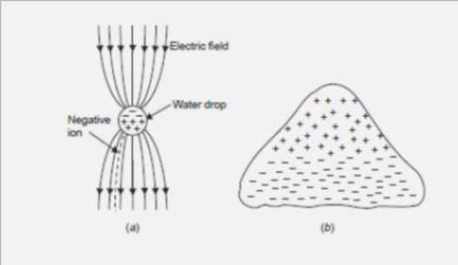
Capture of negative ions by large falling drop; (b) Charge separation in a thunder cloud according to Wilson’s theory.
1

Slide 20
Wilson’s Theory of Charge Separation
Wilson‘s theory is based on the assumption that a large number of ions are present in the atmosphere. Many of these ions attach themselves to small dust particles and water particles. It also assumes that an electric field exists in the earth‘s atmosphere during fair weather which is directed downwards towards the earth (Figure above). The intensity of the field is approximately 1 volt/cm at the surface of the earth and decreases gradually with height so that at 9,500 m it is only about 0.02 V/cm. A relatively large raindrop (0.1 cm radius) falling in this field becomes polarized, the upper side acquires a negative charge and the lower side a positive charge. Subsequently, the lower part of the drop attracts -ve charges from the atmosphere which are available in abundance in the atmosphere leaving a preponderance of positive charges in the air.
The upwards motion of air currents tends to carry up the top of the cloud, the +ve air and smaller drops that the wind can blow against gravity. Meanwhile the falling heavier raindrops which are negatively charged settle on the base of the cloud. It is to be noted that the selective action of capturing -ve charges from the atmosphere by the lower surface of the drop is possible. No such selective action occurs at the upper surface. Thus in the original system, both the positive and negative charges which were mixed up, producing essentially a neutral space charge, are now separated.

Slide 21
Wilson’s Theory of Charge Separation
Thus according to Wilson‘s theory since larger negatively charged drops settle on the base of the cloud and smaller positively charged drops settle on the upper positions of the cloud, the lower base of the cloud is negatively charged and the upper region is positively charged (Figure above). Simpson’s and Scarse Theory Simpson‘s theory is based on the temperature variations in the various regions of the cloud. When water droplets are broken due to air currents, water droplets acquire positive charges whereas the air is negatively charged. Also when ice crystals strike with air, the air is positively charged and the crystals negatively charged. The theory is explained with the help of Fig. below.

Slide 22
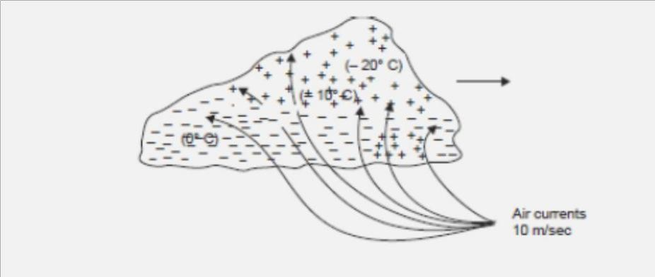
Charge generation and separation in a thunder

Slide 23
cloud according to Simpson‘s theory Let the cloud move in the direction from left to right as shown by the arrow. The air currents are also shown in the diagram. If the velocity of the air currents is about 10 m/sec in the base of the cloud, these air currents when collide with the water particles in the base of the cloud, the water drops are broken and carried upwards unless they combine together and fall down in a pocket as shown by a pocket of positive charges. With the collision of water particles we know the air is negatively charged and the water particles positively charged. These negative charges in the air are immediately absorbed by the cloud particles which are carried away upwards with the air currents. The air currents go still higher in the cloud where the moisture freezes into ice crystals.
The air currents when collide with ice crystals the air is positively charged and it goes in the upper region of cloud whereas the negatively charged ice crystals drift gently down in the lower region of the cloud. This is how the charge is separated in a thundercloud. Once the charge separation is complete, the conditions are now set for a lightning stroke.

Slide 24
Mechanism of Lightning Stroke Lightning phenomenon is the discharge of the cloud to the ground. The cloud and the ground form two plates of a gigantic capacitor and the dielectric medium is air. Since the lower part of the cloud is negatively charged, the earth is positively charged by induction. Lightning discharge will require the puncture of the air between the cloud and the earth. For breakdown of air at STP condition the electric field required is 30 kV/cm peak. But in a cloud where the moisture content in the air is large and also because of the high altitude (lower pressure) it is seen that for breakdown of air the electric field required is only 10 kV/cm. The mechanism of lightning discharge is best explained with the help of Fig. below. After a gradient of approximately 10 kV/cm is set up in the cloud, the air surrounding gets ionized. At this a streamer (Fig. below) starts from the cloud towards the earth which cannot be detected with the naked eye; only a spot travelling is detected. The current in the streamer is of the order of 100 amperes and the speed of the streamer is 0.16 m/μ sec. This streamer is known as pilot streamer because this leads to the lightning phenomenon. Depending upon the state of ionization of the air surrounding the streamer, it is branched to several paths and this is known as stepped leader (Fig. below) The leader steps are of the order of 50 m in length and are accomplished in about a microsecond. The charge is brought from the cloud through the already ionized path to these pauses. The air surrounding these pauses is again ionized and the leader in this way reaches the earth (Fig below)

Slide 25
Once the stepped leader has made contact with the earth it is believed that a power return stroke(Fig below) moves very fast up towards the cloud through the already ionized path by the leader. This streamer is very intense where the current varies between 1000 amps and 200,000 amps and the speed is about 10% that of light. It is here where the –ve charge of the cloud is being neutralized by the positive induced charge on the earth (Fig. below)
It is this instant which gives rise to lightning flash which we observe with our naked eye. There may be another cell of charges in the cloud near the neutralized charged cell. This charged cell will try to neutralize through this ionized path. This streamers known as dart leader (Fig below). The velocity of the dart leader is about 3% of the velocity of light. The effect of the dart leader is much more severe than that of the return stroke. The discharge current in the return streamer is relatively very large but as it lasts only for a few microseconds the energy contained in the streamer is small and hence this streamer is known as cold lightning stroke whereas the dart leader is known as hot lightning stroke because even though the current in this leader is relatively smaller but it lasts for some milliseconds and therefore the energy contained in this leader is relatively larger.

Slide 26
It is found that each thunder cloud may contain as many as 40 charged cells and a heavy lightning stroke may occur. This is known as multiple stroke. 1.2.3 Line Design Based On Lightning The severity of switching surges for voltage 400 kV and above is much more than that due to lightning voltages. All the same it is desired to protect the transmission lines against direct lightning strokes. The object of good line design is to reduce the number of outages caused by lightning. To achieve this following actions are required. (I) The incidence of stroke on to power conductor should be minimized. (ii) The effect of those strokes which are incident on the system should be minimized. To achieve (i) we know that lightning normally falls on tall objects; thus tall towers are more vulnerable to lightning than the smaller towers. In order to keep smaller tower height for a particular ground clearance, the span lengths will decrease which requires more number of towers and hence the associated accessories like insulators etc. The cost will go up very high. Therefore, a compromise has to be made so that adequate clearance is provided, at the same time keeping longer span and hence lesser number of towers.

Slide 27
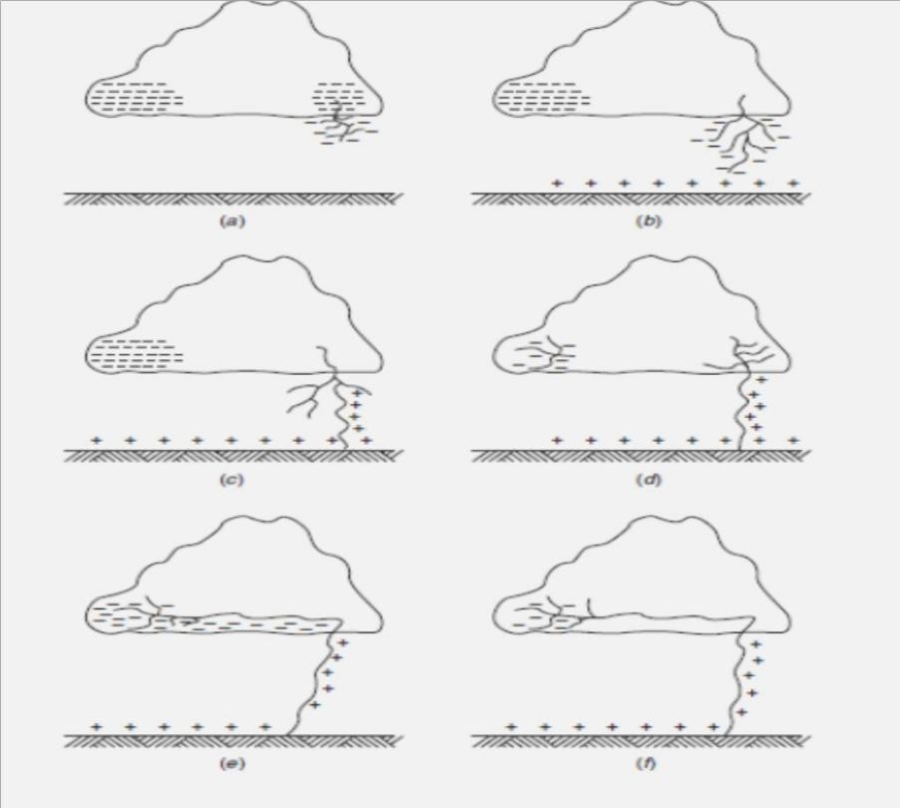
Lightning mechanism

Slide 28
With a particular number of towers the chances of incidence of lightning on power conductor scan be minimized by placing a ground wire at the top of the tower structure. . The tower presents a discontinuity to the travelling waves; therefore they suffer reflections and refraction. The system is, then, equivalent to a line bifurcated at the tower point. We know that the voltage and current transmitted into the tower will depend upon the surge impedance of the tower and the ground impedance (tower footing resistance) of the tower. If it is low, the wave reflected back up the tower will largely remove the potential existing due to the incident wave. In this way the chance of flashover is eliminated. If, on the other hand, the incident wave encounters high ground impedance, positive reflection will take place and the potential on the top of the tower structure will be raised rather than lowered. It is, therefore, desired that for good line design high surge impedances in the ground wire circuits, the tower structures and the tower footing should be avoided.

Slide 29
OVER VOLTAGES DUE TO SWITCHINGSURGES
The increase in transmission voltages needed to fulfill the required increase in transmitted powers, switching surges have become the governing factor in the design of insulation for EHV and UHV systems. In the meantime, lightning over voltages come as a secondary factor in these networks. There are two fundamental reasons for this shift in relative importance from lightning to switching surges as higher transmission voltages are called for:
Overvoltages produced on transmission lines by lightning strokes are only slightly dependent on the power system voltages. As a result, their magnitudes relative to the system peak voltage decrease as the latter is increased.
External insulation has its lowest breakdown strength under surges whose fronts fall in the range 50-500 micro sec., which is typical for switching surges.
According to the International Electro-technical Commission(IEC) recommendations, all equipment designed for operating voltages above 300 kV should be tested under switching impulses (i.e., laboratory-simulated switching surges).

Slide 30
Temporary over voltages
The purpose of this Guide is to provide information on transient and temporary over voltages and currents in end-user AC power systems. With this information in hand, equipment designers and users can more accurately evaluate their operating environment to determine the need for surge protective devices (SPDs) or other mitigation schemes. The Guide characterizes electrical transmission and distribution systems in which surges occur, based upon certain theoretical considerations as well as on the data that have been recorded in interior locations with particular emphasis on industrial environments. There are no specific mathematical models that simulate all surge environments; the complexities of the real world need to be simplified to produce a manageable set of standard surge tests. To this end, a scheme to classify the surge environment is presented.

Slide 31
Temporary over voltages
This classification provides a practical basis for the selection of surge-voltage and surge- current waveforms and amplitudes that can be applied to evaluate the capability of equipment to withstand surges when connected to power circuits. The fundamental approach to electromagnetic compatibility (EMC) in the arena of surges is the requirement that equipment immunity and characteristics of the surge environment characteristics should be properly coordinated. By definition, the duration of the surges considered in this Guide do not exceed a one-half period of the normal mains waveform. They can be periodic or random events and might appear in any combination of line, neutral, or grounding conductors. They include those surges with amplitudes, durations, or rates of change sufficient to cause equipment damage or operational upset (see Figure). Surge protective devices acting primarily on the voltage are often applied to divert damaging surges, but the upset can require other remedies.

Slide 32
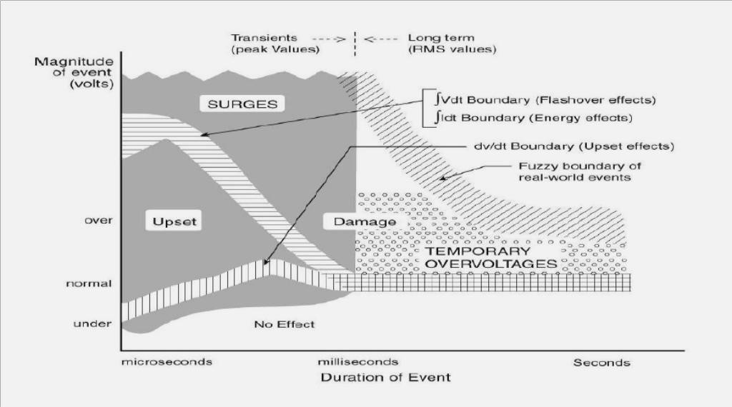
Simplified relationships among voltage, duration, rate of change, and effect on equipment

Slide 33
Temporary over voltages represent a threat to equipment as well as to any surge protective devices that may have been provided for the mitigation of surges. The scope of this Guide includes temporary over voltages only as a threat to the survival of SPDs, and therefore includes considerations on the selection of suitable SPDs. No equipment performance requirements are specified in this Guide. What is recommended is a rational, deliberate approach to recognizing the variables that need to be considered simultaneously, using the information presented here to define a set of representative situations. For specific applications, the designer has to take into consideration not only the rates of occurrence and the waveforms described in this Guide, but also the specific power system environment and the characteristics of the equipment in need of protection. As an example, the following considerations are necessary to reach the goal of practical surge immunity:

Slide 34
Desired protection
Hardware integrity
Process immunity
Specific equipment sensitivities
The power environment
Surge characteristics
Electrical system
Performance of surge protective devices
Protection
Lifetime
The test environment
Cost effectiveness
Answers may not exist that address all of the questions raised by the considerations listed above. In particular, those related to specific equipment sensitivities, both in terms of component failure and especially in terms of processing errors, might not be available to the designer. The goal of the reader may be simply selecting the most appropriate device from among the various surge protective devices available and meet the requirements of the equipment that they must protect. Subsets of the considerations in this section might then apply, and the goal of the reader may then be the testing of various surge protective devices under identical test conditions. The following can guide the reader in identifying parameters, seeking further facts, or quantifying a test plan.

Slide 35
Desired Level of Protection:The desired level of protection can vary greatly depending upon the application. For example, in applications not involving online performance, protection may only be needed to reduce hardware failures by a certain percentage. In other cases, such as data processing or critical medical or manufacturing processes, any interruption or upset of a process might be unacceptable. Hence, the designer should quantify the desired goal with regard to the separate questions of hardware failure and process interruption or upset.
Equipment Sensitivities:Specific equipment sensitivities should be defined in concert with the above-mentioned goals. The sensitivities (immunity) will be different for hardware failure or process upset. Such definitions might include: maximum amplitude and duration of the surge remnant that can be tolerated, wave-form or energy sensitivity, et cetera.
Power Environment: The applicable test waveforms recommended in this Guide should be quantified on the basis of the location categories and exposure levels as explained in the corresponding clauses of the Guide. The magnitude of the rams voltage, including any anticipated variation, should be quantified. Successful application of surge protective devices requires taking into consideration occasional abnormal occurrences. It is essential that an appropriate selection of the SPD limiting voltage is based on actual characteristics of the mains voltage.

Slide 36
Performance of Surge Protective Devices: Evaluation of a surge protective device should verify a long life in the presence of both the surge and electrical system environments described above. At the same time, its remnant and voltage levels should provide a margin below the immunity levels of the equipment in order to achieve the desired protection. It is essential to consider all of these parameters simultaneously. For example, the use of a protective device rated very close to the nominal system voltage might provide attractive remnant figures, but can be unacceptable when a broad range of occasional abnormal deviations in the amplitude of the mains waveform are considered. Lifetime or overall performance of the SPDs should not be sacrificed for the sake of a low remnant.
Test Environment: The surge test environment should be carefully engineered with regard to the preceding considerations and any other parameters that are important to the user. A typical description of the test-environment includes definitions of simultaneous voltages and currents, along with proper demonstrations of short-circuit.
It is important to recognize that the specification of an open-circuit voltage without simultaneous short-circuit current capability is meaningless. Cost Effectiveness The cost of surge protection can be small, compared to overall system cost and benefits in performance. Therefore, added quality and performance in surge protection may be chosen as a conservative engineering approach to compensate for unknown variables in the other parameters. This approach can provide excellent performance in the best interests of the user, while not significantly affecting overall system cost.

Slide 37
Definitions: The definitions given here have been developed by several standards-writing organizations and have been harmonized.
Back Flashover (Lightning):A flashover of insulation resulting from a lightning strike to part of a network or electrical installation that is normally at ground potential. Blind Spot: A limited range within the total domain of application of a device, generally at values less than the maximum rating. Operation of the equipment or the protective device itself might fail in that limited range despite the device's demonstration of satisfactory performance at maximum ratings.
Clamping Voltage: Deprecated term. See measured limiting voltage.
Combination Surge (Wave): A surge delivered by an instrument which has the inherent capability of applying a 1.2/50 us voltage wave across an open circuit, and delivering an 8/20 us current wave into a short circuit. The exact wave that is delivered is determined by the instantaneous impedance to which the combination surge is applied.
Combined Multi-Port Spd: A surge protective device integrated in a single package as the means of providing surge protection at two or more ports of a piece of equipment connected to different systems (such as a power system and a communications system).
Coordination Of Spds (Cascade):The selection of characteristics for two or more SPDs to be connected across the same conductors of a system but separated by some decoupling impedance such that, given the parameters of the impedance and of the impinging surge, this selection will ensure that the energy deposited in each of the SPDs is commensurate with its rating.

Slide 38
Direct Strike: A strike impacting the structure of interest or the soil (or objects) within a few meters from the structure of interest. Energy Deposition: The time integral of the power dissipated in a clamping-type surge protective device during a current surge of a specified waveform. Failure Mode: The process and consequences of device failure.
Leakage Current: Any current, including capacitive coupled currents, that can be conveyed from accessible parts of a product to ground or to other accessible parts of the product.
Lightning Protection System (LPS): The complete system used to protect a space against the effects of lightning. It consists of both external and internal lightning protection systems.
Lightning Flash To Earth: An electrical discharge of atmospheric origin between cloud and earth consisting of one or more strikes.
Lightning Strike: A single electrical discharge in a lightning flash to earth.
Mains: The AC power source available at the point of use in a facility. It consists of the set of electrical conductors (referred to by terms including service entrance, feeder, or branch circuit) for delivering power to connected loads at the utilization voltage level.
Maximum continuous operating voltage (MCOV): The maximum designated root- mean-square (rms) value of power-frequency voltage that may be applied continuously between the terminals of the arrester.
Measured limiting voltage: The maximum magnitude of voltage that appears across the terminals of the SPD during the application of an impulse of specified wave shape and amplitude.

Slide 39
Nearby strike: A strike occurring in the vicinity of the structure of interest.
Nominal System Voltage: A nominal value assigned to designate a system of a given voltage class.
Nominal Arrestor voltage: The voltage across the arrestor measured at a specified pulsed DC current, IN(dc), of specific duration. IN(dc) is specified by the arrestor manufacturer.
One-Port SPD: An SPD having provisions (terminals, leads, plug) for connection to the AC power circuit but no provisions (terminals, leads, receptacles) for supplying current to the AC power loads.
Open-circuit voltage (OCV) :The voltage available from the test set up (surge generator, coupling circuit, back filter, connecting leads) at the terminals where the SPD under test will be connected.
Point of strike: The point where a lightning strike contacts the earth, a structure, or an LPS.
Pulse life: The number of surges of specified voltage, current amplitudes, and wave shapes that may be applied to a device without causing degradation beyond specified limits. The pulse life applies to a device connected to an AC line of specified characteristics and for pulses sufficiently spaced in time to preclude the effects of cumulative heating.
Response time (arrestor): The time between the point at which the wave exceeds the limiting voltage level and the peak of the voltage overshoot. For the purpose of this definition, limiting voltage is defined with a 8/20 Its current waveform of the same peak Current amplitude as the waveform used for this response time.

Slide 40
Short-Circuit Current (Scc): The current which the test set up (surge generator, coupling circuit, back filter, connecting leads) can deliver at the terminals where the SPD under test will be connected, with the SPD replaced by bonding the two lead terminals. (Also sometimes abbreviated as SCI).
SPD disconnect or: A device for disconnecting an SPD from the system in the event of SPD failure. It is to prevent a persistent fault on the system and to give a visible indication of the SPD failure.
Surge Response Voltage: The voltage profile appearing at the output terminals of a protective device and applied to downstream loads, during and after a specified impinging surge, until normal stable conditions are reached.
Surge Protective device (SPD): A device that is intended to limit transient overvoltage's and divert surge currents. It contains at least one nonlinear component—a surge reference equalizer. A surge protective device used for connecting equipment to external systems whereby all conductors connected to the protected load are routed—physically and electrically—through a single enclosure with a shared reference point between the input and output ports of each system.
Swell: A momentary increase in the power frequency voltage delivered by the mains, outside of the normal tolerances, with a duration of more than one cycle and less than a few seconds.

Slide 41
Switching Surge Test Voltage Characteristics
Switching surges assume great importance for designing insulation of overhead lines operating at voltages more than 345 kV. It has been observed that the flashover voltage for various geometrical arrangements under unidirectional switching surge voltages decreases with increasing the front duration of the surge and the minimum switching surge corresponds to the range between 100 and 500 μsec. However, time to half the value has no effect as flashover takes place either at the crest or before the crest of the switching surge. Fig.4.8 gives the relationship between the critical flashover voltage per meter as a function of time to flashover for on a 3 m rod-rod gap and a conductor-plane gap.
Variation of F.O. V/m as a function of time to flashover

Slide 42
It can be seen that the standard impulse voltage (1/50 μ sec) gives highest flashover voltage and switching surge voltage with front time varying between 100 to 500 μ sec has lower flashover voltages compared to power frequency voltage. The flashover voltage not only depends upon the crest time but upon the gap spacing and humidity for the same crest time surges.
It has been observed that the switching surge voltage per meter gap length decreases drastically with increase in gap length and, therefore, for ultra high voltage system, costly design clearances are required. Therefore, it is important to know the behavior of external insulation with different configuration under positive switching surges as it has been found that for nearly all gap configurations which are of practical interest positive switching impulse is lower than the negative polarity switching impulse.
It has also been observed that if the humidity varies between 3 to 16 gm/m3, the breakdown voltage of positive and gaps increases approximately 1.7% for 1 gm/m3 increase in absolute humidity. For testing purposes the switching surge has been standardized with wave front time 250 μ deceit is known that the shape of the electrode has a decided effect on the flashover voltage of the insulation.
Lot of experimental work has been carried on the switching surge flash over voltage furlong gaps using rod-plane gap and it has been attempted to correlate these voltages with switching surge flash over voltage of other configuration electrodes. Several investigators have shown that if the gap length varies between 2 to 8 m, the 50% positive switching surge flash over for any configurations given by the expression

Slide 43
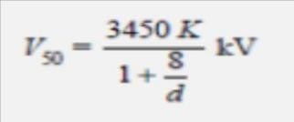
where d is the gap length in meters, k is the gap factor which is a function of electrode geometry. Forrod-plane gaps K = 1.0. Thus K represents a proportionality content and is equal to 50% flash overvoltage of any gap geometry to that of a rod-plane gap for the same gap spacing
i.e., The expression for V50 applies to switching impulse of constant crest time. A more general expression which applies to longer times to crest has been proposed as follows :
here K and d have the same meaning as in the equation above. The gap factor K depends mainly on the gap geometry and hence on the field distribution in the gap. Shown in Fig below

Slide 44
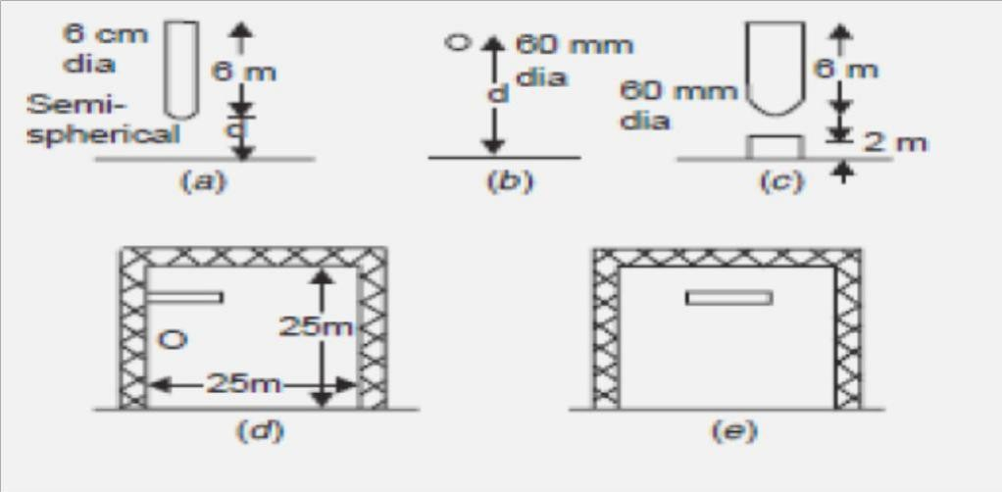
Different gap geometries

Slide 45
Overvoltage Protection
The causes of over voltages in the system have been studied extensively in previous sections. Basically, there are two sources: (i) external over voltages due to mainly lightning, and (ii) internal overvoltage mainly due to switching operation. The system can be protected against external over voltages using what are known as shielding methods which do not allow an arc path to form between the line conductors and ground, thereby giving inherent protection in the line design. For protection against internal voltages normally non-shielding methods are used which allow an arc path between the ground structure and the line conductor but means are provided to quench the arc. The use of ground wire is a shielding method whereas the use of spark gaps, and lightning arresters are the non-shielding methods. We will study first the non- shielding methods and then the shielding methods. However, the non shielding methods can also be used for external over voltages.

Slide 46
Overvoltage Protection
The non-shielding methods are based upon the principle of insulation breakdown as the Overvoltage is incident on the protective device; thereby a part of the energy content in the overvoltage is discharged to the ground through the protective device. The insulation breakdown is not only a function of voltage but it depends upon the time for which it is applied and also it depends upon the shape and size of the electrodes used.
Volt-time curves of gaps for positive and negative polarity

Slide 47
The steeper the shape of the voltage wave, the larger will be the magnitude of voltage required for breakdown; this is because an expenditure of energy is required for the rupture of any dielectric, whether gaseous, liquid or solid, and energy involves time. The energy criterion for various insulations can be compared in terms of a common term known as Impulse Ratio which is defined as the ratio of breakdown voltage due to an impulse of specified shape to the breakdown voltage at power frequency. The impulse ratio for sphere gap is unity because this gap has a fairly uniform field and the breakdown takes place on the field ionization phenomenon mainly whereas for a needle gap it varies between 1.5 to 2.3 depending upon the frequency and gap length. This ratio is higher than unity because of the non-uniform field between the electrodes. The impulse ratio of a gap of given geometry and dimension is greater with solid than with air dielectric. The insulators should have a high impulse ratio for an economic design whereas the lightning arresters should have a low impulse ratio so that a surge incident on the lightning arrester may be-by passed to the ground instead of passing it on to the apparatus. The volt-time characteristics of gaps having one electrode grounded depend upon the polarity of the voltage wave. From Fig. below it is seen that the volt-time characteristic for positive polarity is lower than the negative polarity, i.e. the breakdown voltage for a negative impulse is greater than for a positive because of the nearness of earthed metal or of current carrying conductors. For post insulators the negative polarity wave has a high breakdown value whereas for suspension insulators the reverse is true.

Slide 48
Horn Gap
The horn gap consists of two horn-shaped rods separated by a small distance. One end of this is connected to be line and the other to the earth as shown in Fig. 4.11, with or without a series resistance. The choke connected between the equipment to be protected and the horn gap serves two purposes: (i) The steepness of the wave incident on the equipment to be protected is reduced. (ii) It reflects the voltage surge back on to the horn.
Horn gap connected in the system for protection

Slide 49
Whenever a surge voltage exceeds the breakdown value of the gap a discharge takes place and the energy content in the rest part of the wave is by-passed to the ground. An arc is set up between the gap, which acts like a flexible conductor and rises upwards under the influence of the electro-magnetic forces, thus increasing the length of the arc which eventually blows out. There are two major drawbacks of the horn gap; (i) The time of operation of the gap is quite large as compared to the modern protective gear. (ii) If used on isolated neutral the horn gap may constitute a vicious kind of arcing ground. For these reasons, the horn gap has almost vanished from important power lines.
Surge Diverters
The following are the basic requirements of a surge diverter:
It should not pass any current at normal or abnormal (normally 5% more than the normal voltage) power frequency voltage.
It should breakdown as quickly as possible after the abnormal high frequency voltage arrives.
It should not only protect the equipment for which it is used but should discharge the surge current without damaging itself.
It should interrupt the power frequency follow current after the surge is discharged to ground.

Slide 50
There are mainly three types of surge diverters: (i) Rod gap, (ii) Protector tube or expulsion type of lightning arrester, (iii) Valve type of lightning arrester. Rod gap This type of surge diverter is perhaps the simplest, cheapest and most rugged one. Fig. below shows one such gap for a breaker bushing. This may take the form of arcing ring. Fig. below shows the breakdown characteristics (volt-time) of a rod gap.
For a given gap and wave shape of the voltage, the time for breakdown varies approximately inversely with the applied voltage.
A rod gap Figure: 4.13 Volt-time characteristic of rod gap

Slide 51
The time to flashover for positive polarity is lower than for negative polarities. Also it is found that the flashover voltage depends to some extent on the length of the lower (grounded) rod. For low values of this length there is a reasonable difference between positive (lower value) and negative flashover voltages. Usually a length of 1.5 to 2.0 times the gap spacing is good enough to reduce this difference to a reasonable amount. The gap setting normally chosen is such that its breakdown voltage is not less than 30% below the voltage withstand level of the equipment to be protected. Even though rod gap is the cheapest form of protection, it suffers from the major disadvantage that it does not satisfy one of the basic requirements of a lightning arrester listed at no. (iv) i.e., it does not interrupt the power frequency follow current. This means that every operation of the rod gap results in a L-G fault and the breakers must operate to de- energize the circuit to clear the flashover. The rod gap, therefore, is generally used as back up protection.
Expulsion type of lightning arrester
An improvement of the rod gap is the expulsion tube which consists of (i) a series gap (1) external to the tube which is good enough to withstand normal system voltage, thereby there is no possibility of corona or leakage current across the tube; (ii) a tube which has a fiber lining on the inner side which is a highly gas evolving material; (iii) a spark gap (2) in the tube; and (iv) an open vent at the lower end for the gases to be expelled (Fig. 4.14). It is desired that the breakdown voltage of a tube must be lower than that of the insulation for which it is used. When

Slide 52
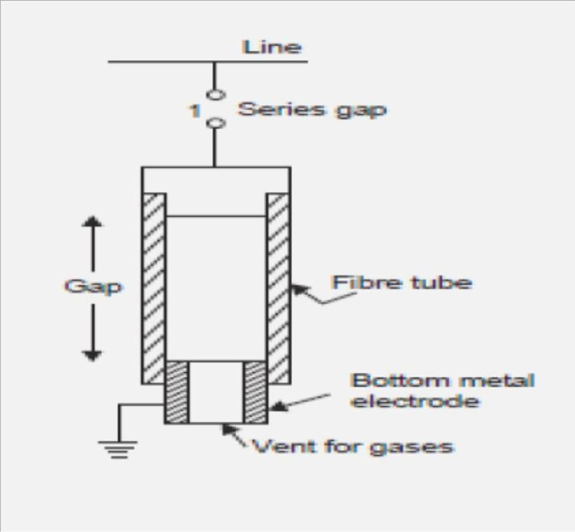
Expulsion type

Slide 53
Surge Protection of Rotating Machine
A rotating machine is less exposed to lightning surge as compared to transformers. Because of the limited space available, the insulation on the windings of rotating machines is kept to a minimum. The main difference between the winding of rotating machine and transformer is that in case of rotating machines the turns are fewer but longer and are deeply buried in the stator slots. Surge impedance of rotating machines in approx. 1000 Ω and since the inductance and capacitance of the windings are large as compared to the overhead lines the velocity of propagation is lower than on the lines. For atypical machine it is 15 to 20 metres/ μ sec. This means that in case of surges with steep fronts, the voltage will be distributed or concentrated at the first few turns. Since the insulation is not immersed in oil, its impulse ratio is approx. unity whereas that of the transformer is more than 2.0.
Surge Protection of Rotating Machine

Slide 54
The rotating machine should be protected against major and minor insulations. By major insulation is meant the insulation between winding and the frame and minor insulation means inter-turn insulation. The major insulation is normally determined by the expected line-to- ground voltage across the terminal of the machine whereas the minor insulation is determined by the rate of rise of the voltage. Therefore, in order to protect the rotating machine against surges requires limiting the surge voltage magnitude at the machine terminals and sloping the wave front of the incoming surge. To protect the major insulation a special lightning arrester is connected at the terminal of the machine and to protect the minor insulation a condenser of suitable rating is connected at the terminals of the machine as shown in Fig. above.

Slide 55
SYSTEM FAULTS AND OTHER ABNORMAL CONDITIONS
The shunt capacitances are also shown. Under balanced conditions and complete transposed transmission lines, the potential of the neutral is near the ground potential and the currents in various phases through the shunt capacitors are leading their corresponding voltages by 90°. They are displaced from each other by 120° so that the net sum of the three currents is zero (Fig. above). Say there is line-to-ground fault on one of the three phases (say phase ‗c‘).The voltage across the shunt capacitor of that phase reduces to zero whereas those of the healthy phases become line-to-line voltages and now they are displaced by 60° rather than 120°. The net charging current now is three times the phase current under balanced conditions (Fig.4.16 (c)). These currents flow through the fault and the windings of the alternator. The magnitude of this current is often sufficient to sustain an arc and, therefore, we have an arcing ground. This could be due to a flashover of a support insulator. Here this flashover acts as a switch. If the arc extinguishes when the current is passing through zero value, the capacitors in phases a and b are charged to line voltages. The voltage across the line and the grounded points of the post insulator will be the super-position of the capacitor voltage and the generator voltage and this voltage may be good enough to cause flashover which is equivalent to strike in a circuit breaker. Because of the presence of the inductance of the generator winding, the capacitances will form an oscillatory circuit and these oscillations may build up to still higher voltages and the arc may reignite causing further transient disturbances which may finally lead to complete rupture of the post insulators.

Slide 56
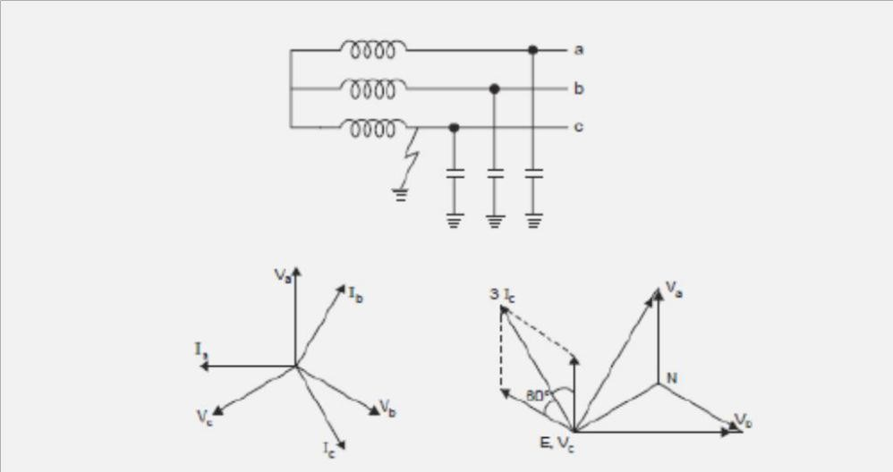
(a) 3-phase system with isolated neutral; (b) Phasor diagram under healthy condition; (c) Phasor diagram under faulted condition.

Slide 57
INSULATION COORDINATION
Insulation Coordination in Power System was introduced to arrange the electrical insulation levels of different components in the electrical power system including transmission network, in such a manner, that the failure of insulator, if occurs, confines to the place where it would result in the least damage of the system, easy to repair and replace, and results least disturbance to the power supply.
When any over voltage appears in the electrical power system, then there may be a chance of failure of its insulation system. Probability of failure of insulation is high at the weakest insulation point nearest to the source of over voltage. In power system and transmission networks, insulation is provided to the all equipment and components.
Insulators in some points are easily replaceable and repairable compared to other. Insulation in some points are not so easily replaceable and repairable and the replacement and repairing may be highly expensive and require long interruption of power. Moreover failure of insulator at these points may causes bigger part of electrical network to be out of service. So, it is desirable that in situation of insulator failure, only the easily replaceable and repairable insulator fails. The overall aim of insulation coordination is to reduce to an economically and operationally acceptable level the cost and disturbance caused by insulation failure. In insulation coordination method, the insulation of the various parts of the system must be so graded that flash over if occurs it must be at intended points.

Slide 58
For proper understanding the insulation coordination we have to understand first, some basic terminologies of the electrical power system. Let us have a discussion.
Nominal System Voltage: Nominal System Voltage is the phase to phase voltage of the system for which the system is normally designed. Such as 11 KV, 33 KV, 132 KV, 220 KV, 400 KV systems.
Maximum System Voltage:Maximum System Voltage is the maximum allowable power frequency voltage which can occurs may be for long time during no load or low load condition of the power system. It is also measured in phase to phase manner.
List of different nominal system voltage and their corresponding maximum system voltage is given below for reference,
NB - It is observed from above table that generally maximum system voltage is 110 % of corresponding nominal system voltage up to voltage level of 220 KV, and for 400 KV and above it is 105 %.
Factor of Earthing:This is the ratio of the highest rms phase to earth power frequency voltage on a sound phase during an earth fault to the rms phase to phase power frequency voltage which would be obtained at the selected location without the fault.
This ratio characterizes, in general terms, the earthing conditions of a system as viewed from the selected fault location.
Nominal System Voltage in KV | 11 | 33 | 66 | 132 | 220 | 400
Maximum System Voltage in KV | 12 | 36 | 72.5 | 145 | 245 | 420

Slide 59
Effectively Earthed System: A system is said to be effectively earthed if the factor of earthing does not exceed 80 % and non-effectively earthed if it does. Factor of earthing is 100 % for an isolated neutral system, while it is 57.7 % (1/√3 = 0.577) for solidly earthed system.
Insulation Level: Every electrical equipment has to undergo different abnormal transient over voltage situation in different times during its total service life period. The equipment may have to withstand lightning impulses, switching impulses and/or short duration power frequency over voltages. Depending upon the maximum level of impulse voltages and short duration power frequency over voltages that one power system component can withstand, the insulation level of high voltage power system is determined.
During determining the insulation level of the system rated less than 300 KV, the lightning impulse withstand voltage and short duration power frequency withstand voltage are considered. For equipment rated more or equal 300 KV, switching impulse withstand voltage and short duration power frequency withstand voltage are considered.
Lightning Impulse Voltage: The system disturbances occur due to natural lightning can be represented by three different basic wave shapes. If a lightning impulse voltage travels some distance along the transmission line before it reaches to a insulator its wave shaped approaches to full wave, and this wave is referred as 1.2/50 wave. If during travelling, the lightning disturbance wave causes flash over across an insulator the shape of the wave becomes chopped wave. If a lightning stroke hits directly on the insulator then the lightning impulse voltage may rise steep until it is relieved by flash over, causing sudden, very steep collapse in voltage. These three waves are quite different in duration and in shapes.

Slide 60
Switching Impulse:During switching operation there may be uni-polar voltage appears in the system. The wave form of which may be periodically damped or oscillating one. Switching impulse wave form has steep front and long damped oscillating tale.
Short Duration Power Frequency Withstand Voltage: Short duration power frequency withstand voltage is the prescribed rms value of sinusoidal power frequency voltage that the electrical equipment shall withstand for a specific period of time normally 60 seconds.
Protection Level Voltage of Protective Device: Over voltage protective device like surge arrestors or lightning arrestors are designed to withstand a certain level of transient over voltage beyond which the devices drain the surge energy to the ground and therefore maintain the level of transient over voltage up to a specific level. Thus transient over voltage cannot exceed that level. The protection level of over voltage protective device is the highest peak voltage value which should not be exceeded at the terminals of over voltage protective device when switching impulses and lightening impulses are applied.
Shield Wire or Earth Wire

Slide 61
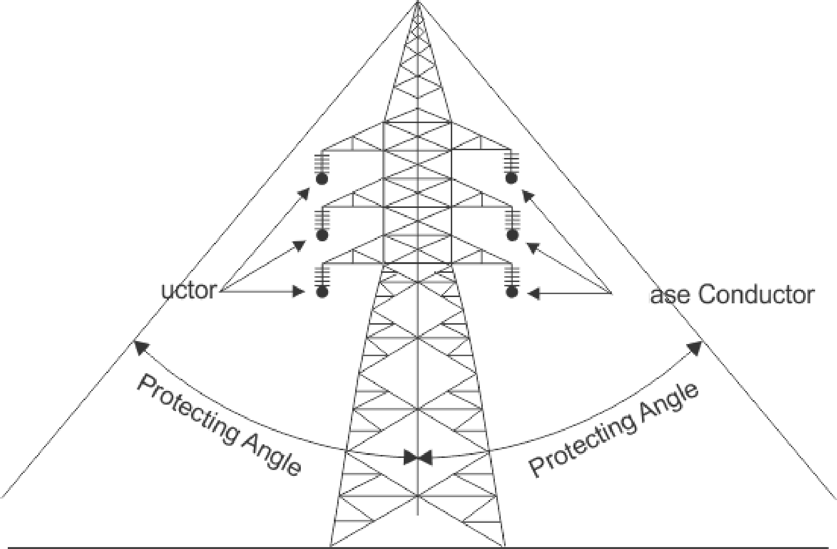
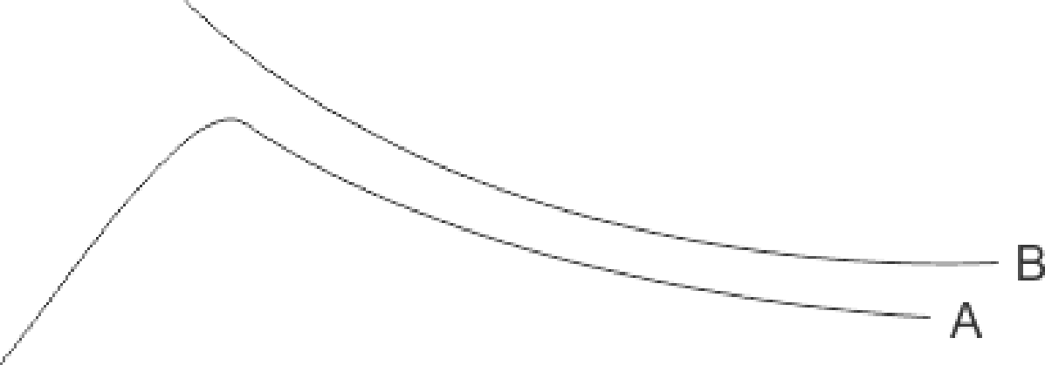
Voltage - Time Curved Used for Insulation Coordination
B - Impulse Insulation Level of Equipment to be protected A - Protection Level Voltage of Protective Device
Phase Cond
Ph
Time in s (Micro Second)

Slide 62
As we discussed above that a component of electrical power system may suffer from different level of transient voltage stresses, switching impulse voltage and lightning impulse voltage. The maximum amplitude of transient over voltages reaches the components can be limited by using protecting device like lightning arrestors in the system. If we maintain the insulation level of all the power system component above the protection level of protective device, then ideally there will be no chance of breakdown of insulation of any component. Since the transient over voltage reaches at the insulation after crossing the surge protective devices will have amplitude equals to protection level voltage and protection level voltage impulse insulation level of the components. Generally, the impulse insulation level is established at 15 to 25 % above the protective level voltage of protective devices.

Slide 63
Bewley Lattice Diagram
In order to keep track of the multiplicity of the successive reflections at the discontinuites in the system, Bewley has devices a time space diagram which shows the position and direction of motion of every incident, reflected and transmitted wave on the system at every instant of time.
In the lattice diagram, two axis are established, a horizontal one scaled in distance along the line and vertical one scaled in time.
Lines showing the passage of surges are drawn such that their slopes given the time corresponding to the distance travelled.
At each point of change in impedance, the reflected and transmitted waves are obtained by multiplying the incident wave magnitude by a proper reflection and transmission coefficients.
To illustrate the method of constructing Bewley lattice diagram, let us consider a simple system where in a DC generator of unit voltage is switched on to a lossless line of characteristic impedance Zc, with a load resistance Rc at its receiving end.
For simplicity, It is assumed that are generator has zero impedance such that a unit voltage wave is continuously fed to the line after the switching instant.
The reflection coefficient at the receiving end is

Slide 64
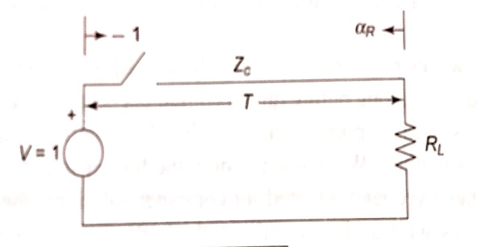
Bewley Lattice Diagram
$$⍺_{R}=\frac{R_{L}−Z_{C}}{R_{L}+Z_{C}}$$
and at the sanding and is
$⍺_{S}=\frac{0−Z_{C}}{0+Z_{C}}$ = -1
Let that time of travel of surge from one end to the other be T.

Slide 65
Bewley Lattice Diagram
Immediately after switching a unit step voltage Surge (infinite length) travels down the line towards the receiving end.
This fact is recorded diagrammatically by a line sloping downwards as shown in figure .
When the surge reaches the line end (in Ts), a surge of amplitude $⍺_{R}$ is originated in the reflection process, which then travels towards the generator and reaching there at t=2T represented by a sloping line (right to left).
The reflection at the generator end causes an outward surge of strength -$⍺_{R}$.This process continues indefinitely.
It is easily observed from the bewley lattice diagram that, at the receiving end, the increment of voltage at each reflection is the sum of the incident and reflected waves.

Slide 66
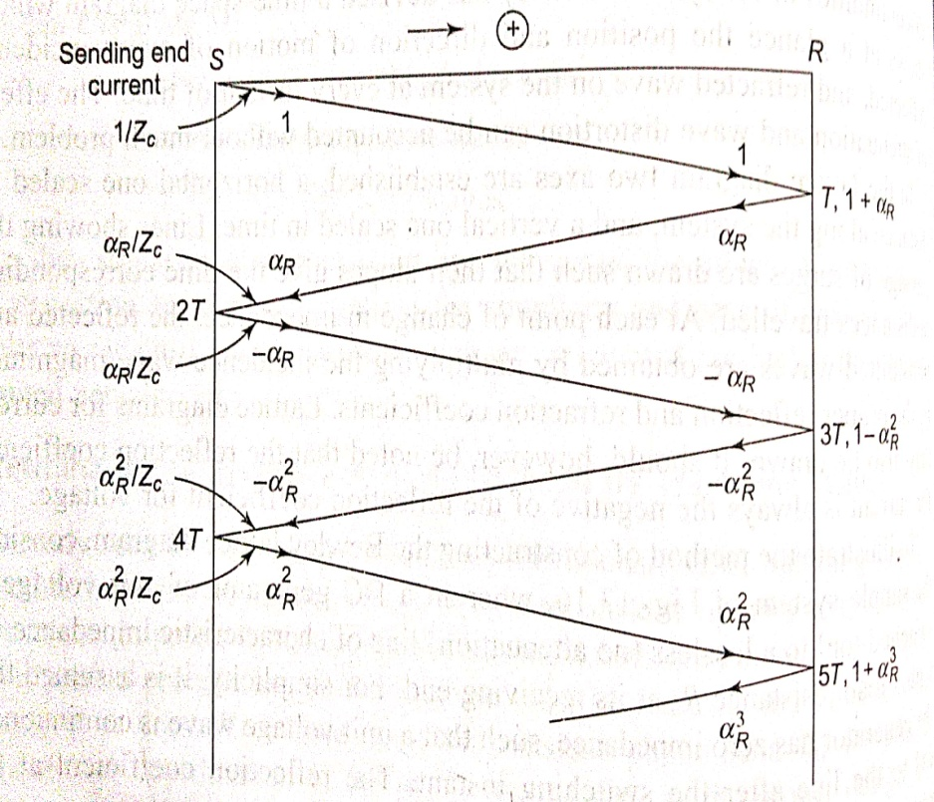
Bewley Lattice Diagram

Slide 67
Bewley Lattice Diagram
$V_{R}=\left(1+⍺_{R}\right)−\left(⍺_{R}+⍺_{R}^{2}\right)+$($⍺_{R}^{2}+⍺_{R}^{3})−….$
=$\left(1+⍺_{R}\right)[(1+⍺_{R}^{2}+⍺_{R}^{4}+….−\left(⍺_{R}+⍺_{R}^{3}+⍺_{R}^{5}+…\right)]$
≈ 1 (Steady state value)
Receiving end voltage vs. time

Slide 68
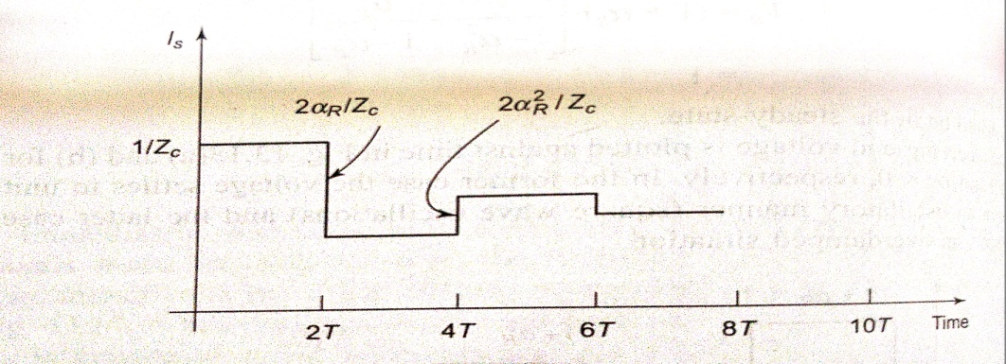
Bewley Lattice Diagram
Let us now plot the sending end current. Each outgoing surge is accompanied by a current wave of strength (Voltage/$Z_{c}$) and each incoming wave is accompanied by a current wave (-Voltage/$Z_{c}$).
The plot of sending end current vs time is drawn in figure for $⍺_{R}>0$.
The steady value of the sending-end current is given by
$$I_{S}=\frac{1}{Z_{C}}[1−2⍺_{R}+⍺_{R}^{2}−2⍺_{R}^{3}+….]$$
=$\frac{1}{R_{L}}$(the reader should prove this)
Sending end current vs. time for $⍺_{R}>0$

Slide 69
JISHA VARGHESE (Asst. professor, EE DEPTT.) , JECRC, JAIPUR

