Slide 1
JAIPUR ENGINEERING COLLEGE AND RESEARCH CENTRE
Year & Sem – B.Tech 3 year, Sem-V
Subject –Power System-1
Unit – 3
Presented by – Mrs. Neha Agrawal
DESIGNATION –Assistant Professor
DEPARTMENT-Electrical Engineering
Jaipur Engineering College & Research Center Power System Components
Prepared by, Mrs. Neha Agrawal

Slide 2
VISSION AND MISSION OF INSTITUTE
Jaipur Engineering College & Research Center Power System Components
Prepared by, Mrs. Neha Agrawal

Slide 3
VISSION AND MISSION OF DEPARTMENT
Jaipur Engineering College & Research Center Power System Components
Prepared by, Mrs. Neha Agrawal

Slide 4
Course Outcome for power System-1
CO1: Identify the different parameters of transmission lines and understand the basic power system.
CO2: Analysis the overhead and underground transmission and distribution lines and identify the faults.
CO3: Design and analysis of over voltage generation and its protection in power system.
Jaipur Engineering College & Research Center Power System Components
Prepared by, Mrs. Neha Agrawal

Slide 5
Syllabus For Chapter-3
Power System Components: Overhead Transmission Lines and Cables: Electrical and Magnetic Fields around conductors, Corona. Parameters of lines and cables. Capacitance and Inductance calculations for simple configurations. Travelling-wave Equations. Sinusoidal Steady state representation of Lines: Short, medium and long lines. Power Transfer, Voltage profile and Reactive Power. Characteristics of transmission lines. Surge Impedance Loading. Series and Shunt Compensation of transmission lines. Transformers: Three-phase connections and Phase-shifts. Three winding transformers, autotransformers, Neutral Grounding transformers. Tap-Changing in transformers. Transformer Parameters. Single phase equivalent of three-phase transformers. Synchronous Machines: Steady-state performance characteristics. Operation when connected to infinite bus. Real and Reactive Power Capability Curve of generators. Typical waveform under balanced terminal short circuit conditions – steady state, transient and subtransient equivalent circuits. Loads: Types, Voltage and Frequency Dependence of Loads. Per-unit System and per-unit calculations.
Jaipur Engineering College & Research Center Power System Components
Prepared by, Mrs. Neha Agrawal

Slide 6
Syllabus of power System-1
Over-voltages and Insulation Requirements Generation of Over-voltages: Lightning and Switching Surges. Protection against Overvoltages, Insulation Coordination. Propagation of Surges. Voltages produced by traveling surges. Bewley Diagrams.
Fault Analysis and Protection Systems Method of Symmetrical Components (positive, negative and zero sequences). Balanced and Unbalanced Faults. Representation of generators, lines and transformers in sequence networks.
Jaipur Engineering College & Research Center Power System Components
Prepared by, Mrs. Neha Agrawal

Slide 7
Syllabus of power System-1
Computation of Fault Currents. Neutral Grounding. Switchgear: Types of Circuit Breakers. Attributes of Protection schemes, Back-up Protection. Protection schemes (Over-current, directional, distance protection, differential protection) and their application.
Introduction to DC Transmission & Renewable Energy Systems DC Transmission Systems: Line-Commutated Converters (LCC) and Voltage Source Converters (VSC). LCC and VSC based dc link, Real Power Flow control in a dc link. Comparison of ac and dc transmission. Solar PV systems: I-V and P-V characteristics of PV panels, power electronic interface of PV to the grid. Wind Energy Systems: Power curve of wind turbine. Fixed and variable speed turbines. Permanent Magnetic Synchronous Generators and Induction Generators. Power Electronics interfaces of wind generators to the grid
Jaipur Engineering College & Research Center Power System Components
Prepared by, Mrs. Neha Agrawal

Slide 8
Power System Components
Electrical and Magnetic Fields around conductors
Corona
Parameters of lines and cables
Capacitance and Inductance calculations for simple configurations
Travelling-wave Equations.
Sinusoidal Steady state representation of Lines: Short, medium and long lines.
Power Transfer, Voltage profile and Reactive Power. Characteristics of transmission lines.
Surge Impedance Loading.
Series and Shunt Compensation of transmission lines
Prepared by, Mrs. Neha Agrawal
Jaipur Engineering College & Research Center Power System Components

Slide 9
Electrical and Magnetic Fields around conductors
Jaipur Engineering College & Research Center Power System Components
Prepared by, Mrs. Neha Agrawal

Slide 10
Corona in Overhead Transmission Line
Ionization of Air Surrounding the Power Conductors is called Corona
Self sustained Electric Discharge Phenomenon
Dielectric Strength of Air equals to 30 kV/cm peak at NTP
Faint violet glow appears which is visible in the dark
Production of ozone gas & Hissing Noise
Jaipur Engineering College & Research Center Power System Components
Prepared by, Mrs. Neha Agrawal

Slide 11
Figure : Corona Discharge

Slide 12
Critical Disruptive Voltage
V_{c} = m_{o} g_{o} δ r log_{e} (d/r) kV/phase
where
δ = air density factor = 3.92b / (273 + t)
m_{o} (irregularity factor ) = 1 for polished conductors
= 0·98 to 0·92 for dirty conductors
= 0·87 to 0·8 for stranded conductors
Visual Critical Voltage
minimum phase-neutral voltage at which corona glow appears all along the line conductors.
Jaipur Engineering College & Research Center Power System Components
Prepared by, Mrs. Neha Agrawal

Slide 13
Corona Loss
Formation of corona is always accompanied by energy loss
which is dissipated in the form of light, heat, sound and chemical action
Power loss due to corona is given by :
Jaipur Engineering College & Research Center Power System Components
Prepared by, Mrs. Neha Agrawal

Slide 14
Factors Affecting Corona
Atmospheric Factors
Field Around the Conductor
Conductor size
Spacing between conductors
No. of Conductor/Phases
Profile of Conductor
Surface Conditions of Conductor
Jaipur Engineering College & Research Center Power System Components
Prepared by, Mrs. Neha Agrawal

Slide 15
Methods Reducing Corona Effect
By increasing conductor size
Using Bundled Conductors
Using Hollow Conductors
Using Corona rings
By increasing conductor spacing
Jaipur Engineering College & Research Center Power System Components
Prepared by, Mrs. Neha Agrawal

Slide 16
Advantages of Corona Losses
Reduces the steepness of voltage Surge produced due to Lighting or Switching
Reduces the Electro-static stresses between the conductors
Disadvantages of Corona Losses
Loss of Power
Reduces the Transmission efficiency of the line
Radios and Television Interference
Inductive interference with neighbouring Communication lines
Prepared by, Mrs. Neha Agrawal
Jaipur Engineering College & Research Center Power System Components

Slide 17
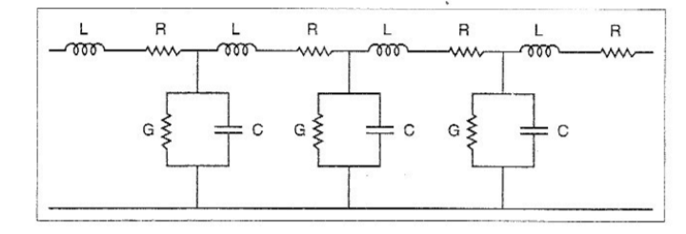
Transmission Line Parameter
An electric transmission line has four parameters, namely resistance, inductance, capacitance and shunt conductance. These four parameters are uniformly distributed along the whole line.
Equivalent Circuit Diagram of Transmission Line
Resistance(R): It is the opposition of line conductors to current flow. The resistance is distributed uniformly along the whole length of the line.
Inductance(L): When an alternating current flows through a conductor, a changing flux is set up which links the conductor. Due to these flux linkages, the conductor possesses inductance. Inductance depends on: Material, size, position, spacing, flux linkage due to own conductor current (both internal & external) and flux linkage due to other conductor current (only External)
Mathematically, inductance is defined as the flux linkages per ampere i.e.
Jaipur Engineering College & Research Center Power System Components
Prepared by, Mrs. Neha Agrawal

Slide 18
Capacitance(C):We know that any two conductors separated by an insulating material constitute a capacitor. As any two conductors of an overhead transmission line are separated by air which acts as an insulation, therefore, capacitance exists between any two overhead line conductors. The capacitance between the conductors is the charge per unit potential difference i.e., Capacitance,
C = $\frac{q}{v}$ farad
where q = charge on the line in coulomb
v = Potential Difference between the conductors in volts
Conductance(G): is defined as the shunt conductance per unit length between the two transmission lines. It is measured in Mhos/Km.
Prepared by, Mrs. Neha Agrawal
Jaipur Engineering College & Research Center Power System Components

Slide 19
Flux Linkages
The inductance of a circuit is defined as the flux linkages per unit current. Therefore, in order to find the inductance of a circuit, the determination of flux linkages is of primary importance. We shall discuss two important cases of flux linkages.
Flux linkages due to a single current carrying conductor
Flux linkages due to internal flux
Flux linkages due to external flux
By Ampere’s Law,
In a closed path,
M.m.f.=Current enclose $I_{X}$
= $I_{X}$
= Current density *Area
= $\frac{I}{{πr}^{2}}×{πx}^{2}$
= $\frac{I}{r^{2}}×x^{2}$
Jaipur Engineering College & Research Center Power System Components
Prepared by, Mrs. Neha Agrawal

Slide 20
Flux Linkages
By Maxwell’s Equation,
M.m.f.=Line integral of magnetic field intensity
= ʃ $H_{X}$dl
=2πxH
On equation both,
H=$\frac{I}{{2πr}^{2}}x$ $AT/m$
Flux Density
B=µH=µ$\frac{I}{{2πr}^{2}}$x wb/ $m^{2}$
Consider a small area ∆A in a conductor of width dx and length l,
Flux dՓ=Flux Density $×$ area
=B $×$ ∆ A=B $×$ dx $×1$ (l=unit length)
=$\frac{µI}{{2πr}^{2}}$ $x×$ dx$×1$
This flux dՓ links only with current $I_{X}$.Therefore , flux linkage per meter axial length is,
Prepared by, Mrs. Neha Agrawal
Jaipur Engineering College & Research Center Power System Components

Slide 21
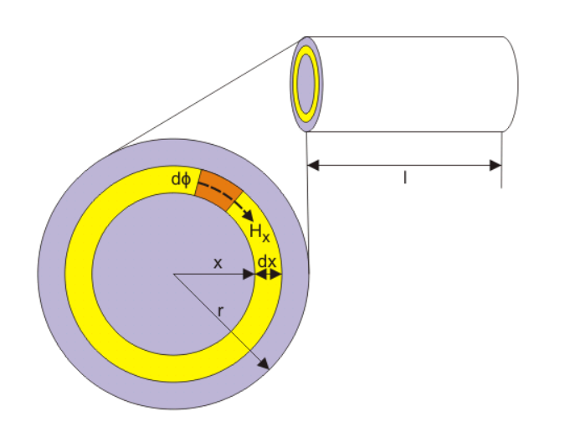
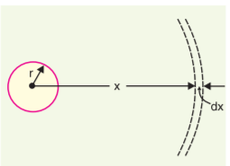
Flux Linkages
Flux dѱ=$\frac{{πx}^{2}}{{πr}^{2}}dՓ$=$\frac{{µIx}^{3}}{{2πr}^{4}}dx wb−T/m$
Flux linkages due to internal flux
ψint = $\int_{0}^{r}{\frac{{µIx}^{3}}{{2πr}^{4}}dx}$
ψint = $\frac{µ_{0}I}{8π}$ weber-turns per metre length
$µ_{0}$=4 $π$ *${10}^{−7}$
ψint = $\frac{ {10}^{−7}I}{2}$ weber-turns per metre length
$L_{int}=\frac{{\text{ψ}}_{int}}{I}$ = $\frac{ {10}^{−7}}{2}$
Prepared by, Mrs. Neha Agrawal
Jaipur Engineering College & Research Center Power System Components

Slide 22
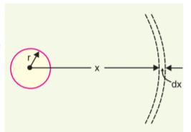
H=$\frac{I}{2πx} AT/m$
B=µH=µ$\frac{I}{2πx}$wb/$m^{2}$
Flux dՓ=flux density X area
= B*∆A=B*dx*1
= µ$\frac{I}{2πx}$dx
Flux dѱ=$\frac{{Iµ}_{0}}{2πx}$dx wb-T/m where $µ_{r}=1$
Prepared by, Mrs. Neha Agrawal
Jaipur Engineering College & Research Center Power System Components

Slide 23
(b) Flux linkages due to external flux
ψext = $\int_{r}^{∞}{\frac{{Iµ}_{0}}{2πX}dx}$
ψext = $\frac{{Iµ}_{0}}{2π} \int_{r}^{∞}{\frac{dx}{X} wb−\frac{T}{m}}(from r to ∞$)
Lext =$\frac{{\text{ψ}}_{ext}}{I}$= $\frac{µ_{0}}{2π} \int_{r}^{∞}{\frac{dx}{X} wb−\frac{T}{m}}$
Overall flux linkageis
Ψ= ψint +ψext= = $\frac{{Iµ}_{0}}{2π} \left[\frac{1}{4}+\int_{r}^{∞}{\frac{dx}{X} }\right]$ $wb−\frac{T}{m}$ (from r to $∞$)
Prepared by, Mrs. Neha Agrawal
Jaipur Engineering College & Research Center Power System Components

Slide 24
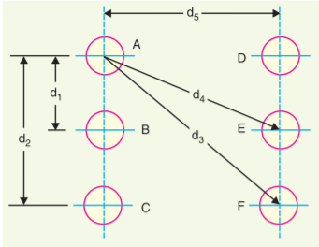
(b) Flux linkages in parallel conductor
Flux linkages with conductor A due to its own current
${\text{ψ}}_{AA}$= $\frac{{I_{A}µ}_{0}}{2π} \left[\frac{1}{4}+\int_{r}^{∞}{\frac{dx}{X} }\right]wb−\frac{T}{m}$ (from r to $∞$) …………….(i)
Flux linkages with conductor A due to Current $I_{B}$
${\text{ψ}}_{AB}$= $\int_{d1}^{∞}{\frac{I_{B}µ_{0}}{2πX}dx}$= $\frac{{I_{B}µ}_{0}}{2π} \int_{d1}^{∞}{\frac{dx}{X} wb−\frac{T}{m}}$(from d1 to ∞) …………(ii)
Flux linkages with conductor A due to Current $I_{B}$
${\text{ψ}}_{AC}$= $\int_{d2}^{∞}{\frac{I_{C}µ_{0}}{2πX}dx}$= $\frac{{I_{C}µ}_{0}}{2π} \int_{d2}^{∞}{\frac{dx}{X} wb−\frac{T}{m}}$(from d2 to ∞) ……….....(iii)
Total flux linkages with conductor A=(i)+(ii)+(iii)+…………
= $\frac{{I_{A}µ}_{0}}{2π} \left[\frac{1}{4}+\int_{r}^{∞}{\frac{dx}{X} }\right]$+ $\frac{{I_{B}µ}_{0}}{2π} \int_{d1}^{∞}{\frac{dx}{X} }$+ $\frac{{I_{C}µ}_{0}}{2π} \int_{d2}^{∞}{\frac{dx}{X}+……..}$
Prepared by, Mrs. Neha Agrawal
Jaipur Engineering College & Research Center Power System Components

Slide 25
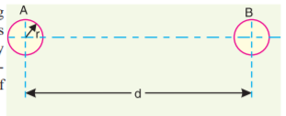
Single Phase Inductance of a Single Phase Two-wire Line
Consider a single phase overhead line consisting of two parallel conductors A and B spaced d metres apart as shown in Fig. Conductors A and B carry the same amount of current (i.e. $I_{A}$= $I_{B}$), but in the opposite direction because one forms the return circuit of the other. ∴ $I_{A}$ + $I_{B}$ = 0
In order to find the inductance of conductor A (or conductor B), we shall have to consider the flux linkages with it. There will be flux linkages with conductor A due to its own current $I_{A}$ and also due to the mutual inductance effect of current $I_{B}$ in the conductor B. Flux linkages with conductor A due to its own current
${\text{ψ}}_{AA}$= $\frac{{I_{A}µ}_{0}}{2π} \left[\frac{1}{4}+\int_{r}^{∞}{\frac{dx}{X} }\right]wb−\frac{T}{m}$
Flux linkages with conductor A due to current IB
${\text{ψ}}_{AB}$= $\frac{{I_{B}µ}_{0}}{2π} \int_{d1}^{∞}{\frac{dx}{X} wb−\frac{T}{m}}$
Prepared by, Mrs. Neha Agrawal
Jaipur Engineering College & Research Center Power System Components

Slide 26
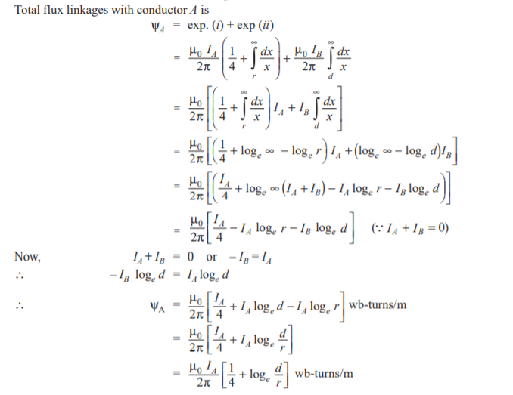
Prepared by, Mrs. Neha Agrawal
Jaipur Engineering College & Research Center Power System Components

Slide 27
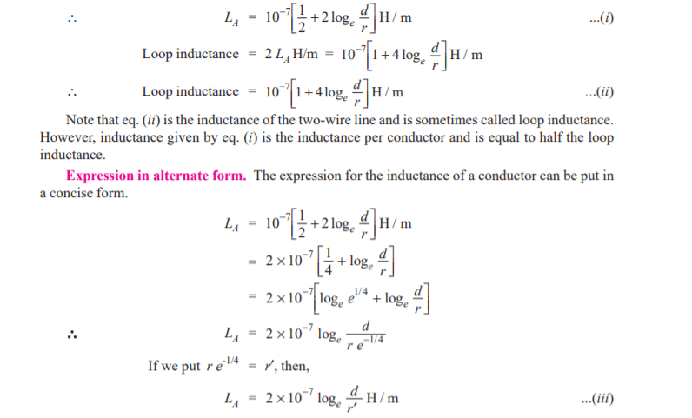
Prepared by, Mrs. Neha Agrawal
Jaipur Engineering College & Research Center Power System Components

Slide 28
Prepared by, Mrs. Neha Agrawal
Jaipur Engineering College & Research Center Power System Components

Slide 29
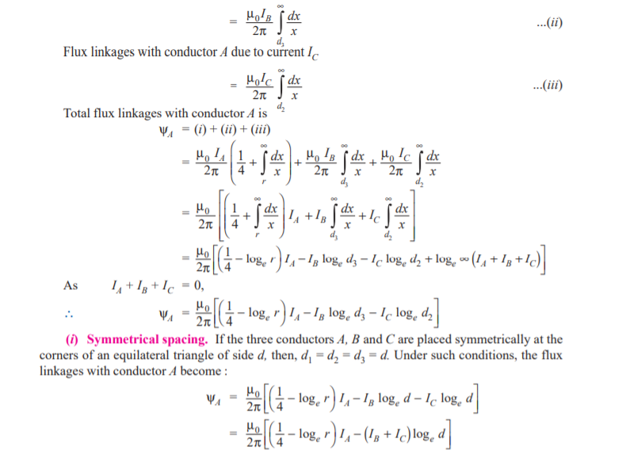
Prepared by, Mrs. Neha Agrawal
Jaipur Engineering College & Research Center Power System Components

Slide 30
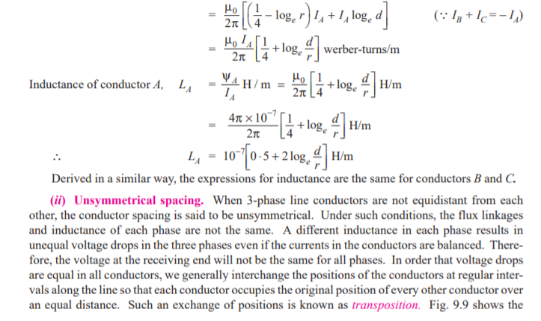
Prepared by, Mrs. Neha Agrawal
Jaipur Engineering College & Research Center Power System Components

Slide 31
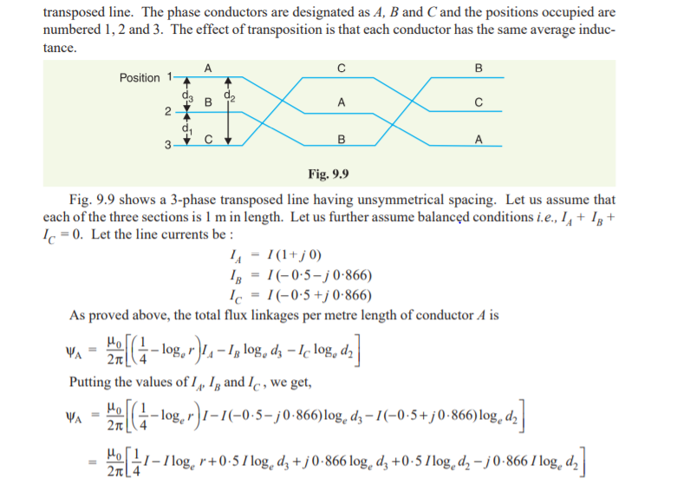
Prepared by, Mrs. Neha Agrawal
Jaipur Engineering College & Research Center Power System Components

Slide 32
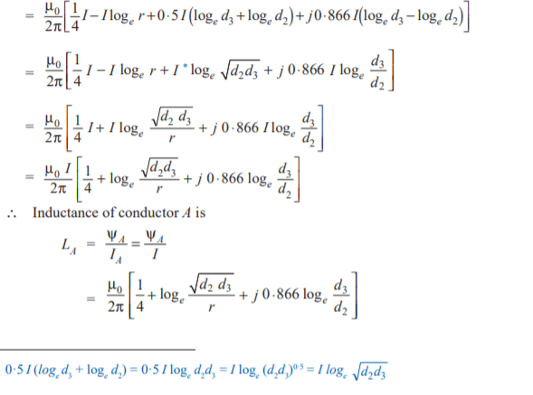
Prepared by, Mrs. Neha Agrawal
Jaipur Engineering College & Research Center Power System Components

Slide 33
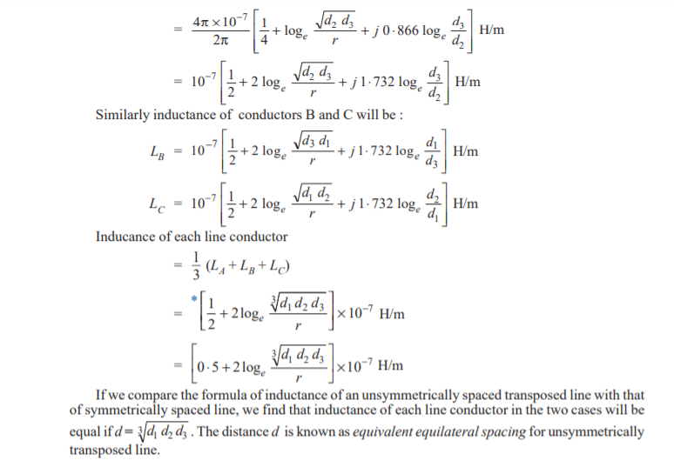
Prepared by, Mrs. Neha Agrawal
Jaipur Engineering College & Research Center Power System Components

Slide 34
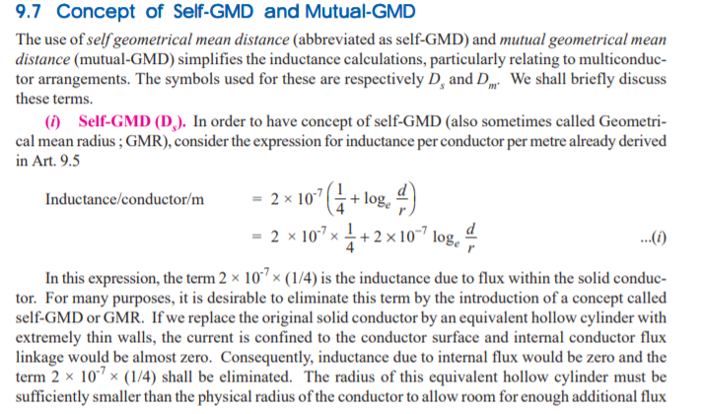
Prepared by, Mrs. Neha Agrawal
Jaipur Engineering College & Research Center Power System Components

Slide 35
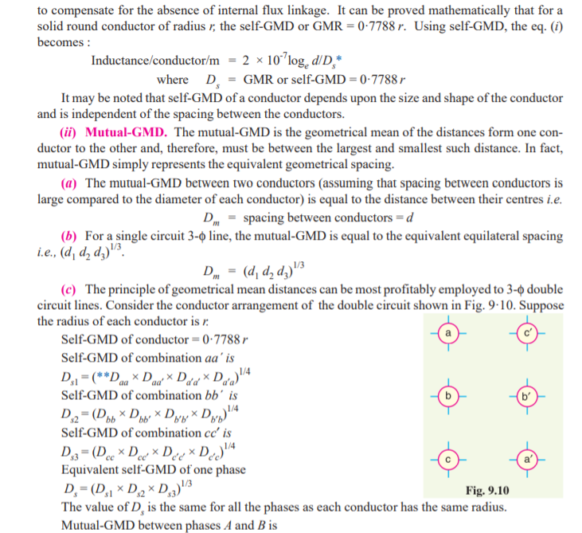
Prepared by, Mrs. Neha Agrawal
Jaipur Engineering College & Research Center Power System Components

Slide 36
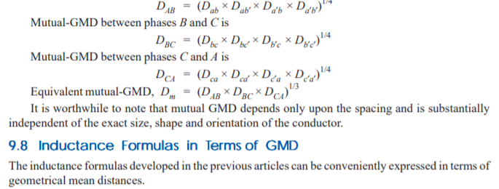
Prepared by, Mrs. Neha Agrawal
Jaipur Engineering College & Research Center Power System Components

Slide 37
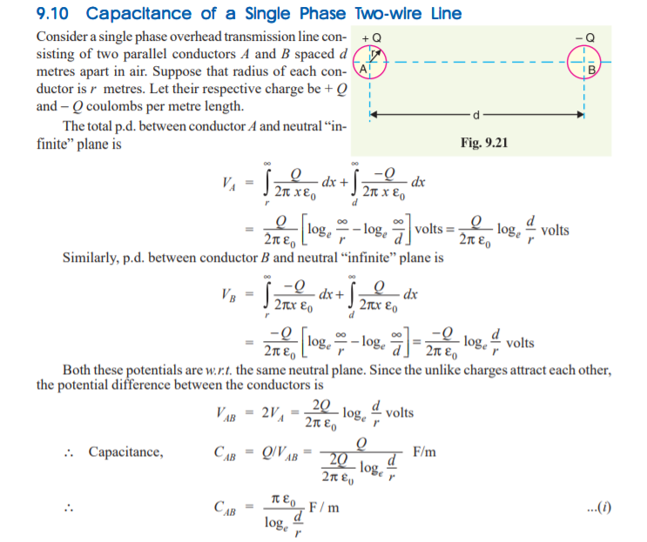
Prepared by, Mrs. Neha Agrawal
Jaipur Engineering College & Research Center Power System Components

Slide 38
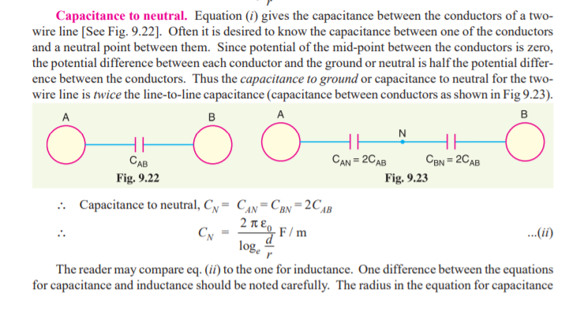
Prepared by, Mrs. Neha Agrawal
Jaipur Engineering College & Research Center Power System Components

Slide 39
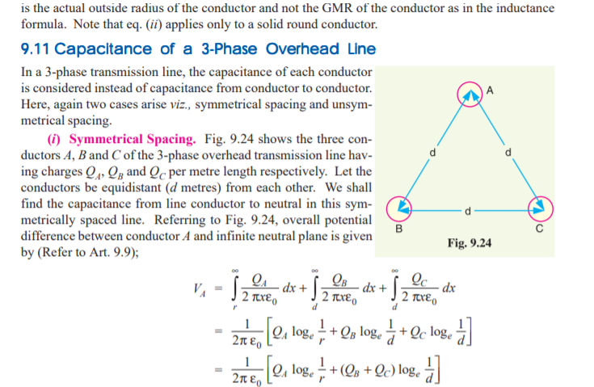
Prepared by, Mrs. Neha Agrawal
Jaipur Engineering College & Research Center Power System Components

Slide 40
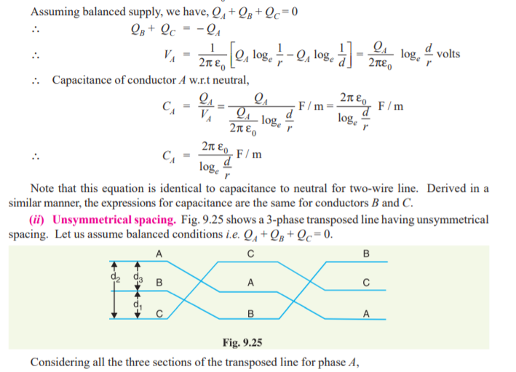
Prepared by, Mrs. Neha Agrawal
Jaipur Engineering College & Research Center Power System Components

Slide 41
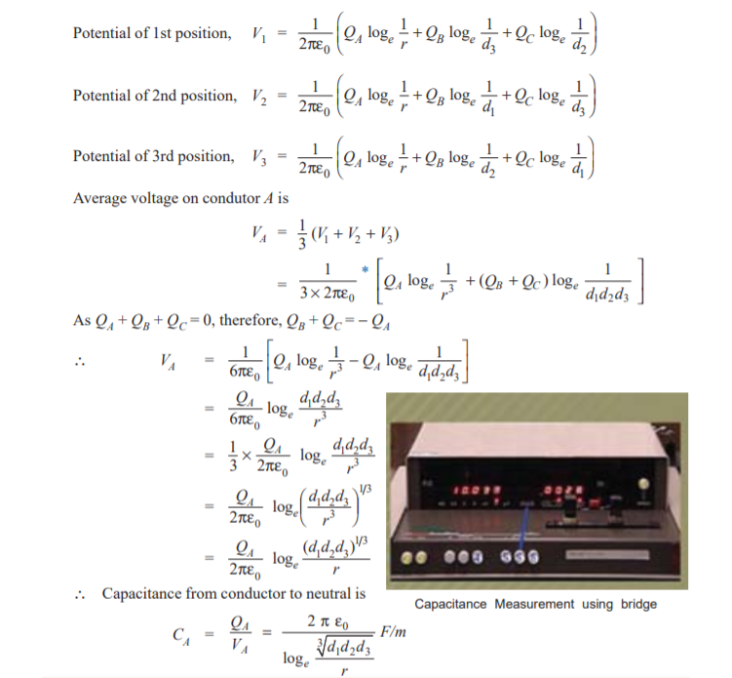
Prepared by, Mrs. Neha Agrawal
Jaipur Engineering College & Research Center Power System Components

Slide 42
Prepared by, Mrs. Neha Agrawal
Jaipur Engineering College & Research Center Power System Components

Slide 43
43
Characteristics of Transmission Line
A transmission line has three constants R, L and C distributed uniformly along the whole length of the line.
The resistance and inductance from the series impedance.
The capacitance existing between conductors for 1- phase line or from a conductor to neutral for 3- phase line forms a shunt path through the length of the line.
Therefore, capacitance effects introduce complications in transmission line calculations.
Prepared by, Mrs. Neha Agrawal
Jaipur Engineering College & Research Center Power System Components

Slide 44
44
Depending upon the manner in which capacitance is taken into account, the overhead transmission lines are classified as
Sr no. | Line | Length | Voltage | Parameter
1 | Short | 50 Miles 80 KM. | 11 & 33 KV | R & L
2 | Medium | 50-100 Miles 80-160 KM. | 66 & 132 KV | R, L & C
3 | Long | Above 100 Miles Above 160 KM | Above 132 KV. | R, L ,C & G
Prepared by, Mrs. Neha Agrawal
Jaipur Engineering College & Research Center Power System Components

Slide 45
45
Voltage Regulation
When a transmission line is carrying current, there is a voltage drop in the line due to resistance and inductance of the line.
The result is the receiving end voltage (Vr) of the line is generally less than the sending end voltage (Vs).
This voltage drop (Vs-Vr) in the line is expressed as a percentage of receiving end voltage Vr and is called voltage regulation.
Mathematically:-
% Voltage regulation:- $\frac{V_{s}−V_{r}}{V_{r}}$ $×$100
Prepared by, Mrs. Neha Agrawal
Jaipur Engineering College & Research Center Power System Components

Slide 46
46
Transmission Efficiency
The power obtained at the receiving end of a transmission line is generally less than the sending end power due to losses in the line resistance.
The ratio of receiving end power to the sending end power of a transmission line is known as the transmission efficiency of the line.
% Transmission efficiency:-
$\frac{\text{Receiving} \text{end} \text{power} }{\text{Sending} \text{end} \text{power} }$ $×$100
Prepared by, Mrs. Neha Agrawal
Jaipur Engineering College & Research Center Power System Components

Slide 47
47
Performance of Single phase Short Transmission Lines
As stated earlier, the effects of the line capacitance are neglected for a transmission line.
Therefore while studying the performance of such a line only resistance and inductance of the line are taken into account.
The equivalent circuit of single phase short transmission line is shown in fig.
Here the total resistance and inductance are shown as concentrated or lumped instead of being distributed.
The circuit is a simple a.c. circuit.
Prepared by, Mrs. Neha Agrawal
Jaipur Engineering College & Research Center Power System Components

Slide 48
48
The phasor diagram of the line for lagging load power factor is shown in. fig. from the right angle traingle ODC, we get
Prepared by, Mrs. Neha Agrawal
Jaipur Engineering College & Research Center Power System Components

Slide 49
49
Prepared by, Mrs. Neha Agrawal
Jaipur Engineering College & Research Center Power System Components

Slide 50
50
Generalized Network Constants
As we know that, the effect of shunt capacitance in short transmission line is neglected.
For a transmission line, it is better to call input voltage and current as Sending end voltage and current. Similarly, output voltage as receiving end voltage and current.
Let V_{R} = Receiving end voltage
V_{s} = Sending end voltage
I_{s} = Sending end current
I_{R} = Receiving end current
The steady state voltages at the sending ad receiving ends are expressed in terms of voltage and current at receiving end.
They are expressed as
V_{s} = AV_{R} + BI_{R} …………………..(1)
I_{s} = CV_{R} + DI_{R} ……………………(2)
Jaipur Engineering College & Research Center Power System Components
Prepared by, Mrs. Neha Agrawal

Slide 51
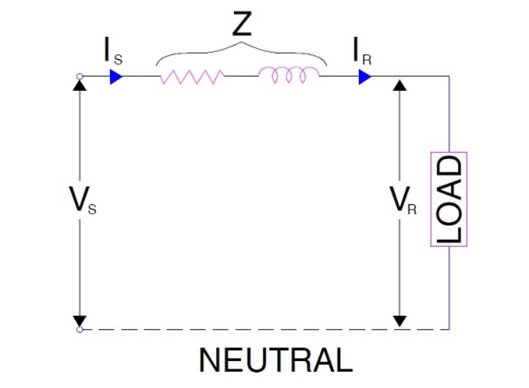
51
From the network shown in figure, We may write
I_{s} = I_{R} ………(3)
and V_{s} = V_{R} + I_{R}Z ……..(4)
Comparing equation (3) & (4) with equation (1) & (2), we get
A = 1, B = Z, C = 0 and D = 1
Thus we see that, A = D and AD – BC = 1
Short Transmission Line model
Prepared by, Mrs. Neha Agrawal
Jaipur Engineering College & Research Center Power System Components

Slide 52
52
Three-Phase Short Transmission Line
for reasons associated with economy, transmission of electric power is done by 3-phase system.
This system may be regarded as consisting of three single phase units, each wire transmitting one-third of the total power.
As a matter of convenience, we generally analyses 3- phase system by considering one phase only.
Therefore expression for regulation, efficiency etc. derived for a single phase line can also be applied to a 3-phase system.
Since only one phase is considered, phase value of 3- phase system to be taken.
Prepared by, Mrs. Neha Agrawal
Jaipur Engineering College & Research Center Power System Components

Slide 53
53
Shows a Y-connected generator supplying a balanced Y- connected load through a transmission line.
Each conductor has a resistance of RΩ and inductive reactance of XlΩ.
Jaipur Engineering College & Research Center Power System Components
Prepared by, Mrs. Neha Agrawal

Slide 54
54
Medium Transmission Lines
In short transmission line calculations, the effect of the line capacitance are neglected because such lines have smaller lengths and transmit power at relatively low voltage.
Since medium transmission lines have sufficient length and usually operate at voltages greater than 20KV, the effect capacitance cannot be neglected.
Therefore in order to obtain reasonable accuracy in medium transmission line calculations, the line capacitance must be taken into consideration.
Prepared by, Mrs. Neha Agrawal
Jaipur Engineering College & Research Center Power System Components

Slide 55
55
The capacitance is uniformly distributed over the entire length of the line.
However, in order to make the calculations simple, the line capacitance is assumed to be lumped or concentrated in the form of capacitor shunted across the line at one or more points.
The most commonly used methods for the solution of medium transmission are.
End condenser method
Nominal T method
Nominal π method
Prepared by, Mrs. Neha Agrawal
Jaipur Engineering College & Research Center Power System Components

Slide 56
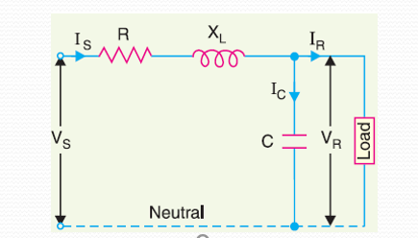
56
End Condenser Method
In this method, the capacitance of the line is lumped or concentrated at the receiving or load end as shown in fig.
Prepared by, Mrs. Neha Agrawal
Jaipur Engineering College & Research Center Power System Components

Slide 57
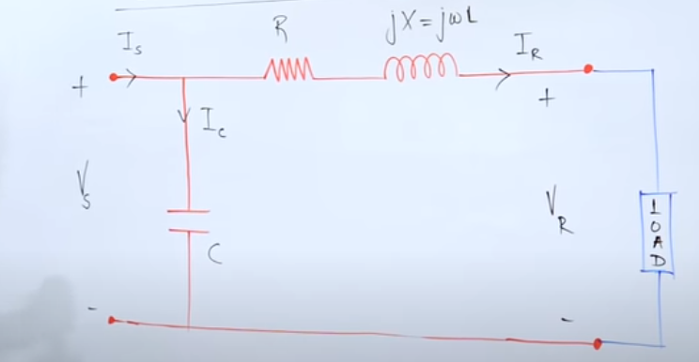
57
Source Condenser Method
In this method, the capacitance of the line is lumped or concentrated at the sending end as shown in fig.
Prepared by, Mrs. Neha Agrawal
Jaipur Engineering College & Research Center Power System Components

Slide 58
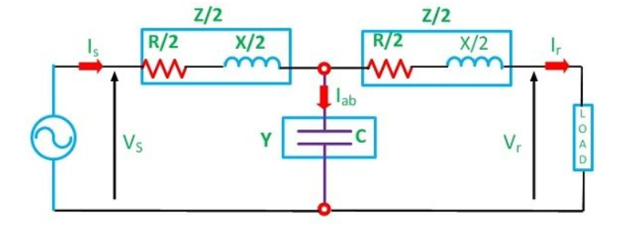
58
Nominal T Method
In this method, the whole line capacitance is assumed to be concentrated at the middle point of the line and half the line resistance and reactance are lumped on its either side as shown in fig.
Prepared by, Mrs. Neha Agrawal
Jaipur Engineering College & Research Center Power System Components

Slide 59
59
Here,
Series impedance of the line Z = R + jX Shunt admittance of the line Y = jwc Receiving end voltage = V_{r} Receiving end current = I_{r} Current in the capacitor = I_{ab} Sending end voltage = V_{s} Sending end current = I_{s}
Sending end voltage and current can be obtained by application of KVL and KCL. to the circuit shown below
Prepared by, Mrs. Neha Agrawal
Jaipur Engineering College & Research Center Power System Components

Slide 60
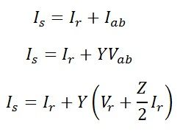
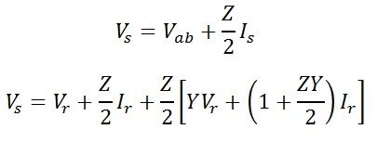
60
Current in the capacitor can be given as,
By Kirchoff’s current law at node a,
or
By Kirchoff’s voltage law
Prepared by, Mrs. Neha Agrawal
Jaipur Engineering College & Research Center Power System Components

Slide 61
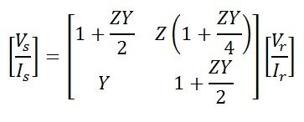
61
Equation of Sending end voltage V_{s} and current I_{s} can be written in the matrix form as
Also,

Slide 62
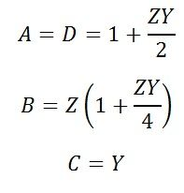
62
Hence, the ABCD constant of the nominal T-circuit model of a medium line are
The phasor diagram of the nominal T-circuit is shown below. It is drawn for a lagging power factor.

Slide 63
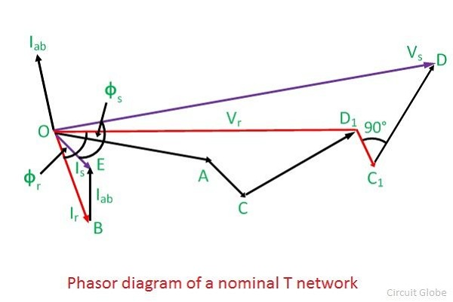
63

Slide 64
64
In the phasor diagram:
OA = V_{r} – receiving end voltage to neutral. It is taken as a reference phasor. OB = I_{r} – load current lagging behind V_{r} by an angle ∅. cos∅ is the power factor of the load. AC = I_{r}R/2 – Voltage drop in the reactance of the right-hand half of the line.It is perpendicular to OB, i.e., Ir. OD₁ = V_{ab} – voltage at the midpoint of the line across the capacitance C. BE = I_{ab} – current in the capacitor. It leads the voltage V_{ab} by 90. OE = I_{s} -sending-end current, the phasor sum of load current and capacitor current. D₁C₁ = I_{s}R/2 – voltage drop in the resistance on the left-hand side of the lines.It is perpendicular to Is. C₁D = I_{s} X/2 – voltage drop in the reactance in the left half of the line. It is perpendicular to Is OD = V_{s} – sending end voltage. It is the phasor sum of the of V_{ab} and the impedance voltage drop in the left-hand half of the line. ∅_{s} – phase angle at the sending end. cos∅_{s} is the power factor at the sending end of the line.

Slide 65
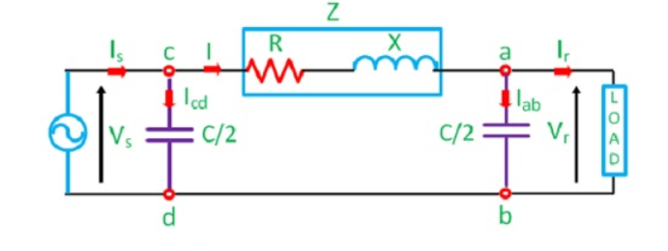
65
Nominal π Method
In this method, the capacitance of each conductor is divided into two halves; one half being lumped at the sending end and the other half at the receiving end as shown in fig.
Prepared by, Mrs. Neha Agrawal
Jaipur Engineering College & Research Center Power System Components

Slide 66
66
In this circuit,
By Ohm’s law
By KCL at node a,
Voltage at the sending end
Prepared by, Mrs. Neha Agrawal
Jaipur Engineering College & Research Center Power System Components

Slide 67
67
By ohm’s law
Sending-end current is found by applying KCL at node c
Prepared by, Mrs. Neha Agrawal
Jaipur Engineering College & Research Center Power System Components

Slide 68
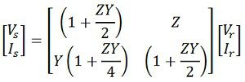
68
Equations can be written in matrix form as
Also,
Hence, the ABCD constants for nominal pi-circuit model of a medium line are

Slide 69
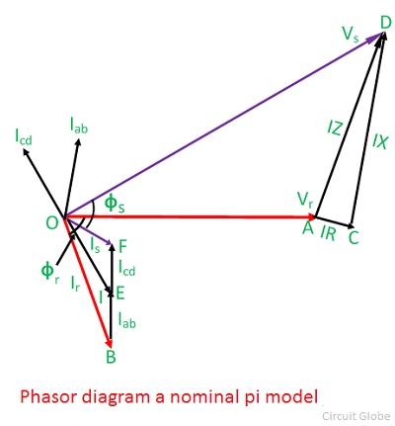
69
Phasor diagram of nominal pi model

Slide 70
70
It is also drawn for a lagging power factor of the load. In the phasor diagram the quantities shown are as follows;
OA = V_{r} – receiving end voltage. It is taken as reference phasor. OB = I_{r} – load current lagging V_{r} by an angle ∅_{r}. BE = I_{ab} – current in receiving-end capacitance. It leads V_{r} by 90°. The line current I is the phasor sum of I_{r} and I_{ab}. It is shown by OE in the diagram. AC = IR – voltage drop in the resistance of the line. It is parallel to I. CD = IX -inductive voltage drop in the line. It is perpendicular to I. AD = IZ – voltage drop in the line impedance. OD = V_{s} – sending–end voltage to neutral. It is phasor sum of V_{r} and IZ. The current taken by the capacitance at the sending end is I_{cd}. It leads the sending–end voltage V_{s} by 90 OF = I_{s} – the sending–end current. It is the phasor sum of I and I_{cd}. ∅s – phase angle between V_{s} and I_{s} at the sending end, and cos∅s will give the sending-end power factor.

Slide 71
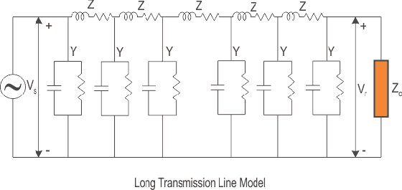
71
Long Transmission Lines
Series and parallel Parameters of overhead transmission lines distributed uniformly over the whole length of the line.
The voltage and current change in every point.
V,I=f(X)
Large number of short section are connect in long transmission line.
Prepared by, Mrs. Neha Agrawal
Jaipur Engineering College & Research Center Power System Components

Slide 72
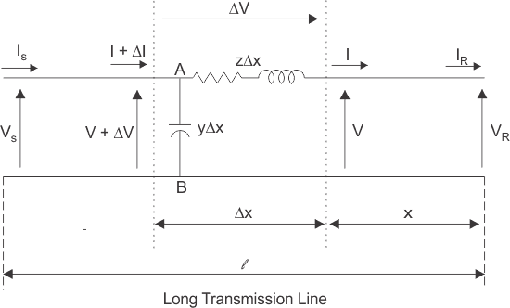
72
Zseries=R+JWL{per unit lenth}
Zparallel=g+jwc{per unit length}
Due to uniformly distributed the element did not lumped.
In hole transmission line the small section will be consider.
Prepared by, Mrs. Neha Agrawal
Jaipur Engineering College & Research Center Power System Components

Slide 73
73
Here a line of length l > 250km is supplied with a sending end voltage and current of V_{S} and I_{S} respectively, whereas the V_{R} and I_{R} are the values of voltage and current obtained from the receiving end. Lets us now consider an element of infinitely small length Δx at a distance x from the receiving end as shown in the figure where. V = value of voltage just before entering the element Δx. I = value of current just before entering the element Δx. V+ΔV = voltage leaving the element Δx. I+ΔI = current leaving the element Δx. ΔV = voltage drop across element Δx. zΔx = series impedance of element Δx yΔx = shunt admittance of element Δx Where, Z = z l and Y = y l are the values of total impedance and admittance of the long transmission line.
Therefore, the voltage drop across the infinitely small element Δx is given by
Prepared by, Mrs. Neha Agrawal
Jaipur Engineering College & Research Center Power System Components

Slide 74
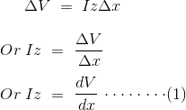
74
Now to determine the current ΔI, we apply KCL to node A.
Since the term ΔV yΔx is the product of 2 infinitely small values, we can ignore it for the sake of easier calculation. Therefore, we can write
Now derivating both sides of eq (1) w.r.t x,
Prepared by, Mrs. Neha Agrawal
Jaipur Engineering College & Research Center Power System Components

Slide 75
75
Now substituting
from equation (2)
The solution of the above second order differential equation is given by.
Derivating equation (4) w.r.to x.
Now comparing equation (1) with equation (5)
Prepared by, Mrs. Neha Agrawal
Jaipur Engineering College & Research Center Power System Components

Slide 76
76
Now to go further let us define the characteristic impedance Z_{c} and propagation constant δ of a long transmission line as
Then the voltage and current equation can be expressed in terms of characteristic impedance and propagation constant as
Now at x=0, V= V_{R} and I= I_{r}. Substituting these conditions to equation (7) and (8) respectively.
Prepared by, Mrs. Neha Agrawal
Jaipur Engineering College & Research Center Power System Components

Slide 77
77
Solving equation (9) and (10), We get values of A₁ and A₂ as,
Now applying another extreme condition at x = l, we have V = V_{S} and I = I_{S}. Now to determine V_{S} and I_{S} we substitute x by l and put the values of A₁ and A₂ in equation (7) and (8) we get
By trigonometric and exponential operators we know
Prepared by, Mrs. Neha Agrawal
Jaipur Engineering College & Research Center Power System Components

Slide 78
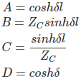
78
Therefore, equation (11) and (12) can be re-written as
Thus compared with the general circuit parameters equation, we get the ABCD parameters of a long transmission line as,

Slide 79
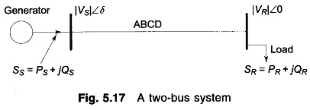
Power Flow through Transmission Line
The transmission line performance equation was presented in the form of voltage and current relationships between sending-and receiving-ends. Since loads are more often expressed in terms of real (watts/kW) and reactive (VARs/ kVAR) power, it is convenient to deal with transmission line equations in the form of sending- and receiving-end complex power and voltages. While the problem of Power Flow through a Transmission Line in a general network will be discussed later, the Power Flow through Transmission Line principles involved are illustrated here through a single transmission line (2-node/2-bus system) as shown in Fig.
Fig A two Bus System
Prepared by, Mrs. Neha Agrawal
Jaipur Engineering College & Research Center Power System Components

Slide 80
Let us take the receiving-end voltage as a reference phasor (V_{R}=|V_{R}|∠0°) and let the sending-end voltage lead it by an angle δ(V_{s}=|V_{s}|∠δ). The angle δ is known as the torque angle.
The complex power leaving the receiving-end and entering the sending-end of the transmission line can be expressed as (on per phase basis)
Receiving- and sending-end currents can, however, be expressed in terms of receiving- and sending-end voltages as
Let A, B, D, the transmission line constants, be written as
Prepared by, Mrs. Neha Agrawal
Jaipur Engineering College & Research Center Power System Components

Slide 81
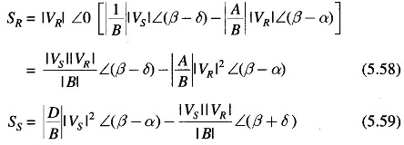
Therefore, we can write
Prepared by, Mrs. Neha Agrawal
Jaipur Engineering College & Research Center Power System Components

Slide 82
SURGE IMPEDANCE LOADING
It is defined as the load that can be delivered by the line having no resistance, the load being at unity power factor.
P_{R}=$\frac{{(\text{V}\text{R})}^{2}}{Z_{0}}MW$,
Where V_{R} is the receiving end line voltage in KV and Zo is the surge impedance of the line in ohms. P_{R} is known as the surge impedance loading, also called “Natural power” of the line.
For Zo=400 ohms, P_{R}= ${2.5(\text{V}\text{R})}^{2} KW$.
The above eqn gives a limit to the maximum power that can be delivered and is useful in the design of transmission lines. This may not be necessarily be the maximum loading on the line. Surge impedance loading can be used for the comparison of loads that can be carried on the different voltages.
Prepared by, Mrs. Neha Agrawal
Jaipur Engineering College & Research Center Power System Components

Slide 83
In order to increase the power transmitted through a long transmission line either value of receiving end voltage is to be increased or more than one transmission line can be run in parallel. The latter method is however very costly. Thus from the above equation , in order to increase PR either VR is to be increased or Zo is to be decreased.
(i) Increase in voltage VR :Nowadays the trend is for higher and higher voltages so that this is the most widely adopted method to increase the power limit for heavily loaded long transmission lines. But there are some Practical difficulties in this method and it is expensive .
(ii) Decrease of surge impedance Zo: sine the spacing between the conductors cannot be decreased much, it being dependent in the line voltages and corona etc., the value of Zo cannot be varied as such. But some are artificial means are employed to decrease Zo. For a lose less transmission
Zo=$\sqrt{\frac{L}{C}}$ And γ=$\sqrt[jw]{LC}=j\text{β}$. We know that γ is the propagation constant and β is the phase Shift. The latter determines the torque angle, between Vs and Vr and hence system stability. To decrease Zo either l is decreased using series capacitor or C is increased using shunt capacitance.
Prepared by, Mrs. Neha Agrawal
Jaipur Engineering College & Research Center Power System Components

Slide 84
Series Compensation
Series compensation is basically a powerful tool to improve the performance of EHV lines. It consists of capacitors connected in series with the line at suitable locations.
Jaipur Engineering College & Research Center Power System Components Prepared by, Mrs. Neha Agrawal

Slide 85
Advantages of Series Compensation
1. Increase in transmission capacity
– The power transfer capacity of a line is given by
$$P=\frac{E.V }{X}Sinδ$$
where, E is sending end voltage
V is receiving end voltage
X is reactance of line
δ is phase angle between E and V
Jaipur Engineering College & Research Center Power System Components Prepared by, Mrs. Neha Agrawal

Slide 86
Power transfer without and with compensation:
P = ^{E.V} sinδ
1
X
L
E.V
P =
sinδ
2
( X_{L} − X_{C} )
P₂
X_{L}
1 1
= = =
P₁ ( X_{L} − X_{C} ) (1− X_{C} / X_{L} ) 1− K
where K is degree of compensation.
The economic degree of compensation lies in the range of 40-70% (K < 1, i.e. 0.4-0.7)
Jaipur Engineering College & Research Center Power System Components Prepared by, Mrs. Neha Agrawal

Slide 87
2. Improvement of System Stability
For same amount of power transfer and same value of E and V, the δ in the case of series compensated line is less than that of uncompensated line.
P = ^{E.V} sinδ
X
1
L
E.V
P =
sinδ
( X_{L} − X_{C} )
2
sinδ₂
₌ ( X_{L} − X_{C} )
sinδ₁
X_{L}
A lower δ means better system stability
Series compensation offers most economic solution for system stability as compared to other methods (reducing generator, x-mer reactance, bundled conductors, increase no. of parallel circuits
Jaipur Engineering College & Research Center Power System Components Prepared by, Mrs. Neha Agrawal

Slide 88
3. Load Division between Parallel Circuits
When a system is to be strengthen by the addition of a new line or when one of the existing circuit is to be adjusted for parallel operation in order to achieve maximum power transfer or minimize losses, series compensation can be used.
It is observed in Sweden that the cost of the series compensation in the 420 kV system was entirely recovered due to decrease in losses in the 220 kV system operating in parallel with the 420 kV system.
Jaipur Engineering College & Research Center Power System Components Prepared by, Mrs. Neha Agrawal

Slide 89
4. Less installation Time
The installation time of the series capacitor is smaller (2 years approx.) as compared to installation time of the parallel circuit line (5 years approx.)
This reduces the risk factor.
Hence used to hit the current thermal limit.
The life of x-mission line and capacitor is generally 20-25 years.
Jaipur Engineering College & Research Center Power System Components Prepared by, Mrs. Neha Agrawal

Slide 90
Disadvantages
Increase in fault current
Mal operation of distance relay- if the degree of compensation and location is not proper.
High recovery voltage of lines- across the circuit breaker contacts and is harmful.
Jaipur Engineering College & Research Center Power System Components Prepared by, Mrs. Neha Agrawal

Slide 91
Shunt Compensation
For high voltage transmission line the line capacitance is high and plays a significant role in voltage conditions of the receiving end.
When the line is loaded then the reactive power demand of the load is partially met by the reactive power generated by the line capacitance and the remaining reactive power demand is met by the reactive power flow through the line from sending end to the receiving end.
Jaipur Engineering College & Research Center Power System Components Prepared by, Mrs. Neha Agrawal

Slide 92
Shunt Compensation (continued…)
When load is high (more than SIL) then a large reactive power flows from sending end to the receiving end resulting in large voltage drop in the line.
To improve the voltage at the receiving end shunt capacitors may be connected at the receiving end to generate and feed the reactive power to the load so that reactive power flow through the line and consequently the voltage drop in the line is reduced.
Jaipur Engineering College & Research Center Power System Components Prepared by, Mrs. Neha Agrawal

Slide 93
Shunt Compensation (continued…)
To control the receiving end voltage a bank of capacitors (large number of capacitors connected in parallel) is installed at the receiving end and suitable number of capacitors are switched in during high load condition depending upon the load demand.
Thus the capacitors provide leading VAr to partially meet reactive power demand of the load to control the voltage.
Jaipur Engineering College & Research Center Power System Components Prepared by, Mrs. Neha Agrawal

Slide 94
Shunt Compensation (continued…)
If X_{C} = 1/ωC be the reactance of the shunt capacitor then the reactive power generated of leading VAr supplied by the capacitor:
Q_{C}=$\frac{{\left|V_{2}\right|}^{2}}{X_{C}}={\left|V_{2}\right|}^{2}ωC$
where, |V₂| is the magnitude of receiving end voltage.
Jaipur Engineering College & Research Center Power System Components Prepared by, Mrs. Neha Agrawal

Slide 95
Shunt Compensation (continued…)
When load is small (less than SIL) then the load reactive power demand may even be lesser than the reactive power generated by the line capacitor. Under these conditions the reactive power flow through the line becomes negative, i.e., the reactive power flows from receiving end to sending end, and the receiving end voltage is higher than sending end voltage (Ferranti effect).
To control the voltage at the receiving end it is necessary to absorb or sink reactive power. This is achieved by connecting shunt reactors at the receiving end.
Jaipur Engineering College & Research Center Power System Components Prepared by, Mrs. Neha Agrawal

Slide 96
Shunt Compensation (continued…)
If X_{L} = ωL be the reactance of the shunt reactor (inductor) then the reactive VAr absorbed by the shunt rector:
V
2
Q = ^{2} = V
² /ωL
L 2
X
L
where, |V₂| is the magnitude of receiving end voltage.
Jaipur Engineering College & Research Center Power System Components Prepared by, Mrs. Neha Agrawal

Slide 97
Shunt Compensation (continued…)
To control the receiving end voltage generally one shunt rector is installed and switched in during the light load condition.
To meet the variable reactive power demands requisite number of shunt capacitors are switched in, in addition to the shunt reactor, which results in adjustable reactive power absorption by the combination.
Jaipur Engineering College & Research Center Power System Components Prepared by, Mrs. Neha Agrawal

Slide 98
Degree of series compensation
We know that the surge impedance
L ₌ jωL ₌
C
Z =
xx
C
jωC
L
Suppose C_{se} is the series capacitance per unit length for series compensation.
Therefore total series reactance will be
j
j . jωL
jωL' = jωL −
ωC_{se}
1
= jωL −
ωC_{se} jωL
⎛
⎞ ⎛
^{X}cse ⎞
⎟ = jωL(1−γ )
= jωL⎜1−
⎟ = jωL⎜1−
⎟
⎜
ω² LC
⎟ ⎜
X
se
⎝ se ⎠ ⎝ L ⎠
where γ_{se} is known as degree of series compensation. Therefore, virtual
surge impedance
_{Z} '
jωL(1−γ_{se} ) _{= Z}
=
(1−γ )
C
jωC
C
se
Jaipur Engineering College & Research Center Power System Components Prepared by, Mrs. Neha Agrawal

Slide 99
Degree of shunt compensation
We know that the surge impedance
L ₌ jωL ₌
C
Z =
x x
C
jωC
L L
Suppose shunt inductance L_{sh} per unit length is used for shunt compensation.
Therefore the net shunt susceptance will be
1
j .ωC
jωC' = jωC + = jωC −
jωL_{sh}
ωL_{sh} ωC
⎛ ⎞
⎛
X_{c}
⎞
= jωC⎜1−
1
⎟ = jωC⎜1−
⎟
= jωC(1−γ )
⎜
ω²CL
⎟ ⎜
X
⎟
sh
⎝ sh ⎠ ⎝ Lsh ⎠
where γ_{sh} is known as degree of shunt compensation. Therefore, virtual
surge impedance
_{Z} '
jωL
Z_{C}
= =
C
jωC(1−γ )
(1−γ )
sh
sh
Jaipur Engineering College & Research Center Power System Components Prepared by, Mrs. Neha Agrawal

Slide 100
Considering both series and shunt compensation
simultaneously:
_{Z} '
jωL' _{= Zc} 1−γ_{se}
=
C
jωC' 1−γ
sh
Therefore, the virtual surge impedance loading
_{P}'
1−γ_{sh}
= Pc
C
1−γ
se
It is clear that a fixed degree of series compensation and capacitive shunt compensation decreases the virtual surge impedance of line.
However, inductive shunt compensation increases the virtual surge impedance and decreases the virtual surge impedance loading of line. If inductive shunt comp. is 100%, the virtual surge impedance becomes infinite and loading zero.
Jaipur Engineering College & Research Center Power System Components Prepared by, Mrs. Neha Agrawal

Slide 101
Suppose, we want flat voltage profile corresponding to 1.2 P_{C} without series compensation, the shunt capacitance compensation required will be:
_{P}'
= Pc / 1−γ
C
se
1.2P_{C} = P_{C} /
1−γ_{se}
γ_{se} = 0.306 pu
Now, assuming shunt compensation to be zero, the series compensation required corresponding to 1.2 P_{C} :
_{P}'
= Pc 1−γ
C
sh
1.2P_{C} = P_{C}
1−γ_{sh}
γ_{sh} = −0.44 pu
However, because of lumped nature of series capacitor,
voltage control using series capacitors is not recommended.
Normally used for improving stability limits of the system.
Jaipur Engineering College & Research Center Power System Components Prepared by, Mrs. Neha Agrawal

Slide 102
Per Unit System
Per Unit quantity = Actual quantity
Base value
Example: Nominal voltage at bus bar A is 132 kV and actual voltage at A is 127 kV. The per unit voltage at A is:
Voltage in p. u. = Voltage in kV
Base voltage in kV
V _{A}^{pu} = 127 kV = 0.96 per unit = 0.96 p .u
132 kV
Jaipur Engineering College & Research Center Power System Components Prepared by, Mrs. Neha Agrawal

Slide 103
Rules for Choosing Base Values
Choice of Base Values
• Need base value for all quantities: Power, Voltage, Current, Impedance, Admittance
• Base values do not have to be the same for all equipment in the system
• Wise choice helps simplify the analysis
Rules
Choose ONE base power for the entire system
Arbitrary choice
Commensurate with the system e.g. 415V use 100kVA or 1MVA, 11kV use 10MVA,132KV use 100MVA, 400kV use 1000MVA
Choice also depends on rating of generators/transformers
If network contains multiple voltages, select base power based on “section of most interest”
commercial/industrial building = mainly 415V use 100kVA
distribution utility = mainly 11kV use 10MVA
transmission utility = use 100MVA or 1000MVA
Choose ONE base voltage for each voltage level
Choose the nominal voltage
Other base values chosen to get the same relations between per unit quantities as between actual quantities
Jaipur Engineering College & Research Center Power System Components Prepared by, Mrs. Neha Agrawal

Slide 104
Single Phase Networks:
Base Current (kA) = (Base MVA_{1φ} )/Base KV _{LN}
Base Impedance (Ω) = (Base KV _{LN} )/ (Base kA) = (Base KV _{LN} )² / (Base MVA_{1φ} )
Base Power (MW _{1φ}) = Base MVA_{1φ}
Example : Consider a single 230 v domestic installation with appropriate base voltage of 0.23 kV and suitable base Volt Ampere is 20 kVA. Find Base kA and Base Impedance.
Soln.: Base VA = 20 kVA = 0.02 MVA
Base kA = 0.02/0.23 = 0.087 kA
Base Impedance = (0.23)² / (0.02) = 2.645 A
S = V I (in VA) S _{pu} = V _{pu} I _{pu} (in pu) S/S_{B} = V/ V_{B} * I/I_{B} 1/S_{B} = 1/ V_{B} * 1/I_{B} Base Current I _{B} = S_{B} /V _{B} | ⊽ = Z Ī ⊽ _{pu}= Z pu * Ī _{pu} ⊽/ V_{B} = Z/Z_{B} * Ī / I_{B} 1/ V_{B} = 1/Z_{B} * 1/ I_{B} Base Impedance = Z_{B} = V_{B} / I_{B}
Jaipur Engineering College & Research Center Power System Components Prepared by, Mrs. Neha Agrawal

Slide 105
Per Units in Three Phase System
Goal:
To Have the same per unit values for line-to-line & Line-to-neutral quantities
Make everything look like a single phase circuit
Three Phase Per Unit Voltage
In a Three Phase System, We’ve :
V_{LL} = √3 V_{LN}
But We’ll Like to have V _{LL} ^{pu} = V _{LN} ^{pu} V _{LL} / V_{B,} _{LL} = V _{LN} / V_{B, LN}
V_{B,} _{LL} = √3 V_{B, LN}
Jaipur Engineering College & Research Center Power System Components Prepared by, Mrs. Neha Agrawal

Slide 106
Three Phase Per Unit Power
In a Three Phase System, S_{3φ} = 3 S_{1φ}
We’d like to have , S_{3φ} ^{pu} = S_{1φ} ^{pu}
(S_{3φ} ) / S_{B, 3φ} = (S_{1φ} )/ S_{B, 1φ}
S_{B, 3φ} = 3 S_{B, 1φ}
Three Phase Per Unit Current
In Three Phase System We’ve, S = 3 V_{LN} * I_{L}
We’d like to have, S^{pu} = V ^{pu} * I ^{pu}
S / S_{B, 3φ} =(V _{LL} / V_{B, LL} ) * (I_{L} / I_{B})
I_{B} = (S_{B, 3φ} ) / √3 V_{B, LL}
Jaipur Engineering College & Research Center Power System Components Prepared by, Mrs. Neha Agrawal

Slide 107
Three Phase Per Unit Impedance
In a Single Phase We’ve: V _{LN} = Z _{1ø} * I _{L}
We’d like to have, V ^{pu} = Z ^{pu} *I ^{pu}
V _{LN} / V_{B,LN} = (Z _{1ø} / Z_{B} ) * (I _{L} / I _{B})
Z_{B} = (V_{B,LN} ) / I _{B} = (V_{B,LL} / √3) / (S_{B, 3φ} / √3 V_{B,LL} )
Z_{B} = (V_{B,LL} )² / S_{B, 3φ}
Jaipur Engineering College & Research Center Power System Components Prepared by, Mrs. Neha Agrawal

Slide 108
Formula
Base Current , I_{B} = (kVA)_{B} / (kV)_{B} Amp.
For 3-φ Star-connected System,
Base Current , I_{B} = (kVA)_{B} / √3 * (kV)_{B} Amp.
Base Impedance, Z_{B} = [(Base Voltage in Volts, V_{B} ) / (Base Current in Amperes, I_{B}) ] Ω
=[ (kV)_{B}² * 1000] / (kVA)_{B} = [(kV)_{B}² / (MVA)_{B} ] Ω
Per Unit kV, V_{pu} = (Actual kV) / (Base kV) = (kV)_{Actual} / (kV)_{B} pu
Per Unit Current, I_{pu} = (Actual Current) / (Base Current) pu
= (Actual Current) * (kV)_{B} / (kVA)_{B} pu
Per Unit Impedance, Z_{pu} = (Actual Impedance) / (Base Impedance) pu
= (Actual Impedance) * (kVA)_{B} / [ (kV)_{B}² * 1000] pu
= (Actual Impedance) * (MVA)_{B} / (kV)_{B}² pu
Jaipur Engineering College & Research Center Power System Components Prepared by, Mrs. Neha Agrawal

Slide 109
Summary
For the entire system, choose arbitrarily S_{B} = S_{B, 3φ}
For each voltage level, choose: V _{B} = V_{B,LL}
Then, for each voltage level, calculate: I_{B} = (S_{B, 3φ} ) / √3 V_{B, LL}
And Z_{B} = (V_{B,LL} )² / S_{B, 3φ}
Jaipur Engineering College & Research Center Power System Components Prepared by, Mrs. Neha Agrawal

Slide 110
Base Conversion
If an impedance is expressed in a new base and an old base, We must have:
Z _{Actual} = Z _{New} ^{pu} * Z _{B, New} = Z _{Old} ^{pu} * Z _{B, Old}
Z _{New} ^{pu} = Z _{Old} ^{pu} * (Z _{B, Old} / Z _{B, New} )
But as we’ve Z _{B} = V _{B} ² / S _{B}
Hence, Z _{New} ^{pu} = Z_{Old} ^{pu} * (S _{B, New} / S _{B, Old}) * (V_{B, Old} / V_{B, New})²
As the Generator is always connected to its Nominal voltage,
Then, V_{B, Old} = V_{B, New}
Hence, Z _{New} ^{pu} = Z_{Old} ^{pu} * (S _{B, New} / S _{B, Old})
Jaipur Engineering College & Research Center Power System Components Prepared by, Mrs. Neha Agrawal

Slide 111
Advantage And Drawbacks Of PU System
Advantages :
Calculation are simplified
The characteristics of machines when described in PU system are specified by almost the same number, regardless of the rating of the machines. PU System provides method of comparison.
Circuit containing Transformers, PU System is more suitable as by choosing suitable Base KV’s the pu reactance remains same referred to either side of Transformer.
Drawbacks :
Factors like √3 and 3 either added or removed by this method.
Equivalent circuits of the components are modified. Sometimes the phase shift which is clearly present in unscaled circuits vanish in the PU System.
Jaipur Engineering College & Research Center Power System Components Prepared by, Mrs. Neha Agrawal

Slide 112
EXAMPLES
Ques. 1
Base voltage = 1100 V. Base kVA = 10⁶. What is Base impedance?
Soln.
Base kVA = 10⁶
Base kV = 1100/1000 = 1.1 kV
Base Current, I_{B} = kVA_{B} / kV_{B} = 10⁶/1.1
Base Impedance Z_{B} = (kV_{B} * 1000) / I_{B} = 0.00121 Ω
Ques. 2
If the resistance in Ohm is 5 Ω, find the per unit value. Given base kVA = 10 and base kV = 11.
Soln.
Resistance R = 5 Ω
Base resistance, R_{B} = (kV_{B})² * 1000 / kVA_{B} = 12100 Ω
Per Unit Resistance R_{pu} = R / R_{B} = 0.000413 pu
Jaipur Engineering College & Research Center Power System Components Prepared by, Mrs. Neha Agrawal

Slide 113
Ques 3.
A 1-φ transformer is rated as 2.5 kVA, 11 / 0.4 kV. If the leakage reactance is 0.96 Ω when referred to low voltage side, then determine its leakage reactance in per unit.
Soln.
Base Voltage, (kV)_{B} = 0.4 kV
Base kVA, (kVA)_{B} = 2.5 kVA
Low Voltage Side Base Impedance, Z_{BLV} = [ (kV)_{B}² * 1000] / (kVA)_{B} = 64Ω
Leakage Reactance in per – unit, Z_{pu} = (Actual Reactance) / (Base Impedance)
= 0.96 / 64 = 0.015 pu
Ques 4.
Determine the pu impedance of a transmission line having an impedance of (30 + j110)Ω on 100 MVA and 132 kV base voltage.
Soln.
Impedance of line, Z = (30 + j110)Ω
Base kVA, (kVA)_{B} = 100 MVA = 100000 kVA
Base Voltage, (kV)_{B} = 132 kV
Per-unit Impedance, Z_{pu} = [Z * (kVA)_{B} ] / [ (kV)_{B}² * 1000] = (0.172 + j0.631) pu
Jaipur Engineering College & Research Center Power System Components Prepared by, Mrs. Neha Agrawal

Slide 114
Ques 5.
An 11 / 0.4 kV, 200 kVA transformer has an equivalent impedance of (2.4 + j 12.4)Ω referred to high voltage side, then determine the base values for the per unit system, the per-unit equivalent impedance and the equivalent impedance drop at one-half rated current.
Soln.
Base kVA, (kVA)_{B} = 200 kVA
For High Voltage Side, Base Voltage, (kV)_{BHV} = 11 kV
Base current I_{BHV} = (kVA)_{B} / (kV)_{BHV} = 200/11 = 18.18 Amp.
Base Impedance, Z_{BHV} = [(kV)_{BHV} * 1000] / I_{BHV} = 605 Ω
Per-unit equivalent impedance, Z_{pu} _{HV} = Z_{HV} / Z_{BHV} = (2.4 + j12.4)/ 605 = (0.004 + j0.0205) pu
Per-unit Impedance Drop at half-rated current, I*Z_{pu} = 0.5 * (0.004 + j0.0205) = 0.0104 pu
Impedance drop is 0.0104 times the rated voltage = 0.0104 * 11,000 = 115 V
For LV Side, Base KV = KV_{BLV} = 0.4 KV, Base Current, I_{BLV} = (kVA)_{B} / (kV)_{BLV} = 200/0.4 = 500Amp.
Base Impedance, Z_{BLV} = (kV_{BLV} / I_{BLV} ) * 1000 = 0.4 * 1000/4000 = 0.8 Ω
Actual Impedance related to low voltage side, Z_{LV} =(2.4 + j12.4)/(11/0.4)²= (0.00317+j0.0164)Ω
Per-unit equivalent impedance, Z _{pu} _{LV} = Z_{LV} / Z_{BLV} = (2.4 + j12.4)/(11/0.4)² *0.8 pu
= (0.004+j0.0205) pu
At one-half rated current,
Equivalent Impedance drop, I* Z _{pu} = 0.5 * (0.004 + j0.0205) = 0.0104 pu
This Impedance drop is 0.104 times the rated voltage = 0.0104 * 400 = 4.16 V
Jaipur Engineering College & Research Center Power System Components Prepared by, Mrs. Neha Agrawal

Slide 115
Ques 6.
A 30 MVA, 11 kV generator has a reactance of 0.2pu referred to its ratings as bases. Determine the per unit reactance when reffered to base kVA of 50,000 kVA and base kV of 33 kV.
Soln.
Old Base kVA = 30,000 kVA
Old Base kV = 11 kV
Old per-unit Impedance, Z _{pu} _{Old} = 0.2 pu
New Base kVA = 50,000 kVA
New Base kV = 33 kV
New per-unit Impedance,
Z _{pu} _{New} = Z _{pu} _{Old} * [New Base kVA / Old Base kVA] * [New Base kVA / Old Base kVA]²
= 0.2 * (50000/30000) * (11/33)² = 0.037 pu
Jaipur Engineering College & Research Center Power System Components Prepared by, Mrs. Neha Agrawal

Slide 116
Ques 7.
The Three Generators are rated as follows:
Generator 1 : 100 MVA, 33 kV, reactance = 10%
Generator 2 : 150 MVA, 32 kV, reactance = 8%
Generator 1 : 110 MVA, 30 kV, reactance = 12%
Choosing 200 MVA and 35 kV as base quantities, compute per unit reactances of the three generators referred to these base quantities. Draw reactance diagram and mark per unit reactances. The three generators are connected to common bus-bars.
Soln.
We know that, Z _{New} ^{pu} = Z_{Old} ^{pu} * (S _{B, New} / S _{B, Old}) * (V_{B, Old} / V_{B, New})²
The reactances on 200 MVA & 35 kV base are :
pu Reactance of Generator 1 :
X _{pu New 1} = (10/100)*(200*1000/100*1000)*(33/35)² = 0.1778pu
pu Reactance of Generator 2 :
X _{pu New2} = (8/100)*(200*1000/150*1000)*(32/35)² = 0.0892pu
pu Reactance of Generator 3 :
X _{pu New 3} = (12/100)*(200*1000/110*1000)*(30/35)² = 0.1603pu
Reactance Diagram
j0.1778
j0.1603
j0.0892
+
+
+
E₁
E₂
E₃
-
-
-
Jaipur Engineering College & Research Center Power System Components Prepared by, Mrs. Neha Agrawal

Slide 117
Ques 8.
Draw the pu impedance diagram for the power system shown in the figure. Neglect resistance and use a base of 100 MVA, 220 kV in 50 Ω line. The rating of the generator, motor and transformer are :
Generator : 40 MVA, 25 kV, reactance (X”) = 20%
Motor : 50 MVA, 11 kV, reactance (X”) = 30%
Y-Y Transformer : 40 MVA, 33 Y- 220 Y kV, reactance (X) = 15%
Y-∆ Transformer : 30 MVA, 11 ∆ - 220 Y kV, reactance (X) = 15%
Jaipur Engineering College & Research Center Power System Components Prepared by, Mrs. Neha Agrawal

Slide 118
Soln.
Base kV for complete Circuit = 100 MVA = 100,000 kVA
Base kV in 50Ω line = 220kV
pu impedance of line = (X _{L} ) * [ kVA_{B} / (kV)_{B}² * 1000 ] = (j50 * 100,000) / (220)² * 1000
= j 0.1033 pu
Base kV in Generator Circuit = 220 * [1 / Transformation ratio of Y-Y transformer]
= 220 * (33/220) = 33 kV
pu reactance of the generator = (20/100) * (100,000/40,000) * (25/33)² = j0.287 pu
Base kV in Motor Circuit = 220 * Transformer ratio of Y-∆ transformer
= 220 * (11/220) = 11 kV
Remembering the Base Conversion,
Z _{New} ^{pu} = Z_{Old} ^{pu} * (S _{B, New} / S _{B, Old}) * (V_{B, Old} / V_{B, New})²
pu reactance of the Motor = (30/100) * (100,000/50,000) * (11/11)² = j0.6 pu
pu reactance of the Y-Y Transformer = (15/100) * (100,000/40,000) * (33/33)² = j0.6375 pu
pu reactance of the Y-∆ Transformer = (15/100) * (100,000/30,000) * (11/11)² = j0.5 pu
The Reactance Diagram is as shown in the Figure given below:
Jaipur Engineering College & Research Center Power System Components Prepared by, Mrs. Neha Agrawal

Slide 119
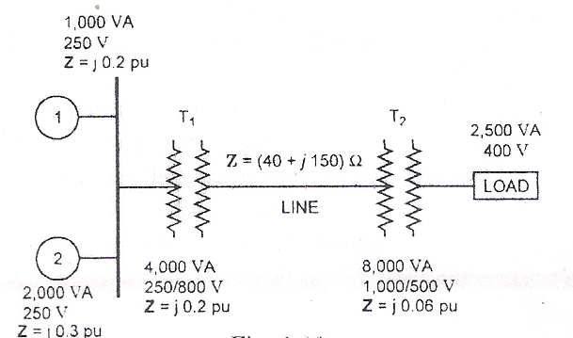
Ques 9.
A simple Power System is shown in the Figure given below. Redraw the System where the per-unit impedances are represented on a common 5,000 VA base and common system base voltage of 250 V.
Jaipur Engineering College & Research Center Power System Components Prepared by, Mrs. Neha Agrawal

Slide 120
Soln.
Base kVA for the complete circuit = (5,000/1,000) = 5 kVA
Base voltage in Generator circuits = (250/1000) = 0.25 kV
Remembering the Base Conversion,
Z _{New} ^{pu} = Z_{Old} ^{pu} * (S _{B, New} / S _{B, Old}) * (V_{B, Old} / V_{B, New})²
pu reactance of Machine 1, X _{pu} _{M1} = j0.2 * (0.25 / 0.25)² * (5.0/1.0) = j 1.0 pu
pu reactance of Machine 2, X _{pu} _{M2} = j0.3 * (0.25 / 0.25)² * (5.0/2.0) = j 0.75 pu
pu reactance of Transformer, T₁ , X _{pu} _{T1} = j0.2 * (0.25 / 0.25)² * (5.0/4.0) = j 0.25 pu
Base Voltage in Line Circuit =
Base Voltage in Generator Circuit * Transformation Ratio of Transformer
kV_{B} = 0.25 * (800/250) = 0.8 kV
pu impedance of Line, X_{pu} _{L} = (40 + j50) * [ kVA_{B} / (kV)_{B}² * 1000 ]
= (40 + j50) * [ 5 / (0.8)² * 1000 ] = (0.3125 + j 1.17) pu
pu impedance of Transformer 2, X _{pu} _{T2} = = j0.6 * (1 / 0.8)² * (5.0/8.0) = j 0.0586 pu
pu Load, kVA_{pu} = 2.5 * 5 = 0.5 pu
The entire system is represented by the impedance Diagram as given below:
Jaipur Engineering College & Research Center Power System Components Prepared by, Mrs. Neha Agrawal

Slide 121
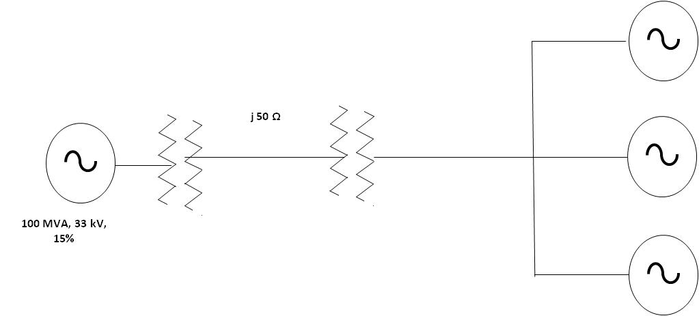
Ques 10.
A 100 MVA, 33 kV, 3-φ Generator has a sub-transient reactance of 15%. The Generator is connected to motor through a transmission line and Transformer as shown in Figure.
The Motors have rated inputs of 30 MVA, 20 MVA, and 50 MVA at 30 kV with 20% sub-transient reactance. The 3-φ Transformer are rated at 110 MVA, 32 kV ∆ / 110 kV Y with leakage reactance 8%.
The line has a reactance of 50Ω. Selecting the generator rating as base quantities in the generator circuit, determine the base quantities in other parts of the system and evaluate the corresponding pu values.
Jaipur Engineering College & Research Center Power System Components Prepared by, Mrs. Neha Agrawal

Slide 122
Soln.
Assume the Base values as 100 MVA and 33 kV in the generator circuit.
The pu reactance of Generator will be 15%
The Base value of Voltage in the line will be, 33 * (110/32) = 113.43 kV
In the Motor circuit, 113.43 * (32/110) = 33 kV
The reactance of the Transformer is given is 8% corresponding to 110 MVA and 32 kV
Remembering the Base Conversion, Z _{New} ^{pu} = Z_{Old} ^{pu} * (S _{B, New} / S _{B, Old}) * (V_{B, Old} / V_{B, New})²
pu Reactance of Transformer will be, 0.08 * (100/110) * (32/33)² = 0.06838 pu
The pu impedance of the Transmission Line = 50/(113.43)² * 100 = 0.3886 pu
The pu reactance of the Motor 1 = 0.2 * (100/30) * (30/33)² = 0.5509 pu
The pu reactance of the Motor 2 = 0.2 * (100/20) * (30/33)² = 0.826 pu
The pu reactance of the Motor 3 = 0.2 * (100/50) * (30/33)² = 0.3305 pu
The Reactance diagram is as shown in the Figure given below:
j0.6838Ω
j0.6838Ω
j0.3888Ω
j 0.15Ω
j0.5509Ω
j0.826Ω
j0.3305Ω
Jaipur Engineering College & Research Center Power System Components Prepared by, Mrs. Neha Agrawal

Slide 123
Assignment
Find an expression for the flux linkages (i) due to a single current carrying conductor (ii) in parallel current carrying conductors.
Derive an expression for the loop inductance of a single phase line.
Derive an expression for the inductance per phase for a 3-phase overhead transmission line when (i) conductors are symmetrically placed (ii) conductors are unsymmetrically placed but the line is completely transposed
Derive an expression for the capacitance of a single phase overhead transmission line.
Deduce an expression for line to neutral capacitance for a 3-phase overhead transmission line when the conductors are (i) symmetrically placed (ii) unsymmetrically placed but transposed.
Prepared by, Mrs. Neha Agrawal
Jaipur Engineering College & Research Center Power System Components

Slide 124
Assignment
Define Lumped and distributed parameters.
How do you classify transmission lines as short, medium and long lines?
How are capacitance considered for medium lines?
What is the effect of line capacitance for lagging load?
Derive the expressions for sending end voltage in nominal T method and end Condenser method.
Define regulation of a transmission line and derive the approximate expression for the regulation of a short transmission line.
What is corona loss? How do you determine this loss?
A 3-Phase, 50 Hz Transmission Line, 100 Km long delivers 25 MW at 110kV and a.85p.f. lagging the resistance and reactance of the lines per phase per kilometer are .3 Ω and .5 Ω respectively, while capactive admittance is 2.5*10-6 Ω/km/ph.Calculate the efficiency of transmission. Use nominal- π and T methods.
Prepared by, Mrs. Neha Agrawal
Jaipur Engineering College & Research Center Power System Components

Slide 125
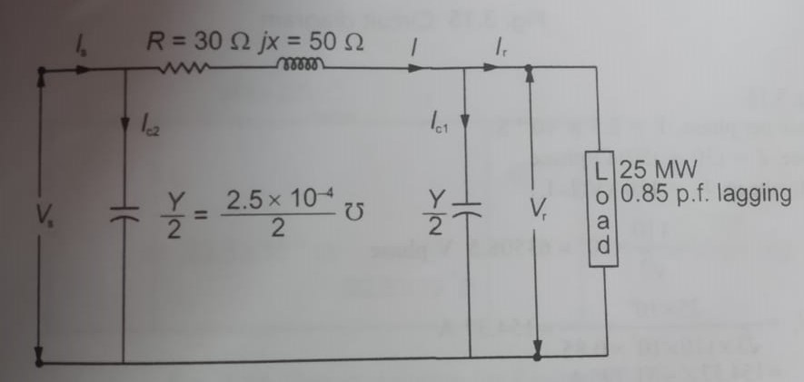
Assignment
Prepared by, Mrs. Neha Agrawal
Jaipur Engineering College & Research Center Power System Components

Slide 126
Assignment
A 220-kV, 150 MVA, 60-Hz, three-phase transmission line is 140 km long. The characteristic parameters of the transmission line are: r = 0.09 Ω/km; x = 0.88 Ω/km; y =4.1×10-6 S/km where, r is the resistance per kilometer, x is the reactance per kilometer, y is the shunt admittance per kilometer. The voltage at the receiving end of the transmission line is 210 kV. Although this transmission line would normally be considered a medium-length transmission line, we will treat it as short line: a) What is series impedance and shunt impedance of the transmission line? b) What is the sending end voltage if the line is supplying rated voltage and apparent power at 0.85 PF lagging? At unity PF? At 0.85 PF leading? c) What is the voltage regulation of the transmission line for each of the cases in (b)? d) What is the efficiency of the transmission line when it is supplying rated apparent power at 0.85 PF lagging?
Prepared by, Mrs. Neha Agrawal
Jaipur Engineering College & Research Center Power System Components

Slide 127
Conclusion:
The basic Basic Concepts of Power System and its various components ,
their role are discussed.
References:
1. | Hadi Saadat, ‘Power System Analysis’, Tata McGraw Hill Education Pvt. Ltd., New Delhi, 21st reprint, 2010.
2. | https://nptel.ac.in
3. | C L Wadhwha “Electrical Power Systems”, New Age International (P) Limited Publishers 5th Edition
4. | J. Duncan Glover, Mulukutla S. Sarma, Thomas J. Overbye, ‘ Power System Analysis & Design’, Cengage Learning, Fifth Edition, 2012.
5. | https://electricalnotes.wordpress.com/2011/03/23/what-is-corona-effect/ (Assesed on 7th July 2017)
6. | C.A.Gross, “Power System Analysis,” Wiley India, 2011.
7. | M.Jeraldin Ahila “Power System Analysis”, Lakshmi Publications, Chennai, Eleventh Edition 2017.
8. | Other web documents
Basic Concepts of Power System

