Slide 1
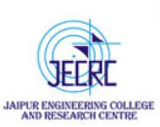
JAIPUR ENGINEERING COLLEGE AND RESEARCH CENTRE
Year & Sem – B.Tech 3 year, Sem-V
Subject –Power System-1
Unit – I & 2
Presented by – Mrs. Neha Agrawal
DESIGNATION –Assistant Professor
DEPARTMENT-Electrical Engineering
Jaipur Engineering College & Research Center Basic Concepts of Power System
Prepared by, Mrs. Neha Agrawal

Slide 2
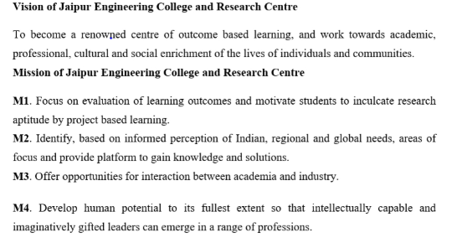
VISSION AND MISSION OF INSTITUTE
Jaipur Engineering College & Research Center Basic Concepts of Power System
Prepared by, Mrs. Neha Agrawal
2

Slide 3
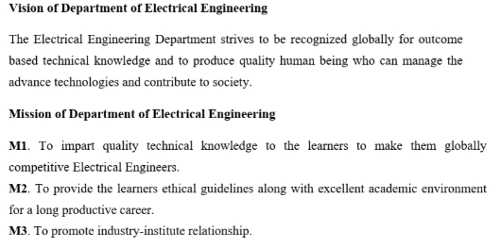
VISSION AND MISSION OF DEPARTMENT
Jaipur Engineering College & Research Center Basic Concepts of Power System
Prepared by, Mrs. Neha Agrawal
3

Slide 4
Course Outcome for power System-1
CO1: Identify the different parameters of transmission lines and understand the basic power system.
CO2: Analysis the overhead and underground transmission and distribution lines and identify the faults.
CO3: Design and analysis of over voltage generation and its protection in power system.
Jaipur Engineering College & Research Center Basic Concepts of Power System
Prepared by, Mrs. Neha Agrawal

Slide 5
Syllabus of power System-1
Introduction: Objective, scope and outcome of the course.
Basic Concepts Evolution of Power Systems and Present-Day Scenario. Structure of a power system: Bulk Power Grids and Micro-grids. Generation: Conventional and Renewable Energy Sources. Distributed Energy Resources. Energy Storage. Transmission and Distribution Systems: Line diagrams, transmission and distribution voltage levels and topologies (meshed and radial systems). Synchronous Grids and Asynchronous (DC) interconnections. Review of Three-phase systems. Analysis of simple three-phase circuits. Power Transfer in AC circuits and Reactive Power.
Power System Components: Overhead Transmission Lines and Cables: Electrical and Magnetic Fields around conductors, Corona. Parameters of lines and cables. Capacitance and Inductance calculations for simple configurations. Travelling-wave Equations. Sinusoidal Steady state representation of Lines: Short, medium and long lines. Power Transfer, Voltage profile and Reactive Power. Characteristics of transmission lines. Surge Impedance Loading. Series and Shunt Compensation of transmission lines. Transformers: Three-phase connections and Phase-shifts.
Jaipur Engineering College & Research Center Basic Concepts of Power System
Prepared by, Mrs. Neha Agrawal

Slide 6
Syllabus of power System-1
Three winding transformers, autotransformers, Neutral Grounding transformers. Tap-Changing in transformers. Transformer Parameters. Single phase equivalent of three-phase transformers. Synchronous Machines: Steady-state performance characteristics. Operation when connected to infinite bus. Real and Reactive Power Capability Curve of generators. Typical waveform under balanced terminal short circuit conditions – steady state, transient and subtransient equivalent circuits. Loads: Types, Voltage and Frequency Dependence of Loads. Per-unit System and per-unit calculations.
Over-voltages and Insulation Requirements Generation of Over-voltages: Lightning and Switching Surges. Protection against Overvoltages, Insulation Coordination. Propagation of Surges. Voltages produced by traveling surges. Bewley Diagrams.
Fault Analysis and Protection Systems Method of Symmetrical Components (positive, negative and zero sequences). Balanced and Unbalanced Faults. Representation of generators, lines and transformers in sequence networks.
Jaipur Engineering College & Research Center Basic Concepts of Power System
Prepared by, Mrs. Neha Agrawal

Slide 7
Syllabus of power System-1
Computation of Fault Currents. Neutral Grounding. Switchgear: Types of Circuit Breakers. Attributes of Protection schemes, Back-up Protection. Protection schemes (Over-current, directional, distance protection, differential protection) and their application.
Introduction to DC Transmission & Renewable Energy Systems DC Transmission Systems: Line-Commutated Converters (LCC) and Voltage Source Converters (VSC). LCC and VSC based dc link, Real Power Flow control in a dc link. Comparison of ac and dc transmission. Solar PV systems: I-V and P-V characteristics of PV panels, power electronic interface of PV to the grid. Wind Energy Systems: Power curve of wind turbine. Fixed and variable speed turbines. Permanent Magnetic Synchronous Generators and Induction Generators. Power Electronics interfaces of wind generators to the grid
Jaipur Engineering College & Research Center Basic Concepts of Power System
Prepared by, Mrs. Neha Agrawal

Slide 8
Contents:
Basic Concepts of Power System
Evolution of power system
Present-Day Scenario
Introduction of Power System
One-Line Diagram
Components of Power System
Bulk Power Grids
Micro-Grids
Jaipur Engineering College & Research Center
Basic Concepts of Power System
Prepared by, Mrs. Neha Agrawal
8

Slide 9
Evolution
First complete DC power system built by Edison (1882): Incandescent lamps supplied by steam driven DC generators (electrical cable system at 110V). 59 customers spread over an approximate area with 1.5 km radius.
Development of transformers led to supersession of DC systems by AC systems.
Nikola Tesla - polyphase induction motors: led to development of AC 3 phase systems.
Several new: Gas turbines, static excitation systems, fast acting circuit breakers, microprocessor based relaying, use of communication technologies etc.
Jaipur Engineering College & Research Center Basic Concepts of Power System
Prepared by, Mrs. Neha Agrawal

Slide 10
To Be Cont.
Interconnection of systems led to standardization of frequency , 60 Hz in North America and 50 Hz in most other countries. Use of higher and higher voltage levels (up to 1000 kV line-line rms AC). Standardization of voltage levels. Development of Mercury Arc Valves, and subsequently thyristors led to high voltage dc transmission (HVDC): DC transmission suited for very long distance bulk transmission and underwater cable links. First commercial DC link in 1954.
Need for better utilization and operation of AC transmission systems by use of high power electronic converters suggested. Several such converters are now in operation.
Prepared by, Mrs. Neha Agrawal
Jaipur Engineering College & Research Center Basic Concepts of Power System

Slide 11
Present day power systems are characterized by:
AC generation (3 phase synchronous machines using hydro, fossil and nuclear as primary energy sources)
AC transmission (a limited number of DC transmission links are present in some systems)
3 phase AC utilization (some loads are single phase, but they are usually distributed equally in all phases to obtain a balanced system)
Prepared by, Mrs. Neha Agrawal
Jaipur Engineering College & Research Center Basic Concepts of Power System

Slide 12
Power Grids
"Except for a few islands and some small isolated systems, the entire electric grid in North America is really one big circuit. The humble wall outlet is actually a gateway to one of the largest and most complex objects ever built.
The Indian Power Grid is not quite as big as North American power systems, but still has a large generating capacity of about 100 GW (100,000 MW). It is actually made up of three synchronized grids:
Northern Regional Grid
Southern Regional Grid
Western + Eastern + North-eastern Regional (WR-ER-NER) Grid
Jaipur Engineering College & Research Center Basic Concepts of Power System
Prepared by, Mrs. Neha Agrawal

Slide 13
To Be Cont.
A synchronised grid implies that the generators in that grid are connected to one another by at least one AC transmission path. This also means that the synchronous generators in that grid are all operating at the same electrical frequency.
For a well designed and operated system, inter-connected synchronous generators are seen to "stick together" in synchronism. However they may lose synchronism if subjected to large disturbances. A generator when connected to a power system has to be connected by a special procedure known as 'synchronisation’.
A load can be connected in a synchronous grid by simply connecting it in shunt.
Jaipur Engineering College & Research Center Basic Concepts of Power System
Prepared by, Mrs. Neha Agrawal

Slide 14
To Be Cont.
There may be a very small number of induction generators in a synchronous grid. Induction generators do not run at synchronous speed and are sometimes used in conjunction with wind turbines. However, since induction generators always absorb reactive power, they are limited to small applications wherein reactive power is supplied externally by capacitors and synchronous generators.
AC interconnected power systems have an important property: frequency all over the grid is the same in steady state.
Jaipur Engineering College & Research Center Basic Concepts of Power System
Prepared by, Mrs. Neha Agrawal

Slide 15
Structure of a Power System
An electrical power system consists of generation, transmission and distribution.
The transmission systems supply bulk power and the distribution systems transfer electric power to the ultimate consumers.
The generation of the electric energy is nothing but the conversion of one form energy into electrical energy.
Electrical energy is generated in hydro, thermal and nuclear power stations.
Sometimes, electrical energy is generated from non- renewable energy sources like wind, waves, fossil fuels, etc. The generating voltages are usually 6.6kV, 10.5kV, 11kV, 13.8kV, 15.75kV, etc.
Jaipur Engineering College & Research Center Basic Concepts of Power System
Prepared by, Mrs. Neha Agrawal

Slide 16
Basic Concepts of Power System

Slide 17
Components of an electric power system:
Generators: A device used to convert one form of energy into electrical
energy.
Transformer: Transfer power or energy from one circuit to other without
the change of frequency.(to increase or decrease the voltage level)
Transmission lines: Transfer power from one location to another
Control Equipment: Used for protection purpose
Primary Transmission: 110kV, 132kV or 220kV or 400kV or 765kV, high
voltage transmission, 3 phase 3-wire system.
Secondary transmission: 3 phase 3-wire system, 33kV or 66kV feeders
are used
Primary distribution: 3 phase 3-wire system, 11kV or 6.6kV, 3 phase 3-
wire system
Secondary distribution: 400V for 3φ, 230V for 1φ
Basic Concepts of Power System

Slide 18
 Generator is a device which converts mechanical energy into electrical energy. Generating voltages are normally 6.6 kV,10.5 kV or 11 kV.
Generators:
This generating voltage can be step up to 110 kV/132 kV/220kV at the generating(indoor or outdoor) to reduce the current in transmission line and to reduce transmission losses.
Generators produce real power (MV) and reactive power (MVAR).
Basic Concepts of Power System

Slide 19
Transformers:
It is a static device which transfers power or energy from one circuit to another circuit without change of frequency.
The main function of transformers is step up voltages from lower generation levels to the higher generation voltage levels and also step down voltages from higher transmission voltage levels to lower distribution levels.
When we are increasing the transmission voltage, current flowing through the current flowing through the grid decreases, thereby transmission losses (I²R) reduces.
Basic Concepts of Power System

Slide 20
Control Equipment
Circuit Breaker (CB): Circuit breakers are used for opening or closing a circuit normal and abnormal (fault) condition.
Different types of circuit breaker are oil circuit breaker, air-blast circuit breaker, vacuum circuit breaker, SF6 circuit breaker.
During fault conditions relay will give command to the circuit
breaker to operate.
Isolators: Isolators are placed in substations to isolate the part of
system during maintenance.
It can operate only during no-load condition. Isolated switches are provided on each side of the circuit breaker.
Basic Concepts of Power System

Slide 21
Contd…
Busbar: Busbars are used to connect number of lines operating at the same voltage electrically.
It is made up of copper or aluminium. Different types
of busbar arrangements are –single busbar
with sectionalisation,
arrangement, single bus bar
double bus bar arrangements, ring bus bar scheme etc.
Basic Concepts of Power System

Slide 22
Transmission System
It supplies only large blocks of power to bulk power station or very big consumers.
It interconnects the neighbouring generating stations in to a power pool i.e, interconnection of two or more generating stations.
Tolerance of transmission line voltage is ±5 to ± 10% due to the variation of loads.
Primary Transmission
If the generated power is transmitted through transmission line without stepping up the generated voltage, the line current and power loss would be very high.
So the generated voltage is stepped up to higher value by using the step up transformer located in substations known as sending end substations near the generating stations.
Basic Concepts of Power System

Slide 23
Contd…
The high voltage transmission lines transmit power from sending end substation to the receiving end substation.
Primary transmission voltages are 110KV, 132 KV or 220KV 0r 400KV or 760KV.It uses 3phase, and 3wire system.
Secondary Transmission
At the receiving end substation, the voltage is stepped down to a value of 66 or 33 or 22 KV using step down transformers.
The secondary transmission line forms the link between the receiving end substation and the secondary station. It uses 3phase,3 wire system and the conductors used are called feeders.
Basic Concepts of Power System

Slide 24
Distribution System
The component of an electrical power system connecting all the consumers in an area to the bulk power sources or transmission line is called a distribution system.
A distribution station distributes power to domestic, commercial and relatively small consumers.
Distribution transformers are normally installed on poles or on plinth mounted or near the consumers
Primary Distribution
At the secondary substations, the voltage is stepped down to 11 KV or 6.6 KV using step down transformers.
The primary distributor forms the link between secondary substation and distribution substation and the power is fed in to the primary distribution system. It uses 3phase, 3 wire system.
Basic Concepts of Power System

Slide 25
Secondary Distribution
At the distribution substation the voltage is stepped down to 400V (for 3phase) or 230V (for 1 phase) using step down transformers.
The distribution lines are drawn along the roads and service connections to the consumers are tapped off from the distributors.
It uses 3 phase, 4 wire system.
Single phase loads are connected between one phase wire and one neutral wire.
Basic Concepts of Power System

Slide 26
Bulk Power Grids
A bulk power system (BPS) is a large interconnected electrical system made up of generation and transmission facilities and their control systems. A BPS does not include facilities used in the local distribution of electric energy. If a bulk power system is disrupted, the effects are felt in more than one location.
Dispatching of large-scale inter resources control and scheduling of AC/DC hybrid Power grid.
Bulk power systems consist of a backbone of a extra high voltage transmission grid with generators pooling their generation into it. The pooled power is withdrawn by loads at lower voltage levels.
Jaipur Engineering College & Research Center Basic Concepts of Power System
Prepared by, Mrs. Neha Agrawal

Slide 27
Micro Grids
A microgrid is a localized group of electricity sources and sinks (loads) that typically operates connected to and synchronous with the traditional centralized grid (macrogrid), but can disconnect and maintain operation autonomously as physical and/or economic conditions dictate.
Dispatching of distribution network with the DG intelligent Microgrid dispatching.
Jaipur Engineering College & Research Center Basic Concepts of Power System
Prepared by, Mrs. Neha Agrawal

Slide 28
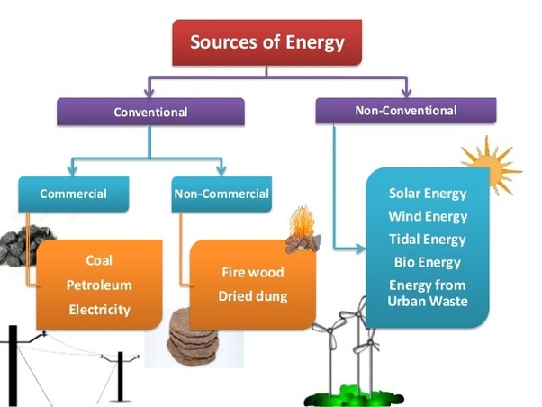
Conventional and non-conventional Resources
Jaipur Engineering College & Research Center Basic Concepts of Power System
Prepared by, Mrs. Neha Agrawal

Slide 29
Distributed Energy Resources
Distributed Energy Resources (DER), small-scale power generation sources located close to where electricity is used, provide an alternative to or an enhancement of the traditional electric power grid.
DER is a faster, less expensive option to the construction of large, central power plants and high-voltage transmission lines. They offer consumers the potential for lower cost, higher service reliability, high power quality, increased energy efficiency, and energy independence. The use of renewable distributed energy generation technologies and "green power" such as wind, photovoltaic, geothermal, biomass, or hydroelectric power can also provide a significant environmental benefit.
Jaipur Engineering College & Research Center Basic Concepts of Power System
Prepared by, Mrs. Neha Agrawal

Slide 30
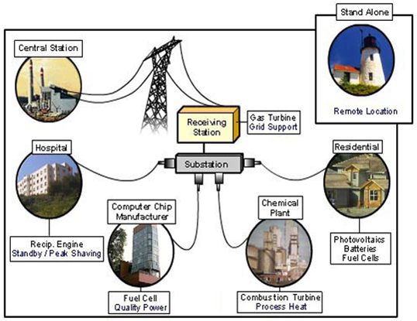
Types of Distributed Energy Resources and Technologies
Jaipur Engineering College & Research Center Basic Concepts of Power System
Prepared by, Mrs. Neha Agrawal

Slide 31
Energy Storage
Storing energy when renewable power enough
Releasing power when renewable power not sufficient
Energy storage devices
Batteries, hydrogen tanks, other energy storage devices
Power electronics
For charging energy storage devices
For converting voltage in appropriate format and level
For achieving MPPT
Jaipur Engineering College & Research Center Basic Concepts of Power System
Prepared by, Mrs. Neha Agrawal

Slide 32
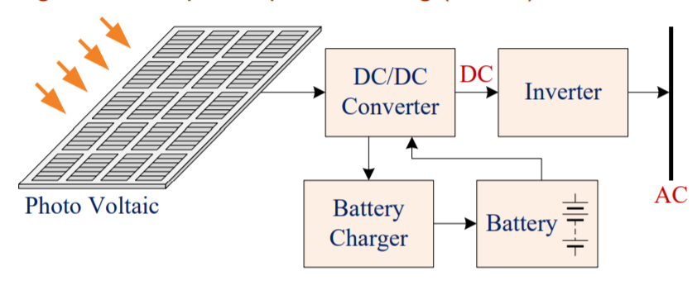
Battery Energy Storage Systems
BESS for PV systems
DC/DC converters
Providing DC link voltage to the inverter from battery
Achieving maximum power point tracking (MPPT)
Jaipur Engineering College & Research Center Basic Concepts of Power System
Prepared by, Mrs. Neha Agrawal

Slide 33
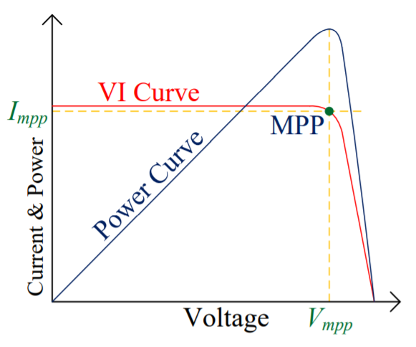
Battery Energy Storage Systems
BESS for PV systems
MPPT
Current of PV increasing while voltage decreasing
Control output current with corresponding output voltage levels of the PV
For maximising output
power
Avoiding overload of PV
Jaipur Engineering College & Research Center Basic Concepts of Power System
Prepared by, Mrs. Neha Agrawal

Slide 34
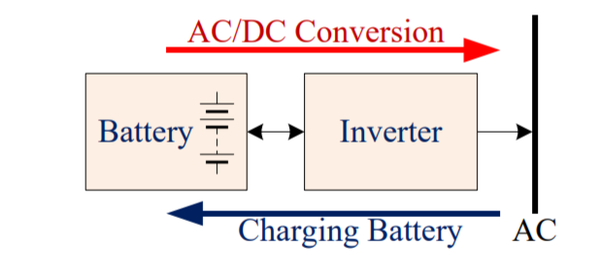
Battery Energy Storage Systems
BESS for Utility
Bidirectional Inverter (DC/AC or AC/DC)
DC/AC conversion to AC grid
AC/DC conversion to charging battery
Jaipur Engineering College & Research Center Basic Concepts of Power System
Prepared by, Mrs. Neha Agrawal

Slide 35
Battery Energy Storage Systems
Comparison of batteries for BESS
Examples of types of lithium-ion batteries
Lithium cobalt oxide (LiCoO₂) battery (high energy density)
Lithium iron phosphate (LiFePo₄ or LFE) battery (safer)
Type | Cell voltage (V) | Density (Whr/kg) | Efficiency (%)
Lead-acid | 2.1, 2.2 | 30-40 | 70-92
Ni-Cad | 1.2 | 40-60 | 70-90
Ni-iron | 1.2 | 50 | 65
NiMH | 1.2 | 30-80 | 66-95
Li-ion Based | 3.6 | 160 | 99
Nano Titanate | 13.8 | 90 | 87-95
Jaipur Engineering College & Research Center Basic Concepts of Power System
Prepared by, Mrs. Neha Agrawal

Slide 36
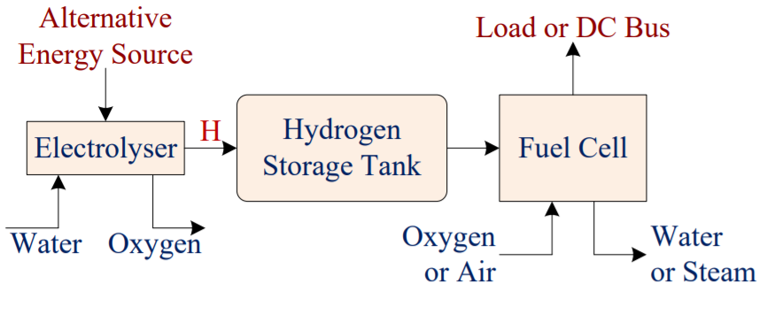
Hydrogen Energy Storage Systems
Hydrogen as fuel
Electrolyser
Decomposing water to H and O₂
H stored in a high pressure tank as fuel storage
Jaipur Engineering College & Research Center Basic Concepts of Power System
Prepared by, Mrs. Neha Agrawal

Slide 37
Hydrogen Energy Storage Systems
Fuel cell
generating DC power by reaction of H and O₂
Water or steam released
as waste
MPPT necessary
Hydrogen able to be transported via gas pipes
Jaipur Engineering College & Research Center Basic Concepts of Power System
Prepared by, Mrs. Neha Agrawal

Slide 38
Hydrogen Energy Storage Systems
Efficiency
Electrolyser best efficiency < 85%
Fuel cell around 35%, best efficiency < 50%
Overall HESS around 30% efficiency
Much lower than BESS
Energy density
Up to 425 Whr / kg
Higher energy density than batteries
Jaipur Engineering College & Research Center Basic Concepts of Power System
Prepared by, Mrs. Neha Agrawal

Slide 39
Other Energy Storage Systems
Ultracapacitors (supercapacitors)
2.7 to 16.2 V
Much faster dynamic response
than batteries
Low energy density and high price
Acting as Assistive energy storage devices with batteries
Improving dynamic response of a BESS
Jaipur Engineering College & Research Center Basic Concepts of Power System
Prepared by, Mrs. Neha Agrawal

Slide 40
Other Energy Storage Systems
Superconducting magnetic energy
storage system
Superconductor
Energy stored as DC current
Energy stored in superconducting coil
Very high L and extremely low R coil
Current freewheeling in coil
0.5LI²
High costs for cold support
Jaipur Engineering College & Research Center Basic Concepts of Power System
Prepared by, Mrs. Neha Agrawal

Slide 41
Single Line Diagram of transmission and distribution
Jaipur Engineering College & Research Center Basic Concepts of Power System
Prepared by, Mrs. Neha Agrawal

Slide 42
Single Line Diagram of transmission and distribution
Jaipur Engineering College & Research Center Basic Concepts of Power System
Prepared by, Mrs. Neha Agrawal

Slide 43
Layout of Single Line Diagram
A power system is consist of the following stages:
Power Station
Primary Transmission
Secondary Transmission
Primary Distribution
Secondary Distribution
Jaipur Engineering College & Research Center Basic Concepts of Power System
Prepared by, Mrs. Neha Agrawal

Slide 44
Power Station
6
The bulk power is generated at the power station by 3- phase, 3 wire system employing several alternators in parallel. The usual generation voltage is 11kV. Due to economic consideration , the generation voltage(ie; 11kV ) is step up to 220kV or 132kV at the power station with the help of step up transformers.
Prepared by, Mrs. Neha Agrawal
Jaipur Engineering College & Research Center Basic Concepts of Power System

Slide 45
Primary Transmission
7
High voltages of the order of 66 kV 132 kV
220 kV and 400 kV are used for transmitting power by 3 phase 3 wire overhead system. This is supplied to substations usually at the out skirts of major distribution centre or city.
Prepared by, Mrs. Neha Agrawal
Jaipur Engineering College & Research Center Basic Concepts of Power System

Slide 46
Secondary Transmission
8
◆ On the outskirt of the city, there are sub- station which step down the primary transmission voltage to 66kV or 33kV and power is transmitted at this voltage. This forms the secondary transmission system. 3 phase wire system is used.
Prepared by, Mrs. Neha Agrawal
Jaipur Engineering College & Research Center Basic Concepts of Power System

Slide 47
Primary Distribution
9
◆ The transmission lines or inner connectors terminate at large main substations from which the power is distributed to small secondary substations scattered throughout the load area. The voltage may range from 11 kV to 132 kV.
Prepared by, Mrs. Neha Agrawal
Jaipur Engineering College & Research Center Basic Concepts of Power System

Slide 48
Secondary Distribution
10
◆ This consists of the low- voltage network laid along the streets, localities and over the rural areas. From these sources connections to individual customers are provided. The circuit used for this purpose is 3 phase 4 wire, 440 V/220 V from which either 3 phase 440 V or single phase 220 V supply to the consumers may be provided.
Prepared by, Mrs. Neha Agrawal
Jaipur Engineering College & Research Center Basic Concepts of Power System

Slide 49
INTRODUCTION OF DISTRIBUTION SYSTEM
Distribution of electric power is an important part of power system. The important requirement of a distribution system is that the power should be distributed to various consumers economically and efficiently .
The electric energy is made available for use in a factory or a residential building by distribution system which can be subdivided into three distinct parts.
Feeders
Distributors
Service mains
Prepared by, Mrs. Neha Agrawal
Jaipur Engineering College & Research Center Basic Concepts of Power System

Slide 50
DISTRIBUTION SYSTEM
The arrangement of conveying electric power from bulk power sources (generating stations or major substations) to the various consumers is called distribution system.
Distribution is of two types. –
High voltage or primary distribution
Low voltage or secondary distribution
High voltage distribution is carried out at voltages of the order of 33kv,66kv or,11kv.
Low voltage distribution which is carried out at 400/230 volts (in three phase 4 wires system)
Prepared by, Mrs. Neha Agrawal
Jaipur Engineering College & Research Center Basic Concepts of Power System

Slide 51
Important terms of distribution system
Feeder
Distributor
Service mains
Feeder- A feeder is a conductor which connects sub-station or generating station to the are where the power is to be distributed. These are the conductors which carry large currents to the feeding points. In Fig. , s is the sub-station and SA and SC are the feeders. A and C are the feeding points.
Prepared by, Mrs. Neha Agrawal
Jaipur Engineering College & Research Center Basic Concepts of Power System

Slide 52
Distributor : A distributor is a conductor from which tapings are taken for supply to the consumers or it is the conductor t which carries current to the service main form the feeding points. The current loading of a distributor varies along its length.
Service mains : A services main is generally a small cable which connects the
distributor to the consumer terminals.
CLASSIFICATION OF DISTRIBUTION SYSTEMS
1. According to Nature of Construction :
Overhead distribution system
Underground distribution system
overhead system is cheaper than underground system. However, underground system is used in thickly populated areas where overhead system may not be practicable.
Jaipur Engineering College & Research Center Basic Concepts of Power System

Slide 53
According to nature of current :
D.C distribution system
A.C distribution system
A.C distribution is universally adopted due to many advantage of a.c. power over d.c. power.
3. According to number of wires :
2-wire d.c. system
3-wire d.c. system
Single phase, 2-wire a.c. system
3-phase, 3-wire a.c. system
3-phase, 4—wire a.c. system
Prepared by, Mrs. Neha Agrawal
Jaipur Engineering College & Research Center Basic Concepts of Power System

Slide 54
4. According to the system of connection:
Radial system
Ring main system
Interconnected system
Radial System: when the distributor is fed at one end
only, it is called radial distribution system. A single line diagram of radial system is shown in fig.
Prepared by, Mrs. Neha Agrawal
Jaipur Engineering College & Research Center Basic Concepts of Power System

Slide 55
Advantages of radial system
its initial cost is minimum.
this system is employed when electrical energy is generated at low voltage and power station is situated at the center of load.
Disadvantages:
the end of the distributor nearest to the supply end would be heavily loaded.
the consumers at the distant end of the distributor would be subjected to serious voltage variations.
When the load on the distributor changes.
Prepared by, Mrs. Neha Agrawal
Jaipur Engineering College & Research Center Basic Concepts of Power System

Slide 56
Ring main system
when the distributor is supplied by two feeders, it is called a ring main distribution system. In this system the feeder closes on itself, i.e. it forms a complete ring and hence the name ring mains.
Advantages of ring main system:
it offers a great reliability of supply. In the event of fault on any system of feeder, the continuity of supply can be maintained.
each distributor is supplied via two feeders, for
example,- the distributor connected at a point “D” is fed via feeder ABC and ADC
Prepared by, Mrs. Neha Agrawal
Jaipur Engineering College & Research Center Basic Concepts of Power System

Slide 57
Inetrconnected system:
Interconnected System
In an “interconnected system” the feeder ring is energised by two or more than two generating stations or substations fig. shows the single line diagram of an interconnected system. The closed feeder ring ABCDA is supplied by four stations S1, S2, S3 & S4 at points D,A, B & C.
Prepared by, Mrs. Neha Agrawal
Jaipur Engineering College & Research Center Basic Concepts of Power System

Slide 58
Synchronous Grids and Asynchronous (DC) interconnections.
Electrical Grid: Electrical grid or power grid is defined as the network which interconnects the generation, transmission and distribution unit. It supplies the electrical power from generating unit to the distribution unit. A large amount of power is transmitted from the generating station to load centre at 220kV or higher. The network form by these high voltage lines is called the super grid. The super grid feeds the sub-transmission network operating at 132kV or less.
Jaipur Engineering College & Research Center Basic Concepts of Power System
Prepared by, Mrs. Neha Agrawal

Slide 59
Types of Electrical Grid
Regional Grid – The Regional grid is formed by interconnecting the different transmission system of a particular area through the transmission line.
National Grid – It is formed by interconnecting the different regional grid.
Reason for an Interconnection:he interconnection of the grid provides the best use of power resource and ensures great security to supply. It makes the system economical and reliable. The generating stations are interconnected for reducing the reserve generation capacity in each area.
Jaipur Engineering College & Research Center Basic Concepts of Power System
Prepared by, Mrs. Neha Agrawal

Slide 60
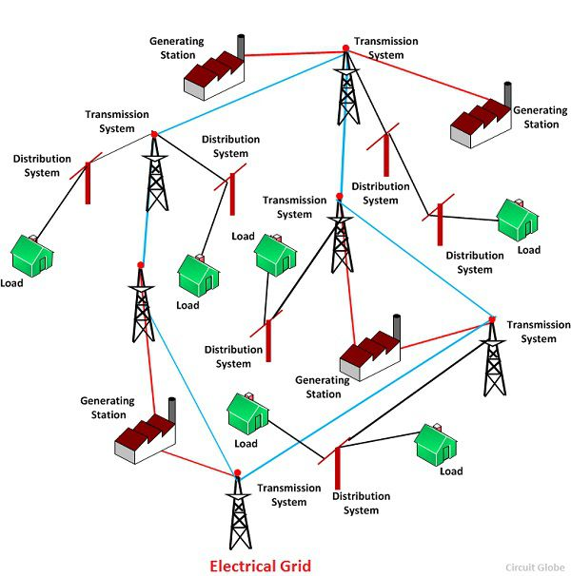
Jaipur Engineering College & Research Center Basic Concepts of Power System
Prepared by, Mrs. Neha Agrawal

Slide 61
Types of an Interconnections
HVAC (High Voltage Alternating Current) Interconnection: In HVAC link the two AC systems are interconnected by an AC link. For interconnecting the AC system, it is necessary that there should be sufficiently close frequency control on each of the two systems.
For the 50Hz system, the frequency should lie between 48.5 Hz and 51.5 Hz. Such an interconnection is known as synchronous interconnection or synchronous tie. The AC link provides a rigid connection between two AC system to be interconnected. But the AC interconnection has certain limitations.
The interconnection of an AC system has suffered from the following problems.
The interconnection of the two AC networks is the synchronous tie. The frequency disturbances in one system are transferred to the other system.
The power swings in one system affect the other system. Large power swing in one system may result in frequent tripping due to which major fault occurs in the system. This fault causes complete failure of the whole interconnected system.
There is an increase in the fault level if an existing AC system is connected with the other AC system with an AC tie line. This is because the additional parallel line reduces the equivalent reactance of the interconnected system. If the two AC system are connected to the fault line, then the fault level of an each AC system remains unchanged.
Jaipur Engineering College & Research Center Basic Concepts of Power System
Prepared by, Mrs. Neha Agrawal

Slide 62
Types of an Interconnections
HVDC (High Voltage Direct Current) Interconnection:
The DC interconnection or DC tie provides a loose coupling between the two AC system to be interconnected. The DC tie between two AC systems is non-synchronous (Asynchronous). The DC interconnection has the certain advantages. They are as follows.
The DC interconnection system is asynchronous thus the system which is to be interconnected is either of the same frequency or at the difference frequency. The DC link thus provides the advantages of interconnection of two AC network at different frequencies. It also enables the system to operate independently and to maintain their frequency standards.
The HVDC links provide fast and reliable control of magnitude and direction of power flow by controlling the firing angle of converters. The rapid control of power flow increases the limit of transient stability.
The power swings in the interconnected AC networks can be damped rapidly by modulating the power flow through the DC tie. Thus, the stability of the system is increased.
Nowadays, the customary grids are replaced by the smart grids. The smart grid uses the smart meter and appliances which improves the efficiency of the system.
Jaipur Engineering College & Research Center Basic Concepts of Power System
Prepared by, Mrs. Neha Agrawal
36

Slide 63
Three-Phase Systems
Almost all electric power generation and most of the power transmission in the world is in the form of three-phase AC circuits. A three-phase AC system consists of three-phase generators, transmission lines, and loads.
There are two major advantages of three-phase systems over a single- phase system:
More power per kilogram of metal form a three-phase machine;
Power delivered to a three-phase load is constant at all time, instead of pulsing as it does in a single-phase system.
The first three-phase electrical system was patented in 1882 by John Hopkinson - British physicist, electrical engineer, Fellow of the Royal Society.
Jaipur Engineering College & Research Center Basic Concepts of Power System
Prepared by, Mrs. Neha Agrawal

Slide 64
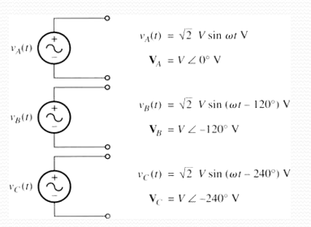
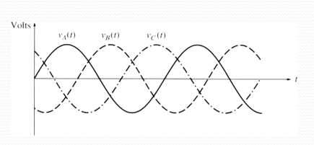
Generation of three-phase voltages and currents
A three-phase generator consists of three single- phase generators with voltages of equal amplitudes and phase differences of 120°.
Jaipur Engineering College & Research Center Basic Concepts of Power System
Prepared by, Mrs. Neha Agrawal

Slide 65
Each of three-phase generators can be connected to one of three identical loads.
This way the system would consist of three single-phase circuits differing in phase angle by 120°.
The current flowing to each load can be found as
I = ^{V}
Z
Jaipur Engineering College & Research Center Basic Concepts of Power System
Prepared by, Mrs. Neha Agrawal

Slide 66
V ∠0⁰
Therefore, the currents flowing in each phase are
I_{A} = $\frac{\text{V}\text{∠} \text{0}\text{0}}{\text{Z}\text{∠}\text{θ} }$= I ∠ −θ
V ∠ −120⁰
Z∠θ
I_{B} =
= I ∠ −120 −θ
V ∠− 240⁰
Z∠θ
I_{A} =
= I ∠ − 240 −θ
Jaipur Engineering College & Research Center Basic Concepts of Power System
Prepared by, Mrs. Neha Agrawal
I_{B} =

Slide 67
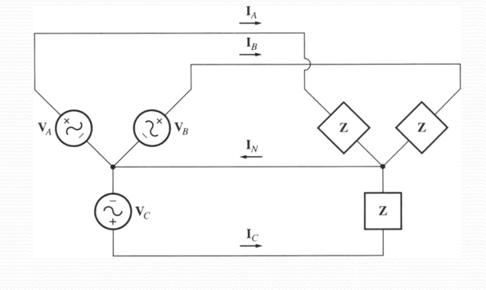
We can connect the negative (ground) ends of the three single-phase generators and loads together, so they share the common return line (neutral).
Jaipur Engineering College & Research Center Basic Concepts of Power System
Prepared by, Mrs. Neha Agrawal

Slide 68
The current flowing through a neutral can be found as
I = I + I + I = I∠−
θ + I∠−θ −
0
θ −240
0
N A B C
120 + I∠−
= I cos(−θ) + jI sin(−θ) + I cos(−θ −120⁰) + jI sin(−θ −120⁰) + I cos(−θ −240⁰) + jI sin(−θ −240⁰)
= I ⎡⎣cos(−θ) +cos(−θ −120⁰) +cos(−θ −240⁰)⎤⎦ + jI ⎡⎣sin(−θ) +sin(−θ −120⁰) +sin(−θ −240⁰)⎤⎦
= I ⎣⎡cos(−θ) +cos(−θ)cos(120⁰) +sin(−θ)sin(120⁰) +cos(−θ)cos(240⁰) +sin(−θ)sin(240⁰)⎦⎤
+ jI ⎡⎣sin(−θ) +sin(−θ)cos(120⁰) −cos(−θ)sin(120⁰) +sin(−θ)cos(240⁰) −cos(−θ)sin(240⁰)⎤⎦
which is simplified to be
⎡ ⎤
1 3 1 3
I = I ⎢cos(−θ ) − ₂ cos(−θ ) + ₂ sin(−θ ) − ₂ cos(−θ ) − ₂ sin(−θ )⎥
N
⎣ ⎦
⎡ ⎤
1 3 1 3
+ jI ⎢sin(−θ ) − ₂ sin(−θ ) + ₂ cos(−θ ) − ₂ sin(−θ ) − ₂ cos(−θ )⎥
⎣
⎦
= 0
Jaipur Engineering College & Research Center Basic Concepts of Power System
Prepared by, Mrs. Neha Agrawal

Slide 69
So, as long as the three loads are equal, the return current in the neutral is zero!
Such three-phase power systems (equal magnitude, phase differences of 120°, identical loads) are called balanced.
In a balanced system, the neutral is unnecessary!
Phase Sequence is the order in which the voltages in the individual phases peak.
Jaipur Engineering College & Research Center Basic Concepts of Power System
Prepared by, Mrs. Neha Agrawal

Slide 70
Connection Types
There are two types of connections in three-phase circuits:
Y (Wye) and Δ (Delta)
Each generator and each load can be either Y- or Δ-connected. Any number of
Y- and Δ-connected elements may be mixed in a power system.
Phase quantities – voltages and currents in a given phase.
Line quantities
– voltages between the lines and currents in the lines connected to the generators.
Jaipur Engineering College & Research Center Basic Concepts of Power System
Prepared by, Mrs. Neha Agrawal

Slide 71
a) Y-connection
Assuming a resistive load…
Jaipur Engineering College & Research Center Basic Concepts of Power System
Prepared by, Mrs. Neha Agrawal

Slide 72
I_{L} = I_{φ}
The current in any line is the same as the current in the corresponding phase.
Voltages are:
⎛
1 _{V}
3 _{V}
V = V −V = V ∠0⁰ −V ∠ −120⁰ = V − ⎜ −
2
− j ³ V ⎞ = ³ V + j
ab a b φ φ φ
φ
2
φ ⎟
2
φ
2
φ
⎝
⎠
= 3V ^{⎛ 3} + j ^{1 ⎞} = 3V ∠30⁰
φ _{⎜ 2}
₂ ⎟
φ
⎝ ⎠
V_{ab} = 3V_{φ} ∠30°
V_{bc} = 3V_{φ} ∠ − 90°
V_{ca} = 3V_{φ} ∠ − 210°
Jaipur Engineering College & Research Center Basic Concepts of Power System
Prepared by, Mrs. Neha Agrawal

Slide 73
Magnitudes of the line-to-line voltages and the line-to-neutral voltages are related as:
V_{LL} = 3V_{φ}
In addition, the line-to-line voltages are shifted by 30° with respect to the phase voltages.
In a connection with abc sequence, the voltage of a line leads the phase voltage by 30° as shown in the figure.
Jaipur Engineering College & Research Center Basic Concepts of Power System
Prepared by, Mrs. Neha Agrawal

Slide 74
b) Δ-connection
Assuming a resistive load…
V = V ∠0⁰
ab φ
I = I ∠0⁰
ab φ
V = V ∠ −120⁰
bc φ
I = I ∠ −120⁰
bc φ
V = V ∠ − 240⁰
ca φ
I = I ∠ − 240⁰
ca φ
Jaipur Engineering College & Research Center Basic Concepts of Power System
Prepared by, Mrs. Neha Agrawal

Slide 75
Line-to-line voltage magnitudes are the same as the phase voltages.
V_{LL} = V_{φ}
Currents are:
⎛
1 _{I}
3 _{I} ⎞
I = I − I = I ∠0⁰ − I ∠240⁰ = I − ⎜ − + j
2
φ ⎟
a
ab
ca
φ φ φ φ
2
⎝
⎠
= ³ I − j
3 _{I}
= 3I ^{⎛ 3} − j ^{1 ⎞} = 3I ∠− 30⁰
2
φ
2
φ
φ _{⎜ 2}
₂ ⎟
φ
⎝ ⎠
I_{a} = 3I_{φ} ∠ − 30°
I_{b} = 3I_{φ} ∠ − 150°
I_{c} = 3I_{φ} ∠ − 270°
Jaipur Engineering College & Research Center Basic Concepts of Power System
Prepared by, Mrs. Neha Agrawal

Slide 76
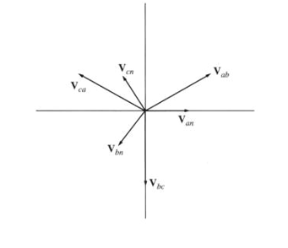
Magnitudes of the line and phase currents are related as:
I_{L} = 3I_{φ}
In addition, the line currents are shifted by 30° with respect to the phase currents.
For the connections with the abc phase sequences, the current of a line lags the corresponding phase current by 30° as shwon in the figure.
Jaipur Engineering College & Research Center Basic Concepts of Power System
Prepared by, Mrs. Neha Agrawal

Slide 77
Wye (Y) Connected Load
Delta (Δ) Connected Load
Jaipur Engineering College & Research Center Basic Concepts of Power System
Prepared by, Mrs. Neha Agrawal

Slide 78
Practical Use
What do you want to use in practice?
[Most common usage]
Δ-connected loads are most common to allow easy addition and removal of loads in each phase
Y-connected sources are most common to avoid circulating currents when there is a small imbalance.
Jaipur Engineering College & Research Center Basic Concepts of Power System
Prepared by, Mrs. Neha Agrawal

Slide 79
c) Power relationship
For a balanced Y-connected load with the impedance Z_{φ} = Z ∠θ and phase voltages as:
v_{an} (t) = 2V sin ωt
v (t) = 2V sin(ωt −120⁰ )
bn
v (t) = 2V sin(ωt − 240⁰ )
cn
The currents can be found as:
i_{a} (t) = 2I sin(ωt −θ )
i (t) = 2I sin(ωt −120⁰ −θ )
b
i (t) = 2I sin(ωt − 240⁰ −θ )
c
Jaipur Engineering College & Research Center Basic Concepts of Power System
Prepared by, Mrs. Neha Agrawal

Slide 80
The instantaneous power is:
p(t) = v(t)i(t)
Therefore, the instantaneous power supplied to each phase is:
p_{a} (t) = v_{an} (t)i_{a} (t) = 2VI sin(ωt) sin(ωt −θ )
ωt −120 ) sin(ωt −120 −θ )
p (t) = v (t)i (t) = 2VI sin(
0
0
b bn b
ωt − 240 ) sin(ωt − 240 −θ )
p (t) = v (t)i (t) = 2VI sin(
0 0
c cn c
Simplify the above equations using
sin α sin β = ¹ [cos(α − β ) − cos(α + β )]
2
p_{a} (t) = VI [cosθ − cos(2ωt −θ )]
p (t) = VI cosθ
ωt − 240 −θ )⎤⎦
⎡
cos(2
0
b
⎣
p (t) = VI cosθ
ωt − 480 −θ )⎤⎦
⎡
cos(2
0
c
⎣
Jaipur Engineering College & Research Center Basic Concepts of Power System
Prepared by, Mrs. Neha Agrawal

Slide 81
The total power on the load is given by
p_{tot} (t) = p_{a} (t) + p_{b} (t) + p_{c} (t) = 3VI cosθ
The pulsing components cancel each other because of 120° phase shifts, so the total power on the load is constant.
The figure shows:
The instantaneous power in each phase.
The total power supplied to the load (which is constant)
Jaipur Engineering College & Research Center Basic Concepts of Power System
Prepared by, Mrs. Neha Agrawal

Slide 82
P = 3V_{φ} I_{φ} cosθ = 3I_{φ} ² Z cosθ
Phase quantities in each phase of a Y- or Δ-connection.
Real Power:
Reactive Power:
Q = 3V_{φ} I_{φ} sinθ = 3I_{φ} ² Z sinθ
Apparent Power:
S = 3V_{φ} I_{φ} = 3I_{φ} ² Z
NOTE: These equations are valid for balanced loads only.
Jaipur Engineering College & Research Center Basic Concepts of Power System
Prepared by, Mrs. Neha Agrawal

Slide 83
Deriving line quantities of a Y-connection.
Power consumed by a load:
P = 3V_{φ} I_{φ} cosθ
since for this load
I_{L} = I_{φ}
and V_{LL} = 3V_{φ}
therefore
P = 3^{VLL}
I cosθ
3
L
Finally
P = 3V_{LL} I_{L} cosθ
NOTE: These equations are valid for balanced loads only.
Jaipur Engineering College & Research Center Basic Concepts of Power System
Prepared by, Mrs. Neha Agrawal

Slide 84
Deriving line quantities of a Δ-connection.
Power consumed by a load:
P = 3V_{φ} I_{φ} cosθ
since for this load
I_{L} = 3I_{φ} and V_{LL} = V_{φ}
therefore
P = 3^{VLL} I cosθ
3
L
Finally
P = 3V_{LL} I_{L} cosθ
Same as for a Y-connected load!
NOTE: These equations are valid for balanced loads only.
Jaipur Engineering College & Research Center Basic Concepts of Power System
Prepared by, Mrs. Neha Agrawal

Slide 85
P = 3V_{LL} I_{L} cosθ
Line quantities for a Y- or Δ-connection.
Real Power:
Reactive Power:
Q = 3V_{LL} I_{L} sinθ
Apparent Power:
S = 3V_{LL} I_{L}
Reminder: θ is the load (or impedance) angle, i.e. the angle between the phase voltage and the phase current.
NOTE: These equations are valid for balanced loads only.
Jaipur Engineering College & Research Center Basic Concepts of Power System
Prepared by, Mrs. Neha Agrawal

Slide 86
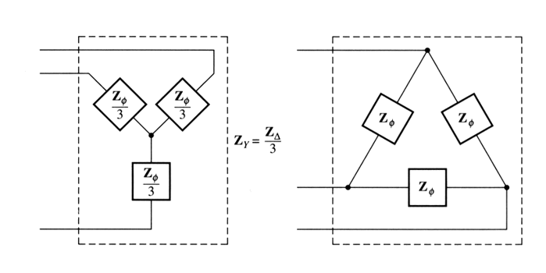
d) Analysis of balanced systems
A Δ-connected circuit can be analyzed via the transform of impedances by the Y-Δ transform. For a balanced load, it states that a Δ-connected load consisting of three equal impedances Z is equivalent to a Y-connected load with the impedances Z/3.
This equivalence implies that the voltages, currents, and powers supplied to both loads would be the same.
Jaipur Engineering College & Research Center Basic Concepts of Power System
Prepared by, Mrs. Neha Agrawal

Slide 87
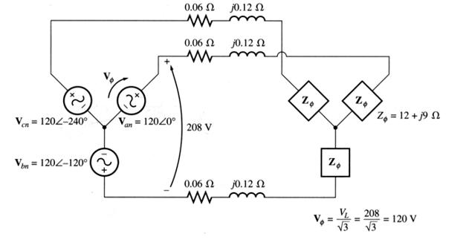
Ex. For a 208-V three-phase ideally balanced system shown below, Find:
The magnitude of the line current I_{L}
The magnitude of the load’s line and phase voltages V_{LL} and V_{φL};
The real, reactive, and the apparent powers consumed by the load;
The power factor of the load.
Jaipur Engineering College & Research Center Basic Concepts of Power System
Prepared by, Mrs. Neha Agrawal

Slide 88
Both, the generator and the load are Y- connected, therefore, it’s easy to construct a per-phase equivalent circuit.
a) Phase current:
I_{L} = _{Z}
V
120∠0⁰
=
120∠0⁰
=
120∠0⁰
0
=
(0.06 + j0.12) + (12 + j9) 12.06 + j9.12 15.12∠37.1
= 7.94∠ − 37.1 A
L
Z
load
0
b) Phase voltage over the load:
V_{φ L} = I_{φ L}Z_{φ L} = (7.94∠ − 37.1 )(12 + j9) = (7.94∠ − 37.1 )(15∠36.9 ) = 119.1∠ − 0.2 V
0 0 0 0
and the maignitude of the line voltage on the load:
V_{LL} = 3V_{φ L} = 206.3 V
Jaipur Engineering College & Research Center Basic Concepts of Power System
Prepared by, Mrs. Neha Agrawal

Slide 89
c) The real power consumed by the load:
P = 3V I cosθ = 3⋅119.1⋅ 7.94 cos 36.9 = 2270 W
load φ φ
0
The reactive power consumed by the load:
Q = 3V I sinθ = 3⋅119.1⋅ 7.94 sin 36.9 = 1702 var
load φ φ
0
The apparent power consumed by the load:
S_{load} = 3V_{φ} I_{φ} = 3⋅119.1⋅ 7.94 = 2839 VA
d) The load power factor:
PF = cosθ = cos 36.9⁰ = 0.8 − lagging
load
Jaipur Engineering College & Research Center Basic Concepts of Power System
Prepared by, Mrs. Neha Agrawal

Slide 90
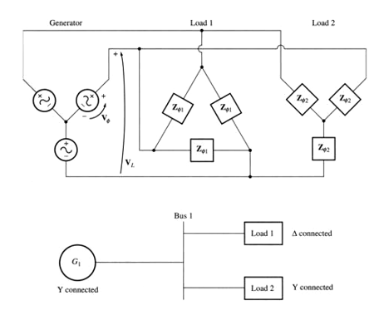
e) One-line diagrams
Since, in a balanced system, three phases are similar except of the 120° phase shift, power systems are frequently represented by a single line showing all three phases of the real system.
This is a one-line diagram.
Such diagrams usually include all the major components of a power system: generators, transformers, transmission lines, loads.
Jaipur Engineering College & Research Center Basic Concepts of Power System
Prepared by, Mrs. Neha Agrawal

Slide 91
If we can neglect the impedance of the transmission line, an important simplification in the power calculation is possible…
If the generator voltage in the system is known, then we can find the current and power factor at any point in the system as follows:
The line voltages at the generator and the loads will be identical since the line is lossless.
Real and reactive powers on each load.
The total real and reactive powers supplied to all loads from the point examined.
The system power factor at that point using the power triangle relationship.
Line and phase currents at that point.
We can treat the line voltage as constant and use the power triangle method to quickly calculate the effect of adding a load on the overall system and power factor.
Jaipur Engineering College & Research Center Basic Concepts of Power System
Prepared by, Mrs. Neha Agrawal

Slide 92
Assignment
Draw the basic structure of power system and mention its voltage label.
Explain the feeder, distributor and service mains.
Draw and describe the different types of grid system.
Derive the equation of power flow in an overhead transmission line.
What is the maximum voltage label of overhead transmission line in India.
What is the voltage lable of ac generation in India.
What do you understand by grid.
Jaipur Engineering College & Research Center Basic Concepts of Power System
Prepared by, Mrs. Neha Agrawal

Slide 93
Conclusion:
The Basic Concepts of Power System and its various components ,
their role are discussed.
References:
1. | Hadi Saadat, ‘Power System Analysis’, Tata McGraw Hill Education Pvt. Ltd., New Delhi, 21st reprint, 2010.
2. | https://nptel.ac.in
3. | Pai M A, ‘Computer Techniques in Power System Analysis’, Tata Mc Graw-Hill Publishing Company Ltd., New Delhi, Second Edition, 2007.
4. | J. Duncan Glover, Mulukutla S. Sarma, Thomas J. Overbye, ‘ Power System Analysis & Design’, Cengage Learning, Fifth Edition, 2012.
5. | Olle. I. Elgerd, ‘Electric Energy Systems Theory – An Introduction’, Tata McGraw Hill Publishing Company Limited, New Delhi, Second Edition, 2012.
6. | C.A.Gross, “Power System Analysis,” Wiley India, 2011.
7. | M.Jeraldin Ahila “Power System Analysis”, Lakshmi Publications, Chennai, Eleventh Edition 2017.
8. | Other web documents
Basic Concepts of Power System

