Slide 1
JAIPUR ENGINEERING COLLEGE AND RESEARCH CENTRE
Year & Sem – III Year/ V sem
Subject – Electrical Machine Design
Subject Code – 5EE4-05
Unit – 2.2
Topic -- Design of Transformer
Presented by – Mr. Atul Kulshrestha, Asstt Professor, EE
1

Slide 2
VISSION AND MISSION OF INSTITUTE
Vision of Jaipur Engineering College and Research Centre
To become a renowned centre of outcome based learning, and work towards academic, professional, cultural and social enrichment of the lives of individuals and communities.
Mission of Jaipur Engineering College and Research Centre
M1. Focus on evaluation of learning outcomes and motivate students to inculcate research aptitude by project based learning.
M2. Identify, based on informed perception of Indian, regional and global needs, areas of focus and provide platform to gain knowledge and solutions.
M3. Offer opportunities for interaction between academia and industry.
M4. Develop human potential to its fullest extent so that intellectually capable and imaginatively gifted leaders can emerge in a range of professions.
1

Slide 3
VISSION AND MISSION OF DEPARTMENT
Vision of Department of Electrical Engineering
Electrical Engineering Department strives to be recognized globally for outcome based knowledge and to develop human potential to practice advance technology which contribute to society.
Mission of Department of Electrical Engineering
M1. To impart quality technical knowledge to the learners to make them globally competitive Electrical Engineers.
M2. To provide the learners ethical guidelines along with excellent academic environment for a long productive career.
M3. To promote industry-institute relationship.
1

Slide 4
Volt / Turn Equation
Rating of the transformer per phase in KVA, Q= V₁*I₁ x 10⁻³ = E₁*I₁ x 10⁻³ = 4.44 φ_{m} f T₁ x I₁ x 10⁻³
The term φ_{m} is called the magnetic loading and T₁ x I₁ is called the electric loading. The required kVA can be obtained by selecting a higher value of φ_{m} and a lesser of T₁ x I₁ or vice-versa.
As the magnetic loading increases, flux density and hence the core loss increases and the
efficiency of operation decreases. Similarly as the electric loading increases, number of turns, resistance and hence the copper loss increases. This leads to reduced efficiency of operation. It is clear that there is no advantage by the selection of higher values of T₁ x I₁ or φ_{m}. For an economical design they must be selected in certain proportion.
Thus in practice
φ_{m /} T₁ x I₁ = a constant ( Kt )
T₁ x I₁ = φ_{m} /Kt
KVA per phase, Q = 4.44 φ_{m} f T₁ x I₁ x 10⁻³ = 4.44 φ_{m} f φ_{m} /Kt x 10⁻³
φ_{m} = √ [ ( Kt * Q) / 4.44*f * 10⁻³ ]

Slide 5
Since the emf induced E1 = 4.44 φm f T1 is in T1 turns,
voltage / turn,Et = E1/T1= 4.44 *f* φm
= 4.44 f √ [ ( Kt * Q) / 4.44*f * 10⁻³ ]
= √ [4.44f x 10³ x Kt x kVA / ph ]
= K √ KVA
Where K (= 4.44 f x 10 ³ x Kt ) is another constant and kVA is the rated output of the transformer.
The constant K depends on the type of transformer-single or three phase, core or shell type, power or distribution type, type of factory organization etc .
Typical values of K :
1.0 to 1.2 for single phase shell type
1.3 for three-phase shell type (power)
0.75 to 0.85 for single phase core type
0.6 to 0.7 for three phase core type (power)
0.45 for three-phase core type (distribution)

Slide 6
Factors for Transformer Winding
It depends upon some of the following factors:
Current rating
Short circuit strength
Temperature rise
Impedance
Surge voltage
Transport facilities

Slide 7
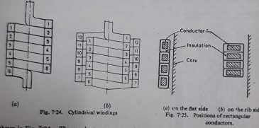
Types of Transformer Winding
1. Cylindrical winding
Helical winding
Double helical winding
Multi layer helical winding
Cross over winding
Disc and continuous disc winding
Aluminium foil winding

Slide 8
Window Space Factor
Window space factor is defined as the ratio of copper area in the window to the area of the window.
For a given window area, as the voltage rating of the transformer increases, quantity of insulation in the window increases, area of copper reduces. Thus the window space factor reduces as the voltage increases. A value for Window space factor (Kw) can be calculated by the following empirical formula:
Kw= 10/(30+kV)for transformer rating 50 to 200kVA
Kw= 12/(30+kV)for rating about 1000 kVA
Kw= 8/(30+kV)for rating about 20 kVA

Slide 9
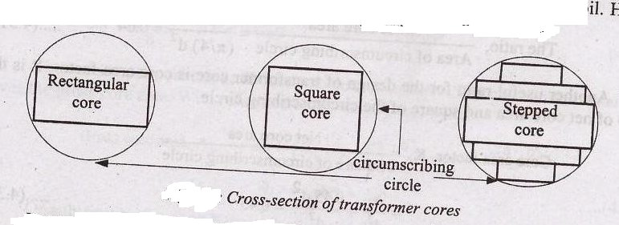
Core Design
For core type transformer, the cross-section of
the core may be
(i) Rectangular
(ii) Square
(iii) Stepped
When circular coils are required
for distribution and power transformers, the square and stepped cores are used.
For shell type transformer, the cross-section may be Rectangular.
When rectangular cores are used, the coils are also rectangular in shape.
The rectangular core is suitable for small and low voltage transformers.
Net iron area of the leg or limb or core, Ai = φ_{m} / B_{m} m²

Slide 10
Core Design Values
Rectangular core: It is used for core type distribution transformer and small power transformer for mode rate and low voltages and shell type transformers.
In core type transformer the ratio of depth to width of core varies between 1.4 to 2.
In shell type transformer width of central limb is 2 to 3 times the depth of core.
Square and stepped cores: For high voltage transformers, where circular coils are required, square and stepped cores are used.

Slide 11
Square Core
d- diameter and diagonal of the square core
a – side of square
Diameter of core / circle
d=√a2+a2
d=√2a2
d=√2 * a
side of square a=d / √2
gross core area Agi = area of square
a2=(d / √2)2
a2 = 0.5d²
stacking factor = Sf= 0.9
net core area Ai
=stacking factor*gross core area
= 0.9 * 0.5d²
Ai = 0.45d²
Ratio =net core area /area of circumscribing circle =
= Ai / (Π/4) d² = = 0.45d² / (Π/4) d² =0.58
Ratio = gross core area /area of circle = 0.64
Core area factor Kc = net core area / square of circumscribing circle (dia of circle)
= 0.45d² /d²
Kc= 0.45

Slide 12
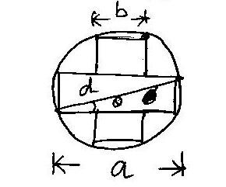
TWO STEPPED CORE / CRUCIFORM CORE
To give maximum area for a given diameter in stepped core:
a- length of the rectangular
b-breath of the rectangular
d-diameter of the circumscribing circle = diagonal of the rectangular
θ-Angle between the diagonal and length of the rectangular
A_{gi} = ab+ b(a-b)= 2ab-b²
a = d cos Ѳ and b= d sin Ѳ
A_{gi}= 2d² sin Ѳ cos Ѳ –d² sin² Ѳ
= d² ( sin2 Ѳ –sin²Ѳ )
Differentiate with respect to Ѳ
dA_{gi}/ d Ѳ = d²( 2 cos2 Ѳ -2sin Ѳ cos Ѳ )
= d²( 2 cos2 Ѳ - sin 2Ѳ )
Equating dAgi/ d Ѳ =0
= d²( 2 cos2 Ѳ - sin 2Ѳ ) = 0
tan 2Ѳ = 2 Ѳ = 31⁰ 45’
A_{gi} =0.618d²
S_{f}= 0.9
Ai = 0.9*0.618d²
Ai =0.56d²
The ratio =net core area /area of circle = 0.71
The ratio = gross core area /area of circle = 0.79
Core area factor Kc = net core area / square of circumscribing circle (dia of circle)
= 0.56d²/d²
Kc= 0.56

Slide 13
Ratio of Area of Core and Circumscribing Circle

Slide 14
Core Design Comparision
For a given area Ai, different types of core section that are used in practice are circular, rectangular and square.
[Note: Choice of core section: 10cm
3.56cm 3.16cm 10cm
Circular core
If the area is 10cm2, then Square core
for Ai = 10cm2, side Rectangular core
for Ai = 10cm2 , the
the diameter of the core of the square = √10 perimeter = (10+1)2=22cm if
=3.56cm and the = 3.16 cm and perimeter the sides of the rectangular
Circumference = is 4x3.16=12.64cm are assumed to be 10cm and 1.0cm
πx3.56=11.2 cm
It is clear that the rectangular core calls for more length of copper for the same number of turns as compared to circular core. Therefore circular core is preferable to rectangular or square core.
3.16cm
1.0cm

Slide 15
Choice Of Flux Density In The Core
Flux density decides –area of cross section of core and core loss
Higher value of flux density –small core area ,lesser cost ,reduction in length of mean
turn of wdg ,higher iron loss,large magnetizing current.
Choice of flux density depends
1.service condition (distribution / power T/F)
2. materials used for laminations of core Laminations are made up of
cold rolled silicon steel (higher flux density )
Hot rolled silicon steel (low flux density)
When hot rolled silicon steel is used for laminations
Bm =1.1 to 1.4 wb/m2 - for distribution T/F
Bm = 1.2 to 1.5 wb/m2 - for power T/F
When cold rolled silicon steel is used for laminations
Bm = 1.55 wb/m2 -T/F with voltage rating up to 132KV
Bm = 1.6 wb/m2 - T/F with voltage upto 132KV to 275KV
Bm = 1.7 Wb/m2 - 275KV to 400KV

Slide 16
OVER ALL DIMENSION OF THE TRANSFORMER
The main dimensions of the transformer are
(i) Height of window(Hw)
(ii) Width of the window(Ww)
The other important dimensions of the transformer are
(i) width of largest stamping(a)
(ii) diameter of circumscribing circle( d)
(iii) distance between core centres(D)
(iv) height of yoke(Hy)
(v) depth of yoke(Dy)
(vi) overall height of transformer frame(H)
(vii) overall width of transformer frame(W)

Slide 17
OVER ALL DIMENSION OF THE TRANSFORMER

Slide 18
Design Of Yoke
The section of yoke can either be taken as rectangular or it may be stepped.
In rectangular section yokes,
Depth of the yoke = depth of core
Area of yoke Ay=Dy x Hy
Dy=depth of yoke and width of largest core stamping =a
Ay=1.15to1.25of Agi for hot rolled steel
=Agi for CRGO

Slide 19
Window Dimensions
Height and width of the window is adjusted to give suitable arrangement of winding and give desired value of leakage reactance.( Increased height keeps low leakage reactance)
Area of window( Aw) depends :
Total conductor area
Window space factor
Aw = total conductor area/ Window space factor
= 2 ap * Tp/ Kw for single phase transformer
= 4 ap * Tp/ Kw for Three phase transformer
Area of window, Aw = Hw * Ww
The ratio of height to width of window Hw / Ww is between 2 to 4.

Slide 20
Width Of Window For Optimum Output
D = width of iron + width of bare conductors + width of insulation and clearance
D’ = width of iron + width of bare conductors
d = width occupied by the iron
m = space occupied by insulation and clearance etc along the width
E_{t} = 4.44 *f * φ_{m} * = 4.44*f* B_{m} * A_{i} = 4.44 *f* B_{m}* k_{c} d²
Output per unit height of window, S = E_{t} * T_{h} * I where T_{h} = turns per unit height
I*Th = mmf per unit height = δ*a*Th
[a*Th =height of conductors* width of conductors =width of conductors( As height=1)]
I*Th = δ* width of conductors in window
Output, S= Ad²(D’-d) = Ad²D’ – Ad³
Optimum value of output, differentiate wrt d, D= 1.7d ( m is taken as 0.2d)
As D= D’+m
Width of window which gives max. output ,Ww= D-d = 0.7d

Slide 21
Overall Dimensions
SinglePhaseTransformer
d=diameter of circumscribing circle
D=distance b/w centers of adjacent limbs
H=over all height
W=length of yoke
D= d+Ww, Dy=a
H= Hw+2Hy
W= D+a
Width over two limbs = D+ outer diameter of hv winding
Width over one limb = outer diameter of hv winding

Slide 22
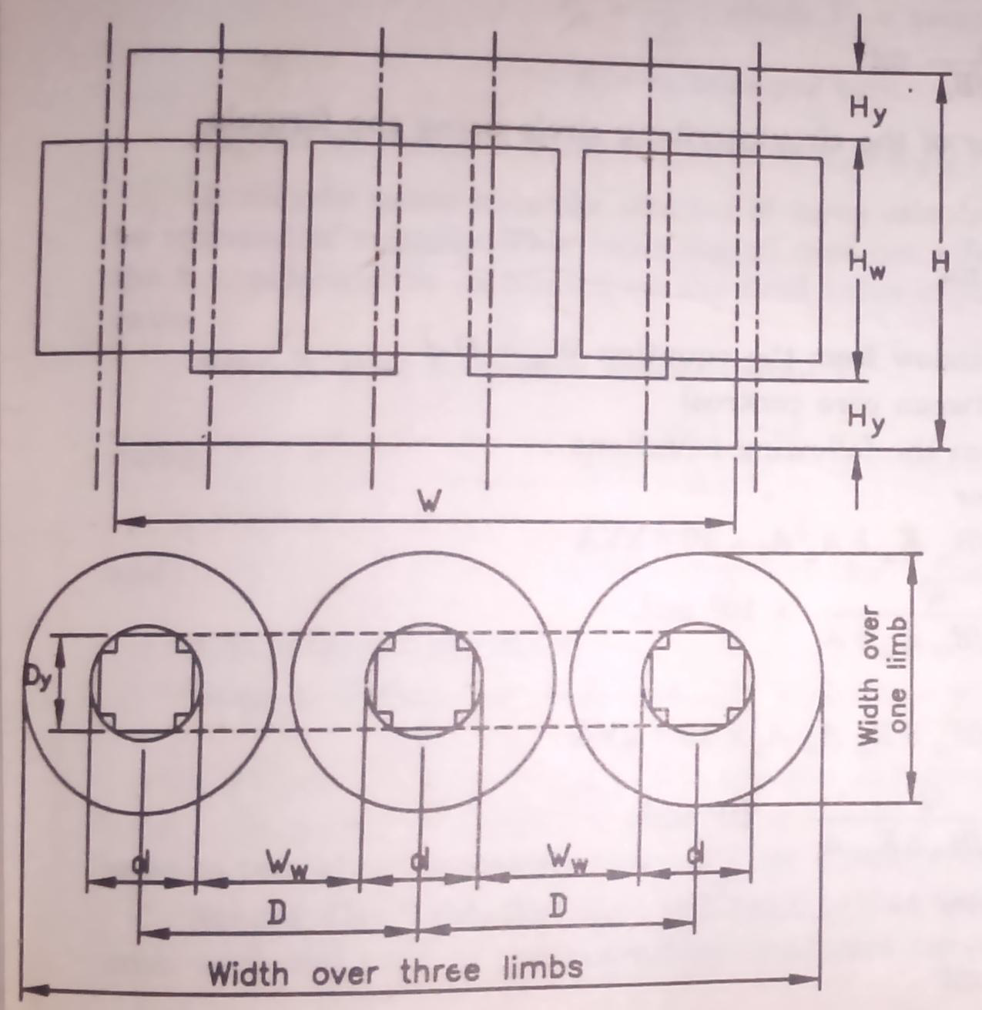
Three Phase Transformer
D=d+Ww,Dy=a
H=Hw+2HyW=2D+a
Width over two limbs=D+outer diameter of hv winding
Width over one limb= outer diameter of hv winding

Slide 23
Dimensions In Core Type Transformer
D-distance between the two core or leg central lines
2. Width Ww is measured from one edge of the leg to the other of the adjacent leg in case of square or rectangular core with square or rectangular coil and between the two circumscribing circles of adjacent legs in case of stepped legs.
3. Depth or width of the core type transformer = b in case of rectangular core
= a in case of square or stepped core
Overall length = (Ww + 2a) or (D+a) in case of single phase core type transformer with square or rectangular core
= (Ww+d+a) or (D+a) in case of single phase core type transformer with a Stepped leg
= (2Ww + 2d + a) or (2D+a) in case of three phase core type transformer with a stepped leg.
No square or rectangular leg is used for high capacity three phase transformers.
Overall height = (Hw + 2Hy) for all core type transformers.

Slide 24
Optimum Design
Transformer may be designed to makeone of the following quantity as minimum
i.Total volume
ii.Total weight
iii.Total cost
iv.Total loss
All these quantities vary with ratio r= фm/AT.
If we choose high value of ‘r’ then flux will be high, so large cross section is required which will increase volume, weight and cost of iron and also give higher iron loss. Also due to decrease in value of ‘AT’ the volume, weight and cost of copper decreased and also decrease in copper losses. Thus ‘r’ is a controlling factor for above mention quantities.

Slide 25
Atul Kulshrestha (Asstt Professor, Electrical Engineering Department) , JECRC, JAIPUR

