Slide 1
JAIPUR ENGINEERING COLLEGE AND RESEARCH CENTRE
Year & Sem – III Year/ V sem
Subject – Electrical Machine Design
Subject Code – 5EE4-05
Unit – 2.1
Topic -- Design of Transformer
Presented by – Mr. Atul Kulshrestha, Asstt Professor, EE
1

Slide 2
VISSION AND MISSION OF INSTITUTE
Vision of Jaipur Engineering College and Research Centre
To become a renowned centre of outcome based learning, and work towards academic, professional, cultural and social enrichment of the lives of individuals and communities.
Mission of Jaipur Engineering College and Research Centre
M1. Focus on evaluation of learning outcomes and motivate students to inculcate research aptitude by project based learning.
M2. Identify, based on informed perception of Indian, regional and global needs, areas of focus and provide platform to gain knowledge and solutions.
M3. Offer opportunities for interaction between academia and industry.
M4. Develop human potential to its fullest extent so that intellectually capable and imaginatively gifted leaders can emerge in a range of professions.
1

Slide 3
VISSION AND MISSION OF DEPARTMENT
Vision of Department of Electrical Engineering
Electrical Engineering Department strives to be recognized globally for outcome based knowledge and to develop human potential to practice advance technology which contribute to society.
Mission of Department of Electrical Engineering
M1. To impart quality technical knowledge to the learners to make them globally competitive Electrical Engineers.
M2. To provide the learners ethical guidelines along with excellent academic environment for a long productive career.
M3. To promote industry-institute relationship.
1

Slide 4
UNIT-2 Design of Transformer
Sizing of a transformer
Types of Transformer
kVA output for single- and three-phase transformers
Window space factor
Overall dimensions
Operating characteristics
Voltage regulation
No load current calculation
Temperature rise in transformers
Design of cooling tank
Methods for cooling of transformers

Slide 5
Sizing of a Transformer
Transformer size depends upon:
Transformer size should be calculated based on the actual running load and not on the connected or rated load.
Atleast 10% margin is to be considered on running load and input power.
Voltage drop shall be within tolerable limit during starting of the largest motor while all other loads are running.

Slide 6
Types of Transformer
Based upon construction, the types are
Core type transformer
shell type transformer
Based on applications, the types are
Distribution transformers
Power transformers
Special transformers
Instrument transformers
Electronics transformers
Based on the type of connection, the types are
Single phase transformer
Three phase transformer
Based on the frequency range, the types are
Power frequency transformer
Audio frequency transformer
UHF transformers
Wide band transformers
Narrow band transformer
Pulse transformer
Based on the number of windings, the types are
Auto transformer
Two winding transformer

Slide 7
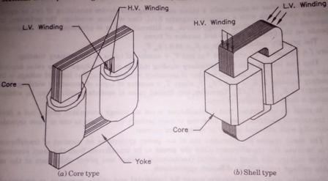
Classification of Transformer
Depending upon the type of construction used:
I.Core type
II.Shell type
Classification on the basis of type of service:
I.Distribution transformer
II.Power transformer
Classification on the basis of power utility:
I.Single phase transformer
II.Three phase transformer
1

Slide 8
Characteristics of Core Type Transformer
1.It is easy in design
2.It has low mechanical strength due to non bracing of windings
3.Less possibility of reduction of leakage reactance.
4.The assembly can be easily dismantled for repair work.
5.Better heat dissipation from windings.
6.Has longer mean length of core and shorter mean length of coil turn. Hence best suited for Extra High voltage(EHV) requirements.

Slide 9
Characteristics of Shell Type Transformer
1.Comparatively complex
2.High mechanical strength
3.Reduction of leakage reactance is highly possible
4.It cannot be easily dismantled for repair work.
5.Heat is not easily dissipated from windings since it is surrounded by core
6.It is not suitable for EHV requirements.

Slide 10
Comparison Of Core Type And Shell Type Transformers
I. Construction:- Core type transformers are much simpler in design and permit easier assembly and insulation of winding.
II.Mechanicalforces:-The forces produced between windings is proportional to the product of the currents carried by them. Very large electromagnetic forces are produced when secondary winding is short-circuited. Since the windings carry currents in opposite direction, there exists a force of repulsion between them. Hence, the inner winding experiences a compressive force and outer winding experiences a tensile force.
III.Leakage reactance:- In core type transformer large space required between the high and low voltage winding, it is not possible to subdivided the winding, while, in shell type transformer the windings can be easily subdivided by using sandwich coil. So it is possible to reduce the leakage reactance of shell type transformers.
IV.Repairs:-The winding of core type transformer is completely accessible so coils can be easily inspected. And also core type transformer is easy to dismantle for repair. In shell type transformer, the coils are surrounded by core, therefore difficulty in inspection and repair of coils.
V.Cooling:-In core type transformer windings are exposed and therefore the cooling is better in winding than core. In case of shell type transformer core is exposed therefore cooling is better in winding.
1

Slide 11
Construction Of Transformer
I.Transformer core
II.Low voltage (LV)Winding and High Voltage (HV) winding
III.Insulation
IV.Tank
V.Bushings
VI.Conservator and breather
VII.Tapping and tap changing
VIII.Buchholz Relay
IX.Explosion vent
X.Transformer oil

Slide 12
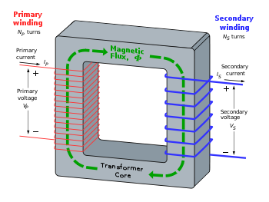
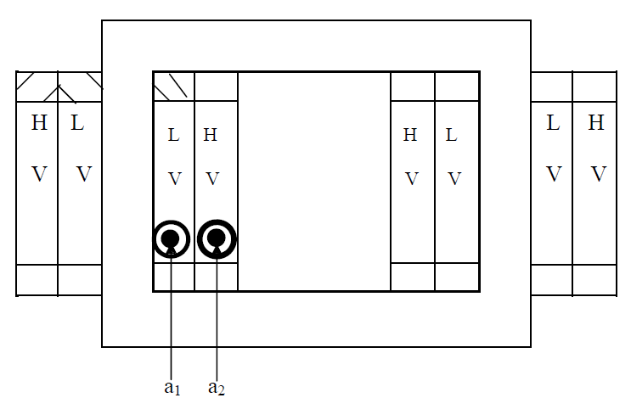
Single Phase Core Type Transformer
The equation which relates the rated KVA output of a transformer to the area of core & window is called output equation.
In transformers the output KVA depends on flux density and ampere turns.
Rating of the transformer in kVA = V₁*I₁ x 10⁻³ = E₁*I₁ x 10⁻³ = 4.44 φ_{m} f T₁ x I₁ x 10⁻³
Each leg carries half of the LV and HV turns
The low voltage winding is placed nearer to the core in order to reduce the insulation requirement. The space inside the core is called window & it is the space available for accommodating the primary and secondary winding. The window area is shared between the winding and their insulations.
1

Slide 13
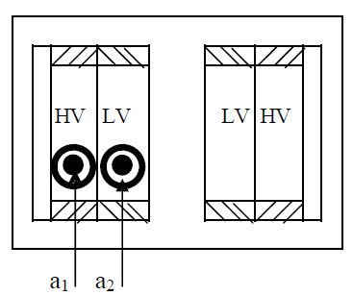
Single Phase Shell Type Transformer
Since there are two windows, it is sufficient to design one of the two windows as both the windows are symmetrical. Since the LV and HV windings are placed on the central leg, each window accommodates T1 and T2 turns of both primary and secondary windings.
Rating of the transformer in kVA = V1* I1 x 10-3 = E1* I1 x 10⁻³
= 4.44 φm f T1 x I1 x 10⁻³

Slide 14
Design Of Windings
Transformer consist of High voltage winding and low voltage winding
Design of wdg involves the determination of number of turns and area of cross section of the conductor used for wdg.
Number of turns = using voltage rating and emf per turns.
The area of cross section – using rated current and current density
Number of turns in low voltage winding TLV = VLV / Et or AT / ILV
Number of turns in high voltage winding THV = TLV * VHV / VLV
Where
VLV = Rated voltage of low voltage winding
ILV = Rated current of low voltage winding
VHV = Rated voltage of high voltage winding
In step up T/F
TLV = Tp
VLV = Vp
THV = Ts
VHV = Vs
In step down T/F
THV =Tp
VHV = Vp
TLV = Ts
VLV = Vs
Rated current in a winding
= KVA per phase *10-3 / voltage rating of the winding
The area of cross section of primary and secondary winding conductors are estimated by assuming a current density

Slide 15
The choice of current density(δ) depends on the allowable temperature rise , copper loss,method of cooling .
δ for various types of T/F
δ =1.1 to 2.2 A/mm2 for distribution T/F
δ = 1.1 to 2.2 A/mm2 for small power T/F with self oil cooling.
δ =2.2 to 3.2 A/mm2 for large power transformer with self oil cooling or air blast .
δ=5.4 to 6.2 A/mm2 for large power T/F with forced circulation of oil or with water cooling coils.
Area of cross section of primary winding conductor ap=Ip / δ
Area of cross section of secondary winding conductor as=Is / δ

Slide 16
Output Equations Single Phase Transformer
Induced emf in a transformer, E= 4.44* f*ϕm*T volts ----------------------------------------------(1)
EMF per turn Et= E/T= 4.44fϕm
Window space factor Kw = Ac/Aw
Where Ac = Conductor area in window = Kw * Aw -----------------------------------------------------(2)
Aw = Total area of window
Current density, δ = Ip/ap=Is/as;
Where ap = area of cross-section of primary conductor
as = area of cross-section of secondary conductor
Ampere turns, AT = IpTp=IsTs
Where Tp,Ts = Number of turns in primary & secondary
Total copper Area in window, Ac= copper area of primary winding + copper area of sec. winding
= Tp*ap + Ts*as= Tp*Ip/ δ + Ts*Is/ δ= 2AT/δ ------------------------------------- (3)
With equations (1), (2), (3), 2AT/δ = Kw * Aw
AT = Kw * Aw *δ/2 ------------------------------------------------------------------------(4)
Transformer KVA rating Q = Vp*Ip* 10⁻³ = Ep*Ip* 10⁻³ ( As Vp = Ep)
= Et*Tp*Ip* 10⁻³ = Et*AT* 10⁻³
= 4.44fϕm * Kw * Aw *δ/2 * 10⁻³
KVA rating of single phase transformer, Q = 2.22*f*Bm*Ai*Aw*Kw* δ * 10⁻³

Slide 17
Output Equations Three Phase Transformer
Each window contains two primary and two secondary windings.
Induced emf in a transformer, E= 4.44* f*ϕm*T volts ----------------------------------------------(1)
EMF per turn Et= E/T= 4.44fϕm
Window space factor Kw = Ac/Aw
Where Ac = Conductor area in window = Kw * Aw -----------------------------------------------------(2)
Aw = Total area of window
Current density, δ = Ip/ap=Is/as;
Where ap = area of cross-section of primary conductor
as = area of cross-section of secondary conductor
Ampere turns, AT = IpTp=IsTs
Where Tp,Ts = Number of turns in primary & secondary
Total copper Area in window, Ac = 2* (copper area of primary winding + copper area of sec. winding)
= 2*( Tp*ap + Ts*as) = 2*(Tp*Ip/ δ + Ts*Is/ δ)= 4AT/δ -------------------------- (3)
With equations (1), (2), (3), 4AT/δ = Kw * Aw
AT = Kw * Aw * δ/4 -----------------------------------------------------------(4)
Now, KVA rating of three phase transformer Q =3* Vp*Ip* 10⁻³ = 3* Ep*Ip* 10⁻³ ( As Vp = Ep)
= 3* Et*Tp*Ip* 10⁻³ = 3* Et*AT* 10⁻³
= 3* 4.44fϕm * Kw * Aw * δ/4 * 10⁻³
KVA rating of three phase transformer, Q = 3.33*f*Bm*Ai*Aw*Kw* δ * 10⁻³

Slide 18
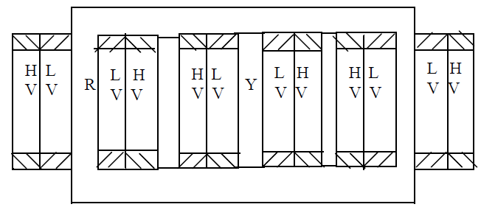
Three phase core type transformer
Single phase shell type transformer
Single phase core type transformer
1

Slide 19
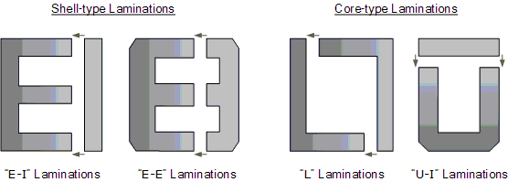
Stamping Size And Shape Of Transformer Core
1

Slide 20
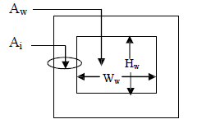
Overall Dimensions
The main dimensions of the transformer are
(i) Height of window(Hw)
(ii) Width of the window(Ww)
The other important dimensions of the transformer are
(i) width of largest stamping(a)
(ii) diameter of circumscribing circle
As the iron area of the leg Ai and the window area Aw = (height of the window Hw x Width of the window Ww) increases the size of the transformer also increases. The size of the transformer increases as the output of the transformer increases.
1

Slide 21
OVER ALL DIMENSION OF THE TRANSFORMER

Slide 22
Core Area Design

Slide 23
Atul Kulshrestha (Asstt Professor, Electrical Engineering Department) , JECRC, JAIPUR

