Slide 1
JAIPUR ENGINEERING COLLEGE AND RESEARCH CENTRE
Year & Sem – III Year/ V sem
Subject – Electrical Machine Design
Subject Code – 5EE4-05
Unit – 1.2
Presented by – Mr. Atul Kulshrestha, Asstt Professor, EE
1

Slide 2
Basic Principles of Machine Design
It Consists of
1. Introduction
2. Constructional Elements of Transformer
3. Constructional Elements of Rotating Machines
4. Classification of design problems
5. Magnetic loading
6. Electrical loading
7. Output Equation
8. Standard Specifications

Slide 3
Introduction
The problem of design and manufacture of electrical machinery is to build as economically as possible, a machine which fulfils a certain set of specifications and guarantees.
The major considerations to evolve good design are
1. Cost
2. Durability
3. Compliance with performance criteria as laid down in specifications

Slide 4
Constructional Elements of Transformer
1.Iron Core
2.Primary and Secondary Winding
3.Transformer Tank
4.Cooling Tubes

Slide 5
Constructional elements of rotating machines
1.Stator
2.Rotor
3.Others
3.(a)DC Machine
1. Stator: Yoke,Field Pole, Pole Shoe, Field Winding, Interpole
2. Rotor: Armature Core, Armature Winding , Commutator
3. Others: Brush and Brush holder
3.(b)Squirrel cage induction motor
1. Stator: Frame, stator core and stator winding
2. Rotor: Rotor core, rotor bars and Endrings

Slide 6
Classification of design problems
Electromagnetic Design
Mechanical Design
3. Thermal Design
4. Dielectric Design

Slide 7
Magnetic loading
Total Magnetic Loading (TML) =Total flux entering and leaving the armature
TML=PØ
2. Specific Magnetic Loading (SML) =(Flux per pole)/Area Under a pole.
SML=(PØ)/(¶DL)

Slide 8
Choice of Specific Magnetic loadings
Specific magnetic loading: Following are the factors which influences the performance of the machine:
(i) Iron loss: A high value of flux density in the air gap leads to higher value of flux in the iron parts of the machine which results in increased iron losses and reduced efficiency.
(ii) Voltage: When the machine is designed for higher voltage space occupied by the insulation becomes more thus making the teeth smaller and hence higher flux density in teeth and core.
(iii) Transient short circuit current: A high value of gap density results in decrease in leakage reactance and hence increased value of armature current under short circuit conditions.
(iv) Stability: The maximum power output of a machine under steady state condition is indirectly proportional to synchronous reactance. If higher value of flux density is used it leads to smaller number of turns per phase in armature winding. This results in reduced value of leakage reactance and hence increased value of power and hence increased steady state stability
(v) Parallel operation: The satisfactory parallel operation of synchronous generators depends on the synchronizing power. Higher the synchronizing power higher will be the ability of the machine to operate in synchronism. The synchronizing power is inversely proportional to the synchronous reactance and hence the machines designed with higher value air gap flux density will have better ability to operate in parallel with other machines.

Slide 9
Electric Loading
1. Total Electric Loading (TEL) =sum of currents in all the conductors on the armature
TEL=I_{z}Z
2. Specific Electric Loading (SEL) =(Total Armature ampere conductors)/ Armatue periphery at airgap.
SEL=(I_{z}Z)/ΠD

Slide 10
Specific Electric Loading:
Following are the some of the factors which influence the choice of specific electric loadings.
(i) Copper loss: Higher the value of q larger will be the number of armature of conductors which results in higher copper loss. This will result in higher temperature rise and reduction in efficiency.
(ii) Voltage: A higher value of q can be used for low voltage machines since the space required for the insulation will be smaller.
(iii) Synchronous reactance: High value of q leads to higher value of leakage reactance and armature reaction and hence higher value of synchronous reactance. Such machines will have poor voltage regulation, lower value of current under short circuit condition and low value of steady state stability limit and small value of synchronizing power.
(iv) Stray load losses: With increase of q stray load losses will increase.

Slide 11
Output Equation
The output of a machine can be expressed in terms of its main dimensions, specific magnetic and electric loadings and speed.
Output Power, P_{a}=C_{o}D²Ln
where
Output coefficient,C_{o}= Π 2B_{av} AC*10⁻³
^{D= Diameter of core}
^{L = Length of the core}
^{N = Speed of machine}
B_{av} ⁼ specific magnetic loadings
AC ⁼ specific electric loadings

Slide 12
Standard Specifications
The standard specifications of electrical machines are
1. Standard ratings of machines
2. Types of enclosure
3. Standard dimensions of conductors to be used
4. Method of marking ratings and name plate details
5. Performance specifications to be met
6. Types of insulation and permissible temperature loss
7. Permissible loss and range of efficiency
8. Procedure for testing of machine parts and machines
9. Auxiliary equipments

Slide 13
Name Plate
Details • KW or KVA rating of machine • Rated working voltage • Operating speed • Full load current • Class of insulation • Frame size • Manufacturers name • Serial number of the machine

Slide 14
ISO numbers with year
• IS 325-1966 : Specifications for 3ph induction motor
• IS 4029-1967 : Guide for testing 3ph induction motor
• IS12615-1986 : Specifications for energy efficient induction motor
• IS13555-1993 : Guide for selection & application of 3ph induction motor for different types of driven equipment
• IS8789-1996 : Values of performance characteristics for 3ph induction motor
• IS 12066-1986 : 3ph induction motors for machine tools

Slide 15
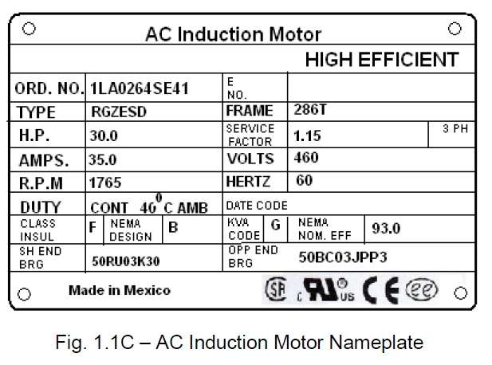
3-Phase AC Induction Motor Name Plate
•

Slide 16
ISO numbers with year
• IS 325-1966 : Specifications for 3ph induction motor • IS 4029-1967 : Guide for testing 3ph induction motor • IS12615-1986 : Specifications for energy efficient induction motor • IS13555-1993 : Guide for selection & application of 3ph induction motor for different types of driven equipment • IS8789-1996 : Values of performance characteristics for 3ph induction motor • IS 12066-1986 : 3ph induction motors for machine tools

