Slide 1
JAIPUR ENGINEERING COLLEGE AND RESEARCH CENTRE
Year & Sem – III Year/ V sem
Subject – Electrical Machine Design
Subject Code – 5EE4-05
Unit – 1.1
Presented by – Mr. Atul Kulshrestha, Asstt Professor, EE
1

Slide 2
VISSION AND MISSION OF INSTITUTE
Vision of Jaipur Engineering College and Research Centre
To become a renowned centre of outcome based learning, and work towards academic, professional, cultural and social enrichment of the lives of individuals and communities.
Mission of Jaipur Engineering College and Research Centre
M1. Focus on evaluation of learning outcomes and motivate students to inculcate research aptitude by project based learning.
M2. Identify, based on informed perception of Indian, regional and global needs, areas of focus and provide platform to gain knowledge and solutions.
M3. Offer opportunities for interaction between academia and industry.
M4. Develop human potential to its fullest extent so that intellectually capable and imaginatively gifted leaders can emerge in a range of professions.
1

Slide 3
VISSION AND MISSION OF DEPARTMENT
Vision of Department of Electrical Engineering
Electrical Engineering Department strives to be recognized globally for outcome based knowledge and to develop human potential to practice advance technology which contribute to society.
Mission of Department of Electrical Engineering
M1. To impart quality technical knowledge to the learners to make them globally competitive Electrical Engineers.
M2. To provide the learners ethical guidelines along with excellent academic environment for a long productive career.
M3. To promote industry-institute relationship.
1

Slide 4
Course Outcomes of Electrical Machine Design (5EE4-05)
After successful completion of this course, students will be able to
CO1: Understand the general concepts and constraints of design of electrical machines including the design principles, heating and cooling, magnetic circuits and windings.
CO2: Design the complete structure of transformer including core, LV & HV windings, overall dimensions of tank by selecting the proper materials and their specifications.
CO3: Design the complete construction of induction motor & synchronous machine including stator & rotor core, AC windings, overall dimensions of machine by select the proper materials and their specifications.
CO4: Familiar the different techniques related with Computer aided Design (CAD) to design the Electrical Machines .

Slide 5
TEXT BOOK & REFERENCE BOOKS
TEXT BOOK
Sawhney, A.K., “A Course in Electrical Machine Design”, 6thEdition, Dhanpat Rai and Sons
REFERENCE BOOKS
1. Agarwal, R.K., “Principles of Electrical Machine Design”, S.K.Kataria and Sons, 2002
2. Mittle,V.N. and Mittle , A., “Design of Electrical Machines”, Standard Publications and Distributors, 2002

Slide 6
Syllabus of Electrical Machine Design
Syllabus of Electrical Machine Design is divided in 5 units:
Unit1: Major Consideration for Design Major considerations in electrical machine design, electrical engineer-ing materials, space factor, choice of specific electrical and magnetic loadings, thermal considerations, heat flow, temperature rise, rating of machines.
Unit 2: Transformers: Sizing of a transformer, main dimensions, kVA output for single- and three-phase transformers, window space factor, overall dimensions, operating characteristics, regulation, no load current, temperature rise in transformers, design of cooling tank, methods for cooling of transformers
Induction Motors Sizing of an induction motor, main dimensions, length of air gap, rules for selecting rotor slots of squirrel cage machines, design of ro-tor bars & slots, design of end rings, design of wound rotor, magnetic leakage calculations, leakage reactance of polyphase machines, magnetizing current, short circuit current, circle diagram, operating characteristics.
Synchronous Machines Sizing of a synchronous machine, main dimensions, design of salient pole machines, short circuit ratio, shape of pole face, armature de-sign, armature parameters, estimation of air gap length, design of ro-tor, design of damper winding, determination of full load field mmf, design of field winding, design of turbo alternators, rotor design.
Computer aided Design (CAD): Limitations (assumptions) of traditional designs, need for CAD analy-sis, synthesis and hybrid methods, design optimization methods, va-riables, constraints and objective function, problem formulation. In-troduction to FEM based machine design. Introduction to complex structures of modern machines-PMSMs, BLDCs, SRM and claw-pole machines.

Slide 7
UNIT-I
The basic design of an electrical machine involves the dimensioning of the magnetic circuit, electrical circuit, insulation system etc., and is carried out by applying analytical equations.

Slide 8
Electrical Machine Design
Design may be defined as a creative physical
realization of theoretical concepts.
Engineering design is application of science,
technology and invention to produce machines
to perform specified tasks with optimum
economy and efficiency.

Slide 9
Problems facing by a Designer
1. A designer is generally confronted with a number of problems for which there may not be one solution, but many solutions.
2. A design should ensure that the products perform in accordance with the requirements at higher efficiency, lower weight of material for the desired output, lower temperature rise and lower cost.
3. A practical designer must effect the design so that the stock (standard frames, punching etc.,) is adaptable to the requirements of the specification
4. The designer must also affect some sort of compromise between the ideal design and a design which comply with manufacturing conditions

Slide 10
Major considerations in Electrical Machine Design
1. Basic Components of Electrical Machine
2. Magnetic circuit or the flux path
3. Electric circuit or windings
4. Insulation
5. Cooling system or ventilation
Machine parts.
Limitation in design (saturation, current, density, insulation temperature rise etc.,)
1. Customer’s needs
2. National and international standards
3. Convenience in production line and transportation
4. Maintenance and repairs
5. Environmental conditions etc.

Slide 11
Limitations in Design
1. Saturation of magnetic parts
Increased core losses and excitation at higher flux density resulting in higher cost for the field system.
2. Temperature rise
Increased temperature rise under higher output weakens the insulation and affects the life of machine.
3. Insulation
It should be able to withstand the electrical, mechanical and thermal stresses which are produced in the machine.
4. Mechanical strength
Specially in turbo machine due to large size and high speed.

Slide 12
Limitations in Design( cont.)
5.Efficiency
If high efficiency is the aim, the machine becomes costly, for lower efficiency higher running cost and temperature rise with associated problems.
6. Customer’s specifications
Imposes limitations to identify criterion for best design
7. Commutation
In DC machine output is limited because of commutation problem
8. Power factor
Power factor imposes a limitation specially in case of 3 phase induction motor.
9.Standard specification
Specification is biggest strain on the design because both the manufacturer as well as the consumer cannot get away from them without satisfying them.

Slide 13
Basic structure of electrical machine
1. Magnetic circuit : core ,yoke, air gap etc.
2. Electric circuit : stator, rotor winding and
transformer winding
3. Dielectric circuit : insulation
4. Thermal circuit : heating and cooling medium
5. Mechanical parts : frame, bearings and shaft

Slide 14
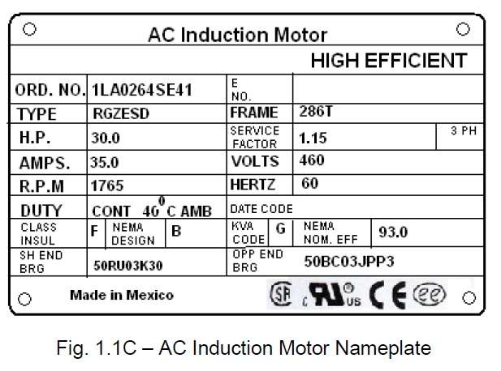
3-Phase AC Induction Motor Name Plate

Slide 15
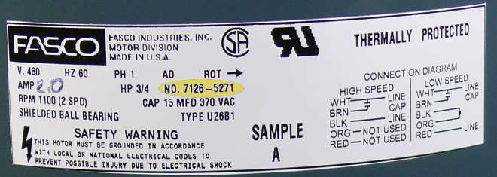
1-Phase Induction Motor Name Plate

Slide 16
Materials for Electrical Machines
Conducting materials
Property of conducting material:
1. Low value of resistivity or high conductivity
2. Low value of temperature coefficient of resistance
3. High tensile strength
4. High melting point
5. High resistance to corrosion
6. Allow brazing, soldering or welding so that the joints are reliable
7. Highly malleable and ductile
8. Durable and cheap by cost

Slide 17
Some of the properties of copper and aluminum are shown in the table
Sl. | Particulars | Copper |  | Aluminum
1 | Resistivity at 200C | 0.0172 ohm / m/ mm2 |  | 0.0269 ohm / m/ mm2
2 | Conductivity at 200C | 58.14 x 106S/m |  | 37.2 x 106S/m
3 | Density at 200C | 8933kg/m3 |  | 2689.9m3
4 | Temperature coefficient (0-100oC) | 0.393 % per 0C |  | 0.4% per 0C
 | Explanation: If the temperature increases by 1oC, the resistance increases by 0.4% in case of aluminum
5 | Coefficient of linear expansion (0-100oC) |  | 16.8x10-6 per oC | 23.5 x10-6 per oC

