Slide 1
JAIPUR ENGINEERING COLLEGE AND RESEARCH CENTRE
Year & Sem. – B. Tech 3rd year, Sem.-5th
Subject –Control System
Presented by – Mr. Ashok Singh Chundawat
Designation - Assistant Professor
Department - Electrical Engineering
1

Slide 2
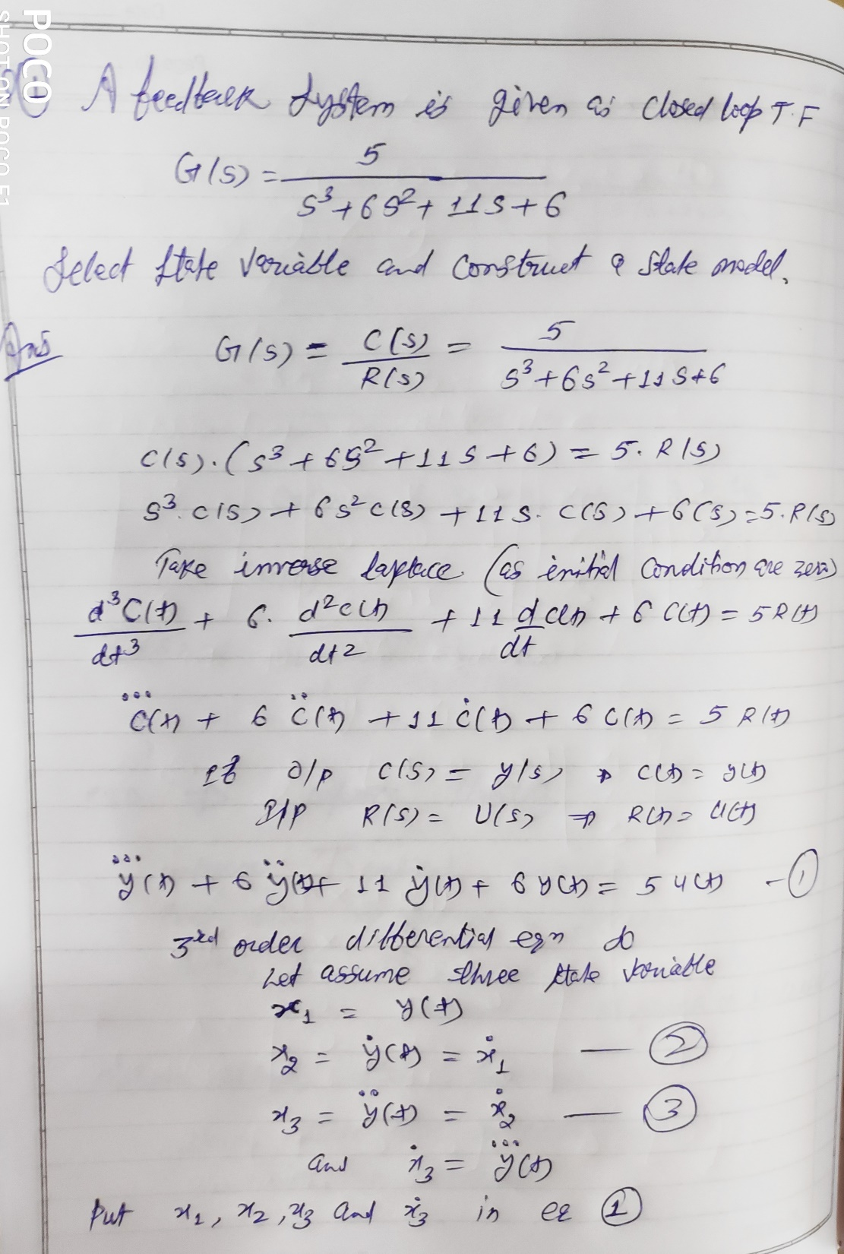

Slide 3
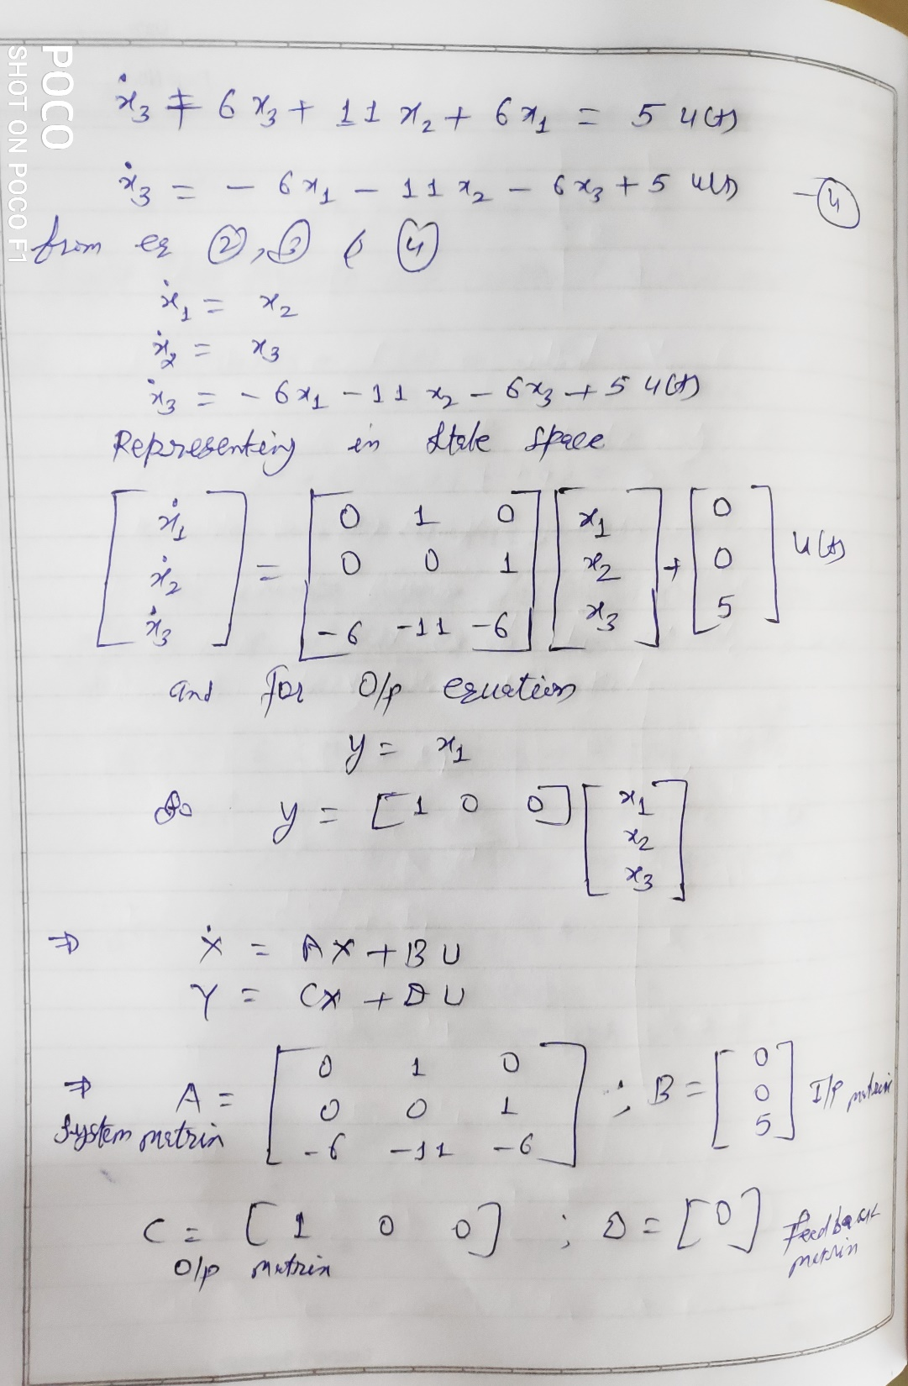

Slide 4
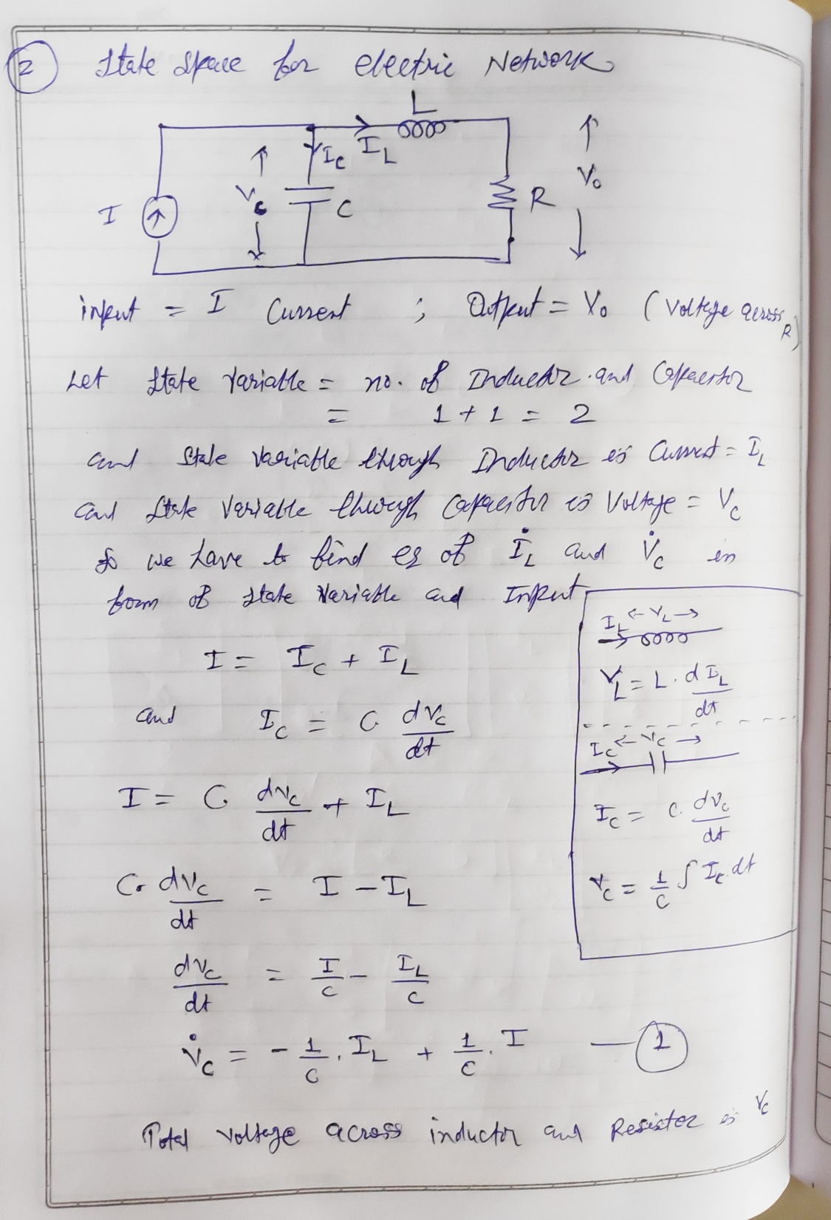

Slide 5
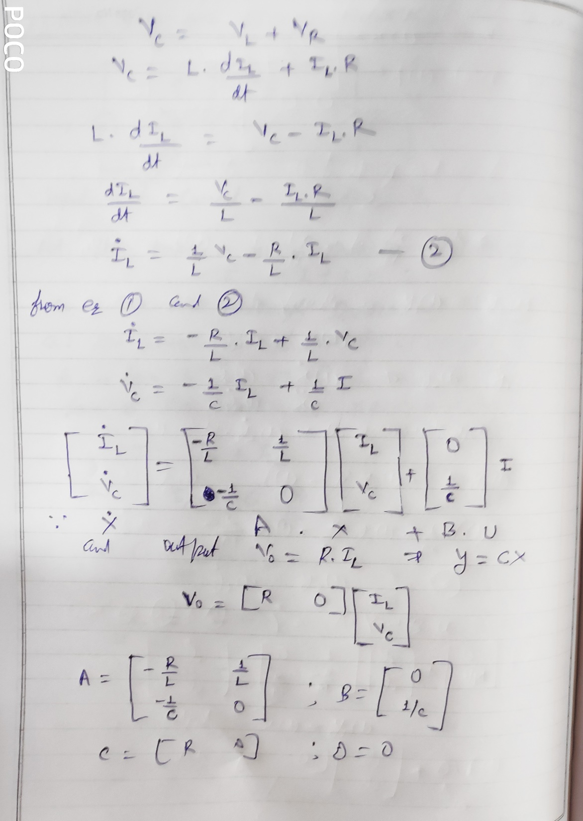

Slide 6
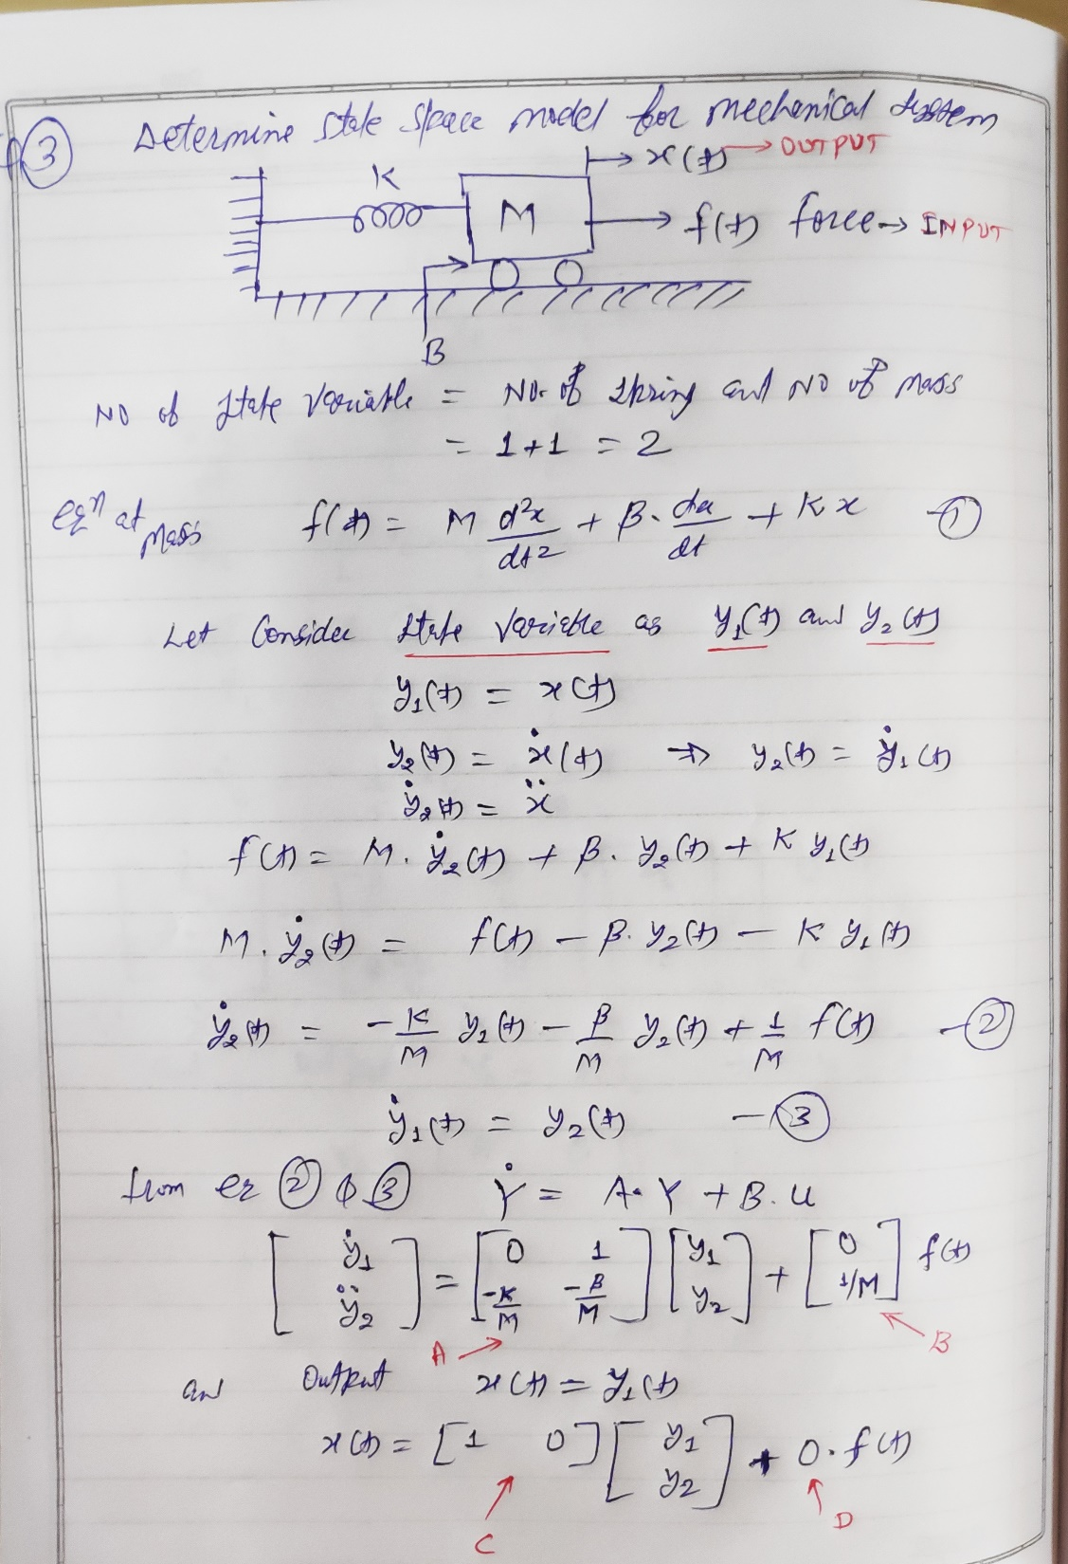

Slide 7
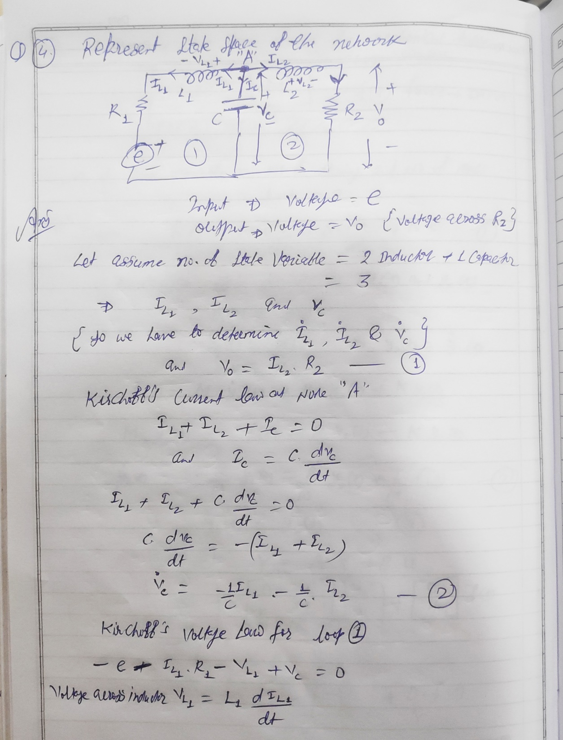

Slide 8
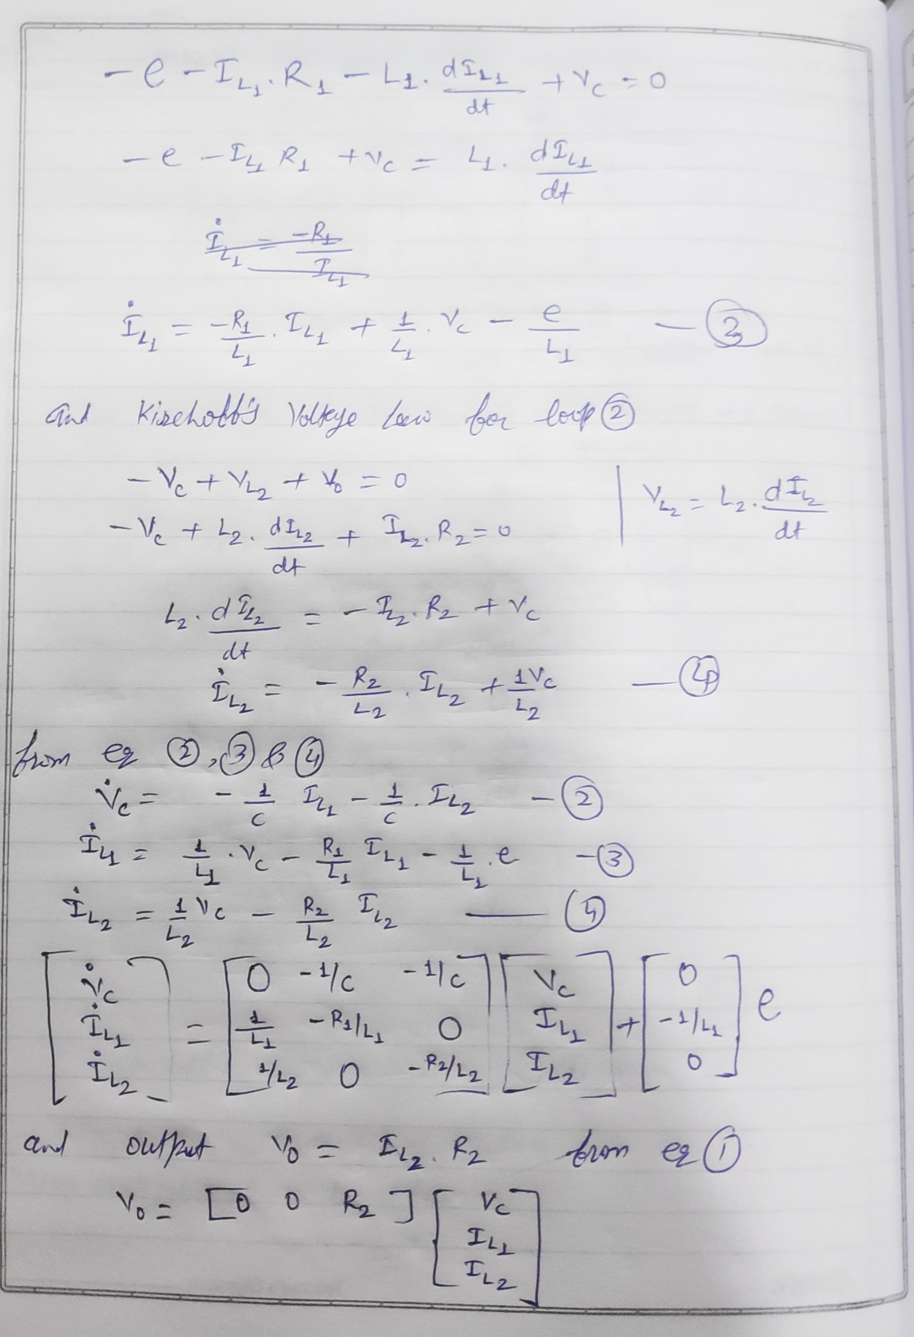

Slide 9
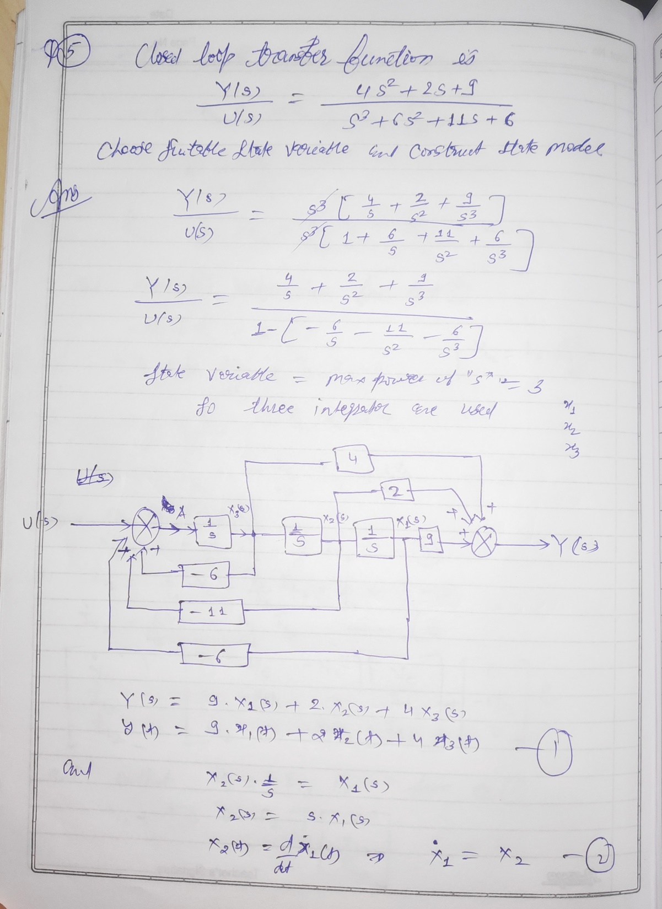

Slide 10
