Slide 1
JAIPUR ENGINEERING COLLEGE AND RESEARCH CENTRE
Year & Sem. – B. Tech 3rd year, Sem.-5th
Subject –Control System
Unit – I
Presented by – Mr. Ashok Singh Chundawat
Designation - Assistant Professor
Department - Electrical Engineering
1

Slide 2
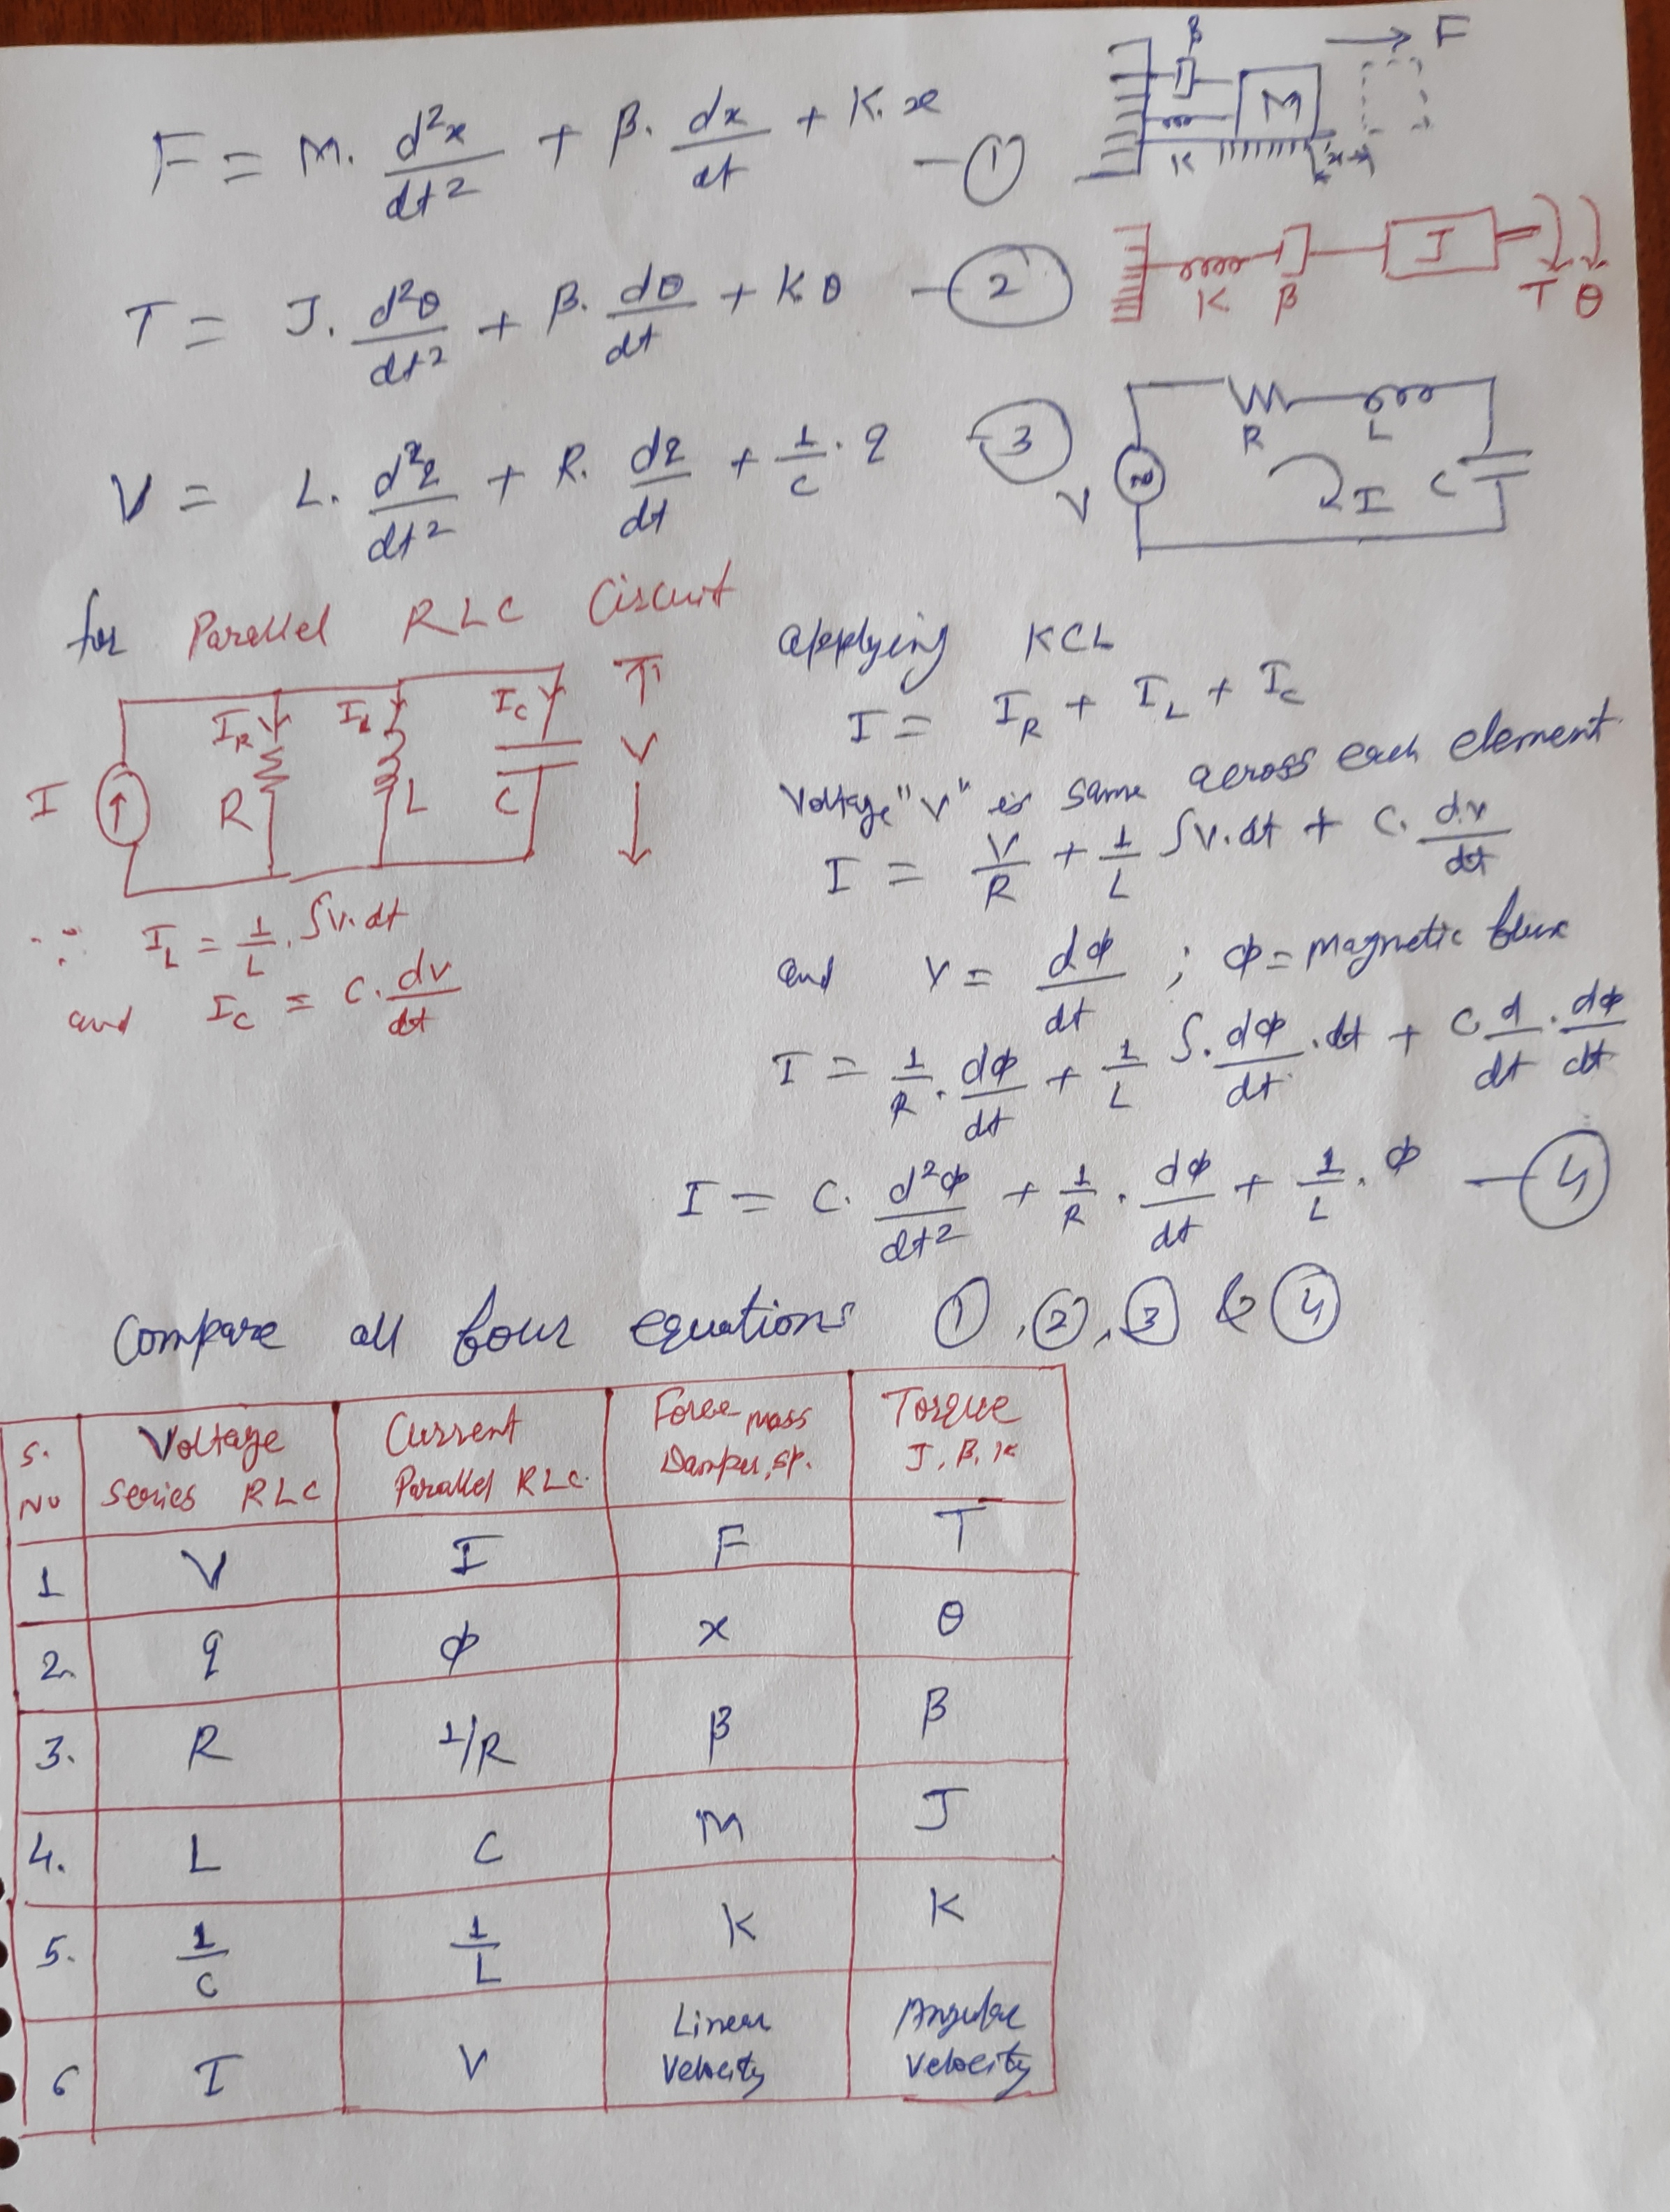

Slide 3
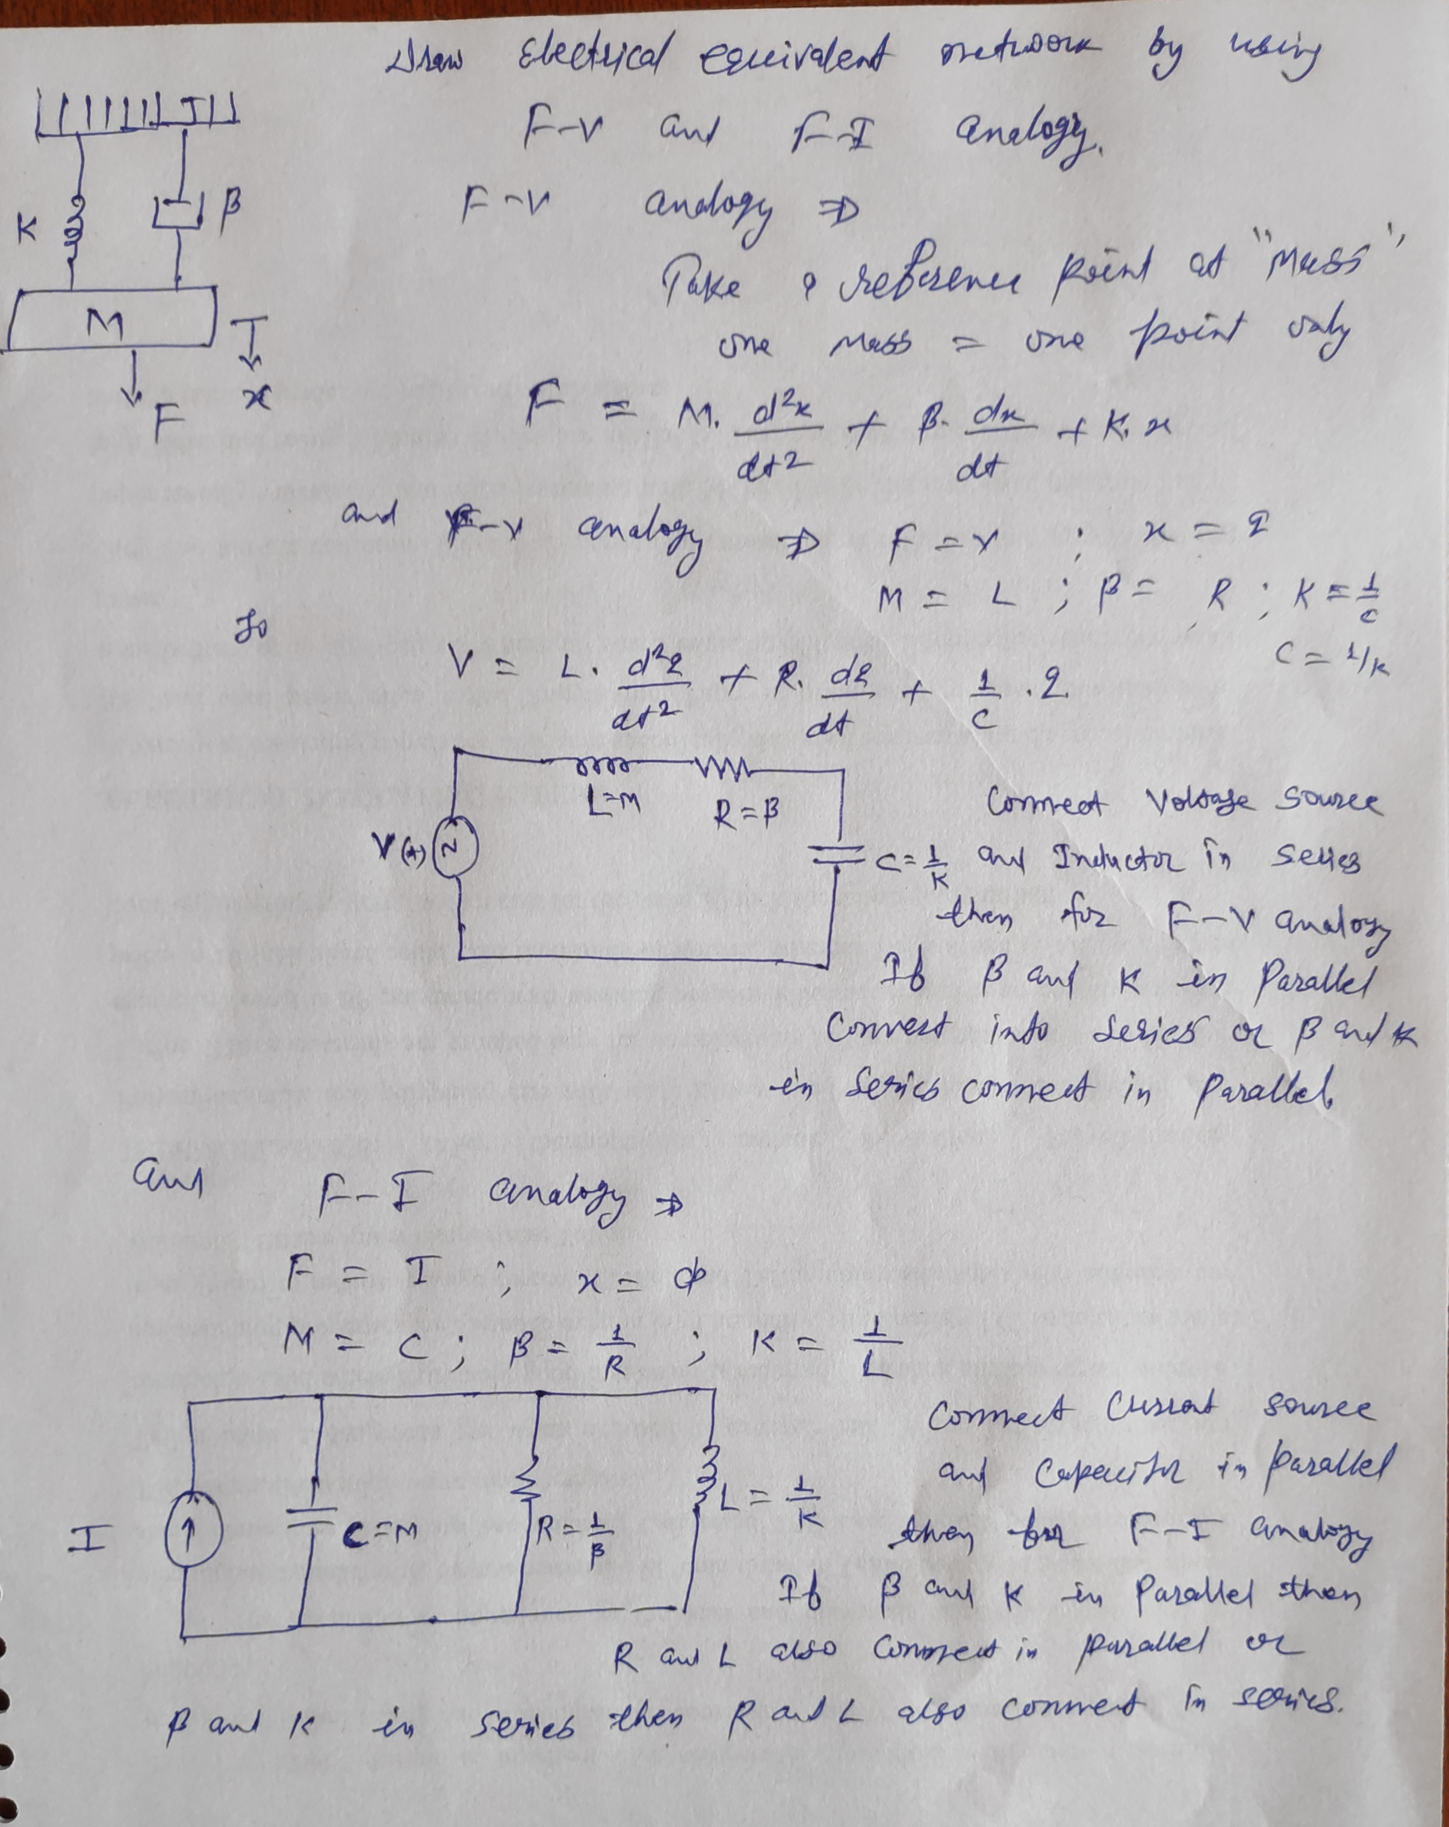

Slide 4
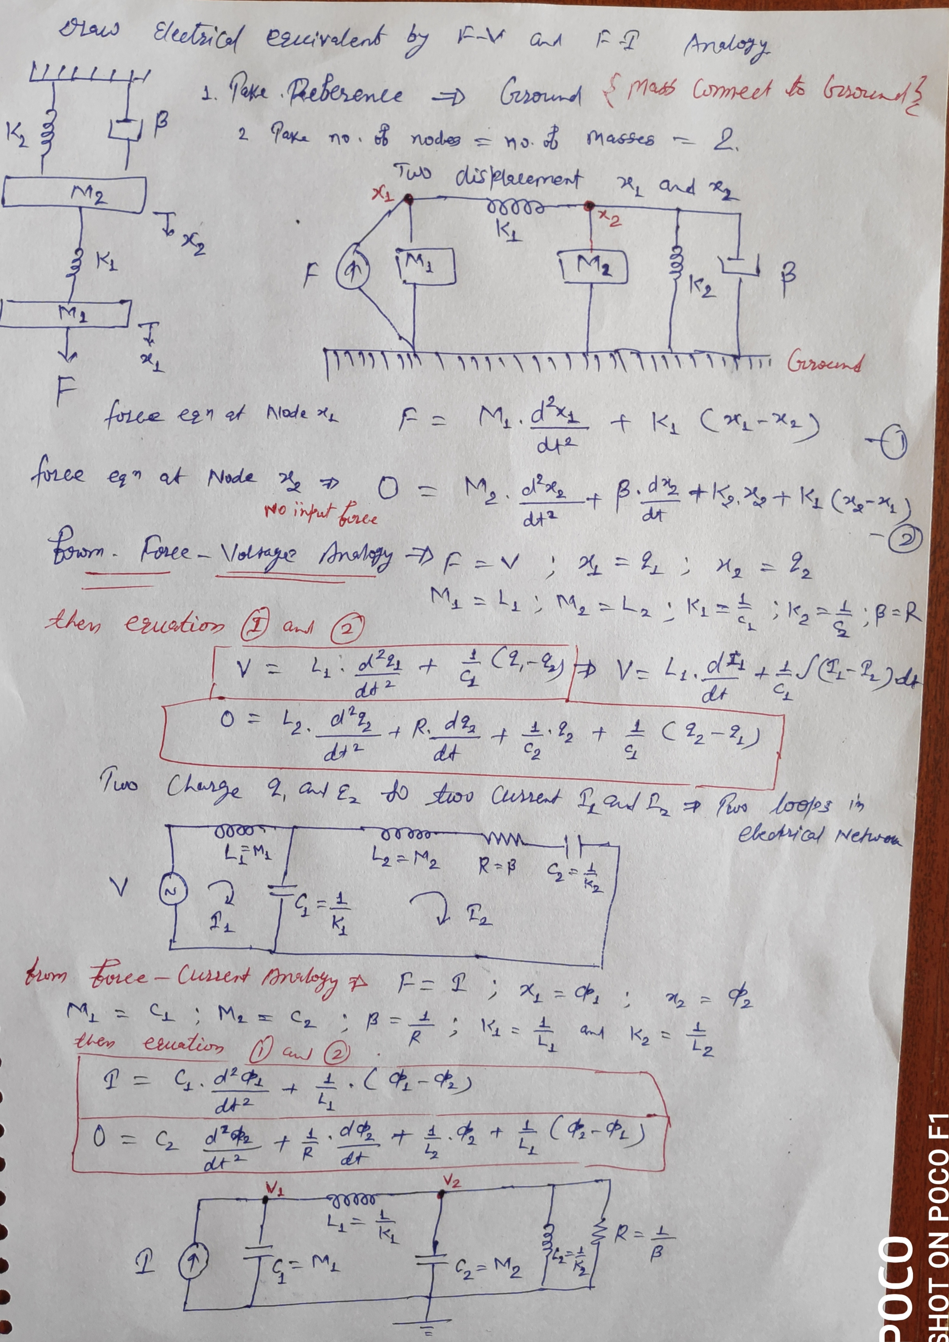

Slide 5
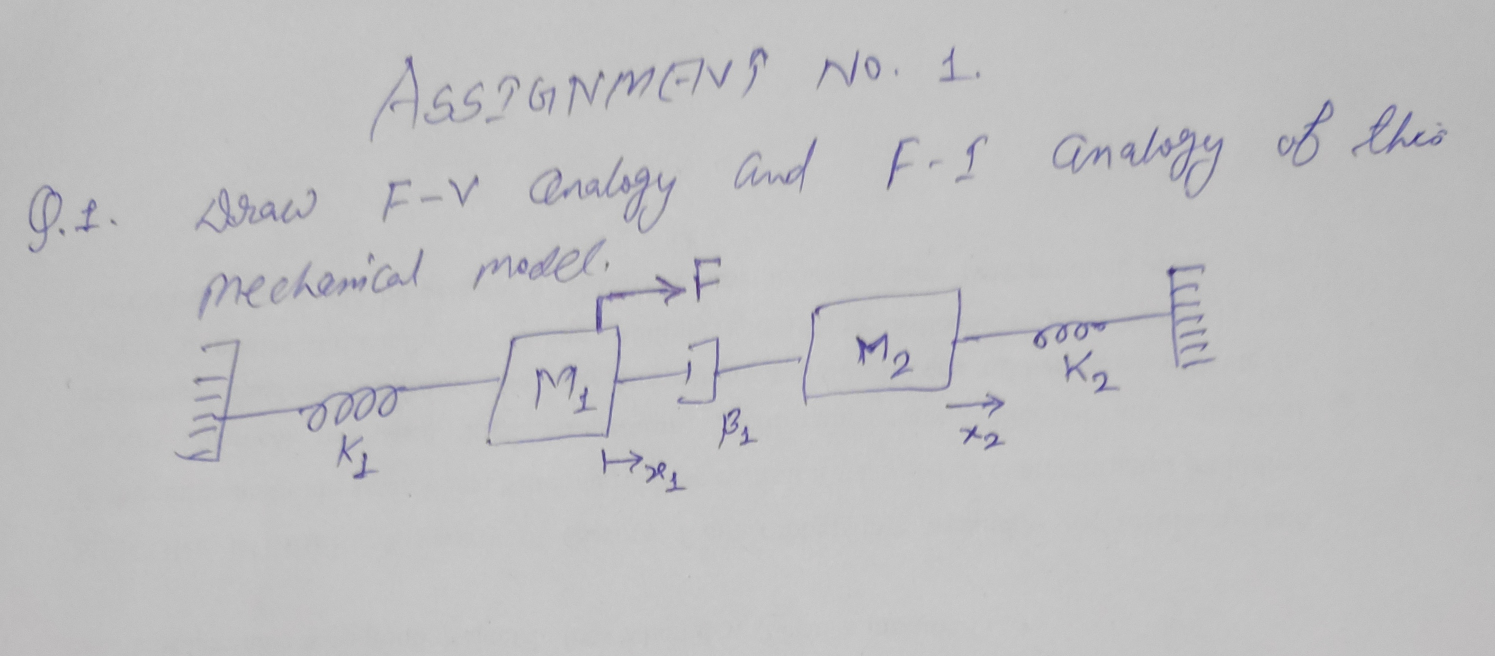

Slide 6
Suggested links from NPTEL & other Platforms:
https://www.youtube.com/watch?v=vVFDm__CdQw&list=PLA74601484F6994D8
https://onlinecourses.nptel.ac.in/noc17_ee12/preview
https://www.javatpoint.com/control-system-tutorial
1

