Slide 1
JAIPUR ENGINEERING COLLEGE
AND RESEARCH CENTRE
Year & Sem – 2nd Year, 3rd Sem
Subject – Technical Communication
Unit – 02
Presented by – Rashmi Kaushik(English & Humanities)

Slide 2
VISION AND MISSION OF INSTITUTE
To become a renowned centre of outcome based learning, and work towards academic, professional, cultural and social enrichment of the lives of individuals and communities.

Slide 3
VISION AND MISSION OF DEPARTMENT
Focus on evaluation of learning outcomes and motivate students to inculcate
research aptitude by project based learning.
Identify, based on informed perception of Indian, regional and global needs, the
areas of focus and provide platform to gain knowledge and solutions.
Offer opportunities for interaction between academia and industry.
Develop human potential to its fullest extent so that intellectually capable and
imaginatively gifted leaders may emerge.

Slide 4
Course Objective
CO1: able to express themselves better in technical writing by understanding the concept, style and methodology used in Technical communication.
CO2: able to pursue higher studies by working on all aspects of English Language and also develop a better understanding of process and design of technical texts.
CO3: able to get an in depth knowledge of technical communication used in professional life by getting to know all the forms and aspects of Technical Communication.

Slide 5
Unit -2
Comprehension of Technical Materials/Texts and Information Design & development-
Reading of technical texts, Reading and comprehending instructions and technical manuals, Interpreting and summarizing technical texts, Note-making. Introduction of different kinds of technical documents, Information collection, factors affecting information and document design, Strategies for organization, Information design and writing for print and online media.

Slide 6
Reading comprehension
For any success of any organisation it is very
It is important that the employees should have good reading and writing skills as they have to read a lot of documents related to their work so every employee should have good comprehension skills .

Slide 7
The ways to work on comprehension skills are :-
Read a lot and read on variety you should not limit yourself to a particular choice of books but it should be reading of everything .
Read the whole books if possible or try to read as a whole ie if you are reading read in a stretch the entire text or the entire book .
Try to jot down the words which you found are difficult and try to search for the meanings and use it in your daily conversation which will enhance your vocabulary .
After reading try to recall and make note of the important things in points
Frame some questions related to what you read or heard someone in the video or read it in text and try to frame questions and ask yourself .

Slide 8
Techniques of good comprehension
To master your reading skills work on these factors
Skimming and scanning
Non verbal signals
Structure of texts
Structure of paragraphs
Punctuation
Summarizing

Slide 9
Skimming and Scanning
It is just like reading without understanding through its meaning and details
The following should be noted while skimming
The audience and purpose of writing the text.
The audience can be a layman , educated professionals, or mixed category .
The text is formal or informal ie whether it is a report , brochure or news letter

Slide 10
Summarizing
Summarizing plays a vital role in Technical writing and technical documents it is all about to be concise up to the point and highlight the main content to de delivered or the aim and objective to be achieved from your clients , sales team and logistics and so on . The main purpose of summarizing is to make the idea clear and reachable .

Slide 11
Points to keep in mind while summarizing in writing stage
Steps are as follows:-
Read and reread then revise the content till you get the main idea to be delivered .
Prepare a draft and organize : Preparing a rough draft and organizing is very important factor which should be kept in mind before writing a technical document see if it is complete? And that it contains all important details? It should contain all relevant details needed by the original text?
Edit your Text : While writing or editing we have to check twice thrice that all details flow in smoothly together. The sentences written and the idea should be clear, concise, correct and coherent? If they require decoding that should be done very carefully . The transitions effectively indicate the relationships between ideas? The following should be focused that How effectively you have introduced, developed and ended?
Proof read: Check for Technical errors (fonts, spelling, punctuation, terms and subject verb agreement ), and editing , typing errors and ,many more like of grammar and usage errors often jargons , words and many others .

Slide 12
Note making
Note making is a important technique that should be Note-taking (sometimes written as note taking or note taking) is the practice of recording information captured from another source. By taking notes, the writer records the essence of the information, freeing their mind from having to recall everything.^{[1]} Notes are commonly drawn from a transient source, such as an oral discussion at a meeting, or a lecture (notes of a meeting are usually called minutes), in which case the notes may be the only record of the event.

Slide 13
Some formal methods :-
Outline /linear method :-divided your content into two main idea corresponding idea or subsidiary . (Bullets )
Sentence / categorical method
Schematic /mapping method –circles , blocks and arrows .
Whether you contribute to intense marketing meetings or you’re tasked with recording official board or committee meetings, taking effective meeting notes or minutes can be elevated to an art form, changing the dynamic and success factor of any organization.

Slide 14
Sentence method
There is a boom of technology in India economy due to liberalization.
It is based on strong agriculture and industry.
Schematic /mapping method
-Represent the main idea in the centre of the box /circle.
-depict the subordinate idea as though they are radiating from the central image .
- Drawn branches and connected with nodal structure.

Slide 15
Note the information noted is simply a draft in your own words to capture the entire information at one place note making is not just about writing down everything you hear or read. It is a process of recalling .
Making notes helps you to:
Remember and quote the exact points and data.
Highlight and focus on the key ideas.
Review and revise before finalizing .

Slide 16
Example note making
[Company]/[Department Name]
Meeting Minutes
[Date], venue, time .
I. Call to order
Facilitator Name called to order the regular meeting of the Organization/Committee Name at the time on date at location.
II. Roll call
Secretary Name conducted a roll call. The following persons were present: attendee names
III. Approval of minutes from the last meeting
Secretary Name read the minutes from the last meeting. The minutes were approved as read.
IIII. Open issues
a) Open issue/summary of the discussion
b) Open issue/summary of the discussion
c) Open issue/summary of the discussion
V. New business
a) New business/summary of the discussion
b) New business/summary of the discussion
c) New business/summary of the discussion
VI. Adjournment
Facilitator Name adjourned the meeting at the time.
Minutes submitted by: Name
Minutes approved by: Name

Slide 17
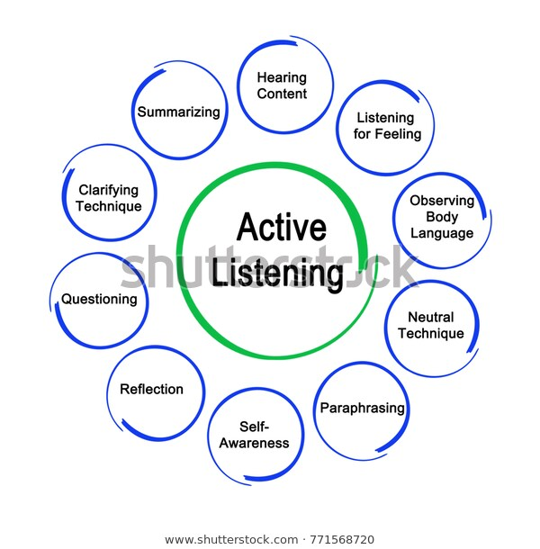
Strategies for writing and designing collection of data listening

Slide 18
Summary
Strategies for writing and designing collection of data all depends on the information , persuasion and satisfying our audiences with the best possible ways, it is a effective part of our communication.
Planning and preparation, framing , delivering use of language , body language , voice modulation and the aids used are the a min factors which will definitely work out to give the best of the results if worked out properly .
while planning the target audience the mode and the message should be kept in mind to get the best results , reaserls can add stars to your presentation or communication.
Next step is collecting sufficient material that can also add to the supporting material for the presentation .
Any communication would be best if we keep in mind the audience, the topic that contains the introduction body and conclusion.
Next is delivery of the data through mode of presentation that would again include attention to verbal aids , non verbal aids and visual aids. The main aim to present the things with a wow factor that needs confidence .with confidence , reaserals we will make wonders .

Slide 19
Bibliography
https://bharatgrouponline.com/10-Essential-Things-to-Know-Before-Making-Your-PPT-Presentation-for-Business.php
Technical Communication Principles And Practices . Third edition , Meenakshi Raman, Sangeeta Sharma

