Slide 1
JAIPUR ENGINEERING COLLEGE
AND RESEARCH CENTRE
Year & Sem – 2nd Year, 3rd Sem
Subject – Technical Communication
Unit – 01
Presented by – Rashmi Kaushik (English & Humanities)

Slide 2
VISION AND MISSION OF INSTITUTE
To become a renowned centre of outcome based learning, and work towards academic, professional, cultural and social enrichment of the lives of individuals and communities.

Slide 3
VISION AND MISSION OF DEPARTMENT
Focus on evaluation of learning outcomes and motivate students to inculcate
research aptitude by project based learning.
Identify, based on informed perception of Indian, regional and global needs, the
areas of focus and provide platform to gain knowledge and solutions.
Offer opportunities for interaction between academia and industry.
Develop human potential to its fullest extent so that intellectually capable and
imaginatively gifted leaders may emerge.

Slide 4
Course Objective
CO1: able to express themselves better in technical writing by understanding the concept, style and methodology used in Technical communication.
CO2: able to pursue higher studies by working on all aspects of English Language and also develop a better understanding of process and design of technical texts.
CO3: able to get an in depth knowledge of technical communication used in professional life by getting to know all the forms and aspects of Technical Communication.

Slide 5
TECHNICAL COMMUNICATION

Slide 6
Introduction
Let’s start

Slide 7
Introduction
Technical Communication is a process of communication that help users to accomplish a defined goal or task . The main purpose is to give a specific information related to some particular task. Technical communication can be either written or verbal communication that can help users to communicate on their specialized topics to accomplish a defined goal or task. It is helpful to assist users who need specific information on completing tasks, using products, operating equipment, and so on.

Slide 8
Technical communication and General communication
Is there any difference ?

Slide 9
What’s the difference between technical communication and General Communication
Technical Communication
1. It has fixed technical message .
2 . It is always formal.
3 It has a set pattern.
4 it can be verbal or non verbal .
5 The audience are fixed.
6 It involves reports ,graphs and pie charts and proper data.

Slide 10
What’s the difference between technical communication and General Communication
General communication
1. Contains a informal message.
2. Informal style and approach.
3. No fixed pattern of communication .
4. It is non verbal .
5 . Audience are varied .
6 it has no fixed technical term(vocabulary ).

Slide 11
Characteristics of Technical communication.
It addresses specific audience or particular group.
It showcases the organisation aims and objectives.
It is produced collaboratively
It is represented in form of words and images.
It is also a replica of culture of a particular organisation .

Slide 12
Things to be kept in mind
The thing we should always have in mind is the Audience
Technical communication usually takes place among professionals in their field and they discuss on some on some specific project on some guidelines , The technical document should be such Firstly in which the reader should get the organized information that can lead to quick understanding along with decision making . Secondly It should be fruitful in inviting other ventures.

Slide 13
Note
How familiar are readers with the terms used by the writer .
In what best way the terms used can be explained?

Slide 14
Technical document
Let’s talk about types….

Slide 15
Types of Technical Documents :-
We will only see how technical communication works in a organization and what are the forms of technical communication .
Memos, Graphics, Letters, Fliers, Reports, Newsletters, Presentations, Web pages, Brochures, Proposals, Instructions, Reviews, Press Releases, Catalogs, Advertisements, Handbooks, Business plans, Policies and procedures, specifications, instructions, style guides, agendas and so forth.
More or frequently used :-
It includes all types of notices , minutes of meeting , circulars quarterly and annually reports and manuals.
Emails , ,Web pages, and even social media.

Slide 16
Engineers and good professionals should have the following skills if they have the below skills then only they can make their communication effective…

Slide 17
Clear and concise to help people get the main idea quickly.
Technical terms and technical aids are used. (specific vocabulary, graphics , table , diagrams , maps and charts , )
Focus on a particular audience or type of work.
Easily-identified thesis statement.
Contains accurate information .

Slide 18
Features of
Technical communication
Let’s talk about it….

Slide 19
Let’s review some user experiences
Reader oriented
Approachable & efficient
Delievered in hard copy or soft copy
Often produced by groups

Slide 20
Importance of
Technical communication
Let’s discuss….

Slide 21
Importance
It is the heart and soul of the organization as it s helpful in recruiting , functioning , decision-making and coordinating whether it is business enterprise, administrative ,academic organization, or medical firm or IT industry.
Good qualitative information will always help a company to grow.
Technical communication is a field that makes our life easier and more productive

Slide 22
Technical Communication Skills
Technical Communication Skills
Listening
Reading
Speaking
Writing

Slide 23
LISTENING
Listening skills are probably one of the most important language skills that you need in order to be successful in your academic and professional pursuits.

Slide 24
LISTENING
The following table will show various types of listening skills under three categories,
General | Academic: Listening to/ during | Professional:
Casual conversation • Formal conversation • Social interaction • Public speeches • Announcements • Radio • Television programmes • News reports | • Lectures • Tutorials and practical • Seminars and workshops • Technical presentations • Academic discussions • Academic interactions • Viva voce | Professional interactions • Meetings • Conferences • Interviews • Professional discussions • Professional presentations • Teleconferencing • videoconferencing

Slide 25
SPEAKING
Speaking skills are also important for a person’s professional survival and growth. A person requires effective oral communication skills in several formal communicative situations.
Oral communication not only makes professional interaction possible, it develops information and understanding essential for decision making in meetings, conferences and other similar oral communicative skills.
As oral communication is a tool of professional and business interactions, one should be able to use it fluently, effectively and confidently.

Slide 26
SPEAKING
General | Academic: Listening to/ during | Professional:
Casual conversation • Casual conversation • Formal conversation • Social interaction • Public speeches • Small talks on local topics • Negotiation meanings in social situations • Conversation tasks in a given social milieu | • Lectures • Tutorials and practical • Seminars and workshops • Technical presentations • Academic discussions • Academic interactions • Viva voce • Oral interactions • Oral reports | • Professional interactions • Oral reports • Oral presentations • Group discussions/ meetings • Conferences • Workshops • Interviews • Professional discussions • Teleconferencing • video conferencing

Slide 27
READING
Like listening and speaking, reading is also important for effective communication. You need effective reading skills as you may be required to read several kinds of reading material for different general, academic and professional purposes.

Slide 28
READING
The following table includes various reading skills,
General | Academic: Listening to/ during | Professional:
• Newspapers • Magazines • Journals • Novels • Stories • Articles • Personal letters • Emails • General books • Entertainment literature | • Text books • Journals • Research papers • Scientific articles • Classroom notes • Lecture notes • Thesis • Dissertations • Abstracts | • Business reports • Proposals • Business letters • Memos • Email messages • Notes & notices • Circulars • Promotional bulletins • Catalogues • Instruction manuals • Corporate brouchers

Slide 29
WRITING
The significance of writing cannot be overemphasised because writing is so important for students of all kinds and professionals in all fields. Both professionals and students need excellent writing skills to survive and excel in their pursuits.

Slide 30
WRITING
The following table includes various writing skills,
General | Academic: Listening to/ during | Professional:
• Personal letters • Personal e-mail messages • Notes • Comments • General articles | • Examination answers • Project reports • Lab reports • Synopsis • Thesis • Dissertations • Abstracts • Research papers • Scientific articles • Classroom notes • Lecture notes | • technical reports • Industrial reports • Project proposals • Business proposals • Business letters • Electronic mailing • Memos, Notices • Agenda, Minutes • Technical abstracts • Job applications • Resumes

Slide 31
WRITING SKILLS
Writing is a way to express human emotions, knowledge. Every writer has his/her own style of writing, which reflects his personality. However, each piece of writing requires different style and tone which can decide on the basis of the content of the writing. No matter what you write it is very important for you to stay focus on your purpose of writing. There are mainly four categories in which all different type of writing fall, which are narrative writing, descriptive writing, expository writing, and persuasive writing.

Slide 32
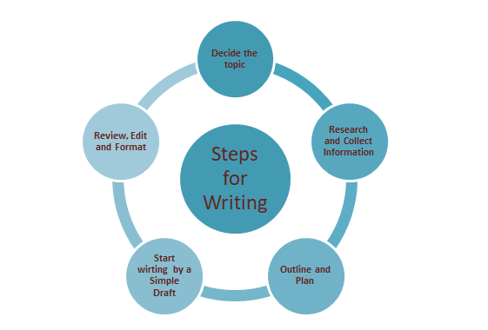

Slide 33
Steps To be followed
Clarity and integrity of the message .
Analyse and simplify the content .
Main purpose and objective(message) should be clear .
Language should be familiar with the parties.
A medium should be appropriate to convey message .
Feed back of the employees should be taken.

Slide 34
The writing process :-
Prewriting
You’re ready to start writing. So why has that blank page been staring back at you for the past hour? Prewriting identifies everything you need to do before you sit down to start your rough draft.
Find Your Idea Ideas are all around you. You might draw inspiration from a routine, an everyday situation or a childhood memory. Alternatively, keep a notebook specifically devoted to catching your ideas as they come to you. Your own imagination is the only limit to finding your source of inspiration.
Build On Your Idea Two of the most popular methods of fleshing out your idea are free writing and brainstorming. Free writing means writing every idea that comes into your head. Do not stop to edit your mistakes, just let the ideas flow. Or, try brainstorming. If you're on a computer, try a manual process first to help you visualize your narrative: write your idea in the center of the page and work outwards in all of the different directions you can take your story.
Plan and Structure Piecing the puzzle together comes next. It's time to sort through your ideas and choose which ones you will use to form your story.

Slide 35
Revision:-
Your story can change a great deal during this stage. When revising their work, many writers naturally adopt the A.R.R.R. approach:
Add: The average novel has between 60,000 and 100,000 words. Does your book have enough words to be considered a novel? Have you given your readers all the information they need to make sense of your story? If not, go back to your notebook that you kept for additional scenes and any additional details.
Rearrange: Consider the flow, pacing and sequencing of your story. Would the plot be better served if some of the events occur in a different order?
Remove: After making additions to your story, how is your word count now? Are your readers experiencing information overload? You may need to eliminate passages that don’t quite fit.
Replace: The most effective way to revise your work is to ask for a second opinion. Do you need more vivid details to help clarify your work? Is one scene contradicting another? Ask friends or fellow writers to take a look and give you feedback, and if something isn’t working rewrite it and replace it.

Slide 36
Editing
You have overhauled your story. It’s time to fine tune your manuscript line by line. Check for repetition, clarity, grammar, spelling and punctuation. Editing is an extremely detailed process and its best when performed by a professional. You can hire your own editor or utilized the editing services available through LifeRich Publishing. Nobody wants to read a book that is full of mistakes, and they certainly won’t buy a book that is riddled with them.
Publishing
You now have a completed manuscript ready to publish.

Slide 37
Types of writing
Narrative writing :-
In narrative writing, the writer develops a lot of fictional character and tell what happened to them in the form of a story. Mostly, stories are narrated from the point of view of one character, which is called first-person narration. All novels, poetry, short stories, biographies, and autobiographies fall under this category. A whole narrative writing is an answer to the simple and small question “what happened then?”. Narrative writing always has a person who tells a story or an event from his / her point of view. It has characters who carry the story. It has a dialogue.

Slide 38
Expository writing : (Information writing )
This type of writing styles is commonly found in textbooks. This types of writing is used to explain things, people, place, relationship or an idea. Expository writing is used to provide information about various things, therefore, it is sometimes also referred to as information writing. In this types of writing, the author provides factual information about a certain subject rather than voicing his / her own opinion.
This types of writing is built on facts, statics, reasons, laws and principle, cause, effects, and examples. As this information written in this types of writing is factual, therefore, it is written without emotions and from the point of view of a third person. Self-reference can be used in expository writing but to give an external description and explanation and not to explain personal feelings and opinions.

Slide 39
Persuasive writing
The main purpose of this type of writing is to persuade its audience about something. It includes opinion and a personal point of view of the author. The author should have known about the other side of the topic so that he can present the strongest information to counter it. He/she should be able to develop a well-defined and debatable topic.
Sometimes the author writes about the other side of the opposing point and refute them and give a strong explanation for why he/she does it. Even though persuasive writing includes a personal opinion of the author, it is still written objectively. Persuasive writing usually uses emotional appeal to win the heart and confidence of readers.

Slide 40
Descriptive writing
It is describing things such as characters, places, events etc. in details. It is like painting a picture in the minds of readers. Descriptive writing is an art of showing something through words. A writer describes everything with respect to all senses. Through words, he tells you how it looks like, feels like, smells like and sounds like. Descriptive writing does the job of connecting the outer world with the inner world.
A writer uses various adjectives and adverbs to make the picture vivid for the reader. Descriptive writing usually written with the point of view of the first person and the context of the writing is emotional and personal. Haruki Murakami, a Japanese writer is famous for his descriptive writing. His books like Kafka on the shore and Norwegian woods are the best samples of his descriptive writing.

Slide 41
REVIEW WRITING :-
Reviewing things has become a trend these days. People review everything like restaurants, food, cosmetic products, books, movies, and even mobile phones and laptops. Tech savvy people read the review of things online before making any purchase. Therefore, it has become so important that many companies pay people to review their products. Review writing is art.
It requires both persuasive writing skills as well as descriptive writing skills.

Slide 42
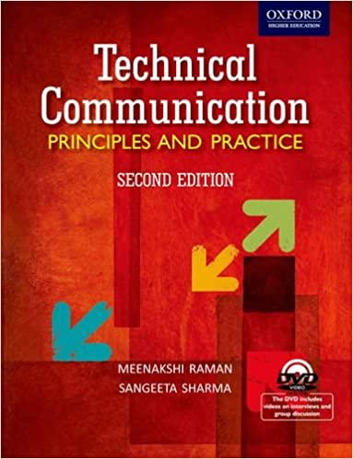
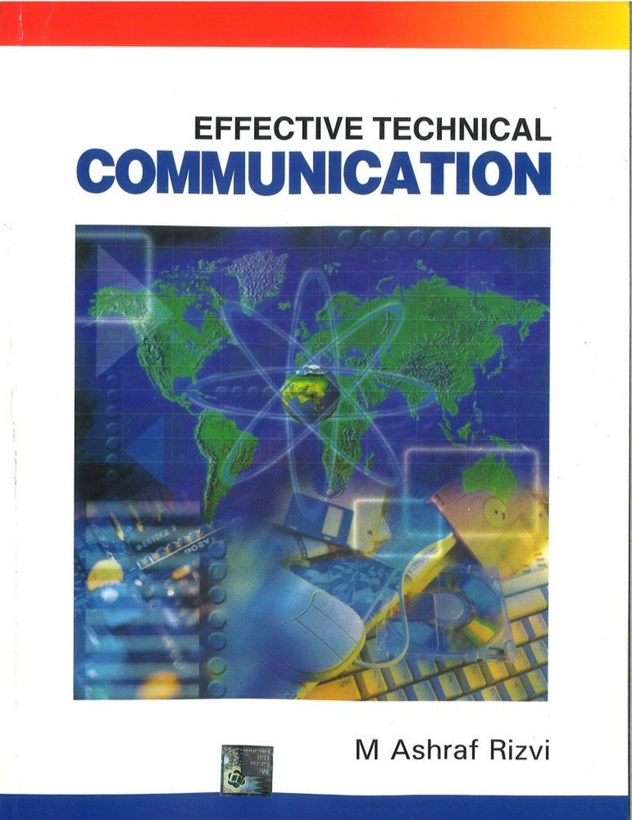
REFERENCES/BIBLOGRAPHY

Slide 43
Thank You!
Any questions?

