Slide 1



JAIPUR ENGINEERING COLLEGE AND RESEARCH CENTRE
Year & Sem – IV year & VII Sem
Subject – Internet of Things &7CS4-01
Unit – V
1

Slide 2
Vision of Computer Science Department
To become renowned Centre of Excellence in Computer Science and Engineering and make competent engineers and professionals with high ethical values prepared for lifelong learning.
Mission of Computer Science Department
M1 - To impart outcome based education for emerging technologies in the field of computer science and engineering.
M2 - To provide opportunities for interaction between academia and industry.
M3 - To provide platform for lifelo learning by accepting the change in technologiesM4 - To develop aptitude of fulfilling social responsibilities.

Slide 3
Course outcomes (CO)
CO1: Understand the revolution of internet in field of cloud, wireless network, embedded system and mobile devices.
CO2: Apply IOT design concepts in various dimensions implementing software and hardware.
CO3: Analyze various M2M and IOT architectures.
CO4: Design and develop various applications in IOT.

Slide 4
Mapping of co & po
Subject | Code | L/T/P | CO | PO1 | PO2 | PO3 | PO4 | PO5 | PO6 | PO7 | PO8 | PO9 | PO10 | PO11 | PO12 | P S O 1 | P S O 2
IOT | 7CS4-01 | L | Understand the revolution of internet in field of cloud, wireless network, embedded system and mobile devices. | H | H | M | M | M | M | - | -- | M | M | M | H | H | H
 |  | L | Apply IOT design concepts in various dimensions implementing software and hardware. | H | H | H | H | H | M | - | -- | L | M | M | H | H | H
 |  | L | Analyze various M2M and IoT architectures. | H | M | M | L | M | M | - | L | M | L | L | H | M | M
 |  | L | Design and develop various applications in IOT. | H | M | H | H | H | M | M | L | H | H | H | H | H | H

Slide 5
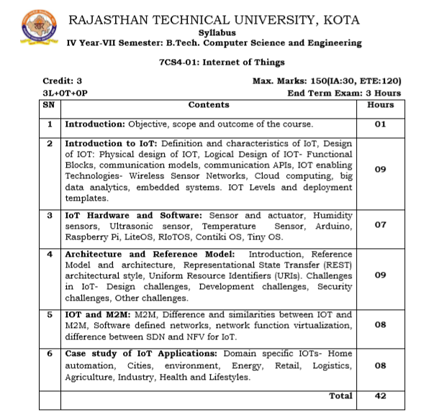
Syllabus

Slide 6
Lecture plan
Unit No./ Total Lecture Reqd. | Topics | Lect. Reqd. | Lect. No.
Unit-I (10) | 1. Introduction to subject and scope | 1 | 1
 | 2. Introduction to learning, Types of learning and Applications | 1 | 2
 | 3. Supervised Learning | 1 | 3
 | 4. Linear Regression Model | 1 | 4
 | 5. Naïve Bayes Classifier | 1 | 5
 | 6. Decision Tree | 1 | 6
 | 7. K-nearest Neighbor | 1 | 7
 | 8. Logistic Regression | 1 | 8
 | 9. Support Vector Machine | 1 | 9
 | 10. Random Forest Algorithm | 1 | 10
Unit-II (7) | 1. IoT sensors | 1 | 11
 | 2. IoT actuators | 1 | 12
 | 3. Humidity sensor | 1 | 13
 | 4. Ultrasonic sensor | 1 | 14
 | 5. Temperature sensor | 1 | 15
 | 6. Arduino and Raspberry Pi | 1 | 16
 | 7. IoT OS | 1 | 17
BC-1 | ARM Processor | 1 | 18

Slide 7
Lecture plan
Unit No./ Total Lecture Reqd. | Topics | Lect. Reqd. | Lect. No.
Unit-III (9) | 1. IoT architecture | 1 | 19
 | 2. Reference model | 1 | 20
 | 3. Representational state transfer (REST) | 1 | 21
 | 4. Uniform resource identifier | 1 | 22
 | 5. Challenges in IoT | 1 | 23
 | 6. Design challenges | 1 | 24
 | 7. Development challenges | 1 | 25
 | 8. Security challenges | 1 | 26
 | 9. Other challenges | 1 | 27
Unit- IV (8) | 1. Machine to Machine vs IoT | 2 | 28
 | 2. Software defined networks | 1 | 29
 | 3. Network function virtualization | 1 | 30
 | 4. Difference between SDN and IoT | 2 | 31
 | 5. Difference between NFV and IoT | 2 | 32
Unit- V (8) | 1. IoT applications | 1 | 33
 | 2. Home automation | 1 | 34
 | 3. Smart cities | 1 | 35
 | 4. Environment and energy | 1 | 36
 | 5. Retail | 1 | 37
 | 6. Logistics | 1 | 38
 | 7. Agriculture and Industries | 1 | 39
 | 8. Health and lifestyle | 1 | 40
BC-2 | IoT Platforms | 1 | 41

Slide 8
Home Automation

Slide 9
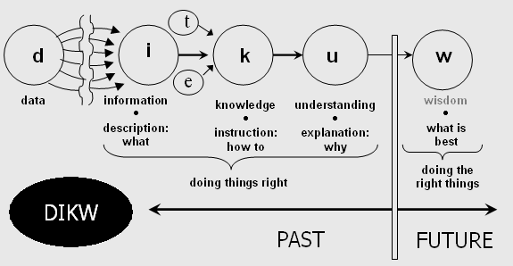
Generate, collect, process and use acquired information to make decisions
    DIKW model
      Information is inferred from data, in the process of answering interrogative questions (e.g., "who", "what", "where", "how many", "when"), thereby making the data useful for "decisions and/or action".
      Knowledge as "synthesis of multiple sources of information over time"
Notes:
There is more to data that meets the eye
E.g. Momentary power of solar boiler based on the rate of temperature increase of fixed volume of water
Shape of power waveform reveals the appliance
Dew point from temperature and humidity
Presence from ping times
If you can’t measure it, you can’t improve it
Example (home scale, imagine on industrial scale)
Power usage
AC compressor heater element consumes ~140W, even when AC is off
TV using 120W in standby mode
Circulation pump UPS consuming 100W in standby mode
Laser printer occasionally using 400W in standby mode to warm up toner
Dishwasher in delayed start mode consumes 150W till program starts
..and many more

Slide 10
Smart objects: Make things that weren’t meant to talk to each other interact smartly
  Phone → Location detection, presence detection → Thermostat
  Doorbell activation → CCTV takes picture→ Email + SMS + Tweet
  Fire Alarm → Email + SMS
  Security System→ CCTV → Email + SMS
  Climate control → presence @ home & weather forecast
  Hot water tank 1 ← → Hot water tank 2 ← → our presence, weather forecast
  Dog→ CCTV + Email
  Weather notifications → email

Slide 11
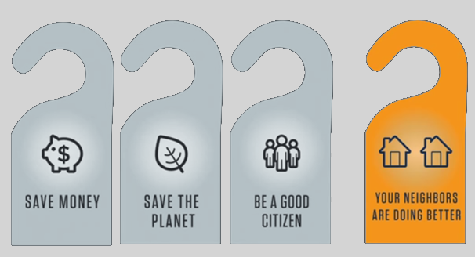
Influence others to reduce their carbon footprint by sharing socially your metrics
Alex Laskey: How behavioral science can lower your energy bill
https://www.youtube.com/watch?v=4cJ08wOqloc
My @iot_house tweets power consumption statistics

Slide 12
Challenges
Global cooperation
  Proprietary and incompatible protocols
  Lack of APIs
  Example: Common external power supply
Technological challenges
  Power usage
  Scalability
  Security
  Communication mechanisms
Ethics, control society, surveillance, consent and data driven life
Notes:
Proprietary and incompatible protocols even from same manufacturer as part of their business model

Slide 13
Overall Architecture
Storage
Visualization, BI
Business logic
Control UI
Logic
M2M
Thing
Interface
Read properties
Protocol
Interface
Protocol
Protocol
Raw
Processed
Set Property
Protocol
Notes:
Data produced by the connected things is acquired, processed and logged; DQ, what data to collect (collecting nothing with great accuracy)
Run on a R/O fs raspberry pi; considering moving to the cloud
As “Things” become increasingly smarter, they can talk directly to M2M layer
It is possible to have multiple interfaces on the same “Thing”, specializing on interfacing with certain its property (AC power, temperature, control)
It is possible that multiple interfaced “Things” have one and the same interface on the M2M end, as long as they use same protocol
Storage: Abstract and treat a “thing” with “interface”. EmonCMS, ThingSpeak, NoSQL; Retrieval of data API;
Visualization: in-built EmonCMS, Thingspeak; collect an relate data for better insight. Actionable analytics.

Slide 14
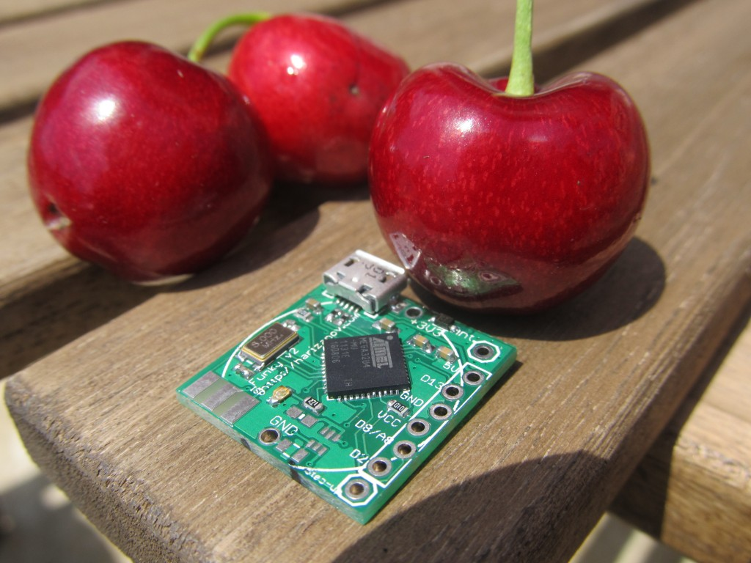
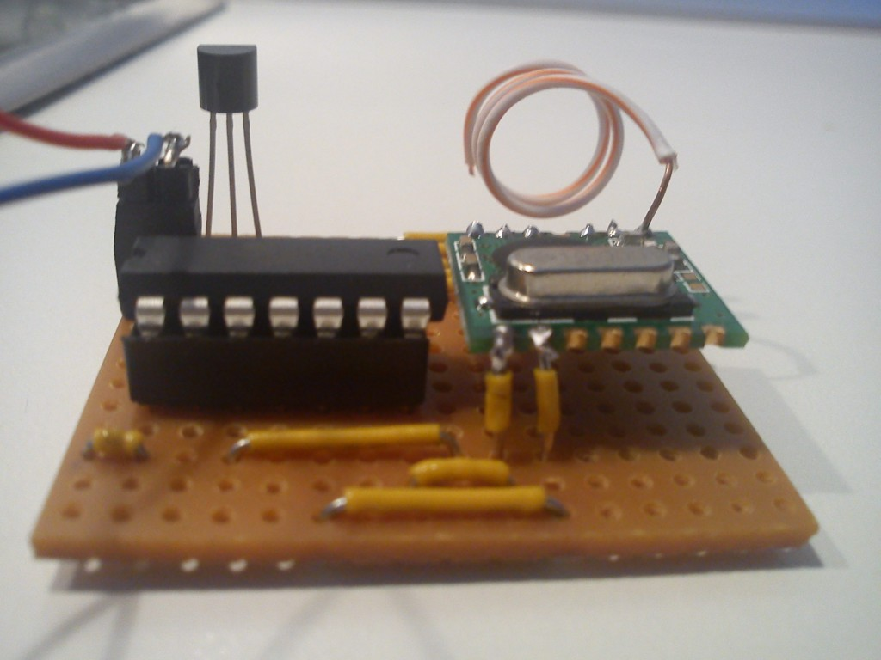
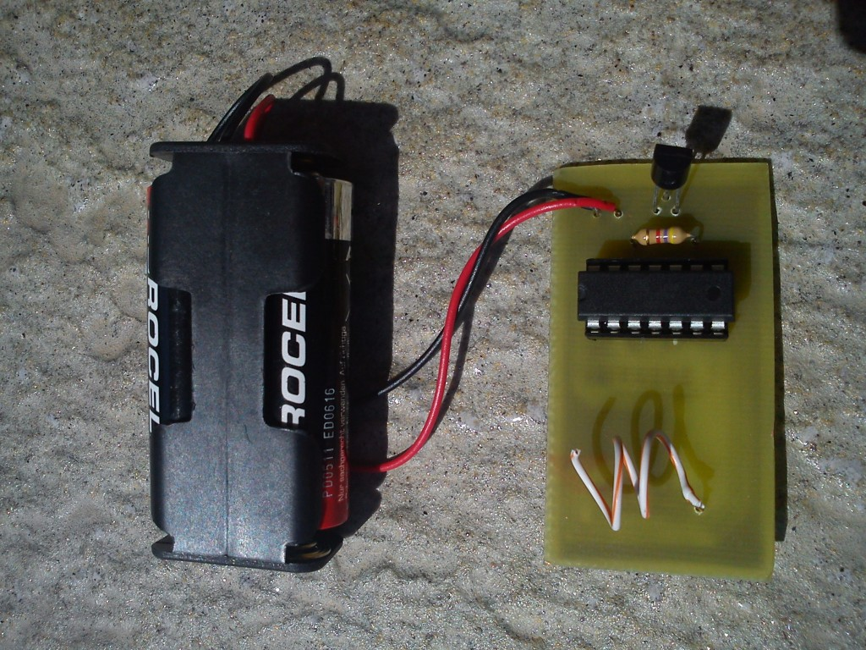
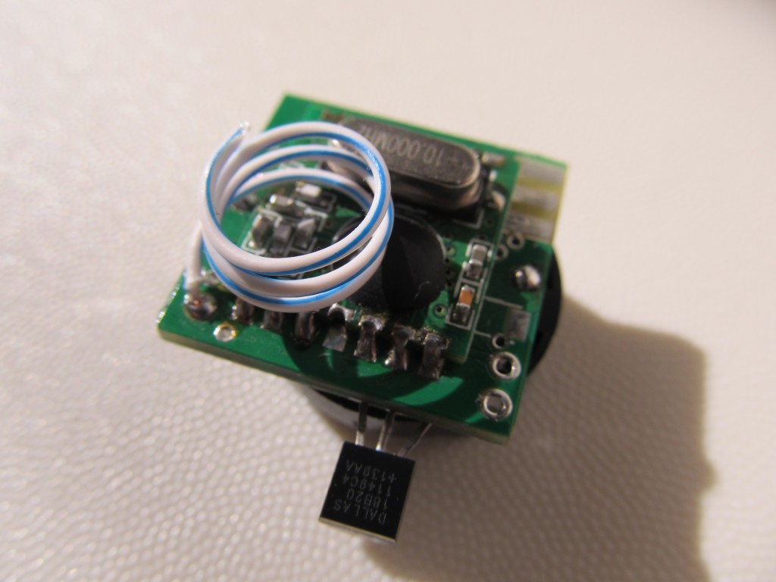
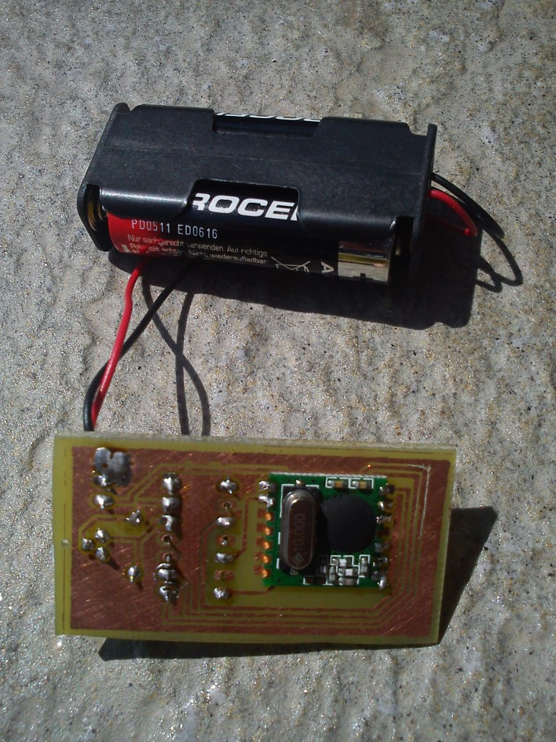
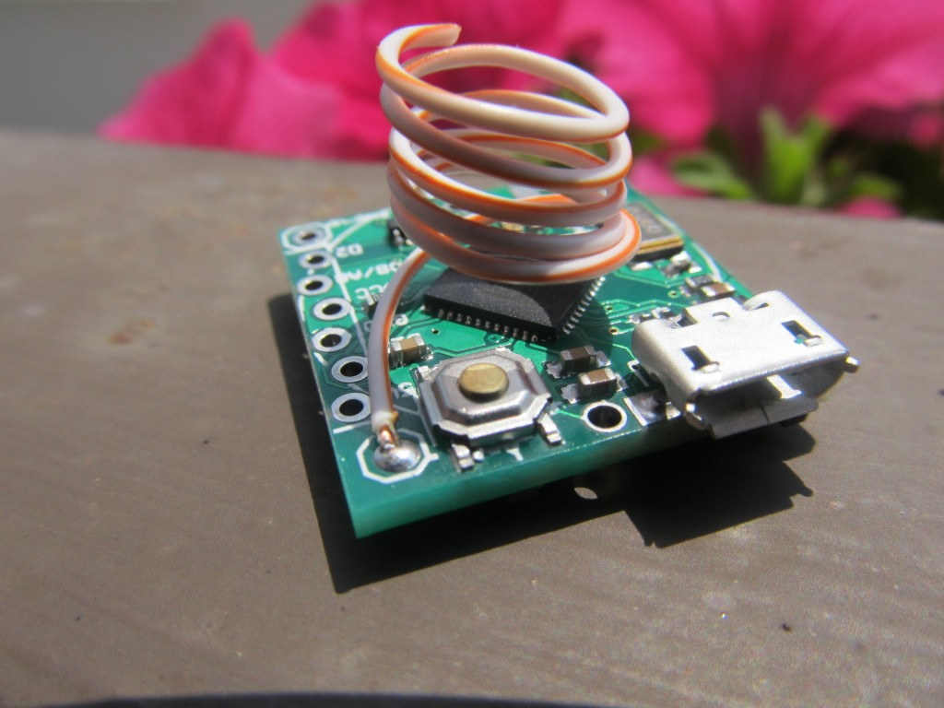
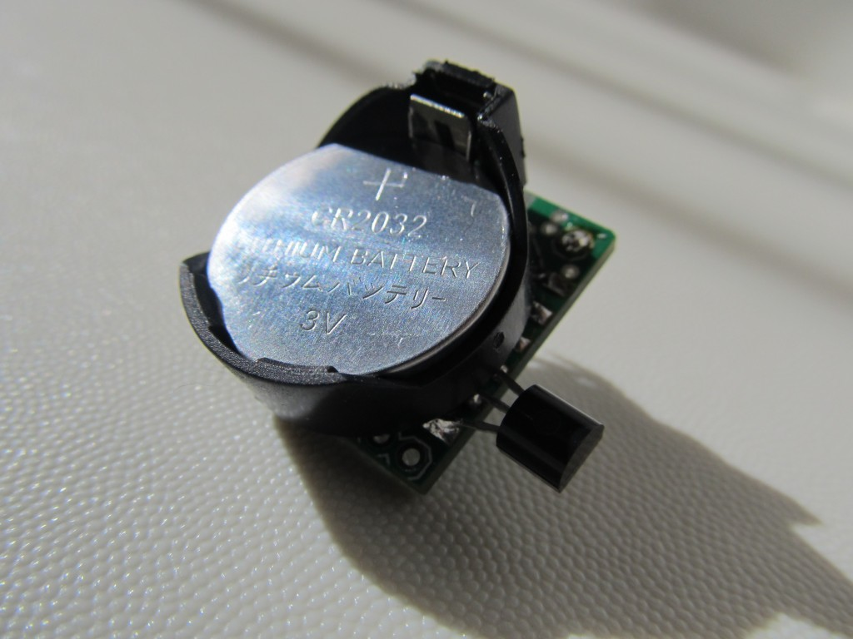
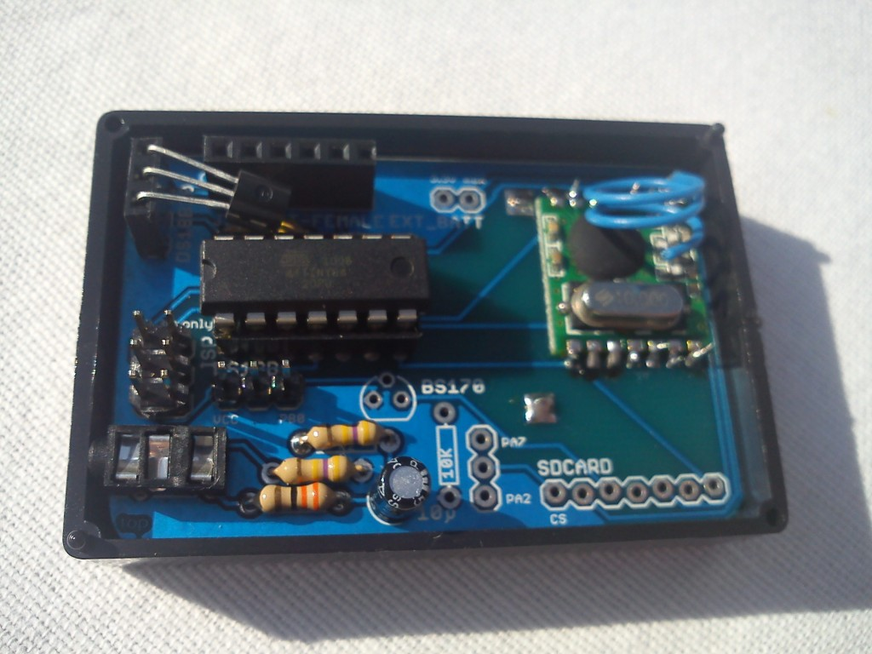
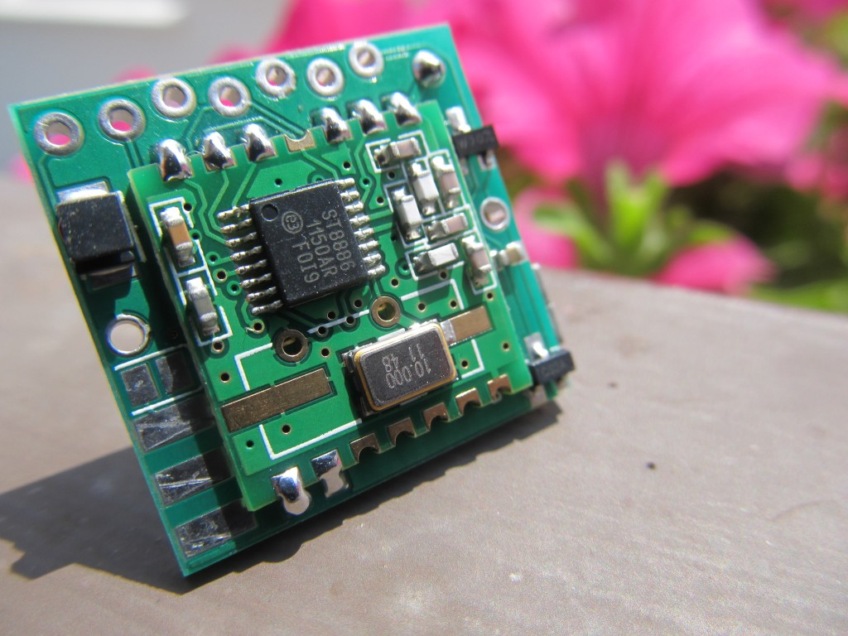
The hardware interface to “things”
The ‘Funky’ project
It is an Arduino-compatible multi purpose micro that is:
  Very small: 20×21.2mm (0.78″x0.83″)
  Very light: 3 grams
  Low power (up to 1 year on coin cell battery)
  Wireless capable (RFM12B transceiver)
Notes:
I’ve created a miniature Arduino compatible clone with wireless connectivity to use as interface to physical objects. The project is open hardware/source.
YAPM,

Slide 15
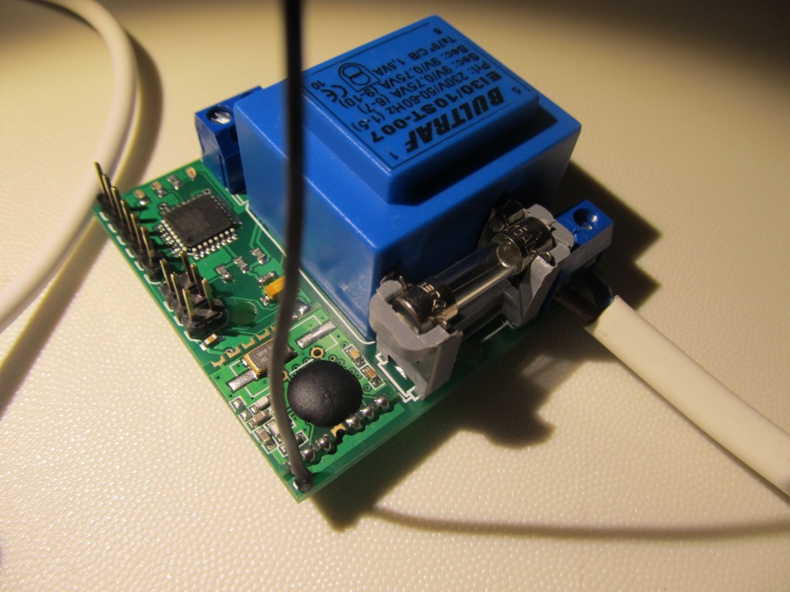
YAPM (Yet Another Power Monitor)
Wireless Power Monitor project

Slide 16
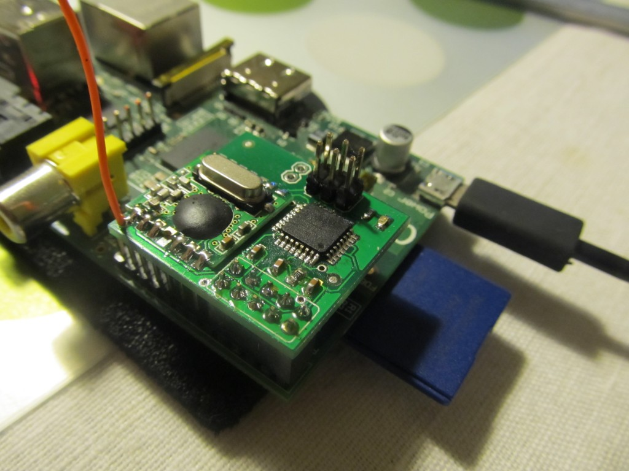
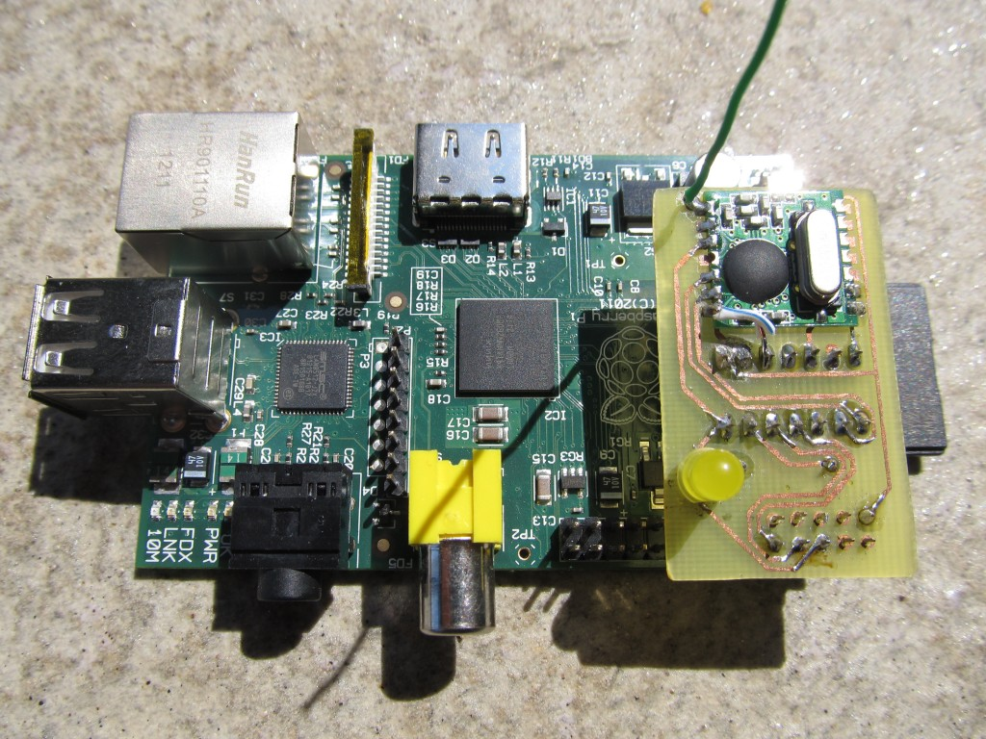
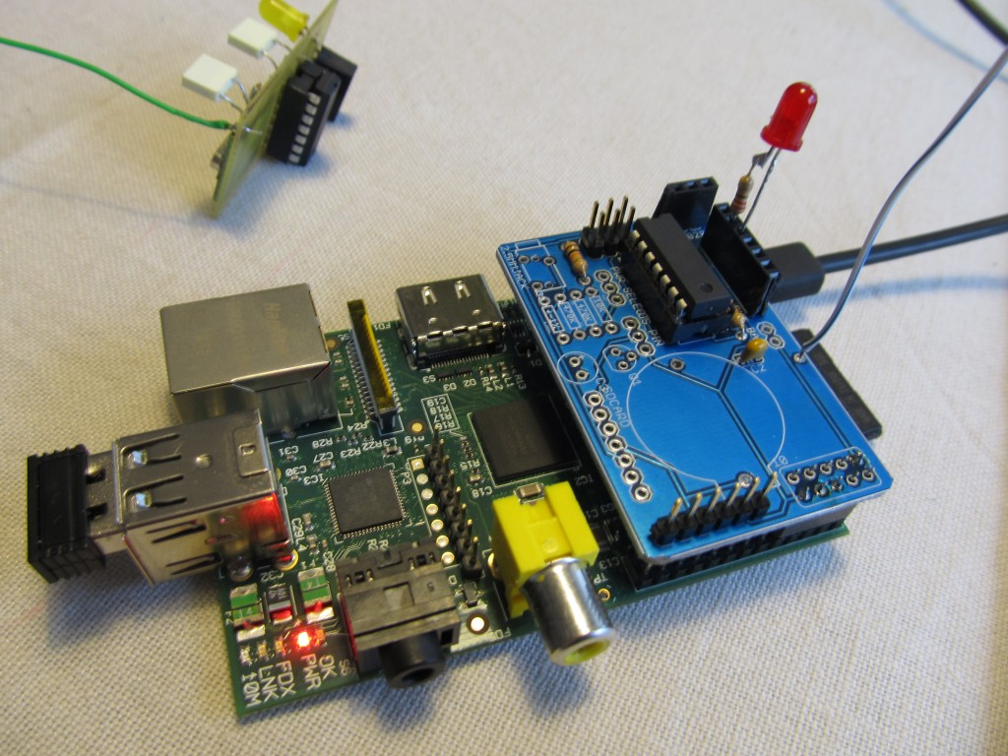
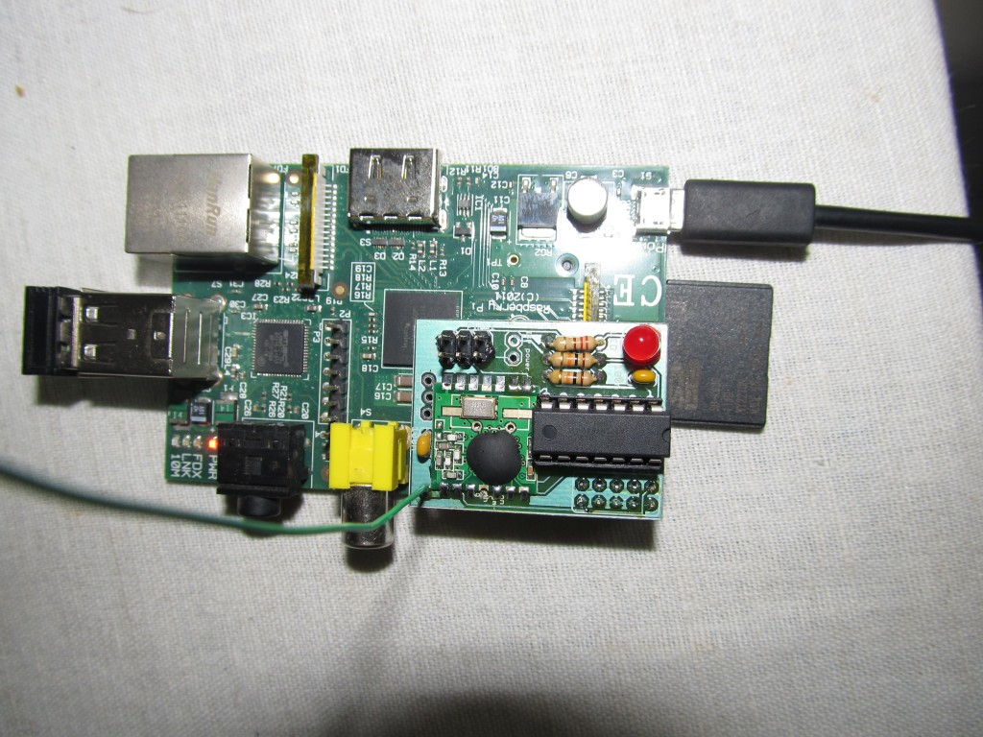
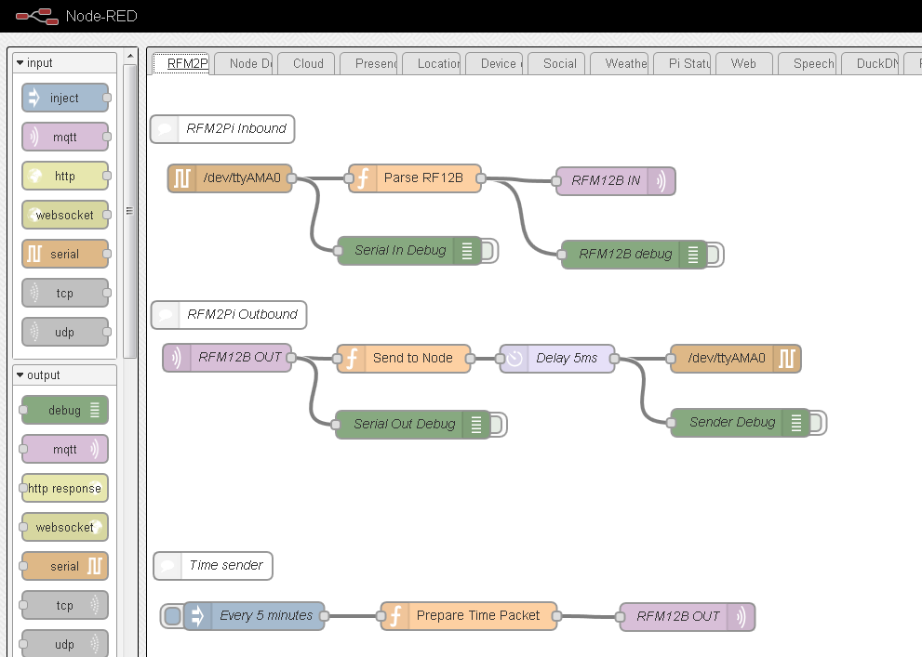
Receiver module
The ‘RFM2Pi’ project
  It is an Arduino-compatible board that acts as a wireless bridge between wireless remote nodes and the M2M layer

Slide 17
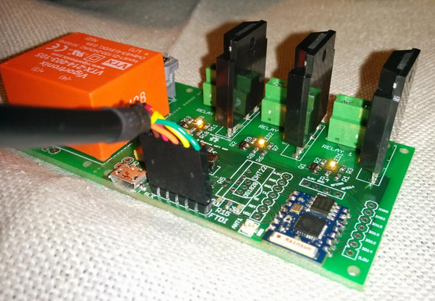
ESP8266 WiFi relay/thermostat project

Slide 18
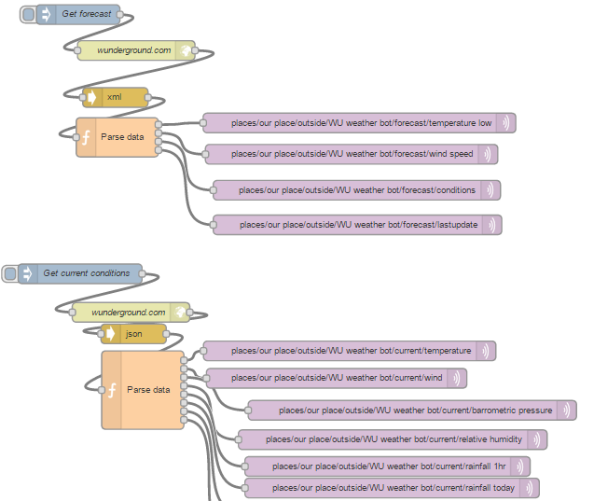
Software Interface example
NodeRED weather forecast/current conditions

Slide 19
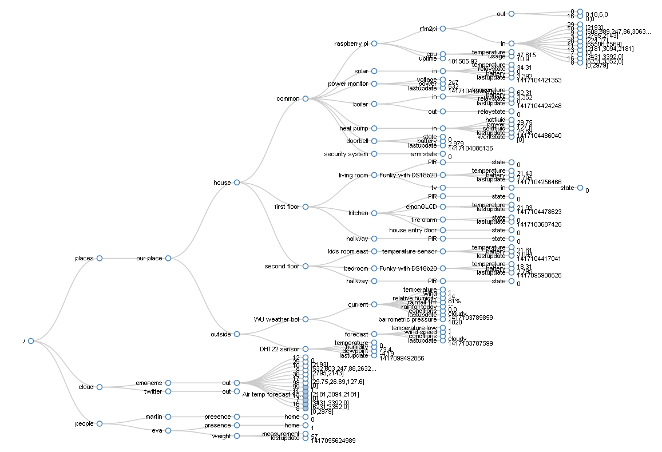
Machine to Machine
Using mosquitto MQTT broker, extremely lightweight publish/subscribe messaging transport protocol
My MQTT topic tree structure:

Slide 20
Business logic layer
Using Node-RED
  Very visual, drag-and-connect
  Encapsulates all logic in single JSON file
  Examples
    Remote sensor data processing
    Speech recognition/generation
    Control UI
    Dynamic DNS updater
Notes:
Speech NR demo

Slide 21
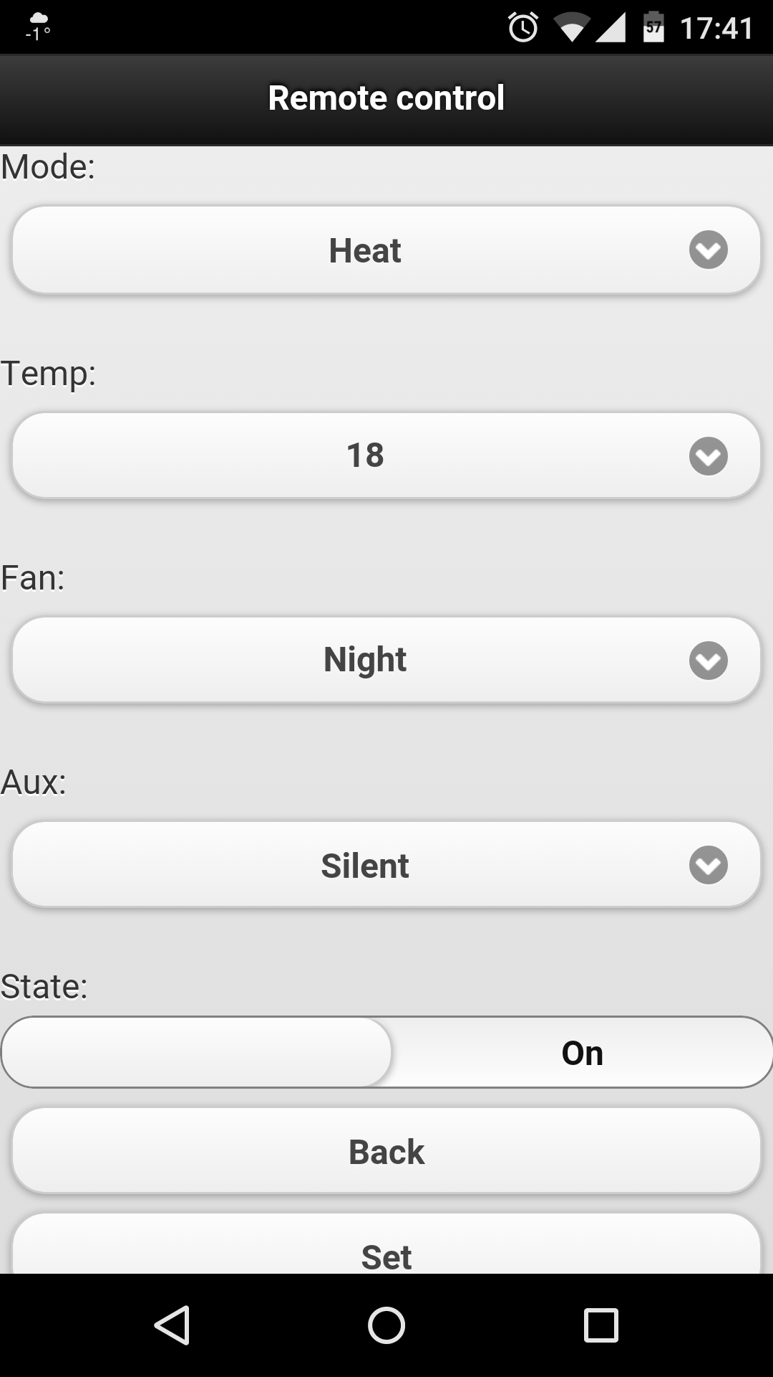
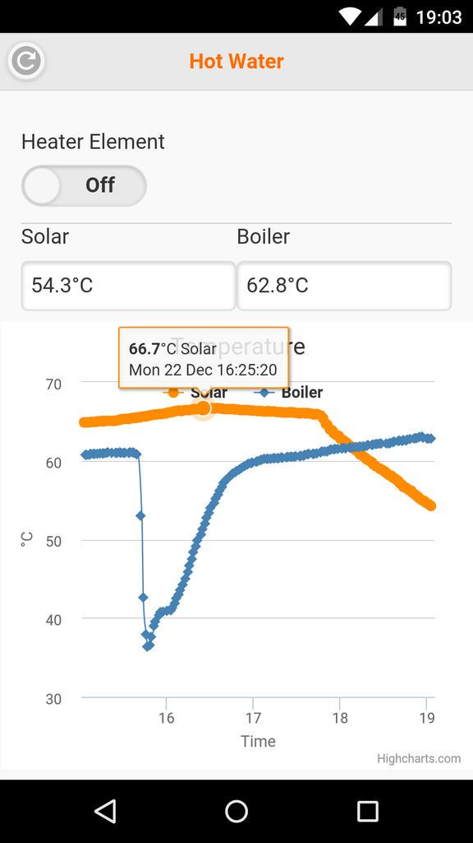
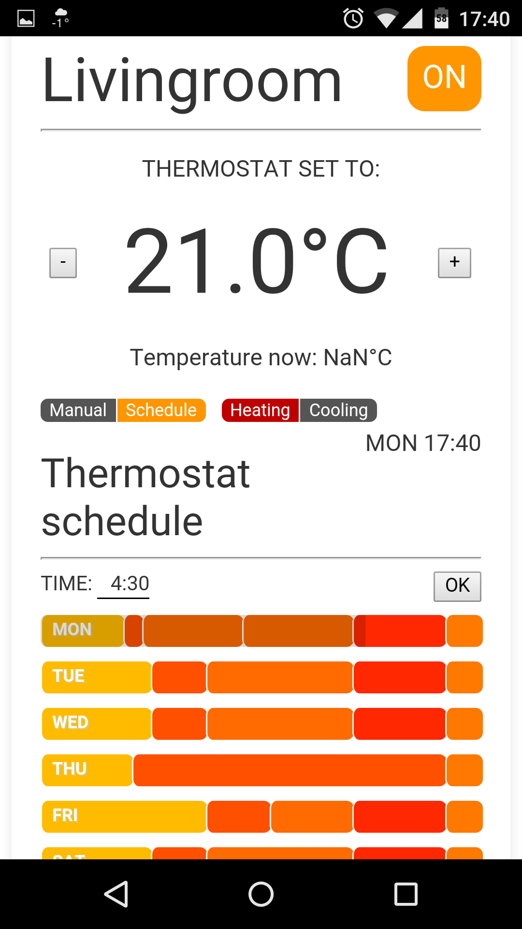
Control UI
Notes:
Need to work on consolidating these
OpenHab?

Slide 22
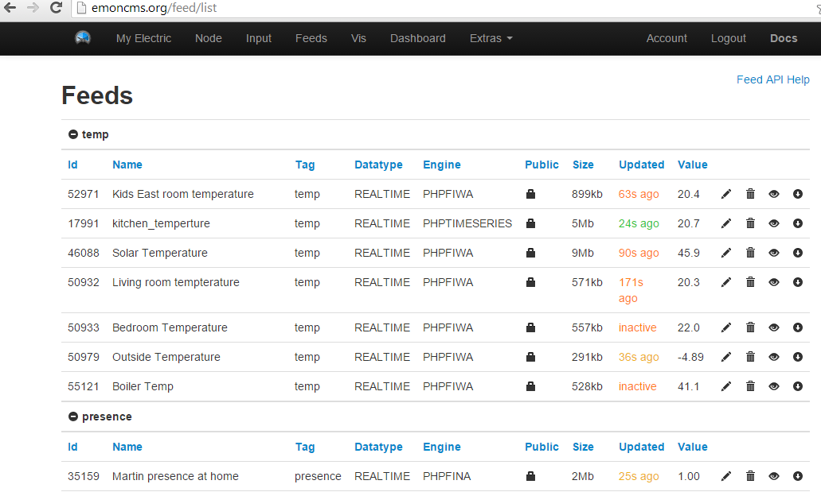
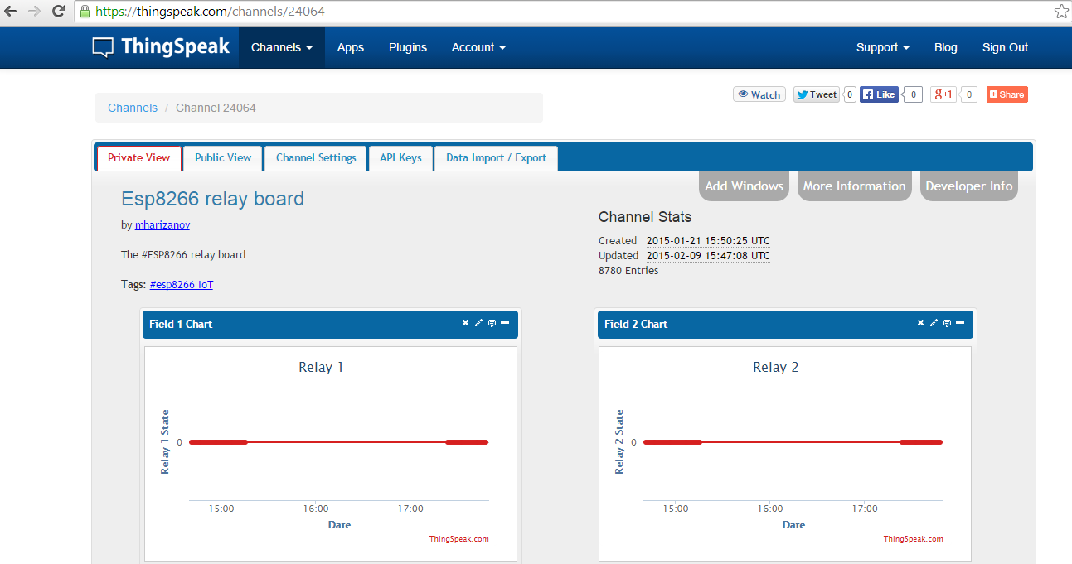
Storage

Slide 23
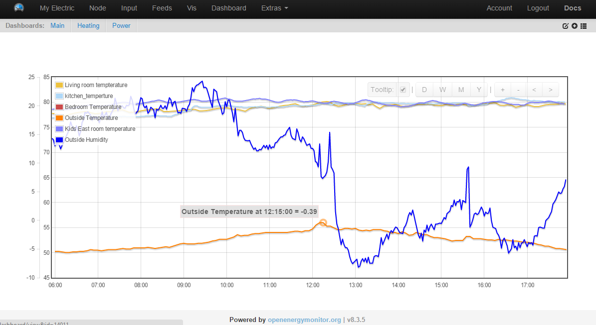
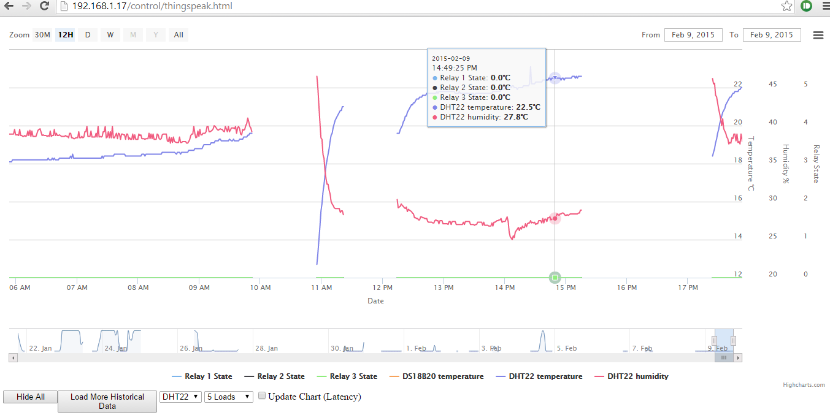
Visualization

Slide 24
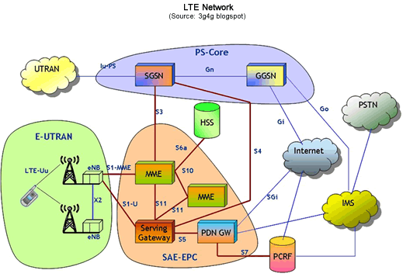
4G – Long Term Evolution (LTE) (2010’s)
Data-centric Network
Killer App = Facebook
Where is the clear voice path???
Broadband backhaul
WAP is crap and WOS is worse…

Slide 25
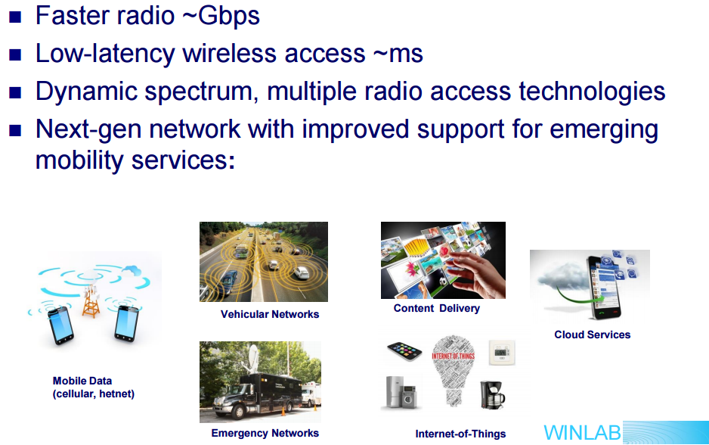
5G – The Vision

Slide 26
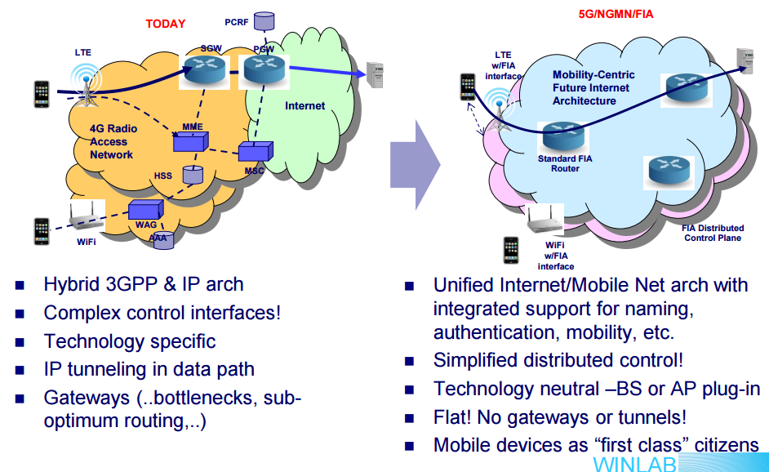
5G Network Architecture?

Slide 27
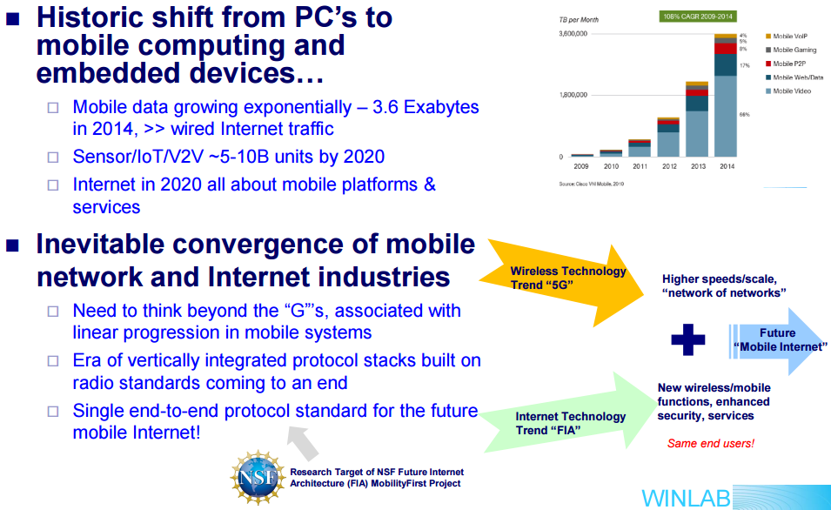
Mobility-centric Internet Protocol Architecture

Slide 28
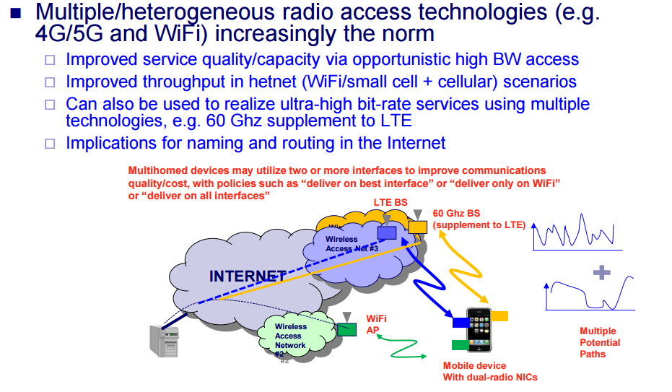
Multi-homing for Service Continuity

Slide 29
The Internet of Things (IoT)
Sensors and Actuators
Virtual Objects
People
Services
Platforms
Networks
Low Bandwidth
Possible high-volume
3GPP is considering GERAN
  IoT over 2G technology
But what about Telematics?

Slide 30
IoT Application Domains
Healthcare
Media
Home & Building
IoT architecture frame work
Logistics
Retail
Mobility/
Transpor-tation
Energy
Manufactur-ing
* due to the diversity of IoT application areas only selected domains and stakeholders are shown

Slide 31
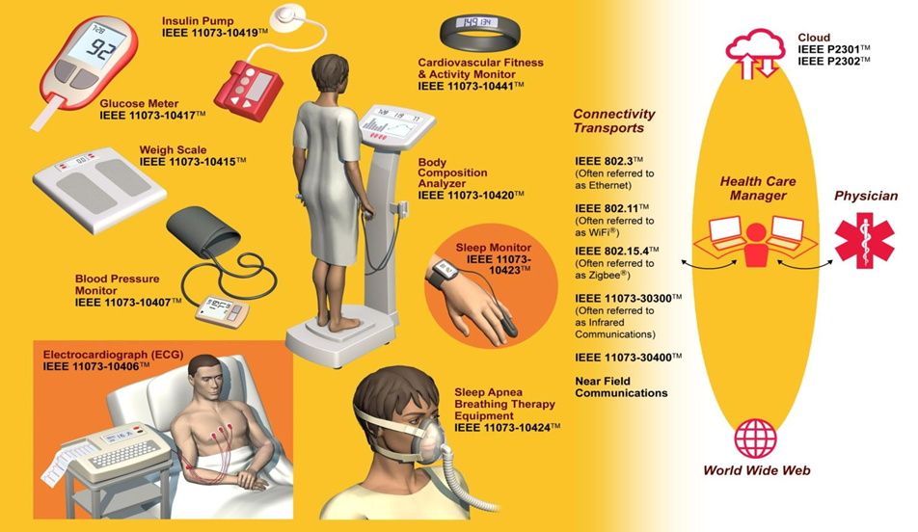
eHealth and Wireless Monitoring
ISO/IEEE 11073 series Health Informatics - Medical / Health Device Communication Standards

Slide 32
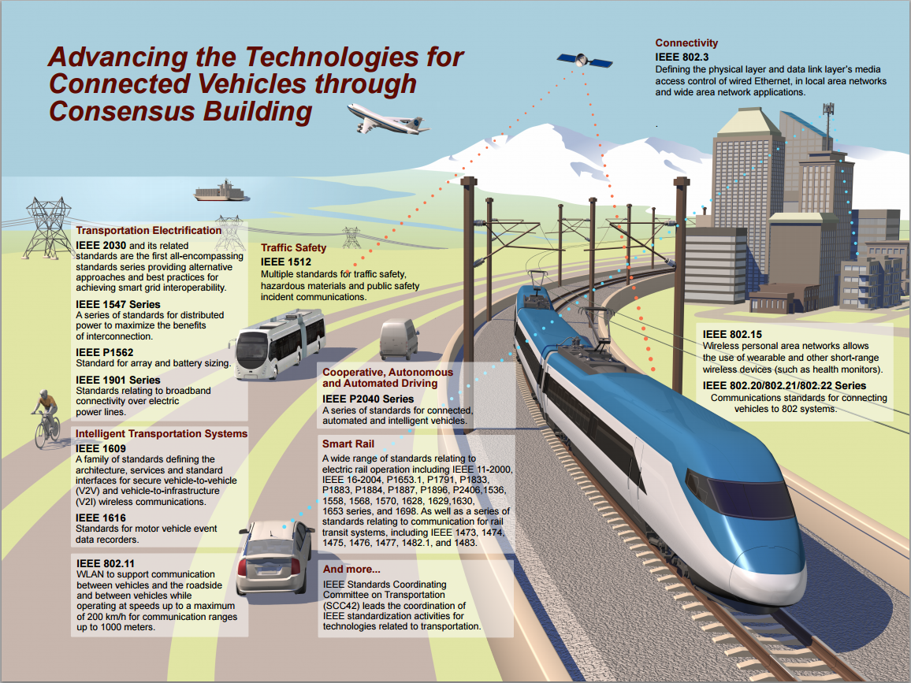
The Connected Vehicle

Slide 33
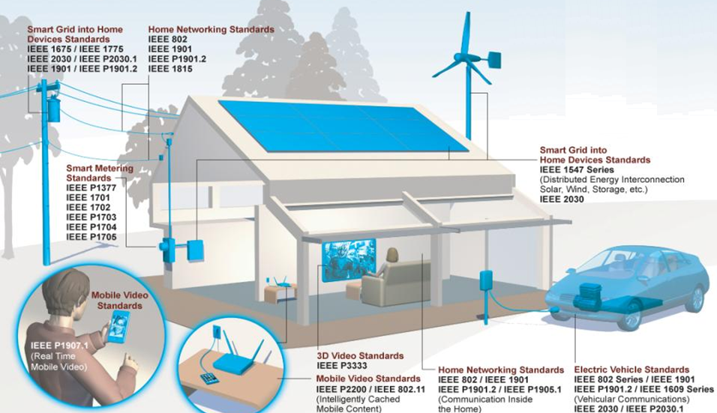
The Smart Home Initiative

Slide 34






Institute of Electrical and Electronics Engineers (IEEE):
World’s Largest Professional Association
Our Global Reach
430,000+
Members
45
Technical Societies
160
Countries
Our Technical Breadth
1,400
Annual Conferences
3,700,000+
Technical Documents
160+
Top-cited Periodicals

Slide 35

IEEE-SA Presence
Leverages the breath of
40+ technical areas
Smart Grid standards
quoted in NIST
Flagship transport layer standards in communications (IEEE 802)
Independent global community
Open standards process…
Globally recognized standards
Clear IPR policy
Approximately 1300 active standards
More than 500 standards
under development
Over 7,000 individual members and 20,000 standards developers from every continent
200+ corporate members
IEEE-SA Strengths
Notes:
IEEE-SA drives the functionality, capabilities and interoperability of a wide range of products and services that transform the way people live, work and communicate. We promote innovation, enable the creation and expansion of international markets and help protect health and public safety.
- IEEE-SA is a a globally recognized standards-development organization with over 900 active standards.
- At any point in time we have more than 500 standards projects under development.
- We have an individual membership of 7,000, more than 200 corporate members and, overall, more than 20,000 developers of standards worldwide.

Slide 36

Different Paths: Standards Development
Individual Method
Participants are individual technical experts
Each individual participant has 1 vote
Entity (Corporate) Method
Participants are “entities,” i.e., companies, universities, government bodies, etc.
Each entity has one vote
Requires 3 entities
Ballot groups are made up of a minimum of 10 individuals
Ballot group participants must be IEEE-SA individual members
Individuals represent themselves
Designated representative and alternate represent the entity
Entity sends representatives to meetings
Open membership, participation, and governance
No restrictions
Any individual or organization
Includes academia
Any industry or size of company

Slide 37
The Market Challenge of Standards
Benefits
Establishes Developer Community
Eliminates Customer Concerns with Sole-Sourcing
Broadens Market Reach
  Sole-source sales restricted to “must have”
Reduces Production Costs
Reduces R&D Costs
Improves Interoperability
  Affiliated Market Potential
Challenges
IP Protection Issues
  What do you protect/what do you expose?
Competition
  Must compete on:
    Efficiency
    Differentiation
Cost/Resources
  R&D Support
  Standards delegate(s)

Slide 38


Tools for Collaboration
ISTO
IEEE Standards
Association
Industry Connections
ICAP

Slide 39
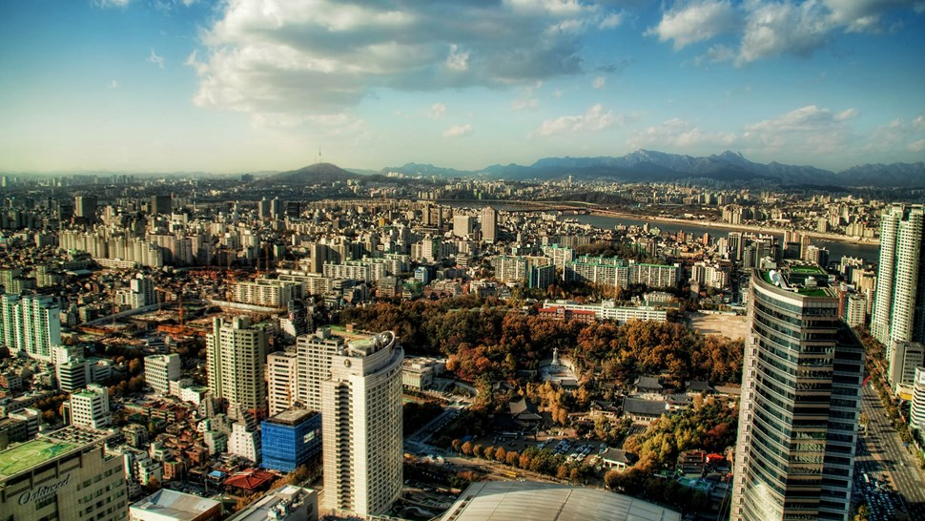







IoT applications for smart sustainable cities and citizens
From 237.2 in 2015 to 371.0 in 2017
From 9.7 in 2015 to 23.4 in 2017
From 10.2 in 2015 to 33.9 in 2017
From 206.2 in 2015 to 648.1 in 2017
From 294.2 in 2015 to 1,067.0 in 2017
From 97.8 in 2015 to 159.5 in 2017
From 252.0 in 2015 to 371.1 in 2017
Smart cities are projected to use 2.7 billion connected things in 2017
Source: Gartner (data in millions)
Notes:
Connected Things Installed Base Within Smart Cities (in Millions)
Smart City Subcategory
Healthcare: From 9.7 in 2015 to 23.4 in 2017
Public Services: From 97.8 in 2015 to 159.5 in 2017
Smart Commercial Buildings: From 206.2 in 2015 to 648.1 in 2017
Smart Homes: From 294.2 in 2015 to 1,067.0 in 2017
Transport: From 237.2 in 2015 to 371.0 in 2017
Utilities: From 252.0 in 2015 to 371.1 in 2017
Others: From 10.2 in 2015 to 33.9 in 2017
Total from 1,107.3 in 2015 projected to 2,674.0 in 2017
Source: Gartner (March 2015)
http://www.gartner.com/newsroom/id/3008917

Slide 40








Building smart sustainable cities
IoT enabled services and infrastructure to improve and manage power, resources and urban planning.
5G
5G
5G
Notes:
Smart Sustainable Cities are cities that use smart infrastructure and the IoT to improve and manage power, resources, and urban planning.

Slide 41

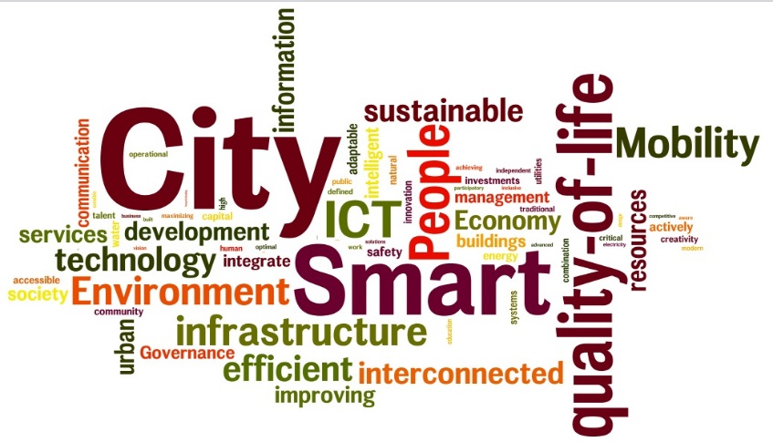
First internationally agreed definition…
“A smart sustainable city is an innovative city that uses information and communication technologies (ICTs) and other means to improve quality of life, efficiency of urban operation and services, and competitiveness, while ensuring that it meets the needs of present and future generations with respect to economic, social and environmental aspects”
Source: ITU-T Focus Group on Smart Sustainable Cities

Slide 42





ITU-T Focus Group on Smart Sustainable Cities
Mandate and achievements
Working groups
Established in February 2013 and concluded in May 2015
As an open platform for smart-city stakeholders
WG1. ICT role and roadmap for SSC
Over 150 participants/collaborators from different stakeholders
Liaison with other SDOs (ETSI, ISO, IEC etc) & IGOs (UNFCCC, UN-Habitat, etc)
21 technical specifications and reports approved
WG2. SSC infrastructure
WG3. Standardization gaps, KPIs and metrics
WG4.Policy and positioning

Slide 43



FG-SSC technical reports and specifications
High Level and WG1 reports:
Smart sustainable cities: an analysis of definitions
An overview of smart sustainable cities and the role of ICTs
Smart sustainable cities: a guide for city leaders
Master plan for smart sustainable cities
WG3 reports:
Overview of KPIs in smart sustainable cities
KPIs definitions for smart sustainable cities
KPIs related to the use of ICT in smart sustainable cities
KPIs related to the sustainability impacts of ICT in smart sustainable cities
Standardization roadmap for smart sustainable cities
Standardization activities for smart sustainable cities

Slide 44





FG-SSC technical reports and specifications
WG2 reports:
Overview of smart sustainable cities infrastructure
Setting the framework for an ICT architecture of a smart sustainable city
Multi-service infrastructure for smart sustainable cities in new-development areas
Anonymization infrastructure and open data in smart sustainable cities
Intelligent sustainable buildings for smart sustainable cities
ICTs for climate change adaptation in cities
Smart water management in cities
Cybersecurity, data protection and cyber resilience in smart sustainable cities
EMF considerations in smart sustainable cities
Integrated management for smart sustainable cities
WG4 reports:
Setting the stage for stakeholders’ engagement in smart sustaintable cities

Slide 45







Smart sustainable cities: a six step transition cycle
6. Ensure accountability
1. Set the vision
5. Measure success
2. Identify targets
3. Political commitment
4. Build your SSC

Slide 46
Six step transition cycle in details (1)
Political priorities of the city
Long-term development strategies
Identify the relevant SSC stakeholders
1. Set the vision
Development of an appropriate SSC infrastructure
Development of SSC service by integrating ICT into existing urban services
2. Identify targets
Achievement of consensus and support for the implementation of the SSC vision and targets
3. Political commitment
Notes:
(1) Set the vision for your Smart Sustainable City venture
▪ This should be done in line with the city’s identity, political priorities and long-term development strategy.
▪ It is important to identify the relevant SSC stakeholders who will assist with the journey.
▪ It is pertinent to determine the level of current ICT use in the city and identify existing governance mechanisms that would allow an efficient and effective management of SSC solutions.
(2) Identify your SSC
These targets include:
▪ Developing of an appropriate SSC infrastructure.
▪ Developing SSC services by integrating ICT into existing urban services.
▪ Defining the SSC KPIs.
▪ Educating the stakeholders identified in Step (1) of the advantages of SSC.
(3) Achieve political commitment:
▪ This includes adoption of SSC targets/ programmes through consensus.
▪ This consensus would provide the basis for an agreed document that has widespread support and which can serve as a reference for strategic planning

Slide 47
Six step transition cycle in details (2)
4. Build your SSC
Establishment of a feasible master plan for the SSC transition
Ensure good operation and maintenance
Monitor, evaluation and assessment of the implementation of the master plan
Use the FG-SSC KPIs as baseline
5. Measure success
Analysis and reporting of the progress achieved
Identification and preparation of future plans
6. Ensure accountability
Notes:
(4) Build your Smart Sustainable City
▪ Make a feasible Master Plan for your Smart Sustainable City transition
▪ Conform to appropriate construction models including Public Private Partnerships in various SSC programmes
▪ Ensuring long term services via good operation and maintenance after infrastructure is in place.
(5) Measure your city progress
▪ This step involves monitoring and evaluating a work programme required to achieve the targets set in Step (2).
▪ The FG-SSC KPIs form an excellent baseline for city decision makers, as they map the city’s progress in terms of their overall SSC journey.
(6) Ensure accountability and responsibility
▪ This focuses on evaluating, reporting and learning from the SSC process and related experiences.
▪ This includes an assessment of the implementation of the work programme, and an analysis of reflections about strengths and shortcomings.
▪ This step helps with the preparation of future baseline reviews to deepen SSC master plans, among others.

Slide 48

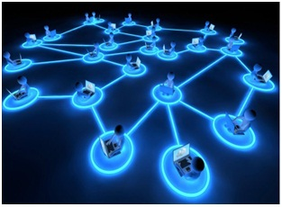



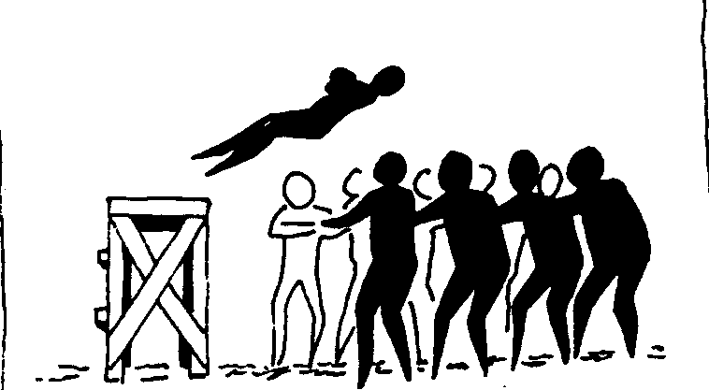




Building trust
Privacy
Openness
Scalability
Resilience
Data protection
Flexibility
Security
Cultural and age adaptation
Reliability

Slide 49



Pilot the ITU’s SSC-KPIs in your city
Background
Benefits
A global project launched by ITU in cooperation with other UN agencies to support cities in the implementation and use of the ITU’s SSC-KPIs developed by FG-SSC.
Several cities are testing the ITU’s SSC-KPIs and will get a certificate from ITU.
ITU will also develop a Global Smart Sustainable Cities Index.
Cities will be able to measure current performance and identify opportunities to improve city services towards sustainability and operational eco-efficiency.
First pilot project, May 2015
Join ITU’ Smart Sustainable Cities Initiative!
Notes:
ITU (through its Telecommunication Standardization Sector) in cooperation with other UN agencies, has now initiated a global project to:
To support cities in the implementation and use of the ITU SSC KPIs
To test and verify the applicability of ITU-T Smart Sustainable Cities Key Performance Indicators (SSC-KPIs) in several cities of the world.
ITU-T will implement a verification process for the SSC-KPIs and provide cities with a defined procedure to obtain a certificate from ITU
To develop a global Smart Sustainable Cities (SSC) Index.
The Focus Group on Smart Sustainable Cities developed four Technical Specifications and Reports on KPIs for Smart Sustainable Cities.
The key phases of this project include:
Review and updating of the KPIs
Analysis of ITU KPIs applicability to cities
Collection of data by the city administrators
KPI reporting and verification of the data presented to ITU.
Establishment of an ITU Smart Sustainable Cities Global Index
Establishment of a Global Advisory Board to oversee the project and the ITU Smart Sustainable Cities Global Index
ITU-T SSC KPIs are designed to be implemented in cities across the world and are the basis to build the ITU Smart Sustainable City Index.
City leaders will benefit from these KPIs in terms of strategic planning and measurement of their city’s progress towards their smart city goals.

Slide 50
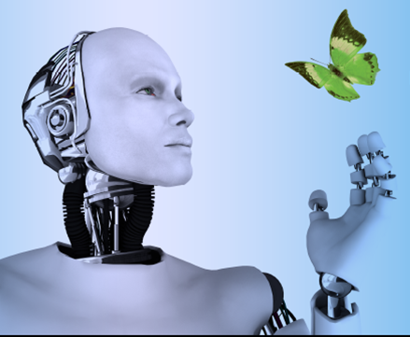
Forum on “Internet of things: empowering the new urban agenda ”
This forum will provide a platform to discuss why the Internet of things will be at the heart of smart city transformation.
When: 19 October 2015
Where: ITU Headquarters, Geneva, Switzerland

Slide 51

A win-win way forward for the future of IoT
IoT involves many manufacturers, spans multiple industries, and differs widely in application scenarios and user requirements.
Standardization can create the necessary framework for any large-scale IoT deployment and ensure commercial revenues in future.

Slide 52
IoT in Healthcare
Compliance with treatment and medication at home and by healthcare providers
Various medical devices, sensors, and diagnostic and imaging devices can be viewed as smart devices or objects constituting a core part of the IoT.
Notes:
IOT has the potential to give rise to many medical applications such as remote health monitoring, fitness programs, chronic diseases, and elderly care.

Slide 53
IOT Healthcare Networks
Notes:
The IoT healthcare network or the IoT network for health care (hereafter ‘‘the IoThNet’’) is one of the vital elements of the IoT in health care. It supports access to the IoT backbone, facilitates the transmission and reception of medical data, and enables the use of healthcare-tailored communications.
The IoThNet topology refers to the arrangement of different elements of an IoT healthcare network and indicates representative scenarios of seamless healthcare environments.

Slide 54
The IoThNet Topology
Notes:
The IoThNet topology refers to the arrangement of differ- ent elements of an IoT healthcare network and indicates representative scenarios of seamless healthcare environments/

Slide 55
Protocol stack of 6LoWPAN
Notes:
6LoWPAN – Ipv6 low power wireless personal area network originated from the idea that Internet should be applied even to the smallest device an low power devide with limited processing capabiities should be able to pariticipate in IoT.
According to the IoThNet concept, sensors and wearables use IPv6 and 6LoWPAN systems for data transmission over the 802.15.4 protocol. Data are then replied back by sensor nodes with the help of the user datagram protocol (UDP). However, the 6LoWPAN is limited in that it does not support mobile IPv6 (MIPv6), a subset of the IPv6 protocol with mobility

Slide 56
IoTNet Platform

Slide 57
IoT healthcare services and applications

Slide 58
Security Issues with IoT in Healthcare
Healthcare devices deal with private information
This information needs to be protected from been revealed, modified or forged
Critical to identify and analyze distinct features of IoT security and privacy

Slide 59
Security Issues with IoT in Healthcare

Slide 60
Security Requirements
Confidentiality
Integrity
Authentication
Availability
Data Freshness
Non – Repudiation
Authorization
Resiliency
Fault Tolerance
Self – Healing

Slide 61
Security Challenges
Computational Limitation
Memory Limitation
Energy Limitation
Mobility
Scalability
Communications Media
The Multiplicity of Devices
A Dynamic Network Topology
A Multi – Protocol Network
Dynamic Security
Tamper – Resistant Packages

Slide 62
Attack Taxonomy
Attacks based on Information Disruption
Attacks based on Host properties
Attacks based on Network properties

Slide 63
Attacks based on Information Disruption
Interruption
  Denial – Of – Service attack.
  Communication links lost or made unavailable
Interception
  Eavesdrop on the information to threaten data privacy and confidentiality
Modification
  Tamper medical information
Fabrication
  Forge or inject false information
Replay
  Replay existing information

Slide 64
Attacks based on Host properties
User Compromise
  Compromise a user’s health device or network
  Mostly involves revealing passwords, cryptographic keys or user data
Hardware Compromise
  Physically tamper the device
  Extract on – device program code, keys and data
  Reprogram with false program
Software Compromise
  Forces malfunction by taking advantages of the vulnerabilities in either the operating system or other applications of the device

Slide 65
Attacks based on Network properties
Standard Protocol Compromise
  An attacker deviates from standard protocols
  Acts maliciously to threaten service availability, message privacy, integrity, and authenticity
Network Protocol Stack Attack

Slide 66
Network Protocol Stack Attack

Slide 67
Proposed Security Model
Security services should have dynamic properties
Should include 3 main services
  Protection Service
  Detection Service
  Reaction Service

Slide 68
Proposed Security Model

