Slide 1
JAIPUR ENGINEERING COLLEGE AND RESEARCH CENTRE
Year & Sem – IV year & VII Sem
Subject – Internet of Things &7CS4-01
Unit – III
1

Slide 2
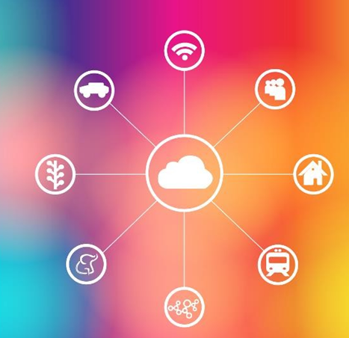
Internet of Things
CSE/ VIISem
UNIT-III
Architecture and Reference Model

Slide 3
Vision of Computer Science Department To become renowned Centre of Excellence in Computer Science and Engineering and make competent engineers and professionals with high ethical values prepared for lifelong learning.
Mission of Computer Science Department M1 - To impart outcome based education for emerging technologies in the field of computer science and engineering. M2 - To provide opportunities for interaction between academia and industry. M3 - To provide platform for lifelo learning by accepting the change in technologiesM4 - To develop aptitude of fulfilling social responsibilities.

Slide 4
Course outcomes (CO)
CO1: Understand the revolution of internet in field of cloud, wireless network, embedded system and mobile devices.
CO2: Apply IOT design concepts in various dimensions implementing software and hardware.
CO3: Analyze various M2M and IOT architectures.
CO4: Design and develop various applications in IOT.

Slide 5
Mapping of co & po
Subject | Code | L/T/P | CO | PO1 | PO2 | PO3 | PO4 | PO5 | PO6 | PO7 | PO8 | PO9 | PO10 | PO11 | PO12 | P S O 1 | P S O 2
IOT | 7CS4-01 | L | Understand the revolution of internet in field of cloud, wireless network, embedded system and mobile devices. | H | H | M | M | M | M | - | -- | M | M | M | H | H | H
 |  | L | Apply IOT design concepts in various dimensions implementing software and hardware. | H | H | H | H | H | M | - | -- | L | M | M | H | H | H
 |  | L | Analyze various M2M and IoT architectures. | H | M | M | L | M | M | - | L | M | L | L | H | M | M
 |  | L | Design and develop various applications in IOT. | H | M | H | H | H | M | M | L | H | H | H | H | H | H

Slide 6
syllabus

Slide 7
Lecture plan
Unit No./ Total Lecture Reqd. | Topics | Lect. Reqd. | Lect. No.
Unit-I (10) | 1. Introduction to subject and scope | 1 | 1
 | 2. Introduction to learning, Types of learning and Applications | 1 | 2
 | 3. Supervised Learning | 1 | 3
 | 4. Linear Regression Model | 1 | 4
 | 5. Naïve Bayes Classifier | 1 | 5
 | 6. Decision Tree | 1 | 6
 | 7. K-nearest Neighbor | 1 | 7
 | 8. Logistic Regression | 1 | 8
 | 9. Support Vector Machine | 1 | 9
 | 10. Random Forest Algorithm | 1 | 10
Unit-II (7) | 1. IoT sensors | 1 | 11
 | 2. IoT actuators | 1 | 12
 | 3. Humidity sensor | 1 | 13
 | 4. Ultrasonic sensor | 1 | 14
 | 5. Temperature sensor | 1 | 15
 | 6. Arduino and Raspberry Pi | 1 | 16
 | 7. IoT OS | 1 | 17
BC-1 | ARM Processor | 1 | 18

Slide 8
Lecture plan
Unit No./ Total Lecture Reqd. | Topics | Lect. Reqd. | Lect. No.
Unit-III (9) | 1. IoT architecture | 1 | 19
 | 2. Reference model | 1 | 20
 | 3. Representational state transfer (REST) | 1 | 21
 | 4. Uniform resource identifier | 1 | 22
 | 5. Challenges in IoT | 1 | 23
 | 6. Design challenges | 1 | 24
 | 7. Development challenges | 1 | 25
 | 8. Security challenges | 1 | 26
 | 9. Other challenges | 1 | 27
Unit- IV (8) | 1. Machine to Machine vs IoT | 2 | 28
 | 2. Software defined networks | 1 | 29
 | 3. Network function virtualization | 1 | 30
 | 4. Difference between SDN and IoT | 2 | 31
 | 5. Difference between NFV and IoT | 2 | 32
Unit- V (8) | 1. IoT applications | 1 | 33
 | 2. Home automation | 1 | 34
 | 3. Smart cities | 1 | 35
 | 4. Environment and energy | 1 | 36
 | 5. Retail | 1 | 37
 | 6. Logistics | 1 | 38
 | 7. Agriculture and Industries | 1 | 39
 | 8. Health and lifestyle | 1 | 40
BC-2 | IoT Platforms | 1 | 41

Slide 9
Internet of Things
CSE/ VII Sem

Slide 10
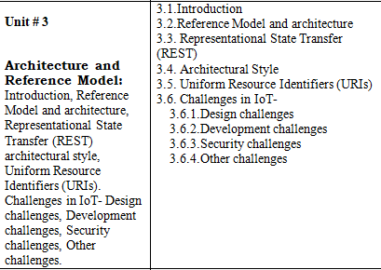
Subject Detailed Blown Up for unit -iII
Internet of Things
CSE/ VII Sem

Slide 11
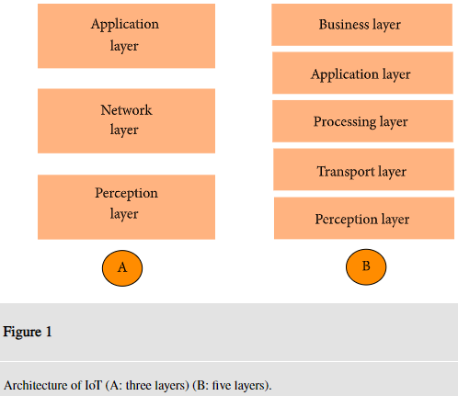
Architecture of iot
Internet of Things
CSE/ VII Sem
There is no single consensus on architecture for IoT, which is agreed universally.
The most basic architecture is a three-layer architecture. It has three layers, namely, the perception, network, and application layers.

Slide 12
3-layer Architecture of iot cont...
Internet of Things
CSE/ VII Sem
(i)The perception layer is the physical layer, which has sensors for sensing and gathering information about the environment. It senses some physical parameters or identifies other smart objects in the environment.
(ii)The network layer is responsible for connecting to other smart things, network devices, and servers. Its features are also used for transmitting and processing sensor data.
(iii)The application layer is responsible for delivering application specific services to the user. It defines various applications in which the Internet of Things can be deployed, for example, smart homes, smart cities, and smart health.

Slide 13
5-layer Architecture of iot cont...
Internet of Things
CSE/ VII Sem
One is the five-layer architecture, which additionally includes the processing and business layers. The five layers are perception, transport, processing, application, and business layers The role of the perception and application layers is the same as the architecture with three layers.
(i)The transport layer transfers the sensor data from the perception layer to the processing layer and vice versa through networks such as wireless, 3G, LAN, Bluetooth, RFID, and NFC.
(ii)The processing layer is also known as the middleware layer. It stores, analyzes, and processes huge amounts of data that comes from the transport layer.
(iii)The business layer manages the whole IoT system, including applications, business and profit models, and users’ privacy.

Slide 14
Architecture and Reference Model
Internet of Things
CSE/ VII Sem
The IoT Reference Model aims at establishing a common grounding and a common language for IoT architectures and IoT systems.
It consists of the sub-models shown in following Fig. The yellow arrows show how concepts and aspects of one model are used as the basis for another.

Slide 15
Architecture and Reference Model-domain model
Internet of Things
CSE/ VII Sem
Foundation of the IoT Reference Model is the IoT Domain Model, which introduces the main concepts of the Internet of Things like Devices, IoT Services and Virtual Entities (VE), and it also introduces relations between these concepts.
The abstraction level of the IoT Domain Model has been chosen in such a way that its concepts are independent of specific technologies and use-cases.

Slide 16
Architecture and Reference Model Cont-domain model
Internet of Things
CSE/ VII Sem
Based on the IoT Domain Model, the IoT Information Model has been developed.
Defines the structure (e.g. relations, attributes) of IoT related information in an IoT system on a conceptual level without discussing how it would be represented.
The information pertaining to those concepts of the IoT Domain Model is modeled, which is explicitly gathered, stored and processed in an IoT system.

Slide 17
Architecture and Reference Model Cont-functional model
Internet of Things
CSE/ VII Sem
The IoT Functional Model identifies groups of functionalities, of which most are grounded in key concepts of the IoT Domain Model.
A number of these Functionality Groups (FG) build on each other, following the relations identified in the IoT Domain Model.
The Functionality Groups provide the functionalities for interacting with the instances of these concepts or managing the information related to the concepts, e.g. information about Virtual Entities or descriptions of IoT Services.
The functionalities of the FGs that manage information use the IoT Information Model as the basis for structuring their information.

Slide 18
Representational state transfer (rest) architectural style
Internet of Things
CSE/ VII Sem
Representational state transfer (REST) is a software architectural style that defines a set of constraints to be used for creating Web services. Web services that conform to the REST architectural style, called RESTful Web services, provide interoperability between computer systems on the internet.
Representational State Transfer is a software architecture style.
REST was developed along the HTTP/1.1 protocol. And HTTP/1.1
The term representational state transfer was introduced and defined in 2000 by Roy Fielding in his doctoral dissertation.

Slide 19
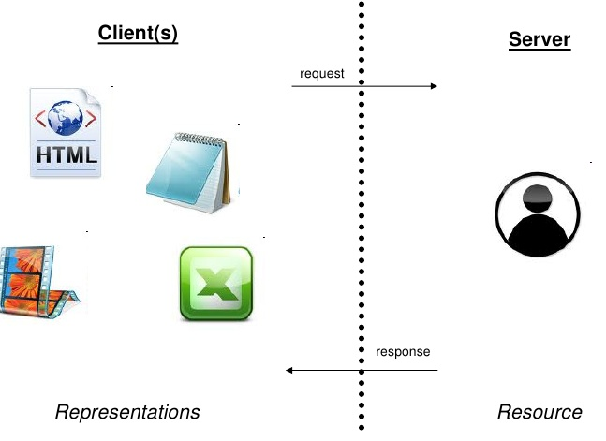
Rest concept-1 (client and server)
Internet of Things
CSE/ VII Sem
The architecture consists of clients and servers; requests and responses.
Requests and responses are built around the transfer of representations of resources.
Clients contain representations, servers the resources (concepts) themselves.

Slide 20
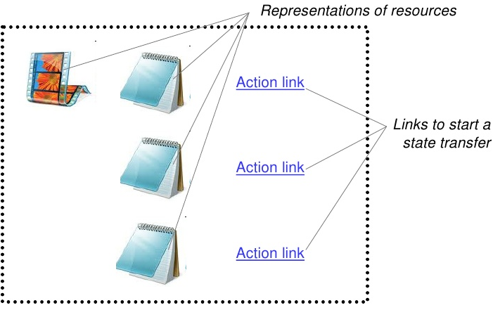
Rest concept-2 (rest client application)
Internet of Things
CSE/ VII Sem
A client can be either transitioning between states or be at rest.
A client is considered to be transitioning between states while one or more requests are outstanding.
The representation of the client state contains links that can be used to initiate new state transitions.

Slide 21
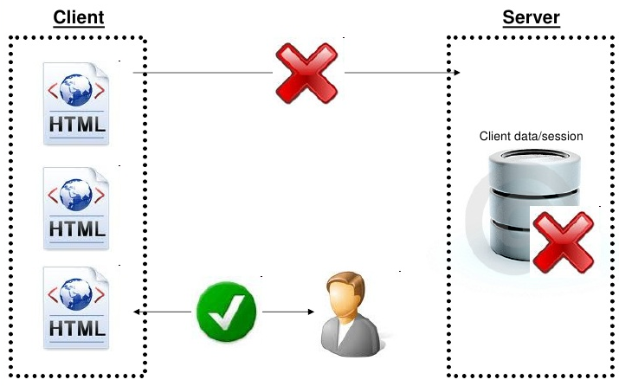
Rest concept-3 (rest at rest)
Internet of Things
CSE/ VII Sem
A client in a rest state is able to interact with its user.
A client at rest creates no load on the servers or the network.
A client at rest consumes no per-client storage on the servers.

Slide 22
REST way of Implementing the web services
Internet of Things
CSE/ VII Sem

Slide 23
Principles of REST web service design
Internet of Things
CSE/ VII Sem
1.Identify all the conceptual entities that we wish to expose as services.
2. Create a URL to each resource.
3. Categorize our resources according to whether clients can just receive a representation of the resource (using an HTTP GET), or whether clients can modify (add to) the resource using HTTP POST, PUT, and/or DELETE).
4.All resources accessible via HTTP GET should be side-effect free.
5.Put hyperlinks within resource representations to enable clients.
6. Design to reveal data gradually.
7. Specify the format of response data using a schema. For those services that require a POST or PUT to it, also provide a schema to specify the format of the response.
8. Describe how our services are to be invoked using either a WSDL document, or simply an HTML document.

Slide 24
Rest: Architectural Constraints
Internet of Things
CSE/ VII Sem
REST defines 6 architectural constraints which make any web service – a true RESTful API.
Uniform interface
Client–server
Stateless
Cacheable
Layered system
Code on demand

Slide 25
Some rest based web services
REST based web services:
Online shopping
Search services
Dictionary services

Slide 26
Uniform resource identifier (uri’s)
Internet of Things
CSE/ VII Sem
A Uniform Resource Identifier (URI) is a string of characters used to identify a resource.
Such identification enables interaction with representations of the resource over a network, typically the World Wide Web, using specific protocols.
Unique identifier makes content addressable on the Internet by uniquely targeting items, such as text, video, images, and applications.

Slide 27
Challenges in iot
Internet of Things
CSE/ VII Sem
Internet of Things (IoT) is one of the hottest technologies in the era of digital transformation, connecting everything to the Internet.
Core technology behind smart homes, self-driving cars, smart utility meters, and smart cities. But there are many challenges for the future of the internet of things (IoT).
Design challenges
Development challenges
Security challenges
Other challenges

Slide 28
Design challenges
Internet of Things
CSE/ VII Sem
Stability of network
Power management
Network failover and memory management
Non-functional requirements
Os optimization and tuning
Many of the common design challenges faced in Embedded field apply to IoT as well.

Slide 29
Development challenges
Internet of Things
CSE/ VII Sem
Data Exchange Security: This is important to understand that the data transfer from IoT sensors & devices to a platform or gateway and then stored at the cloud. It is essential to ensure data encryption protocol is followed while app development.
Physical Security: The IoT devices are usually unattended and hence can be easily tampered by the hackers.
Cloud Storage Security: Though cloud storage is considered secured it is a challenge for developers to ensure that the IoT platform is properly encrypted, is capable of protecting data and appropriate access & authorization is taken care of.
Privacy Updates: Data fetched by IoT devices are always under certain rules & regulations.

Slide 30
Development challenges cont...
Internet of Things
CSE/ VII Sem
5.Connectivity
6.Cross-Platform Compatibility (Hardware & Devices)
7.Data Collection & Processing

Slide 31
Security challenges
Internet of Things
CSE/ VII Sem
Secure constrained devices
Authorize and authenticate devices
Manage device updates
Secure communication
Ensure data privacy and integrity
Secure web, mobile, and cloud applications
Ensure high availability
Prevent incidents by detecting vulnerabilities
Manage vulnerabilities
Predict and preempt security issues

Slide 32
Other challenges
Internet of Things
CSE/ VII Sem
Managing Big data- as large number of devices communicate which each other ,large data is accumulated out of which only a little bit is useful ,managing this Big data is big challenge.
Security and Privacy- security and privacy is another challenge as each layer IoT system is prone to cyber attacks/malware .

Slide 33
Internet of Things
CSE/ VII Sem
Thanks and Regards

