Slide 1



JAIPUR ENGINEERING COLLEGE AND RESEARCH CENTRE
Year & Sem – III year & V Sem
Subject – Operating System
Topic : File Management (UNIT 4)
Presented by – Dr. Nilam Choudhary, Associate Professor, CSE
1

Slide 2

Believe it or Not
1

Slide 3
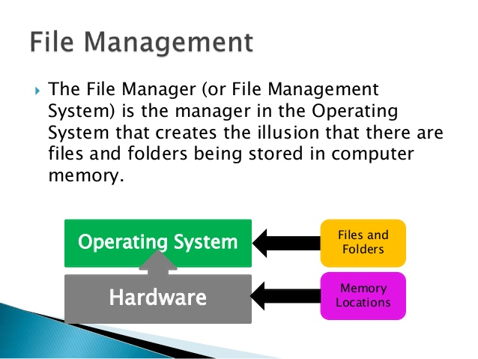
Introduction
1

Slide 4
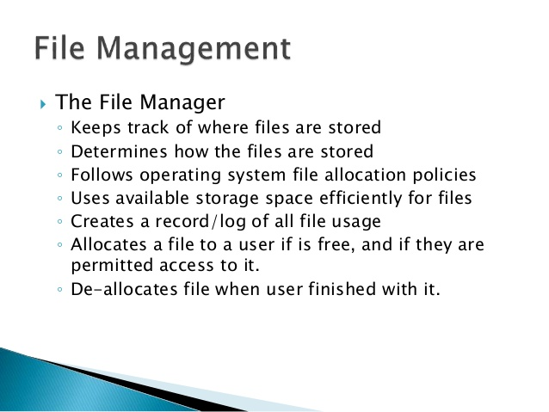
Cont..
1

Slide 5
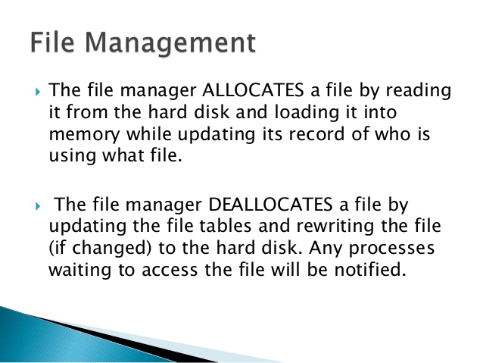
Cont..
1

Slide 6
Cont..
What is File System?
A file is a collection of correlated information which is recorded on secondary or non-volatile storage like magnetic disks, optical disks, and tapes. It is a method of data collection that is used as a medium for giving input and receiving output from that program.
In general, a file is a sequence of bits, bytes, or records whose meaning is defined by the file creator and user. Every File has a logical location where they are located for storage and retrieval.
1

Slide 7
Objective of File management System
Here are the main objectives of the file management system:
It provides I/O support for a variety of storage device types.
Minimizes the chances of lost or destroyed data
Helps OS to standardized I/O interface routines for user processes.
It provides I/O support for multiple users in a multiuser systems environment.
1

Slide 8
Properties of a File System
Here, are important properties of a file system:
Files are stored on disk or other storage and do not disappear when a user logs off.
Files have names and are associated with access permission that permits controlled sharing.
Files could be arranged or more complex structures to reflect the relationship between them.
1

Slide 9
File structure
A File Structure needs to be predefined format in such a way that an operating system understands . It has an exclusively defined structure, which is based on its type.
Three types of files structure in OS:
A text file: It is a series of characters that is organized in lines.
An object file: It is a series of bytes that is organized into blocks.
A source file: It is a series of functions and processes.
1

Slide 10
File Attributes
A file has a name and data. Moreover, it also stores meta information like file creation date and time, current size, last modified date, etc. All this information is called the attributes of a file system.
Here, are some important File attributes used in OS:
Name: It is the only information stored in a human-readable form.
Identifier: Every file is identified by a unique tag number within a file system known as an identifier.
Location: Points to file location on device.
Type: This attribute is required for systems that support various types of files.
Size. Attribute used to display the current file size.
Protection. This attribute assigns and controls the access rights of reading, writing, and executing the file.
Time, date and security: It is used for protection, security, and also used for monitoring
1

Slide 11
File Type
It refers to the ability of the operating system to differentiate various types of files like text files, binary, and source files. However, Operating systems like MS_DOS and UNIX has the following type of files:
Character Special File
It is a hardware file that reads or writes data character by character, like mouse, printer, and more.
Ordinary files
These types of files stores user information.
It may be text, executable programs, and databases.
It allows the user to perform operations like add, delete, and modify.
Directory Files
Directory contains files and other related information about those files. Its basically a folder to hold and organize multiple files.
Special Files
These files are also called device files. It represents physical devices like printers, disks, networks, flash drive, etc.
1

Slide 12
Functions of File
Create file, find space on disk, and make an entry in the directory.
Write to file, requires positioning within the file
Read from file involves positioning within the file
Delete directory entry, regain disk space.
Reposition: move read/write position.
1

Slide 13
Commonly used terms in File systems
Field:
This element stores a single value, which can be static or variable length.
DATABASE:
Collection of related data is called a database. Relationships among elements of data are explicit.
FILES:
Files is the collection of similar record which is treated as a single entity.
RECORD:
A Record type is a complex data type that allows the programmer to create a new data type with the desired column structure. Its groups one or more columns to form a new data type. These columns will have their own names and data type.
1

Slide 14
File Access Methods
File access is a process that determines the way that files are accessed and read into memory. Generally, a single access method is always supported by operating systems. Though there are some operating system which also supports multiple access methods.
Three file access methods are:
Sequential access
Direct random access
Index sequential access
Sequential Access
In this type of file access method, records are accessed in a certain pre-defined sequence. In the sequential access method, information stored in the file is also processed one by one. Most compilers access files using this access method.
1

Slide 15
Cont..
Random Access
The random access method is also called direct random access. This method allow accessing the record directly. Each record has its own address on which can be directly accessed for reading and writing.
Sequential Access
This type of accessing method is based on simple sequential access. In this access method, an index is built for every file, with a direct pointer to different memory blocks. In this method, the Index is searched sequentially, and its pointer can access the file directly. Multiple levels of indexing can be used to offer greater efficiency in access. It also reduces the time needed to access a single record.
1

Slide 16
Space Allocation
In the Operating system, files are always allocated disk spaces.
Three types of space allocation methods are:
Linked Allocation
Indexed Allocation
Contiguous Allocation
Contiguous Allocation
In this method,
Every file users a contiguous address space on memory.
Here, the OS assigns disk address is in linear order.
In the contiguous allocation method, external fragmentation is the biggest issue.
1

Slide 17
Cont..
Linked Allocation
In this method,
Every file includes a list of links.
The directory contains a link or pointer in the first block of a file.
With this method, there is no external fragmentation
This File allocation method is used for sequential access files.
This method is not ideal for a direct access file.
Indexed Allocation
In this method,
Directory comprises the addresses of index blocks of the specific files.
An index block is created, having all the pointers for specific files.
All files should have individual index blocks to store the addresses for disk space.
1

Slide 18
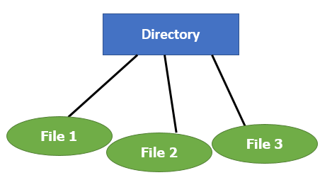
File Directories
A single directory may or may not contain multiple files. It can also have sub-directories inside the main directory. Information about files is maintained by Directories. In Windows OS, it is called folders.
Following is the information which is maintained in a directory:
Name The name which is displayed to the user.
Type: Type of the directory.
Position: Current next-read/write pointers.
Location: Location on the device where the file header is stored.
Size : Number of bytes, block, and words in the file.
Protection: Access control on read/write/execute/delete.
Usage: Time of creation, access, modification
1

Slide 19
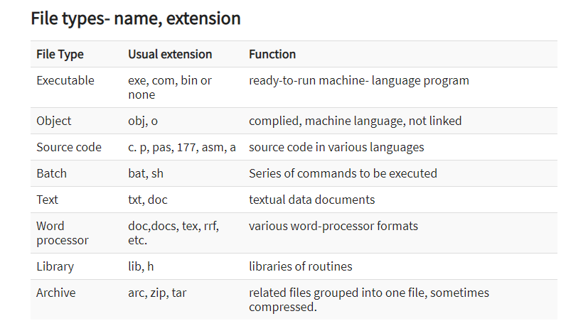
Extensions
1

Slide 20
Summary
A file is a collection of correlated information which is recorded on secondary or non-volatile storage like magnetic disks, optical disks, and tapes.
It provides I/O support for a variety of storage device types.
Files are stored on disk or other storage and do not disappear when a user logs off.
A File Structure needs to be predefined format in such a way that an operating system understands it.
File type refers to the ability of the operating system to differentiate different types of files like text files, binary, and source files.
Create find space on disk and make an entry in the directory.
Indexed Sequential Access method is based on simple sequential access
In Sequential Access method records are accessed in a certain pre-defined sequence
The random access method is also called direct random access
Three types of space allocation methods are:
  Linked Allocation
  Indexed Allocation
  Contiguous Allocation
Information about files is maintained by Directories
1

Slide 21
File Directory
Collection of files is a file directory. The directory contains information about the files, including attributes, location and ownership. Much of this information, especially that is concerned with storage, is managed by the operating system. The directory is itself a file, accessible by various file management routines.
Information contained in a device directory are:
Name
Type
Address
Current length
Maximum length
Date last accessed
Date last updated
Owner id
Protection information
1

Slide 22
Cont..
Operation performed on directory are:
Search for a file
Create a file
Delete a file
List a directory
Rename a file
Traverse the file system
Advantages of maintaining directories are:
Efficiency: A file can be located more quickly.
Naming: It becomes convenient for users as two users can have same name for different files or may have different name for same file.
Grouping: Logical grouping of files can be done by properties e.g. all java programs, all games etc.
1

Slide 23
Structures of Directory in Operating System
A directory is a container that is used to contain folders and file. It organizes files and folders into a hierarchical manner.
1

Slide 24
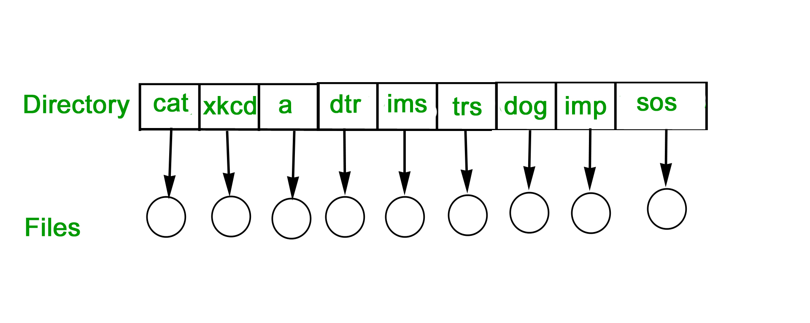
Cont..
SINGLE-LEVEL DIRECTORY
In this a single directory is maintained for all the users.
Naming problem: Users cannot have same name for two files.
Grouping problem: Users cannot group files according to their need.
1

Slide 25
Cont..
Single-level directory –
Single level directory is simplest directory structure.In it all files are contained in same directory which make it easy to support and understand.A single level directory has a significant limitation, however, when the number of files increases or when the system has more than one user. Since all the files are in the same directory, they must have the unique name . if two users call their dataset test, then the unique name rule violated.
Advantages:
Since it is a single directory, so its implementation is very easy.
If the files are smaller in size, searching will become faster.
The operations like file creation, searching, deletion, updating are very easy in such a directory structure.
Disadvantages:
There may chance of name collision because two files can not have the same name.
Searching will become time taking if the directory is large.
In this can not group the same type of files together.
1

Slide 26
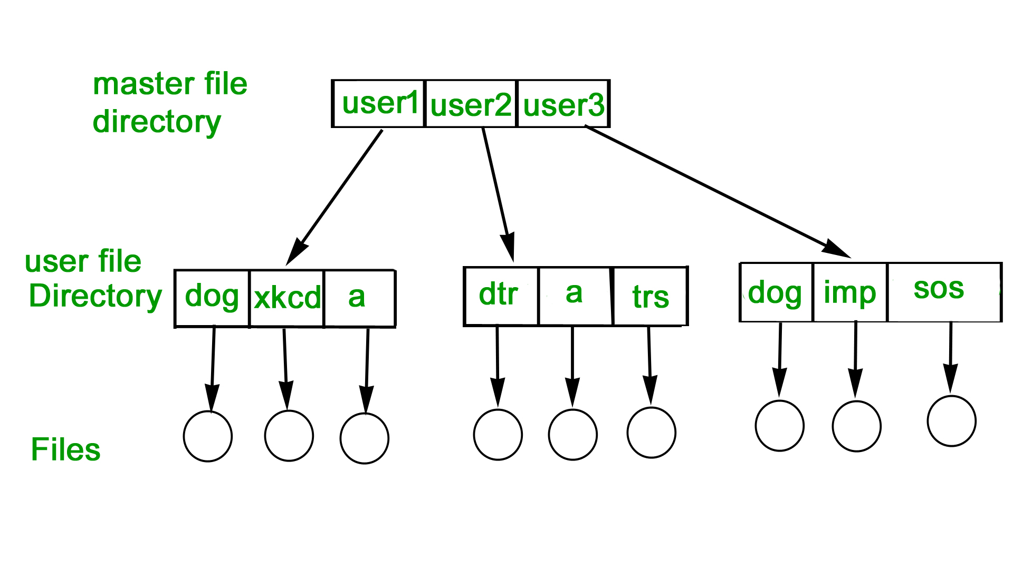
Cont..
TWO-LEVEL DIRECTORY
In this separate directories for each user is maintained.
Path name: Due to two levels there is a path name for every file to locate that file.
Now, we can have same file name for different user.
Searching is efficient in this method.
1

Slide 27
Cont..
As we have seen, a single level directory often leads to confusion of files names among different users. the solution to this problem is to create a separate directory for each user.In the two-level directory structure, each user has there own user files directory (UFD). The UFDs has similar structures, but each lists only the files of a single user. system’s master file directory (MFD) is searches whenever a new user id=s logged in. The MFD is indexed by username or account number, and each entry points to the UFD for that user.
1

Slide 28
Cont..
Advantages:
We can give full path like /User-name/directory-name/.
Different users can have same directory as well as file name.
Searching of files become more easy due to path name and user-grouping.
Disadvantages:
A user is not allowed to share files with other users.
Still it not very scalable, two files of the same type cannot be grouped together in the same user.
1

Slide 29
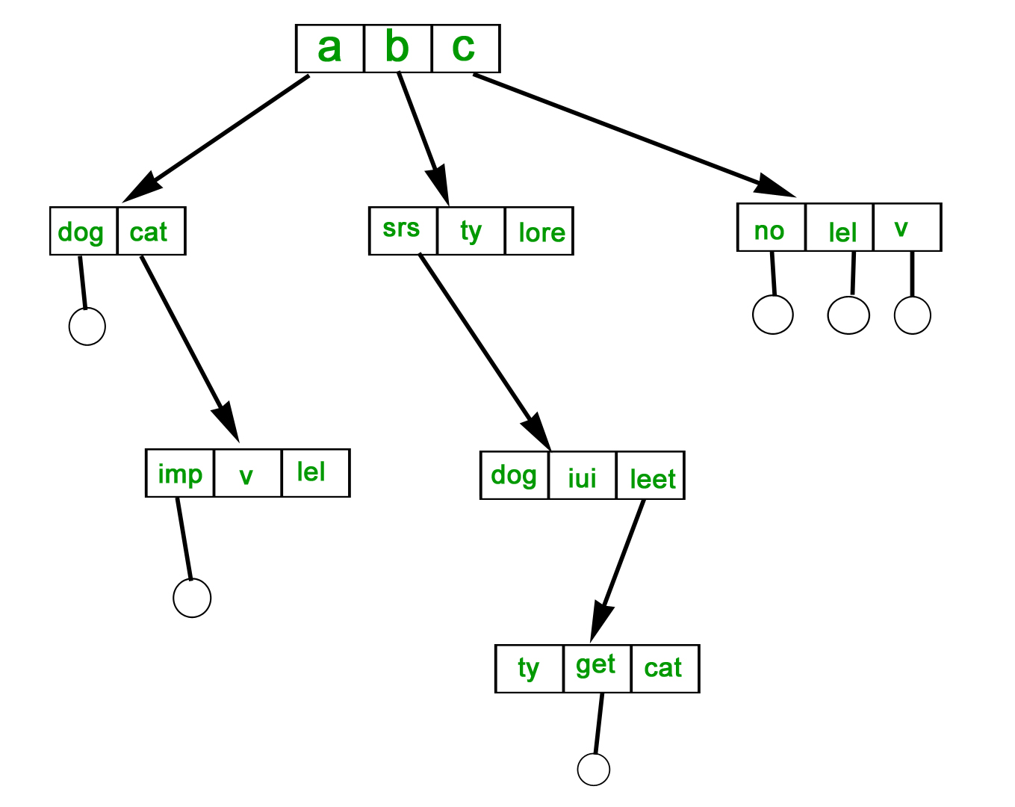
Cont..
TREE-STRUCTURED DIRECTORY :
Directory is maintained in the form of a tree.
Searching is efficient and also there is grouping capability.
We have absolute or relative path name for a file.
1

Slide 30
Cont..
TREE-STRUCTURED DIRECTORY :
Once we have seen a two-level directory as a tree of height 2, the natural generalization is to extend the directory structure to a tree of arbitrary height.
This generalization allows the user to create there own subdirectories and to organize on their files accordingly.
1

Slide 31
Cont..
TREE-STRUCTURED DIRECTORY :
A tree structure is the most common directory structure. The tree has a root directory, and every file in the system have a unique path.
Advantages:
Very generalize, since full path name can be given.
Very scalable, the probability of name collision is less.
Searching becomes very easy, we can use both absolute path as well as relative.
Disadvantages:
Every file does not fit into the hierarchical model, files may be saved into multiple directories.
We can not share files.
It is inefficient, because accessing a file may go under multiple directories.
1

Slide 32
Acyclic graph directory –
An acyclic graph is a graph with no cycle and allows to share subdirectories and files. The same file or subdirectories may be in two different directories. It is a natural generalization of the tree-structured directory.It is used in the situation like when two programmers are working on a joint project and they need to access files.
The associated files are stored in a subdirectory, separating them from other projects and files of other programmers, since they are working on a joint project so they want the subdirectories to be into their own directories. The common subdirectories should be shared. So here we use Acyclic directories.
It is the point to note that shared file is not the same as copy file . If any programmer makes some changes in the subdirectory it will reflect in both subdirectories.
1

Slide 33
Acyclic graph directory –
Advantages:
We can share files.
Searching is easy due to different-different paths.
Disadvantages:
We share the files via linking, in case of deleting it may create the problem,
If the link is softlink then after deleting the file we left with a dangling pointer.
In case of hardlink, to delete a file we have to delete all the reference associated with it.
1

Slide 34
General graph directory structure –
In general graph directory structure, cycles are allowed within a directory structure where multiple directories can be derived from more than one parent directory.
The main problem with this kind of directory structure is to calculate total size or space that has been taken by the files and directories.
Advantages:
It allows cycles.
It is more flexible than other directories structure.
Disadvantages:
It is more costly than others.
It needs garbage collection.
1

Slide 35
FILE ALLOCATION METHODS
The allocation methods define how the files are stored in the disk blocks. There are three main disk space or file allocation methods.
Contiguous Allocation
Linked Allocation
Indexed Allocation
The main idea behind these methods is to provide:
Efficient disk space utilization.
Fast access to the file blocks.
All the three methods have their own advantages and disadvantages as discussed
1

Slide 36
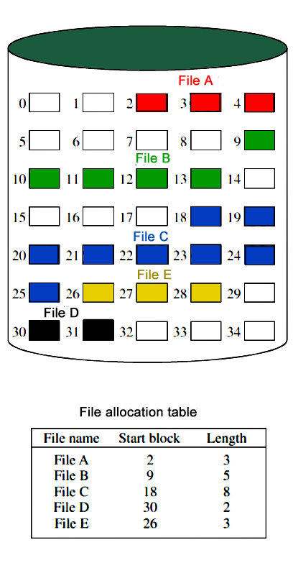
FILE ALLOCATION METHODS
Continuous Allocation: A single continuous set of blocks is allocated to a file at the time of file creation. Thus, this is a pre-allocation strategy, using variable size portions. The file allocation table needs just a single entry for each file, showing the starting block and the length of the file.
This method is best from the point of view of the individual sequential file. Multiple blocks can be read in at a time to improve I/O performance for sequential processing. It is also easy to retrieve a single block. For example, if a file starts at block b, and the ith block of the file is wanted, its location on secondary storage is simply b+i-1.
1

Slide 37
Cont..
The directory entry for a file with contiguous allocation contains
Address of starting block
Length of the allocated portion.
Advantages:
Both the Sequential and Direct Accesses are supported by this.
For direct access, the address of the kth block of the file which starts at block b can easily be obtained as (b+k).
This is extremely fast since the number of seeks are minimal because of contiguous allocation of file blocks.
1

Slide 38
Cont..
Disadvantage
External fragmentation will occur, making it difficult to find contiguous blocks of space of sufficient length.
Compaction algorithm will be necessary to free up additional space on disk.
Also, with pre-allocation, it is necessary to declare the size of the file at the time of creation.
1

Slide 39
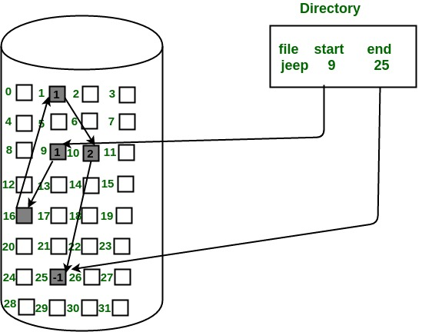
Linked Allocation(Non-contiguous allocation) :
Allocation is on an individual block basis. Each block contains a pointer to the next block in the chain. Again the file table needs just a single entry for each file, showing the starting block and the length of the file. Although pre-allocation is possible, it is more common simply to allocate blocks as needed. Any free block can be added to the chain. The blocks need not be continuous. Increase in file size is always possible if free disk block is available. There is no external fragmentation because only one block at a time is needed but there can be internal fragmentation but it exists only in the last disk block of file.
1

Slide 40
Linked Allocation(Non-contiguous allocation) :
Advantages:
This is very flexible in terms of file size. File size can be increased easily since the system does not have to look for a contiguous chunk of memory.
This method does not suffer from external fragmentation. This makes it relatively better in terms of memory utilization.
Disadvantages:
Because the file blocks are distributed randomly on the disk, a large number of seeks are needed to access every block individually. This makes linked allocation slower.
It does not support random or direct access. We can not directly access the blocks of a file. A block k of a file can be accessed by traversing k blocks sequentially (sequential access ) from the starting block of the file via block pointers.
Pointers required in the linked allocation incur some extra overhead.
Internal fragmentation exists in last disk block of file.
There is an overhead of maintaining the pointer in every disk block.
If the pointer of any disk block is lost, the file will be truncated.
It supports only the sequencial access of files.
1

Slide 41
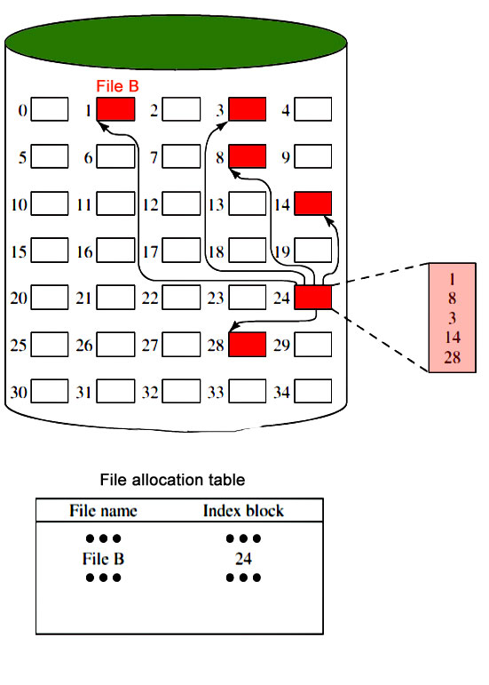
Indexed Allocation
It addresses many of the problems of contiguous and chained allocation. In this case, the file allocation table contains a separate one-level index for each file.
The index has one entry for each block allocated to the file. Allocation may be on the basis of fixed-size blocks or variable-sized blocks.
Allocation by blocks eliminates external fragmentation, whereas allocation by variable-size blocks improves locality. This allocation technique supports both sequential and direct access to the file and thus is the most popular form of file allocation.
1

Slide 42
Indexed Allocation
Advantages:
This supports direct access to the blocks occupied by the file and therefore provides fast access to the file blocks.
It overcomes the problem of external fragmentation.
Disadvantages:
The pointer overhead for indexed allocation is greater than linked allocation.
For very small files, say files that expand only 2-3 blocks, the indexed allocation would keep one entire block (index block) for the pointers which is inefficient in terms of memory utilization. However, in linked allocation we lose the space of only 1 pointer per block.
1

Slide 43
Cont..
For files that are very large, single index block may not be able to hold all the pointers.
Following mechanisms can be used to resolve this:
Linked scheme: This scheme links two or more index blocks together for holding the pointers. Every index block would then contain a pointer or the address to the next index block.
Multilevel index: In this policy, a first level index block is used to point to the second level index blocks which inturn points to the disk blocks occupied by the file. This can be extended to 3 or more levels depending on the maximum file size.
Combined Scheme: In this scheme, a special block called the Inode (information Node) contains all the information about the file such as the name, size, authority, etc and the remaining space of Inode is used to store the Disk Block addresses which contain the actual file
1

Slide 44
Disk Free Space Management
Just as the space that is allocated to files must be managed ,so the space that is not currently allocated to any file must be managed. To perform any of the file allocation techniques,it is necessary to know what blocks on the disk are available. Thus we need a disk allocation table in addition to a file allocation table.The following are the approaches used for free space management.
Bit Tables : This method uses a vector containing one bit for each block on the disk. Each entry for a 0 corresponds to a free block and each 1 corresponds to a block in use.
For example: 00011010111100110001In this vector every bit correspond to a particular block and 0 implies that, that particular block is free and 1 implies that the block is already occupied. A bit table has the advantage that it is relatively easy to find one or a contiguous group of free blocks.
Advantages
a bit table works well with any of the file allocation methods.
Another advantage is that it is as small as possible.
1

Slide 45
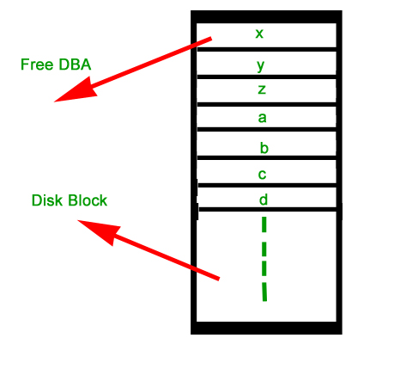
Disk Free Space Management
Free Block List : In this method, each block is assigned a number sequentially and the list of the numbers of all free blocks is maintained in a reserved block of the disk.
1

Slide 46
REFERENCES
Text/Reference Books:
A. Silberschatz and Peter B Galvin: Operating System Principals, Wiley India Pvt. Ltd.
Achyut S Godbole: Operating Systems, Tata McGraw Hill
Tanenbaum: Modern Operating System, Prentice Hall.
DM Dhamdhere: Operating Systems – A Concepts Based Approach, Tata McGraw Hill 5.
Charles Crowly: Operating System A Design – Oriented Approach, Tata McGraw Hill.
1

Slide 47



B.Umamaheswari (Asst. Prof, CSE) , JECRC, JAIPUR

