Slide 1
JAIPUR ENGINEERING COLLEGE AND RESEARCH CENTRE
Year & Sem – III year & V Sem
Subject – Operating System
Topic : DeadLock (UNIT 3)
Presented by – Dr. Nilam Choudhary, Associate Professor, CSE
1

Slide 2
System Model
For the purposes of deadlock discussion, a system can be modeled as a collection of limited resources, which can be partitioned into different categories, to be allocated to a number of processes, each having different needs.
Resource categories may include memory, printers, CPUs, open files, tape drives, CD-ROMS, etc.
By definition, all the resources within a category are equivalent, and a request of this category can be equally satisfied by any one of the resources in that category.
If this is not the case ( i.e. if there is some difference between the resources within a category ), then that category needs to be further divided into separate categories. For example, "printers" may need to be separated into "laser printers" and "color inkjet printers".
Some categories may have a single resource.
1

Slide 3
System Model Cont..
In normal operation a process must request a resource before using it, and release it when it is done, in the following sequence:
Request - If the request cannot be immediately granted, then the process must wait until the resource(s) it needs become available. For example the system calls open( ), malloc( ), new( ), and request( ).
Use - The process uses the resource, e.g. prints to the printer or reads from the file.
Release - The process relinquishes the resource. so that it becomes available for other processes. For example, close( ), free( ), delete( ), and release( ).
1

Slide 4
System Model Cont..
For all kernel-managed resources, the kernel keeps track of what resources are free and which are allocated, to which process they are allocated, and a queue of processes waiting for this resource to become available.
Application-managed resources can be controlled using mutexes or wait( ) and signal( ) calls, ( i.e. binary or counting semaphores. )
A set of processes is deadlocked when every process in the set is waiting for a resource that is currently allocated to another process in the set ( and which can only be released when that other waiting process makes progress. )
1

Slide 5
DeadLock in Operating System
A process in operating systems uses different resources and uses resources in following way. 1) Requests a resource 2) Use the resource 3) Releases the resource
Deadlock is a situation where a set of processes are blocked because each process is holding a resource and waiting for another resource acquired by some other process.
Consider an example when two trains are coming toward each other on same track and there is only one track, none of the trains can move once they are in front of each other.
Similar situation occurs in operating systems when there are two or more processes hold some resources and wait for resources held by other(s).
1

Slide 6
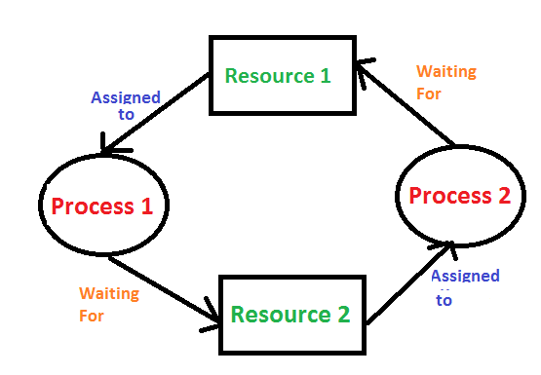
(Cont..)
For example, in the below diagram, Process 1 is holding Resource 1 and waiting for resource 2 which is acquired by process 2, and process 2 is waiting for resource 1.
In this scenario, a cycle is being formed among the two processes. None of the process is progressing and they are all waiting. The computer becomes unresponsive since all the processes got blocked.
1

Slide 7
Difference between Starvation and Deadlock
1

Slide 8
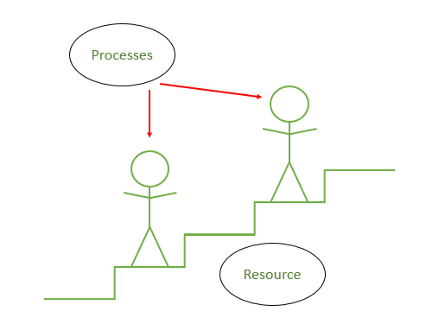
Conditions for Deadlock in Operating System
We can visualize the occurrence of deadlock as a situation where there are two people on a staircase.
One is ascending the staircase while the other is descending. The staircase is so narrow that it can only fit one person at a time.
As a result, one has to retreat while the others moves on and uses the staircase. Once that person is finished, the other one can use that staircase.
But here, none of the people is willing to retreat and waits for the each other to retreat. None of them is able to use the staircase. The people here is the process and the staircase is the resource.
1

Slide 9
There are 4 conditions necessary for the occurrence of a deadlock.
Mutual Exclusion: When two people meet in the landings, they can’t just walk through because there is space only for one person. This condition to allow only one person (or process) to use the step between them (or the resource) is the first condition necessary for the occurrence of the deadlock.
Hold and Wait: When the 2 people refuses to retreat and hold their grounds, it is called holding. This is the next necessary condition for the the deadlock.
No Preemption: For resolving the deadlock one can simply cancel one of the processes for other to continue. But Operating System doesn’t do so. It allocates the resources to the processors for as much time needed until the task is completed. Hence, there is no temporary reallocation of the resources. It is third condition for deadlock.
1

Slide 10
There are 4 conditions necessary for the occurrence of a deadlock.
4.Circular Wait: When the two people refuses to retreat and wait for each other to retreat, so that they can complete their task, it is called circular wait. It is the last condition for the deadlock to occur.
Note
All the 4 conditions are necessary for the deadlock to occur. If any one is prevented or resolved, the deadlock is resolved.
1

Slide 11
Coffman Conditions
A deadlock occurs if the four Coffman conditions hold true. But these conditions are not mutually exclusive.
The Coffman conditions are given as follows −
Mutual Exclusion
There should be a resource that can only be held by one process at a time. In the diagram below, there is a single instance of Resource 1 and it is held by Process 1 only.
1

Slide 12
Cont..
Hold and Wait:
A process can hold multiple resources and still request more resources from other processes which are holding them. In the diagram given below, Process 2 holds Resource 2 and Resource 3 and is requesting the Resource 1 which is held by Process 1.
1

Slide 13
Cont..
No Preemption
A resource cannot be preempted from a process by force. A process can only release a resource voluntarily. In the diagram below, Process 2 cannot preempt Resource 1 from Process 1. It will only be released when Process 1 relinquishes it voluntarily after its execution is complete.
1

Slide 14
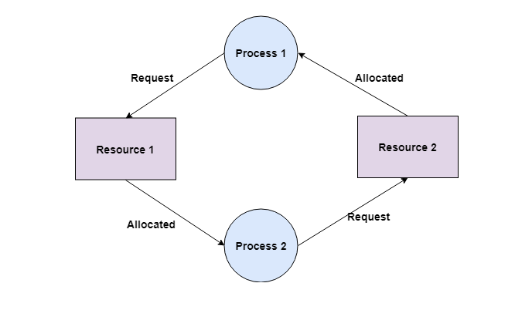
Cont..
Circular Wait
A process is waiting for the resource held by the second process, which is waiting for the resource held by the third process and so on, till the last process is waiting for a resource held by the first process. This forms a circular chain. For example: Process 1 is allocated Resource2 and it is requesting Resource 1. Similarly, Process 2 is allocated Resource 1 and it is requesting Resource 2. This forms a circular wait loop.
1

Slide 15
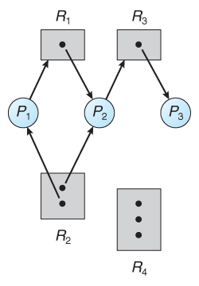
Resource-Allocation Graph
In some cases deadlocks can be understood more clearly through the use of Resource-Allocation Graphs, having the following properties:A set of resource categories, { R1, R2, R3, . . ., RN }, which appear as square nodes on the graph. Dots inside the resource nodes indicate specific instances of the resource. ( E.g. two dots might represent two laser printers. )
A set of processes, { P1, P2, P3, . . ., PN }
Request Edges - A set of directed arcs from Pi to Rj, indicating that process Pi has requested Rj, and is currently waiting for that resource to become available.
Assignment Edges - A set of directed arcs from Rj to Pi indicating that resource Rj has been allocated to process Pi, and that Pi is currently holding resource Rj.
Note that a request edge can be converted into an assignment edge by reversing the direction of the arc when the request is granted. ( However note also that request edges point to the category box, whereas assignment edges emanate from a particular instance dot within the box.
1

Slide 16
Resource-Allocation Graph(RAG)
Resource Allocation Graph (RAG) is the state of the system in terms of processes and resources.
Like how many resources are available, how many are allocated and what is the request of each process. Everything can be represented in terms of the diagram.
One of the advantages of having a diagram is, sometimes it is possible to see a deadlock directly by using RAG, but then you might not be able to know that by looking at the table.
But the tables are better if the system contains lots of process and resource and Graph is better if the system contains less number of process and resource.
Any graph contains vertices and edges. So RAG also contains vertices and edges.
1

Slide 17
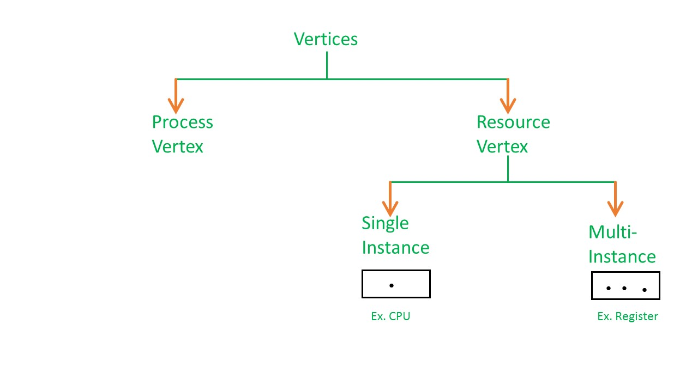
Resource-Allocation Graph Cont..
In RAG vertices are two type –
Process vertex – Every process will be represented as a process vertex.Generally, the process will be represented with a circle.
Resource vertex – Every resource will be represented as a resource vertex. It is also two type –
Single instance type resource – It represents as a box, inside the box, there will be one dot. So the number of dots indicate how many instances are present of each resource type.
Multi-resource instance type resource – It also represents as a box, inside the box, there will be many dots present.
1

Slide 18
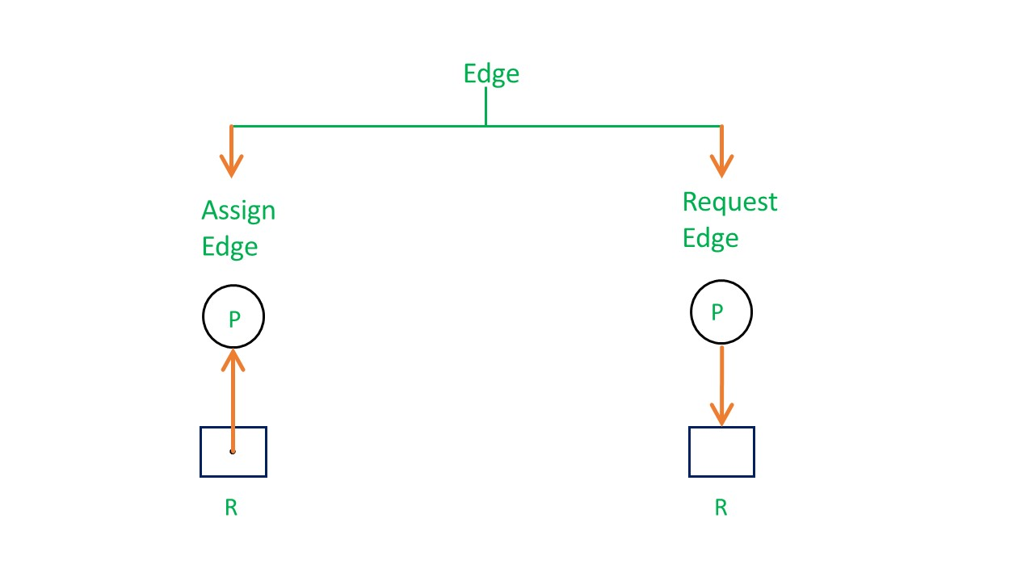
Resource-Allocation Graph Cont..
Now coming to the edges of RAG.There are two types of edges in RAG – 1. Assign Edge – If you already assign a resource to a process then it is called Assign edge. 2. Request Edge – It means in future the process might want some resource to complete the execution, that is called request edge.
So, if a process is using a resource, an arrow is drawn from the resource node to the process node. If a process is requesting a resource, an arrow is drawn from the process node to the resource node.
1

Slide 19
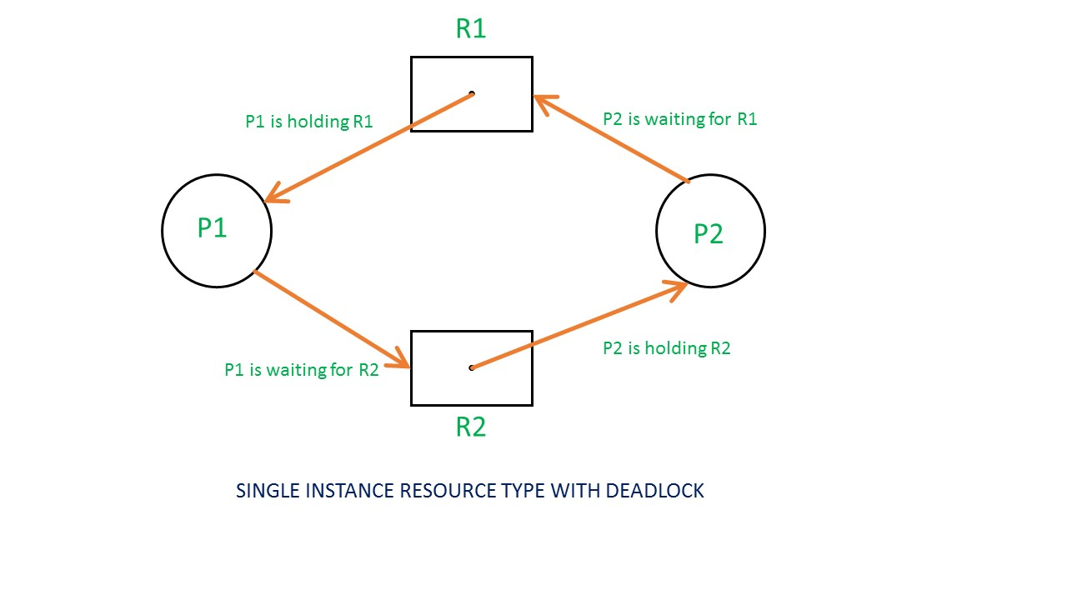
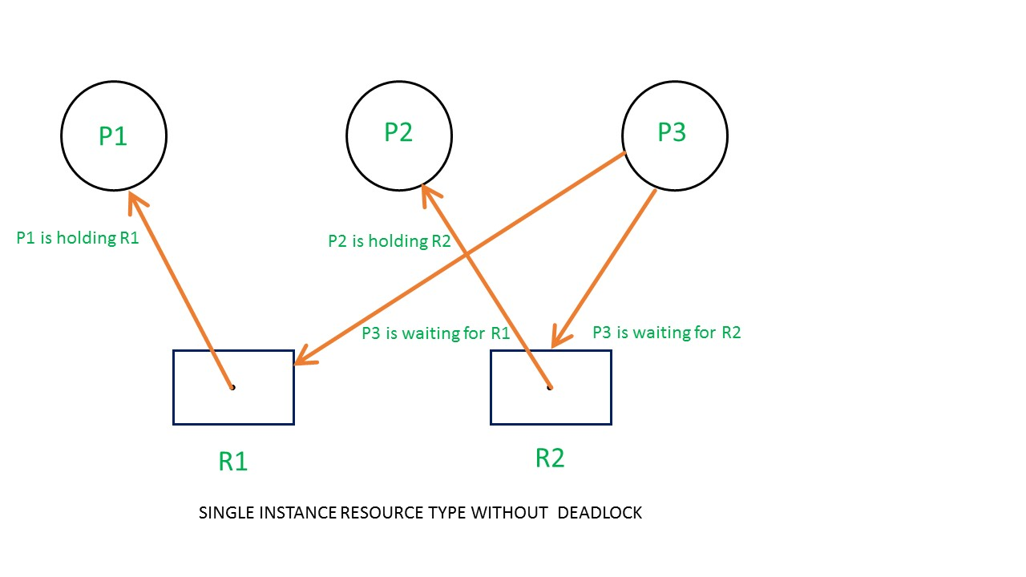
Example 1 (Single instances RAG) –
If there is a cycle in the Resource Allocation Graph and each resource in the cycle provides only one instance, then the processes will be in deadlock. For example, if process P1 holds resource R1, process P2 holds resource R2 and process P1 is waiting for R2 and process P2 is waiting for R1, then process P1 and process P2 will be in deadlock.
Here’s another example, that shows Processes P1 and P2 acquiring resources R1 and R2 while process P3 is waiting to acquire both resources. In this example, there is no deadlock because there is no circular dependency. So cycle in single-instance resource type is the sufficient condition for deadlock.
1

Slide 20
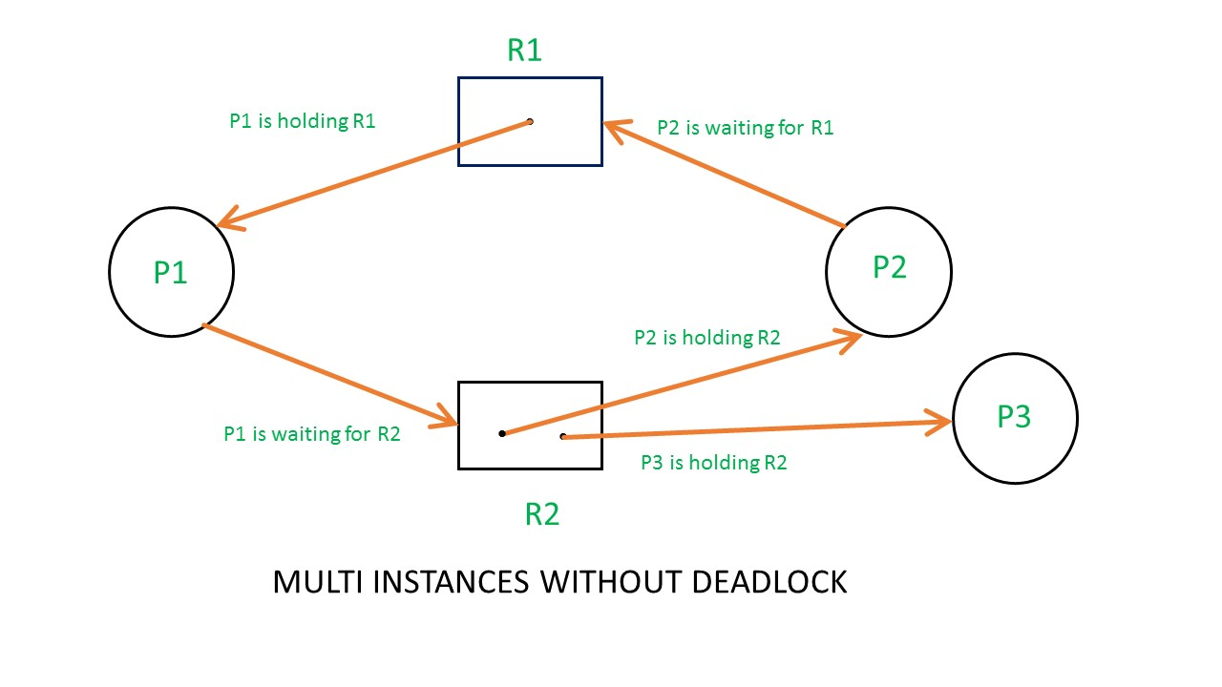
Example 2 (Multi-instances RAG) –
From the above example, it is not possible to say the RAG is in a safe state or in an unsafe state.So to see the state of this RAG, let’s construct the allocation matrix and request matrix.
1

Slide 21
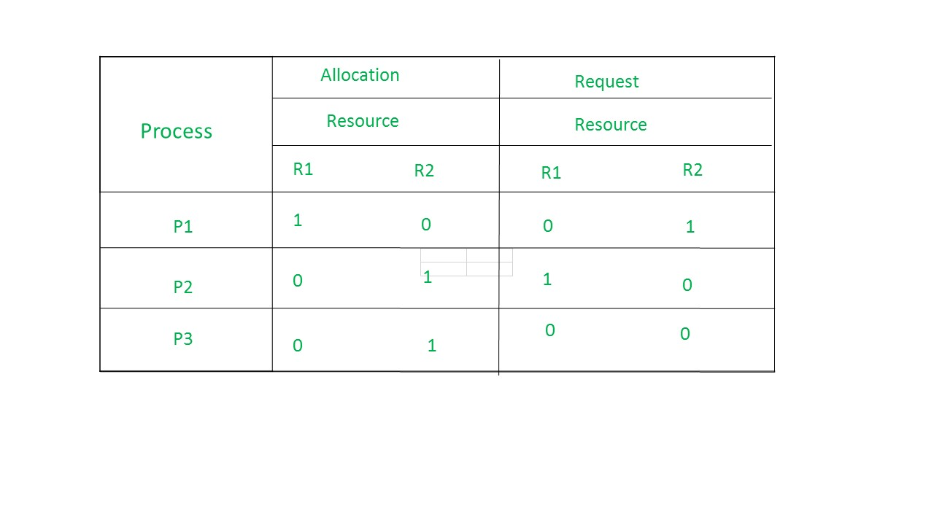
Multi-instances RAG(Cont..)
The total number of processes are three; P1, P2 & P3 and the total number of resources are two; R1 & R2.
Allocation matrix –
For constructing the allocation matrix, just go to the resources and see to which process it is allocated.
R1 is allocated to P1, therefore write 1 in allocation matrix and similarly, R2 is allocated to P2 as well as P3 and for the remaining element just write 0.
1

Slide 22
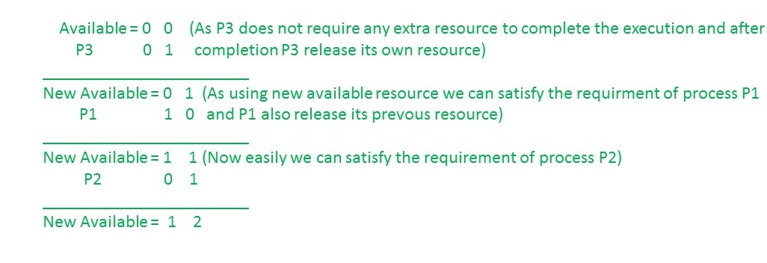
Multi-instances RAG(Cont..)
Request matrix –
In order to find out the request matrix, you have to go to the process and see the outgoing edges.
P1 is requesting resource R2, so write 1 in the matrix and similarly, P2 requesting R1 and for the remaining element write 0.
So now available resource is = (0, 0).
Checking deadlock (safe or not) –
So, there is no deadlock in this RAG. Even though there is a cycle, still there is no deadlock. Therefore in multi-instance resource cycle is not sufficient condition for deadlock.
1

Slide 23
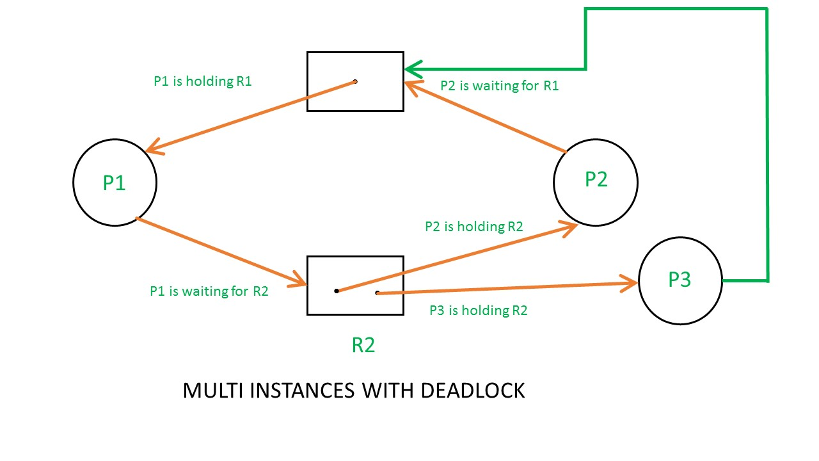
Cont..
Above example is the same as the previous example except that, the process P3 requesting for resource R1. So the table becomes as shown in below.
1

Slide 24
Cont..
Basic Facts
If graph contains no cycles ⇒ no deadlock
If graph contains a cycle ⇒
if only one instance per resource type, then deadlock
if several instances per resource type, possibility of deadlock
So the Available resource is = (0, 0), but requirement are (0, 1), (1, 0) and (1, 0).So you can’t fulfill any one requirement. Therefore, it is in deadlock.
Therefore, every cycle in a multi-instance resource type graph is not a deadlock, if there has to be a deadlock, there has to be a cycle. So, in case of RAG with multi-instance resource type, the cycle is a necessary condition for deadlock, but not sufficient.
1

Slide 25
Strategies for handling Deadlock
Ensure that the system will never enter a deadlock state:
Deadlock prevention
Deadlock avoidance
Allow the system to enter a deadlock state and then recover
Ignore the problem and pretend that deadlocks never occur in the system; used by most operating systems, including UNIX
1

Slide 26
Strategies for handling Deadlock Cont..
Deadlock Ignorance
Deadlock Ignorance is the most widely used approach among all the mechanism. This is being used by many operating systems mainly for end user uses. In this approach, the Operating system assumes that deadlock never occurs. It simply ignores deadlock. This approach is best suitable for a single end user system where User uses the system only for browsing and all other normal stuff.
There is always a tradeoff between Correctness and performance. The operating systems like Windows and Linux mainly focus upon performance. However, the performance of the system decreases if it uses deadlock handling mechanism all the time if deadlock happens 1 out of 100 times then it is completely unnecessary to use the deadlock handling mechanism all the time.
In these types of systems, the user has to simply restart the computer in the case of deadlock. Windows and Linux are mainly using this approach.
1

Slide 27
Strategies for handling Deadlock Cont..
Deadlock prevention
Deadlock happens only when Mutual Exclusion, hold and wait, No preemption and circular wait holds simultaneously. If it is possible to violate one of the four conditions at any time then the deadlock can never occur in the system.
The idea behind the approach is very simple that we have to fail one of the four conditions but there can be a big argument on its physical implementation in the system.
1

Slide 28
Strategies for handling Deadlock Cont..
Deadlock avoidance
In deadlock avoidance, the operating system checks whether the system is in safe state or in unsafe state at every step which the operating system performs. The process continues until the system is in safe state. Once the system moves to unsafe state, the OS has to backtrack one step. In simple words, The OS reviews each allocation so that the allocation doesn't cause the deadlock in the system.
Deadlock detection and recovery
This approach let the processes fall in deadlock and then periodically check whether deadlock occur in the system or not. If it occurs then it applies some of the recovery methods to the system to get rid of deadlock.
1

Slide 29
Deadlock Prevention
Restrain the ways request can be made
Mutual Exclusion – not required for sharable resources (e.g., read-only files); must hold for non-sharable resources
Hold and Wait – must guarantee that whenever a process requests a resource, it does not hold any other resources
Require process to request and be allocated all its resources before it begins execution, or allow process to request resources only when the process has none allocated to it.
Low resource utilization; starvation possible
1

Slide 30
Deadlock Prevention (Cont.)
No Preemption –
If a process that is holding some resources requests another resource that cannot be immediately allocated to it, then all resources currently being held are released
Preempted resources are added to the list of resources for which the process is waiting
Process will be restarted only when it can regain its old resources, as well as the new ones that it is requesting
Circular Wait – impose a total ordering of all resource types, and require that each process requests resources in an increasing order of enumeration
1

Slide 31
Handling Deadlock
The above points focus on preventing deadlocks. But what to do once a deadlock has occured.
Following three strategies can be used to remove deadlock after its occurrence.
PreemptionWe can take a resource from one process and give it to other. This will resolve the deadlock situation, but sometimes it does causes problems.
RollbackIn situations where deadlock is a real possibility, the system can periodically make a record of the state of each process and when deadlock occurs, roll everything back to the last checkpoint, and restart, but allocating resources differently so that deadlock does not occur.
Kill one or more processesThis is the simplest way, but it works.
1

Slide 32
What is a Livelock?
There is a variant of deadlock called livelock.
This is a situation in which two or more processes continuously change their state in response to changes in the other process(es) without doing any useful work.
This is similar to deadlock in that no progress is made but differs in that neither process is blocked or waiting for anything.
A human example of livelock would be two people who meet face-to-face in a corridor and each moves aside to let the other pass, but they end up swaying from side to side without making any progress because they always move the same way at the same time.
1

Slide 33
Deadlock Avoidance
Requires that the system has some additional a priori information available
Simplest and most useful model requires that each process declare the maximum number of resources of each type that it may need
The deadlock-avoidance algorithm dynamically examines the resource-allocation state to ensure that there can never be a circular-wait condition
Resource-allocation state is defined by the number of available and allocated resources, and the maximum demands of the processes
1

Slide 34
Safe State
When a process requests an available resource, system must decide if immediate allocation leaves the system in a safe state
System is in safe state if there exists a sequence <P₁, P₂, …, P_{n}> of ALL the processes in the systems such that for each P_{i}, the resources that P_{i} can still request can be satisfied by currently available resources + resources held by all the P_{j}, with j < I
That is:
If P_{i} resource needs are not immediately available, then P_{i} can wait until all P_{j} have finished
When P_{j} is finished, P_{i} can obtain needed resources, execute, return allocated resources, and terminate
When P_{i} terminates, P_{i +1} can obtain its needed resources, and so on
1

Slide 35
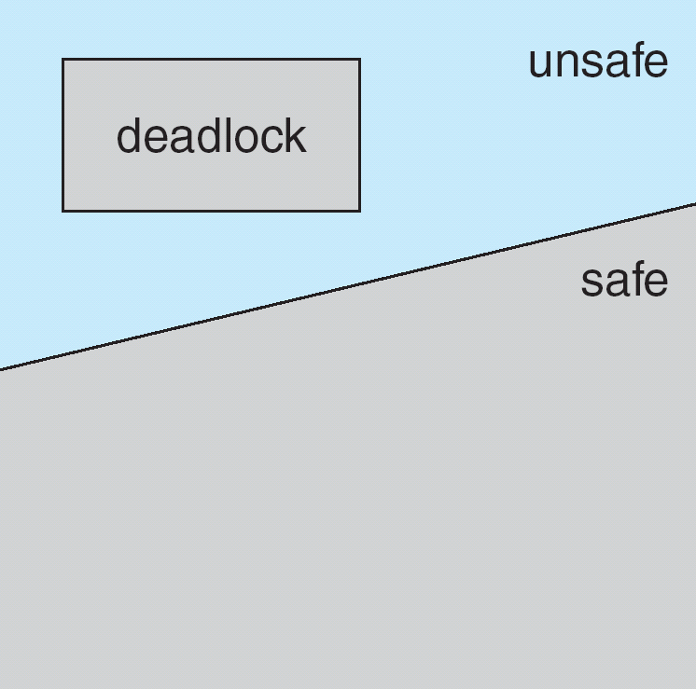
Basic Facts
Safe, Unsafe, Deadlock State
If a system is in safe state ⇒ no deadlocks
If a system is in unsafe state ⇒ possibility of deadlock
Avoidance ⇒ ensure that a system will never enter an unsafe state.
1

Slide 36
Avoidance Algorithms
Single instance of a resource type
Use a resource-allocation graph
Multiple instances of a resource type
Use the banker’s algorithm
1

Slide 37
What is Banker's Algorithm?
Banker's Algorithm is used majorly in the banking system to avoid deadlock. It helps you to identify whether a loan will be given or not.
This algorithm is used to test for safely simulating the allocation for determining the maximum amount available for all resources. It also checks for all the possible activities before determining whether allocation should be continued or not.
For example, there are X number of account holders of a specific bank, and the total amount of money of their accounts is G.
When the bank processes a car loan, the software system subtracts the amount of loan granted for purchasing a car from the total money ( G+ Fixed deposit + Monthly Income Scheme + Gold, etc.) that the bank has.
It also checks that the difference is more than or not G. It only processes the car loan when the bank has sufficient money even if all account holders withdraw the money G simultaneously.
1

Slide 38
Banker's Algorithm Notations
Let ‘n’ be the number of processes in the system and ‘m’ be the number of resources types.
Available :
It is a 1-d array of size ‘m’ indicating the number of available resources of each type.
Available[ j ] = k means there are ‘k’ instances of resource type R_{j}
Max :
It is a 2-d array of size ‘n*m’ that defines the maximum demand of each process in a system.
Max[ i, j ] = k means process P_{i} may request at most ‘k’ instances of resource type R_{j.}
Allocation :
It is a 2-d array of size ‘n*m’ that defines the number of resources of each type currently allocated to each process.
Allocation[ i, j ] = k means process P_{i} is currently allocated ‘k’ instances of resource type R_{j}
1

Slide 39
Banker's Algorithm Notations Cont…
It is a 2-d array of size ‘n*m’ that indicates the remaining resource need of each process.
Need [ i, j ] = k means process P_{i} currently need ‘k’ instances of resource type R_{j}
for its execution.
Need [ i, j ] = Max [ i, j ] – Allocation [ i, j ]
Allocation_{i} specifies the resources currently allocated to process P_{i} and Need_{i} specifies the additional resources that process P_{i} may still request to complete its task.
Banker’s algorithm consists of Safety algorithm and Resource request algorithm
1

Slide 40
Safety Algorithm
The algorithm for finding out whether or not a system is in a safe state can be described as follows:
1) Let Work and Finish be vectors of length ‘m’ and ‘n’ respectively. Initialize: Work = Available Finish[i] = false; for i=1, 2, 3, 4….n
2) Find an i such that both a) Finish[i] = false b) Need_{i} <= Work if no such i exists goto step (4)
3) Work = Work + Allocation[i] Finish[i] = true goto step (2)
4) if Finish [i] = true for all i then the system is in a safe state
1

Slide 41
Resource-Request Algorithm
Let Request_{i} be the request array for process P_{i}. Request_{i} [j] = k means process P_{i} wants k instances of resource type R_{j}. When a request for resources is made by process P_{i}, the following actions are taken:
1) If Request_{i} <= Need_{i} Goto step (2) ; otherwise, raise an error condition, since the process has exceeded its maximum claim.
2) If Request_{i} <= Available Goto step (3); otherwise, P_{i} must wait, since the resources are not available.
3) Have the system pretend to have allocated the requested resources to process Pi by modifying the state as follows: Available = Available – Requesti Allocation_{i} = Allocation_{i} + Request_{i} Need_{i} = Need_{i}– Request_{i}
1

Slide 42
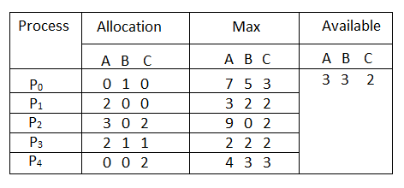
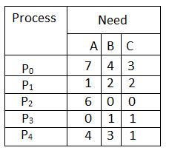
Example:
Considering a system with five processes P₀ through P₄ and three resources of type A, B, C. Resource type A has 10 instances, B has 5 instances and type C has 7 instances. Suppose at time t₀ following snapshot of the system has been taken:
What will be the content of the Need matrix?
Need [i, j] = Max [i, j] – Allocation [i, j]
So, the content of Need Matrix is:
1

Slide 43
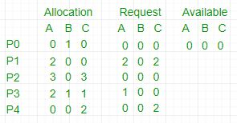
Cont…
In this, Work = [0, 0, 0] & Finish = [false, false, false, false, false]
i=0 is selected as both Finish[0] = false and [0, 0, 0]<=[0, 0, 0].
Work =[0, 0, 0]+[0, 1, 0] =>[0, 1, 0] & Finish = [true, false, false, false, false].
i=2 is selected as both Finish[2] = false and [0, 0, 0]<=[0, 1, 0].
Work =[0, 1, 0]+[3, 0, 3] =>[3, 1, 3] & Finish = [true, false, true, false, false].
i=1 is selected as both Finish[1] = false and [2, 0, 2]<=[3, 1, 3].
Work =[3, 1, 3]+[2, 0, 0] =>[5, 1, 3] & Finish = [true, true, true, false, false].
i=3 is selected as both Finish[3] = false and [1, 0, 0]<=[5, 1, 3].
Work =[5, 1, 3]+[2, 1, 1] =>[7, 2, 4] & Finish = [true, true, true, true, false].
i=4 is selected as both Finish[4] = false and [0, 0, 2]<=[7, 2, 4].
Work =[7, 2, 4]+[0, 0, 2] =>[7, 2, 6] & Finish = [true, true, true, true, true].
Since Finish is a vector of all true it means there is no deadlock in this example.
1

Slide 44
Disadvantage of Banker's algorithm
Here, are cons/drawbacks of using banker's algorithm
Does not allow the process to change its Maximum need while processing
It allows all requests to be granted in restricted time, but one year is a fixed period for that.
All processes must know and state their maximum resource needs in advance.
1

Slide 45
Characteristics of Banker's Algorithm
Here are important characteristics of banker's algorithm:
Keep many resources that satisfy the requirement of at least one client
Whenever a process gets all its resources, it needs to return them in a restricted period.
When a process requests a resource, it needs to wait
The system has a limited number of resources
Advance feature for max resource allocation
1

Slide 46
Summary
Banker's algorithm is used majorly in the banking system to avoid deadlock. It helps you to identify whether a loan will be given or not.
Notations used in banker's algorithms are 1) Available 2) Max 3) Allocation 4) Need
Resource request algorithm enables you to represent the system behavior when a specific process makes a resource request.
Banker's algorithm keeps many resources that satisfy the requirement of at least one client
The biggest drawback of banker's algorithm this that it does not allow the process to change its Maximum need while processing.
1

Slide 47
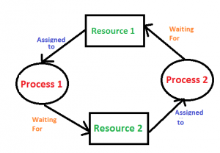
Deadlock Detection And Recovery
Deadlock Detection
If resources have single instance: In this case for Deadlock detection we can run an algorithm to check for cycle in the Resource Allocation Graph. Presence of cycle in the graph is the sufficient condition for deadlock.
In the above diagram, resource 1 and resource 2 have single instances.
There is a cycle R1 → P1 → R2 → P2. So, Deadlock is Confirmed.
If there are multiple instances of resources: Detection of the cycle is necessary but not sufficient condition for deadlock detection, in this case, the system may or may not be in deadlock varies according to different situations.
1

Slide 48
Deadlock Recovery
A traditional operating system such as Windows doesn’t deal with deadlock recovery as it is time and space consuming process. Real-time operating systems use Deadlock recovery.
Recovery method
Killing the process: killing all the process involved in the deadlock. Killing process one by one. After killing each process check for deadlock again keep repeating the process till system recover from deadlock.
Resource Preemption: Resources are preempted from the processes involved in the deadlock, preempted resources are allocated to other processes so that there is a possibility of recovering the system from deadlock. In this case, the system goes into starvation.
1

Slide 49
REFERENCES
Text/Reference Books:
A. Silberschatz and Peter B Galvin: Operating System Principals, Wiley India Pvt. Ltd.
Achyut S Godbole: Operating Systems, Tata McGraw Hill
Tanenbaum: Modern Operating System, Prentice Hall.
DM Dhamdhere: Operating Systems – A Concepts Based Approach, Tata McGraw Hill 5.
Charles Crowly: Operating System A Design – Oriented Approach, Tata McGraw Hill.
1

Slide 50
B.Umamaheswari (Asst. Prof, CSE) , JECRC, JAIPUR

