Slide 1
JAIPUR ENGINEERING COLLEGE AND RESEARCH CENTRE
Year & Sem – III year & V Sem
Subject – Operating System
Topic : Memory Management (UNIT 2)
Presented by – Dr. Nilam Choudhary, Associate Professor,CSE
1

Slide 2
Memory Management Requirements
Let us begin by examining the issues that prompt the main memory management.
Allocation:
First of all the processes that are scheduled to run must be resident in the memory.
These processes must be allocated space in main memory.
Swapping, fragmentation and compaction: If a program is moved out or terminates, it creates a hole, (i.e. a contiguous unused area) in main memory.
When a new process is to be moved in, it may be allocated one of the available holes.
It is quite possible that main memory has far too many small holes at a certain time.
In such a situation none of these holes is really large enough to be allocated to a new process that may be moving in.
The main memory is too fragmented.
It is, therefore, essential to attempt compaction.
Compaction means OS re-allocates the existing programs in contiguous regions and creates a large enough free area for allocation to a new process.
Garbage collection:
Some programs use dynamic data structures.
These programs dynamically use and discard memory space.
Technically, the deleted data items (from a dynamic data structure) release memory locations.
1

Slide 3
Memory Management Requirements (Cont..)
However, in practice the OS does not collect such free space immediately for allocation.
This is because that affects performance. Such areas, therefore, are called garbage.
When such garbage exceeds a certain threshold, the OS would not have enough memory available for any further allocation.
This entails compaction (or garbage collection), without severely affecting performance.
Protection:
With many programs residing in main memory it can happen that due to a programming error (or with malice) some process writes into data or instruction area of some other process.
The OS ensures that each process accesses only to its own allocated area, i.e. each process is protected from other processes.
Virtual memory:
Often a processor sees a large logical storage space (a virtual storage space) though the actual main memory may not be that large.
So some facility needs to be provided to translate a logical address available to a processor into a physical address to access the desired data or instruction.
IO support:
Most of the block-oriented devices are recognized as specialized files.
Their buffers need to be managed within main memory alongside the other processes.
The considerations stated above motivate the study of main memory management.
1

Slide 4
What does main memory (RAM) contain?
Immediately after boot up, it contains the memory image of the kernel executable, typically in “low memory” or physical memory addresses starting from byte 0.
Over time, the kernel allocates the rest of the memory to various running processes.
For any process to execute on the CPU, the corresponding instructions and data must be available in main memory.
The execution of a process on the CPU generates several requests for memory reads and writes.
The memory subsystem of an OS must efficiently handle these requests.
Note that contents of main memory may also be cached in the various levels of caches between the CPU and main memory, but the OS largely concerns itself with CPU caches.
The OS tries to ensure that running processes reside in memory as far as possible.
When the system is running low on memory, however, running processes may be moved to a region identified as swap space on a secondary storage device.
Swapping processes out leads to a performance penalty, and is avoided as far as possible.
1

Slide 5
Address
The memory addresses generated by the CPU when accessing the code and data of a running process are called logical addresses.
The logical/virtual address space of a process ranges from 0 to a maximum value that depends on the CPU architecture (4GB for 32-bit addresses).
Code and data in the program executable are assigned logical addresses in this space by the compiler.
On the other hand, the addresses used by the actual memory hardware to locate information are called physical addresses.
The physical address space of a system spans from 0 to a maximum value (determined by how much RAM the machine has).
The OS plays a big role in mapping logical addresses of a process to physical addresses.
1

Slide 6
Memory Allocation
When a new process is created, there are two ways of allocating memory to it:
Contiguous Allocation or Non-Contiguous Allocation.
Single Contiguous Allocation
With contiguous allocation, the kernel tries to find a contiguous portion of physical memory to accommodate the new process.
The kernel may use a best-fit or worst-fit or first-fit heuristic to identify a portion of unused memory. The problem with this type of allocation is (external) fragmentation of memory:
sometimes, there is enough free memory in the system, but it is fragmented over several locations, so that a contiguous block cannot be found to satisfy a request.
To avoid external fragmentation with contiguous allocation, the OS must periodically relocate running processes to other regions of memory.
With contiguous allocation, the mapping between logical and physical addresses is straightforward.
The OS maintains the starting physical address (or base) and the size of the memory image (or limit) for every process it places in memory.
This base address value is added to the logical addresses to translate it to a physical address.
While contiguous allocation has the benefit of simplicity, it is rarely used in modern operating systems due to the issues around memory fragmentation.
1

Slide 7
Non Contiguous Allocation
The most common way of allocating memory to processes in modern operating systems is a type of non-contiguous allocation called paging.
The logical address space of every process is divided into fixed-size (e.g., 4KB) chunks called pages.
The physical memory is divided into fixed size chunks called frames, which are typically the same size as pages.
Every process is allocated some free physical memory frames, and its logical pages are mapped to these physical frames.
A page table of a process maintains this mapping from logical page numbers to physical frame numbers.
The operating system maintains a separate page table for every process it creates. With paging, the issue of external fragmentation is completely eliminated, because any free frame can be allocated to any process.
1

Slide 8
Cont..
However, a smaller problem of internal fragmentation (the last page being partially filled) arises.
Paging adds a level of indirection between logical and physical addressing, and this provides several benefits.
There is now a clean separation between logical addresses and physical addresses:
The compiler can assign addresses to code and data without worrying about where the
program would reside in memory.
Paging also makes sharing of memory between processes easier:
two logical pages can point to the same physical frame in the page tables.
However, paging adds the additional overhead of address translation.
1

Slide 9
How are virtual addresses mapped to physical addresses with paging?
The virtual address is first split into a page number and an offset within the page.
The page number is mapped to the physical frame number by looking up the page table of the process.
The physical address is then obtained from the physical frame number and the offset within the frame.
Who does this translation from CPU-generated logical addresses to physical addresses?
The OS takes the responsibility of constructing and maintaining page tables during the lifecycle of a process;
The PCB contains a pointer to the page table. The OS also maintains a pointer to the page table of the current process in a special CPU register (CR3 in x86), and updates this pointer during context switches.
A specialized piece of hardware called the memory management unit / MMU then uses the page table to translate logical addresses requested by the CPU to physical
addresses.
1

Slide 10
Segmentation
Segmentation is another way of allocating physical memory to a process.
With segmentation, the process memory image is divided into segments corresponding to code, data, stack, and so on.
Each segment is then given a contiguous chunk of physical memory.
A segment table stores the mapping between the segments of a process and the base/limit addresses of that segment.
Most modern operating systems, however, use paging, or a combination of segmentation and paging.
Unix-like operating systems make minimal use of segmentation.
1

Slide 11
Memory Partitioning
Memory management brings processes into main memory for execution by the processor
involves virtual memory
based on segmentation and paging
Partitioning
used in several variations in some now-obsolete operating systems
does not involve virtual memory
1

Slide 12
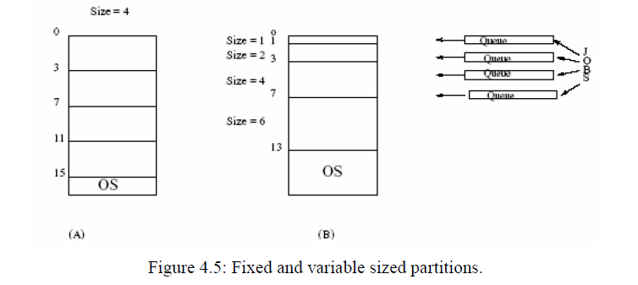
Fixed Size Partitioning
In a fixed size partitioning of the main memory all partitions are of the same size. The memory resident processes can be assigned to any of these partitions. Fixed sized partitions are relatively simple to implement. However, there are two problems. This scheme is not easy to use when a program requires more space than the partition size. In this situation the programmer has to resort to overlays. Overlays involve moving data and program segments in and out of memory essentially reusing the area in main memory.
The second problem has to do with internal fragmentation. No matter what the size of the process is, a fixed size of memory block is allocated as shown in Figure 4.5(a). So there will always be some space which will remain unutilized within the partition.
1

Slide 13
Cont
In a variable-sized partition, the memory is partitioned into partitions with different sizes. Processes are loaded into the size nearest to its requirements. It is easy to always ensure the best-fit. One may organize a queue for each size of the partition as shown in the Figure 4.5(b). With best-fit policy, variable partitions minimize internal fragmentation.
However, such an allocation may be quite slow in execution. This is so because a process may end up waiting (queued up) in the best-fit queue even while there is space available elsewhere. For example, we may have several jobs queued up in a queue meant for jobs that require 1 unit of memory, even while no jobs are queued up for jobs that require say 4 units of memory.
Both fixed and dynamic partitions suffer from external fragmentation whenever there are partitions that have no process in it. One of techniques that have been used to keep both internal and external fragmentations low is dynamic partitioning. It is basically a variable partitioning with a variable number of partitions determined dynamically (i.e. at run time). Such a scheme is difficult to implement.
1

Slide 14
Another scheme which falls between the fixed and dynamic partitioning is a buddy system
The Buddy system of partitioning:
The buddy system of partitioning relies on the fact that space allocations can be conveniently handled in sizes of power of 2.
There are two ways in which the buddy system allocates space.
Suppose we have a hole which is the closest power of two. In that case, that hole is used for allocation.
In case we do not have that situation then we look for the next power of 2 hole size, split it in two equal halves and allocate one of these. Because we always split the holes in two equal sizes, the two are buddies. Hence, the name buddy system.
We shall illustrate allocation using a buddy system. We assume that initially we have a space of 1024 K. We also assume that processes arrive and are allocated following a time sequence as shown in figure 4.6.
With 1024 K or (1 M) storage space we split it into buddies of 512 K, splitting one of them to two 256 K buddies and so on till we get the right size. Also, we assume scan of memory from the beginning. We always use the first hole which accommodates the process.
Otherwise, we split the next sized hole into buddies. Note that the buddy system begins search for a hole as if we had a fixed number of holes of variable sizes but turns into a dynamic partitioning scheme when we do not find the best-fit hole.
1

Slide 15
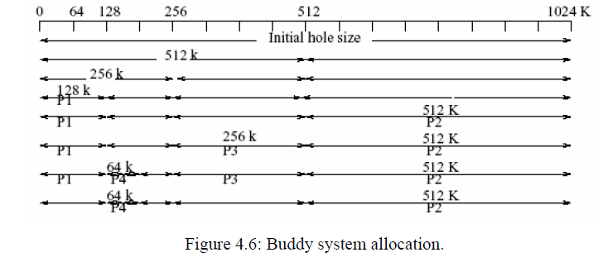
Cont..
The buddy system has the advantage that it minimizes the internal fragmentation.
However, it is not popular because it is very slow
1

Slide 16
Address Binding:
Programs are stored on the secondary storage disks as binary executable files.
When the programs are to be executed they are brought in to the main memory and placed within a process.
The collection of processes on the disk waiting to enter the main memory forms the input queue.
One of the processes which are to be executed is fetched from the queue and placed in the main memory.
During the execution it fetches instruction and data from main memory.
After the process terminates it returns back the memory space.
During execution the process will go through different steps and in each step the address is represented in different ways. In source program the address is symbolic.
The compiler converts the symbolic address to re-locatable address.
The loader will convert this re-locatable address to absolute address..
1

Slide 17
(Cont..)
Binding of instructions and data can be done at any step along the way:
Compile time:-
If we know whether the process resides in memory then absolute code can be generated.
If the static address changes then it is necessary to re-compile the code from the beginning.
Load time:-
If the compiler doesn’t know whether the process resides in memory then it generates the re-locatable code. In this the binding is delayed until the load time.
Execution time:-
If the process is moved during its execution from one memory segment to another then the binding is delayed until run time.
Special hardware is used for this. Most of the general purpose operating system uses this method
1

Slide 18
Swapping
Swapping is a technique of temporarily removing inactive programs from the memory of the system.
A process can be swapped temporarily out of the memory to a backing store and then brought back in to the memory for continuing the execution. This process is called swapping.
Eg:-In a multi-programming environment with a round robin CPU scheduling whenever the time quantum expires then the process that has just finished is swapped out and a new process swaps in to the memory for execution.
A variation of swap is priority based scheduling. When a low priority is executing and if a high priority process arrives then a low priority will be swapped out and high priority is allowed for execution. This process is also called as Roll out and Roll in.
Normally the process which is swapped out will be swapped back to the same memory space that is occupied previously. This depends upon address binding.
If the binding is done at load time, then the process is moved to same memory location.
If the binding is done at run time, then the process is moved to different memory location.
1

Slide 19
Cont..
Swapping requires backing store and it should be large enough to accommodate the copies of all memory images.
The system maintains a ready queue consisting of all the processes whose memory images are on the backing store or in memory that are ready to run.
Swapping is constant by other factors:
To swap a process, it should be completely idle.
A process may be waiting for an i/o operation.
If the i/o is asynchronously accessing the user memory for i/o buffers, then the process cannot be swapped.
1

Slide 20
In Contiguous Memory Allocation
The OS keeps a table indicating which part of the memory is free and is occupied.
When the process enters the system it will be loaded in to the input queue.
The OS keeps track of the memory requirement of each process and the amount of memory available and determines which process to allocate the memory.
When a process requests, the OS searches for large hole for this process, hole is a large block of free memory available. If the hole is too large it is split in to two. One part is allocated to the requesting process and other is returned to the set of holes. The set of holes are searched to determine which hole is best to allocate.
There are three strategies to select a free hole:
First bit:-Allocates first hole that is big enough. This algorithm scans memory from the beginning and selects the first available block that is large enough to hold the process.
Best bit:-It chooses the hole i.e., closest in size to the request. It allocates the smallest hole i.e., big enough to hold the process.
Worst fit:-It allocates the largest hole to the process request. It searches for the largest hole in the entire list
1

Slide 21
Basic Terms
Frame
A fixed-length block of main memory.
Page
A fixed-length block of data that resides in secondary memory (such as disk). A page of data may temporarily be copied into a frame of main memory.
Segment
A variable-length block of data that resides in secondary memory. An entire segment may temporarily be copied into an available region of main memory (segmentation) or the segment may be divided into pages which can be individually copied into main memory (combined segmentation and paging).
1

Slide 22
Fragmentation:
Memory fragmentation can be of two types:
Internal Fragmentation
External Fragmentation
Internal Fragmentation
there is wasted space internal to a portion due to the fact that block of data loaded is smaller than the partition.
Eg:-If there is a block of 50kb and if the process requests 40kb and if the block is allocated to the process then there will be 10kb of memory left.
External Fragmentation
exists when there is enough memory space exists to satisfy the request, but it not contiguous i.e., storage is fragmented in to large number of small holes. External Fragmentation may be either minor or a major problem. One solution for over-coming external fragmentation is compaction. The goal is to move all the free memory together to form a large block. Compaction is not possible always. If the relocation is static and is done at load time then compaction is not possible. Compaction is possible if the re-location is dynamic and done at execution time. Another possible solution to the external fragmentation problem is to permit the logical address space of a process to be non-contiguous, thus allowing the process to be allocated physical memory whenever the latter is available.
1

Slide 23
Segmentation
Most users do not think memory as a linear array of bytes rather the users thinks memory as a collection of variable sized segments which are dedicated to a particular use such as code, data, stack, heap etc.
A logical address is a collection of segments.
Each segment has a name and length.
The address specifies both the segment name and the offset within the segments.
The users specify address by using two quantities: a segment name and an offset.
For simplicity the segments are numbered and referred by a segment number.
So the logical address consists of <Segment number, Offset>.
Advantages:
Eliminates fragmentation.
Provides virtual growth.
Allows dynamic segment growth.
Assist dynamic linking.
Segmentation is visible.
1

Slide 24
Differences between segmentation and paging:-
Segmentation:
• Program is divided in to variable sized segments.
User is responsible for dividing the program in to segments.
• Segmentation is slower than paging.
• Visible to user.
• Eliminates internal fragmentation.
• Suffers from external fragmentation.
• Process or user segment number, offset to calculate absolute address.
Paging:
• Programs are divided in to fixed size pages.
• Division is performed by the OS.
• Paging is faster than segmentation.
• Invisible to user.
• Suffers from internal fragmentation.
• No external fragmentation.
• Process or user page number, offset to calculate absolute address.
1

Slide 25
What is Virtual Memory?
Virtual Memory is a space where large programs can store themselves in form of pages while their execution and only the required pages or portions of processes are loaded into the main memory.
This technique is useful as large virtual memory is provided for user programs when a very small physical memory is there.
In real scenarios, most processes never need all their pages at once, for following reasons :
Error handling code is not needed unless that specific error occurs, some of which are quite rare.
Arrays are often over-sized for worst-case scenarios, and only a small fraction of the arrays are actually used in practice.
Certain features of certain programs are rarely used.
Benefits of having Virtual Memory
Large programs can be written, as virtual space available is huge compared to physical memory.
Less I/O required, leads to faster and easy swapping of processes.
More physical memory available, as programs are stored on virtual memory, so they occupy very less space on actual physical memory
1

Slide 26
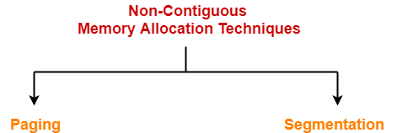
Non-Contiguous Memory Allocation-
Non-contiguous memory allocation is a memory allocation technique.
It allows to store parts of a single process in a non-contiguous fashion.
Thus, different parts of the same process can be stored at different places in the main memory.
Techniques-
There are two popular techniques used for non-contiguous memory allocation-
Paging
Segmentation
1

Slide 27
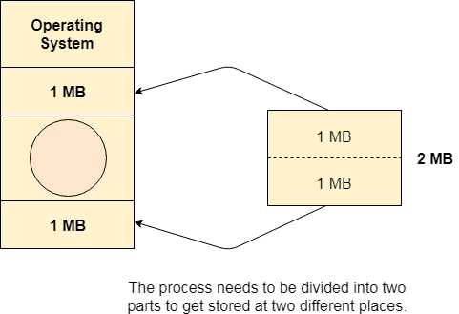
Need for Paging
Lets consider a process P1 of size 2 MB and the main memory which is divided into three partitions. Out of the three partitions, two partitions are holes of size 1 MB each.
P1 needs 2 MB space in the main memory to be loaded.
We have two holes of 1 MB each but they are not contiguous.
Although, there is 2 MB space available in the main memory in the form of those holes but that remains useless until it become contiguous.
This is a serious problem to address.
We need to have some kind of mechanism which can store one process at different locations of the memory.
The Idea behind paging is to divide the process in pages so that, we can store them in the memory at different holes
1

Slide 28
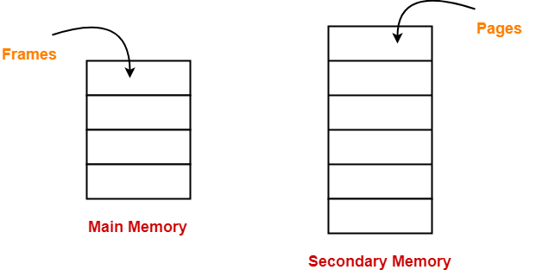
Paging-
Paging is a fixed size partitioning scheme.
In paging, secondary memory and main memory are divided into equal fixed size partitions.
The partitions of secondary memory are called as pages.
The partitions of main memory are called as frames.
Each process is divided into parts where size of each part is same as page size.
The size of the last part may be less than the page size.
The pages of process are stored in the frames of main memory depending upon their availability.
1

Slide 29
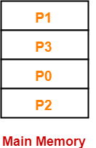
Example
Consider a process is divided into 4 pages P₀, P₁, P₂ and P₃.
Depending upon the availability, these pages may be stored in the main memory frames in a non-contiguous fashion as shown-
Translating Logical Address into Physical Address-
CPU always generates a logical address.
A physical address is needed to access the main memory.
1

Slide 30
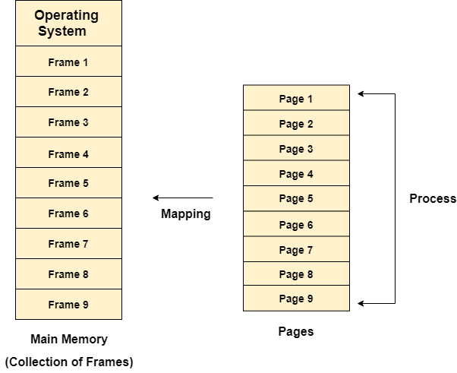
Paging with Example
In Operating Systems, Paging is a storage mechanism used to retrieve processes from the secondary storage into the main memory in the form of pages.
The main idea behind the paging is to divide each process in the form of pages. The main memory will also be divided in the form of frames.
One page of the process is to be stored in one of the frames of the memory. The pages can be stored at the different locations of the memory but the priority is always to find the contiguous frames or holes.
Pages of the process are brought into the main memory only when they are required otherwise they reside in the secondary storage.
Different operating system defines different frame sizes.
The sizes of each frame must be equal. Considering the fact that the pages are mapped to the frames in Paging, page size needs to be as same as frame size.
1

Slide 31
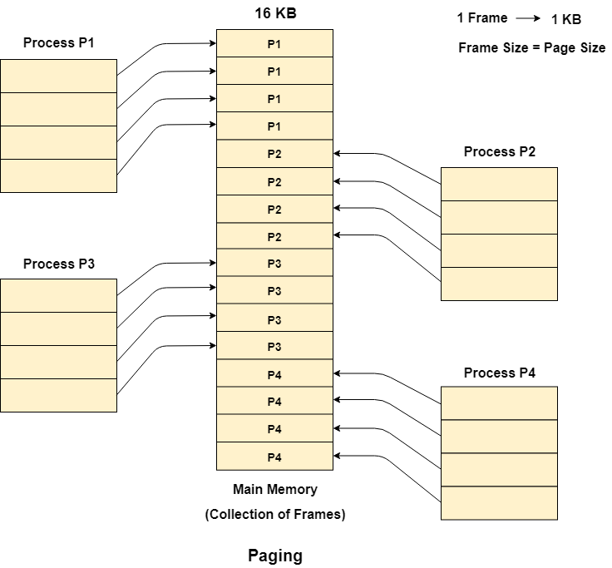
Example
Let us consider the main memory size 16 Kb and Frame size is 1 KB therefore the main memory will be divided into the collection of 16 frames of 1 KB each.
There are 4 processes in the system that is P1, P2, P3 and P4 of 4 KB each. Each process is divided into pages of 1 KB each so that one page can be stored in one frame.
Initially, all the frames are empty therefore pages of the processes will get stored in the contiguous way.
Frames, pages and the mapping between the two is shown in the image below.
1

Slide 32
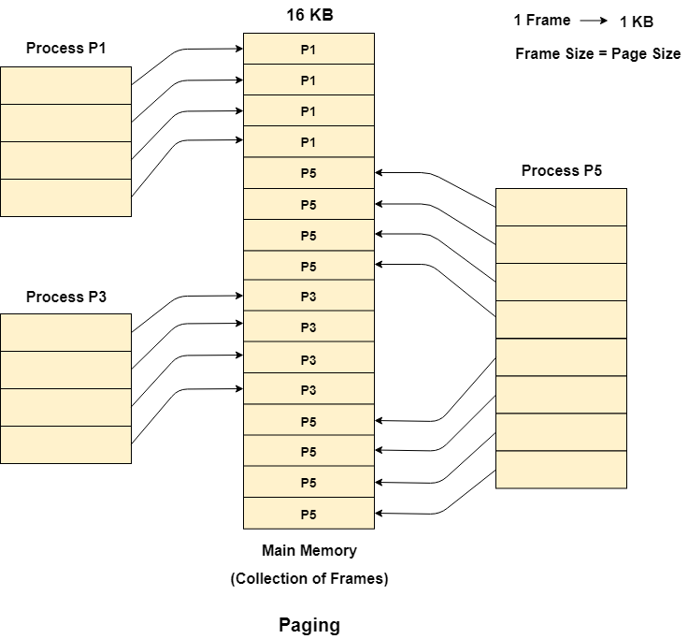
Cont..
Let us consider that, P2 and P4 are moved to waiting state after some time.
Now, 8 frames become empty and therefore other pages can be loaded in that empty place.
The process P5 of size 8 KB (8 pages) is waiting inside the ready queue.
Given the fact that, we have 8 non contiguous frames available in the memory and paging provides the flexibility of storing the process at the different places.
Therefore, we can load the pages of process P5 in the place of P2 and P4.
1

Slide 33
Memory Management Unit
The purpose of Memory Management Unit (MMU) is to convert the logical address into the physical address.
The logical address is the address generated by the CPU for every page
while the physical address is the actual address of the frame where each page will be stored.
When a page is to be accessed by the CPU by using the logical address, the operating system needs to obtain the physical address to access that page physically.
The logical address has two parts.
Page Number Offset
Memory management unit of OS needs to convert the page number to the frame number.
1

Slide 34
Physical Address Space
Physical address space in a system can be defined as the size of the main memory.
It is really important to compare the process size with the physical address space.
The process size must be less than the physical address space
Physical Address Space = Size of the Main Memory If, physical address space = 64 KB = 2 ^ 6 KB = 2 ^ 6 X 2 ^ 10 Bytes = 2 ^ 16 bytes Let us consider, word size = 8 Bytes = 2 ^ 3 Bytes Hence, Physical address space (in words) = (2 ^ 16) / (2 ^ 3) = 2 ^ 13 Words Therefore, Physical Address = 13 bits
In General, If, Physical Address Space = N Words then, Physical Address = log₂ N
1

Slide 35
Logical Address Space
Logical address space can be defined as the size of the process.
The size of the process should be less enough so that it can reside in the main memory.
Let's say,
Logical Address Space = 128 MB = (2 ^ 7 X 2 ^ 20) Bytes = 2 ^ 27 Bytes Word size = 4 Bytes = 2 ^ 2 Bytes Logical Address Space (in words) = (2 ^ 27) / (2 ^ 2) = 2 ^ 25 Words Logical Address = 25 Bits In general, If, logical address space = L words Then, Logical Address = Log₂L bits
1

Slide 36
What is a Word?
The Word is the smallest unit of the memory.
It is the collection of bytes.
Every operating system defines different word sizes after analyzing the n-bit address that is inputted to the decoder and the 2 ^ n memory locations that are produced from the decoder.
Page Table
Page Table is a data structure used by the virtual memory system to store the mapping between logical addresses and physical addresses.
Logical addresses are generated by the CPU for the pages of the processes therefore they are generally used by the processes.
Physical addresses are the actual frame address of the memory. They are generally used by the hardware or more specifically by RAM subsystems.
1

Slide 37
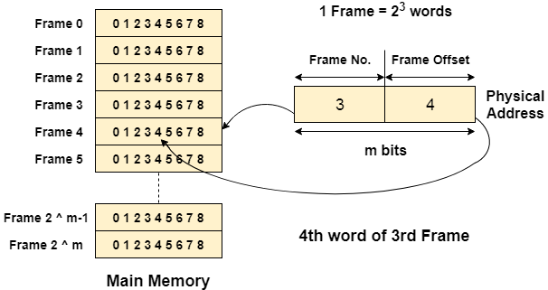
The CPU always accesses the processes through their logical addresses. However, the main memory recognizes physical address only.
In this situation, a unit named as Memory Management Unit comes into the picture. It converts the page number of the logical address to the frame number of the physical address. The offset remains same in both the addresses.
To perform this task, Memory Management unit needs a special kind of mapping which is done by page table. The page table stores all the Frame numbers corresponding to the page numbers of the page table.
In other words, the page table maps the page number to its actual location (frame number) in the memory.
1

Slide 38
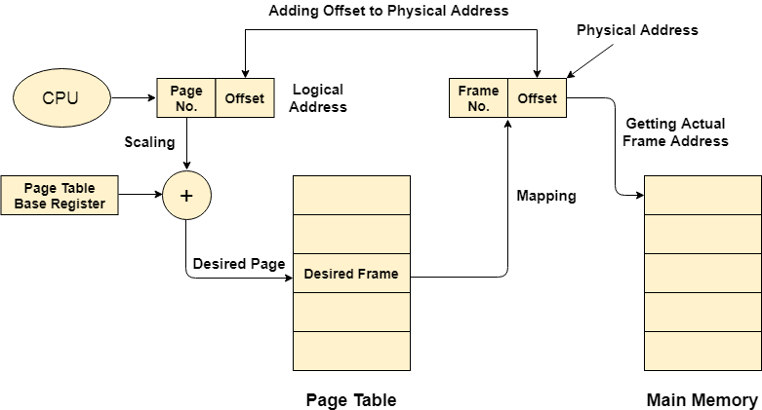
Mapping from page table to main memory
1. Generation of logical address
CPU generates logical address for each page of the process.
This contains two parts: page number and offset.
2. Scaling
To determine the actual page number of the process, CPU stores the page table base in a special register.
Each time the address is generated, the value of the page table base is added to the page number to get the actual location of the page entry in the table.
This process is called scaling.
1

Slide 39
Mapping from page table to main memory
3. Generation of physical Address
The frame number of the desired page is determined by its entry in the page table.
A physical address is generated which also contains two parts : frame number and offset.
The Offset will be similar to the offset of the logical address therefore it will be copied from the logical address.
4. Getting Actual Frame Number
The frame number and the offset from the physical address is mapped to the main memory in order to get the actual word address.
1

Slide 40
Page Table Entry
Along with page frame number, the page table also contains some of the bits representing the extra information regarding the page.
1. Caching Disabled
Sometimes, there are differences between the information closest to the CPU and the information closest to the user. Operating system always wants CPU to access user's data as soon as possible. CPU accesses cache which can be inaccurate in some of the cases, therefore, OS can disable the cache for the required pages. This bit is set to 1 if the cache is disabled.
2. Referenced
There are variouspage replacement algorithms which will be covered later in this tutorial. This bit is set to 1 if the page is referred in the last clock cycle otherwise it remains 0.
3. Modified
This bit will be set if the page has been modified otherwise it remains 0.
1

Slide 41
Page Table Entry
4. Protection
The protection field represents the protection level which is applied on the page. It can be read only or read & write or execute. We need to remember that it is not a bit rather it is a field which contains many bits.
5. Present/Absent
In the concept of demand paging, all the pages doesn't need to be present in the main memory Therefore, for all the pages that are present in the main memory, this bit will be set to 1 and the bit will be 0 for all the pages which are absent.
If some page is not present in the main memory then it is called page fault.
1

Slide 42
Paging
Advantages-
The advantages of paging are-
It allows to store parts of a single process in a non-contiguous fashion.
It solves the problem of external fragmentation.
Disadvantages-
The disadvantages of paging are-
It suffers from internal fragmentation.
There is an overhead of maintaining a page table for each process.
The time taken to fetch the instruction increases since now two memory accesses are required.
1

Slide 43
Virtual Memory in Operating System
Virtual Memory is a storage allocation scheme in which secondary memory can be addressed as though it were part of main memory.
The addresses a program may use to reference memory are distinguished from the addresses the memory system uses to identify physical storage sites, and program generated addresses are translated automatically to the corresponding machine addresses.
The size of virtual storage is limited by the addressing scheme of the computer system and amount of secondary memory is available not by the actual number of the main storage locations.
It is a technique that is implemented using both hardware and software. It maps memory addresses used by a program, called virtual addresses, into physical addresses in computer memory.
1

Slide 44
(Cont..)
All memory references within a process are logical addresses that are dynamically translated into physical addresses at run time.
This means that a process can be swapped in and out of main memory such that it occupies different places in main memory at different times during the course of execution.
A process may be broken into number of pieces and these pieces need not be continuously located in the main memory during execution.
The combination of dynamic run-time address translation and use of page or segment table permits this.
If these characteristics are present then, it is not necessary that all the pages or segments are present in the main memory during execution.
This means that the required pages need to be loaded into memory whenever required.
Virtual memory is implemented using Demand Paging or Demand Segmentation.
1

Slide 45
Virtual Memory
Virtual Memory is a storage scheme that provides user an illusion of having a very big main memory. This is done by treating a part of secondary memory as the main memory.
In this scheme, User can load the bigger size processes than the available main memory by having the illusion that the memory is available to load the process.
Instead of loading one big process in the main memory, the Operating System loads the different parts of more than one process in the main memory.
By doing this, the degree of multiprogramming will be increased and therefore, the CPU utilization will also be increased.
1

Slide 46
How Virtual Memory Works?
In modern world, virtual memory has become quite common these days.
In this scheme, whenever some pages needs to be loaded in the main memory for the execution and the memory is not available for those many pages, then in that case, instead of stopping the pages from entering in the main memory, the OS search for the RAM area that are least used in the recent times or that are not referenced and copy that into the secondary memory to make the space for the new pages in the main memory.
Since all this procedure happens automatically, therefore it makes the computer feel like it is having the unlimited RAM.
1

Slide 47
Snapshot of Virtual Memory
Let us assume 2 processes, P1 and P2, contains 4 pages each. Each page size is 1 KB.
The main memory contains 8 frame of 1 KB each.
The OS resides in the first two partitions.
In the third partition, 1st page of P1 is stored and the other frames are also shown as filled with the different pages of processes in the main memory.
The page tables of both the pages are 1 KB size each and therefore they can be fit in one frame each.
The page tables of both the processes contain various information that is also shown in the image.
The CPU contains a register which contains the base address of page table that is 5 in the case of P1 and 7 in the case of P2. This page table base address will be added to the page number of the Logical address when it comes to accessing the actual corresponding entry.
1

Slide 48
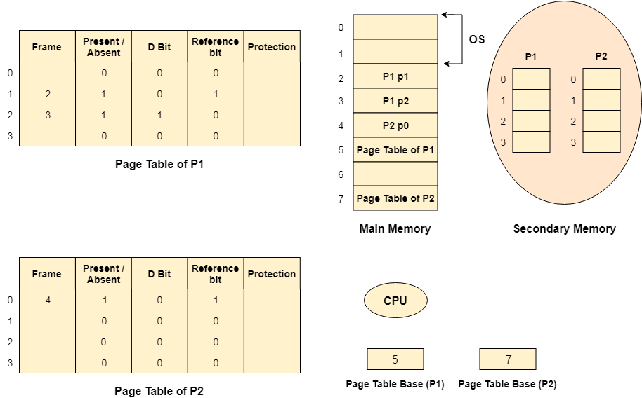
Snapshot of Virtual Memory Cont..
1

Slide 49
Advantages and Disadvantages
Advantages of Virtual Memory
The degree of Multiprogramming will be increased.
User can run large application with less real RAM.
There is no need to buy more memory RAMs.
Disadvantages of Virtual Memory
The system becomes slower since swapping takes time.
It takes more time in switching between applications.
The user will have the lesser hard disk space for its use.
1

Slide 50
Demand Paging
According to the concept of Virtual Memory, in order to execute some process, only a part of the process needs to be present in the main memory which means that only a few pages will only be present in the main memory at any time.
However, deciding, which pages need to be kept in the main memory and which need to be kept in the secondary memory, is going to be difficult because we cannot say in advance that a process will require a particular page at particular time.
Therefore, to overcome this problem, there is a concept called Demand Paging is introduced.
Demand Paging is a popular method of virtual memory management. In demand paging, the pages of a process which are least used, get stored in the secondary memory.
A page is copied to the main memory when its demand is made or page fault occurs. There are various page replacement algorithms which are used to determine the pages which will be replaced.
1

Slide 51
Demand Paging Cont..
It suggests keeping all pages of the frames in the secondary memory until they are required.
In other words, it says that do not load any page in the main memory until it is required.
Whenever any page is referred for the first time in the main memory, then that page will be found in the secondary memory.
After that, it may or may not be present in the main memory depending upon the page replacement algorithm
1

Slide 52
What is a Page Fault?
If the referred page is not present in the main memory then there will be a miss and the concept is called Page miss or page fault.
The CPU has to access the missed page from the secondary memory. If the number of page fault is very high then the effective access time of the system will become very high.
What is Thrashing?
If the number of page faults is equal to the number of referred pages or the number of page faults are so high so that the CPU remains busy in just reading the pages from the secondary memory then the effective access time will be the time taken by the CPU to read one word from the secondary memory and it will be so high. The concept is called thrashing.
If the page fault rate is PF %, the time taken in getting a page from the secondary memory and again restarting is S (service time) and the memory access time is ma then the effective access time can be given as;
EAT = PF X S + (1 - PF) X (ma)
1

Slide 53
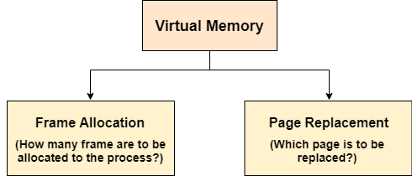
Page Replacement Algorithms
The page replacement algorithm decides which memory page is to be replaced. The process of replacement is sometimes called swap out or write to disk. Page replacement is done when the requested page is not found in the main memory (page fault).
There are two main aspects of virtual memory, Frame allocation and Page Replacement. It is very important to have the optimal frame allocation and page replacement algorithm. Frame allocation is all about how many frames are to be allocated to the process while the page replacement is all about determining the page number which needs to be replaced in order to make space for the requested page.
1

Slide 54
Types of Page Replacement Algorithms
There are various page replacement algorithms. Each algorithm has a different method by which the pages can be replaced.
Optimal Page Replacement algorithm → this algorithms replaces the page which will not be referred for so long in future. Although it can not be practically implementable but it can be used as a benchmark. Other algorithms are compared to this in terms of optimality.
Least recent used (LRU) page replacement algorithm → this algorithm replaces the page which has not been referred for a long time. This algorithm is just opposite to the optimal page replacement algorithm. In this, we look at the past instead of staring at future.
FIFO → in this algorithm, a queue is maintained. The page which is assigned the frame first will be replaced first. In other words, the page which resides at the rare end of the queue will be replaced on the every page fault.
1

Slide 55
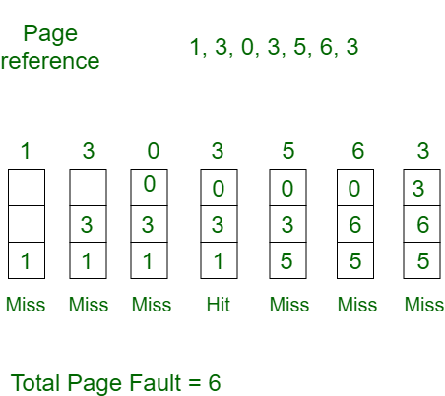
FIFO EXAMPLE
FIFO → in this algorithm, a queue is maintained. The page which is assigned the frame first will be replaced first. In other words, the page which resides at the rare end of the queue will be replaced on the every page fault.
Example-1
Consider page reference string 1, 3, 0, 3, 5, 6 with 3 page frames.
Find number of page faults.
Initially all slots are empty, so when 1, 3, 0 came they are allocated to the empty slots —> 3 Page Faults. when 3 comes, it is already in memory so —> 0 Page Faults. Then 5 comes, it is not available in memory so it replaces the oldest page slot i.e 1. —>1 Page Fault. 6 comes, it is also not available in memory so it replaces the oldest page slot i.e 3 —>1 Page Fault. Finally when 3 come it is not avilable so it replaces 0 1 page fault
1

Slide 56
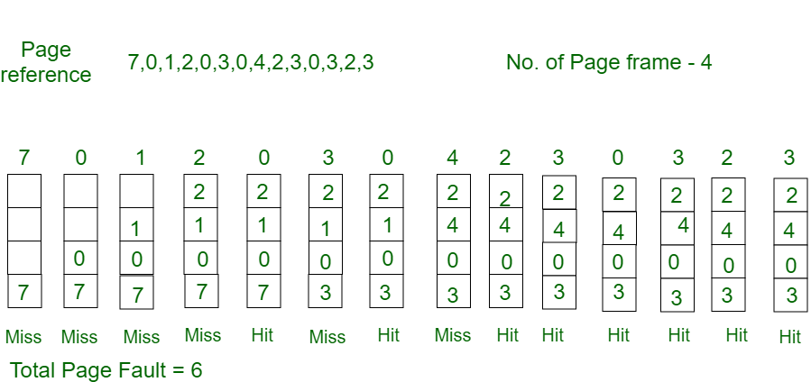
Optimal Page Replacement EXAMPLE
In this algorithm, pages are replaced which would not be used for the longest duration of time in the future.
Example-2:Consider the page references 7, 0, 1, 2, 0, 3, 0, 4, 2, 3, 0, 3, 2, with 4 page frame. Find number of page fault.
Initially all slots are empty, so when 7 0 1 2 are allocated to the empty slots —> 4 Page faults 0 is already there so —> 0 Page fault. when 3 came it will take the place of 7 because it is not used for the longest duration of time in the future.—>1 Page fault. 0 is already there so —> 0 Page fault.. 4 will takes place of 1 —> 1 Page Fault. Now for the further page reference string —> 0 Page fault because they are already available in the memory.
1

Slide 57
Cont..
Optimal page replacement is perfect, but not possible in practice as the operating system cannot know future requests.
The use of Optimal Page replacement is to set up a benchmark so that other replacement algorithms can be analyzed against it.
1

Slide 58
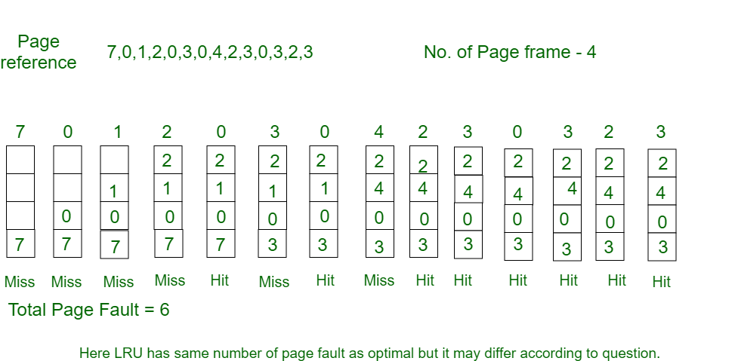
Least Recently Used Example
In this algorithm page will be replaced which is least recently used.
Example-3
Consider the page reference string 7, 0, 1, 2, 0, 3, 0, 4, 2, 3, 0, 3, 2 with 4 page frames.Find number of page faults.
Initially all slots are empty, so when 7 0 1 2 are allocated to the empty slots —> 4 Page faults 0 is already their so —> 0 Page fault. when 3 came it will take the place of 7 because it is least recently used —>1 Page fault 0 is already in memory so —> 0 Page fault. 4 will takes place of 1 —> 1 Page Fault Now for the further page reference string —> 0 Page fault because they are already available in the memory.
1

Slide 59
Belady'sAnomaly
In the case of LRU and optimal page replacement algorithms, it is seen that the number of page faults will be reduced if we increase the number of frames.
However, Balady found that, In FIFO page replacement algorithm, the number of page faults will get increased with the increment in number of frames.
This is the strange behavior shown by FIFO algorithm in some of the cases. This is an Anomaly called as Belady'sAnomaly.
Let's examine such example :
The reference String is given as 0 1 5 3 0 1 4 0 1 5 3 4.
Let's analyze the behavior of FIFO algorithm in two cases.
1

Slide 60
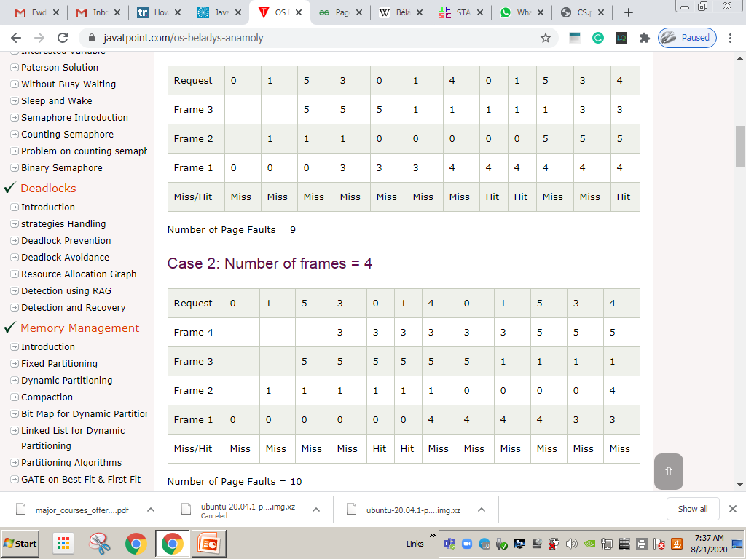
Belady'sAnomaly
1

Slide 61
Segmentation
In Operating Systems, Segmentation is a memory management technique in which, the memory is divided into the variable size parts. A process is divided into Segments. The chunks that a program is divided into which are not necessarily all of the same sizes are called segments. Segmentation gives user’s view of the process which paging does not give. Here the user’s view is mapped to physical memory.
There are types of segmentation:
Virtual memory segmentation – Each process is divided into a number of segments, not all of which are resident at any one point in time.
Simple segmentation – Each process is divided into a number of segments, all of which are loaded into memory at run time, though not necessarily contiguously.
1

Slide 62
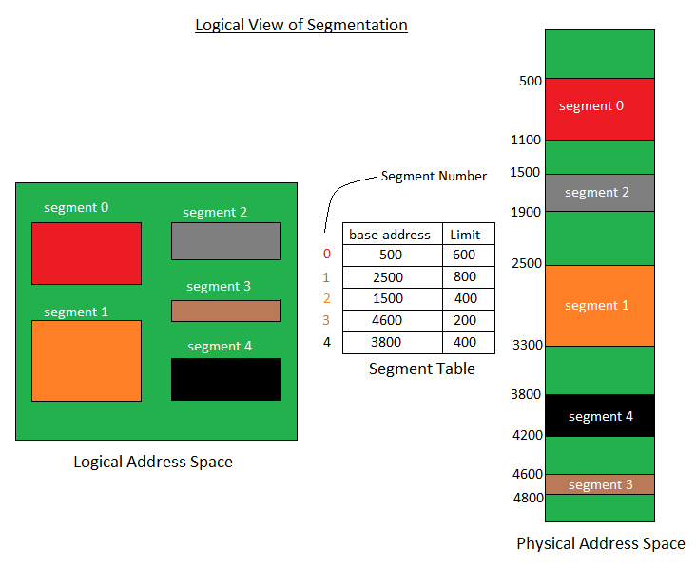
Segmentation
The details about each segment are stored in a table called as segment table.
Segment table is stored in one (or many) of the segments.
Segment table contains mainly two information about segment:
Base: It is the base address of the segment
Limit: It is the length of the segment.
1

Slide 63
Why Segmentation is required?
Till now, we were using Paging as our main memory management technique.
Paging is more close to Operating system rather than the User.
It divides all the process into the form of pages regardless of the fact that a process can have some relative parts of functions which needs to be loaded in the same page.
Operating system doesn't care about the User's view of the process.
It may divide the same function into different pages and those pages may or may not be loaded at the same time into the memory.
It decreases the efficiency of the system.
It is better to have segmentation which divides the process into the segments.
Each segment contain same type of functions such as main function can be included in one segment and the library functions can be included in the other segment,
1

Slide 64
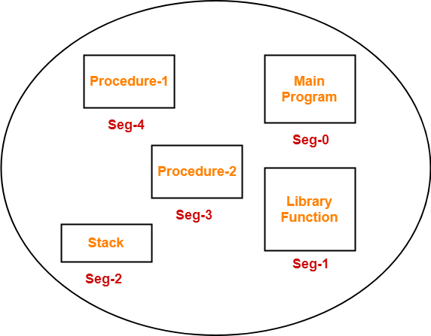
Example-
Consider a program is divided into 5 segments as-
1

Slide 65
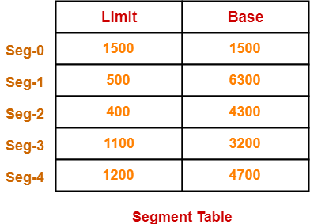
Segment Table-
Segment table is a table that stores the information about each segment of the process.
It has two columns.
First column stores the size or length of the segment.
Second column stores the base address or starting address of the segment in the main memory.
Segment table is stored as a separate segment in the main memory.
Segment table base register (STBR) stores the base address of the segment table.
1

Slide 66
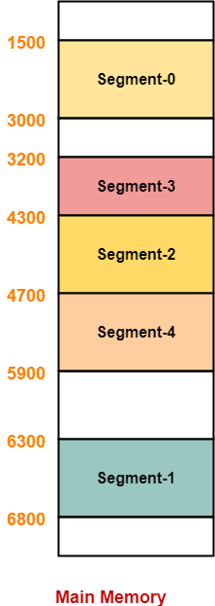
Segment Table Cont..
Limit indicates the length or size of the segment.
Base indicates the base address or starting address of the segment in the main memory.
In accordance to the above segment table, the segments are stored in the main memory as-
1

Slide 67
Translation of Logical address into physical address by segment table
CPU always generates a logical address.
A physical address is needed to access the main memory.
Following steps are followed to translate logical address into physical address-
Step-01:
CPU generates a logical address consisting of two parts-
Segment Number
Segment Offset
Segment Number specifies the specific segment of the process from which CPU wants to read the data.
Segment Offset specifies the specific word in the segment that CPU wants to read.
1

Slide 68
Cont..
Step-02:
For the generated segment number, corresponding entry is located in the segment table.
Then, segment offset is compared with the limit (size) of the segment.
Now, two cases are possible-
Case-01: Segment Offset >= Limit
If segment offset is found to be greater than or equal to the limit, a trap is generated.
Case-02: Segment Offset < Limit
If segment offset is found to be smaller than the limit, then request is treated as a valid request.
The segment offset must always lie in the range [0, limit-1],
Then, segment offset is added with the base address of the segment.
The result obtained after addition is the address of the memory location storing the required word.
1

Slide 69
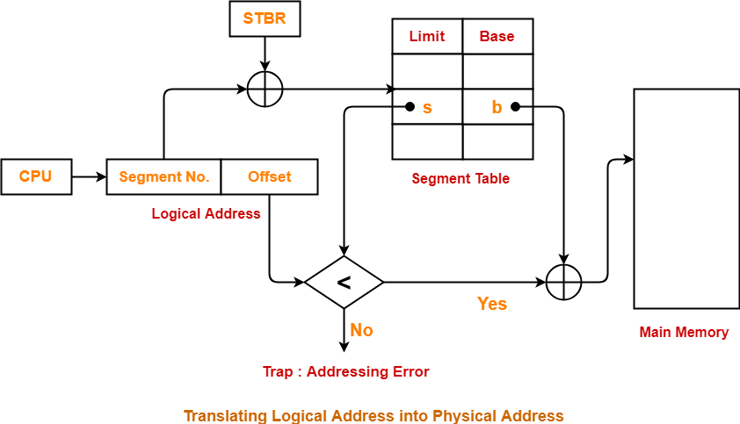
Cont..
1

Slide 70
Advantages and Disadvantages
Advantages of Segmentation
No internal fragmentation
Average Segment Size is larger than the actual page size.
Less overhead
It is easier to relocate segments than entire address space.
The segment table is of lesser size as compare to the page table in paging.
Disadvantages of Segmentation
It can have external fragmentation.
it is difficult to allocate contiguous memory to variable sized partition.
Costly memory management algorithms.
1

Slide 71
1

Slide 72
Cont..
1

Slide 73
REFERENCES
Text/Reference Books:
A. Silberschatz and Peter B Galvin: Operating System Principals, Wiley India Pvt. Ltd.
Achyut S Godbole: Operating Systems, Tata McGraw Hill
Tanenbaum: Modern Operating System, Prentice Hall.
DM Dhamdhere: Operating Systems – A Concepts Based Approach, Tata McGraw Hill 5.
Charles Crowly: Operating System A Design – Oriented Approach, Tata McGraw Hill.
1

Slide 74
B.Umamaheswari (Asst. Prof, CSE) , JECRC, JAIPUR

