Slide 1



JAIPUR ENGINEERING COLLEGE AND RESEARCH CENTRE
Year & Sem – III year & V Sem
Subject – Operating System
Unit – I
Presented by – Dr. Nilam Choudhary, Associate Professor ,CSE
1

Slide 2
VISION AND MISSION OF DEPARTMENT
VISION:
To become renowned Centre of excellence in computer science and engineering and make competent engineers &amp; professionals with high ethical values prepared for lifelong learning.
MISSION:
M1: To impart outcome based education for emerging technologies in the field of computer science and engineering.
M2: To provide opportunities for interaction between academia and industry.
M3: To provide platform for lifelong learning by accepting the change in
technologies
M4: To develop aptitude of fulfilling social responsibilities
1

Slide 3
PROGRAM OUTCOMES
Engineering knowledge: Apply the knowledge of mathematics, science, engineering fundamentals and Computer Science and Engineering specialization to the solution of complex Computer Science and Engineering problems.
Problem analysis: Identify, formulate, research literature, and analyse complex Computer Science and Engineering problems reaching substantiated conclusions using first principles of mathematics, natural sciences, and engineering sciences.
Design/development of solutions: Design solutions for complex Computer Science and Engineering problems and design system components or processes that meet the specified needs with appropriate consideration for the public health and safety, and the cultural, societal, and environmental considerations.
Conduct investigations of complex problems: Use research-based knowledge and research methods including design of Computer Science and Engineering experiments, analysis and interpretation of data, and synthesis of the information to provide valid conclusions.
Modern tool usage: Create, select, and apply appropriate techniques, resources, and modern engineering and IT tools including prediction and modelling to complex Computer Science Engineering activities with an understanding of the limitations.
The engineer and society: Apply reasoning informed by the contextual knowledge to assess societal, health, safety, legal and cultural issues and the consequent responsibilities relevant to the professional Computer Science and Engineering practice.
1

Slide 4
Cntd…
Environment and sustainability: Understand the impact of the professional Computer Science and Engineering solutions in societal and environmental contexts, and demonstrate the knowledge of, and need for sustainable development.
Ethics: Apply ethical principles and commit to professional ethics and responsibilities and norms of the Computer Science and Engineering practice.
Individual and team work: Function effectively as an individual, and as a member or leader in diverse teams, and in multidisciplinary settings in Computer Science and Engineering.
Communication: Communicate effectively on complex Computer Science and Engineering activities with the engineering community and with society at large, such as, being able to comprehend and write effective reports and design documentation, make effective presentations, and give and receive clear instructions.
Project management and finance: Demonstrate knowledge and understanding of the Computer Science and Engineering and management principles and apply these to one’s own work, as a member and leader in a team, to manage projects and in multidisciplinary environments.
Life-long learning: Recognize the need for, and have the preparation and ability to engage in independent and life-long learning in the broadest context of technological change in Computer Science and Engineering.
1

Slide 5
PROGRAM SPECIFIC OUTCOMES
PSO1: Ability to interpret and analyze network specific, cyber security issues, automation in real world environment.
PS2: Ability to design and develop mobile and web-based applications under realistic constraints.
1

Slide 6
CO of Operating System
Demonstrate the concepts, structure design of operating system and analysis of process management.
Recognize the concepts, implementation of memory management policies, design issues of paging and virtual memory.
Understand and design the concepts of deadlock handling and device management.
Analyze the file system structure, implementation process and acquainted with various types of operating systems.
1

Slide 7
CO-PO& CO-PSO Mapping
SEM :5 |  |  |  | Subject Code:5CS4-03 |  |  |  |  |  | Subject: Operating System
CO, PO,PSO | PO1 | PO2 | PO3 |  | PO4 | PO5 | PO6 | PO7 | PO8 | PO9 | PO10 | PO11 | PO12 | PSO1 | PSO2
CO1 | 3 | 2 | 2 |  | 2 | 2 | 1 | 1 | 1 | 1 | 1 | 1 | 3 | 1 | 2
CO2 | 3 | 3 | 3 |  | 3 | 2 | 1 | 1 | 1 | 1 | 2 | 1 | 3 | 2 | 2
CO3 | 3 | 3 | 3 |  | 2 | 3 | 1 | 1 | 1 | 1 | 2 | 1 | 3 | 2 | 2
CO4 | 3 | 3 | 3 |  | 3 | 2 | 1 | 1 | 1 | 2 | 2 | 2 | 3 | 2 | 2
1

Slide 8
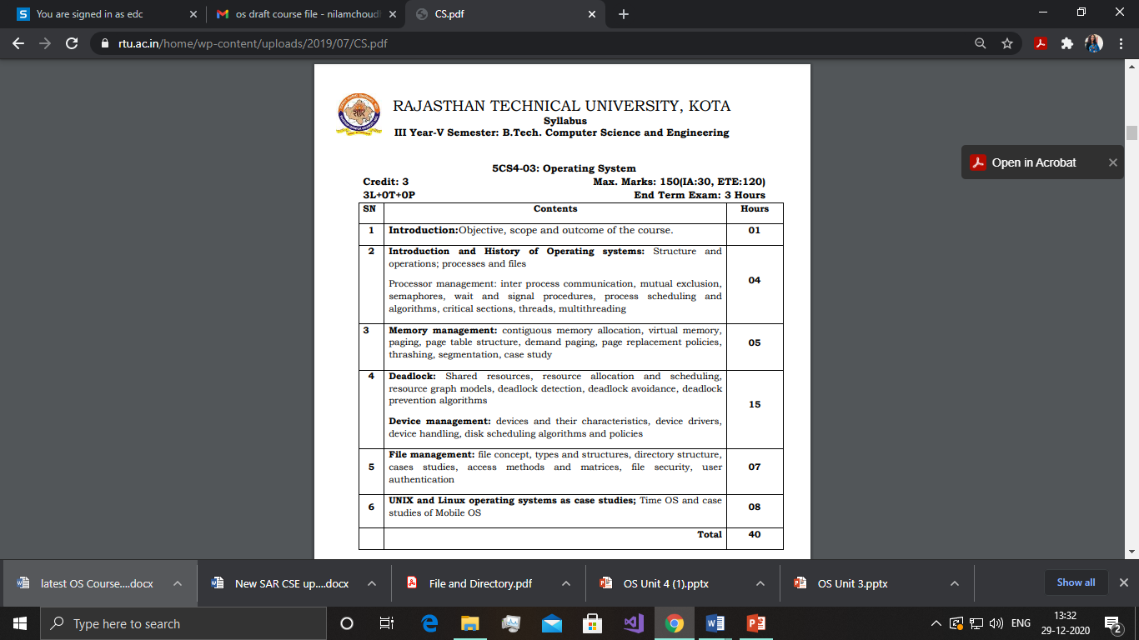
Syllabus
1

Slide 9
Lecture Plan
UNIT | MAIN TOPIC | NO. OF LEC.s | UNIT | MAIN TOPIC | NO. OF LEC.s
1. | Introduction: Objective, scope and outcome of the course. | 1 | 4. | File management: file concept | 1
 | Introduction and History of Operating systems: Structure and operations; processes and files Processor management | 1 |  | types and structures, directory structure | 2
 | inter process communication, mutual exclusion, semaphores | 1 |  | cases studies | 2
 | wait and signal procedures, process scheduling and algorithms | 1 |  | access methods and matrices | 1
 | critical sections, threads, multithreading | 1 |  | file security, user authentication | 1
2. | Memory management: contiguous memory allocation | 1 | 5. | UNIX and Linux operating systems as case studies | 1
 | virtual memory, paging | 1 |  | Time OS Introduction | 1
 | page table structure, demand paging | 1 |  | RTS work Procedure | 1
 | replacement policies, thrashing | 1 |  | RTS application area A study | 1
 | segmentation, case study | 1 |  | Case studies of Mobile OS | 1
 |  |  |  | Android OS | 1
3. | Deadlock: Shared resources | 1 |  | IOS | 1
 | resource allocation and scheduling | 2 |  | Security Issue on Different Time OS | 1
 | resource graph models | 2 |  | Total | 40
 | deadlock detection | 1 | Content beyond Curricula Multitasking, context switching Buddy system, overlays Fragmentation compaction Disk management IOS and KALI linux
 | deadlock avoidance | 2
 | deadlock prevention algorithms | 2
 | Device management: devices and their characteristics | 1
 | device drivers, device handling | 1
 | disk scheduling algorithms | 2
 | Device algorithm policies | 1
1

Slide 10
Introduction of OS
Goal of an Operating System:
The fundamental goal of a Computer System is to execute user programs and to make tasks easier.
Various application programs along with hardware system are used to perform this work.
Definition of Operating System:
A software which manages and control the entire set of resources and effectively utilize every part of a computer.
1

Slide 11
Definition of OS
Operating System Definitions
■ Resource allocator – manages and allocates resources.
■ Control program – controls the execution of user programs and operations of I/O devices .
■ Kernel – the one program running at all times (all else being application programs).
1

Slide 12
Introduction of OS
The figure shows how OS acts as a medium between hardware unit and application programs.
1

Slide 13
Introduction of OS
Computer System Components
Hardware – provides basic computing resources (CPU, memory, I/O devices).
Operating system – controls and coordinates the use of the hardware among the various application programs for the various users.
Applications programs – define the ways in which the system resources are used to solve the computing problems of the users (compilers, database systems, video games, business programs).
Users (people, machines, other computers).
1

Slide 14
Need of Operating System:
Platform for Application programs
Managing Input-Output unit
Consistent user interface
Multitasking
1

Slide 15
Functions of Operating System:
Memory Management 6. Control over System Performance
Processor Management 7. Job accounting
Device Management 8. Error detecting aids
File Management 9.Coordination between other s/w
            and users
Security
1

Slide 16
Operating Systems Structures
Just like any other software, the operating system code can be structured in different ways. The following are some of the commonly used structures.
Simple/Monolithic Structure
In this case, the operating system code has no structure.
It is written for functionality and efficiency (in terms of time and space).
DOS and UNIX are examples of such systems.
Layered Approach
The modularization of a system can be done in many ways.
In the layered approach, the operating system is broken up into a number of layers or levels each built on top of lower layer.
The bottom layer is the hardware; the highest layer is the user interface.
A typical OS layer consists of data structures and a set of routines that can be invoked by higher-level layers.
1

Slide 17
Virtual Machines
The computer system is made up of layers.
The hardware is the lowest level in all such systems.
The kernel running at the next level uses the hardware instructions to create a set of system call for use by outer layers.
The system programs above the kernel are therefore able to use either system calls or hardware instructions and in some ways these programs do not differentiate between these two.
System programs, in turn, treat the hardware and the system calls as though they were both at the same level.
In some systems, the application programs can call the system programs. The application programs view everything under them in the hierarchy as though the latter were part of the machine itself.
This layered approach is taken to its logical conclusion in the concept of a virtual machine (VM).
The VM operating system for IBM systems is the best example of VM concept.
1

Slide 18
Virtual Machines Cont..
There are two primary advantages to using virtual machines:
first by completely protecting system resources the virtual machine provides a robust level of security.
Second, the virtual machine allows system development to be done without disrupting normal system operation.
Although the virtual machine concept is useful it is difficult to implement.
Java Virtual Machine (JVM) loads, verifies and executes programs that have been translated into Java Bytecode. VMWare can be run on a Windows platform to create a virtual machine on which you can install an operating of your choice, such as Linux. Virtual PC software works in a similar fashion.
1

Slide 19
Operating System Types
Single-user systems
A computer system that allows only one user to use the computer at a given time is known as a single-user system.
The goals of such systems are maximizing user convenience and responsiveness, instead of maximizing the utilization of the CPU and peripheral devices.
Single-user systems use I/O devices such as keyboards, mouse, display screens, scanners, and small printers. They can adopt technology developed for larger operating systems.
They may run different types of operating systems, including DOS, Windows, and MacOS. Linux and UNIX operating systems can also be run in single-user mode.
1

Slide 20
Batch Systems
Early computers were large machines run from a console with card readers and tape drives as input devices and line printers, tape drives, and card punches as output devices.
The user did not interact directly with the system; instead, the user prepared a job, (which consisted of the program, data, and some control information about the nature of the job in the form of control cards) and submitted this to the computer operator.
The job was in the form of punch cards, and at some later time, the output was generated by the system. The output consisted of the result of the program, as well as a dump of the final memory and register contents for debugging.
1

Slide 21
Batch Systems Cont..
To speed up processing, operators batched together jobs with similar needs and ran them through the computer as a group. For example, all FORTRAN programs were compiled one after the other.
The major task of such an operating system was to transfer control automatically from one job to the next.
Such systems in which the user does not get to interact with his jobs and jobs with similar needs are executed in a “batch”, one after the other, are known as batch systems.
Digital Equipment Corporation’s VMS is an example of a batch operating system.
1

Slide 22
Multi-programmed Systems
Such systems organize jobs so that CPU always has one to execute.
In this way, CPU utilization is increased.
The operating system picks and executes from amongst the available jobs in memory.
The job has to wait for some task such as an I/O operation to complete.
In a non-multi-programmed system CPU would sit idle while in case of multiprogrammed system, the operating system simply switches to, and executes another job.
Computer running excel and firefox browser simultaneously is an example.
1

Slide 23
Time-sharing systems
These are multi-user and multi-process systems.
Multi-user means system allows multiple users simultaneously.
In this system, a user can run one or more processes at the same time.
Examples of time-sharing systems are UNIX, Linux, Windows server editions.
1

Slide 24
Real-time systems
Real time systems are used when strict time requirements are placed on the operation of a processor or the flow of data.
These are used to control a device in a dedicated application.
For example, medical imaging system and scientific experiments.
1

Slide 25
Examples of Operating System:
There are many types of operating system. Some most popular examples of operating system are:
Unix Operating System
Unix was initially written in assembly language. Later on, it was replaced by C, and Unix, rewritten in C and was developed into a large, complex family of inter-related operating systems. The major categories include BSD, and Linux.
“UNIX” is a trademark of The Open Group which licenses it for use with any operating system that has been shown to conform to their definitions.
1

Slide 26
Examples of Operating System Cont..
macOS
Mac-OS is developed by Apple Inc. and is available on all Macintosh computers.
It was formerly called “Mac OS X” and later on “OS X”.
MacOS was developed in 1980s by NeXT and that company was purchased by Apple in 1997.
Linux
Linux is Unix-like operating system and was developed without any Unix code. Linux is open license model and code is available for study and modification. It has superseded Unix on many platforms. Linux is commonly used smartphones and smartwatches.
1

Slide 27
Examples of Operating System Cont..
Microsoft Windows
Microsoft Windows is most popular and widely used operating system.
It was designed and developed by Microsoft Corporation.
The current version of operating system is Windows-10.
Microsoft Windows was first released in 1985.
In 1995, Windows 95 was released which only used MS-DOS as a bootstrap.
Other operating systems
Various operating systems like OS/2, BeOS and some other operating system which were developed over time are no longer used now.
1

Slide 28
Program vs Process
A process is an instance of a program in execution.
Batch systems work in terms of "jobs".
Many modern process concepts are still expressed in terms of jobs,
( e.g. job scheduling ), and the two terms are often used interchangeably.
A process is a program in execution. For example, when we write a program in C or C++ and compile it, the compiler creates binary code. The original code and binary code are both programs. When we actually run the binary code, it becomes a process.
A process is an ‘active’ entity, as opposed to a program, which is considered to be a ‘passive’ entity. A single program can create many processes when run multiple times; for example, when we open a .exe or binary file multiple times, multiple instances begin (multiple processes are created).
1

Slide 29
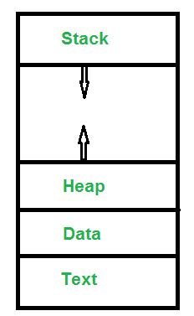
What does a process look like in memory?
Text Section:A Process, sometimes known as the Text Section, also includes the current activity represented by the value of the Program Counter.
Data Section: Contains the global variable.
Heap Section: Dynamically allocated memory to process during its run time.
Stack: The Stack contains the temporary data, such as function parameters, returns addresses, and local variables.
1

Slide 30
Cont..
  Note that the stack and the heap start at opposite ends of the process's free space and grow towards each other.
  If they should ever meet, then either a stack overflow error will occur, or else a call to new or malloc will fail due to insufficient memory available.
When processes are swapped out of memory and later restored, additional information must also be stored and restored.
Key among them are the program counter and the value of all program registers.
1

Slide 31
Attributes or Characteristics of a Process
Process Id: A unique identifier assigned by the operating system
Process State: Can be ready, running, etc.
CPU registers: Like the Program Counter (CPU registers must be saved and restored when a process is swapped in and out of CPU)
Accounts information: user and kernel CPU time consumed, account numbers, limits, etc.
I/O status information: For example, devices allocated to the process, open files, etc
1

Slide 32
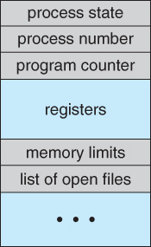
Cont
CPU scheduling information: For example, Priority (Different processes may have different priorities, for example a short process may be assigned a low priority in the shortest job first scheduling)
Memory-Management information - E.g. page tables or segment tables.
PCB(Process Control Block)
1

Slide 33
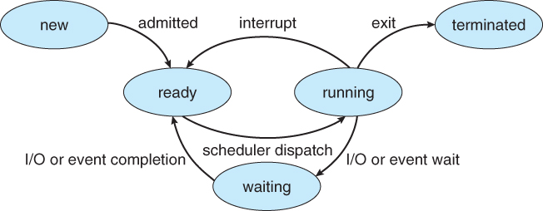
Process State
Processes may be in one of 5 states
  New - The process is in the stage of being created.
  Ready - The process has all the resources available that it needs to run, but the CPU is not currently working on this process's instructions.
  Running - The CPU is working on this process's instructions.
  Waiting - The process cannot run at the moment, because it is waiting for some resource to become available or for some event to occur. For example the process may be waiting for keyboard input, disk access request, inter-process messages, a timer to go off, or a child process to finish.
  Terminated - The process has completed.
1

Slide 34
Threads
What is a Thread?
A thread is a path of execution within a process. A process can contain multiple threads.
Process vs Thread?
The primary difference is that threads within the same process run in a shared memory space, while processes run in separate memory spaces.
Threads are not independent of one another like processes are, and as a result threads share with other threads their code section, data section, and OS resources (like open files and signals).
But, like process, a thread has its own program counter (PC), register set, and stack space.
1

Slide 35
Process Scheduling
The two main objectives of the process scheduling system are to keep the CPU busy at all times and to deliver "acceptable" response times for all programs, particularly for interactive ones.
The process scheduler must meet these objectives by implementing suitable policies for swapping processes in and out of the CPU.
( Note that these objectives can be conflicting. In particular, every time the system steps in to swap processes it takes up time on the CPU to do so, which is thereby "lost" from doing any useful productive work. )
1

Slide 36
Importance of Process Scheduling
Early computer systems were monoprogrammed and, as a result, scheduling was a non-issue.
For many current personal computers, which are definitely multiprogrammed, there is in fact very rarely more than one runnable process. As a result, scheduling is not critical.
For servers (or old mainframes), scheduling is indeed important and these are the systems you should think of.
1

Slide 37
Cont
Definition
The process scheduling is the activity of the process manager that handles the removal of the running process from the CPU and the selection of another process on the basis of a particular strategy.
Process scheduling is an essential part of a Multiprogramming operating systems.
Such operating systems allow more than one process to be loaded into the executable memory at a time and the loaded process shares the CPU using time multiplexing.
1

Slide 38
Process Scheduling Queues
The OS maintains all PCBs in Process Scheduling Queues.
The OS maintains a separate queue for each of the process states and PCBs of all processes in the same execution state are placed in the same queue.
When the state of a process is changed, its PCB is unlinked from its current queue and moved to its new state queue.
1

Slide 39
Cont..
The Operating System maintains the following important process scheduling queues −
Job queue − This queue keeps all the processes in the system.
Ready queue − This queue keeps a set of all processes residing in main memory, ready and waiting to execute. A new process is always put in this queue.
Device queues − The processes which are blocked due to unavailability of an I/O device constitute this queue.
1

Slide 40
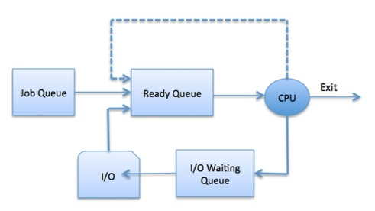
Cont..
The OS can use different policies to manage each queue (FIFO, Round Robin, Priority, etc.).
The OS scheduler determines how to move processes between the ready and run queues which can only have one entry per processor core on the system;
In this diagram, it has been merged with the CPU.
1

Slide 41
Two-State Process Model
Running
When a new process is created, it enters into the system as in the running state.
Not Running
Processes that are not running are kept in queue, waiting for their turn to execute.
Each entry in the queue is a pointer to a particular process.
Queue is implemented by using linked list.
Use of dispatcher is as follows.
When a process is interrupted, that process is transferred in the waiting queue. If the process has completed or aborted, the process is discarded. In either case, the dispatcher then selects a process from the queue to execute.
1

Slide 42
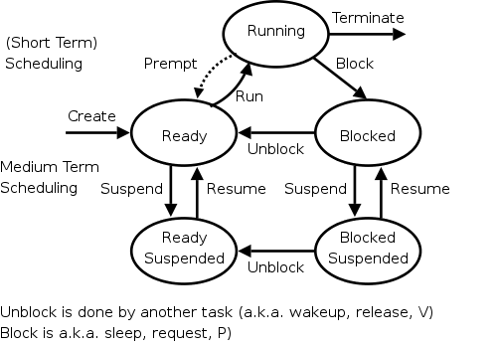
Process Scheduling
For now we are discussing the arcs connecting running↔ready in the diagram on the right showing the various states of a process.
Medium term scheduling is discussed later as is disk-arm scheduling.
Naturally, the part of the OS responsible for (short-term, processor) scheduling is called the (short-term, processor) scheduler
The algorithm used is called the (short-term, processor) scheduling algorithm.
1

Slide 43
Process Scheduling
New: Newly Created Process (or) being-created process.
Ready: After creation process moves to Ready state, i.e. the process is ready for execution.
Run: Currently running process in CPU (only one process at a time can be under execution in a single processor).
Wait (or Block): When a process requests I/O access.
Complete (or Terminated): The process completed its execution.
Suspended Ready: When the ready queue becomes full, some processes are moved to suspended ready state
Suspended Block: When waiting queue becomes full.
1

Slide 44
Context Switching
The process of saving the context of one process and loading the context of another process is known as Context Switching.
In simple terms, it is like loading and unloading the process from running state to ready state.
When does context switching happen?
1. When a high-priority process comes to ready state (i.e. with higher priority than the running process)
2. An Interrupt occurs
3. User and kernel mode switch (It is not necessary though)
4. Preemptive CPU scheduling used.
1

Slide 45
Context Switch vs Mode Switch
A mode switch occurs when CPU privilege level is changed, for example when a system call is made or a fault occurs.
The kernel works in more a privileged mode than a standard user task.
If a user process wants to access things which are only accessible to the kernel, a mode switch must occur.
The currently executing process need not be changed during a mode switch.
A mode switch typically occurs for a process context switch to occur. Only the kernel can cause a context switch.
1

Slide 46
CPU-Bound vs I/O-Bound Processes:
  A CPU-bound process requires more CPU time or spends more time in the running state.
  An I/O-bound process requires more I/O time and less CPU time.
  An I/O-bound process spends more time in the waiting state.
1

Slide 47
Process Schedulers
Schedulers are special system software which handle process scheduling in various ways.
Their main task is to select the jobs to be submitted into the system and to decide which process to run.
Schedulers are of three types −
Long-Term Scheduler
Short-Term Scheduler
Medium-Term Scheduler
1

Slide 48
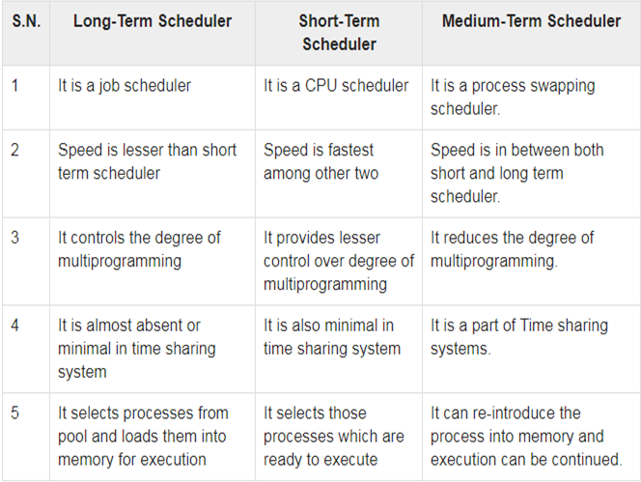
Comparison among Scheduler
1

Slide 49
Context Switching
A context switch is the mechanism to store and restore the state or context of a CPU in Process Control block so that a process execution can be resumed from the same point at a later time.
Using this technique, a context switcher enables multiple processes to share a single CPU.
Context switching is an essential part of a multitasking operating system features.
When the scheduler switches the CPU from executing one process to execute another, the state from the current running process is stored into the process control block.
After this, the state for the process to run next is loaded from its own PCB and used to set the PC, registers, etc. At that point, the second process can start executing.
1

Slide 50
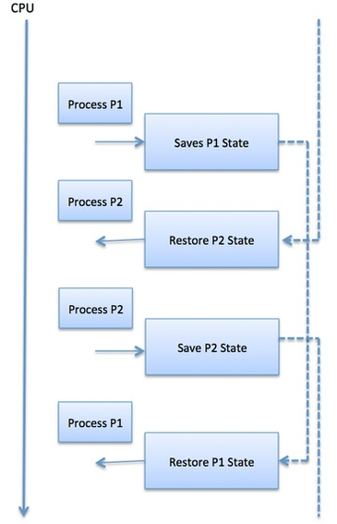
Cont..
Context switches are computationally intensive since register and memory state must be saved and restored.
To avoid the amount of context switching time, some hardware systems employ two or more sets of processor registers.
When the process is switched, the following information is stored for later use.
Program Counter
Scheduling information
Base and limit register value
Currently used register
Changed State
I/O State information
Accounting information
1

Slide 51
OS Scheduling Algorithms
A Process Scheduler schedules different processes to be assigned to the CPU based on particular scheduling algorithms.
There are six popular process scheduling algorithms
First-Come, First-Served (FCFS) Scheduling
Shortest-Job-Next (SJN) Scheduling
Priority Scheduling
Shortest Remaining Time
Round Robin(RR) Scheduling
Multiple-Level Queues Scheduling
1

Slide 52
Cont..
These algorithms are either non-preemptive or preemptive.
Non-preemptive algorithms are designed so that once a process enters the running state, it cannot be preempted until it completes its allotted time,
Preemptive scheduling is based on priority where a scheduler may preempt a low priority running process anytime when a high priority process enters into a ready state.
1

Slide 53
First Come First Serve (FCFS)
Jobs are executed on first come, first serve basis.
It is a non-preemptive, pre-emptive scheduling algorithm.
Easy to understand and implement.
Its implementation is based on FIFO queue.
Poor in performance as average wait time is high.
1

Slide 54
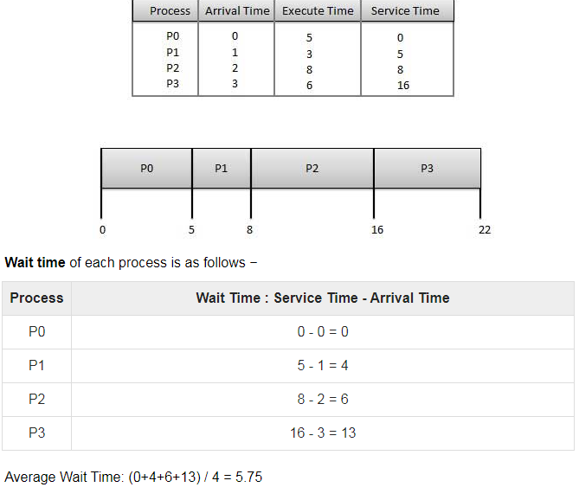
Cont..
1

Slide 55
Shortest Job Next (SJN)
This is also known as shortest job first, or SJF
This is a non-preemptive, pre-emptive scheduling algorithm.
Best approach to minimize waiting time.
Easy to implement in Batch systems where required CPU time is known in advance.
Impossible to implement in interactive systems where required CPU time is not known.
The processer should know in advance how much time process will take.
1

Slide 56
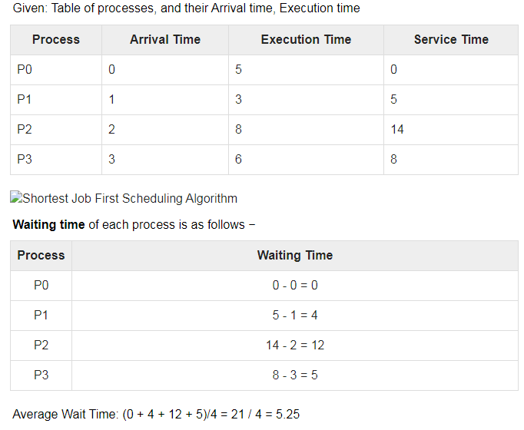
Cont
1

Slide 57
Priority Based Scheduling
Priority scheduling is a non-preemptive algorithm and one of the most common scheduling algorithms in batch systems.
Each process is assigned a priority. Process with highest priority is to be executed first and so on.
Processes with same priority are executed on first come first served basis.
Priority can be decided based on memory requirements, time requirements or any other resource requirement.
1

Slide 58
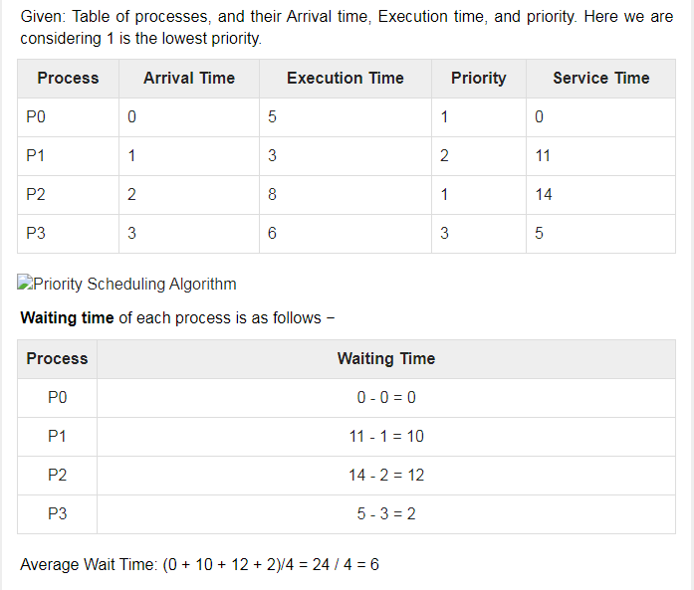
Cont..
1

Slide 59
Shortest Remaining Time
Shortest remaining time (SRT) is the preemptive version of the SJN algorithm.
The processor is allocated to the job closest to completion but it can be preempted by a newer ready job with shorter time to completion.
Impossible to implement in interactive systems where required CPU time is not known.
It is often used in batch environments where short jobs need to give preference.
1

Slide 60
Round Robin Scheduling
Round Robin is the preemptive process scheduling algorithm.
Each process is provided a fix time to execute, it is called a quantum.
Once a process is executed for a given time period, it is preempted and other process executes for a given time period.
Context switching is used to save states of preempted processes.
1

Slide 61
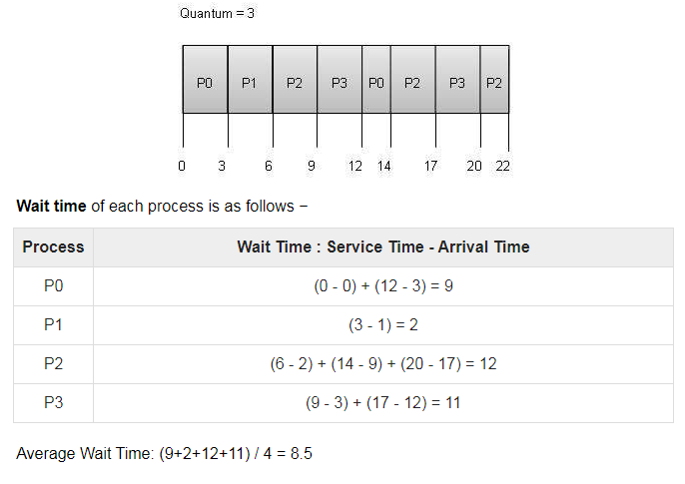
Round Robin Scheduling Cont..
1

Slide 62
Multiple-Level Queues Scheduling
Multiple-level queues are not an independent scheduling algorithm.
They make use of other existing algorithms to group and schedule jobs with common characteristics.
Multiple queues are maintained for processes with common characteristics.
Each queue can have its own scheduling algorithms.
Priorities are assigned to each queue.
For example, CPU-bound jobs can be scheduled in one queue and all I/O-bound jobs in another queue. The Process Scheduler then alternately selects jobs from each queue and assigns them to the CPU based on the algorithm assigned to the queue.
1

Slide 63
CPU Scheduling in OS
Arrival Time: Time at which the process arrives in the ready queue.
Completion Time: Time at which process completes its execution.
Burst Time: Time required by a process for CPU execution.
Turn Around Time: Time Difference between completion time and arrival time.
Turn Around Time = Completion Time – Arrival Time
Waiting Time(W.T): Time Difference between turn around time and burst time.
Waiting Time = Turn Around Time – Burst Time
1

Slide 64
Comparison among Scheduling Algorithm
FCFS can cause long waiting times, especially when the first job takes too much CPU time.
Both SJF and Shortest Remaining time first algorithms may cause starvation. Consider a situation when the long process is there in the ready queue and shorter processes keep coming.
If time quantum for Round Robin scheduling is very large, then it behaves same as FCFS scheduling.
SJF is optimal in terms of average waiting time for a given set of processes,i.e., average waiting time is minimum with this scheduling, but problems are, how to know/predict the time of next job.
1

Slide 65
What is Thread
A thread is a flow of execution through the process code, with its own program counter that keeps track of which instruction to execute next, system registers which hold its current working variables, and a stack which contains the execution history.
A thread shares with its peer threads few information like code segment, data segment and open files. When one thread alters a code segment memory item, all other threads see that.
A thread is also called a lightweight process.
Threads provide a way to improve application performance through parallelism.
Threads represent a software approach to improving performance of operating system by reducing the overhead thread is equivalent to a classical process.
1

Slide 66
Cont..
Each thread belongs to exactly one process and no thread can exist outside a process.
Each thread represents a separate flow of control.
Threads have been successfully used in implementing network servers and web server.
They also provide a suitable foundation for parallel execution of applications on shared memory multiprocessors.
1

Slide 67
Difference between Process and Thread
S.N. | Process | Thread
1 | Process is heavy weight or resource intensive. | Thread is light weight, taking lesser resources than a process.
2 | Process switching needs interaction with operating system. | Thread switching does not need to interact with operating system.
3 | In multiple processing environments, each process executes the same code but has its own memory and file resources. | All threads can share same set of open files, child processes.
4 | If one process is blocked, then no other process can execute until the first process is unblocked. | While one thread is blocked and waiting, a second thread in the same task can run.
5 | Multiple processes without using threads use more resources. | Multiple threaded processes use fewer resources.
6 | In multiple processes each process operates independently of the others. | One thread can read, write or change another thread's data.
1

Slide 68
Advantages of Thread and its types
Threads minimize the context switching time.
Use of threads provides concurrency within a process.
Efficient communication.
It is more economical to create and context switch threads.
Threads allow utilization of multiprocessor architectures to a greater scale and efficiency.
Types of Thread
User Level Threads − User managed threads.
Kernel Level Threads − Operating System managed threads acting on kernel, an operating system core.
1

Slide 69
User Level Threads
In this case, the thread management kernel is not aware of the existence of threads.
The thread library contains code for creating and destroying threads, for passing message and data between threads, for scheduling thread execution and for saving and restoring thread contexts.
The application starts with a single thread.
Advantages
Thread switching does not require Kernel mode privileges.
User level thread can run on any operating system.
Scheduling can be application specific in the user level thread.
User level threads are fast to create and manage.
Disadvantages
In a typical operating system, most system calls are blocking.
Multithreaded application cannot take advantage of multiprocessing.
1

Slide 70
Kernel Level Threads
In this case, thread management is done by the Kernel.
There is no thread management code in the application area.
Kernel threads are supported directly by the operating system.
Any application can be programmed to be multithreaded.
All of the threads within an application are supported within a single process.
The Kernel maintains context information for the process as a whole and for individuals threads within the process.
Scheduling by the Kernel is done on a thread basis. The Kernel performs thread creation, scheduling and management in Kernel space. Kernel threads are generally slower to create and manage than the user threads.
1

Slide 71
Cont..
Advantages
Kernel can simultaneously schedule multiple threads from the same process on multiple processes.
If one thread in a process is blocked, the Kernel can schedule another thread of the same process.
Kernel routines themselves can be multithreaded.
Disadvantages
Kernel threads are generally slower to create and manage than the user threads.
Transfer of control from one thread to another within the same process requires a mode switch to the Kernel.
1

Slide 72
Multithreading Models
Some operating system provide a combined user level thread and Kernel level thread facility.
Solaris is a good example of this combined approach.
In a combined system, multiple threads within the same application can run in parallel on multiple processors and a blocking system call need not block the entire process.
Multithreading models are three types
Many to many relationship.
Many to one relationship.
One to one relationship.
1

Slide 73
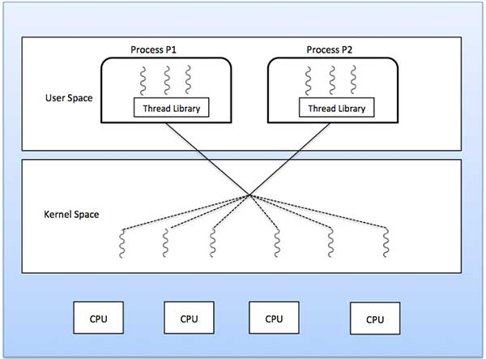
The many-to-many model multiplexes any number of user threads onto an equal or smaller number of kernel threads.
In this threading model where 6 user level threads are multiplexing with 6 kernel level threads.
In this model, developers can create as many user threads as necessary and the corresponding Kernel threads can run in parallel on a multiprocessor machine.
This model provides the best accuracy on concurrency and when a thread performs a blocking system call, the kernel can schedule another thread for execution.
Many to Many Model
1

Slide 74
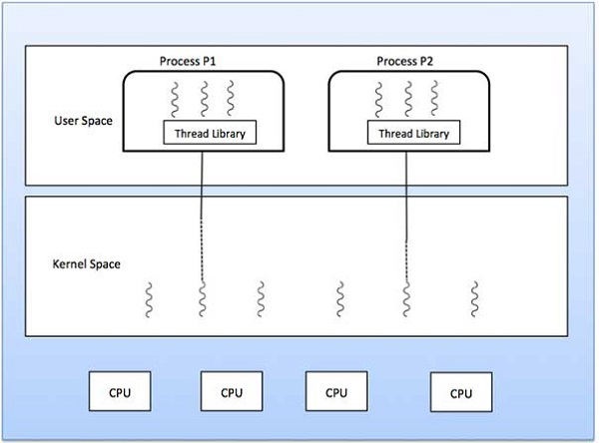
Many-to-one model maps many user level threads to one Kernel-level thread.
Thread management is done in user space by the thread library.
When thread makes a blocking system call, the entire process will be blocked.
Only one thread can access the Kernel at a time, so multiple threads are unable to run in parallel on multiprocessors.
If the user-level thread libraries are implemented in the operating system in such a way that the system does not support them, then the Kernel threads use the many-to-one relationship modes.
Many to One Model
1

Slide 75
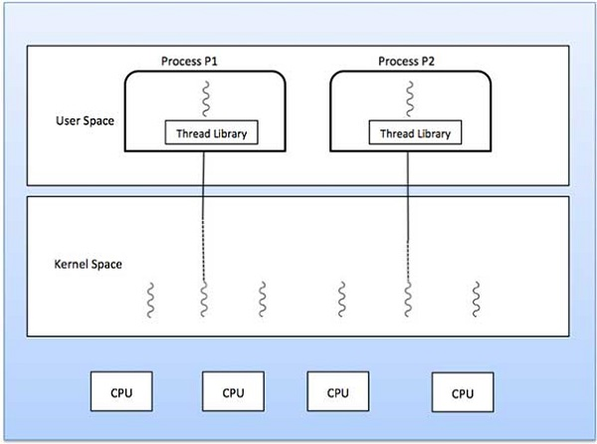
There is one-to-one relationship of user-level thread to the kernel-level thread.
This model provides more concurrency than the many-to-one model.
It also allows another thread to run when a thread makes a blocking system call.
It supports multiple threads to execute in parallel on microprocessors.
Disadvantage of this model is that creating user thread requires the corresponding Kernel thread.
OS/2, windows NT and windows 2000 use one to one relationship model.
One to One Model
1

Slide 76
Difference between User level and Kernel level threads
User-Level Threads
User-level threads are faster to create and manage.
Implementation is by a thread library at the user level.
User-level thread is generic and can run on any operating system.
Multi-threaded applications cannot take advantage of multiprocessing.
Kernel-Level Threads
Kernel-level threads are slower to create and manage.
Operating system supports creation of Kernel threads.
Kernel-level thread is specific to the operating system.
Kernel routines themselves can be multithreaded.
1

Slide 77
InterProcess Communication (IPC)
IPC is a set of programming interfaces that allow a programmer to coordinate activities among different program processes that can run concurrently in an operating system.
This allows a program to handle many user requests at the same time.
Since even a single user request may result in multiple processes running in the operating system on the user's behalf, the processes need to communicate with each other.
The IPC interfaces make this possible.
Each IPC method has its own advantages and limitations so it is not unusual for a single program to use all of the IPC methods.
1

Slide 78
Approaches IPC
File : A record stored on disk, or a record synthesized on demand by a file server, which can be accessed by multiple processes.
Socket : A data stream sent over a network interface, either to a different process on the same computer or to another computer on the network.
Typically byte-oriented, sockets rarely preserve message boundaries.
Data written through a socket requires formatting to preserve message boundaries.
1

Slide 79
Approaches Cont..
Pipe :
A unidirectional data channel.
Data written to the write end of the pipe is buffered by the operating system until it is read from the read end of the pipe.
Two-way data streams between processes can be achieved by creating two pipes utilizing standard input and output
Shared Memory :
Multiple processes are given access to the same block of memory which creates a shared buffer for the processes to communicate with each other.
1

Slide 80
Approaches Cont..
Message Passing :
Allows multiple programs to communicate using message queues and/or non-OS managed channels, commonly used in concurrency models.
Message queue :
A data stream similar to a socket, but which usually preserves message boundaries.
Typically implemented by the operating system, they allow multiple processes to read and write to the message queue without being directly connected to each other.
1

Slide 81
Message passing
Message Passing provides a mechanism for processes to communicate and to synchronize their actions without sharing the same address space.
IPC facility provides two operations:
• send (message)
•Receive (massage)
1

Slide 82
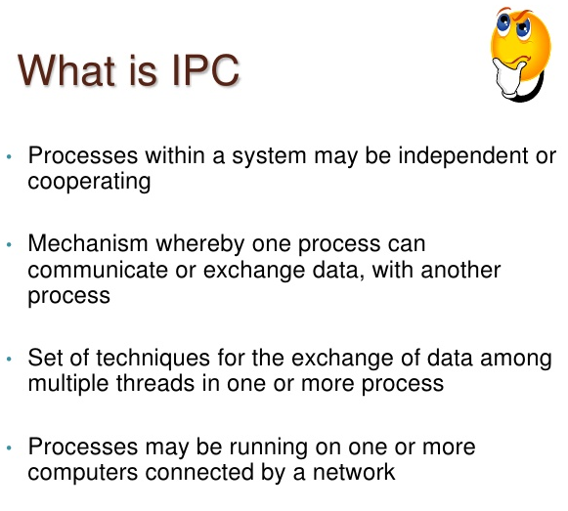
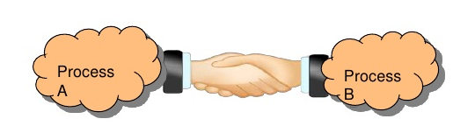
Inter Process Communication
1

Slide 83
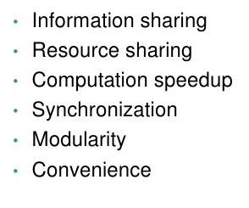
Why IPC
1

Slide 84
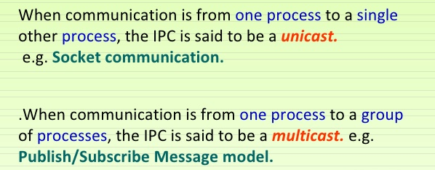
Unicast and Multicast IPC
1

Slide 85
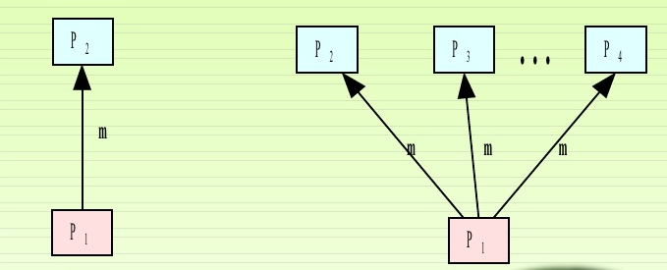
Unicast IPC
MultiCast IPC
1

Slide 86
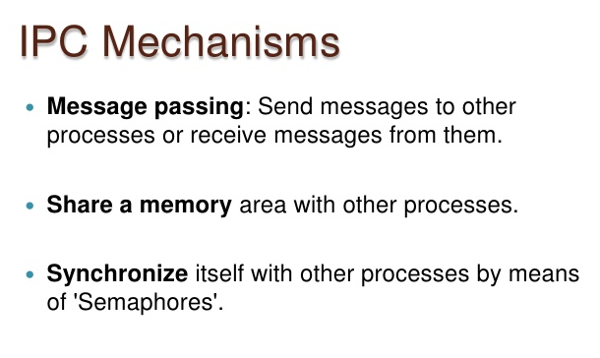
.
1

Slide 87
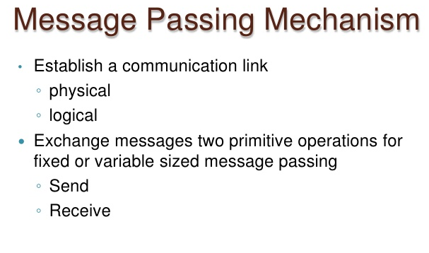
1

Slide 88
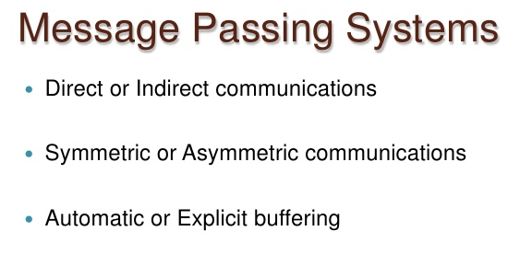
1

Slide 89
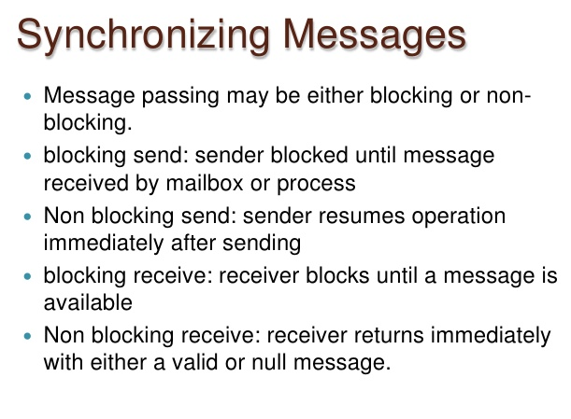
1

Slide 90
Shared Memory
This is the another mechanism by which processes can communicate with each other
In this mechanism we declare a section of memory as shared memory
This shared memory section is used by communicating processes simultaneously
We have to synchronize the processes so that they don’t alter shared memory simultaneously
1

Slide 91
Allocating a Shared Memory
A shared memory segment is allocated first.
Header Files : #include<sys/types.h>
#include<sys/ipc.h>
#include<sys/shm.h>
Shmget() - allocate a shared memory segment.
Int shmget(key_t key , size_t size , int shmflg)
1

Slide 92
Attaching and Detaching a shared memory
shmat() – attaches the shared memory segment.
Void *shmat(int shmid , const. void *shmaddr. , int shmflg);
shmdt() – detaches the shared memory segment.
It takes a pointer to the address returned by shmat() ; on success it returns 0, on error it returns -1.
1

Slide 93
Controlling the Shared Memory
shmctl() – control the operations on shared memory.
Int shmctl(int shmid , int cmd , struct ds *buf); cmd is one of the following
IPC_STAT
IPC_SET
IPC_RMID
IPC_RMID – deletes the shared memory segment.
1

Slide 94
Semaphores
Semaphores are used to synchronize the processes so that they can’t access critical section simultaneously.
Semaphores is of two types.
Binary and General Semaphores
Binary semaphore : binary semaphore is a variable that can take only the values 0 and 1.
General semaphore : general semaphore can take any positive value. The two functions are associated with two values of binary semaphore. wait() and signal().
1

Slide 95
Semaphore functions
Header File : #include<sys/types.h>
#include<sys/ipc.h>
#include<sys/sem.h>
semget() - The semget function creates a new semaphore.
Int semget(key_t key , int num_sems , int semflag);
semop() – change the value of the semaphore
Int semop(int semid , struct sembuf *semops , size_t num_sem_ops);
semctl() – allow direct control of semaphore information.
int semctl(int sem_id , int sem_num , int cmd);
1

Slide 96
What is Semaphore?
Semaphore is simply a variable that is non-negative and shared between threads.
A semaphore is a signalling mechanism, and a thread that is waiting on a semaphore can be signalled by another thread.
It uses two atomic operations,
1)wait, and 2) signal for the process synchronization.
A semaphore either allows or disallows access to the resource, which depends on how it is set up.
1

Slide 97
For Example, process A changing the data in a memory location while another process B is trying to read the data from the same memory location. There is a high probability that data read by the second process will be erroneous.
Characteristic of Semaphore
It is a mechanism that can be used to provide synchronization of tasks.
It is a low-level synchronization mechanism.
Semaphore will always hold a non-negative integer value.
Semaphore can be implemented using test operations and interrupts, which should be executed using file descriptors.
1

Slide 98
Types of Semaphores
The two common kinds of semaphores are
Counting semaphores
Binary semaphores.
Counting Semaphores
This type of Semaphore uses a count that helps task to be acquired or released numerous times.
If the initial count = 0, the counting semaphore should be created in the unavailable state.
1

Slide 99
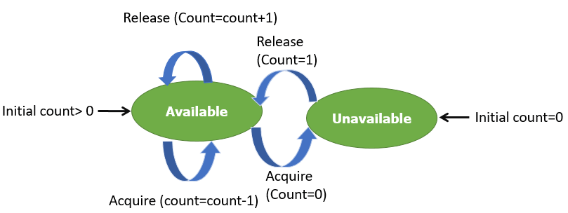
Cont
However, If the count is > 0, the semaphore is created in the available state, and the number of tokens it has equals to its count.
1

Slide 100
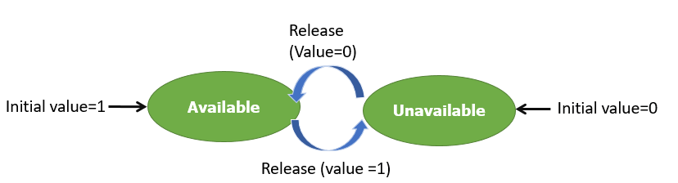
Cont..
Binary Semaphores
The binary semaphores are quite similar to counting semaphores, but their value is restricted to 0 and 1.
In this type of semaphore, the wait operation works only if semaphore = 1, and the signal operation succeeds when semaphore= 0. It is easy to implement than counting semaphores.
1

Slide 101
Cont..
Example of Semaphore
The below-given program is a step by step implementation, which involves usage and declaration of semaphore.
Shared var mutex: semaphore = 1;
Process i begin . . P(mutex);
execute CS; V(mutex); . .
End;
Wait and Signal Operations in Semaphores
Both of these operations are used to implement process synchronization. The goal of this semaphore operation is to get mutual exclusion.
Wait for Operation
This type of semaphore operation helps you to control the entry of a task into the critical section. However, If the value of wait is positive, then the value of the wait argument X is decremented. In the case of negative or zero value, no operation is executed. It is also called P(S) operation.
After the semaphore value is decreased, which becomes negative, the command is held up until the required conditions are satisfied.
1

Slide 102
Cont..
Copy CodeP(S)
{
while (S<=0);
S--;
}
Signal operation
This type of Semaphore operation is used to control the exit of a task from a critical section. It helps to increase the value of the argument by 1, which is denoted as V(S).
Copy CodeP(S)
{
while (S>=0);
S++;
}
1

Slide 103
Synchronization Hardware and Software
Some times the problems of the Critical Section are also resolved by hardware. Some operating system offers a lock functionality where a Process acquires a lock when entering the Critical section and releases the lock after leaving it.
So when another process is trying to enter the critical section, it will not be able to enter as it is locked. It can only do so if it is free by acquiring the lock itself.
Mutex Locks
Synchronization hardware not simple method to implement for everyone, so strict software method known as Mutex Locks was also introduced.
In this approach, in the entry section of code, a LOCK is obtained over the critical resources used inside the critical section. In the exit section that lock is released.
1

Slide 104
Cont..
Semaphore is simply a variable that is non-negative and shared between threads.
It is another algorithm or solution to the critical section problem.
It is a signaling mechanism and a thread that is waiting on a semaphore, which can be signaled by another thread.
It uses two atomic operations, 1)wait, and 2) signal for the process synchronization
1

Slide 105
Preemptive Scheduling
Preemptive Scheduling is a scheduling method where the tasks are mostly assigned with their priorities.
Sometimes it is important to run a task with a higher priority before another lower priority task, even if the lower priority task is still running.
At that time, the lower priority task holds for some time and resumes when the higher priority task finishes its execution.
1

Slide 106
What is Non- Preemptive Scheduling?
In this type of scheduling method, the CPU has been allocated to a specific process.
The process that keeps the CPU busy will release the CPU either by switching context or terminating.
It is the only method that can be used for various hardware platforms.
That's because it doesn't need specialized hardware (for example, a timer) like preemptive Scheduling.
Non-Preemptive Scheduling occurs when a process voluntarily enters the wait state or terminates.
1

Slide 107
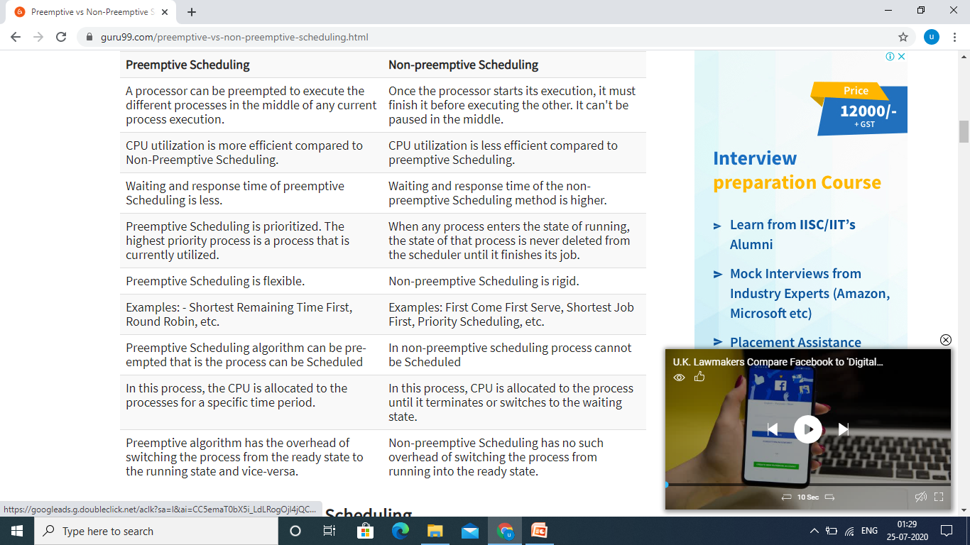
1

Slide 108
Advantages of Preemptive Scheduling
Here, are pros/benefits of Preemptive Scheduling method:
Preemptive scheduling method is more robust, approach so one process cannot monopolize the CPU
Choice of running task reconsidered after each interruption.
Each event cause interruption of running tasks
The OS makes sure that CPU usage is the same by all running process.
In this, the usage of CPU is the same, i.e., all the running processes will make use of CPU equally.
This scheduling method also improvises the average response time.
Preemptive Scheduling is beneficial when we use it for the multi-programming environment.
Disadvantages of Preemptive Scheduling
Here, are cons/drawback of Preemptive Scheduling method:
Need limited computational resources for Scheduling
Takes a higher time by the scheduler to suspend the running task, switch the context, and dispatch the new incoming task.
The process which has low priority needs to wait for a longer time if some high priority processes arrive continuously.
1

Slide 109
Advantages of Non-preemptive Scheduling
Here, are pros/benefits of Non-preemptive Scheduling method:
Offers low scheduling overhead
Tends to offer high throughput
It is conceptually very simple method
Less computational resources need for Scheduling
Disadvantages of Non-Preemptive Scheduling
Here, are cons/drawback of Non-Preemptive Scheduling method:
It can lead to starvation especially for those real-time tasks
Bugs can cause a machine to freeze up
It can make real-time and priority Scheduling difficult
Poor response time for processes
1

Slide 110
Example of Non-Preemptive Scheduling
In non-preemptive SJF scheduling, once the CPU cycle is allocated to process, the process holds it till it reaches a waiting state or terminated.
Consider the following five processes each having its own unique burst time and arrival time.
Process Queue Arrival Time Burst Time
P1 6 2
P2 2 5
P3 8 1
P4 3 0
P5 4 4
Step 0) At time=0, P4 arrives and starts execution.
Step 1) At time= 1, Process P3 arrives. But, P4 still needs 2 execution units to complete. It will continue execution.
Step 2) At time =2, process P1 arrives and is added to the waiting queue. P4 will continue execution.
1

Slide 111
Cont..
Step 3) At time = 3, process P4 will finish its execution. The burst time of P3 and P1 is compared. Process P1 is executed because its burst time is less compared to P3.
Step 4) At time = 4, process P5 arrives and is added to the waiting queue. P1 will continue execution.
Step 5) At time = 5, process P2 arrives and is added to the waiting queue. P1 will continue execution.
Step 6) At time = 9, process P1 will finish its execution. The burst time of P3, P5, and P2 is compared. Process P2 is executed because its burst time is the lowest.
Step 7) At time=10, P2 is executing, and P3 and P5 are in the waiting queue.
Step 8) At time = 11, process P2 will finish its execution. The burst time of P3 and P5 is compared. Process P5 is executed because its burst time is lower.
Step 9) At time = 15, process P5 will finish its execution.
Step 10) At time = 23, process P3 will finish its execution.
1

Slide 112
Cont..
Step 11) Let's calculate the average waiting time for above example.
1

Slide 113
Example of Pre-emptive Scheduling
Consider this following three processes in Round-robin
Process Queue Burst time Time Slice=2
P1 4
P2 3
P3 5
Step 1) The execution begins with process P1, which has burst time 4. Here, every process executes for 2 seconds. P2 and P3 are still in the waiting queue.
Step 2) At time =2, P1 is added to the end of the Queue and P2 starts executing
Step 3) At time=4 , P2 is preempted and add at the end of the queue. P3 starts executing.
Step 4) At time=6 , P3 is preempted and add at the end of the queue. P1 starts executing.
Step 5) At time=8 , P1 has a burst time of 4. It has completed execution. P2 starts execution
Step 6) P2 has a burst time of 3. It has already executed for 2 interval. At time=9, P2 completes execution. Then, P3 starts execution till it completes.
Step 7) Let's calculate the average waiting time for above example.
1

Slide 114
KEY DIFFERENCES
In Preemptive Scheduling, the CPU is allocated to the processes for a specific time period, and non-preemptive scheduling CPU is allocated to the process until it terminates.
In Preemptive Scheduling, tasks are switched based on priority while non-preemptive Schedulign no switching takes place.
Preemptive algorithm has the overhead of switching the process from the ready state to the running state while Non-preemptive Scheduling has no such overhead of switching.
Preemptive Scheduling is flexible while Non-preemptive Scheduling is rigid.
1

Slide 115
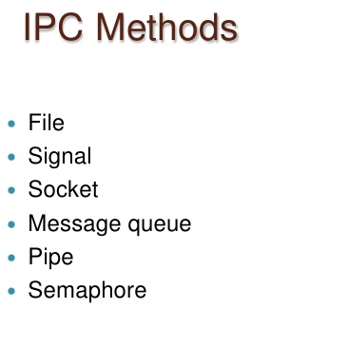
1

Slide 116
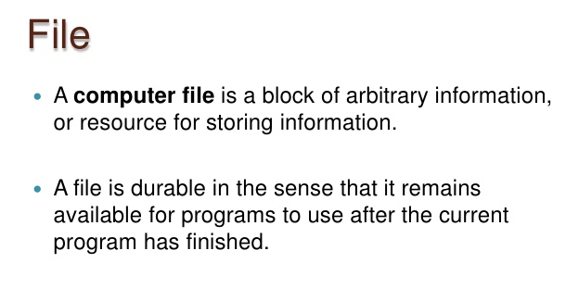
1

Slide 117
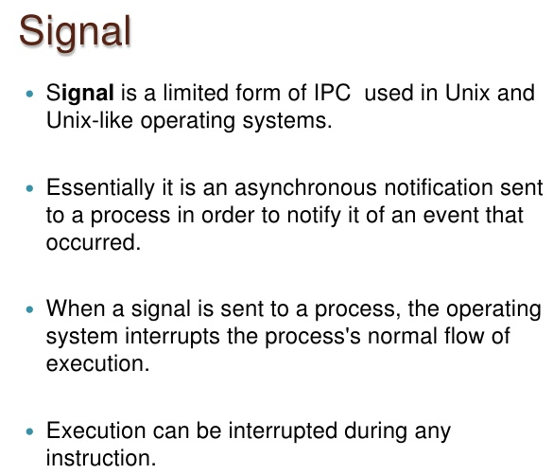
1

Slide 118
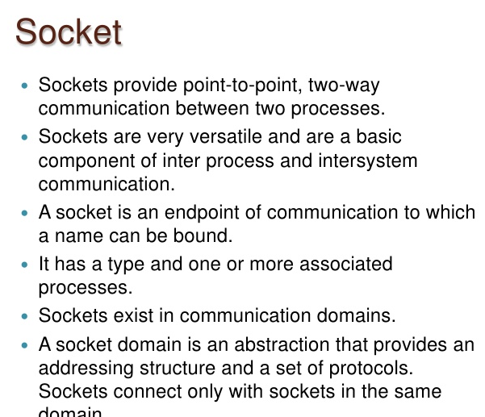
1

Slide 119
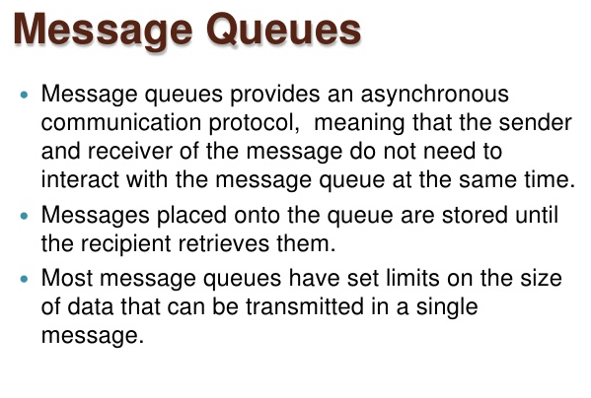
1

Slide 120
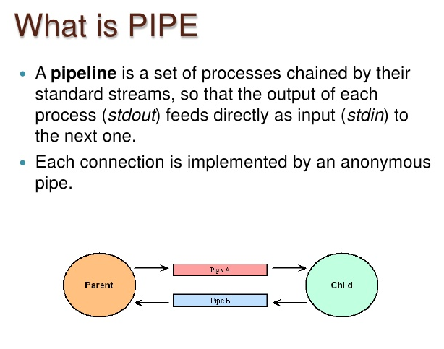
1

Slide 121
1

Slide 122
Process Synchronization: Critical Section Problem in OS
Process Synchronization is the task of coordinating the execution of processes in a way that no two processes can have access to the same shared data and resources.
It is specially needed in a multi-process system when multiple processes are running together, and more than one processes try to gain access to the same shared resource or data at the same time.
This can lead to the inconsistency of shared data. So the change made by one process not necessarily reflected when other processes accessed the same shared data.
To avoid this type of inconsistency of data, the processes need to be synchronized with each other.
1

Slide 123
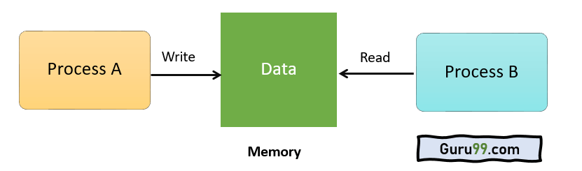
For Example, process A changing the data in a memory location while another process B is trying to read the data from the same memory location. There is a high probability that data read by the second process will be erroneous.
How Process Synchronization Works?
For Example, process A changing the data in a memory location while another process B is trying to read the data from the same memory location. There is a high probability that data read by the second process will be erroneous.
Memory
1

Slide 124
Sections of a Program
Here, are four essential elements of the critical section:
Entry Section: It is part of the process which decides the entry of a particular process.
Critical Section: This part allows one process to enter and modify the shared variable.
Exit Section: Exit section allows the other process that are waiting in the Entry Section, to enter into the Critical Sections. It also checks that a process that finished its execution should be removed through this Section.
Remainder Section: All other parts of the Code, which is not in Critical, Entry, and Exit Section, are known as the Remainder Section.
1

Slide 125
What is Critical Section Problem?
A critical section is a segment of code which can be accessed by a signal process at a specific point of time. The section consists of shared data resources that required to be accessed by other processes.
The entry to the critical section is handled by the wait() function, and it is represented as P().
The exit from a critical section is controlled by the signal() function, represented as V().
In the critical section, only a single process can be executed.
Other processes, waiting to execute their critical section, need to wait until the current process completes its execution.
1

Slide 126
Rules for Critical Section
The critical section need to must enforce all three rules:
Mutual Exclusion: Mutual Exclusion is a special type of binary semaphore which is used for controlling access to the shared resource. It includes a priority inheritance mechanism to avoid extended priority inversion problems. Not more than one process can execute in its critical section at one time.
Progress: This solution is used when no one is in the critical section, and someone wants in. Then those processes not in their reminder section should decide who should go in, in a finite time.
Bound Waiting: When a process makes a request for getting into critical section, there is a specific limit about number of processes can get into their critical section. So, when the limit is reached, the system must allow request to the process to get into its critical section.
1

Slide 127
Solutions To The Critical Section
In Process Synchronization, critical section plays the main role so that the problem must be solved.
Here are some widely used methods to solve the critical section problem.
Peterson Solution
Peterson's solution is widely used solution to critical section problems. This algorithm was developed by a computer scientist Peterson that's why it is named as a Peterson's solution.
In this solution, when a process is executing in a critical state, then the other process only executes the rest of the code, and the opposite can happen. This method also helps to make sure that only a single process runs in the critical section at a specific time.
1

Slide 128
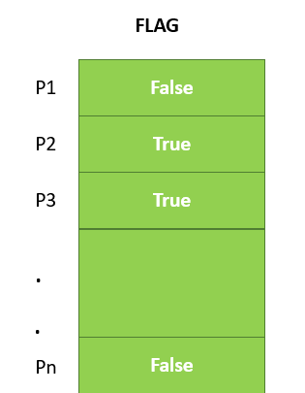
PROCESS Pi
FLAG[i] = true
while( (turn != i) AND (CS is !free) )
{ wait; }
CRITICAL SECTION FLAG[i] = false
turn = j; //choose another process to go to CS
Cont..
Assume there are N processes (P1, P2, ... PN) and every process at some point of time requires to enter the Critical Section
A FLAG[] array of size N is maintained which is by default false. So, whenever a process requires to enter the critical section, it has to set its flag as true.
For example, If Pi wants to enter it will set FLAG[i]=TRUE.
Another variable called TURN indicates the process number which is currently wating to enter into the CS.
The process which enters into the critical section while exiting would change the TURN to another number from the list of ready processes.
Example: turn is 2 then P2 enters the Critical section and while exiting turn=3 and therefore P3 breaks out of wait loop.
1

Slide 129
Synchronization Hardware and Software
Some times the problems of the Critical Section are also resolved by hardware. Some operating system offers a lock functionality where a Process acquires a lock when entering the Critical section and releases the lock after leaving it.
So when another process is trying to enter the critical section, it will not be able to enter as it is locked. It can only do so if it is free by acquiring the lock itself.
Mutex Locks
Synchronization hardware not simple method to implement for everyone, so strict software method known as Mutex Locks was also introduced.
In this approach, in the entry section of code, a LOCK is obtained over the critical resources used inside the critical section. In the exit section that lock is released.
1

Slide 130
Cont..
Semaphore is simply a variable that is non-negative and shared between threads.
It is another algorithm or solution to the critical section problem.
It is a signaling mechanism and a thread that is waiting on a semaphore, which can be signaled by another thread.
It uses two atomic operations, 1)wait, and 2) signal for the process synchronization
1

Slide 131
Preemptive Scheduling
Preemptive Scheduling is a scheduling method where the tasks are mostly assigned with their priorities.
Sometimes it is important to run a task with a higher priority before another lower priority task, even if the lower priority task is still running.
At that time, the lower priority task holds for some time and resumes when the higher priority task finishes its execution.
1

Slide 132
What is Non- Preemptive Scheduling?
In this type of scheduling method, the CPU has been allocated to a specific process.
The process that keeps the CPU busy will release the CPU either by switching context or terminating.
It is the only method that can be used for various hardware platforms.
That's because it doesn't need specialized hardware (for example, a timer) like preemptive Scheduling.
Non-Preemptive Scheduling occurs when a process voluntarily enters the wait state or terminates.
1

Slide 133
1

Slide 134
Advantages of Preemptive Scheduling
Here, are pros/benefits of Preemptive Scheduling method:
Preemptive scheduling method is more robust, approach so one process cannot monopolize the CPU
Choice of running task reconsidered after each interruption.
Each event cause interruption of running tasks
The OS makes sure that CPU usage is the same by all running process.
In this, the usage of CPU is the same, i.e., all the running processes will make use of CPU equally.
This scheduling method also improvises the average response time.
Preemptive Scheduling is beneficial when we use it for the multi-programming environment.
Disadvantages of Preemptive Scheduling
Here, are cons/drawback of Preemptive Scheduling method:
Need limited computational resources for Scheduling
Takes a higher time by the scheduler to suspend the running task, switch the context, and dispatch the new incoming task.
The process which has low priority needs to wait for a longer time if some high priority processes arrive continuously.
1

Slide 135
Advantages of Non-preemptive Scheduling
Here, are pros/benefits of Non-preemptive Scheduling method:
Offers low scheduling overhead
Tends to offer high throughput
It is conceptually very simple method
Less computational resources need for Scheduling
Disadvantages of Non-Preemptive Scheduling
Here, are cons/drawback of Non-Preemptive Scheduling method:
It can lead to starvation especially for those real-time tasks
Bugs can cause a machine to freeze up
It can make real-time and priority Scheduling difficult
Poor response time for processes
1

Slide 136
Example of Non-Preemptive Scheduling
In non-preemptive SJF scheduling, once the CPU cycle is allocated to process, the process holds it till it reaches a waiting state or terminated.
Consider the following five processes each having its own unique burst time and arrival time.
Process Queue Arrival Time Burst Time
P1 6 2
P2 2 5
P3 8 1
P4 3 0
P5 4 4
Step 0) At time=0, P4 arrives and starts execution.
Step 1) At time= 1, Process P3 arrives. But, P4 still needs 2 execution units to complete. It will continue execution.
Step 2) At time =2, process P1 arrives and is added to the waiting queue. P4 will continue execution.
1

Slide 137
Cont..
Step 3) At time = 3, process P4 will finish its execution. The burst time of P3 and P1 is compared. Process P1 is executed because its burst time is less compared to P3.
Step 4) At time = 4, process P5 arrives and is added to the waiting queue. P1 will continue execution.
Step 5) At time = 5, process P2 arrives and is added to the waiting queue. P1 will continue execution.
Step 6) At time = 9, process P1 will finish its execution. The burst time of P3, P5, and P2 is compared. Process P2 is executed because its burst time is the lowest.
Step 7) At time=10, P2 is executing, and P3 and P5 are in the waiting queue.
Step 8) At time = 11, process P2 will finish its execution. The burst time of P3 and P5 is compared. Process P5 is executed because its burst time is lower.
Step 9) At time = 15, process P5 will finish its execution.
Step 10) At time = 23, process P3 will finish its execution.
1

Slide 138
Cont..
Step 11) Let's calculate the average waiting time for above example.
1

Slide 139
Example of Pre-emptive Scheduling
Consider this following three processes in Round-robin
Process Queue Burst time Time Slice=2
P1 4
P2 3
P3 5
Step 1) The execution begins with process P1, which has burst time 4. Here, every process executes for 2 seconds. P2 and P3 are still in the waiting queue.
Step 2) At time =2, P1 is added to the end of the Queue and P2 starts executing
Step 3) At time=4 , P2 is preempted and add at the end of the queue. P3 starts executing.
Step 4) At time=6 , P3 is preempted and add at the end of the queue. P1 starts executing.
Step 5) At time=8 , P1 has a burst time of 4. It has completed execution. P2 starts execution
Step 6) P2 has a burst time of 3. It has already executed for 2 interval. At time=9, P2 completes execution. Then, P3 starts execution till it completes.
Step 7) Let's calculate the average waiting time for above example.
1

Slide 140
KEY DIFFERENCES
In Preemptive Scheduling, the CPU is allocated to the processes for a specific time period, and non-preemptive scheduling CPU is allocated to the process until it terminates.
In Preemptive Scheduling, tasks are switched based on priority while non-preemptive Schedulign no switching takes place.
Preemptive algorithm has the overhead of switching the process from the ready state to the running state while Non-preemptive Scheduling has no such overhead of switching.
Preemptive Scheduling is flexible while Non-preemptive Scheduling is rigid.
1

Slide 141
REFERENCES
Text/Reference Books:
A. Silberschatz and Peter B Galvin: Operating System Principals, Wiley India Pvt. Ltd.
Achyut S Godbole: Operating Systems, Tata McGraw Hill
Tanenbaum: Modern Operating System, Prentice Hall.
DM Dhamdhere: Operating Systems – A Concepts Based Approach, Tata McGraw Hill 5.
Charles Crowly: Operating System A Design – Oriented Approach, Tata McGraw Hill.
1

Slide 142



B.Umamaheswari (Asst. Prof, CSE) , JECRC, JAIPUR

