Slide 1
Sets

Slide 2
Contents
Sets
Definition
Types of sets
Venn Diagram
Operation on sets
Algebra of Sets
Inclusion and Exclusion Principle

Slide 3
Session Objectives -1
Introduction of sets
Representation of sets
Types of sets
Subsets and proper subsets
Universal sets
7. Euler-Venn diagram
8. Algebra of sets (i.e. union, intersection, difference etc.)
9. Complement of set
10. Laws of algebra of sets
11. De Morgan’s laws
12. Cardinal number of union, intersection, difference and symmetric difference of sets

Slide 4
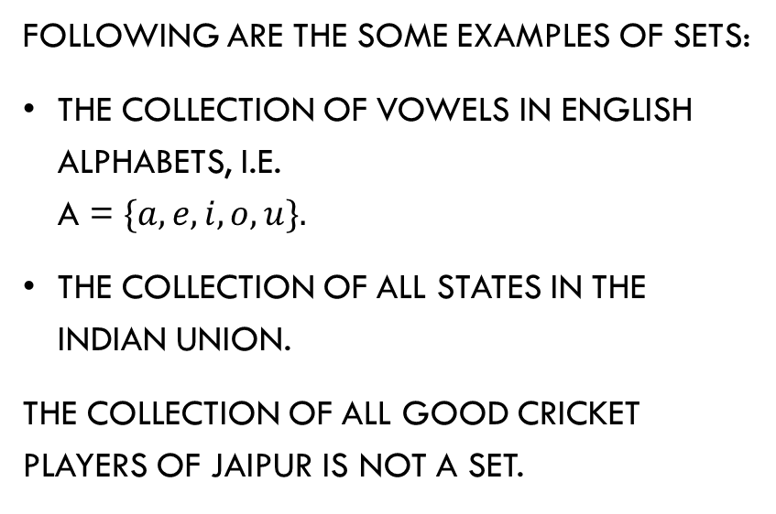
Introduction
Following are the some examples of sets:
The collection of vowels in English alphabets, i.e.
A = $\{a, e, i, o, u\}.$
The collection of all states in the Indian Union.
The collection of all good cricket players of Jaipur is not a set.
‘Set is any collection of distinct and distinguishable or well defined objects of our intuition or thought’.

Slide 5
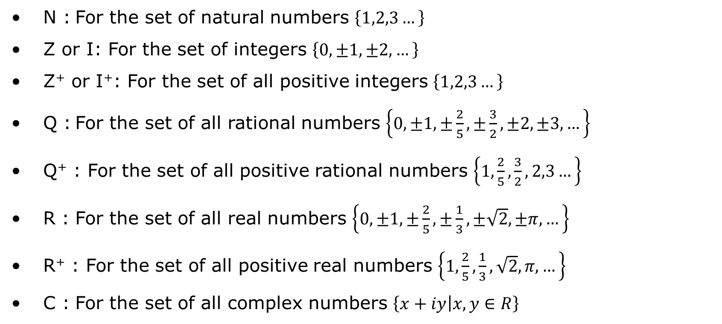
Introduction
The following sets, we are using frequently in set theory:
N : For the set of natural numbers $\left\{1,2,3…\right\}$
Z or I: For the set of integers $\left\{0,±1,±2,…\right\}$
Z⁺ or I⁺: For the set of all positive integers $\left\{1,2,3…\right\}$
Q : For the set of all rational numbers $\left\{0,±1,±\frac{2}{5},±\frac{3}{2},±2,±3,…\right\}$
Q⁺ : For the set of all positive rational numbers $\left\{1,\frac{2}{5},\frac{3}{2},2,3…\right\}$
R : For the set of all real numbers $\left\{0,±1,±\frac{2}{5},±\frac{1}{3},±\sqrt{2},±π,…\right\}$
R⁺ : For the set of all positive real numbers $\left\{1,\frac{2}{5},\frac{1}{3},\sqrt{2},π,…\right\}$
C : For the set of all complex numbers $\left\{x+iy | x,y∈R\right\}$

Slide 6
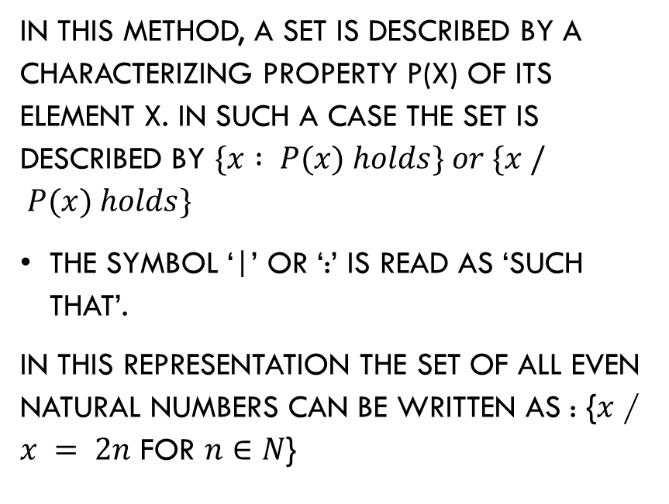
Representation of a Set
Roster method (Tabular form)
Set Builder Method
In this method a set is described by listing elements separated by commas, within braces { }.
For example, the set of even natural numbers can be described as
{2, 4, 6, 8, ...}
In this method, a set is described by a characterizing property P(x) of its element x. In such a case the set is described by $\{x : P(x) holds\} or \{x / P(x) holds\}$
The symbol ‘|’ or ‘:’ is read as ‘such that’.
In this representation the set of all even natural numbers can be written as : {$x$ / $x = 2n$ for$n∈N$}

Slide 7
Types of Sets
Empty sets: A set having no element is called an empty set. It is also known as null set or void set. It is denoted by
For example:
(a)
(b)
Singleton set: A set having single element is called singleton set.
For example, {2}, {0}, {5} are singleton set.
2
5

Slide 8
Types of Sets
Finite set: A set is called a finite set if it is called either void set or its elements can be counted by natural numbers and process of listing terminates at a certain natural numbers.
For example, {1, 2, 4, 6} is a finite set because it has four elements.
Infinite set: A set which is not a finite set, i.e. the counting up of whose elements is impossible, is called an infinite set.
For example:
The set of all straight line in a given plane.
The set of all natural numbers.
The set of real numbers between ‘1’ and ‘2’.

Slide 9
Cardinal number or order of a finite set
The total number of elements in a finite set is called cardinal number or order of a finite set. It is denoted by n(A).
For example, if
Set of sets: A set S having all its elements as sets is called set of sets.
For example:
S = { {1, 2}, {2, 4}, {3, 5, 7} }is a set of sets
But S = { {1, 2}, 3, {3, 5, 7} } is not a set of sets as
is not a set.

Slide 10
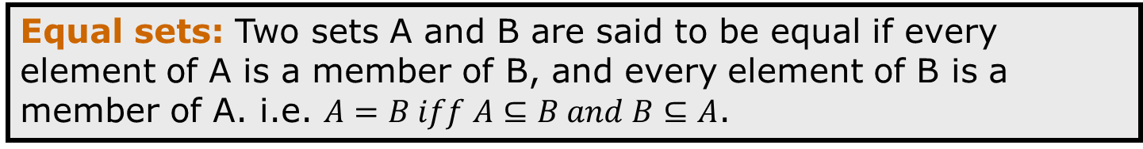
Equivalent and Equal Sets
Equivalent sets: Two finite sets A and B are equivalent if their cardinal number is same, i.e. n(A) = n(B).
Equal sets:Two sets A and B are said to be equal if every element of A is a member of B, and every element of B is a member of A. i.e. $A=B iff A⊆B and B⊆A$.
For example:
A = {4, 5, 6} and
B = {a, b, c} are equivalent but
A = {4, 5, 6} and
C = {6, 5, 4} are equal, i.e. A = C.
Notes:
It is clear from the above definitions that equal sets are equivalent but equivalentt sets need not be equal.

Slide 11
Equivalent and Equal Sets
A B if n(A) = n(B)
A
B
A
C
A = C if each element of each set is equal to each other
=

Slide 12
Subsets, superset and Proper Subsets
Subset and Superset: A set A is said to be a subset of a set B if each element of A is also an element of B and the set B is called the superset of A.
A
Subsets
For example:
Let A = {2, 4, 6, 8},
B = {2, 4, 6, 8, 10, 12},
then
Notes:
Super set: If A is a subset of B, we say that B contains A or B is a superset of A and we write B ⊇ A

Slide 13
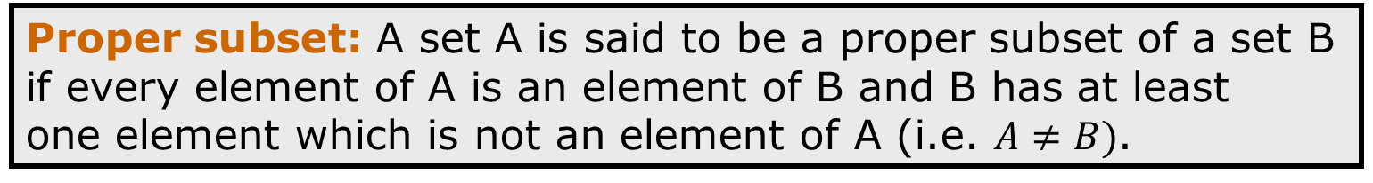
Subsets and Proper Subsets
Proper subset: A set A is said to be a proper subset of a set B if every element of A is an element of B and B has at least
one element which is not an element of A (i.e. $A≠B)$.
It can be written as
For example:
Let A = {1, 2, 3}, B = {2, 3, 4, 1, 5}, then
Thus if A is a proper subset of B, then there exists an element such that
For example,

Slide 14
Procedure for Proving Equality of Sets
As we have discussed earlier that two sets A and B are said to be equal if every element of set A is an element of set B and every element of B is an element of A.
It is clear that

Slide 15
Some Results on Subsets
(i) Every set is a subset of itself.
(ii) The empty set is a subset of every set.
(iii) The total number of subsets of a finite set containing n elements is 2^{n}.

Slide 16
Power Set
The set of all the subsets of a given set A is said to be the power set of A and is denoted by P(A).
i.e.
Also, for all sets A.
For example, if A = {a, b, c}, then
A
P(A)

Slide 17
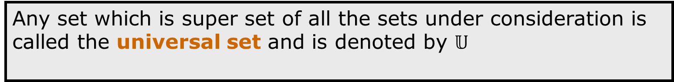
Universal Set
Any set which is super set of all the sets under consideration is called the universal set and is denoted by $𝕌$
For example:
(i) When we are using sets containing natural numbers then N is the universal set.
Euler-Venn Diagram
An Euler-Venn diagram is a pictorial representation of sets, which is used to show representations/operations between sets.

Slide 18
Euler - Venn diagram
To draw venn diagrams following points are to be taken in to consideration.
The universal set is represented by a rectangle.
All the sets under consideration are usually represented by circles.
The complement of the set is represented by the portion of the universal set which is not in the set.

Slide 19
Algebra of Sets
Union of sets:
Clearly, if
and
Generalised definition
If is a finite family of sets, then their union is

Slide 20
Algebra of Sets
Intersection of sets
Clearly, if
and
Generalised definition
The intersection of sets is the set of all the elements
which are common to all the sets It is denoted by

Slide 21

Algebra of Sets
Disjoint sets
Difference of sets
$$A−B=A−\left(A∩B\right)$$
$$B−A=B−\left(A∩B\right)$$

Slide 22
Algebra of Sets
Difference of sets

Slide 23

Algebra of Sets
Symmetric Differences of sets
$$=\left(A∪B\right)−(A∩B)$$

Slide 24
Algebra of Sets
Complement of set
Clearly,

Slide 25
Do You Know

Slide 26
Law of Algebra of Sets
Indempotent laws
For any set A, we have
(i)
(ii)
Identity laws
For any set A, we have
(i)
(ii)
i.e. are identity elements for union and intersection respectively.

Slide 27
Law of Algebra of Sets
Commutative laws
For any two sets A and B, we have
(i)
(ii)
i.e. union and intersection are commutative.

Slide 28
Law of Algebra of Sets
Associative laws
If A, B and C are any three sets, then
(i)
(ii)
i.e. union and intersection are associative.

Slide 29
Law of Algebra of Sets
Distributive laws
If A, B and C are any three sets, then
(i)
(ii)
In other words, union and intersection are
distributive over intersection and union respectively.

Slide 30
De Morgan’s Law
If A and B are any two sets, then
(i)
(ii)

Slide 31
Some Important Results on Cardinal Number of Union, Intersection, Difference, and Symmetric Difference of Sets
If A, B and C are finite sets and U be the finite universal set, then
(Inclusion and Exclusion Principle)
(ii) are disjoint
non-void sets.
(iii) n (A – B) = n(A) –
(iv) Number of elements which
belong to exactly one of A or B.

Slide 32
Some Important Results on Cardinal Number of Union, Intersection, Difference, and Symmetric Difference of Sets
(vi) Number of elements in exactly two of the
sets A, B and C
(vii) Number of elements in exactly one of the sets A, B and C

