Slide 1
Functions

Slide 2
Contents
Functions
Definition
Image of a Function
Domain and Range of a Function
Some Special Functions
Kinds of Function
Composition of Functions
Pigeonhole principle
Countable and uncountable set

Slide 3
Functions

Slide 4
Session objective
Function
Relation to function
Domain of a function
Range of a function
Vertical line test for function
Some important specific functions
Different types of functions
Composition of functions
Pigeonhole principle
One to one correspondence
Countable and uncountable sets

Slide 5

A function f from set A to set B is a rule of correspondence that assigns to each element x in the set A exactly one element y in the set B.
A function f from set A to set B is a rule of correspondence that assigns to each element x in the set A exactly one element y in the set B.
A function f from set A to set B is a rule of correspondence that assigns to each element x in the set A exactly one element y in the set B.
1
2
No x has more than one y assigned
All x’s are assigned
2
4
3
6
4
8
5
10
Set A is the domain
Set B is the Codomain/range
Whew! What did that say?
This is a function ---it meets our conditions
Must use all the x’s
The x value can only be assigned to one y

Slide 6
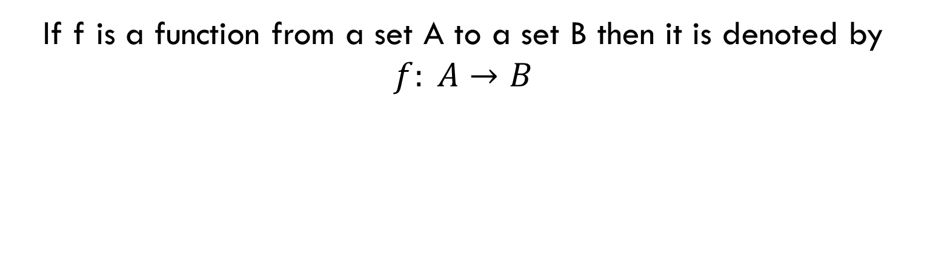
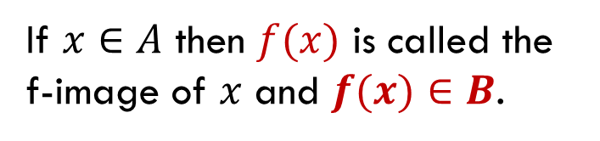
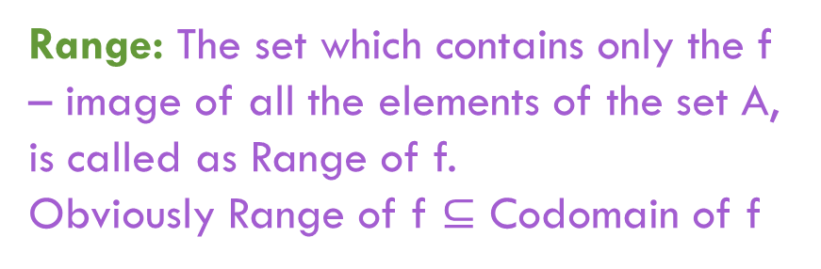
Codomain
Domain
If $x∈A$ then $f(x)$is called the f-image of $x$ and $f(x)∈B$.
Range:The set which contains only the f – image of all the elements of the set A, is called as Range of f.
Obviously Range of f $⊆$ Codomain of f

Slide 7
Let’s look at another relation and decide if it is a function.
The second condition says each x can have only one y, but it CAN be the same y as another x gets assigned to.
1
2
No x has more than one y assigned
All x’s are assigned
2
4
3
6
4
8
5
10
Set A is the domain
Set B is the range
This is a function ---it meets our conditions
Must use all the x’s
The x value can only be assigned to one y

Slide 8
A good example that you can “relate” to is students in our maths class this semester are set A. The grade they earn out of the class is set B. Each student must be assigned a grade and can only be assigned ONE grade, but more than one student can get the same grade (we hope so---we want lots of A’s). The example show on the previous screen had each student getting the same grade. That’s okay.
A good example that you can “relate” to is students in our maths class this semester are set A. The grade they earn out of the class is set B. Each student must be assigned a grade and can only be assigned ONE grade, but more than one student can get the same grade (we hope so---we want lots of A’s). The example shown on the previous screen had each student getting the same grade. That’s okay.
1
2
2
4
3
6
4
8
5
10
2 was assigned both 4 and 10
Is the relation shown above a function?
NO
Why not???

Slide 9
Check this relation out to determine if it is a function.
It is not---3 didn’t get assigned to anything
Comparing to our example, a student in maths must receive a grade
1
2
2
4
3
6
4
8
5
10
Set A is the domain
Set B is the range
This is not a function---it doesn’t assign each x with a y
Must use all the x’s
The x value can only be assigned to one y

Slide 10
Check this relation out to determine if it is a function.
This is fine—each student gets only one grade. More than one can get an A and I don’t have to give any D’s (so all y’s don’t need to be used).
1
2
2
4
3
6
4
8
5
10
Set A is the domain
Set B is the range
This is a function
Must use all the x’s
The x value can only be assigned to one y

Slide 11
Is a relation a function?
Focus on the x-coordinates, when given a relation
If the set of ordered pairs have different x-coordinates,
it IS A function
If the set of ordered pairs have same x-coordinates,
it is NOT a function
Y-coordinates have no bearing in determining functions

Slide 12
Example 3
:00
Is this a function?
  Hint: Look only at the x-coordinates
YES

Slide 13
Example 4
:40
Is this a function?
  Hint: Look only at the x-coordinates
NO

Slide 14
Example 5
:40
Which mapping represents a function?
Choice One Choice Two
–1
2
3
2
–1
3
2
3
–2
0
3
1
0
Choice 1

Slide 15
Example 6
Which situation represents a function?
a. The items in a store to their prices on a certain date
b. Types of fruits to their colors
There is only one price for each different item on a certain date. The relation from items to price makes it a function.
A fruit, such as an apple, from the domain would be associated with more than one color, such as red and green. The relation from types of fruits to their colors is not a function.

Slide 16
Vertical Line Test
Vertical Line Test: a relation is a function if a vertical line drawn through its graph, passes through only one point.
AKA: “The Pencil Test”
Take a pencil and move it from left to right (–x to x); if it crosses more than one point, it is not a function

Slide 17
Vertical Line Test
Would this graph be a function?
YES

Slide 18
Vertical Line Test
Would this graph be a function?
NO

Slide 19
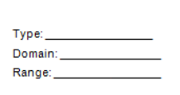
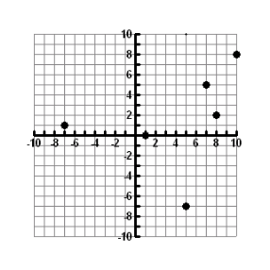
Is the following function discrete or continuous? What is the Domain? What is the Range?
Discrete

Slide 20
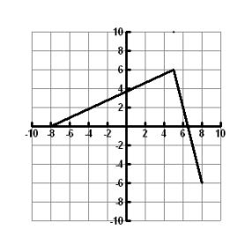
Is the following function discrete or continuous? What is the Domain? What is the Range?
continuous

Slide 21
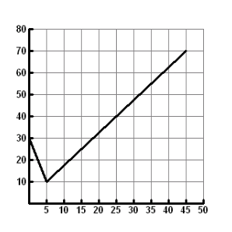
Is the following function discrete or continuous? What is the Domain? What is the Range?
continuous

Slide 22
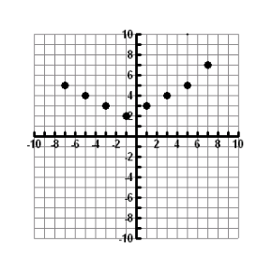
Is the following function discrete or continuous? What is the Domain? What is the Range?
discrete

Slide 23
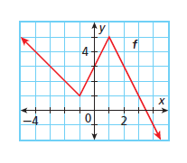
For each function, evaluate f(0), f(1.5), f(-4),
3
f(0) =
f(1.5) =
f(-4) =
4
4

Slide 24
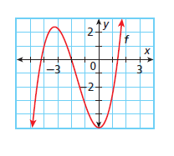
For each function, evaluate f(0), f(1.5), f(-4),
-5
f(0) =
f(1.5) =
f(-4) =
1
1

Slide 25
The thing we need to learn about functions for this section is something about their domain. Recall domain meant "Set A" which is the set of values you plug in for x.
For the functions we will be dealing with, there are two "illegals":
You can't divide by zero (denominator (bottom) of a fraction can't be zero)
You can't take the square root (or even root) of a negative number
When you are asked to find the domain of a function, you can use any value for x as long as the value won't create an "illegal" situation.

Slide 26
Find the domain for the following functions:
Since no matter what value you choose for x, you won't be dividing by zero or square rooting a negative number, you can use anything you want so we say the answer is: All real numbers x.
Note: There is nothing wrong with the top = 0 just means the fraction = 0
If you choose x = 2, the denominator will be 2 – 2 = 0 which is illegal because you can't divide by zero. The answer then is: All real numbers x such that x ≠ 2.
illegal if this is zero
means does not equal

Slide 27
Let's find the domain of another one:
Can't be negative so must be ≥ 0
solve this
We have to be careful what x's we use so that the second "illegal" of square rooting a negative doesn't happen. This means the "stuff" under the square root must be greater than or equal to zero (maths way of saying "not negative").
So the answer is:
All real numbers x such that x ≠ 4

Slide 28
Summary of How to Find the Domain of a Function
Look for any fractions or square roots that could cause one of the two "illegals" to happen. If there aren't any, then the domain is All real numbers x.
If there are fractions, figure out what values would make the bottom equal zero and those are the values you can't use. The answer would be: All real numbers x such that x ≠ those values.
If there is a square root, the "stuff" under the square root cannot be negative so set the stuff ≥ 0 and solve. Then answer would be: All real numbers x such that x ≠ whatever you got when you solved.
NOTE: Of course your variable doesn't have to be x, can be whatever is in the problem.

Slide 29
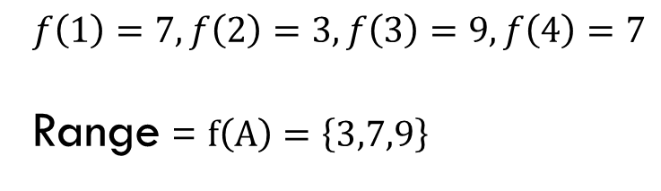

Range of function
The range of a function $f$ is the $f$-image of its domain.
Range of function $f⊆$ codomain of function $f$
Generally we are looking only real domain and real range of a function.
Ex. Let $f:A→B$ is a function as –
1.
2.
3.
4.
.3
.5
.7
.9
$$f\left(1\right)=7, f\left(2\right)=3, f\left(3\right)=9, f\left(4\right)=7$$
Range = $f\left(A\right)=\left\{3,7,9\right\}$
Domain
Codomain

Slide 30
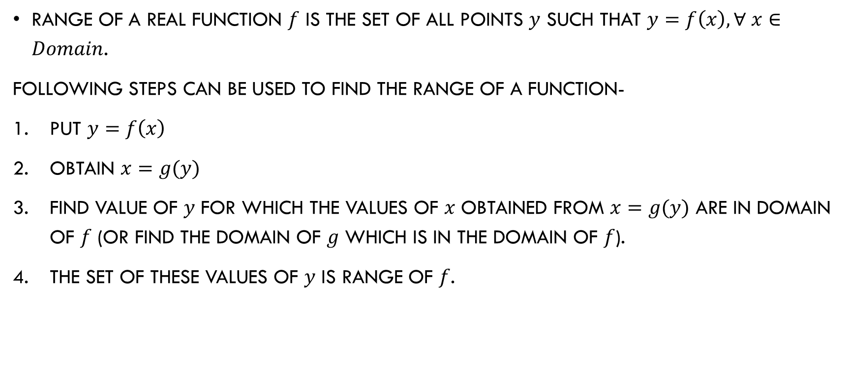
Finding range of a function
Range of a real function $f$ is the set of all points $y$ such that $y=f\left(x\right), ∀ x∈Domain$.
Following steps can be used to find the range of a function-
Put $y=f\left(x\right)$
Obtain $x=g(y)$
Find value of $y$ for which the values of $x$ obtained from $x=g(y)$ are in domain of $f$ (or find the domain of $g$ which is in the domain of $f$).
The set of these values of $y$ is range of $f$.

Slide 31
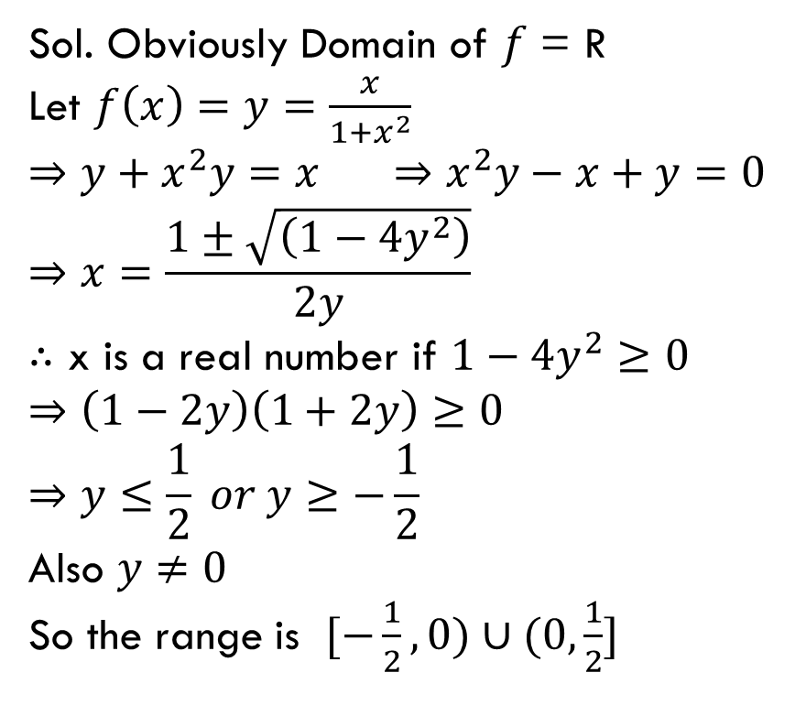
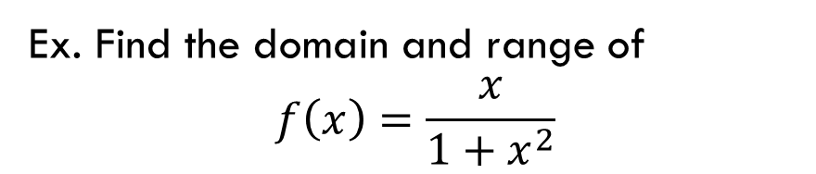
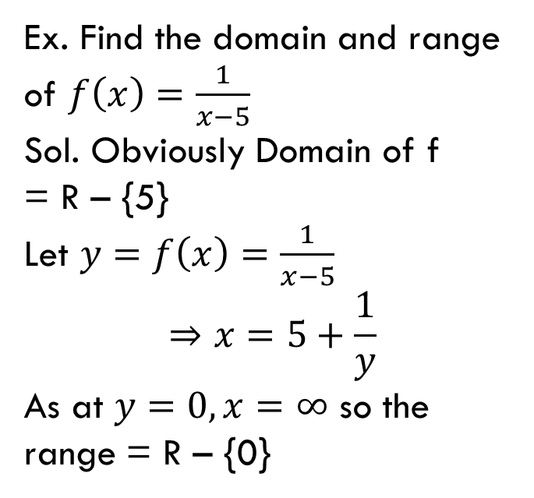
Ex. Find the domain and range of
$$f\left(x\right)=\frac{x}{1+x^{2}}$$
Ex. Find the domain and range of $f\left(x\right)=\frac{1}{x−5}$
Sol. Obviously Domain of f
= R – {5}
Let $y=f\left(x\right)=\frac{1}{x−5}$
$$⇒x=5+\frac{1}{y}$$
As at $y=0, x=∞$ so the range = R – {0}
Sol. Obviously Domain of $f$ = R
Let $f\left(x\right)=y=\frac{x}{1+x^{2}}$
$$⇒y+x^{2}y=x ⇒x^{2}y−x+y=0$$
$$⇒x=\frac{1±\sqrt{\left(1−4y^{2}\right)}}{2y}$$
$∴$ x is a real number if $1−4y^{2}≥0$
$$⇒\left(1−2y\right)\left(1+2y\right)≥0$$
$$⇒y≤\frac{1}{2} or y≥−\frac{1}{2}$$
Also $y≠0$
So the range is $[−\frac{1}{2},0)∪(0,\frac{1}{2}]$

Slide 32
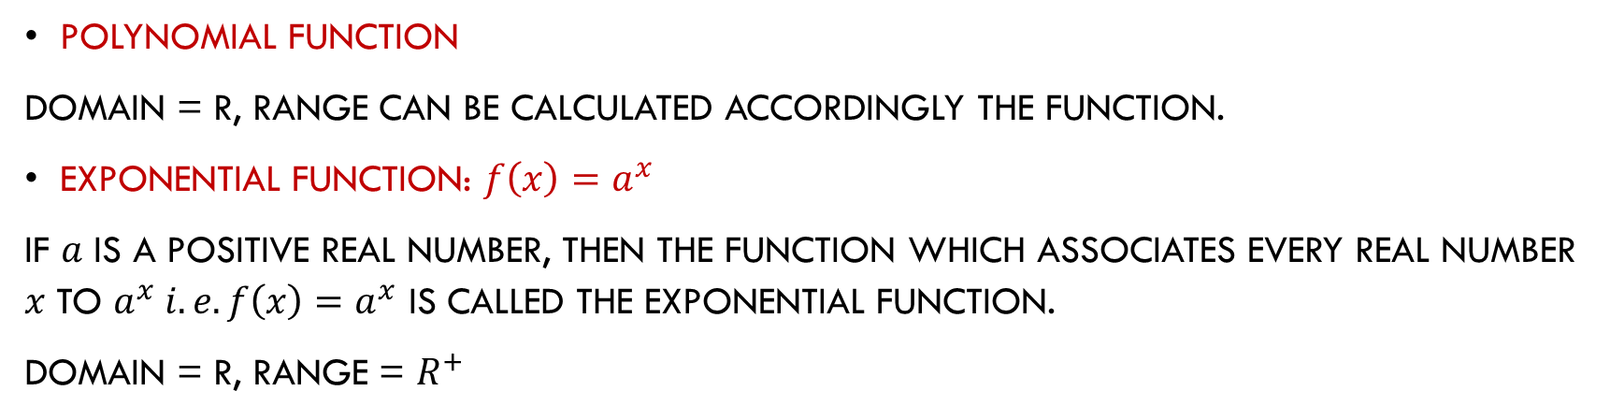
Some functions
Polynomial function
Domain = R, Range can be calculated accordingly the function.
Exponential function: $f\left(x\right)=a^{x}$
If $a$ is a positive real number, then the function which associates every real number $x$ to $a^{x} i.e. f\left(x\right)=a^{x}$ is called the exponential function.
Domain = R, Range = $R^{+}$

Slide 33
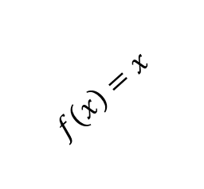
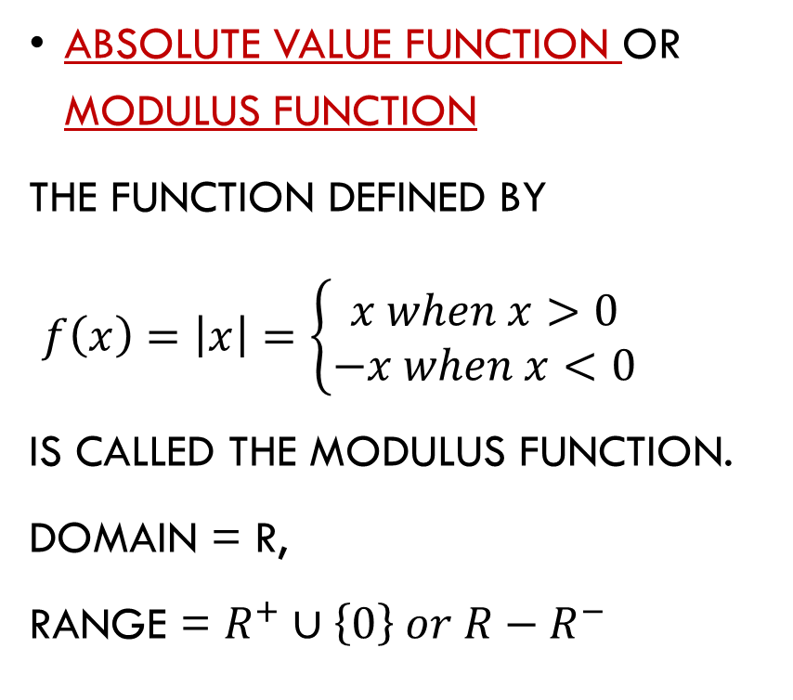

Some functions
Absolute value function or modulus function
The function defined by
$f\left(x\right)=\left|x\right|=\left\{\begin{aligned}x when x>0 \\ −x when x<0\end{aligned}\right.$
is called the modulus function.
Domain = R,
Range = $R^{+}∪\left\{0\right\} or R−R^{−}$
$$f\left(x\right)=−x$$
$$f\left(x\right)=x$$

Slide 34
some functions
Floor function: ⎣x⎦ means take the greatest integer less than or equal to the number
  Domain = R, Range = Z or I
Ceiling function: ⎡x⎤ means take the lowest integer greater than or equal to the number
  Domain = R, Range = Z or I
round(x) = floor(x+0.5)
  Domain = R, Range = Z or I

Slide 35
Sample floor/ceiling questions
Find these values
⎣1.1⎦
⎡1.1⎤
⎣-0.1⎦
⎡-0.1⎤
⎡2.99⎤
⎡-2.99⎤
⎣½+⎡½⎤⎦
⎡⎣½⎦ + ⎡½⎤ + ½⎤
1
2
-1
0
3
-2
⎣½+1⎦ = ⎣3/2⎦ = 1
⎡0 + 1 + ½⎤ = ⎡3/2⎤ = 2

Slide 36
Ceiling and floor properties
Let n be an integer
(1a) ⎣x⎦ = n if and only if n ≤ x < n+1
(1b) ⎡x⎤ = n if and only if n-1 < x ≤ n
(1c) ⎣x⎦ = n if and only if x-1 < n ≤ x
(1d) ⎡x⎤ = n if and only if x ≤ n < x+1
(2) x-1 < ⎣x⎦ ≤ x ≤ = ⎡x⎤ < x+1
(3a) ⎣-x⎦ = - ⎡x⎤
(3b) ⎡-x⎤ = - ⎣x⎦
(4a) ⎣x+n⎦ = ⎣x⎦+n
(4b) ⎡x+n⎤ = ⎡x⎤+n

Slide 37

Factorial
Factorial is denoted by $n!$
$n! = n ∗ (n−1) ∗ (n−2) ∗ … ∗ 2 ∗ 1$
Thus, $6! = 6 ∗ 5 ∗ 4 ∗ 3 ∗ 2 ∗ 1 = 720$
Note that $0!$is defined to equal 1

Slide 38
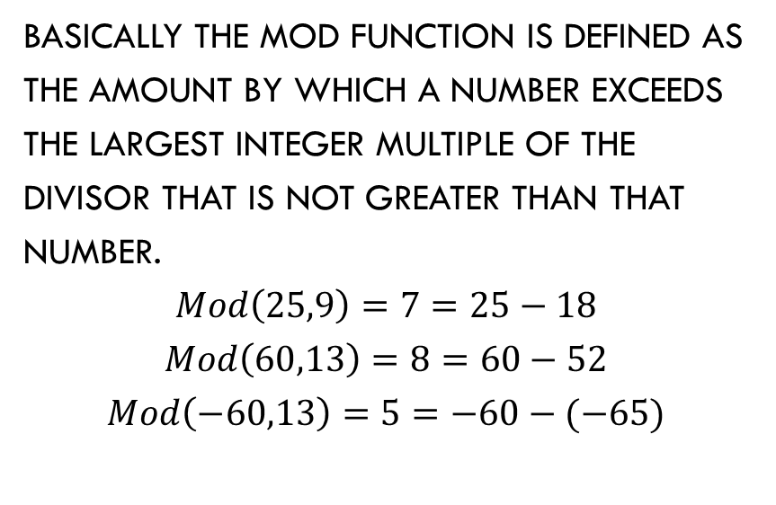
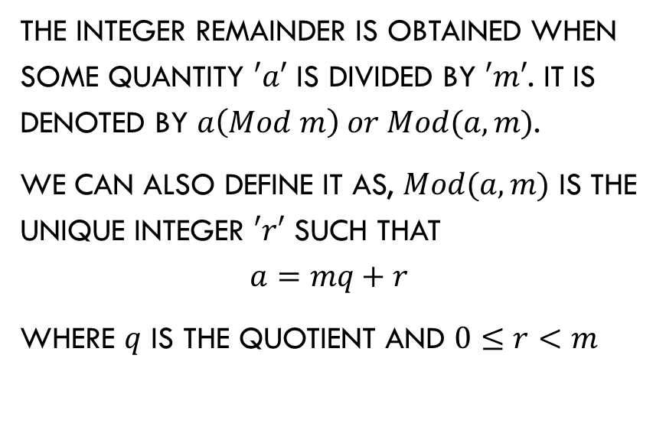
Mod function (remainder function)
The integer remainder is obtained when some quantity $′a′$ is divided by $′m′$. It is denoted by $a\left(Mod m\right) or Mod(a,m)$.
We can also define it as, $Mod(a,m)$ is the unique integer $′r′$ such that
$$a=mq+r$$
Where $q$ is the quotient and $0≤r<m$
Basically the mod function is defined as the amount by which a number exceeds the largest integer multiple of the divisor that is not greater than that number.
$$Mod\left(25,9\right)=7=25−18$$
$$Mod\left(60,13\right)=8=60−52$$
$$Mod\left(−60,13\right)=5=−60−(−65)$$

Slide 39
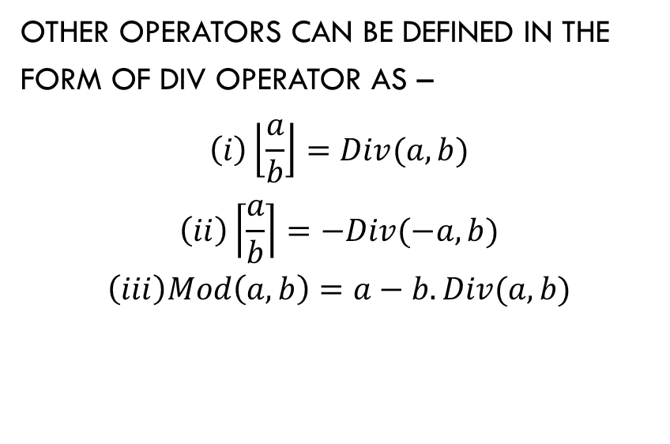
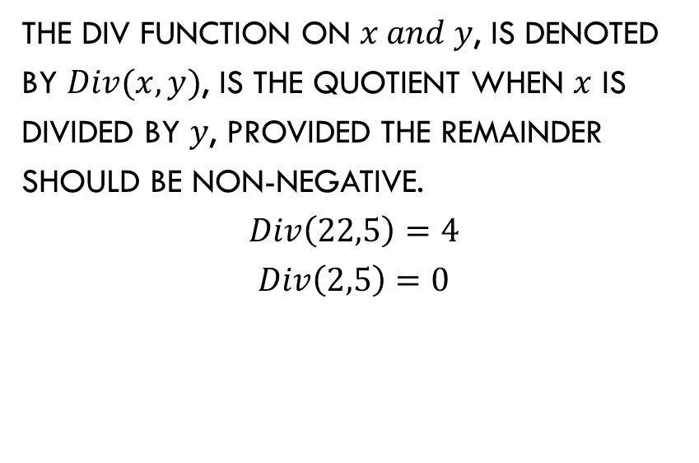
Div function
The div function on $x and y$, is denoted by $Div(x,y)$, is the quotient when $x$ is divided by $y$, provided the remainder should be non-negative.
$$Div\left(22,5\right)=4$$
$$Div\left(2,5\right)=0$$
Other operators can be defined in the form of div operator as –
$$\left(i\right)\left\lfloor \left.\frac{a}{b}\right\rfloor =Div(a,b)\right.$$
$$\left(ii\right)\left\lceil \left.\frac{a}{b}\right\rceil =−Div(−a,b)\right.$$
$$\left(iii\right)Mod\left(a,b\right)=a−b.Div(a,b)$$

Slide 40
Constant function
A function is said to be constant if each element in the domain has the same image in co-domain.
2
1
4
2
6
3
8
4
10
5
Set B is the range
Set A is the domain

Slide 41
One-to-one functions
A function is one-to-one if each element in the co-domain has a unique pre-image
  Meaning no 2 values map to the same result
a
e
i
o
1
2
3
4
5
a
e
i
o
1
2
3
4
5
A one-to-one function
A function that is
not one-to-one

Slide 42
More on one-to-one
Injective is synonymous with one-to-one
  “A function is injective”
A function is an injection if it is one-to-one
Note that there can
be un-used elements
in the co-domain
a
e
i
o
1
2
3
4
5
A one-to-one function

Slide 43
Onto functions
A function is onto if each element in the co-domain is an image of some pre-image
  Meaning all elements in the right are mapped to
a
e
i
o
u
1
2
3
4
a
e
i
o
1
2
3
4
5
An onto function
A function that is not onto

Slide 44
More on onto
Surjective is synonymous with onto
  “A function is surjective”
A function is an surjection if it is onto
Note that there can
be multiply used
elements in the
co-domain
a
e
i
o
u
1
2
3
4
An onto function

Slide 45
Onto vs. one-to-one
Are the following functions onto, one-to-one, both, or neither?
a
b
c
1
2
3
4
a
b
c
d
1
2
3
4
a
b
c
1
2
3
4
1-to-1, not onto
Both 1-to-1 and onto
Not a valid function
a
b
c
d
1
2
3
a
b
c
d
1
2
3
4
Onto, not 1-to-1
Neither 1-to-1 nor onto

Slide 46
Bijections
a
b
c
d
1
2
3
4
Consider a function that is
both one-to-one and onto:
Such a function is a one-to-one correspondence, or a bijection

Slide 47
Identity functions
A function such that the image and the pre-image are ALWAYS equal
f(x) = 1*x
f(x) = x + 0
The domain and the co-domain must be the same set

Slide 48
Inverse functions
Let f(x) = 2*x
R
f
R
f⁻¹
f(4.3)
4.3
8.6
f⁻¹(8.6)
Then f⁻¹(x) = x/2

Slide 49
More on inverse functions
Can we define the inverse of the following functions?
An inverse function can ONLY be done defined on a bijection
a
b
c
1
2
3
4
a
b
c
d
1
2
3
What is f⁻¹(2)?
Not onto!
What is f⁻¹(2)?
Not 1-to-1!

Slide 50
Compositions of functions
Let (f ○ g)(x) = f(g(x))
Let f(x) = 2x+3 Let g(x) = 3x+2
g(1) = 5, f(5) = 13
Thus, (f ○ g)(1) = f(g(1)) = 13

Slide 51
Compositions of functions
f ○ g
A
B
C
g
f
g(a)
f(a)
a
f(g(a))
g(a)
(f ○ g)(a)

Slide 52
Compositions of functions
Let f(x) = 2x+3 Let g(x) = 3x+2
f ○ g
R
R
R
g
f
g(1)
f(5)
f(g(1))=13
1
g(1)=5
(f ○ g)(1)
f(g(x)) = 2(3x+2)+3 = 6x+7

Slide 53
Compositions of functions
Does f(g(x)) = g(f(x))?
Let f(x) = 2x+3 Let g(x) = 3x+2
f(g(x)) = 2(3x+2)+3 = 6x+7
g(f(x)) = 3(2x+3)+2 = 6x+11
Function composition is not commutative!
Not equal!

Slide 54
Graphs of functions
f(x)=3
x=1
Let f(x)=2x+1
Plot (x, f(x))
This is a plot
of f(x)
f(x)=5
x=2

Slide 55

Pigeonhole principle
normal
generalized
“If there are ‘many’ pigeons and ‘a few’ pigeonholes then there must be some pigeonholes which occupied by two or more pigeons.”
“if $n$ pigeons are assigned to $m$ pigeonholes, then one of the pigeonhole must contain atleast $\left\lfloor \left.\frac{n−1}{m}\right\rfloor +1\right.$ pigeons.”

Slide 56
example
If there are 5 separate departments in a departmental store and the total number of employee are 36. then one of the department have atleast 8 employee.

Slide 57
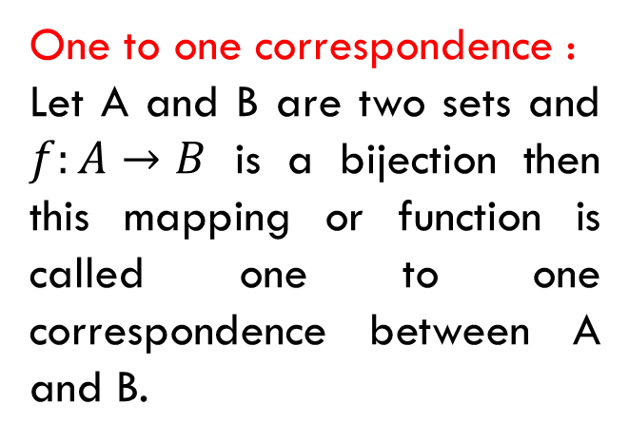
ONE TO ONE CORRESPONDANCE, COUNTABLY INFINITE SET
One to one correspondence :
Let A and B are two sets and $f:A→B$ is a bijection then this mapping or function is called one to one correspondence between A and B.
Countably Infinite Set:
An infinite set A is said to be countably infinite or denumerable if there is a one to one correspondence between the set N of all natural numbers and A.

Slide 58
COUNTABLE AND UNCOUNTABLE SETS
Countable Set:
A set which is either empty, finite or countably infinite is called a countable set.
The set N of all natural numbers and the set Z of all integers are countable set.
Uncountable Set:
A set which is not a countable set is called as uncountable set.
So it is very clear that not all infinite sets are uncountable.

