Slide 1



JAIPUR ENGINEERING COLLEGE AND RESEARCH CENTRE
Year & Sem – II & III
Subject – Software Engineering (3CS4 - 07)
Unit – III
Presented by – Manju Vyas (Asst. Prof., CSE)
1

Slide 2
VISION AND MISSION OF INSTITUTE
VISION
To become renowned centre of outcome based learning and work towards academic, professional, cultural and social enrichments of the lives of individual and communities”
MISSION
1. Focus on evaluation of learning outcomes and motivate students to inculcate research aptitude by project based learning.
2. Identify areas of focus and provide platform to gain knowledge and solutions based on informed perception of Indian, regional and global needs.
3. Offer opportunities for interaction between academia and industry.
4. Develop human potential to its fullest extent so that intellectually capable and imaginatively gifted leaders can emerge in a range of professions.
1

Slide 3
VISION AND MISSION OF DEPARTMENT
VISION
To become renowned Centre of excellence in computer science and engineering and make competent engineers & professionals with high ethical values prepared for lifelong learning.
MISSION
M1: To impart outcome based education for emerging technologies in the field of computer science and engineering.
M2: To provide opportunities for interaction between academia and industry.
M3: To provide platform for lifelong learning by accepting the change in technologies
M4: To develop aptitude of fulfilling social responsibilities.
1

Slide 4
CONTENTS (TO BE COVERED)
Introduction to requirement analysis
Requirement Analysis Tasks
Analysis Principles
Software Prototyping
Data Dictionary
Finite State Machines
Structured Analysis
Data and Control Flow Diagrams
Behavioral Modelling
1

Slide 5
Requirements Engineering
The systematic use of proven principles, techniques, languages and tools for the cost-effective analysis, documentation and on-going evolution of user needs and the external behaviour of a system to satisfy those user needs.
1

Slide 6
Requirement Analysis
  This task is done to understand the specific requirements that must be achieved to build high quality software.
  One who perform this task is called System Analyst.
  If analysis is not done properly, then it may result in a software which is a solution of a wrong problem.
  It will lead to waste of money and time, personal frustration and unhappy customers.
  Requirement analysis is a software engineering task that bridges the gap between system level requirements engineering and software design.
1

Slide 7
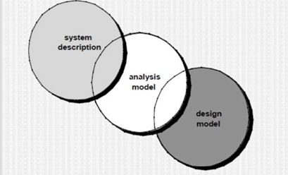
Analysis Concepts and Principles: A Bridge
1

Slide 8
Analysis Concepts and Principles
Requirements engineering activities results in:
  the specification of software’s operational characteristics (function, data and behavioral).
  indicate software’s interface with other system elements and
  establish constraints that the software must meet.
1

Slide 9
Analysis Concepts and Principles
Requirement analysis :
  allows the software engineer(system analyst) to refine software allocation and build models of the data ,functional and behavioral domains that will be treated by software.
  Provides the software designer with a representation of information ,function and behavior that can be translated to data ,architectural, interface and component level designs.
  The requirement specification provides the developer and the customer with the means to assess quality once software is built.
1

Slide 10
Software Requirement Analysis
Software requirement analysis may be divided into five areas of effort:
  Problem recognition
  Evaluation and Synthesis
  Modelling
  Specification
  Review
1

Slide 11
Software Requirement Analysis
Problem recognition:
  Initially ,the system analyst studies the system specification and the software project plan.
  Next, communication must be established for analysis so that problem recognition is ensured. The goal is recognition of the basic problem elements as perceived by the customers/users.
Problem Evaluation and Solution synthesis: a)Problem Evaluation
The analyst must define all externally observable data objects .
Evaluate the flow and content of information .
Define and elaborate all software functions .
understand software behavior in the context of events that affect the system
Establish system, interface characteristics
Uncover additional design constraints.
1

Slide 12
b) Solution synthesis:
Upon evaluating current problems and desired information (input and output),the analyst begins to synthesize one or more solutions.
  First, data objects ,processing functions and behavior of the system are defined in detail.
  Second, the basic architecture for implementation are considered.
  The process of evaluation and synthesis continues until both analyst and customer feel confident that software can be adequately specified for subsequent development steps.
  Throughout evaluation and synthesis ,the analyst‘s primary focus is on “what” and not “how”.
  i.e. what does the system produce and consume, what functions must the system perform, what behaviors does the system exhibit, what interfaces are defined and what constraints apply.
1

Slide 13
Software Requirement Analysis
Modeling
  the analyst creates models of the system in an effort to better understand data and control flow ,functional processing, operational behavior and information content.
Specification
  Modeling serves as the foundation of specification.
Review
  Specification is reviewed by both analyst and customers
1

Slide 14
Requirement Elicitation for Software
Before the requirements can be analyzed, modelled or specified , they must be gathered through an elicitation process.
A customer will have a problem that is amenable to a computer-based solution.
The developer will respond to the customer’s request for help.
Thus communication between customer and developer begins
1

Slide 15
Requirement Elicitation for Software
Initiating the process
  Most commonly used requirement elicitation technique is
a meeting or interview.
First meeting may not lead to get a clear idea, so they should continue the communication.
Analyst should ask some context-free questions.
i.e. a set of questions that lead to a basic understanding of the problem, the people who want a solution, the nature of the solution that is desired and the effectiveness of the first encounter itself.
The first set of questions focuses on the customer, the overall goals and the benefits.
  Who is behind the request for this work?
  Who will use the solution?
  What will be the economic benefit of a successful solution?
  Is there another source for the solution that you need?
1

Slide 16
Requirement Elicitation for Software
The next set of questions enables the analyst to gain better understanding of the problem and the customer to voice his or her perceptions about a solution:
  How could you characterize “good” output that would be generated by a successful solution?
  What problem(s) will this solution address?
  Can you show me the environment in which the solution will be used?
  Will special performance issues or constraints affect the way the solution is approached?
1

Slide 17
Requirement Elicitation for Software
The final set of questions focuses on the effectiveness of the meeting:
  Are you the right person to answer these questions? Are your answers official?
  Are my questions relevant to the problems that you may have?
  Am I asking too many questions?
  Can anyone else provide additional information.
  Should I be asking you anything else?
1

Slide 18
Requirement Elicitation for Software
These questions will help to initiate the communication that is essential to successful analysis.
The question and answer meeting is not always successful .
It is useful for first encounter only.
Then it is replaced by a meeting format that combines elements of problem solving, negotiation and specification
1

Slide 19
Software Prototyping
After requirement elicitation and applying analysis principles, a model of the software to be built ,called a prototype is constructed for customer and developer assessment.
This model then evolves into production software.
The prototyping approach can be either close-ended or open-ended.
The closed-ended approach is called throwaway prototyping.
a prototype serves only as a rough demonstration of requirements.
it is then discarded and the software is engineered using a different paradigm.
The open-ended approach is called evolutionary prototyping.
- a prototype serves as the first evolution of the finished system.
1

Slide 20
Software Prototyping
Before choosing the approach it is necessary to determine whether the system to be built is amenable to prototyping
.
This is done based on the factors like application area
,application complexity, customer characteristics and project characteristics.
If the software application demands dynamic visual displays or if it interacts heavily with the user ,then the evolutionary fashion is used.
If the software has tens of thousands of lines of code, then prototyping the software becomes complex.
It can be done in parts by partitioning the complexity.
1

Slide 21
Prototyping Methods and Tools
Software prototyping to be effective ,a prototype must be developed rapidly so that the customer may assess results and recommend changes.
Prototyping Methods and Tools:
  Fourth Generation Techniques
Encompass a broad array of database query and reporting languages, program and application generators and other very high level non procedural languages.
  Reusable Software Components
» Prototyping can be done by a assembling rather than building
by using a set of existing software components.
» Formal specification languages and tools have been developed .
    It provides interactive environments that
      Enable an analyst to interactively create language- based specifications of a system or a software.
      Invoke automated tools that translate the language- based specifications into executable code.
      Enable the customer to use prototype executable
code to refine formal requirements.
1

Slide 22
SOFTWARE REQUIREMENT SPECIFICATION
The Software Requirements Specification is produced at the culmination of the analysis task.
The function and performance allocated to software as part of system engineering are refined by establishing:
  a complete information description,
  a detailed functional description,
  a representation of system behavior,
  an indication of performance requirements and design constraints,
  appropriate validation criteria, and
  other information pertinent to requirements.
1

Slide 23
Content of SRS
Introduction
Information Description
Functional Description
Behavioral Description
Validation Criteria
Bibliography and Appendix
1

Slide 24
SPECIFICATION PRINCIPLES
Requirements are represented in a manner that ultimately leads to successful software implementation. A number of specification principles, adapted from the work of Balzer and Goodman [BAL86], can be proposed:
1. Separate functionality from implementation.
2. Develop a model of the desired behavior of a system that encompasses data and the functional responses of a system to various stimuli from the environment.
3 Establish the context in which software operates by specifying the manner in which other system components interact with software.
4. Define the environment in which the system operates and indicate how “a highly intertwined collection of agents react to stimuli in the environment(changes to objects) produced by those agents” .
5. Create a cognitive model rather than a design or implementation model. The cognitive model describes a system as perceived by its user community.
1

Slide 25
DATA DICTIONARY
The data dictionary has been proposed for describing the content of objects defined during structured analysis.
This important modeling notation has been defined in the following manner :
“ The data dictionary is an organized listing of all data elements that are pertinent to the system, with precise, rigorous definitions so that both user and system analyst will have a common understanding of inputs, outputs, components of stores and [even] intermediate calculations”.
1

Slide 26
Content of data dictionary
Although the format of dictionaries varies from tool to tool, most contain the following information:
Name—the primary name of the data or control item, the data store or an external entity.
Alias—other names used for the first entry.
Where-used/how-used—a listing of the processes that use the data or control
item and how it is used (e.g., input to the process, output from the process, as a store, as an external entity.
Content description—a notation for representing content.
Supplementary information—other information about data types, preset values (if known), restrictions or limitations, and so on.
1

Slide 27
Example
The data dictionary entry begins as follows:
name: telephone number
aliases: none
where used/how used: assess against set-up (output)
dial phone (input)
description:
  telephone number = [local number | long distance number]
  local number = prefix + access number
  long distance number = 1 + area code + local number
  area code = [800 | 888 | 561]
  prefix = *a three digit number that never starts with 0 or 1*
access number = * any four number string *
1

Slide 28
Finite state machine (FSM) model
A finite state machine is simply this - a machine that has a set of (typically finite) states in which it can be in.
The conditions on which this depends are its current state and inputs.
A simple example of a state machine is a light-bulb.
It has two states, on and off. These two states can be changed based on what state it is currently in and whether or not you flip the switch.
So, if it is currently in the off state, it can either be kept in the off state by doing nothing or it can transition to the on state if the switch is flipped and vice versa.
This is relevant to the field of software engineering because this is usually seen in the contest of finite-state machines (FSM) or finite automaton (FA) and you can learn more about those in the link below.
1

Slide 29
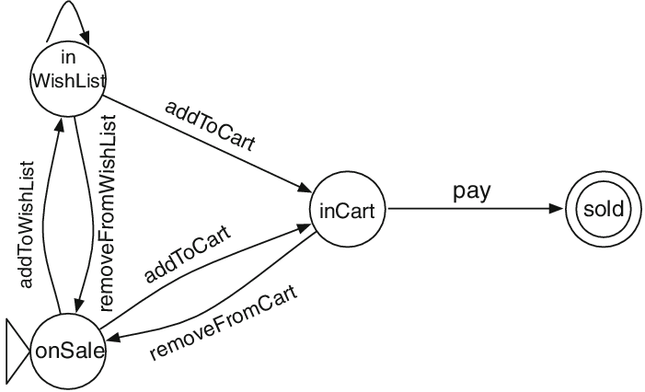
Online shopping cart example
1

Slide 30
Structured analysis
The analysis model must achieve three primary objectives:
(1) to describe what the customer requires
(2) to establish a basis for the creation of a software design, and
(3) to define a set of requirements that can be validated once the software is built.
To accomplish these objectives, the analysis model derived during structured analysis takes the form illustrated in following figure:
1

Slide 31
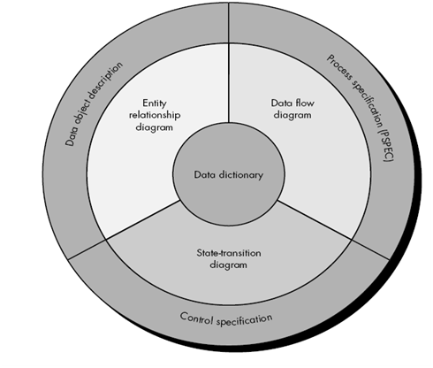
Structured analysis
1

Slide 32
Entity Relationship Diagram (ERD)
The entity relation diagram (ERD) depicts relationships between data objects.
The ERD is the notation that is used to conduct the data modeling activity.
The attributes of each data object noted in the ERD can be described using a data object description.
1

Slide 33
ERD example
1

Slide 34
Data Flow Diagram
The data flow diagram (DFD) serves two purposes: (1) to provide an indication of how data are transformed as they move through the system and (2) to depict the functions (and subfunctions) that transform the data flow.
The DFD provides additional information that is used during the analysis of the information domain and serves as a basis for the modeling of function.
A description of each function presented in the DFD is contained in a process specification (PSPEC).
1

Slide 35
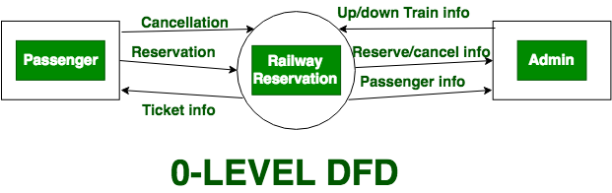
Data flow diagram (DFD)
1

Slide 36
State Transition Diagram (STD)
The state transition diagram (STD) indicates how the system behaves as a consequence of external events.
To accomplish this, the STD represents the various modes of behavior (called states) of the system and the manner in which transitions are made from state to state.
The STD serves as the basis for behavioral modeling.
Additional information about the control aspects of the software is contained in the control specification (CSPEC).
1

Slide 37
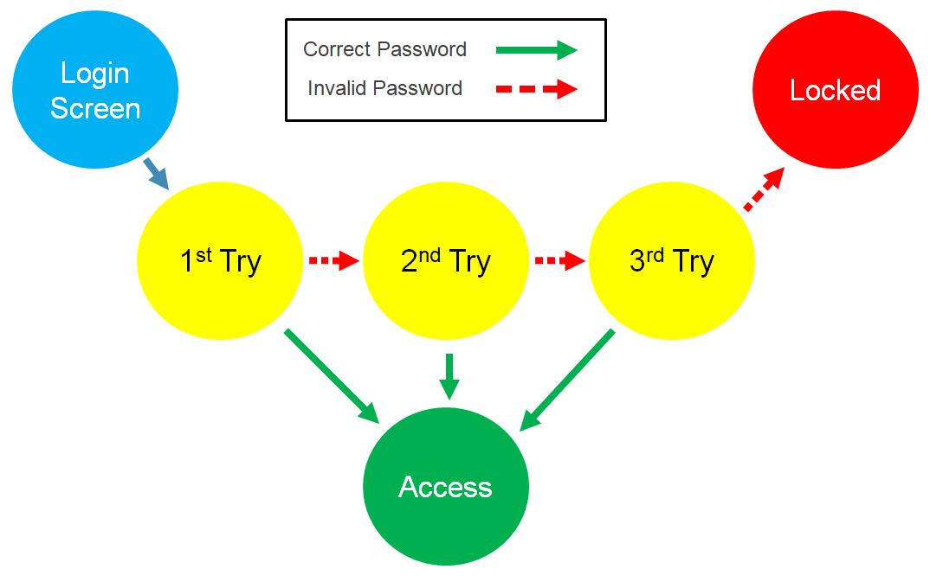
State Transition Diagram (STD)
1

Slide 38
Control Flow Diagrams (CFD)
A control flow diagram helps us understand the detail of a process.
It shows us where control starts and ends and where it may branch off in another direction, given certain situations.
Let's say you are working on software to start a car.
What happens if the engine is flooded, or a spark plug is broken?
Control then changes the flow to other parts of the software.
We can represent these branches with a diagram.
Control flow diagram is helpful because it can be understood by both users and professionals.
1

Slide 39
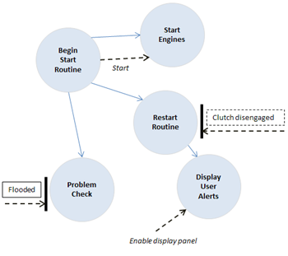
Control Flow Diagrams (CFD)
1

Slide 40
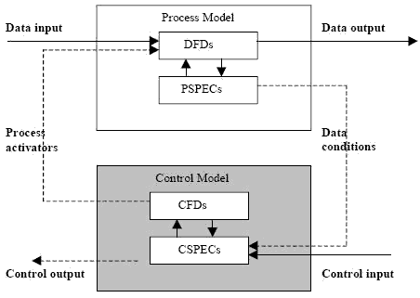
CSPEC
1

Slide 41
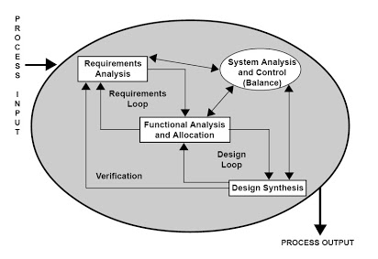
PSPEC
1

Slide 42
REFERENCES/BIBLOGRAPHY
https://www.tutorialspoint.com/software_engineering/software_engineering_overview.htm
https://lecturenotes.in/m/19317-note-for-software-engineering-se-by-anna-superkings/16?reading=true
https://rmd.ac.in/dept/cse/notes/4/SE/unit1.pdf
https://hackersdata.com/2017/04/24/five-framework-activities-in-software-engineering/
https://nptel.ac.in/content/storage2/courses/106105087/pdf/m02L03.pdf
“Software Engineering: A practitioner's Approach” By Roger S. Pressman, TMH
https://www.technotrice.com/what-is-waterfall-model-software-engineering/
https://www.geeksforgeeks.org/software-engineering-sdlc-v-model/
https://www.softwaretestingclass.com/software-requirement-specification-srs/#:~:text=A%20software%20requirements%20specification%20(SRS,to%20interact%20with%20software%20system.
https://www.unf.edu/~ncoulter/cen6070/handouts/specifications.pdf
https://www.geeksforgeeks.org/differences-between-verification-and-validation/
1

Slide 43



Manju Vyas (Asst. Prof., CSE), JECRC, JAIPUR

