Slide 1
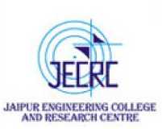
JAIPUR ENGINEERING COLLEGE AND RESEARCH CENTRE
Year & Sem – IV & VII
Subject – Environmental Engineering and Disaster Management
Unit – II
Presented by – Prof. Omprakash Netula
1

Slide 2
VISSION AND MISSION OF INSTITUTE
Vision
To become a renowned center of outcome based learning, and work towards academic, professional, cultural and social enrichment of the lives of individuals and communities.
Mission
M-1: Focus on evaluation of learning outcomes and motivate students to inculcate research Aptitude by project based learning.
M-2: Identify, based on informed perception of Indian, Regional and global needs, areas of focus and provide platform to gain knowledge and solutions.
M-3: Offer opportunities for interaction between academia and industry.
M-4: Develop human potential to its fullest extent so that intellectually capable and imaginatively gifted leaders can emerge in a range of professions.
1

Slide 3
VISSION AND MISSION OF DEPARTMENT
VISION
To become a role model in the field of Civil Engineering for the sustainable development of the society.
MISSION
To provide outcome base education.
To create a learning environment conducive for achieving academic excellence.
To prepare civil engineers for the society with high ethical values.
1

Slide 4
CONTENTS
Drinking Water Treatment Plant
1

Slide 5
INTRODUCTION
Water treatment is the process of removing contaminants from wastewater and household water.
It includes physical, chemical, and biological processes to remove physical, chemical and biological contaminants.
Its objective is to produce an environmentally safe fluid waste stream and a solid waste suitable for disposal or reuse .

Slide 6
IMPORTANCE OF DRINKING WATER TREATMENT PLANT:-
1. SCREENING
2 . AERATION
FLOCULATION
SEDIMENTATION
FILTERATION
DISINFECTION
SOFTENING

Slide 7
Screening is done to carry out the remove of heavy suspended solid from the water.
like:- plants, stones, animals,trees, etc.
Screening is generally adopted for the treatment of surface water.
Screening is done with the help of -------
➢
➢
Coarse Screen
Fine Screen

Slide 8
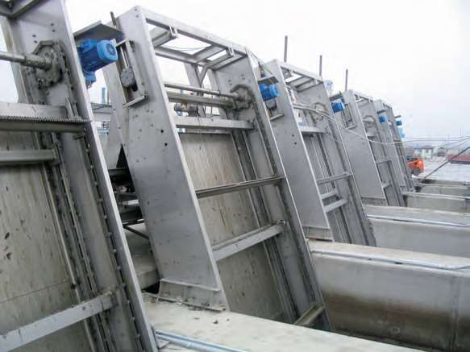
○ Coarse Screen:- Coarse Screen in the form of bar of size 10mm to 25mm having sepcing of 2200mm center to center.

Slide 9
○ Fine Screen:- Fine screen iin the form of wire cruss of size 10mm

Slide 10
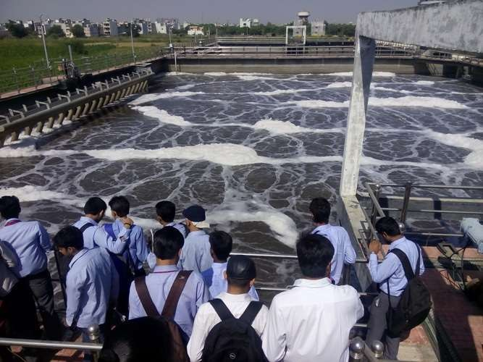
Aeration:- It is the process in which water of brought intimate contact of air .
It removes undesirable gases. Co2 , H2S.
It removes undesirable organic mater.

Slide 11
○ Floculation:- It is the process in which naturalize particle are in contact with each other , so as to promote their resulting in increased size.

Slide 12
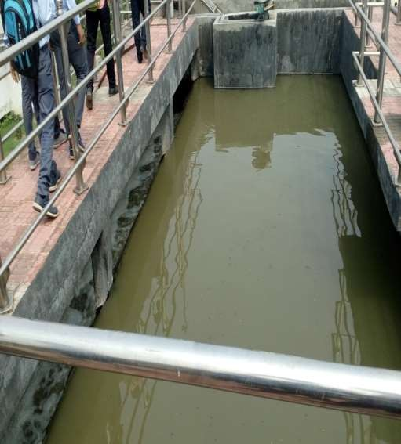
○ Sedimentation:- Sedimentation is the process removes suspended particle form the water which could not be removes in the screening process.

Slide 13
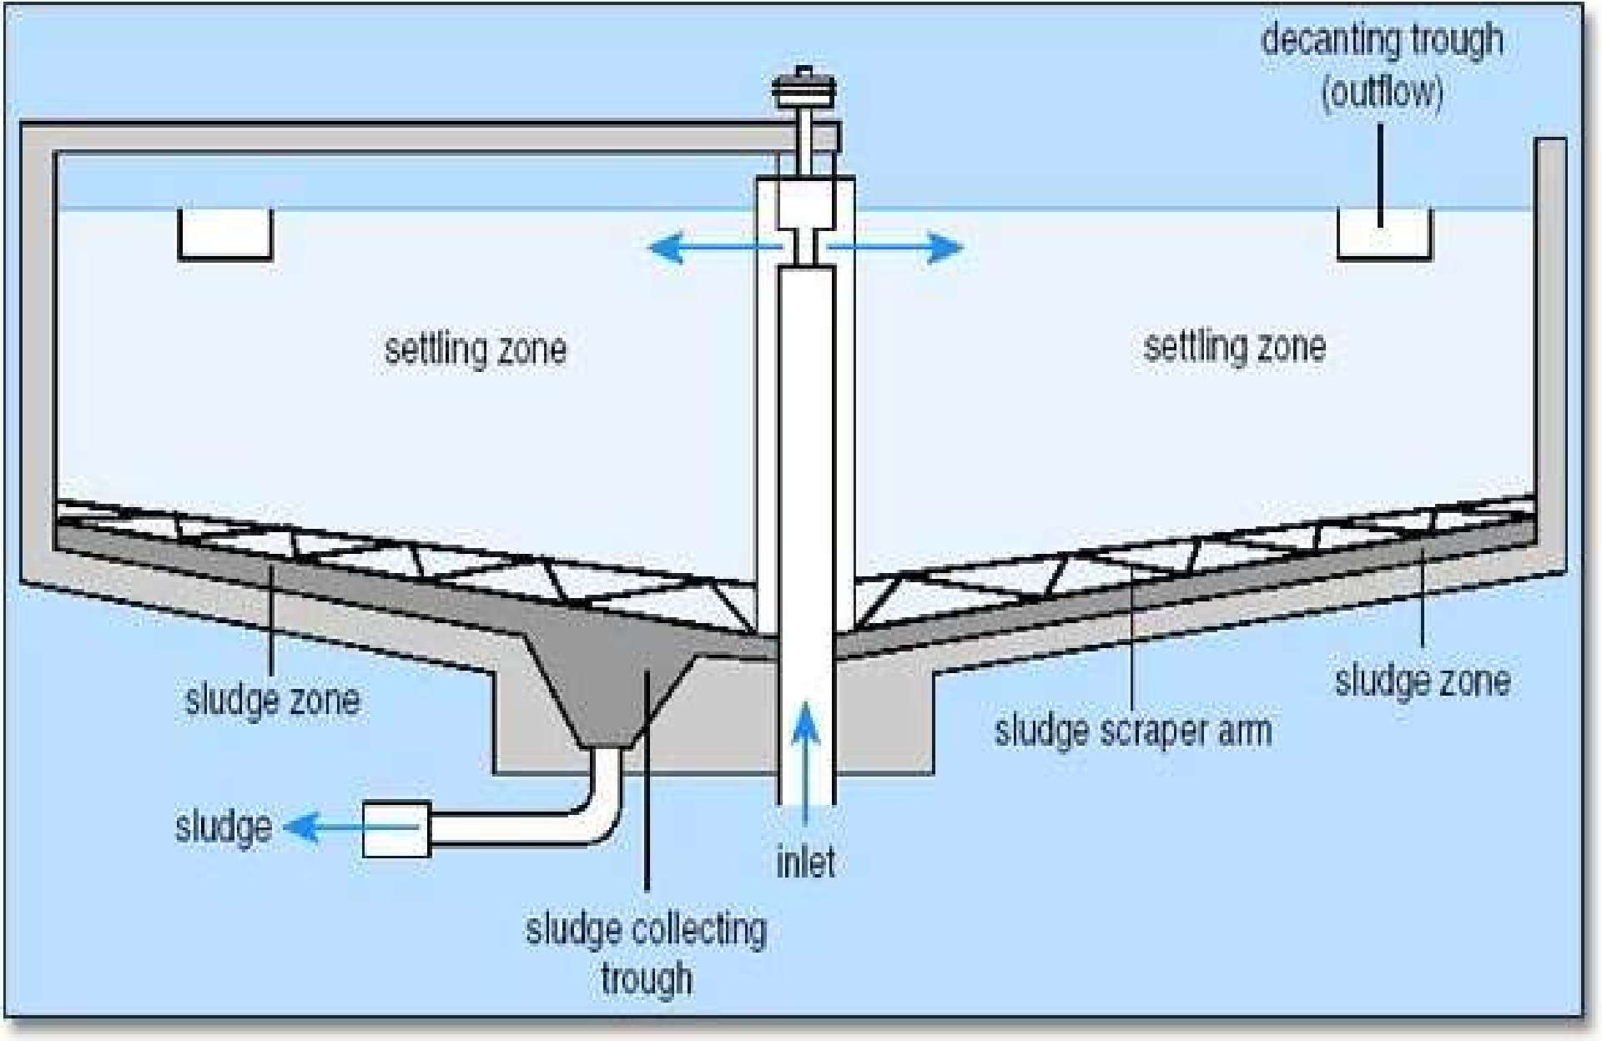

Slide 14
Filteration:- It is carry out for the removes of fine suspended particles and flow from the water.
Filteration also remove organic matter. Micro organism , minerals form the water,

Slide 15
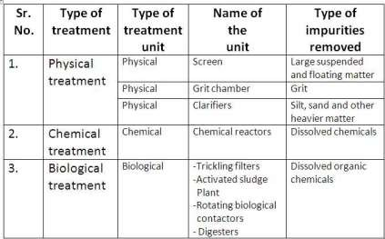
TYPES OF THE TREATMENT PROCESS

Slide 16
○ Softening:- Softening is done in order to carry out the remove of the hardness form the water.

Slide 17
REFERENCES/BIBLOGRAPHY
https://pas.org.in/Portal/document/ResourcesFiles/pdfs/Module_1%20Basics%20of%20water%20supply%20system.pdf
https://ec.europa.eu/echo/files/evaluation/watsan2005/annex_files/WEDC/oitc/oitc03.pdf
https://www.slideshare.net/GhassanHadi/sources-of-water-supply-2
https://www.slideshare.net/Tarunkumar689/sources-of-water-supply#:~:text=INTAKES%3A%20The%20main%20function%20of,to%20its%20requirements%20and%20situations.
http://ecoursesonline.iasri.res.in/mod/page/view.php?id=2573
https://www.slideshare.net/anuj110/water-treatment-plant-ppt
1

