Slide 1
JAIPUR ENGINEERING COLLEGE AND RESEARCH CENTRE
Year & Sem – II Year & 3 Sem
Subject – Advanced Engineering Mathematics-I
Unit – V
Presented by – (Dr.Vishal Saxena, Associate Professor)
1

Slide 2
VISION AND MISSION OF INSTITUTE
VISION OF INSTITUTE
To became a renowned centre of outcome based learning and work towards academic professional, cultural and social enrichment of the lives of individuals and communities .
MISSION OF INSTITUTE
Focus on evaluation of learning, outcomes and motivate students to research aptitude
by project based learning.
Identify based on informed perception of Indian, regional and global needs, the area of focus and provide platform to gain knowledge and solutions.
Offer opportunities for interaction between academic and industry .
Develop human potential to its fullest extent so that intellectually capable and imaginatively gifted leaders may emerge.
1

Slide 3
VISION AND MISSION OF DEPARTMENT
Vision
To become a role model in the field of Civil Engineering for the sustainable development of the society.
Mission
To provide outcome base education.
To create a learning environment conducive for achieving academic excellence.
To prepare civil engineers for the society with high ethical values.
1

Slide 4
CONTENTS (TO BE COVERED)
Examples of Z- Transform
1

Slide 5
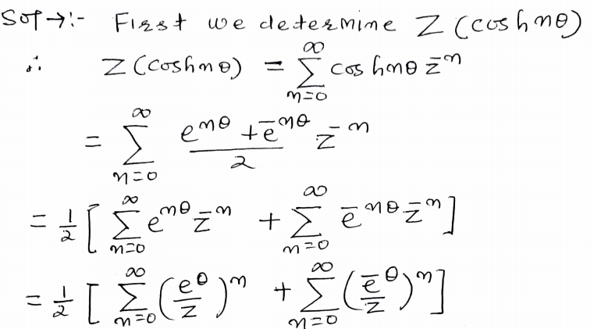
1

Slide 6
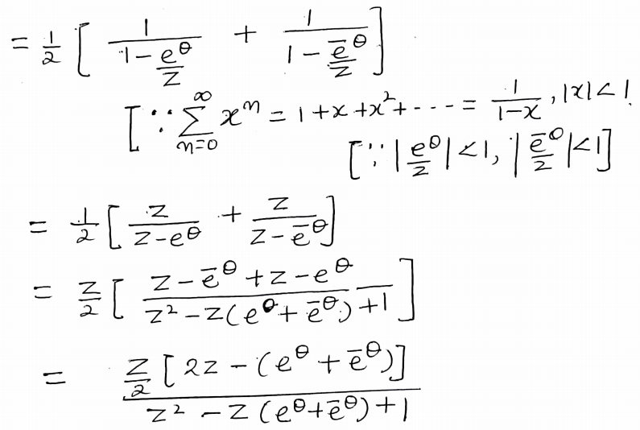
1

Slide 7
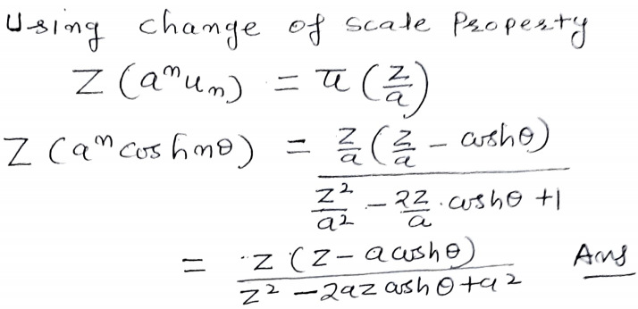
1

Slide 8
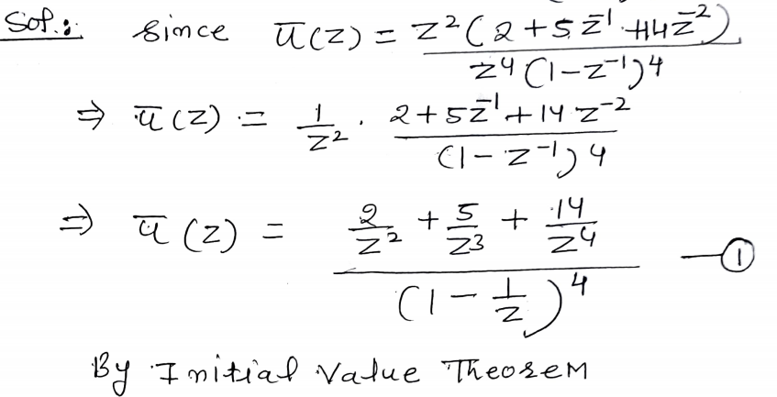
1

Slide 9
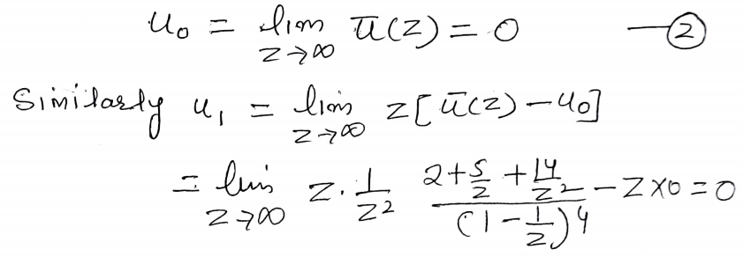
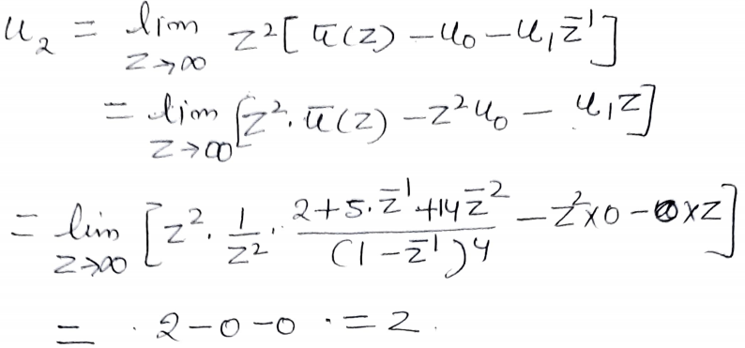
1

Slide 10
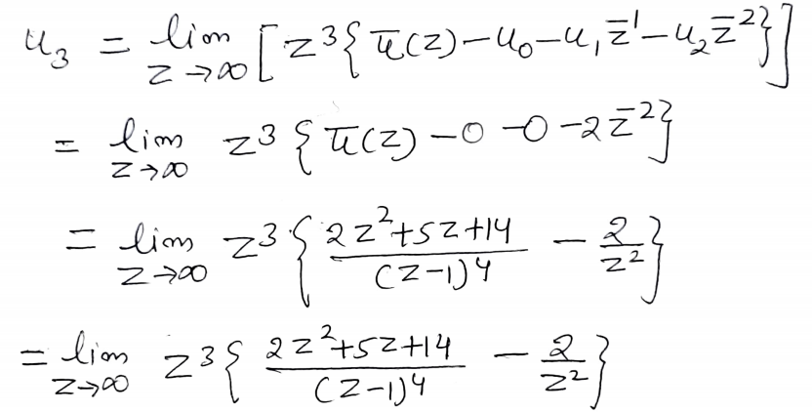
1

Slide 11
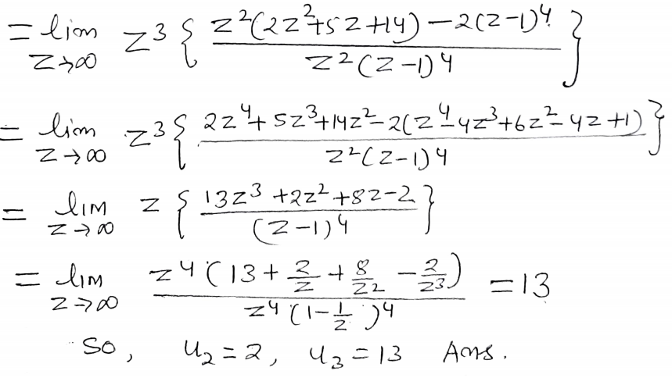
1

Slide 12
1

Slide 13
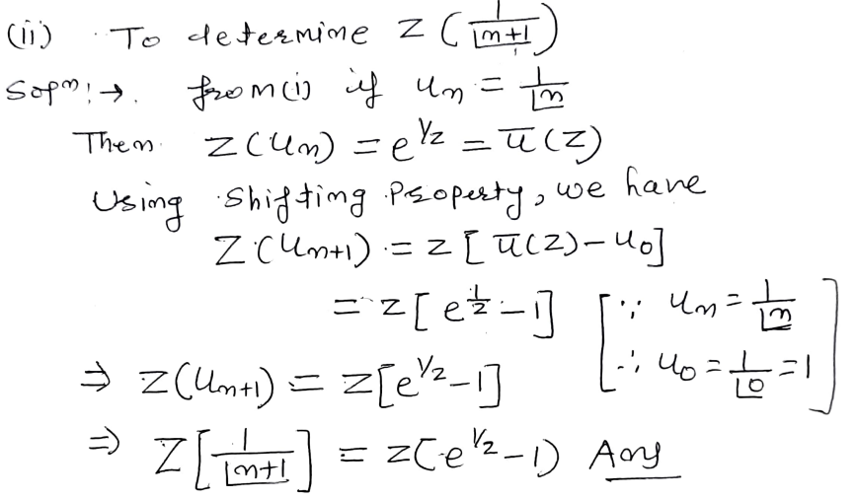
1

Slide 14
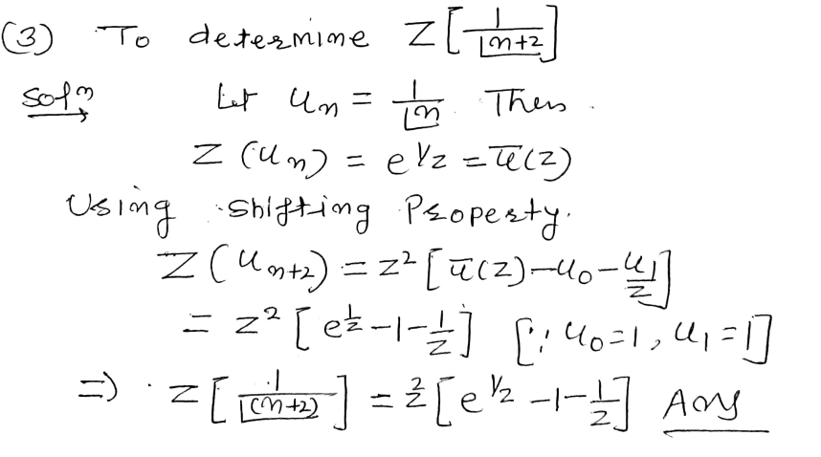
1

Slide 15
1

Slide 16
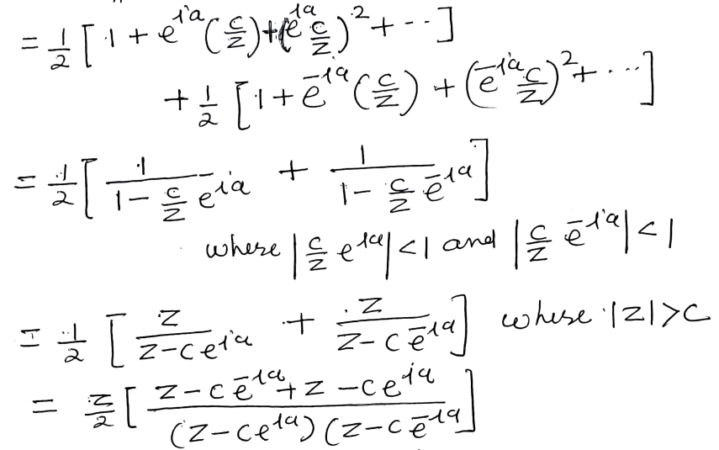
1

Slide 17
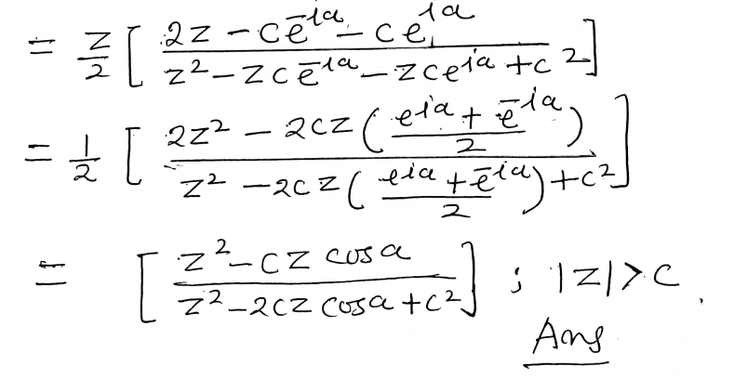
1

Slide 18
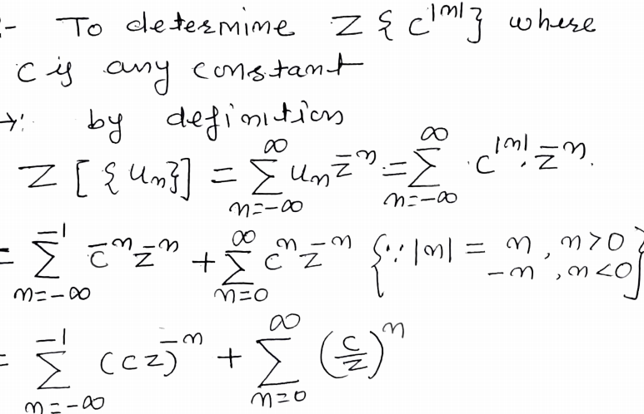
1

Slide 19
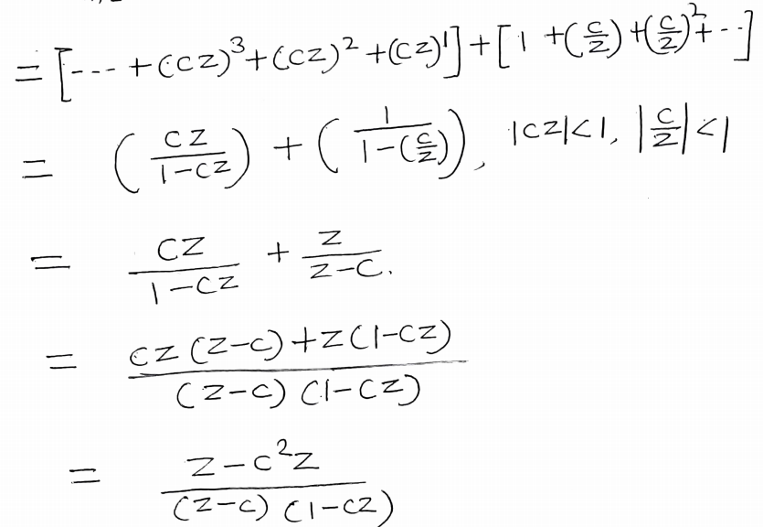
1

Slide 20
1

Slide 21
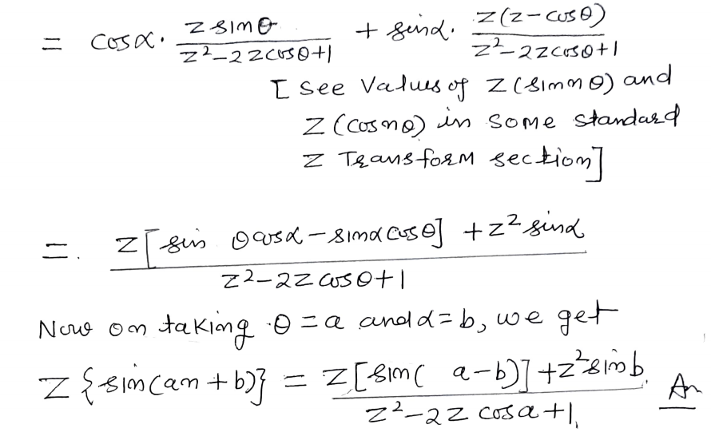
1

Slide 22
1

Slide 23
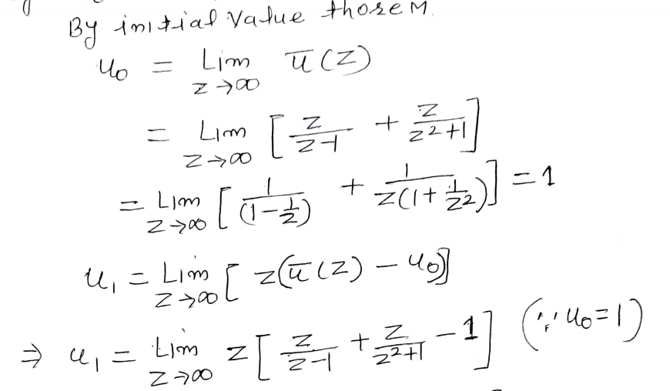
1

Slide 24
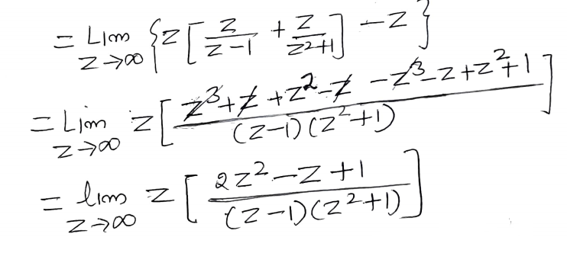
1

Slide 25
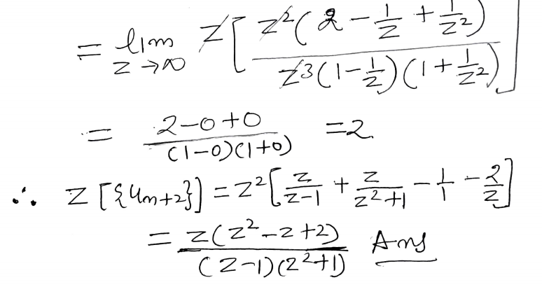
1

Slide 26
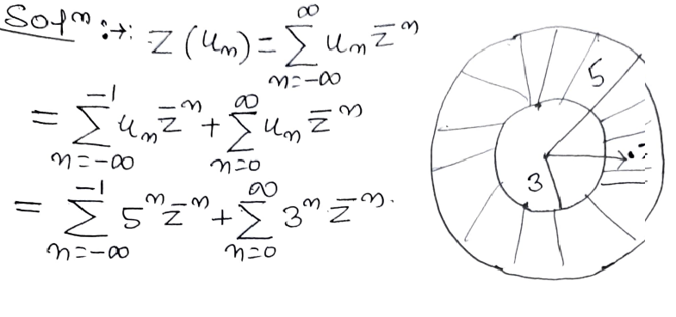
1

Slide 27
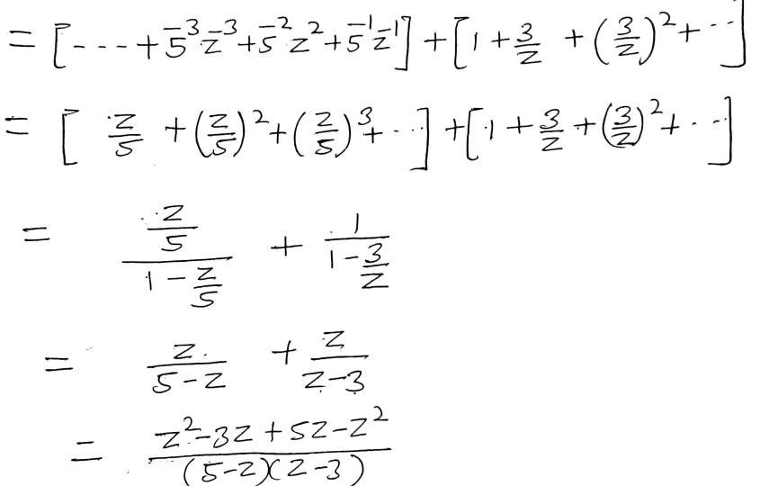
1

Slide 28
1

Slide 29
Refrences
1.Higher Engineering Mathematics by B.V Ramana (Ch.21,page no.21.12-21.20)
2. Advanced Engineering Mathematics by Prof.H.K Dass (Ch.19,page no.979-1012)
3.Advanced Engineering Mathematics by Prof. Kantesh Gupta (Ch.7,page no.7.1-7.32)
4.NPTEL Lectures available on
http://www.infocobuild.com/education/audio-video-courses/mathematics/TransformTechniquesForEngineers-IIT-Madras/lecture-45.html
1

Slide 30
Dr. Vishal Saxena (Associate Professor, Deptt. of Mathematics) , JECRC, JAIPUR

