Slide 1
JAIPUR ENGINEERING COLLEGE AND RESEARCH CENTRE
Year & Sem – II & III
Subject – Software Engineering (3AID4 - 07)
Unit – I
Presented by – Manju Vyas (Asst. Prof., AI&DS)
1

Slide 2
CONTENTS (TO BE COVERED)
Introduction to Software Engineering
Characteristics of software
SDLC (software Development Life - cycle Models)
Phases and activities in SDLC
Types of SDLC Models
SRS (software Requirements Specification)
Purpose and characteristics of good SRS
SRS Format
Formal Requirement Specification
Verification and Validation
1

Slide 3
WHAT IS SOFTWARE ENGINEERING?
“Software engineering is the practical application of scientific knowledge in the design and the construction of programs and associated documentation required to develop, operate and maintain them”.
According to Boehm-Software being a commercial products ,calls for engineering approach to ensure that it is design with correct choice of technology
1

Slide 4
COMPONENTS OF SOFTWARE
Software engineering is concerned with all aspects of computer based development including hardware, software, and process engineering. SET of PROGRAM and SOFTWARE DOCUMENTS are the main component of software.
A program is a set of instruction which is developed by individual to solve their day to day simple mathematical and logical problems.
1

Slide 5
SDLC (SOFTWARE DEVELOPMENT LIFE - CYCLE MODELS)
SDLC stand for “SOFTWARE DEVELOPMENT LIFE CYCLE”.
It represents number of identifiable stages under which s/w goes during its life.
It is a diagrammatically representation which also provide description of various phases and their sequence in life cycle of software product.
Software undergoes basic stages during its life cycle i.e. requirement analysis and specification, design, coding and maintenance.
We have different SDLC models, each one have its own advantage and disadvantage on the basis of: Development speed
1. Product Quality 2. Project Visibility 3. Risk Exposure 4. Administrative overhead
1

Slide 6
PHASES AND ACTIVITIES IN SDLC
1

Slide 7
TYPES OF SDLC
There are many software development life-cycle models as there is no general agreement about various phases and their sequence in product life cycle. Some most commonly used life cycles models are given :
Water Fall Model
The V – Model
Incremental Model
The RAD Model
Prototype Model
Spiral Model
Concurrent Development Model
1

Slide 8
SDLC: WATERFALL MODEL
It is a theoretical software development model.
It is developed by BOEHM in 1970.
It is also known as classical, traditional, conventional or linear segment model.
There are different stages to the development and the output of first stage flow to the next stage and so on.
It force on sequential phase.
development in which no phase can overlap another phase.
Each phase of this model is well define the starting and ending criteria which is to be documented by which the standard outputs produce by each phase can formulate.
Requirement analysis
Software Design & Detailed Design
Unit Implementation & Unit Testing
Integration & System Testing
Installation & Operation
Maintenance & Enhancement
1

Slide 9
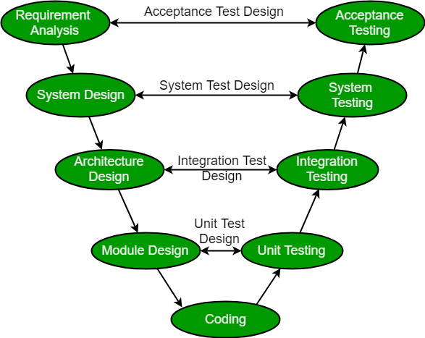
SDLC: THE V - MODEL
The V-model is a type of SDLC model where process executes in a sequential manner in V-shape.
It is also known as Verification and Validation model. It is based on the association of a testing phase for each corresponding development stage.
Development of each step directly associated with the testing phase.
The next phase starts only after completion of the previous phase i.e. for each development activity, there is a testing activity corresponding to it.
So V-Model contains Verification phases on one side of the Validation phases on the other side. Verification and Validation phases are joined by coding phase in V-shape. Thus it is called V-Model.
1

Slide 10
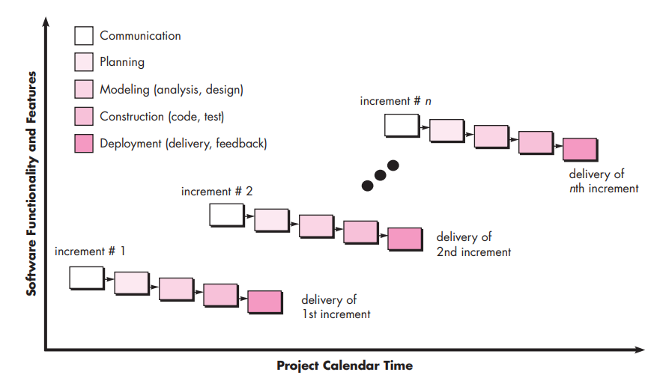
SDLC: THE INCREMENTAL MODEL
The incremental model combines elements of linear and parallel process flows and applies linear sequences in a stepwise manner according to calendar.
Each linear sequence produces deliverable “increments” of the software.
When an incremental model is used, the first increment is often a core product.
That is, basic requirements are addressed but many supplementary features (some known, others unknown) remain undelivered.
The core product is used by the customer (or undergoes detailed evaluation). As a result of use and/or evaluation, a plan is developed for the next increment.
1

Slide 11
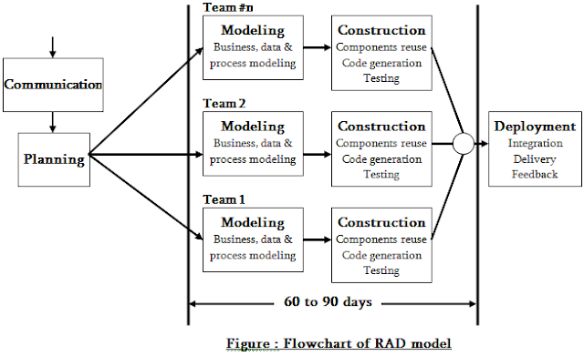
SDLC:THE RAD (RAPID APPLICATION DEVELOPMENT) MODEL
Rapid Application Development (RAD) is an incremental software development process model which is a “high-speed” adaptation of the linear sequential model in which rapid development is achieved by using component-based construction.
If requirements are well understood and project scope is constrained, the RAD process enables a development team to create a “fully functional system” within very short time periods, such as in 60 to 90 days.
1

Slide 12
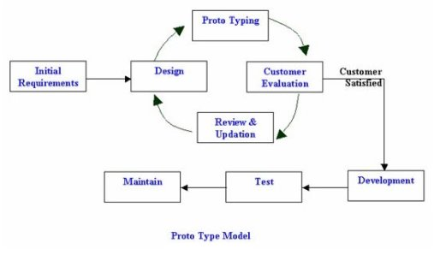
SDLC: PROTOTYPE MODEL
This The prototype model firstly a working prototype developed instead of developing actual software.
is developed according to available requirements which basically have limited functions, low reliability while it passes through all stages of development.
This model is used by developer and given to user for review which help the user to better understand his needs and requirement and then feedback from users
1

Slide 13
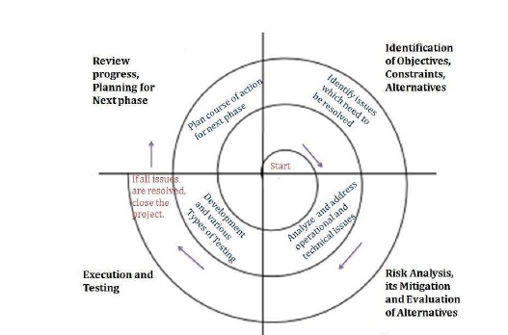
SDLC: SPIRAL MODEL
In 1987 the BOEHM proposed a model for development of software known as “Boehm Spiral Life cycle Model”.
According to its name the activity of this model are organize like spiral that has many circles whose number depends on software requirements.
The radial dimension of this model, the cumulative cost for accomplishing different stages and angular dimension show the progress in completing each cycle of the spiral.
The main objective of this model is to minimize the RISK through the use of prototype.
1

Slide 14
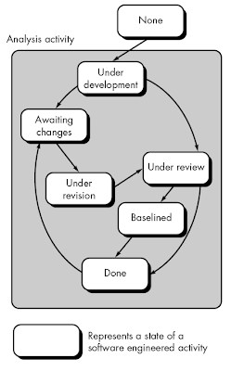
SDLC: CONCURRENT DEVELOPMENT MODEL
It allows a software team to represent iterative and concurrent elements of any of the process model.
For example, the modeling activity defined for the spiral model is accomplished by invoking one or more of the software engineering actions: prototyping, analysis, and design.
The activity—modeling—may be in any one of the states noted at any given time.
Similarly, other activities, actions, or tasks (e.g., communication or construction) can be represented in an similar manner.
1

Slide 15
SRS (SOFTWARE REQUIREMENTS SPECIFICATION)
SRS is the official statement of what the system developers should implement.
SRS is a complete description of the behavior of the system to be developed.
SRS should include both a definition of user requirements and a specification of the system requirements.
The SRS fully describes what the software will do and how it will be expected to perform.
1

Slide 16
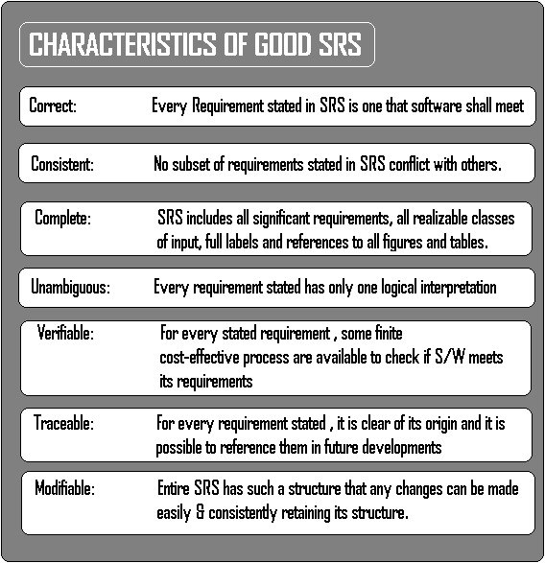
PURPOSE AND CHARACTERISTICS OF GOOD SRS
The SRS precisely defines the software product that will be built.
SRS used to know all the requirements for the software development and thus that will help in designing the software.
It provides feedback to the customer.
1

Slide 17
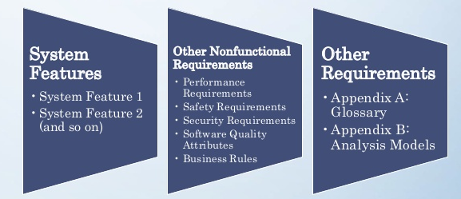
SRS FORMAT
1

Slide 18
FORMAL REQUIREMENT SPECIFICATION
Formal Specification - Techniques for the Unambiguous Specification of Software.
A formal software specification is a statement expressed in a language whose vocabulary, syntax, and semantics are formally defined. The need for a formal semantic definition means that the specification languages cannot be based on natural language.
It must be based on mathematics.
It can be of two types functional and non functional requirements.
FUNCTIONAL REQUIREMENTS
Should be both complete and consistent
Completeness
-- All services required by the user should be defined
Consistent
-- Requirements should not have contradictory definition
Difficult to achieve completeness and consistency for large system
1

Slide 19
CONT...
NON-FUNCTIONALREQUIREMENTS
Types of Non-functional Requirements
1. Product Requirements:
- Specify product behavior
- Include the following
Usability
Efficiency
Reliability
Portability
1

Slide 20
CONT...
2.Organisational Requirements
-- Derived from policies and procedures
-- Include the following:
Delivery
Implementation
Standard
3. External Requirements
-- Derived from factors external to the system and its development process
-- Includes the following
Interoperability
Ethical & Legislative
1

Slide 21
VERIFICATION AND VALIDATION
Verification and Validation is the process of investigating that a software system satisfies specifications and standards and it fulfills the required purpose. Barry Boehm described verification and validation as the following:
Verification: Are we building the product right?
Validation: Are we building the right product?
Verification: Verification is the process of checking that a software achieves its goal without any bugs. It is the process to ensure whether the product that is developed is right or not. It verifies whether the developed product fulfills the requirements that we have.
Verification is Static Testing. Activities involved in verification:
Inspections
Reviews
Walkthroughs
Desk-checking
1

Slide 22
CONT...
Validation: Validation is the process of checking whether the software product is up to the mark or in other words product has high level requirements. It is the process of checking the validation of product i.e. it checks what we are developing is the right product. it is validation of actual and expected product.
Validation is the Dynamic Testing.
Activities involved in validation:
Black box testing
White box testing
Unit testing
Integration testing
1

Slide 23
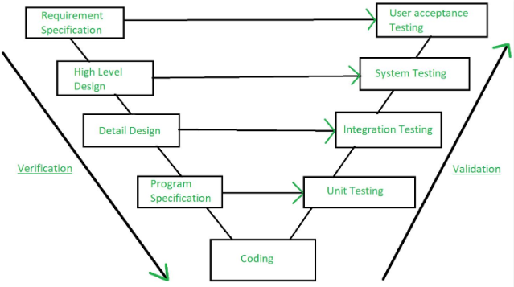
IN SHORT WE CAN SAY THAT....
Note: Verification is followed by Validation
1

Slide 24
REFERENCES/BIBLOGRAPHY
https://www.tutorialspoint.com/software_engineering/software_engineering_overview.htm
https://lecturenotes.in/m/19317-note-for-software-engineering-se-by-anna-superkings/16?reading=true
https://rmd.ac.in/dept/cse/notes/4/SE/unit1.pdf
https://hackersdata.com/2017/04/24/five-framework-activities-in-software-engineering/
https://nptel.ac.in/content/storage2/courses/106105087/pdf/m02L03.pdf
“Software Engineering: A practitioner's Approach” By Roger S. Pressman, TMH
https://www.technotrice.com/what-is-waterfall-model-software-engineering/
https://www.geeksforgeeks.org/software-engineering-sdlc-v-model/
https://www.softwaretestingclass.com/software-requirement-specification-srs/#:~:text=A%20software%20requirements%20specification%20(SRS,to%20interact%20with%20software%20system.
https://www.unf.edu/~ncoulter/cen6070/handouts/specifications.pdf
https://www.geeksforgeeks.org/differences-between-verification-and-validation/
1

