Slide 1
JAIPUR ENGINEERING COLLEGE AND RESEARCH CENTRE
Year & Sem – II & III
Subject – Data Structures & Algorithms
Unit – II
1

Slide 2
VISSION AND MISSION OF INSTITUTE
Vision of the Institute
To become a renowned Centre of higher learning, and work towards academic, professional, cultural and social enrichment of the lives of individuals and communities.
Mission of the Institute
M1: Focus on evaluation of learning outcomes and motivate students to inculcate research aptitude by project based learning.
M2: Identify, based on informed perception of Indian, regional and global needs, the areas of focus and provide platform to gain knowledge and solutions.
M3: Offer opportunities for interaction between academia and industry.
M4: Develop human potential to its fullest extent so that intellectually capable and imaginatively gifted leaders can emerge in a range of professions.
1

Slide 3
VISSION AND MISSION OF DEPARTMENT
Vision of the Department
To prepare students in the field of Artificial Intelligence and Data Science for competing with the global perspective through outcome based education, research and innovation.
Mission of the Department
M1:To impart outcome based education in the area of AI&DS.
M2:To provide platform to the experts from institutions and industry of repute to transfer the knowledge to students for providing competitive and sustainable solutions.
M3:To provide platform for innovation and research.
1

Slide 4
COURSE OUTCOME
CO1:Understand the data structure of stacks and queues and solve applications using them
CO2:Analyze and apply operations of linked lists and demonstrate their applications
CO3:Evaluate the computational efficiency of the principal algorithms for sorting, searching, and hashing.
CO4:Demonstrate operations on trees and graph.
1

Slide 20
Operations on Deque:
Mainly the following four basic operations are performed on queue:
insertFront(): Adds an item at the front of Deque. insertLast(): Adds an item at the rear of Deque. deleteFront(): Deletes an item from front of Deque. deleteLast(): Deletes an item from rear of Deque.
In addition to above operations, following operations are also supported getFront(): Gets the front item from queue. getRear(): Gets the last item from queue. isEmpty(): Checks whether Deque is empty or not. isFull(): Checks whether Deque is full or not.

Slide 28
STACKS | QUEUES
Stacks are based on the LIFO principle, i.e., the element inserted at the last, is the first element to come out of the list. | Queues are based on the FIFO principle, i.e., the element inserted at the first, is the first element to come out of the list.
Insertion and deletion in stacks takes place only from one end of the list called the top. | Insertion and deletion in queues takes place from the opposite ends of the list. The insertion takes place at the rear of the list and the deletion takes place from the front of the list.
Insert operation is called push operation. | Insert operation is called enqueue operation.
Delete operation is called pop operation. | Delete operation is called dequeue operation.
In stacks we maintain only one pointer to access the list, called the top, which always points to the last element present in the list. | In queues we maintain two pointers to access the list. The front pointer always points to the first element inserted in the list and is still present, and the rear pointer always points to the last inserted element.
Stack is used in solving problems works on recursion. | Queue is used in solving problems having sequential processing.

Slide 30
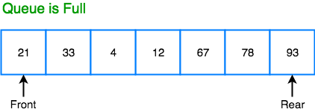
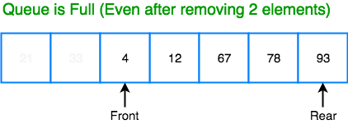
In a Linear queue, once the queue is completely full, it's not possible to insert more elements.
Even if we dequeue the queue to remove some of the elements, until the queue is reset, no new
elements can be inserted.
When we dequeue any element to remove it from the queue, we are actually moving the front of
the queue forward, thereby reducing the overall size of the queue. And we cannot insert new
elements, because the rear pointer is still at the end of the queue.
The only way is to reset the linear queue, for a fresh start.
Circular Queue is also a linear data structure, which follows the principle of FIFO(First In First Out), but instead of ending the queue at the last position, it again starts from the first position after the last, hence making the queue behave like a circular data structure.

Slide 31
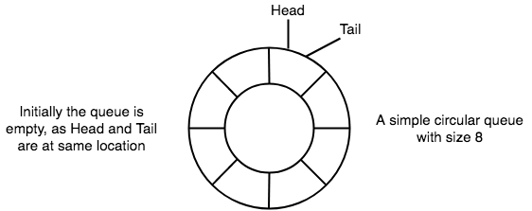
Basic features of Circular Queue
In case of a circular queue, head pointer will always point to the front of the queue, and tail pointer will always
point to the end of the queue.
Initially, the head and the tail pointers will be pointing to the same location, this would mean that the queue is empty.

Slide 32
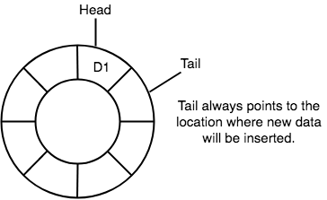
3. New data is always added to the location pointed by the tail pointer, and once the data is added, tail
pointer is incremented to point to the next available location.

Slide 33
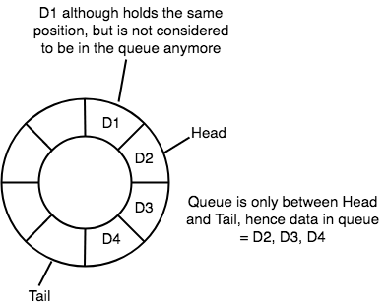
4. In a circular queue, data is not actually removed from the queue. Only the head pointer is incremented by one position when dequeue is executed. As the queue data is only the data between head and tail, hence the data left outside is not a part of the queue anymore, hence removed.

Slide 34
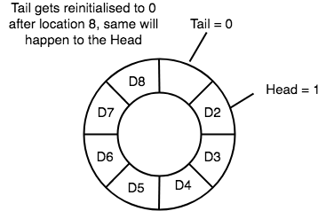
The head and the tail pointer will get reinitialised to 0 every time they reach the end of the queue

Slide 35
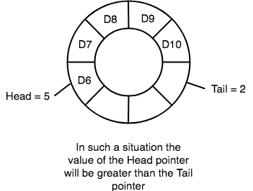
Also, the head and the tail pointers can cross each other. In other words, head pointer can be greater than
the tail. Sounds odd? This will happen when we dequeue the queue a couple of times and the tail pointer
gets reinitialised upon reaching the end of the queue.

Slide 36
Queue operations work as follows:
Two pointers called FRONT and REAR are used to keep track of the first and last elements in the queue.
When initializing the queue, we set the value of FRONT and REAR to -1.
On enqueuing an element, we circularly increase the value of REAR index and place the new element in the position pointed to by REAR.
On dequeuing an element, we return the value pointed to by FRONT and circularly increase the FRONT index.
Before enqueuing, we check if the queue is already full.
Before dequeuing, we check if the queue is already empty.
When enqueuing the first element, we set the value of FRONT to 0.
When dequeuing the last element, we reset the values of FRONT and REAR to -1.

Slide 37
Going Round and Round
Another very important point is keeping the value of the tail and the head pointer within the maximum queue size.In the
diagrams above the queue has a size of 8, hence, the value of tail and head pointers will always be between 0 and 7.
This can be controlled either by checking everytime whether tail or head have reached the maxSize and then setting the
value 0 or, we have a better way, which is, for a value x if we divide it by 8, the remainder will never be greater than 8,
it will always be between 0 and 0, which is exactly what we want.
So the formula to increment the head and tail pointers to make them go round and round over and again will be,
head = (head+1) % maxSize or tail = (tail+1) % maxSize

Slide 38
Application of Circular Queue
Below we have some common real-world examples where circular queues are used:
Computer controlled Traffic Signal System uses circular queue.2
CPU scheduling and Memory management.

Slide 39
Implementation of Circular Queue
Below we have the implementation of a circular queue:
Initialize the queue, with size of the queue defined (maxSize), and head and tail pointers.
enqueue: Check if the number of elements is equal to maxSize - 1:
If Yes, then return Queue is full.
If No, then add the new data element to the location of tail pointer and increment the tail pointer.
dequeue: Check if the number of elements in the queue is zero:
If Yes, then return Queue is empty.
If No, then increment the head pointer.
Finding the size:
If, tail >= head, size = (tail - head) + 1
But if, head > tail, then size = maxSize - (head - tail) + 1

Slide 42
Operations on Deque:
Mainly the following four basic operations are performed on queue:
insertFront(): Adds an item at the front of Deque. insertLast(): Adds an item at the rear of Deque. deleteFront(): Deletes an item from front of Deque. deleteLast(): Deletes an item from rear of Deque.
In addition to above operations, following operations are also supported getFront(): Gets the front item from queue. getRear(): Gets the last item from queue. isEmpty(): Checks whether Deque is empty or not. isFull(): Checks whether Deque is full or not.

Slide 56
PRIORITY QUEUE
Priority Queue is more specialized data structure than Queue. Like ordinary queue, priority queue has same method but with a major difference. In Priority queue items are ordered by key value so that item with the lowest value of key is at front and item with the highest value of key is at rear or vice versa. So we're assigned priority to item based on its key value. Lower the value, higher the priority. Following are the principal methods of a Priority Queue.A priority queue is an abstract data type similar to regular queue or stack data structure in which each element additionally has a "priority" associated with it. In a priority queue, an element with high priority is served before an element with low priority. In some implementations, if two elements have the same priority, they are served according to the order in which they were enqueued, while in other implementations, ordering of elements with the same priority is undefined.

Slide 57
Operations
A priority queue must at least support the following operations:
is_empty: check whether the queue has no elements.
insert_with_priority: add an element to the queue with an associated priority.
pull_highest_priority_element: remove the element from the queue that has the highest priority, and return it.
This is also known as "pop_element(Off)", "get_maximum_element" or "get_front(most)_element".
Some conventions reverse the order of priorities, considering lower values to be higher priority, so this may also be known as "get_minimum_element", and is often referred to as "get-min" in the literature.
This may instead be specified as separate "peek_at_highest_priority_element" and "delete_element" functions, which can be combined to produce "pull_highest_priority_element".

Slide 58
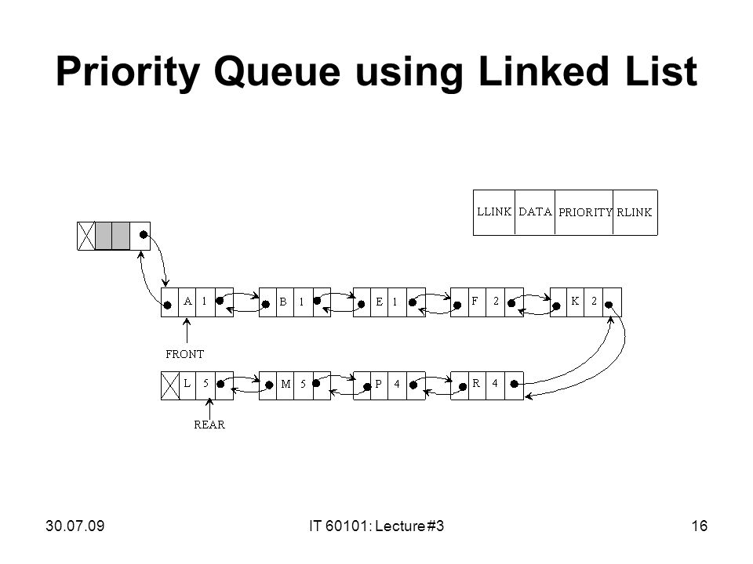

Slide 59
Priority Queue Representation
We're going to implement Queue using array in this article. There is few more operations supported by queue which are following.
Peek − get the element at front of the queue.
isFull − check if queue is full.
isEmpty − check if queue is empty.

Slide 60
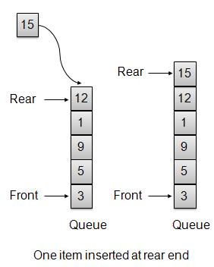
Insert / Enqueue Operation
Whenever an element is inserted into queue, priority queue inserts the item according to its order. Here we're assuming that data with high value has low priority.

Slide 61
void insert(int data)
{
int i = 0;
if(!isFull())
{
// if queue is empty, insert the data
if(itemCount == 0)
{ intArray[itemCount++] = data;
}
Else
{
// start from the right end of the queue
for(i = itemCount - 1; i >= 0; i-- )
{
// if data is larger, shift existing item to right end
if(data > intArray[i])
{
intArray[i+1] = intArray[i];
}
else{ break; }
}
// insert the data
intArray[i+1] = data;
itemCount++;
}
}
}

Slide 62
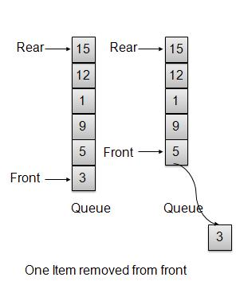
Remove / Dequeue Operation
Whenever an element is to be removed from queue, queue get the element using item count. Once element is removed. Item count is reduced by one.
int removeData()
{
return intArray[--itemCount];
}

Slide 63
Linked List
63

Slide 64
Introduction
A linked list is a data structure which can change during execution.
Successive elements are connected by pointers.
Last element points to NULL.
It can grow or shrink in size during execution of a program.
It can be made just as long as required.
head
– It does not waste memory space.
A
B
C
64

Slide 65
Keeping track of a linked list:
Must know the pointer to the first element of the list (called start, head, etc.).
Linked lists provide flexibility in allowing the items to be rearranged efficiently.
Insert an element.
Delete an element.
65

Slide 66
Illustration: Insertion
A
B
C
X
Item to be inserted
A
B
C
A
X
66

Slide 67
Illustration: Deletion
Item to be deleted
A
B
C
A
B
C
67

Slide 68
In essence ...
For insertion:
A record is created holding the new item.
The next pointer of the new record is set to link it to the item which is to follow it in the list.
The next pointer of the item which is to precede it must be modified to point to the new item.
For deletion:
The next pointer of the item immediately preceding the one to be deleted is altered, and made to point to the item following the deleted item.
68

Slide 69
Array versus Linked Lists
Arrays are suitable for:
Inserting/deleting an element at the end.
Randomly accessing any element.
Searching the list for a particular value.
Linked lists are suitable for:
Inserting an element.
Deleting an element.
Applications where sequential access is required.
In situations where the number of elements cannot be predicted beforehand.
69

Slide 70
Types of Lists
Depending on the way in which the links are used to maintain adjacency, several different types of linked lists are possible.
Linear singly-linked list (or simply linear list)
One we have discussed so far.
head
A
B
C
70

Slide 71
Circular linked list
The pointer from the last element in the list points back to the first element.
head
A
B
C
71

Slide 72
Doubly linked list
Pointers exist between adjacent nodes in both directions.
The list can be traversed either forward or backward.
Usually two pointers are maintained to keep track of the list, head and tail.
head tail
A
B
C

Slide 73
Basic Operations on a List
Creating a list
Traversing the list
Inserting an item in the list
Deleting an item from the list
Concatenating two lists into one

Slide 74
List is an Abstract Data Type
What is an abstract data type?
It is a data type defined by the user.
Typically more complex than simple data types like int, float, etc.
Why abstract?
Because details of the implementation are hidden.
When you do some operation on the list, say insert an element, you just call a function.
Details of how the list is implemented or how the insert function is written is no longer required.

Slide 75
Conceptual Idea
Insert
List implementation and the
related functions
Delete
Traverse

Slide 76
Example: Working with linked list
Consider the structure of a node as follows:
struct stud {
int roll; char name[25]; int age;
struct stud *next;
};
/* A user-defined data type called “node” */
typedef struct stud node; node *head;

Slide 77
Creating a List

Slide 78
How to begin?
To start with, we have to create a node (the first node), and make head point to it.
head = (node *) malloc(sizeof(node));
head
roll | next
name
age

Slide 79
Contd.
If there are n number of nodes in the initial linked list:
Allocate n records, one by one.
Read in the fields of the records.
Modify the links of the records so that the chain is formed.
head
A
B
C

Slide 80
node *create_list()
{
int k, n;
node *p, *head;
printf ("\n How many elements to enter?"); scanf ("%d", &n);
for (k=0; k<n; k++)
{
if (k == 0) {
head = (node *) malloc(sizeof(node)); p = head;
}
else {
p->next = (node *) malloc(sizeof(node)); p = p->next;
}
scanf ("%d %s %d", &p->roll, p->name, &p->age);
}
p->next = NULL; return (head);
}

Slide 81
To be called from main() function as:
node *head;
………
head = create_list();

Slide 82
Traversing the List

Slide 83
What is to be done?
Once the linked list has been constructed and head points to the first node of the list,
Follow the pointers.
Display the contents of the nodes as they are traversed.
Stop when the next pointer points to NULL.

Slide 84
void display (node *head)
{
int count = 1; node *p;
p = head;
while (p != NULL)
{
printf ("\nNode %d: %d %s %d", count,
p->roll, p->name, p->age);
count++;
p = p->next;
}
printf ("\n");
}

Slide 85
To be called from main() function as:
node *head;
………
display (head);

Slide 86
Inserting a Node in a List

Slide 87
How to do?
The problem is to insert a node before a specified node.
Specified means some value is given for the node (called key).
In this example, we consider it to be roll.
Convention followed:
If the value of roll is given as negative, the node will be inserted at the end of the list.

Slide 88
Contd.
When a node is added at the beginning,
Only one next pointer needs to be modified.
head is made to point to the new node.
New node points to the previously first element.
When a node is added at the end,
Two next pointers need to be modified.
Last node now points to the new node.
New node points to NULL.
When a node is added in the middle,
Two next pointers need to be modified.
Previous node now points to the new node.
New node points to the next node.

Slide 89
void insert (node **head)
{
int k = 0, rno; node *p, *q, *new;
new = (node *) malloc(sizeof(node)); printf ("\nData to be inserted: ");
scanf ("%d %s %d", &new->roll, new->name, &new->age); printf ("\nInsert before roll (-ve for end):");
scanf ("%d", &rno);
p = *head;
if (p->roll == rno)
{
new->next = p;
*head = new;
}
/* At the beginning */

Slide 90
else
{
while ((p != NULL) && (p->roll != rno))
{
q = p;
p = p->next;
}
The pointers q and p always point
to consecutive nodes.
if (p == NULL)
{
q->next = new; new->next = NULL;
/* At the end */
}
else if (p->roll
{
== rno)
/* In the middle */
q->next = new; new->next = p;
}
}
}

Slide 91
To be called from main() function as:
node *head;
………
insert (&head);

Slide 92
Deleting a node from the list

Slide 93
What is to be done?
Here also we are required to delete a specified node.
Say, the node whose roll field is given.
Here also three conditions arise:
Deleting the first node.
Deleting the last node.
Deleting an intermediate node.

Slide 94
void delete (node **head)
{
int rno; node *p, *q;
printf ("\nDelete for roll :"); scanf ("%d", &rno);
p = *head;
if (p->roll == rno)
/* Delete the first element */
{
*head = p->next; free (p);
}

Slide 95
else
{
while ((p != NULL) && (p->roll != rno))
{
q = p;
p = p->next;
}
if (p == | NULL) | /* Element not found */
printf | ("\nNo | match :: deletion failed");
else if (p->roll == rno)
/* Delete any other element */
{
q->next = p->next; free (p);
}
}
}

Slide 96
Few Exercises to Try Out
Write a function to:
Concatenate two given list into one big list.
node *concatenate (node *head1, node *head2);
Insert an element in a linked list in sorted order. The function will be called for every element to be inserted.
void insert_sorted (node **head, node *element);
Always insert elements at one end, and delete elements from the other end (first-in first-out QUEUE).
void insert_q (node **head, node *element)
node *delete_q (node **head)
/* Return the deleted node */

Slide 97
A First-in First-out (FIFO) List
Out
In
A
B
C B A
Also called a QUEUE

Slide 98
A Last-in First-out (LIFO) List
In
Out
C B A
B C
Also called a STACK

Slide 99
Abstract Data Types

Slide 100
Example 1 :: Complex numbers
struct cplx {
float re;
float im;
Structure definition
}
typedef struct cplx complex;
complex *add (complex a, complex b); complex *sub (complex a, complex b); complex *mul (complex a, complex b); complex *div (complex a, complex b); complex *read();
void print (complex a);
Function prototypes

Slide 101
Complex Number
add
sub
mul
div
read print

Slide 102
Example 2 :: Set manipulation
struct node {
int element; struct node *next;
}
typedef struct node set;
Structure definition
set *union (set a, set b);
set *intersect (set a, set b); set *minus (set a, set b); void insert (set a, int x); void delete (set a, int x); int size (set a);
Function prototypes

Slide 103
union
intersect
minus
Set
insert
delete
size

Slide 104
Example 3 :: Last-In-First-Out STACK
Assume:: stack contains integer elements
void push (stack *s, int element);
/* Insert an element in the stack */
int pop (stack *s);
/* Remove and return the top element */
void create (stack *s);
/* Create a new stack */
int isempty (stack *s);
/* Check if stack is empty */
int isfull (stack *s);
/* Check if stack is full */

Slide 105
push
pop
create
STACK
isempty
isfull

Slide 106
Contd.
We shall look into two different ways of implementing stack:
Using arrays
Using linked list

Slide 107
Example 4 :: First-In-First-Out QUEUE
Assume:: queue contains integer elements
void enqueue (queue *q, int element);
/* Insert an element in the queue */
int dequeue (queue *q);
/* Remove an element from the queue */
queue *create();
/* Create a new queue */
int isempty (queue *q);
/* Check if queue is empty */
int size (queue *q);
/* Return the no. of elements in queue */

Slide 108
enqueue
dequeue
create isempty
size
QUEUE

Slide 109
Stack Implementations: Using Array and Linked List

Slide 110
STACK USING ARRAY
PUSH
top
top

Slide 111
STACK USING ARRAY
POP
top
top

Slide 112
Stack: Linked List Structure
PUSH OPERATION
top

Slide 113
Stack: Linked List Structure
POP OPERATION
top

Slide 114
Basic Idea
In the array implementation, we would:
Declare an array of fixed size (which determines the maximum size of the stack).
Keep a variable which always points to the “top” of the stack.
Contains the array index of the “top” element.
In the linked list implementation, we would:
Maintain the stack as a linked list.
A pointer variable top points to the start of the list.
The first element of the linked list is considered as the stack top.

Slide 115
Declaration
#define MAXSIZE 100
struct lifo
{
int st[MAXSIZE]; int top;
};
typedef struct lifo
stack;
stack s;
struct lifo
{
int value;
struct lifo *next;
};
typedef struct lifo
stack;
stack *top;
ARRAY
LINKED LIST

Slide 116
Stack Creation
void create (stack *s)
{
s->top = -1;
/* s->top points to last element pushed in; initially -1 */
}
void create (stack **top)
{
*top = NULL;
/* top points to NULL, indicating empty stack */
}
LINKED LIST
ARRAY

Slide 117
Pushing an element into the stack
void push (stack *s, int element)
{
if (s->top == (MAXSIZE-1))
{
printf (“\n Stack overflow”); exit(-1);
}
else
{
s->top ++;
s->st[s->top] = element;
}
}
ARRAY

Slide 118
void push (stack **top, int element)
{
stack *new;
new = (stack *) malloc(sizeof(stack)); if (new == NULL)
{
printf (“\n Stack is full”); exit(-1);
}
new->value = element; new->next = *top;
*top = new;
}
LINKED LIST

Slide 119
Popping an element from the stack
int pop (stack *s)
{
if (s->top == -1)
{
printf (“\n Stack underflow”); exit(-1);
}
else
{
return (s->st[s->top--]);
}
}
ARRAY

Slide 120
int pop (stack **top)
{
int t; stack *p;
if (*top == NULL)
{
printf (“\n Stack is empty”); exit(-1);
}
else
{
t = (*top)->value; p = *top;
*top = (*top)->next;
free (p); return t;
}
}
LINKED LIST

Slide 121
Checking for stack empty
int isempty (stack *s)
{
if (s->top == -1)
return 1;
else
return (0);
}
int isempty (stack *top)
{
if (top == NULL)
return (1); else
return (0);
}
ARRAY
LINKED LIST

Slide 122
Checking for stack full
int isfull (stack *s)
{
if (s->top ==
(MAXSIZE–1))
return 1;
else
return (0);
}
Not required for linked list implementation.
In the push() function, we can check the return value of malloc().
– If -1, then memory cannot be allocated.
ARRAY
LINKED LIST

Slide 123
Example main function :: array
#include <stdio.h> #define MAXSIZE 100
struct lifo
{
int st[MAXSIZE];
push(&A,30);
push(&B,100); push(&B,5);
printf (“%d %d”, pop(&A),
pop(&B));
push (&A, pop(&B)); if (isempty(&B))
printf (“\n B is empty”);
int top;
};
typedef struct lifo stack;
main()
{
stack A, B;
create(&A); create(&B); push(&A,10);
push(&A,20);
}

Slide 124
Example main function :: linked list
#include <stdio.h> struct lifo
{
int value;
struct lifo *next;
};
typedef struct lifo stack;
push(&A,30);
push(&B,100);
push(&B,5);
printf (“%d %d”,
pop(&A), pop(&B));
push (&A, pop(&B)); if (isempty(B))
printf (“\n B is empty”);
}
main()
{
stack *A, *B; create(&A); create(&B); push(&A,10);
push(&A,20);

Slide 125
Queue Implementation using Linked List

Slide 126
Basic Idea
Basic idea:
Create a linked list to which items would be added to one end and deleted from the other end.
Two pointers will be maintained:
One pointing to the beginning of the list (point from where elements will be deleted).
Another pointing to the end of the list (point where new elements will be inserted).
Rear
Front
DELETION
INSERTION

Slide 127
QUEUE: LINKED LIST STRUCTURE
ENQUEUE
front
rear

Slide 128
QUEUE: LINKED LIST STRUCTURE
DEQUEUE
front
rear

Slide 129
QUEUE using Linked List
#include <stdio.h> #include <stdlib.h> #include <string.h>
struct node{
char name[30]; struct node *next;
};
typedef struct node _QNODE; typedef struct {
_QNODE *queue_front, *queue_rear;
} _QUEUE;

Slide 130
_QNODE *enqueue (_QUEUE *q, char x[])
_QNODE *temp; temp= (_QNODE *)
malloc (sizeof(_QNODE)); if (temp==NULL){
printf(“Bad allocation \n");
return NULL;
}
strcpy(temp->name,x); temp->next=NULL;
{
if(q->queue_rear==NULL)
{
q->queue_rear=temp;
q->queue_front=
q->queue_rear;
}
else
{
q->queue_rear->next=temp;
q->queue_rear=temp;
}
return(q->queue_rear);
}
Data Structure 68

Slide 131
char *dequeue(_QUEUE *q,char x[])
{
_QNODE *temp_pnt;
else{
strcpy(x,q->queue_front->name);
temp_pnt=q->queue_front;
if(q->queue_front==NULL){ q->queue_rear=NULL; printf("Queue is empty \n"); return(NULL);
}
q->queue_front=
q->queue_front->next;
free(temp_pnt);
if(q->queue_front==NULL)
q->queue_rear=NULL;
return(x);
}
}

Slide 132
void init_queue(_QUEUE *q)
{
q->queue_front= q->queue_rear=NULL;
}
int isEmpty(_QUEUE *q)
{
if(q==NULL) return 1;
else return 0;
}

Slide 133
main()
{
int i,j;
char command[5],val[30];
_QUEUE q;
init_queue(&q); command[0]='\0';
printf("For entering a name use 'enter <name>'\n");
printf("For deleting use 'delete' \n"); printf("To end the session use 'bye' \n"); while(strcmp(command,"bye")){ scanf("%s",command);

Slide 134
if(!strcmp(command,"enter")) { scanf("%s",val); if((enqueue(&q,val)==NULL)) printf("No more pushing please \n"); else printf("Name entered %s \n",val);
}
if(!strcmp(command,"delete")) { if(!isEmpty(&q))
printf("%s \n",dequeue(&q,val));
else printf("Name deleted %s \n",val);
}
} /* while */
printf("End session \n");
}
July 21, 2009
Progra
mming and Data Structure 72

Slide 135
Problem With Array Implementation
ENQUEUE DEQUEUE
Effective queuing storage area of array gets reduced.
0 N
re | are | ar
fr
on_{fr}t_{o}
nt
Use of circular array indexing

Slide 136
Queue: Example with Array Implementation
#define MAX_SIZE 100
typedef struct { char name[30];
} _ELEMENT;
typedef struct {
_ELEMENT q_elem[MAX_SIZE]; int rear;
int front;
int full,empty;
} _QUEUE;

Slide 137
Queue Example: Contd.
void init_queue(_QUEUE *q)
{q->rear= q->front= 0; q->full=0; q->empty=1;
}
int IsFull(_QUEUE *q)
{return(q->full);}
int IsEmpty(_QUEUE *q)
{return(q->empty);}

Slide 138
Queue Example: Contd.
void AddQ(_QUEUE *q, _ELEMENT ob)
{
if(IsFull(q)) {printf("Queue is Full \n"); return;}
q->rear=(q->rear+1)%(MAX_SIZE); q->q_elem[q->rear]=ob;
if(q->front==q->rear) q->full=1; else q->full=0; q->empty=0;
return;
}

Slide 139
Queue Example: Contd.
_ELEMENT DeleteQ(_QUEUE *q)
{
_ELEMENT temp; temp.name[0]='\0';
if(IsEmpty(q)) {printf("Queue is EMPTY\n");return(temp);} q->front=(q->front+1)%(MAX_SIZE);
temp=q->q_elem[q->front];
if(q->rear==q->front) q->empty=1; else q->empty=0; q->full=0;
return(temp);
}
77

Slide 140
Queue Example: Contd.
main()
{
int i,j;
char command[5];
_ELEMENT ob;
_QUEUE A;
#include <stdio.h> #include <stdlib.h> #include <string.h>
init_queue(&A);
command[0]='\0';
printf("For adding a name use 'add [name]'\n"); printf("For deleting use 'delete' \n"); printf("To end the session use 'bye' \n");

Slide 141
Queue Example: Contd.
while (strcmp(command,"bye")!=0){ scanf("%s",command);
if(strcmp(command,"add")==0) { scanf("%s",ob.name);
if (IsFull(&A))
printf("No more insertion please \n"); else {
AddQ(&A,ob);
printf("Name inserted %s \n",ob.name);
}
}

Slide 142
Queue Example: Contd.
if (strcmp(command,"delete")==0) { if (IsEmpty(&A))
printf("Queue is empty \n"); else {
ob=DeleteQ(&A);
printf("Name deleted %s \n",ob.name);
}
}
} /* End of while */ printf("End session \n");
}

Slide 143
Neelkamal Chaudhary(Assistant Professor, AI&DS) , JECRC, JAIPUR

