Slide 1
Theory of Computation
UNIT – III

Slide 2
Vision of the Department
To become renowned Centre of excellence in computer science and engineering and make competent engineers & professionals with high ethical values prepared for lifelong learning.
Mission of the Department
M1: To impart outcome based education in the area of AI&DS.
M2: To provide platform to the experts from institutions and industry of repute to transfer the knowledge to students for providing competitive and sustainable solutions.
M3: To provide platform for innovation and research.

Slide 3
Course Objectives
CO1: Examine Finite Automata and Regular Expression.
CO2: Classify regular sets of Regular Grammars.
CO3: Categorize Context Free Language and Design Pushdown automata.
CO4: Design Turing machine, compare Chomsky hierarchy languages and analyze Linear bounded automata.

Slide 4
CO-PO Mapping
Semester | Course Objectives | P O 1 | P O2 | P O 3 | P O 4 | P O 5 | P O 6 | P O 7 | P O 8 | P O 9 | P O 10 | P O 11 | P O 12
IV | CO1 | H | L | M | H | M | L | L | M | L | L | L | L
 | CO2 | H | M | H | H | L | L | M | M | H | M | L | M
 | CO3 | H | M | H | H | L | L | M | L | M | M | M | L
 | CO4 | L | M | L | H | M | L | H | M | L | L | H | H

Slide 5
Pushdown Automaton -- PDA Input String
Stack
States

Slide 6
Initial Stack Symbol
Stack
Stack
$
bottom special symbol

Slide 7
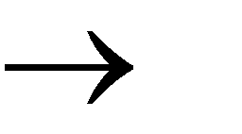
The States
Input
Pop
Push
symbol
symbol
symbol
a, b c
q₁
q₂

Slide 8
a, b c
q₁
q₂
input
stack
b
c
top
h
Replace
h
$
$

Slide 9
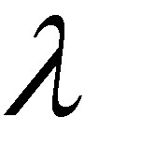
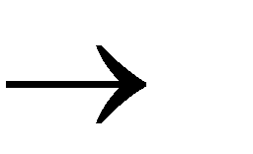
a,
c
q₁
q₂
input
stack
c
b
b
top
h
Push
h
$
$

Slide 10
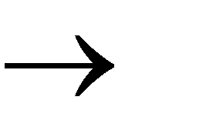
a, b
q₁
q₂
input
stack
b
top
h
Pop
h
$
$

Slide 11
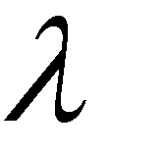
a,
q₁
q₂
input
stack
b
b
h
top
h
No Change
$
$

Slide 12
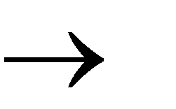
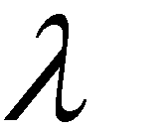
Non-Determinism
q₂
a, b c
q₁
a, b c
, b c
transition
q₁
q₂
q
3
These are allowed transitions in a Non-deterministic PDA (NPDA)

Slide 13
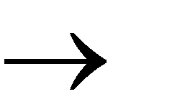
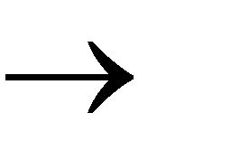
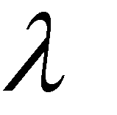
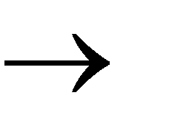
NPDA: PDA
Non-Deterministic
Example:
a,
a
b, a
,
_{q1} b, a
, $ $
q₀
q₂
q₃

Slide 14
Execution Example:
Input
b b b
Time 0
$
Stack
current
a,
a
b, a
state
,
_{q1} b, a
, $ $
q₀
q₂
q₃

Slide 15
Time 1
Input
b b b
$
Stack
a,
a
b, a
,
b, a
, $
$
q₀
q₁
q₂
q₃

Slide 16
Time 2
Input
b b b
$
Stack
a,
a
b, a
,
b, a
, $
$
q₀
q₁
q₂
q₃

Slide 17
Time 3
Input
b b b
$
Stack
a,
a
b, a
,
b, a
, $
$
q₀
q₁
q₂
q₃

Slide 18
Time 4
Input
b b b
$
Stack
a,
a
b, a
,
b, a
, $
$
q₀
q₁
q₂
q₃

Slide 19
Time 5
Input
b b b
$
Stack
a,
a
b, a
,
b, a
, $
$
q₀
q₁
q₂
q₃

Slide 20
Time 6
Input
b b b
$
Stack
a,
a
b, a
,
b, a
, $
$
q₀
q₁
q₂
q₃

Slide 21
Time 7
Input
b b b
$
Stack
a,
a
b, a
,
b, a
, $
$
q₀
q₁
q₂
q₃

Slide 22
Time 8
Input
b b b
$
Stack
a,
a
b, a
accept
,
b, a
, $
$
q₀
q₁
q₂
q₃

Slide 23
The Language of PDA
A string is accepted if there is a computation such that:
All the input is consumed
The last state is a final state At the end of the computation,
we do not care about the stack contents

Slide 24
^{F}Nºon^{r}-D^{m}etªer^{l}m^{D}in^{e}ist^{f}i^{i}c^{n}P^{i}u^{t}s^{i}hºdo^{n}wn Automaton
NPDA
M (Q, Σ, Γ, δ, q₀ , z, F )
Final states
States
Input
Stack
alphabet
Stack
alphabet
Transition function
start symbol
Initial state

Slide 25
Instantaneous Description
(q, u, s)
Current state
Current stack contents
Remaining input

Slide 26
Acceptance by Final State
L(M)= set of all strings w such that starting from initial ID machine consumes w from input and enters an accepting state.
The contents of the stack at that time is irrelevant.
{w | (q0, w, Z) (q, , )
*
For some final state q of F and any stack staring .

Slide 27
Acceptance by empty stack
N(M) = (w | (q0,w,Z)
* (q, , )
That is N(M) is the set of all strings w such that M can consume w and at the same time empties its stack.Here we do not care whether q is a final state or not.

Slide 28
The input string aaabbb
is accepted by the NPDA:
a,
a
b, a
,
b, a
, $
$
q₀
q₁
q₂
q₃

Slide 29
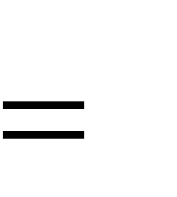
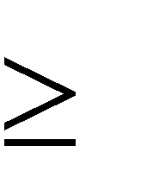
L {a^{n}b^{n} : n 0}
In general,
is the language accepted by the NPDA:
a,
a
b, a
,
b, a
, $
$
q₀
q₁
q₂
q₃

Slide 30
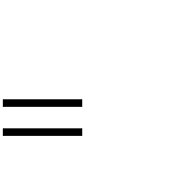
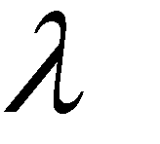
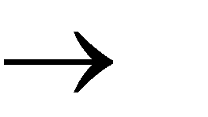
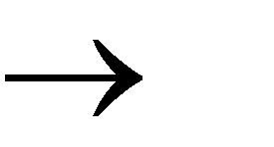
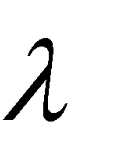
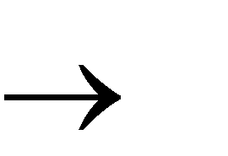
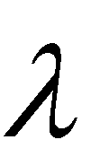
Another NPDA example
NPDA
M
L(M ) {ww^{R}}
a, a
b, b
a b
a,
b,
,
, $
$
q₂
q₀
q₁

Slide 31
Execution Example:
Input
b b
Time 0
$
Stack
a b
a, a
b, b
a,
b,
,
, $
$
q₂
q₀
q₁

Slide 32
Time 1
Input
b b
$
Stack
a b
a, a
b, b
a,
b,
,
, $
$
q₂
q₀
q₁

Slide 33
Time 2
Input
b
b b
$
Stack
a b
a, a
b, b
a,
b,
,
, $
$
q₂
q₀
q₁

Slide 34
Time 3
Input
b
b b
Guess the middle
$
of string
Stack
a b
a, a
b, b
a,
b,
,
, $
$
q₂
q₀
q₁

Slide 35
Time 4
Input
b
b b
$
Stack
a b
a, a
b, b
a,
b,
,
, $
$
q₂
q₀
q₁

Slide 36
Time 5
Input
b b
$
Stack
a b
a, a
b, b
a,
b,
,
, $
$
q₂
q₀
q₁

Slide 37
Time 6
Input
b b
$
Stack
a b
a, a
b, b
a,
b,
accept
,
, $
$
q₂
q₀
q₁

Slide 38
Rejection Example:
Input
b b b
Time 0
$
Stack
a b
a, a
b, b
a,
b,
,
, $
$
q₂
q₀
q₁

Slide 39
Time 1
Input
b b b
$
Stack
a b
a, a
b, b
a,
b,
,
, $
$
q₂
q₀
q₁

Slide 40
Time 2
Input
b
b b b
$
Stack
a b
a, a
b, b
a,
b,
,
, $
$
q₂
q₀
q₁

Slide 41
Time 3
Input
b
b b b
Guess the middle
$
of string
Stack
a b
a, a
b, b
a,
b,
,
, $
$
q₂
q₀
q₁

Slide 42
Time 4
Input
b
b b b
$
Stack
a b
a, a
b, b
a,
b,
,
, $
$
q₂
q₀
q₁

Slide 43
Time 5
There is no possible transition.
Input
b b b
Input is not
consumed
$
Stack
a b
a, a
b, b
a,
b,
,
, $
$
q₂
q₀
q₁

Slide 44
Another computation on same string:
Input
Time 0
b b b
$
Stack
a b
a, a
b, b
a,
b,
,
, $
$
q₂
q₀
q₁

Slide 45
Time 1
Input
b b b
$
Stack
a b
a, a
b, b
a,
b,
,
, $
$
q₂
q₀
q₁

Slide 46
Time 2
Input
b
b b b
$
Stack
a b
a, a
b, b
a,
b,
,
, $
$
q₂
q₀
q₁

Slide 47
Time 3
b
Input
b
b b b
$
Stack
a b
a, a
b, b
a,
b,
,
, $
$
q₂
q₀
q₁

Slide 48
Time 4
b
b
Input
b
b b b
$
Stack
a b
a, a
b, b
a,
b,
,
, $
$
q₂
q₀
q₁

Slide 49
Time 5
No final state
b
b
Input
b
b b b
is reached
$
Stack
a b
a, a
b, b
a,
b,
,
, $
$
q₂
q₀
q₁

Slide 50
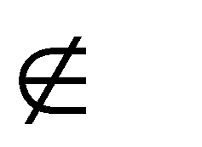
There is no computation that accepts string abbb
abbb L(M )
a b
a, a
b, b
a,
b,
,
, $
$
q₂
q₀
q₁

Slide 51
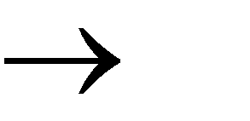
Pushing Strings
Input
Pop
Push
symbol
symbol
string
_{q1} a, b w
q₂

Slide 52
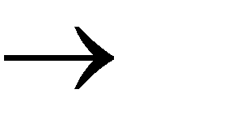
Example:
a, b cdf
q₁ q₂
input
pushed string
stack
d
b h
top
f
Push
h
$
$

Slide 53
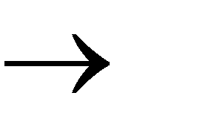
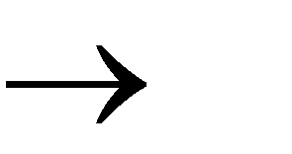
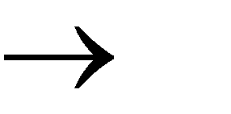
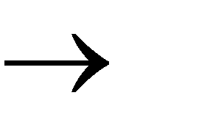
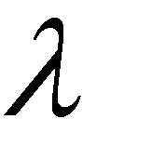
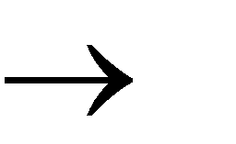
Another N_{N}P_{PD}D_{A}A_{M}example
L(M ) {w : n_{a} n_{b}}
a, $ 0$
a, 0 00
a, 1
b, $ 1$
b, 1 11
b, 0
, $ $
q₁
q₂

Slide 54
Execution Example:
Input
b b
Time 0
b
$
a, $ 0$
a, 0 00
a, 1
b, $ 1$
b, 1 11
b, 0
Stack
current state
, $ $
q₁
q₂

Slide 55
Time 1
Input
b b
b
0
$
a, $ 0$
b, $ 1$
Stack
a, 0 00 b, 1 11
a, 1 b, 0
, $
$
q₁
q₂

Slide 56
Time 3
Input
b b
b
0
$
a, $ 0$
b, $ 1$
Stack
a, 0 00 b, 1 11
a, 1 b, 0
, $
$
q₁
q₂

Slide 57
Time 4
Input
b b
b
1
$
a, $ 0$
b, $ 1$
Stack
a, 0 00 b, 1 11
a, 1 b, 0
, $
$
q₁
q₂

Slide 58
Time 5
Input
b b
b
1
1
$
a, $ 0$
b, $ 1$
Stack
a, 0 00 b, 1 11
a, 1 b, 0
, $
$
q₁
q₂

Slide 59
Time 6
Input
b b
b
1
1
$
a, $ 0$
b, $ 1$
Stack
a, 0 00 b, 1 11
a, 1 b, 0
, $
$
q₁
q₂

Slide 60
Time 7
Input
b b
b
1
$
a, $ 0$
b, $ 1$
Stack
a, 0 00 b, 1 11
a, 1 b, 0
, $
$
q₁
q₂

Slide 61
Time 8
Input
b b
b
$
a, $ 0$
a, 0 00
a, 1
b, $ 1$
b, 1 11
b, 0
Stack
accept
, $
$
q₁
q₂

Slide 62
Formalities for NPDAs

Slide 63
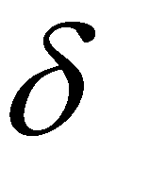
_{q1} a, b w
q₂
Transition function:
(q₁, a,b)
{(q₂, w)}

Slide 64
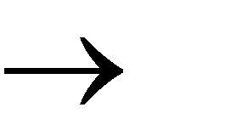
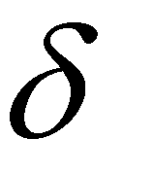
q₂
a, b w
q₁
a, b w
q₃
Transition function:
(q₁, a,b)
{(q₂, w), (q₃, w)}

Slide 65
^{F}Nºon^{r}-D^{m}etªer^{l}m^{D}in^{e}ist^{f}i^{i}c^{n}P^{i}u^{t}s^{i}hºdo^{n}wn Automaton
NPDA
M (Q, Σ, Γ, δ, q₀ , z, F )
Final states
States
Input
Stack
alphabet
Stack
alphabet
Transition function
start symbol
Initial state

Slide 66
Instantaneous Description
(q, u, s)
Current state
Current stack contents
Remaining input

Slide 67
(q₁,bbb, aaa$)
Example:
Instantaneous Description
Time 4:
Input
 |  |  | b | b | b
$
Stack
a,
a
b, a
,
b, a
, $ $
q₀
q₁
q₂
q₃

Slide 68
(q₂,bb, aa$)
Example:
Instantaneous Description
Time 5:
Input
 |  |  | b | b | b
$
Stack
a,
a
b, a
,
b, a
, $ $
q₀
q₁
q₂
q₃

Slide 69
(q₁,bbb, aaa$)  (q₂,bb, aa$)
We write:
Time 4
Time 5

Slide 70
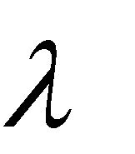
A computation:
(q₀, aaabbb,$)  (q₁, aaabbb,$) 
(q₁, aabbb, a$)  (q₁, abbb, aa$)  (q₁,bbb, aaa$) 
(q₂,bb, aa$)  (q₂,b, a$)  (q₂, ,$)  (q₃, ,$)
a,
a
b, a
,
b, a
, $ $
q₀
q₁
q₂
q₃

Slide 71
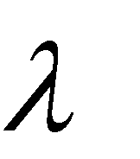
(q₀, aaabbb,$)  (q₁, aaabbb,$) 
(q₁, aabbb, a$)  (q₁, abbb, aa$)  (q₁,bbb, aaa$) 
(q₂,bb, aa$)  (q₂,b, a$)  (q₂, ,$)  (q₃, ,$)
For convenience we write:
(q₀ , aaabbb,$)  (q₃, ,$)

Slide 72
Formal Definition
Language of NPDA M :
L(M )
{w : (q₀ , w, s)  (q _{f} , , s')}
Initial state
Final state

Slide 73
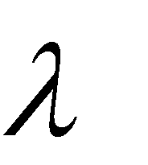
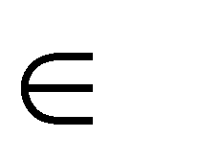
(q₀ , aaabbb,$)  (q₃, ,$)
Example:
aaabbb
L(M )
NPDA
M :
a,
a
b, a
,
b, a
, $
$
q₀
q₁
q₂
q₃

Slide 74
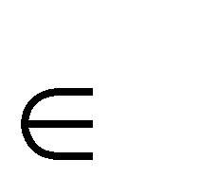
(q₀ , a^{n}b^{n} ,$)  (q₃, ,$)
_{a}n_{b}n
L(M )
NPDA
M :
a,
a
b, a
,
b, a
, $
$
q₀
q₁
q₂
q₃

Slide 75
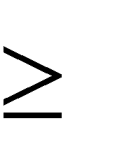
L(M )
Therefore:
{a^{n}b^{n} : n 0}
NPDA
M :
a,
a
b, a
,
b, a
, $
$
q₀
q₁
q₂
q₃

Slide 76
NPDAs Accept Context-Free Languages

Slide 77
Theorem:
Context-Free Languages (Grammars)
Languages Accepted by NPDAs

Slide 78
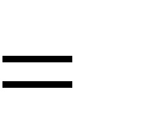
Proof - Step 1:
Context-Free
Languages
Languages (Grammars)
Accepted by NPDAs
Convert any context-free grammar G
to a NPDA M with: L(G)
L(M )

Slide 79
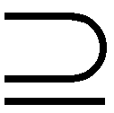
Proof - Step 2:
Context-Free
Languages
Languages (Grammars)
Accepted by NPDAs
Convert any NPDA M to a context-free
grammar G
L(G) L(M )
with:

Slide 80
Converting Context-Free Grammars
to NPDAs

Slide 81
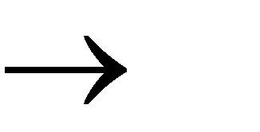
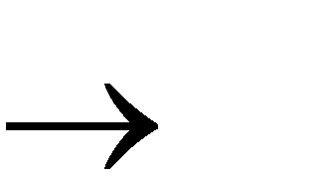
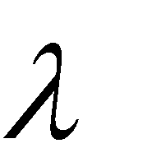
S aSTb
An example grammar:
b
Ta T
What is the equivalent NPDA?

Slide 82
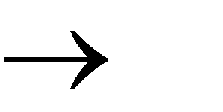
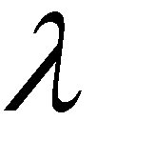
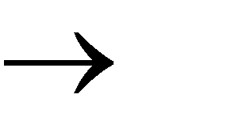
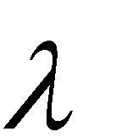
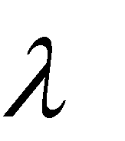
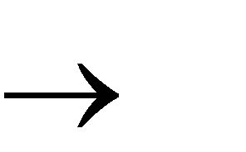
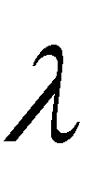
Grammar:
S aSTb
S b
NPDA:
T Ta
, S aSTb
, S b
, T Ta a, a
, T b, b
T
,
S
, $ $
q₀
q₁
q₂

Slide 83
The NPDA simulates
leftmost derivations of the grammar
L(Grammar) = L(NPDA)

Slide 84
S aSTb
Grammar:
b
Ta T
A leftmost derivation:
S aSTb abTb
abTab
abab

Slide 85
NPDA execution:
Time 0
Input
 | b |  | b
, S aSTb
, S b
, T Ta a, a
, T b, b
$
Stack
current
state
q₀
,
S
, $ $
q₁
q₂

Slide 86
Time 1
Input
 | b |  | b
S
, S aSTb
$
, S b
, T Ta a, a
, T b, b
Stack
,
S
, $
$
q₀
q₁
q₂

Slide 87
Time 2
S
Input
 | b |  | b
T
b
, S aSTb
$
, S b
, T Ta a, a
, T b, b
Stack
,
S
, $
$
q₀
q₁
q₂

Slide 88
Time 3
S
Input
 | b |  | b
T
b
, S aSTb
$
, S b
, T Ta a, a
, T b, b
Stack
,
S
, $
$
q₀
q₁
q₂

Slide 89
Time 4
b
Input
 | b |  | b
T
b
, S aSTb
$
, S b
, T Ta a, a
, T b, b
Stack
,
S
, $
$
q₀
q₁
q₂

Slide 90
Time 5
b
Input
 | b |  | b
T
b
, S aSTb
$
, S b
, T Ta a, a
, T b, b
Stack
,
S
, $
$
q₀
q₁
q₂

Slide 91
Time 6
T
Input
 | b |  | b
b
, S aSTb
$
, S b
, T Ta a, a
, T b, b
Stack
,
S
, $
$
q₀
q₁
q₂

Slide 92
Time 7
T
Input
 | b |  | b
b
, S aSTb
$
, S b
, T Ta a, a
, T b, b
Stack
,
S
, $
$
q₀
q₁
q₂

Slide 93
Time 8
Input
 | b |  | b
b
, S aSTb
$
, S b
, T Ta a, a
, T b, b
Stack
,
S
, $
$
q₀
q₁
q₂

Slide 94
Time 9
Input
 | b |  | b
b
, S aSTb
$
, S b
, T Ta a, a
, T b, b
Stack
,
S
, $
$
q₀
q₁
q₂

Slide 95
, S aSTb
Time 10
Input
 | b |  | b
$
, S b
, T Ta a, a
, T b, b
Stack
accept
,
S
, $
$
q₀
q₁
q₂

Slide 96
In general:
Given any grammar
G
We can construct a NPDA M
With
L(G) L(M )

Slide 97
Constructing NPDA M from grammar G :
For any production
A w
For any terminal
a
, A w
a, a
,
S
, $
$
q₀
q₁
q₂

Slide 98
generates string w
Grammar
G
if and only if
NPDA
M
accepts
w
L(G)
L(M )

Slide 99
Therefore:
For any context-free language there is an NPDA
that accepts the same language

Slide 100
Converting
NPDAs
to
Context-Free Grammars

Slide 101
For any NPDA
M
we will construct
a context-free grammar
G
with
L(M ) L(G)

Slide 102
A derivation in Grammar G :
Intuition: The grammar simulates the machine
S ☹ abc😐 ABC 😐
😐 abc😐
Current configuration in NPDA M

Slide 103
A derivation in Grammar G :
terminals variables
S ☹ abc😐 ABC 😐
😐 abc😐
Input processed
in NPDA
Stack contents
M

Slide 104
Some Necessary
FMirsot,dwiefimcodaiftyiothnesNPDA:
It has a single final state
q _{f}
It empties the stack when it accepts the input
Original NPDA
Empty Stack
q _{f}

Slide 105
Second, we modify the NPDA transitions:
all transitions will have form
a, B
q_{i}
q _{j}
or
a, B CD
q_{i}
q _{j}
B,C, D : stack symbols

Slide 106
L(M ) {w : n_{a} n_{b}}
Example of a NPDA in correct form:
$: initial stack symbol
a, $ 0$
a, 0 00
a, 1
b, $ 1$
b, 1 11
b, 0
, $
q₀
q _{f}

Slide 107
The Grammar
^{In}C^{g}o^{ra}n^{m}s^{m}tªr^{r} u^{G}c:tion
Stack symbol
Variables:
(q_{i} Bq _{j} )
states
Terminals:
Input symbols of NPDA

Slide 108
a, B
For each transition
q_{i}
q _{j}
We add production
(q_{i} Bq _{j} ) a

Slide 109
a, B CD
For each transition
q_{i}
q _{j}
We add production (qi Bqk )
a(q _{j}Cq_{l} )(q_{l} Dq_{k} )
For all states ^{q}k ^{, q}l

Slide 110
Stack bottom symbol
(q_{o} $q _{f} )
Start Variable:
Start state
final state

Slide 111
a, $ 0$
a, 0 00
Example:
b, $ 1$
b, 1 11
a, 1
b, 0
, $
q₀
q _{f}
Grammar production:
(q₀1q₀ ) a

Slide 112
a, $ 0$
a, 0 00
Example:
b, $ 1$
b, 1 11
a, 1
b, 0
, $
q₀
q _{f}
Grammar productions:
b(q₀1q₀ )(q₀ $q₀ ) | b(q₀1q _{f} )(q _{f} $q₀ )
b(q₀1q₀ )(q₀$q _{f} ) | b(q₀1q _{f} )(q _{f} $q _{f} )
(q₀ $q₀ )
(q₀ $q _{f} )

Slide 113
a, $ 0$
a, 0 00
Example:
b, $ 1$
b, 1 11
a, 1
b, 0
, $
q₀
q _{f}
Grammar production: (q0$q f )

Slide 114
(q₀$q _{f} ) : start variable
Resulting Grammar:
(q₀ $q₀ ) b(q₀1q₀ )(q₀ $q₀ ) | b(q₀1q _{f} )(q _{f} $q₀ )
(q₀ $q _{f} )
b(q₀1q₀ )(q₀$q _{f} ) | b(q₀1q _{f} )(q _{f} $q _{f} )
b(q₀1q₀ )(q₀1q₀ ) | b(q₀1q _{f} )(q _{f} 1q₀ )
b(q₀1q₀ )(q₀1q _{f} ) | b(q₀1q _{f} )(q _{f} 1q _{f} )
(q₀1q₀ )
(q₀1q _{f} )
a(q₀0q₀ )(q₀ $q₀ ) | a(q₀0q _{f} )(q _{f} $q₀ )
a(q₀0q₀ )(q₀ $q _{f} ) | a(q₀0q _{f} )(q _{f} $q _{f} )
(q₀ $q₀ )
(q₀ $q _{f} )

Slide 115
(q₀0q₀ )
a(q₀0q₀ )(q₀0q₀ ) | a(q₀0q _{f} )(q _{f} 0q₀ )
a(q₀0q₀ )(q₀0q _{f} ) | a(q₀0q _{f} )(q _{f} 0q _{f} )
(q₀0q _{f} )
(q₀1q₀ ) a
(q₀0q₀ ) b
(q₀$q _{f} )

Slide 116
abba
Derivation of string
(q₀$q _{f} ) a(q₀0q₀ )(q₀$q _{f} )
ab(q₀$q _{f} )
abb(q₀1q₀ )(q₀ $q _{f} )
abba(q₀$q _{f} )
abba

Slide 117
(q₀ $q _{f} ) w
In general, in Grammar:
if and only if
w is accepted by the NPDA

Slide 118
Explanation:
By construction of Grammar:
(q_{i} Aq _{j} ) w
if and only if
in the NPDA going from q_{i} to q _{j}
the stack doesn’t change below A
and A
is removed from stack

