Slide 1

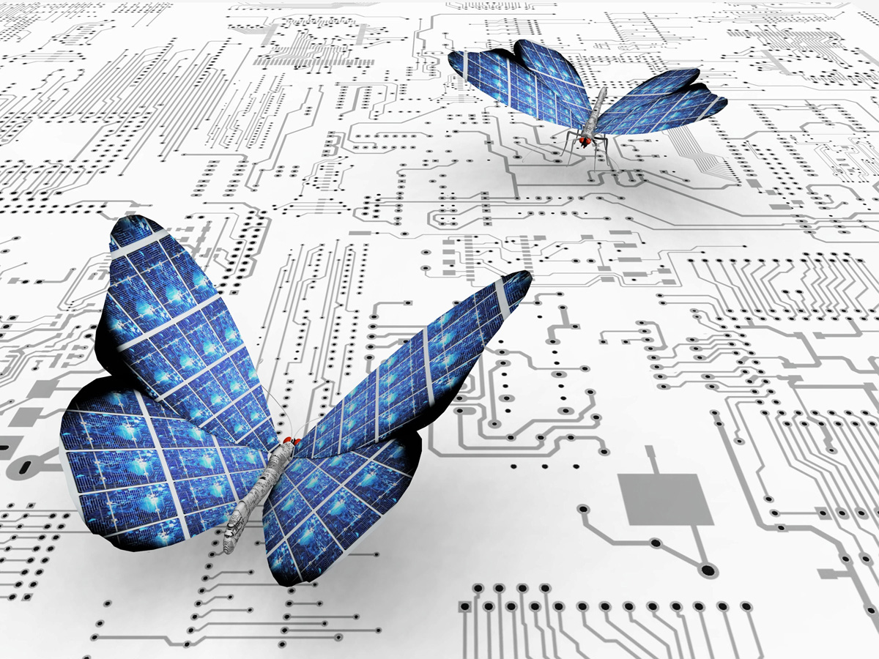
Jaipur Engineering College And Research Centre
Ujjwalam
Department of Electronics and
Communication Engineering
July 2023

Slide 2
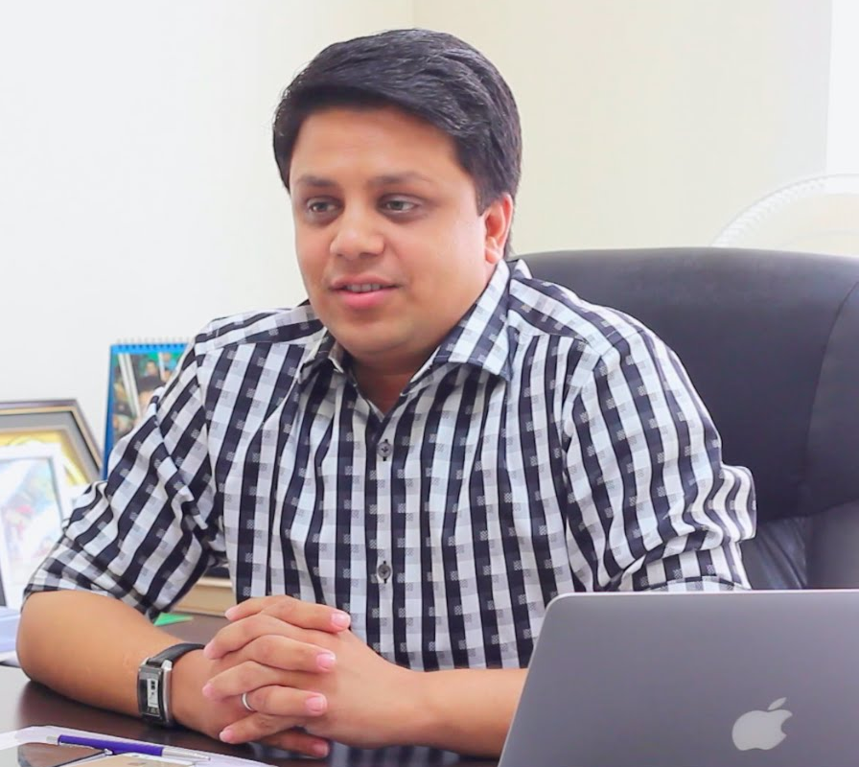
Director’s Message
We are currently in the era of engineering revolution, spearheaded by recent developments in engineering sciences providing sustainable solutions to various issues in different areas. The Indian engineering programs have a promising future particularly the Electronics and Communication sectors are on the threshold of becoming global players by 2020. Fragments of this newsletter will tracks different event and activities that are taking place in the department. I extend my best wishes to all those who contributed to Ujjwalam and I am confident that the interaction will be a source of inspiration to the young talent budding in the college, who would be the educationists, technocrats and researchers of tomorrow. They would shoulder the responsibility of bringing in the desired innovations in their fields, leading to the advancement of the country.
Mr. Arpit Agarwal
Director, JECRC

Slide 3
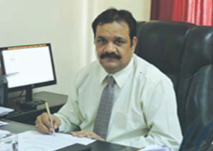
Principal’s Message
Jaipur Engineering College and Research Centre (JECRC), Jaipur is recognised as one of the best technical institutes in Rajasthan and is adopting the process of change that demands quality outcome based education. The vision of the institute is to become an institute of excellence in imparting outcome based education, providing platform to students for overall self development that includes ethics, moral values, etc. and develop research aptitude through project base learning. In the process of implementing outcome based education (OBE) the faculty members are measuring the progress and competency of the student as they go through a course in each semester and are being accessed against pre defined package.
The campus will soon have a video server where video lectures of all under graduate and post graduate programs delivered from the professors of IIT and IISc would be made available to the students 24x7 through a high speed Wi-Fi networking. This will create ample opportunities to learn the subject at there own base on there laptops and smart phones.
All the credit goes to outstanding reputation and dedication of the institute for all these years, under the able guidance of visionary Shree Arpit Agarwal Ji, Director of JECRC. Here at JECRC ,Jaipur, we are committed to impart necessary skills and knowledge to our students in best possible manner, in good spirit and in good environment by allowing them to dream big and help them to achieve the same.
Dr. V.K. Chandna,
Principal, JECRC

Slide 4
Mission and Vision of the College
VISION
MISSION
To become a renowned centre of outcome based learning, and work towards academic, professional, cultural and social enrichment of the lives of individuals and communities.
Focus on evaluation of learning outcomes and motivate students to inculcate research aptitude by project based learning.
Identify, based on informed perception of Indian, regional and global needs, areas of focus and provide platform to gain knowledge and solutions.
Offer opportunities for interaction between academia and industry.
Develop human potential to its fullest extent so that intellectually capable and imaginatively gifted leaders can emerge in a range of professions

Slide 5
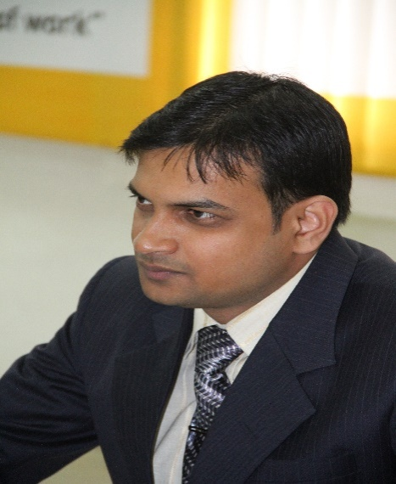
VISION
To contribute through excellence in scientific and technical education, teaching and research in Electronics and Communication Engineering & to meet the needs of global industry.
Newsletter ECE,
JECRC Foundation,
July Issue 2023
HOD’S Message
The Department of Electronics and Communication Engineering came into existence at the Jaipur Engineering College & Research Center in 2000, by the approval of All India Council for Technical Education (AICTE), to meet the growing requirement of practical design engineers in the country and abroad. The greatest asset of the department is its highly motivated and learned faculty. The available diversity of expertise of the faculty with the support of the other technical staff prepares the students to work in the global multicultural environment. The department not only aims to make our students technically sound and knowledgeable but also to nurture their wisdom and make them a better and responsible human being. The graduates of the Electronics & Communication Stream have been selected by some of the world’s leading corporations & as well as by most of the leading Indian counterparts. We hope that we will continue to deliver our best to serve the society and mankind. It is also expected that our students will continue to pass on the skills which they have developed during their stay at this department to the whole of the world for a better society.
- Dr. Sandeep Vyas
MISSION
To equip the students with a strong foundation of basic sciences and domain knowledge of ECE, so that they are able to creatively apply their knowledge to the solution arising in their career path.
To induce the habit of life-long learning to enhance overall performance.
Students are able to communicate their ideas clearly and concisely so that they can work in a team as well as an individual.
To make students responsive towards the ethical, social, environmental and economic context for the society.

Slide 6
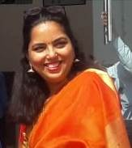
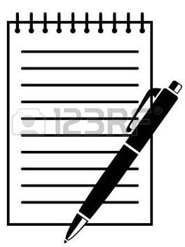
It is with great pleasure that we bring to you the July issue of Ujjwalam, the newsletter of ECE Department JECRC Jaipur. The name of our newsletter- Ujjwalam- signifies brightness, With faculty members that consist of bright minds and students who are keen to leave a mark, our future is in safe hands indeed.
The goal of this newsletter is to update you all with the developments at ECE department (JECRC) Jaipur. The current issue will provide the information about the various initiatives of department which are related to academics, research and innovation, student affairs, alumni and departmental laboratory / workshop. This newsletter besides reporting on the major events will also report on laurels earned by our faculty members, staff and students.
While acknowledging valuable inputs received from the faculty members, staff and students, we also welcome suggestions from them to help us develop the newsletter further.
The July issue is in your hands.
Happy reading!!
              Dr. Parul Tyagi
Editor’s Desk

Slide 7
Program Outcomes
PROGRAM OUTCOMES are Graduate Attributes
Engineering knowledge: Apply the knowledge of mathematics, science, engineering fundamentals, and electronics & communication engineering specialization to the solution of complex electronics and communication engineering problems.
Problem analysis: Identify, formulate, research literature, and analyze complex electronics and communication engineering problems reaching substantiated conclusions using first principles of mathematics, natural sciences, and engineering sciences. .
Design/development of solutions: Design solutions for complex electronics and communication engineering problems and design system components or processes that meet the specified needs with appropriate consideration for the public health and safety, and the cultural, societal, and environmental considerations.
Conduct investigations of complex problems: Use research-based knowledge and research methods including design of electronics and communication engineering experiments, analysis and interpretation of data, and synthesis of the information to provide valid conclusions.

Slide 8
Program Outcomes
Modern tool usage: Create, select, and apply appropriate techniques, resources, and modern electronic engineering and IT tools including prediction and modeling to complex electronics and communication engineering activities with an understanding of the limitations.
The engineer and society: Apply reasoning informed by the contextual knowledge to assess societal, health, safety, legal and cultural issues and the consequent responsibilities relevant to the professional engineering practice.
Environment and sustainability: Understand the impact of the professional electronics and communication engineering solutions in societal and environmental contexts, and demonstrate the knowledge of, and need for sustainable development.
Ethics: Apply ethical principles and commit to professional ethics and responsibilities and norms of the electronics and communication engineering practice.
Individual and team work: Function effectively as an individual, and as a member or leader in diverse teams, and in multidisciplinary settings.

Slide 9
Program Outcomes
Communication: Communicate effectively on complex electronics and communication engineering activities with the engineering community and with society at large, such as, being able to comprehend and write effective reports and design documentation, make effective presentations, and give and receive clear instructions.
Project management and finance: Demonstrate knowledge and understanding of the electronics and communication engineering and management principles and apply these to one’s own work, as a member and leader in a team, to manage projects and in multidisciplinary environments.
Life-long learning: Recognize the need for, and have the preparation and ability to engage in independent and life-long learning in the broadest context of electronics and communication engineering changes.

Slide 10
v
Program Specific Outcomes
PSO1: Ability to develop knowledge of Embedded Systems and its application in Automation.
PSO2: Ability to develop the concept of Electric Vehicle (EV) to meet Industry Applications.
v

Slide 11
v
Program Educational Outcomes
PEO 1
To provide students with the fundamentals of engineering sciences with more emphasis in electronics & communication engineering by way of analyzing and exploiting electronics engineering challenges.
PEO 2
To train students with good scientific and electronics & communication engineering knowledge so as to comprehend, analyze, design, and create electronic based novel products and solutions for the real life problems.
PEO 3
To inculcate professional and ethical attitude, effective communication skills, teamwork skills, multidisciplinary approach, entrepreneurial thinking and an ability to relate electronics & communication engineering with social issues.
PEO 4
To provide students with an academic environment aware of excellence, leadership, written ethical codes and guidelines, and the self-motivated life-long learning needed for a successful electronics & communication engineering professional career.
v

Slide 12

Inside This
Issue!!
Introduction to Newsletter
Workshop on Embedded System Design and Development Using Arduino
Project Exhibition
Placement Statics
Diverse Dialogue - I
Debate Competition
Photography Competition
Industrial Visit to RCAT

Slide 13
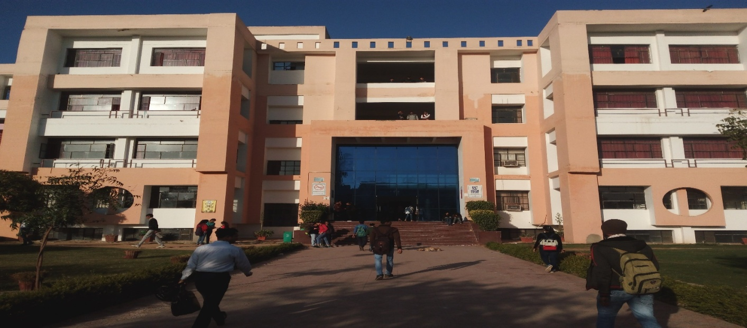
Introduction to Newsletter
The aim of the newsletter is to keep each member of ECE family of JECRC connected and updated. Notable achievements of our students, alumni and faculty members will be highlighted along with some articles on latest technologies, and campus life. We wish that all who contribute to the growth and achievements of the
department get acknowledged. We welcome your inputs for future newsletters and urge you to stay connected with us.

Slide 14
Workshop on Embedded System Design and Development Using Arduino
One day Workshop on “Embedded System Design and Development using Arduino” was held on 14th September, 2023 by the OPTICA Student Chapter-JECRC in association with IEEE Student Branch JECRC and department of Electronics and Communication Engineering, JECRC.
The workshop mainly focuses to give participants a chance to get hands-on experience on the latest trending embedded system hardware and different types of sensors. Emphasis is given to make the participants learn how to program the control boards for different types of sensors and different applications. About 78 participants attended the programme.
.

Slide 15
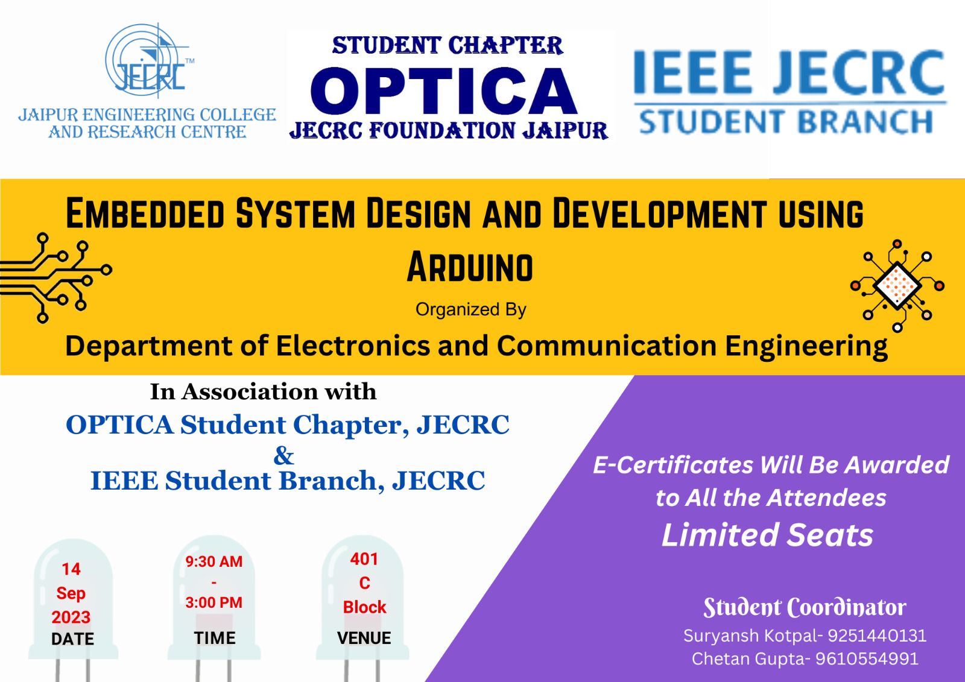
Poster of the event

Slide 16
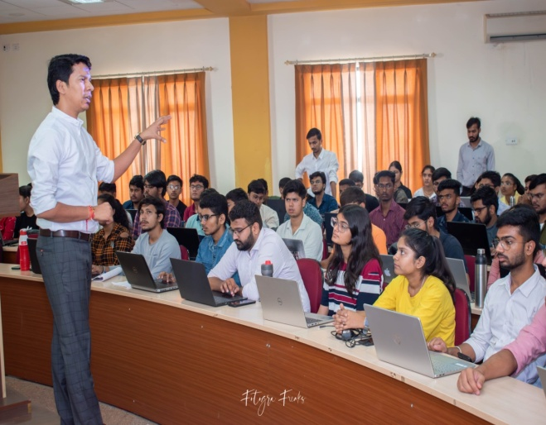
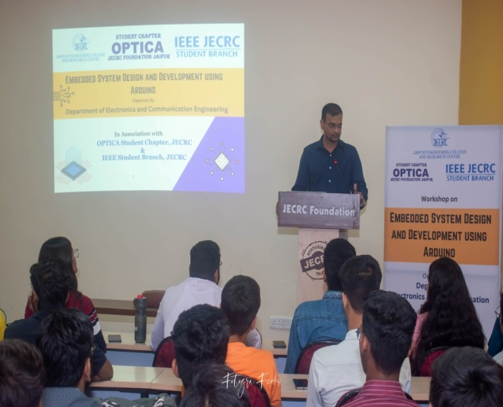
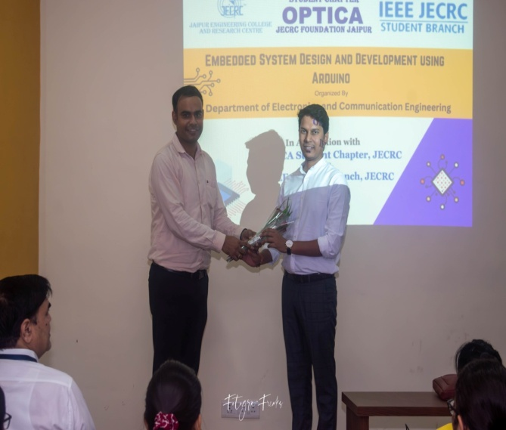
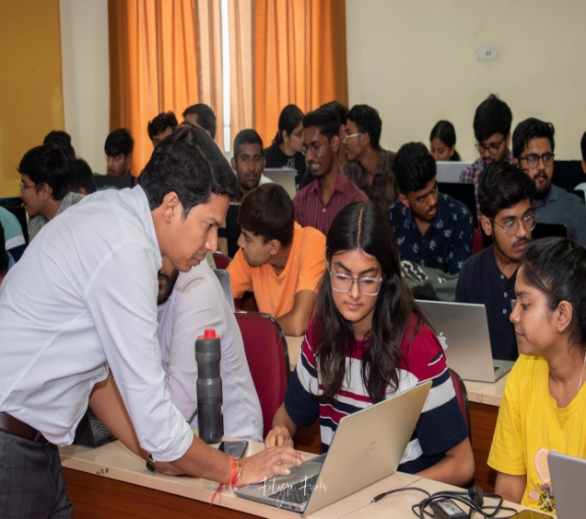
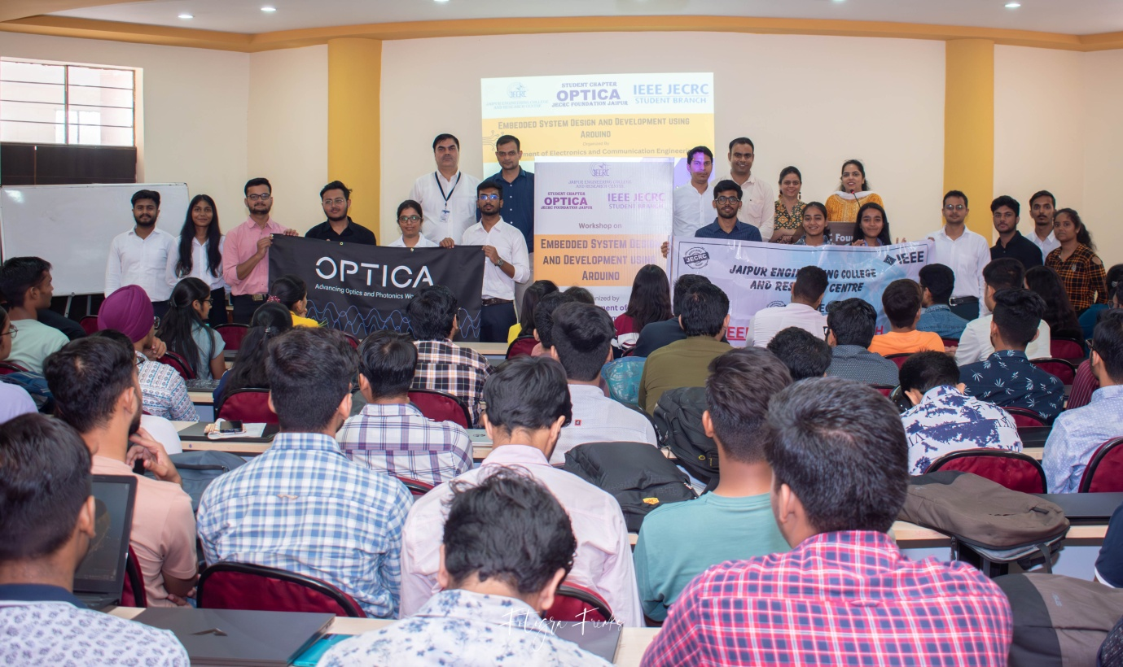
v
GLIMPSE OF THE EVENT
v

Slide 17
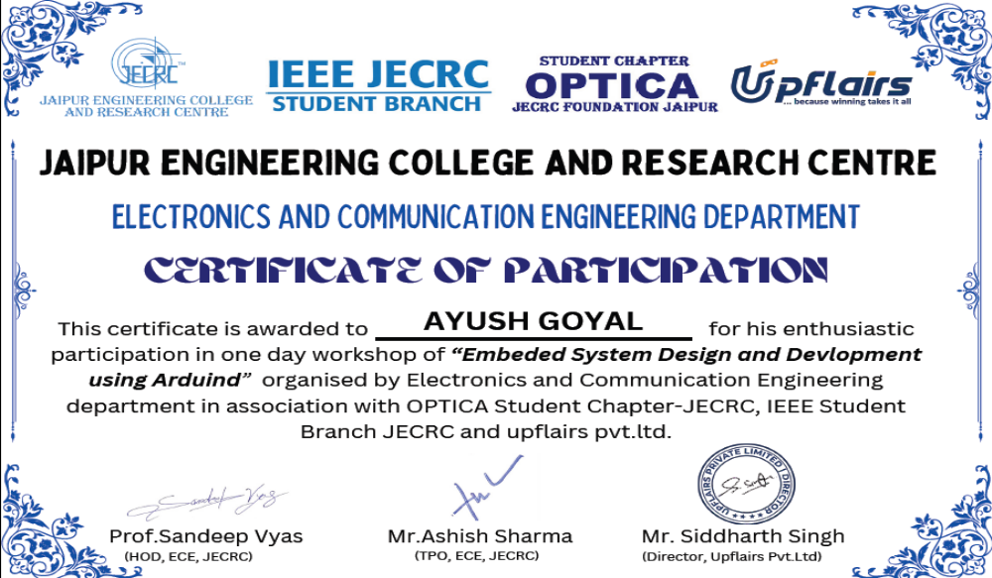
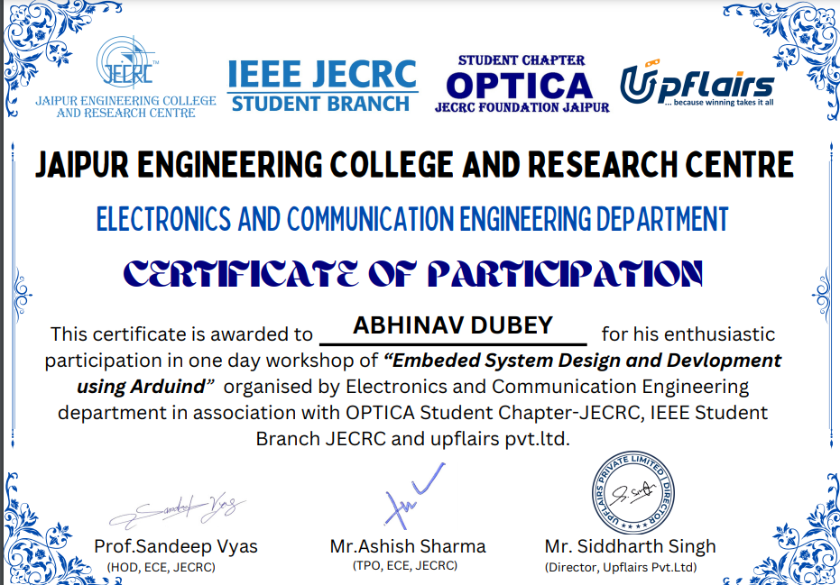
Certificates

Slide 18
Project Exhibition
The event was scheduled on 12 Dec 2023 which was an outcome based event organized in association with the Centre of Excellence in Embedded system design. This event was a project development after the add on course completed in the department and the other departments. Total 170 and more students participated and many more visited the inventions. Mr. Sudarshan Jain and Mr. Mangilal (Assistant Professor) ECE department were the evaluator and judges for the event. The projects were based on hardware embedded systems, Internet of Things and machine learning software based.

Slide 19
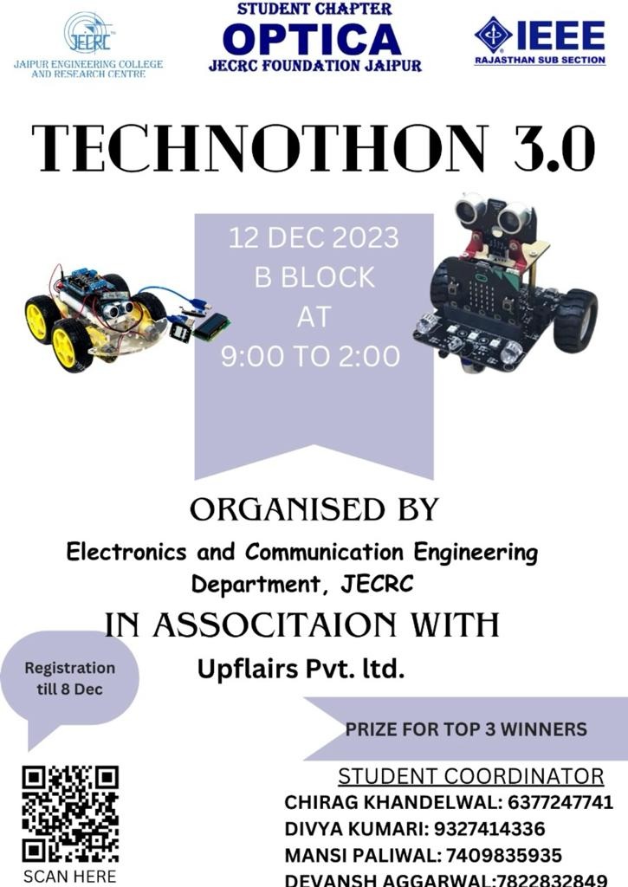
v
Poster of the Event
v

Slide 20
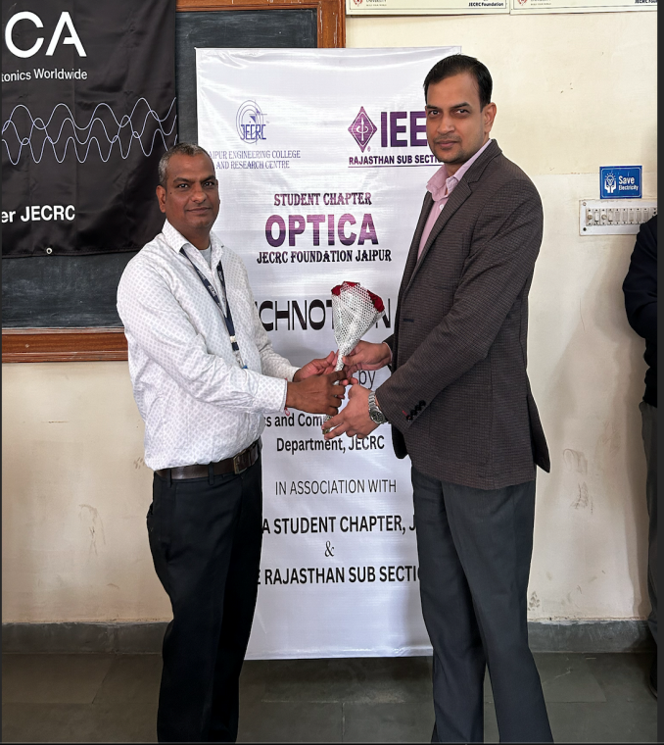
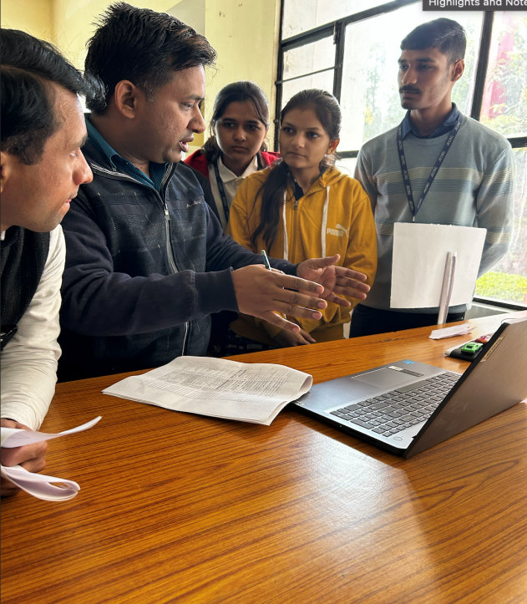
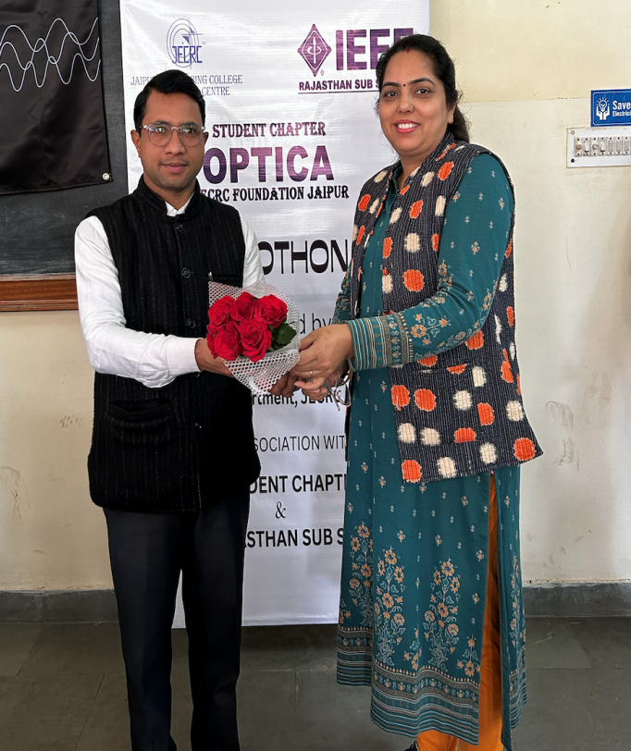
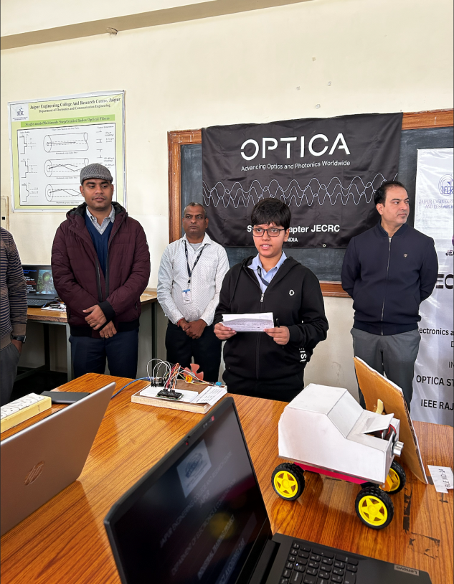
v
GLIMPSE OF THE EVENT
v

Slide 21
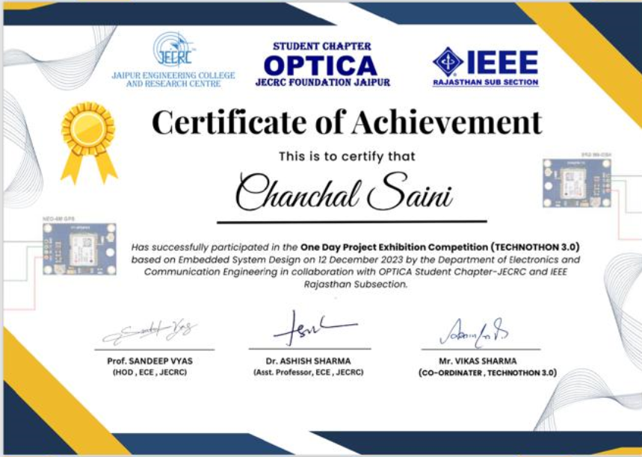
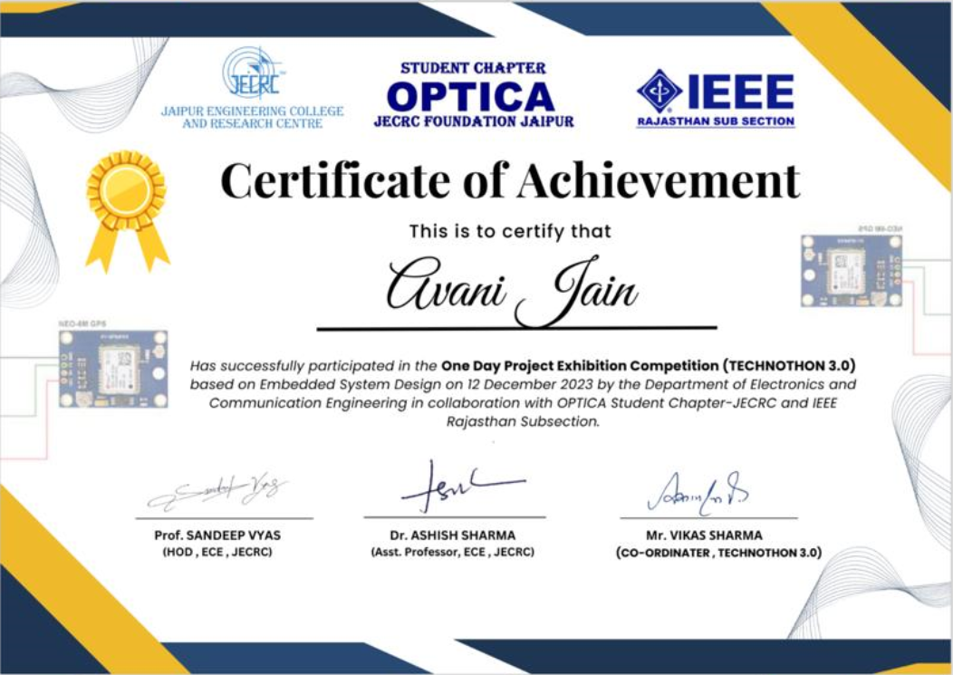
v
Certificate
v

Slide 22
Placement Statistics- 2024
Student details :-
Branch Electronics and Communication Engineering
Number of Students | 181
Students registered for CRT | 166
Students from Inset Category | 109
Students from Outset Category | 57

Slide 23
v
Placements in CS/ IT Companies –
v
Placed | Profile | Number of student selected | Package
Accenture | Software Engineer | 4 | 5.5 LPA
HPE | Software Engineer | 2 | 17.5 LPA
Newgen | Application Engineer | 5 | 4 LPA
AU Bank | IT Engineer | 3 | 5 LPA
Total |  | 14 | AVG = 8 LPA

Slide 24
v
Placements in Core Companies
Companies | Profile | Number of student selected | Package
Genus R and D | R and D | 2 | 5.5 LPA
Genus Power | Service Engineer | 2 | 5.5 LPA
RJ Solar | Solar Device | 24 | 5 LPA
E-oxygen | GET- Electric Vehicle | 6 | 5 LPA
EV Clinic | GET- Electric Vehicle | 5 | 5 LPA
Victory EV | GET- Electric Vehicle | 1 | 5 LPA
Total |  | 40 | Avg = 5.1
v

Slide 25
v
Overall Statistics :-
Branch ECE |  | Placed | Remaining
Numer of Students | 155 | 88 | 66
Students from Inset Category | 109 | 59 | 49
Students from Outset Category | 57 | 29 | 28
v

Slide 26
Diverse Dialogues-1
Commencement of the series of diverse dialogues where we will be honored to have eminent professors, distinguished educationists and industry experts to guide and mentor us by motivating our academicians to enhance the teaching learning process. This set of events will form a bridge to fulfill any gaps between the current education curriculum & industry demands. Our guest of the day took time to engage with our faculties, answer their questions, and provide valuable insights. His willingness to connect with the audience on a personal level left a lasting positive impression and his deep insight knowledge about AICTE aided us to understand the rules and latest changes in the AICTE norms.

Slide 27
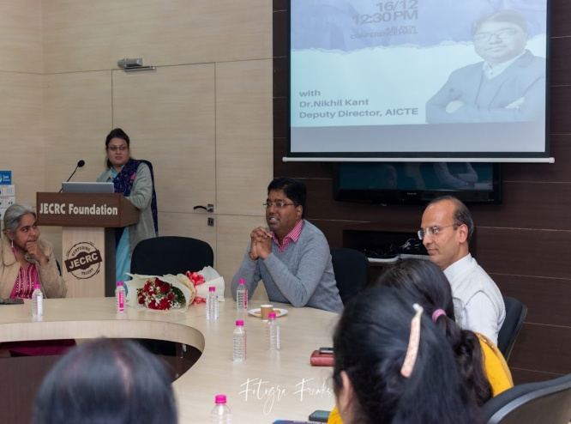
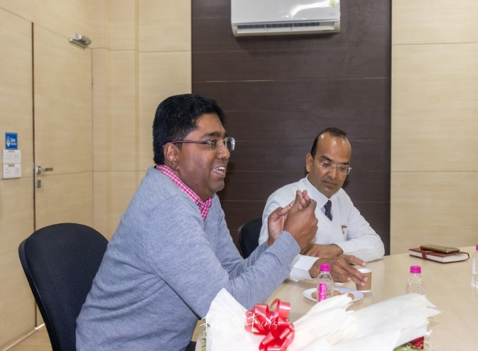
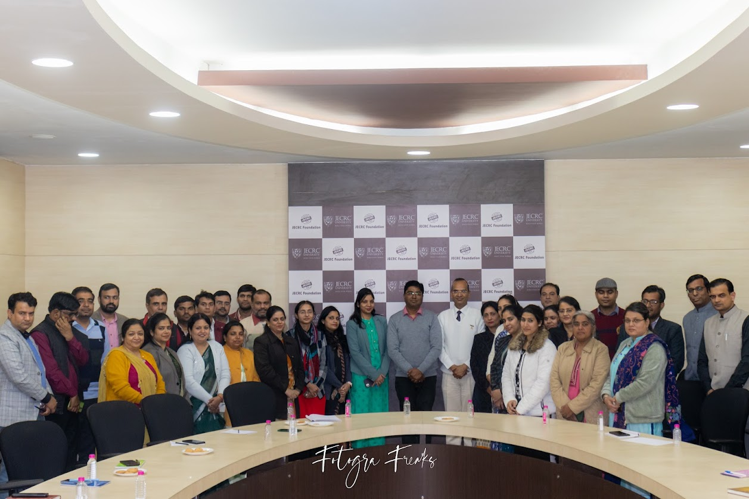
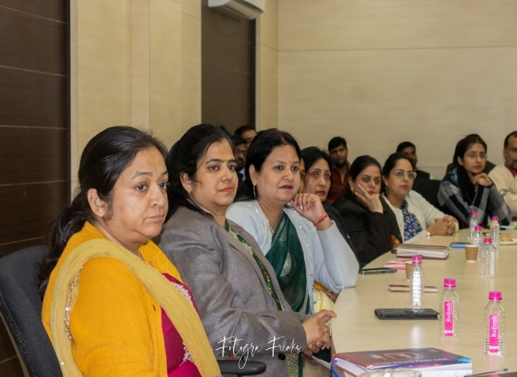
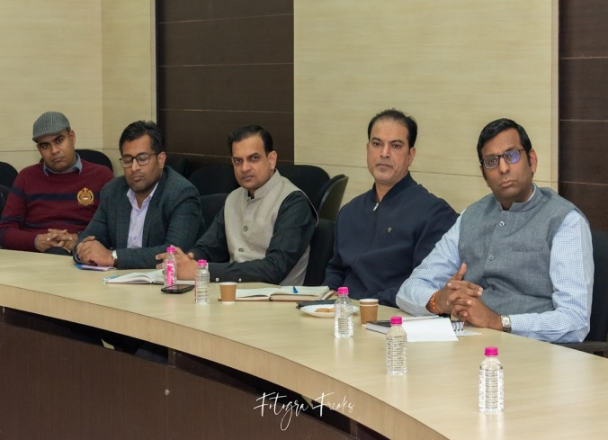
v
GLIMPSE OF THE EVENT
v

Slide 28
Debate Competition
JECRC IEEE Student Branch hosted a thought-provoking debate competition on (date), sparking intellectual discourse and critical thinking among its members. The event attracted passionate debaters from various disciplines, all eager to engage in lively discussions on contemporary issues. With topics ranging from 'The Role of Technology in Shaping Society' to 'Ethical Dilemmas in Artificial Intelligence,' participants showcased their eloquence, research skills, and ability to construct compelling arguments. The competition was characterized by rigorous yet respectful exchanges of ideas, with participants presenting diverse perspectives and challenging each other's viewpoints. Esteemed judges evaluated the debates, considering not only the strength of arguments but also the clarity of expression and logical reasoning. As winners were announced, applause filled the room, acknowledging the outstanding performances and intellectual rigor displayed by the participants. Through this competition, JECRC IEEE Student Branch not only promoted critical thinking and effective communication skills but also fostered a culture of intellectual curiosity and debate within its community.

Slide 29
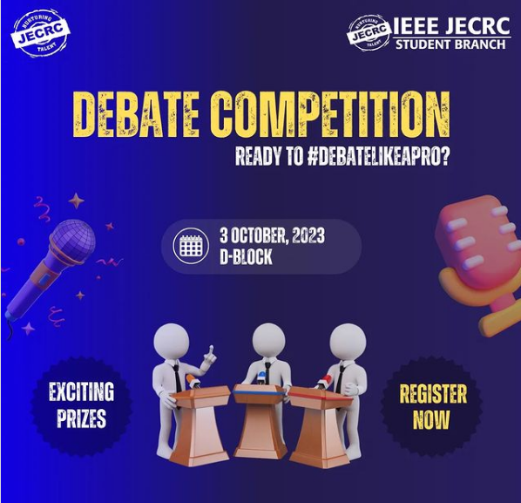
v
Poster of the Event
v

Slide 30
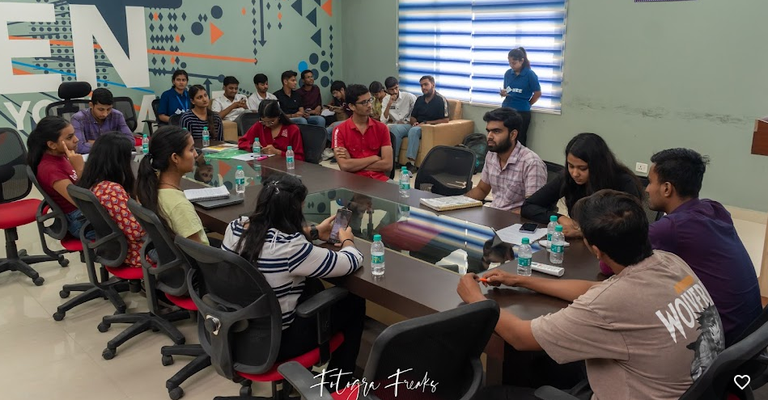
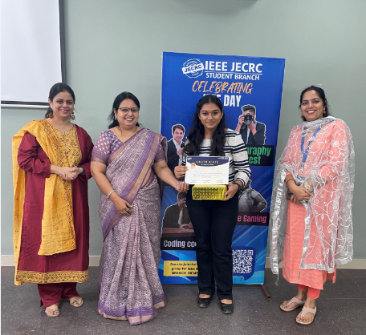
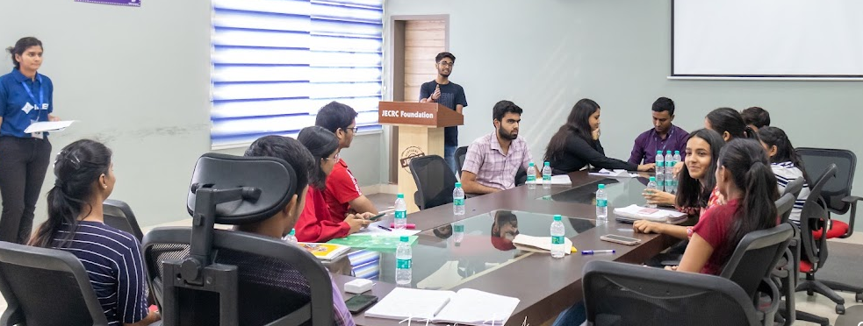
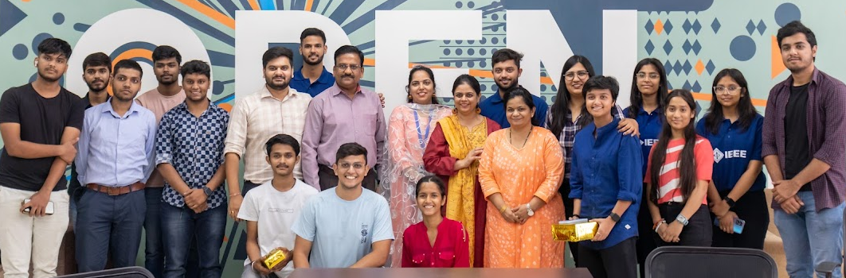
v
GLIMPSE OF THE EVENT
v

Slide 31
JECRC IEEE Student Branch hosted an electrifying photography competition on (date), igniting a spark of creativity among its members. The event drew participants from all corners, each armed with a camera and a unique perspective. With themes ranging from 'Moments in Motion' to 'Contrast and Composition,' photographers showcased their artistic prowess and technical finesse. The competition was fierce, with captivating images flooding the submissions. Expert judges meticulously evaluated each entry, considering not just technical proficiency but also storytelling ability and creativity. As the winners were announced, the air buzzed with excitement and applause, acknowledging the talent and dedication of the participants. Through this competition, JECRC IEEE Student Branch not only promoted the art of photography but also fostered camaraderie and a spirit of healthy competition among its members. It was a testament to the branch's commitment to nurturing creative expression and pushing the boundaries of innovation.
Photography Competition

Slide 32
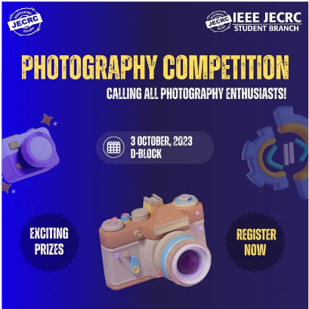
v
Poster of the Event
v

Slide 33
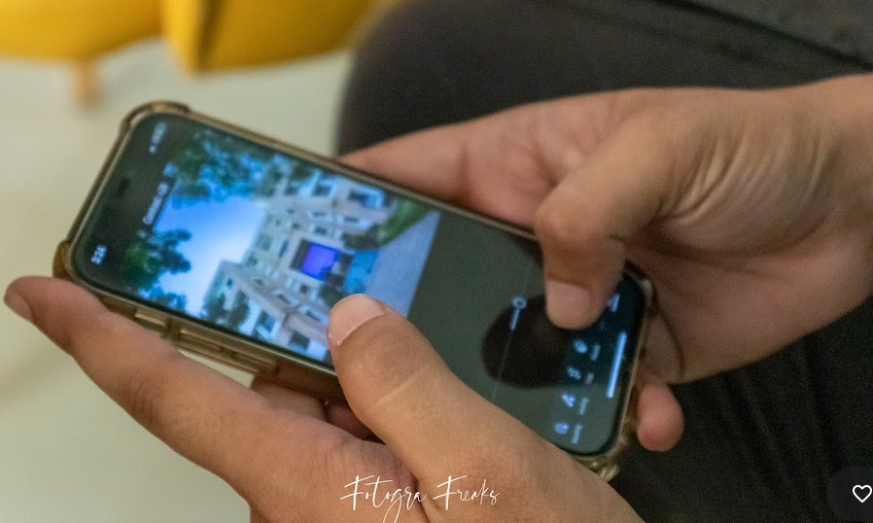
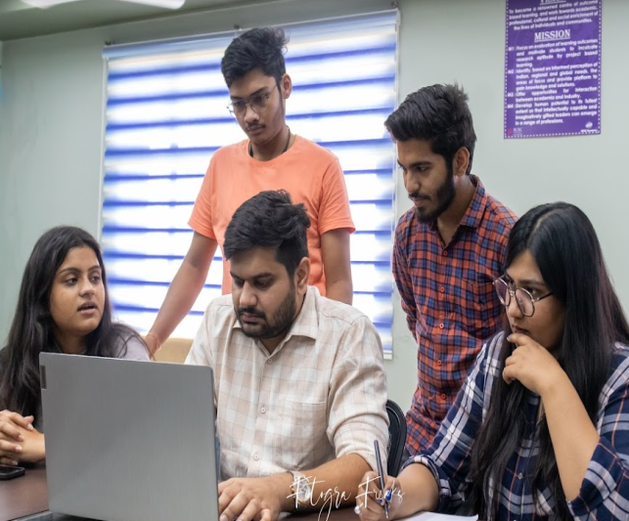
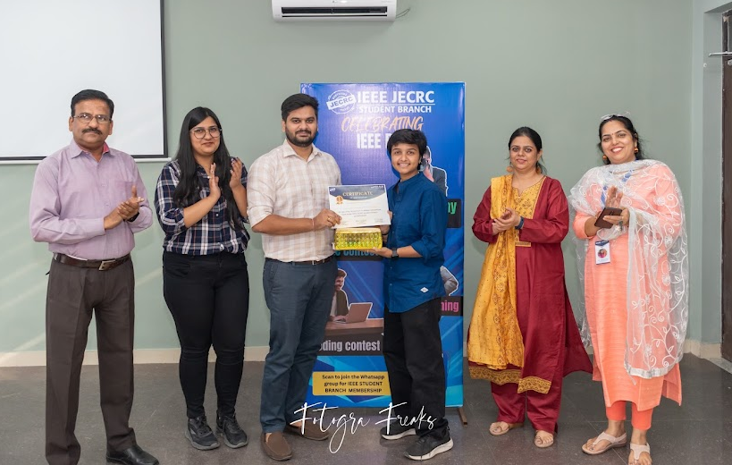
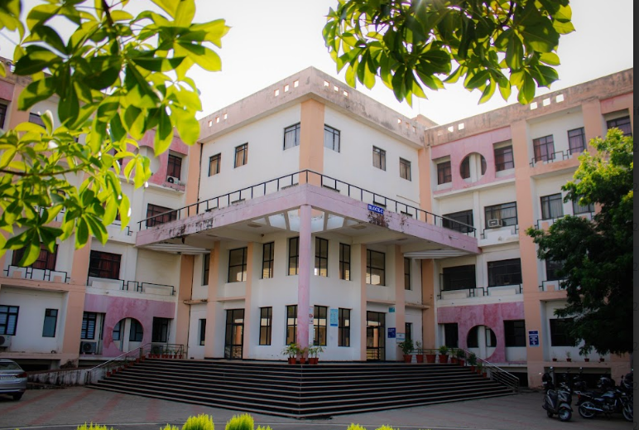
v
GLIMPSE OF THE EVENT
v

Slide 34
Industrial Visit to RCAT
On September 30th, 2023, the 3rd semester "Students from JECRC Foundation embarked on an insightful industrial trip to RCAT (Regional Center for Advanced Technologies) recently. The visit provided a hands-on experience and deepened their understanding of cutting-edge technologies and industrial processes. From witnessing advanced manufacturing techniques to engaging with industry experts, the trip was an enriching experience for all. It offered invaluable insights into real-world applications of theoretical knowledge gained in classrooms, fostering a holistic learning environment. Overall, the visit to RCAT was a resounding success, leaving students inspired and motivated towards their future careers in the industrial sector."

Slide 35
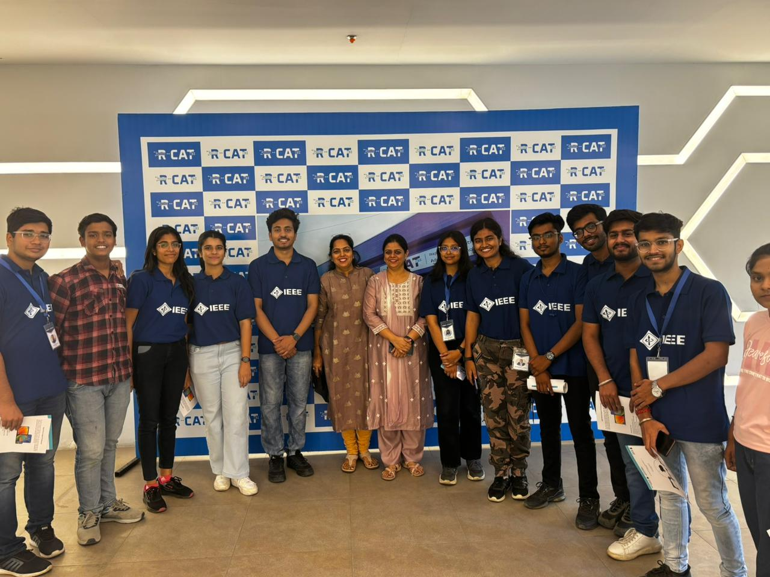
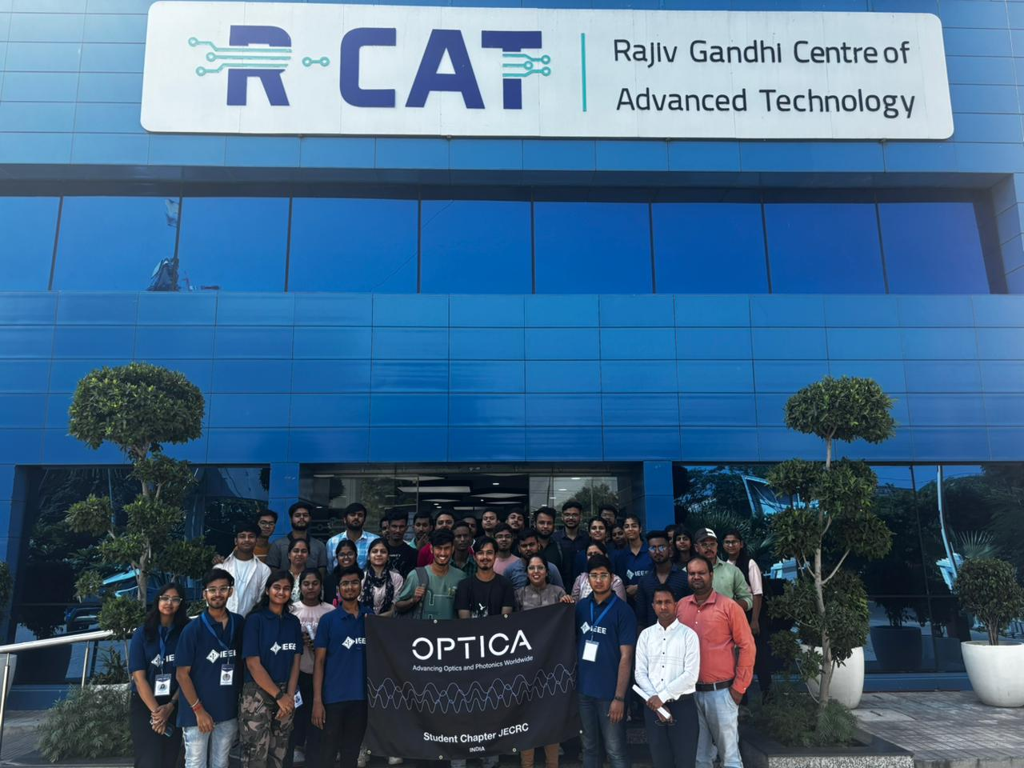
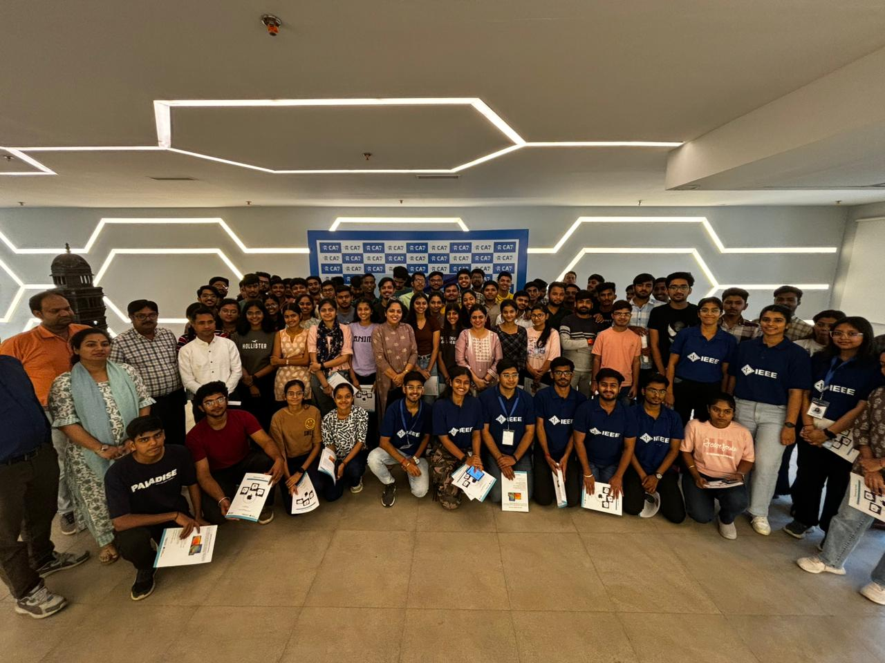
GLIMPSE OF THE EVENT
v
v

Slide 36
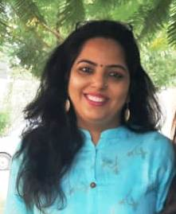
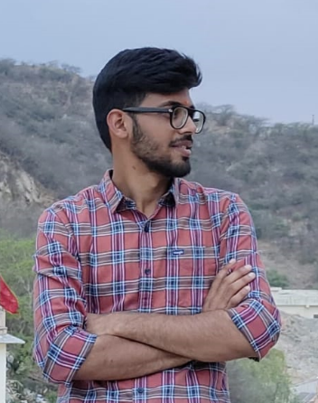
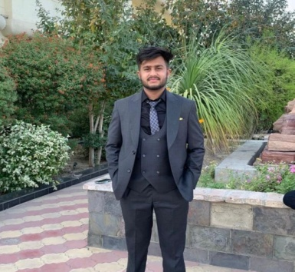
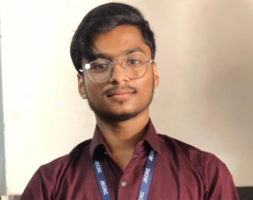
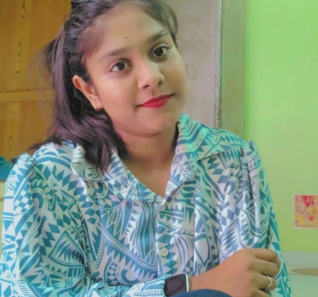
k
v
EDITOR’S DESK
v
Dr. Parul Tyagi
PARULTYAGI.ECE@JECRC.AC.IN
Chetan Gupta
ECE 2nd YEAR
Devansh Aggarwal
ECE 2nd YEAR
Kunal Agarwal
ECE 2nd Year
Chanchal Saini
ECE 2nd YEAR

Slide 37
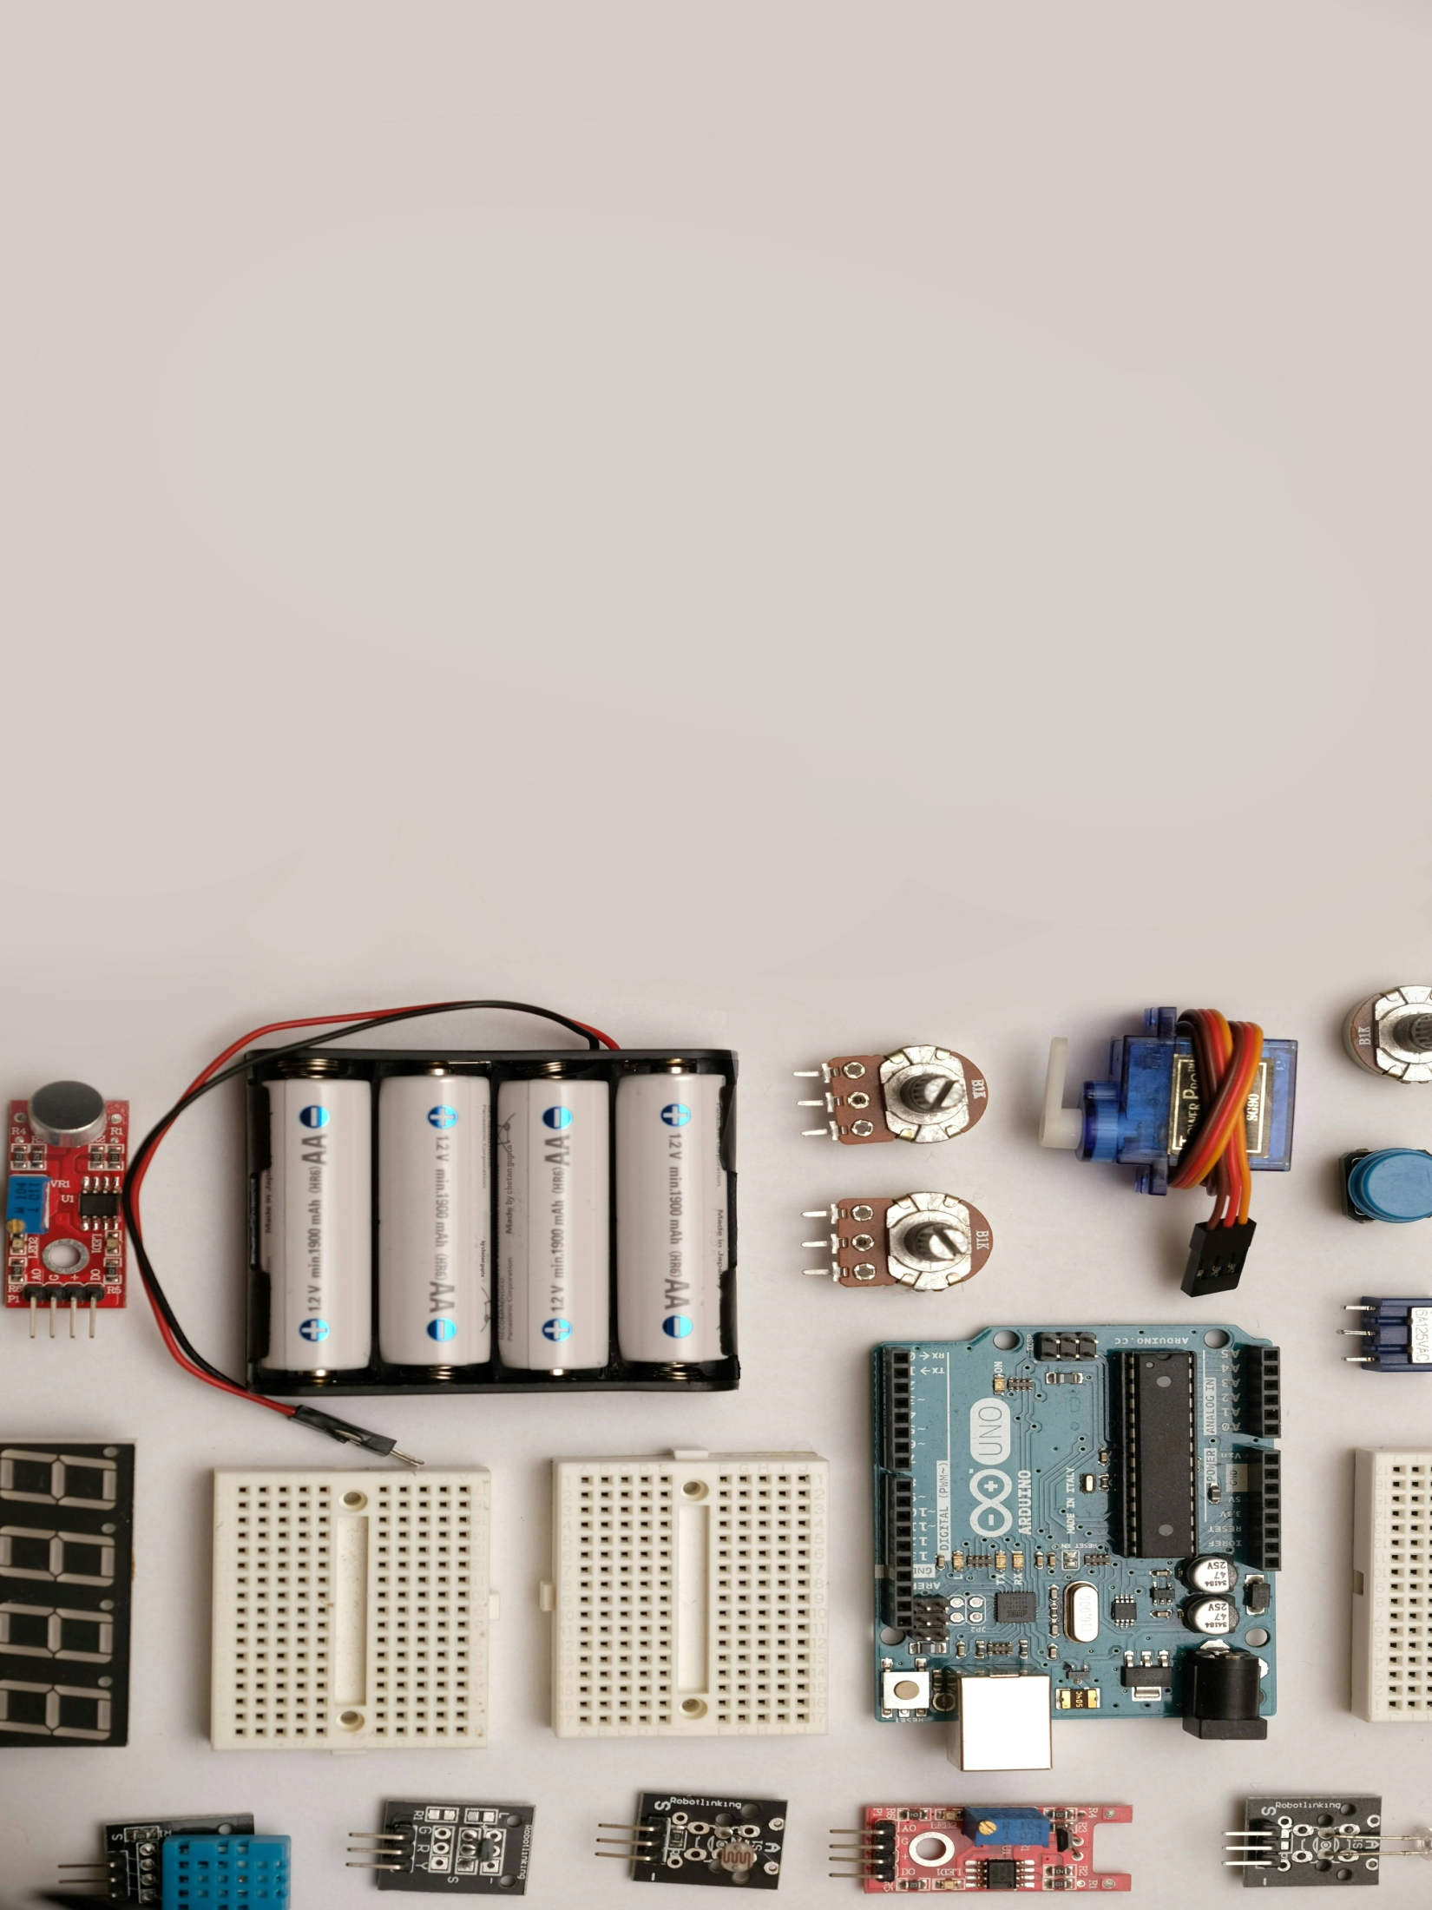
Aircraft and
automobile sector
Core electronics job
GMAT
Signal And
Processing firm
IES
Private Non Core Sector
Electronics
GATE
ROBOTICS
Research
Softwares
Core electronics job
GRE
UPSC
Government and
bank jobs
CAT
PSU Jobs
Teaching
Designing

Slide 38
To be continued….

